Slide 1
TPB Version 2.3 travel model on the 3,722-TAZ area system: Status report and sensitivity tests
Item #2
July 22,2011
Ron Milone and Mark Moran
National Capital Region Transportation Planning Board (TPB)
Metropolitan Washington Council of Governments (MWCOG)
"I:\ateam\meetings_conf\tfs\2011\2011-07-22\Item2_Ver2.3_Status_Report_v8.pptx"

Slide 2
Acknowledgements
Mary Martchouk, for her analysis work on the sensitivity tests and her help preparing today’s presentation.
The COG/DTP models applications group, especially Dusan Vuksan and Feng Xie, who performed a series of sensitivity tests with earlier variants of the Ver. 2.3 travel model. Their work helped the models development group better understand the performance of the new model.

Slide 3
Outline
Overview
Year-2007 validation summaries for Ver. 2.3.27
Sensitivity tests
Conclusions

Slide 4
Overview

Slide 5
Recent past events
April 29 (Special) TFS meeting
  Version 2.3.17 model was released
  2007 & 2040 scenarios made available
  Documentation was released
May 20 TFS meeting
  TPB staff shared transit assignment process, results
  Sensitivity analysis with respect to the use of Cube Cluster

Slide 6
Staff activities since May 20
Minor changes, refinements made to modeling procedures and inputs (described later)
Sensitivity tests undertaken
Documentation updated
Ver. 2.3-based transit constraint process updated
Staff focus: Preparation of Version 2.3 inputs for Air Quality Conformity
  Networks based on the 2011 CLRP inputs: In progress
  Round 8.0a land use: Completed
  Exogenous travel files: Completed
  Version 2.3/Mobile 6-based AQ post processor: In progress
Version 2.3.27 now available upon request
Notes:
"O:\model_dev\Ver2.3.17_3722TAZ\2040f_final\transum\newSegSumm5purps2040_05_06.xlsx“
All transit assignment results are from V2.3.17
14 workdays since April 29

Slide 7
Production schedule for 2011 CLRP update
Air Quality Conformity: July – November
  Analysis years: 2002, 2016, 2020, 2030, 2040
  (Version 2.3 anticipated for adoption as the regional modeling process in November, along with Round 8.0a Cooperative Forecasts, and AQC Findings)
PM Maintenance SIP: December-February
  Analysis years: 2002, 2007, 2017, 2025
Notes:
PM = Fine particulate matter, 2.5 microns

Slide 8
Remaining modeling issues
Excessive model running times
Some external users have problems running the model
Need to update and verify the coded toll values on all the highway networks

Slide 9
Updates to the model since April 29
(Ver. 2.3.17 => 2.3.27)
Highway assignment
  Raised maximum number of user equilibrium iterations from 200 to 300
  Decreased night peaking factor from 0.35 to 0.15
Mode Choice: Updated AEMS.exe (2004 version => 2009 version)
Added Intrastep Distributed Processing (IDP) to MATRIX procedures in
  MFARE2.s
  Transit_Skims_[MR|CR|BM|AB].s
Updated batch file to run walkacc.s only in the pump prime iteration

Slide 10
Updates to the inputs since April 29
(Ver. 2.3.17 => 2.3.27)
Various network corrections, e.g., removed PNR lot at the Stadium Armory station from the station.dbf file
CTPP adjustment applied to the 3722-TAZ Round 8.0 land use
  CTPP adjustment ensures consistent definition of employment across the region
  Script that applied adjustment had coding error that has now been fixed

Slide 11
Validation summaries:
Ver. 2.3.27

Slide 12
2007 est. & obs. VMT by state for MSA
Ver. 2.3.27
VMT in thousands
State | Observed VMT | Estimated VMT | Difference | Pct. Difference
DC | 8,272 | 8,802 | 530 | 1.06
MD | 56,366 | 56,391 | 25 | 1.00
VA | 50,238 | 51,514 | 1,276 | 1.03
Total | 114,876 | 116,707 | 1,831 | 1.02
At the regional level, the model overestimates by about 2%. For DC, the model overestimates by 6%, but the quality of the traffic counts may also be at play.

Slide 13
2007 est. & obs. VMT (in 000s) by jurisdiction, Ver. 2.3.27
Jurisdiction | Observed VMT | Estimated VMT | Difference (E-O) | Ratio (E/O)
District of Columbia | 8,272 | 8,802 | 530 | 1.06
Montgomery County | 19,890 | 20,880 | 991 | 1.05
Prince George's County | 23,316 | 21,958 | -1,357 | 0.94
Arlington County | 4,392 | 4,341 | -51 | 0.99
City of Alexandria | 1,958 | 2,015 | 58 | 1.03
Fairfax County | 26,799 | 26,213 | -586 | 0.98
Loudoun County | 5,260 | 6,220 | 960 | 1.18
Prince William County | 8,000 | 8,685 | 685 | 1.09
Frederick County | 7,842 | 8,720 | 878 | 1.11
Howard County | 10,094 | 10,171 | 76 | 1.01
Anne Arundel County | 15,330 | 14,652 | -678 | 0.96
Charles County | 3,348 | 3,022 | -326 | 0.90
Carroll County | 3,395 | 4,255 | 861 | 1.25
Calvert County | 1,971 | 1,810 | -161 | 0.92
St. Mary's County | 2,195 | 2,079 | -116 | 0.95
King George County | 789 | 678 | -111 | 0.86
City of Fredericksburg | 948 | 822 | -127 | 0.87
Stafford County | 3,829 | 4,040 | 211 | 1.06
Spotsylvania County | 3,300* | 2,061 | -1,238 | 0.62
Fauquier County | 3,149 | 2,989 | -160 | 0.95
Clarke County | 770 | 930 | 161 | 1.21
Jefferson County | 1,082 | 1,370 | 289 | 1.27
Total | 155,927 | 156,714 | 787 | 1.01
Note: The values in this table represent “on-network VMT,” not total VMT, so they do not include local VMT.
*Spotsylvania Co.: Obs. VMT includes the entire county; Est. VMT includes only the northern half of the county.

Slide 14
2007 est. & obs. VMT by facility type
Ver. 2.3.27
VMT (in thousands) based on 6,563 links with daily traffic counts
FTYPE | Estimated | Observed | Estimated/Observed
Freeway | 33,603 | 31,204 | 1.08
Maj. Art. | 20,922 | 20,407 | 1.03
Min. Art. | 6,259 | 6,492 | 0.96
Collector | 2,299 | 3,482 | 0.66
Expwy | 3,590 | 4,009 | 0.90
Ramp | 32 | 73 | 0.45
Total | 66,704 | 65,666 | 1.02
Estimated-to-observed ratio for ramp VMT is low (0.45), but the estimated and observed VMT values for ramps are also relatively small.

Slide 15
2007 est. & obs. VMT by time of day
Ver. 2.3.27
VMT (in thousands) based on 1,717 links with hourly traffic counts
Time of Day | Estimated | Observed | Difference (E.-O.) | Ratio (E./O.)
AM Peak | 4,062 | 3,701 | 361 | 1.10
Midday | 6,499 | 6,411 | 88 | 1.01
PM Peak | 5,990 | 5,713 | 277 | 1.05
Night | 4,714 | 4,636 | 78 | 1.02
Total | 21,265 | 20,460 | 805 | 1.04

Slide 16
2007 RMSE Analysis
Ver. 2.3.27
Daily link volume pct. RMSE by Facility Type
Facility Type |  | % RMSE
FTYPE1 | Freeway | 24%
FTYPE2 | Major Arterial | 38%
FTYPE3 | Minor Arterial | 56%
FTYPE4 | Collector | 82%
FTYPE5 | Expressway | 34%
All FTYPEs |  | 43%
As is typically seen, error is lowest for the highest-class facilities (e.g., freeways at 24%) and highest for the lowest-class facilities (e.g., collectors).
These values are comparable to those seen in previous TPB travel models

Slide 17
Conclusions: Validation
Year-2007 model validation results are very similar to what was found April 29 for the earlier variant of the Ver. 2.3 model
Estimated VMT matches observed VMT to within one or two percent at the regional level

Slide 18
Sensitivity tests

Slide 19
Why do sensitivity testing?
Another approach to validate the model
Provides a “feel” for the model’s response to changes in inputs or assumptions
Points to possible problems in the model specification that need to be addressed – it aids in heading off unexpected surprises

Slide 20
Typical tests to consider
Operational or capacity changes to the highway or transit system
Land use changes
Transportation policy changes
Model specification changes such as the traffic assignment convergence threshold or the number of gravity model iterations

Slide 21
Notes about the sensitivity tests presented today
Based on the most recent Version 2.3 specification (2.3.27) and inputs
Focuses on changes to the 2007 base scenario (“Pseudo Round 8.0” land use)
The 2007 network is based on information in the 2010 CLRP, not the 2011 CLRP update that will be used in this year’s AQC determination.
We recognize that there are some errors with tolls that will need to be updated.

Slide 22
Sensitivity Test Summary
(all are for year 2007, except where noted)
 | Test | Test Type
1 | Close Memorial Bridge to auto use | System change
2 | Add lane in each direction on American Legion Bridge | System change
3 | Increase transit service: Double the freq. of the X2 bus | System change
4 | Raise Metrorail base fare by 25 cents (135 => 160 cents) | Policy change
5 | Raise tolls on the Dulles Toll Road: Doubled the tolls at the main plaza and the associated ramps | Policy change
6 | Change area type of a selected TAZ from 3 to 2 (TAZ 1817 in Fairfax Co.) | Land use change
7 | Change area type of a selected TAZ from 3 to 1 (TAZ 1817 in Fairfax Co.) | Land use change
8 | Load 2040 demand onto 2007 network | Land use change
9 | Change highway assignment convergence criterion for test #2 (Amer. Legion Bridge): Relative gap, 10⁻³ => 10⁻⁴ | Specification change (on top of the system change)
For tests number 6 and 7, increase represents a net increase in land activity, not simply a redistribution.

Slide 23
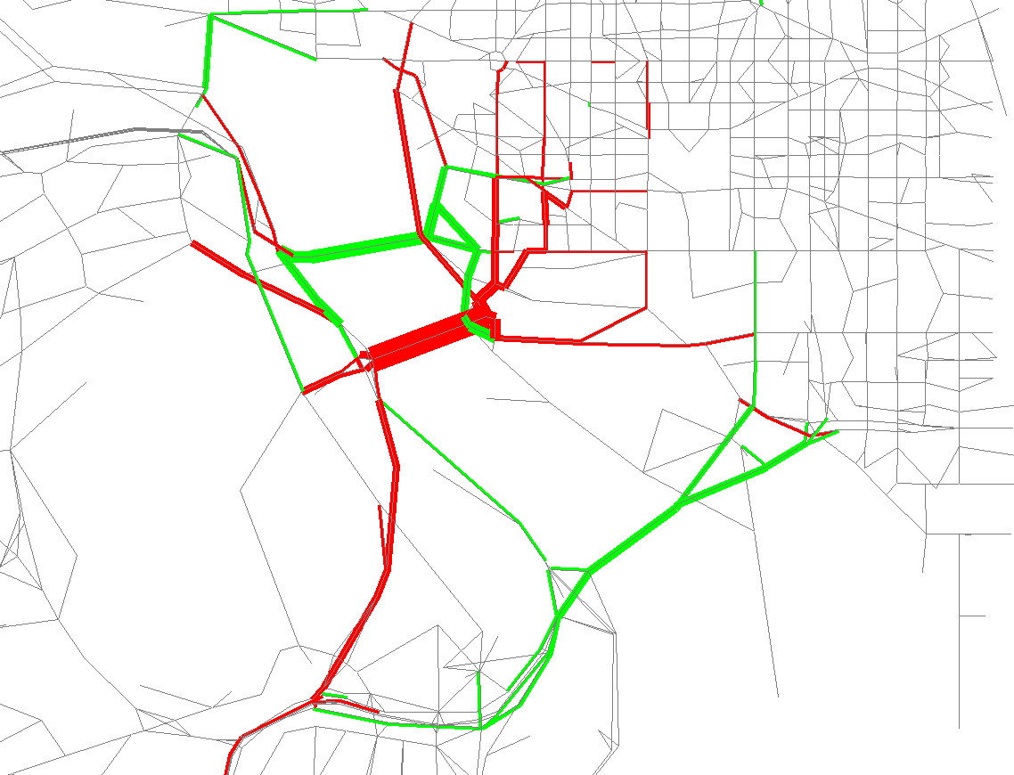
Test 1: Close Memorial Bridge to autos
Results, 2007
Red: Decrease in Volume
Green: Increase in Volume
Tolerance: +/- 2000 vehicles
Relative gap threshold: 10⁻³
Large decrease (red) where Memorial Bridge used to be
Moderate increases on the three neighboring bridges (Theod. Roosev., 14ths St, and Key)
Notes:
+/-2000 vehicles = 4000 value/pixel in bandwidth settings

Slide 24
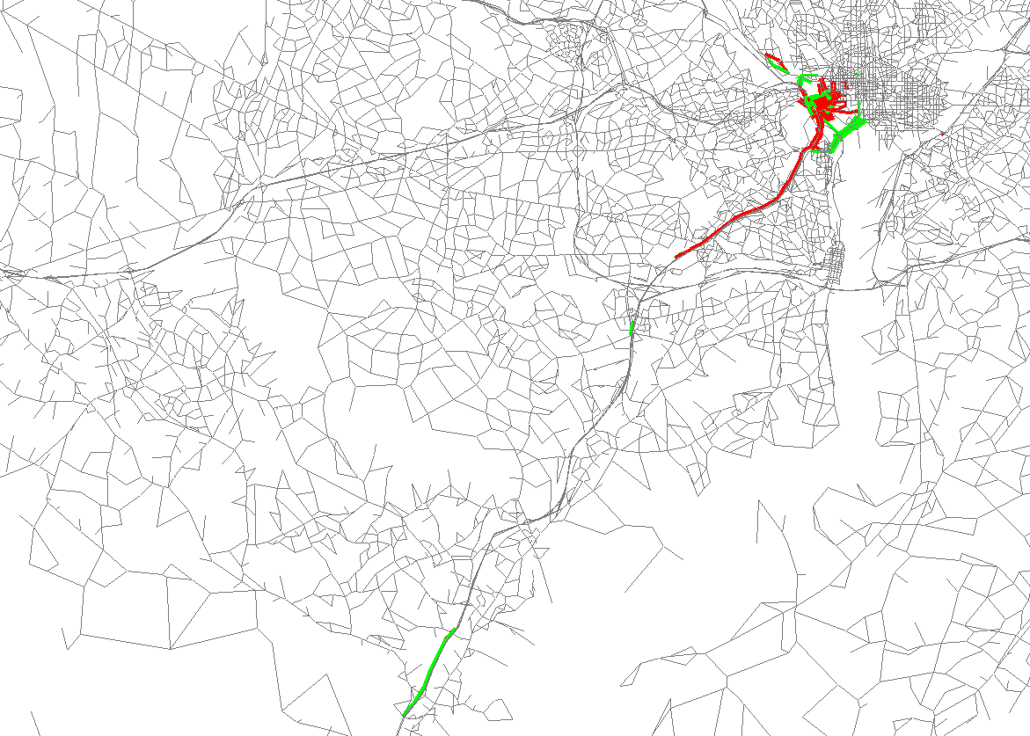
Test 1: Close Memorial Bridge to autos
Results, 2007
Red: Decrease in Volume
Green: Increase in Volume
Tolerance: +/- 2000 vehicles
Relative gap threshold: 10⁻³
There does appear to be some noise outside of the area where the system change occurred.
Likely a sign of incomplete convergence in the highway assignment
Notes:
+/-2000 vehicles = 4000 value/pixel in bandwidth settings

Slide 25
Test 1: Close Memorial Bridge to autos
Results, 2007
Regional VMT decreased by 91,102 or 0.06%
Auto drivers to DC (from all jurisdictions) decreased by about 3,000 vehicle trips
  But change is not evenly distributed
    Auto driver trips from DC: +1,000
    Auto driver trips from VA/WV: -9,000
    Auto driver trips from MD: +5,000
Transit increased by 1,624 trips or 0.15%
  Existing bus service on the bridge, WMATA 13B/A, was allowed to continue
All three findings are reasonable

Slide 26
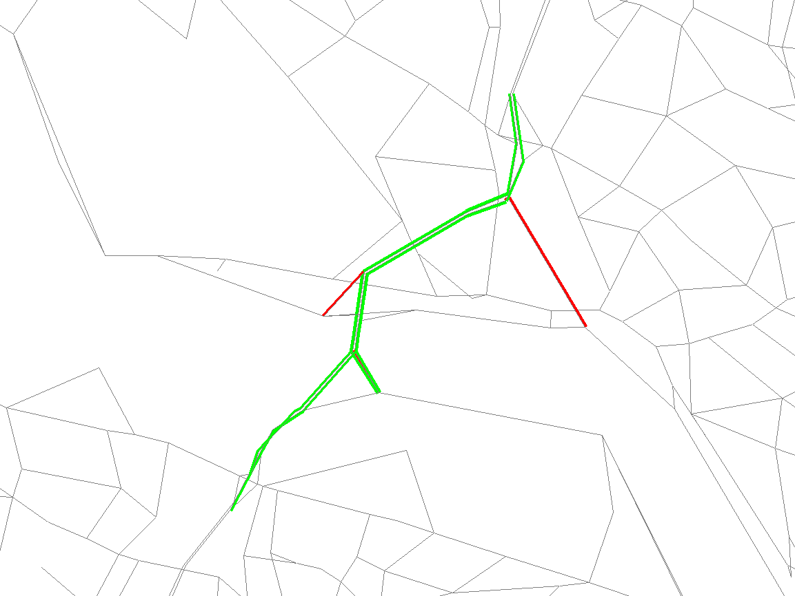
Test 2: Add Lanes to American Legion Bridge
Daily Volume difference, 2007
Red: Decrease in Volume
Green: Increase in Volume
Tolerance: +/- 500 vehicles
Relative gap threshold: 10⁻³
Volume increase (green) on bridge and neighboring Beltway links
Notes:
+/-700 vehicles = 1400 value/pixel in bandwidth settings

Slide 27
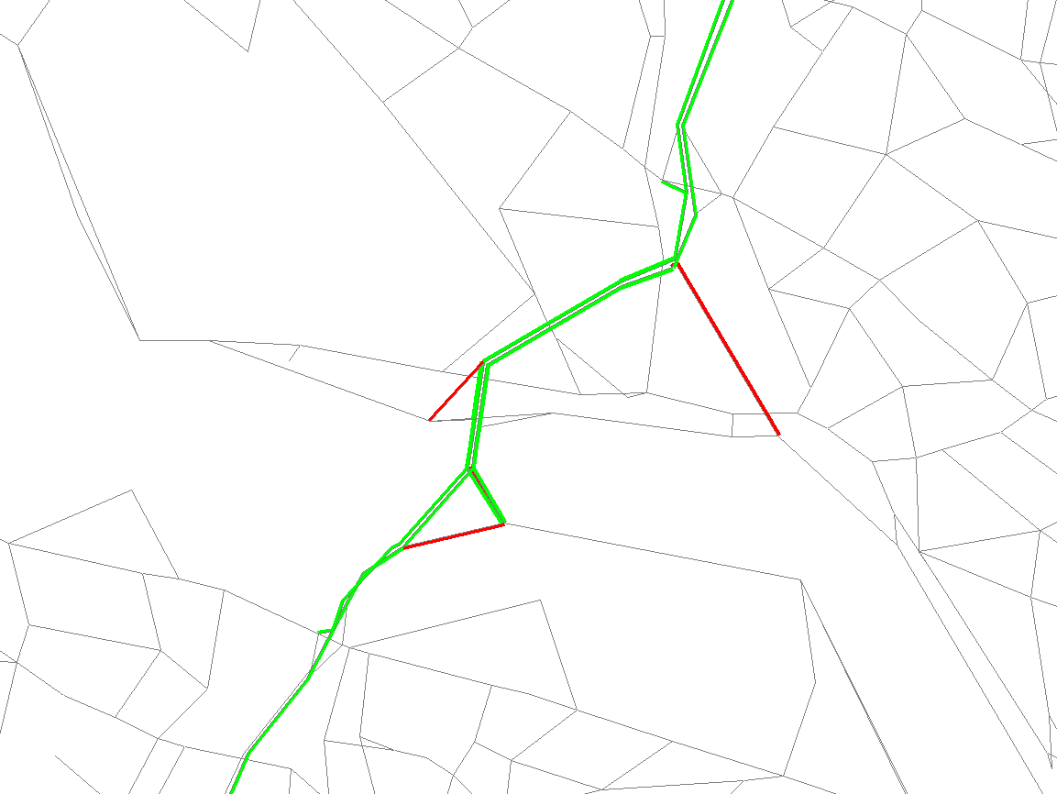
Test 9: Add Lanes to American Legion Bridge with relative gap of 10⁻⁴
Daily Volume difference, 2007
Red: Decrease in Volume
Green: Increase in Volume
Tolerance: +/- 500 vehicles
Relative gap threshold: 10⁻⁴
Very similar to previous map, though green extends farther

Slide 28
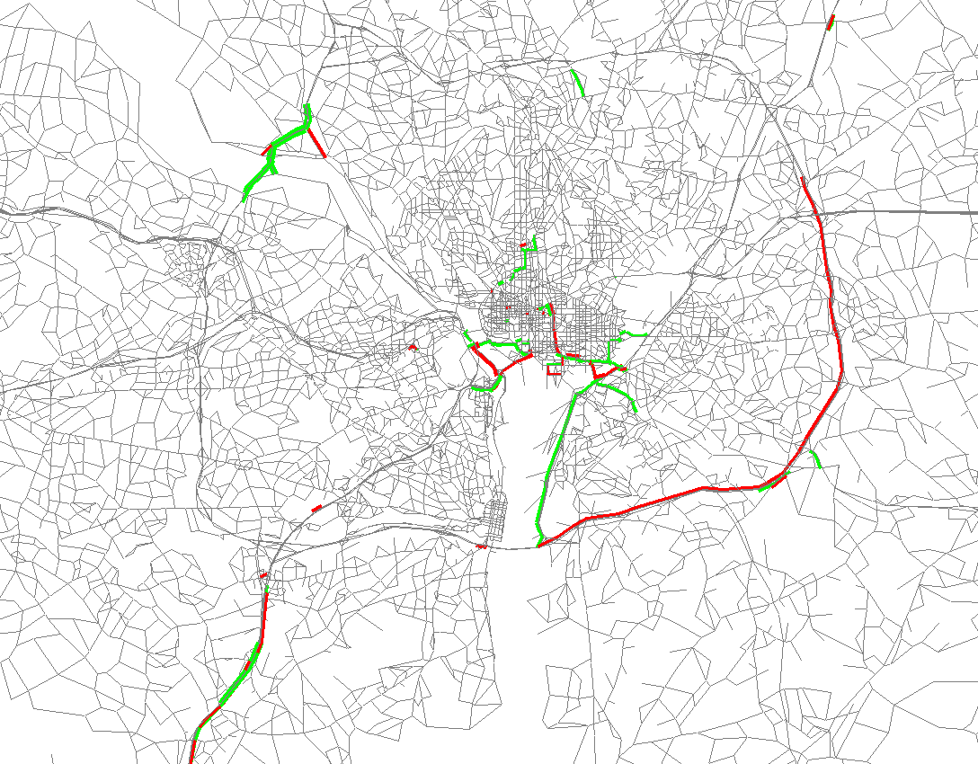
Test 2: Add Lanes to American Legion Bridge
Daily Volume difference, 2007
Volume increase (green) on bridge and neighboring Beltway links
Volume decrease (red) on the opposite side of the Beltway
Evidence of some network noise
Red: Decrease in Volume
Green: Increase in Volume
Tolerance: +/- 500 vehicles
Relative gap threshold: 10⁻³
Notes:
+/-500 vehicles = 1000 value/pixel in bandwidth settings

Slide 29
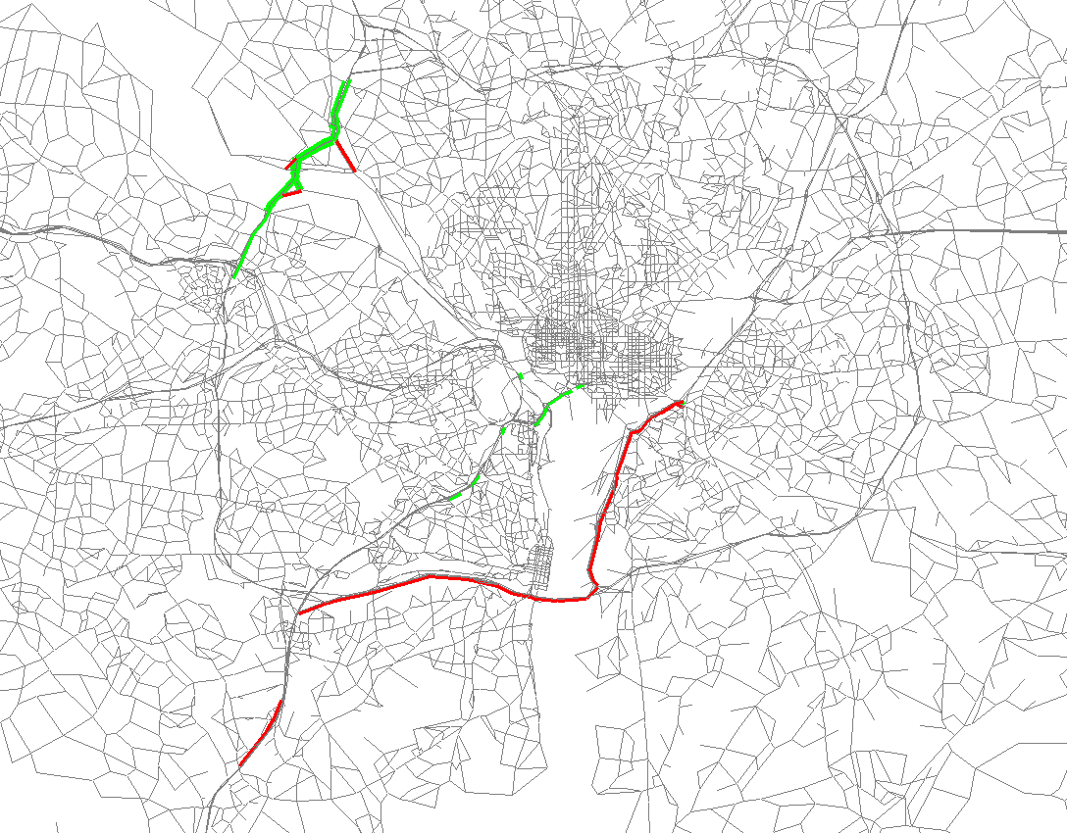
Test 9: Add Lanes to American Legion Bridge with relative gap of 10⁻⁴
Daily Volume difference, 2007
Less network noise
Volume increase (green) in the same area as before, around the Amer. Leg. Bridge
Volume decrease (red) has shifted to a different part of the Beltway and I-295
Red: Decrease in Volume
Green: Increase in Volume
Tolerance: +/- 500 vehicles
Relative gap threshold: 10⁻⁴

Slide 30
Test 2: Add Lanes to American Legion Bridge
Results, 2007 (from the case with a 10⁻³ relative gap)
 |  | Westbound |  |  | Eastbound
 |  | Base | Alt | Diff. | Base | Alt | Diff
AM | Lanes | 5 | 6 | 1 | 5 | 6 | 1
 | Volume | 29,882 | 30,524 | 642 | 28,446 | 28,962 | 516
 | V/C | 1.25 | 1.06 | -0.19 | 1.19 | 1.01 | -0.18
 | Speed (mph) | 8 | 19 | 11 | 10 | 30 | 20
MD | Lanes | 5 | 6 | 1 | 5 | 6 | 1
 | Volume | 50,120 | 50,439 | 319 | 48,841 | 49,223 | 382
 | V/C | 0.89 | 0.74 | -0.15 | 0.86 | 0.73 | -0.13
 | Speed (mph) | 51 | 59 | 8 | 53 | 59 | 6
PM | Lanes | 5 | 6 | 1 | 5 | 6 | 1
 | Volume | 41,314 | 42,273 | 959 | 41,810 | 42,550 | 740
 | V/C | 1.21 | 1.04 | -0.17 | 1.23 | 1.04 | -0.19
 | Speed (mph) | 9 | 23 | 14 | 8 | 22 | 14
NT | Lanes | 5 | 6 | 1 | 5 | 6 | 1
 | Volume | 39,224 | 39,434 | 210 | 40,193 | 40,465 | 272
 | V/C | 0.59 | 0.49 | -0.1 | 0.60 | 0.51 | -0.09
 | Speed (mph) | 62 | 63 | 1 | 62 | 63 | 1
Although this table shows estimated volume and speed values for individual links, it should be noted that the model is not validated to the level of individual links, so values should be used in a relative sense. Furthermore, link speeds have not been validated in the model, and, since they are based on link impedances, not true link travel times, the speed values should not be construed as true operational speeds.

Slide 31
Tests 2 and 9 (American Legion Br.):
Change in VMT, 2007
The addition of capacity on the American Legion Bridge results in a net increase in regional VMT, which is what we expected, but the amount of increase is different for the two scenarios:
  Relative gap of 10⁻³, regional VMT: +21,005 (0.01%)
  Relative gap of 10⁻⁴, regional VMT: +39,279 (0.03%)
What does this mean? (see next slide)

Slide 32
Tests 2 and 9 (American Legion Br.):
Change in VMT, 2007
 | Relative gap
 | 1.00E-03 | 1.00E-04 | Diff | Pct Diff
 | A | B | (B-A) | (B vs A)
No build | 156,713,974 | 156,626,643 | -87,331 | -0.06%
Build (add lane) | 156,734,979 | 156,665,922 | -69,057 | -0.04%
Diff (build-NB) | 21,005 | 39,279
Pct Diff (build vs NB) | 0.01% | 0.03%
VMT differences due to added capacity (ca. 20-40k VMT) are trumped by VMT differences due to the level of convergence (ca. 70-90k VMT).
So, to make a meaningful statement about the actual increase in VMT due to the bridge widening, we need to have a more converged highway assignment solution.
For example, if we were to re-run the “no build” and build with a higher convergence threshold, say a relative gap of 10⁻⁵, the VMT differences due to adding a lane will be more meaningful.
Notes:
"I:\ateam\meetings_conf\tfs\2011\2011-07-22\ver2.3_sensitivity_addLaneAmerLegBridge.xlsx"

Slide 33
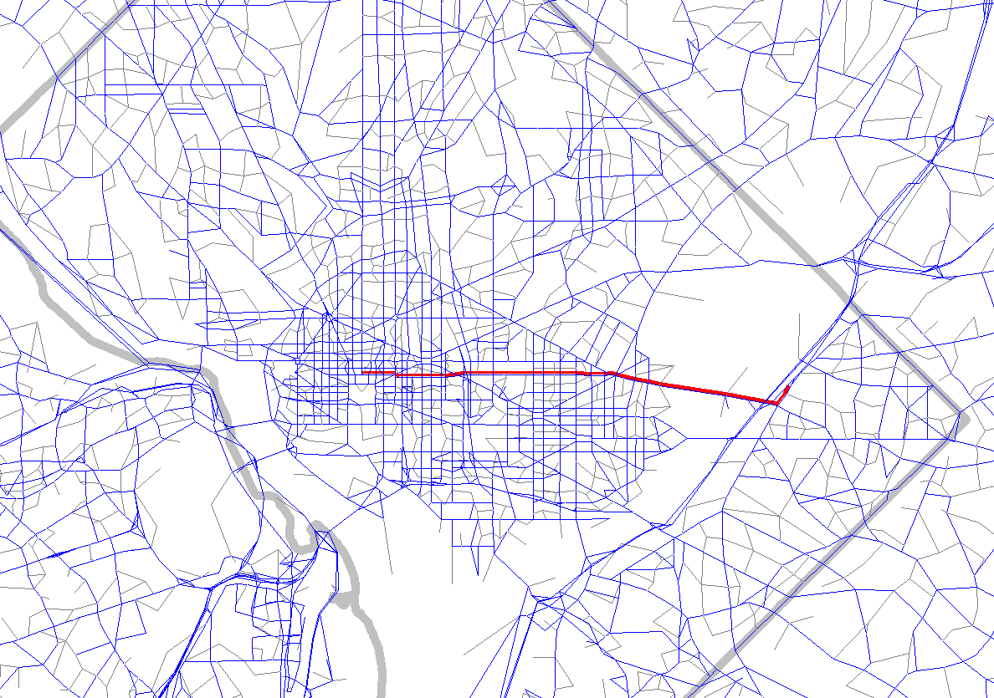
Test 3: Increase WMATA X2 Bus Frequency, 2007
Route | Base headway (min) | Alternative headway (min)
X2 AM Inbound | 7 | 3.5
X2 AM Outbound | 6 | 3
X2 OP Inbound | 9 | 4.5
X2 OP Outbound | 8 | 5

Slide 34
Test 3: Increase WMATA X2 Bus Frequency
Results, 2007
Transit into DC core increased
VMT declined by 52,253 or 0.03%
Results are intuitive and reasonable
 | Destination
Origin | DC core | DC Non-core
DC core | 218 | 94
DC Non-core | 303 | 375

Slide 35
Test 4: Raise Base Metrorail Fare
Results, 2007
Change: Base Metrorail fare raised by 25 cents (135 => 160)
Result: Reduction in Metrorail use
Mode | Base | Raised Fare | Change | Pct. Change
Commuter Rail | 21,327 | 21,088 | -239 | -1.12%
Metrorail | 493,649 | 477,911 | -15,738 | -3.19%
Bus/Metrorail | 223,466 | 215,820 | -7,646 | -3.42%
All Bus | 341,597 | 350,353 | 8,756 | 2.56%
All | 1,080,039 | 1,065,172 | -14,867 | -1.38%
19% increase in base fare for MR results in about 3% drop in MR and BU/MR
“All bus” trips increase, since their fare was not changed.
It is hard to compute fare elasticity, since not all trips see the same fare increase:
  DC to DC trip would see full 19% increase
  Long distance trips would see no increase (390-cent max. fare did not change)
Notes:
160/135 = 1.185

Slide 36
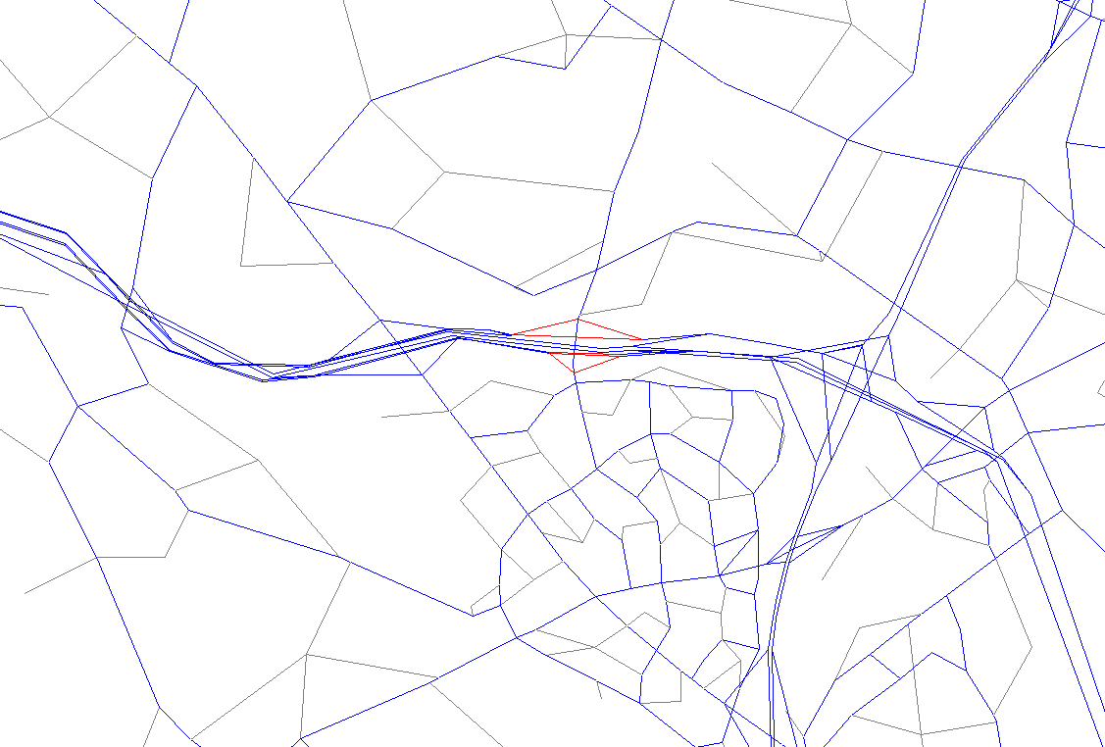
Test 5: Raise Toll on Dulles Toll Rd Main Plaza, 2007
 | Base Toll | Alternative Toll
Main Toll Plaza | $0.50 | $1.00
Ramps | $0.25 | $0.50

Slide 37
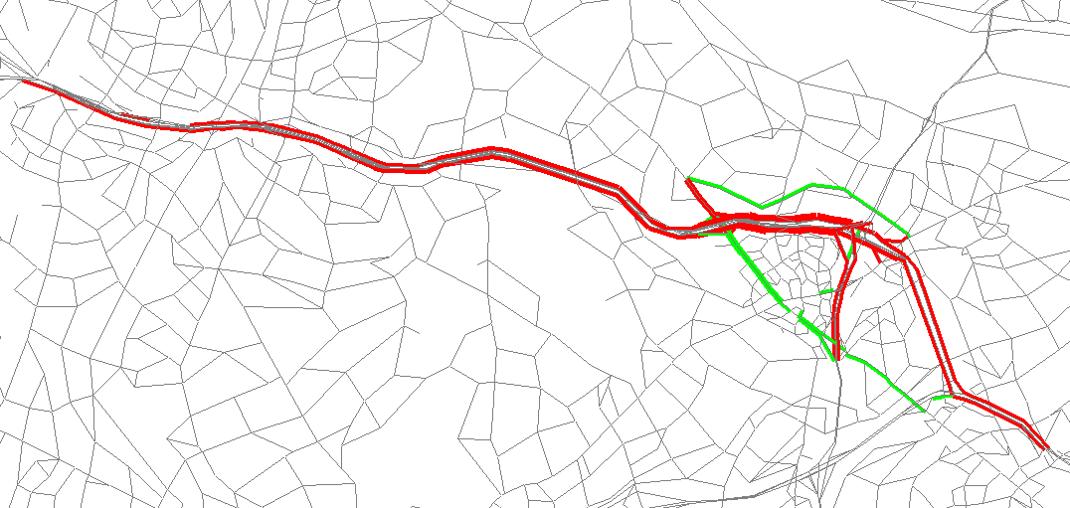
Test 5: Raise Toll on Dulles Toll Rd Main Plaza
Daily Volume difference, 2007
Red: Decrease in Volume
Green: Increase in Volume
Tolerance: +/- 2000 vehicles
Volume decrease (red) on DTR and some connecting Beltway links
Volume increase (green) on Route 7 and Lewinsville Rd
 | Main Plaza Vol. Before | Main Plaza Vol. After
Westbound | 79,132 | 61,280
Eastbound | 77,509 | 59,690
Notes:
+/-2000 vehicles = 4000 value/pixel in bandwidth settings

Slide 38
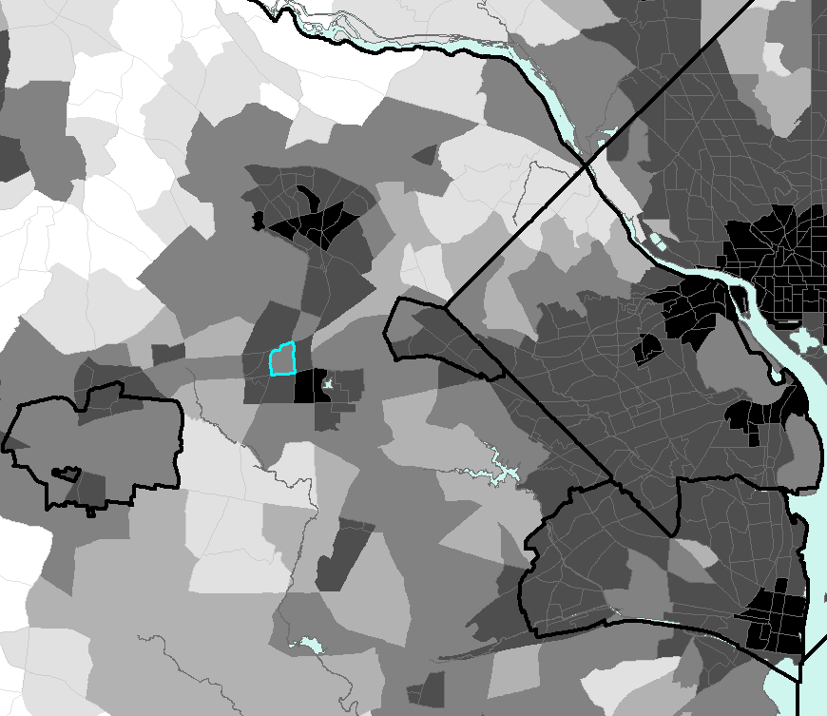
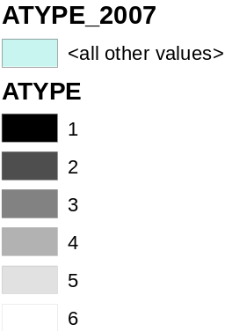
Test 6: Change TAZ 1817 area type 3 to 2 (2007)
Increased zonal population from 944 to 1888 (doubled)
AT1:
High mixed employment and population density
AT2:
Medium/high mixed density
AT3:
Medium employment density
See Table 24 in Ver. 2.3 calibration report
TAZ 1817

Slide 39
Test 6: Change TAZ 1817 area type 3 to 2
Results, 2007
Increase in zonal non-motorized productions
Increase in zonal non-motorized attractions
 | HBW Trips | HBW NonM Pct | Non-HBW NonM Trips | Non-HBW NonM Pct | All Trips | All NonM Pct
Base Case | 19 | 2.45% | 263 | 8.90% | 282 | 7.57%
LU Test 1 | 51 | 4.98% | 484 | 10.31% | 535 | 9.35%
 | HBW Trips | HBW NonM Pct | Non-HBW NonM Trips | Non-HBW NonM Pct | All Trips | All NonM Pct
Base Case | 102 | 1.90% | 645 | 4.90% | 747 | 4.03%
LU Test 1 | 251 | 4.05% | 767 | 7.49% | 1,019 | 6.19%

Slide 40
Test 7: Change TAZ 1817 area type 3 to 1 (2007)
Same zone (TAZ 1817) as previous test
Population increased from 944 to 1,888
Employment increased from 6,114 to 24,456

Slide 41
Test 7: Change TAZ 1817 area type 3 to 1
Results, 2007
Increase in zonal non-motorized productions
Increase in zonal non-motorized attractions
 | HBW Trips | HBW NonM Pct | Non-HBW NonM Trips | Non-HBW NonM Pct | All Trips | All NonM Pct
Base Case | 19 | 2.45% | 263 | 8.90% | 282 | 7.57%
LU Test 1 | 51 | 4.98% | 484 | 10.31% | 535 | 9.35%
LU Test 2 | 95 | 9.13% | 451 | 10.18% | 546 | 9.98%
 | HBW Trips | HBW NonM Pct | Non-HBW NonM Trips | Non-HBW NonM Pct | All Trips | All NonM Pct
Base Case | 102 | 1.90% | 645 | 4.90% | 747 | 4.03%
LU Test 1 | 251 | 4.05% | 767 | 7.49% | 1,019 | 6.19%
LU Test 2 | 1864 | 5.91% | 2,588 | 8.64% | 4,452 | 7.24%

Slide 42
Test 8: Load 2040 land use onto 2007 network
Results
Regional VMT increased by 38,886,000 (24.8%)
Regional vehicle trips increased by 5,604,000 (36.5%)
VMT per capita decreased from 26.2 to 22.7
VMT per trip declined from 10.2 to 9.33

Slide 43
Conclusions: Sensitivity Tests
The model response to system changes makes sense and meets our expectations, e.g.,
  When road capacity is increased, traffic on and near the improved facility increases and regional VMT increases;
  When transit service is increased on a bus line, transit trips go up and VMT decreases

Slide 44
Conclusions: Sensitivity Tests
When looking at some of the difference plots, it is evident that there is still some degree of noise in the system, due to the fact that the traffic assignment is still not fully converged
  A relative gap threshold of 10⁻³ (which is the default value used in the Ver. 2.3 mode) is probably sufficient for regional analyses, such as the AQC analysis
  A smaller relative gap threshold may need to be considered for corridor studies that require a minimum degree of noise in the traffic assignment
  Both the relative gap threshold and the max. no. of UE iterations can be easily set in the highway assignment script

Slide 45
Other conclusions
The TPB Version 2.3 Travel Model remains in beta release
  an updated version (2.3.27) is now available for data request, including
    Model inputs for 2007 and 2040
    Documentation (PDF documents on the TFS web page)
  Please follow the normal data request procedures (www.mwcog.org/transportation/activities/models/documentation.asp)
The Ver. 2.3 model will not become the official TPB model until the TPB approves the Air Quality Conformity Determination of the 2011 CLRP and the FY 2012-2018 TIP (expected November 2011)
Between now and Nov. 2011, the model may undergo changes

Slide 46
Other conclusions
The model has been run on a variety of software/hardware platforms, but there are still issues
  Long run times (these have been made shorter by distributed processing)
  Stability: Some users report problems getting the model to run (most of these have been fixed by hardware or software changes)
  We have found some incorrect tolls in the 2007 highway network
Transit constraint through regional core: Now added to the Ver. 2.3 model
Emissions post processor: In progress

Slide 47
Other conclusions
We continue to recommend using the bi-conjugate Frank-Wolfe algorithm in traffic assignment, which leads to faster convergence than the regular FW algorithm
We continue to recommend users use distributed processing (DP), though we have noticed that the introduction of DP results in very small changes in estimated VMT.
Manage these small differences by
  Running all your modeling scenarios (e.g. build and no-build) with DP on or off (don’t mix the two)
  When using DP, use the same number of cores for each modeled scenario (we tend to use four cores per model run on our computers with 8 and 12 cores)

