Slide 1

MOU
Kenny Miller
MD GIO
June 28, 2011

Slide 2
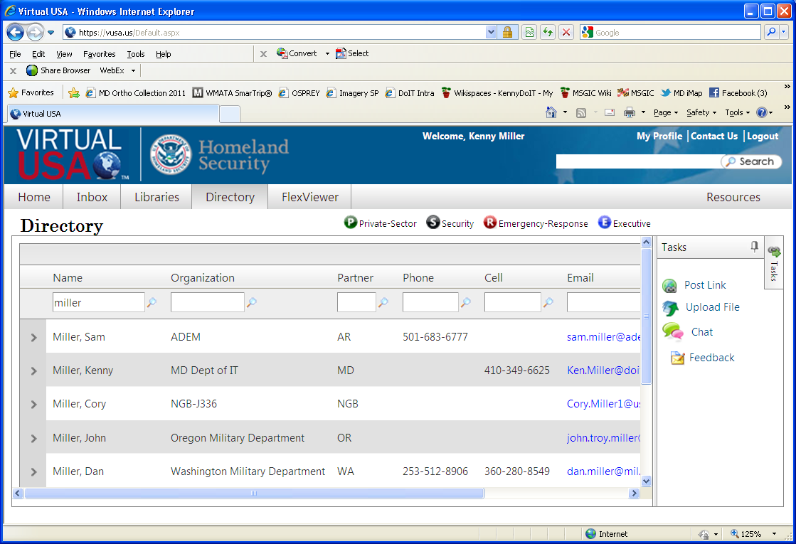

Slide 3
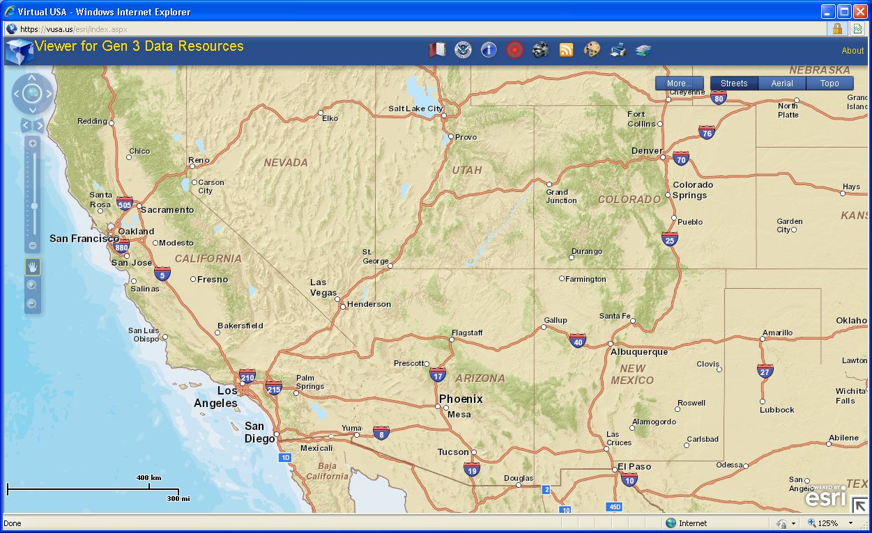

Slide 4
Core Principles
Simplicity
Practitioner/user-driven
Creating a trusted environment
Creating a “culture of collaboration”
Respecting stakeholder parity
Respecting data owner rights; data providers maintain ownership and control of their data

Slide 5
Provisions
SECTION I – PURPOSE
SECTION II – AUTHORITIES AND GENERAL IMPLEMENTATION
SECTION III – AUTHORIZED REPRESENTATIVE RESPONSIBILITIES
SECTION IV - INFORMATION REQUIREMENTS
SECTION V – ARCHITECTURE
SECTION VI - PERMISSIONS TO SHARE
SECTION VII – IMPLEMENTATION
SECTION VIII – VALIDITY

Slide 6
vUSA MOU FAQ’s
Local jurisdictions are covered by the state/district execution of the MOA
VA and all its jurisdictions will be grandfathered into the National MOA
Locals can execute their own MOA if they would like
The National MOA should be approved and ready for execution very soon
Generation IV
Maryland’s attorney’s are OK – OMG!

