Slide 1
Regional Bus Subcommittee: 2011 Work Programme
Eric Randall
TPB Staff
April 26, 2011

Slide 2
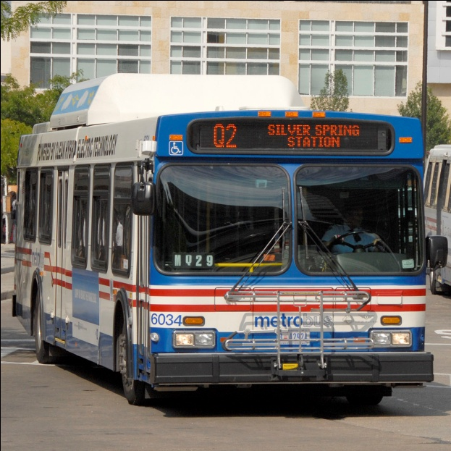
2011 Regional Priorities for Bus –
Presentation to TPB on May 18
Major themes for projects needed to meet regional bus customer and agency needs:
Serving Customers
Connecting the Region
Bottlenecks and Hot Spots – Bus Access to Regional Hubs / Activity Centers
The DC Core – Downtown DC Bus Center & Bus Stops
Regional Transit and Intermodal Transfer Centers
Providing the Fleet – Bus Facilities
Service Needs and Changes
Federal Relocation & BRAC

Slide 3
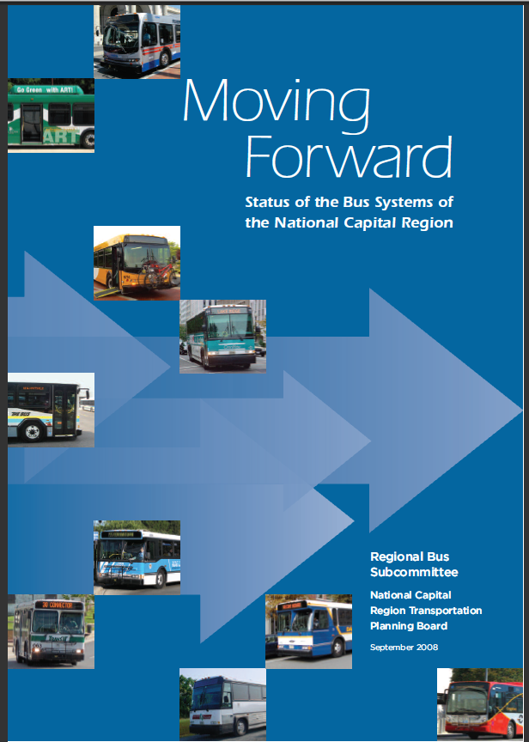
Future Work Activities
Annual Transit Forum w/ Private Providers Task Force
  May 24, 11:00 AM – 1:30 PM
  Local Jurisdiction updates…
Update Moving Forward Brochure
  Also produce a Status Report?
High-Frequency Mapping Effort?
Other Topics

