Slide 1
Item 9: Briefing on the Update to the
Bicycle and Pedestrian Plan for the National Capital Region
TPB Technical Committee, 10/1/2010
Item #5
Michael Farrell
TPB Staff
Presentation to the
TPB Technical Committee
October 1st, 2010
Item #5

Slide 2
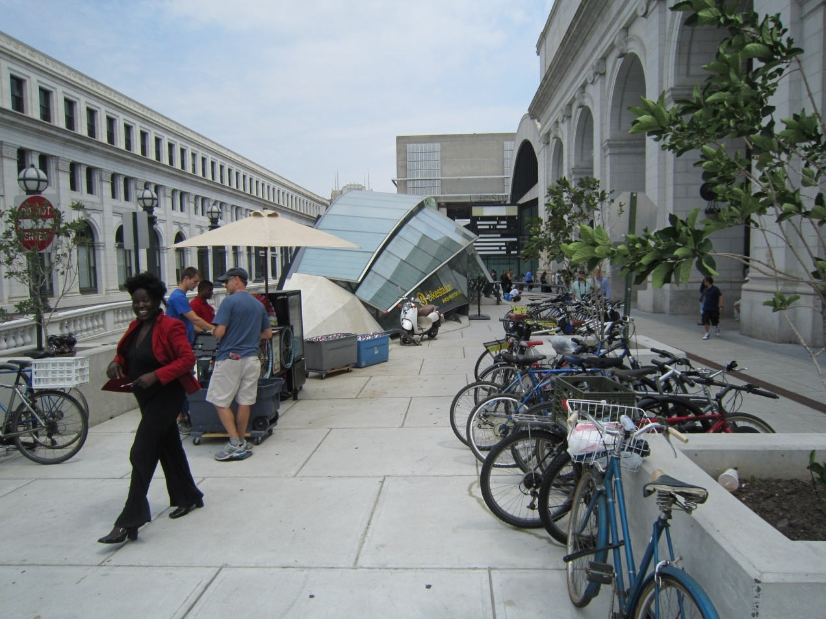
Overview
Last Bicycle and Pedestrian Plan was adopted by the TPB in July 2006
An updated Bicycle and Pedestrian Plan will go to the TPB for approval October 20, 2010

Slide 3
The 2010 Bicycle and Pedestrian Plan
Identifies major bicycle and pedestrian projects the region wishes to carry out by 2040
  Contains both funded and unfunded projects
Incorporates goals and performance indicators for walking and bicycling from:
  1999 TPB Vision
  2010 COG Region Forward 2050 plan
Identifies “best practices” likely to be effective in achieving those goals
Discusses trends in policy, mode share, safety

Slide 4
Plan Outline
Chapter 1: Planning context of federal, state, and local bicycle/pedestrian policies and plans
Chapter 2: Demographic and geographic overview of bicycling and walking in the region
Chapter 3: Pedestrian and Bicyclist Safety
Chapter 4: Overview of existing facilities
Chapter 5: Goals and Indicators
Chapter 6: Best Practices
Chapter 7: The 2040 Network

Slide 5
Plan Development
Oversight
  Bicycle and Pedestrian Subcommittee of the TPB Technical Committee
Project listings
  Submitted by state and local jurisdictional staffs
  On-line database
Criteria for including projects:
  Of a size and scope to be regionally significant
    Regional connectivity
    Access to transit, pedestrian safety
  Inclusion in jurisdictional/agency plans

Slide 6
Plan Projects
(Chapter 7 and Appendix A)
409 total projects
      336 planned projects
      73 projects completed since 2006
      View projects at : http://www.mwcog.org/bikepedplan/
Chapter 7: The 2040 Network shows:
    Planned facilities
      450 miles of bicycle lanes, 630 miles shared-used paths, and signed bicycle routes
      20 major pedestrian/bicycle intersection improvement projects
      10 bridges or tunnels
      21 major streetscaping projects
      Ongoing sidewalk retrofit and pedestrian safety programs
      Estimated cost: $1 billion
    Does not include privately provided facilities.

Slide 8
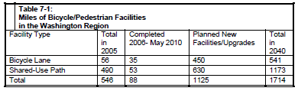
Planned Facility Mileage

Slide 9
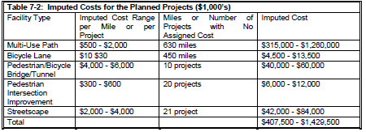
Cost Estimates
  Projects mostly not yet designed, no cost estimate
  Bike/Ped Projects often part of a larger project
    Bike/Ped cost not available, even after the fact
    Example: Woodrow Wilson Bridge
  “Imputed Cost” per facility/mile
    All cost estimates are 2010 dollars

Slide 10
Progress Since 2006
73 projects completed, including:
  13 miles of shared-use path and nine miles of bike lane added per year
  Sixteen major pedestrian intersection improvement projects
  Nine streetscaping projects
  Five pedestrian bridges or tunnels
Notable projects finished since 2006 include:
  Pedestrian bridge over Route 50 at 7 Corners
  Woodrow Wilson Bridge
  College Park Trolley Trail
  DC Bike Station at Union Station

Slide 11
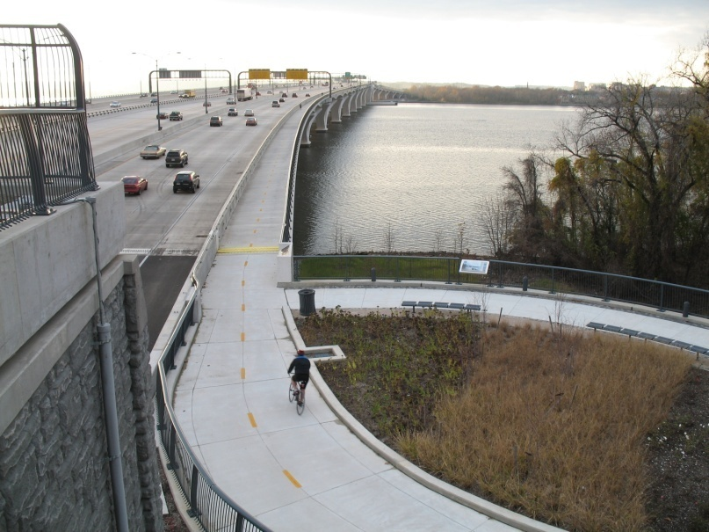
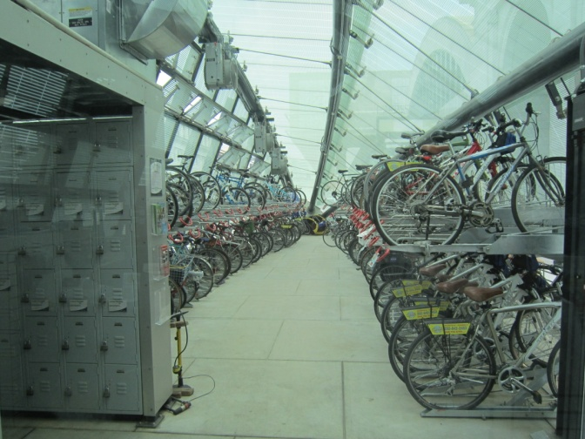
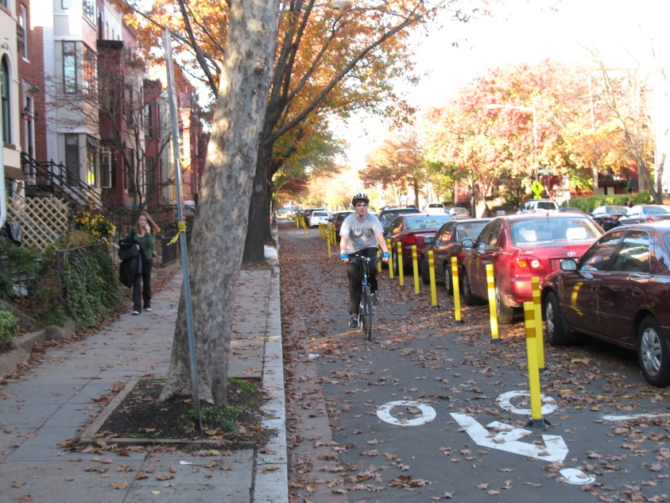
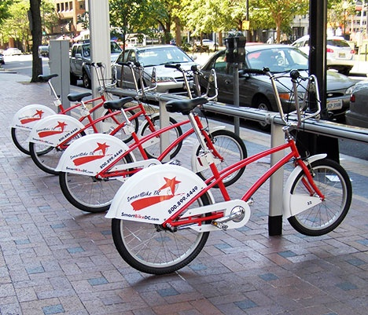
Some projects built since 2006

Slide 12
Regional Planning Context: Goals & Indicators (Ch. 1, 5)
TPB Vision (1999) calls for
  Mixed-use, walkable regional activity centers
  Reduced reliance on the automobile
  Safe, convenient walking and biking
COG Region Forward 2050 plan builds on the Vision, adds performance indicators
  More rapid implementation of projects in the bicycle and pedestrian plan
  Increase walk and bike mode share
  Reduce pedestrian and bicyclist deaths & injuries
  Regular progress reports
This Plan incorporates relevant Region Forward Goals and Indicators (Chapter 5)

Slide 13
Federal and State Policies
(Chapter 1)
Federal
  FHWA Guidance 2010
      “Go beyond the minimum requirements”
  ADA, Safe Routes to School
States – “Complete Streets”
  VDOT: “Policy for Bicycle and Pedestrian Accommodation” (2004)
    Secondary Street Acceptance Requirements 2009
  DDOT: “Action Agenda” (2010)
    Create a “walk-centric, bike-centric” city
Notes:
VDOT – all transportation projects will accommodate peds/bikes. Exceptions
DDOT – “Pedestrian Strategy” calls for a pedestrian-friendly city and accommodating pedestrians in all road projects.
FWHA Guidance 2000 calls for walking and bicycling to be incorporated into all transportation projects unless exceptional circumstances exist.

Slide 14
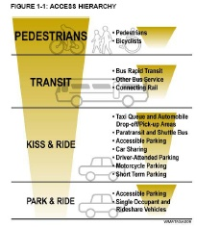
WMATA Policies
(Chapter 1)
Old policy:
  First priority to auto access, park & ride
  Bus access second
New policy:
  Pedestrian access first
  “Joint development”
Bike/Ped Access Study (September 2010)

Slide 15
Pedestrian and Bicycle Safety
(Chapter 3)
Nearly ¼ of all traffic deaths
  Low income, immigrant, inner suburbs especially affected
  Total traffic deaths are falling, but pedestrian deaths are not
Street Smart Safety Campaign
Trail Safety

Slide 16
Walking and Bicycling Trends
(Chapter 2)
Growth in Walking and Bicycling,1994 – 2007/8
  Walk trips grew from 7.7% to 8.5% of all trips
  Bicycling stayed at 0.5%.
    Grew in the urban core
    Decline d in the outer suburbs
  DC bike counts show peak hour volumes doubled between 2004 and 2009
Potential for growth in walking and bicycling
  25% of auto trips were 1.5 miles or less
  25% of auto passenger trips were 1.2 miles or less
Walking is the usual mode of accessing transit
  62% Metrorail, 80% bus (all day)
  33% Metrorail am peak

Slide 17
Follow-On Actions
Annual Database Updates
  Measure progress
  Tool for generating lists of “ready to go” projects
Annual Progress Reports to TPB
  Projects completed
  Other indicators as data is available
Plan Updates
  Every 4 years
  General information for bicycle and pedestrian planning in the region
  Changes in best practices, goals

