Slide 1

Climate Action
Progress Report
Concepts
September 2010
EAC and CEEPC Meetings

Slide 2
PROGRESS REPORT OUTLINE
Message from Chairman and committee member list
About us / background
Key accomplishments
Sections by topic: brief summary and visuals
  Local inventories and plans, energy efficiency, renewable and cleaner energy, transportation, education
Financials
Select project highlights: map and pictures
Detailed summary chart of progress towards goals

Slide 3
DRAFT - ILLUSTRATIVE DATA ONLY
2010 KEY ACCOMPLISHMENTS

Slide 4
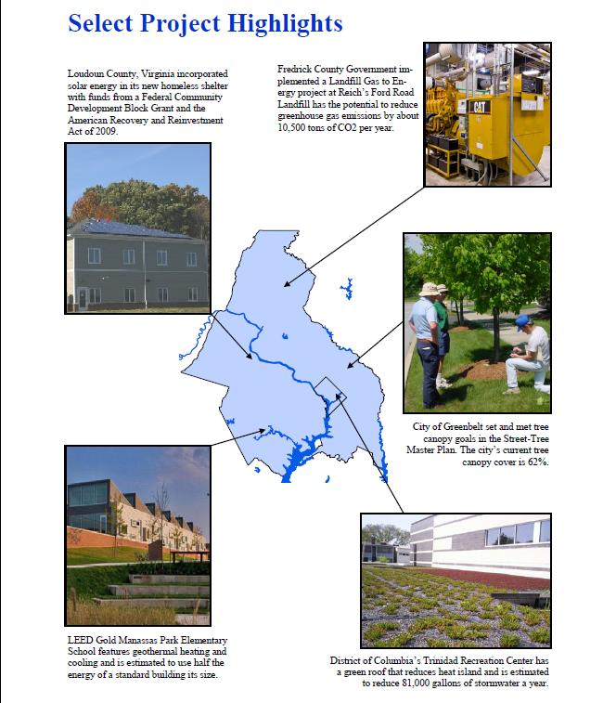
DRAFT - ILLUSTRATIVE DATA ONLY

Slide 5
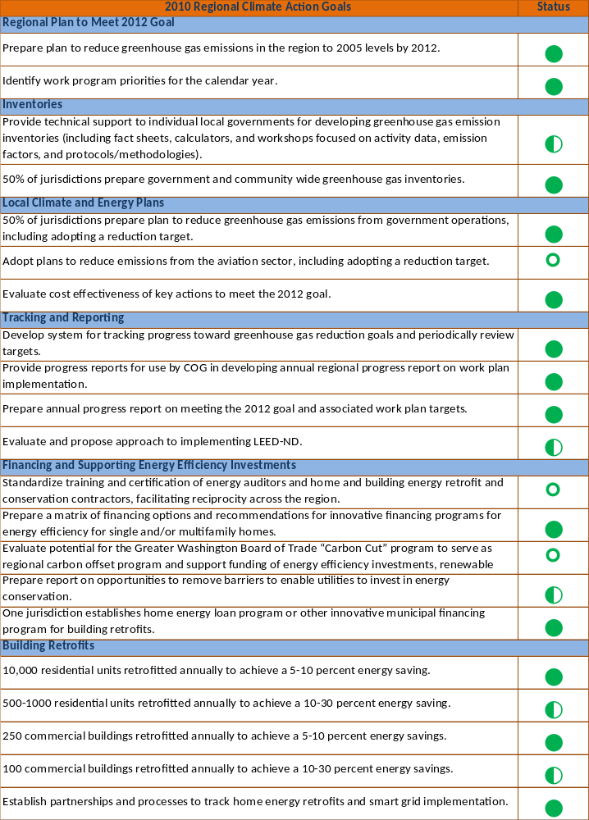
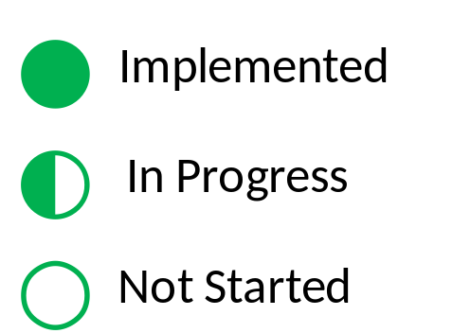
DRAFT - ILLUSTRATIVE DATA ONLY
Universal symbols for:
Percentage goals
Programmatic goals
Numerical goals

Slide 6
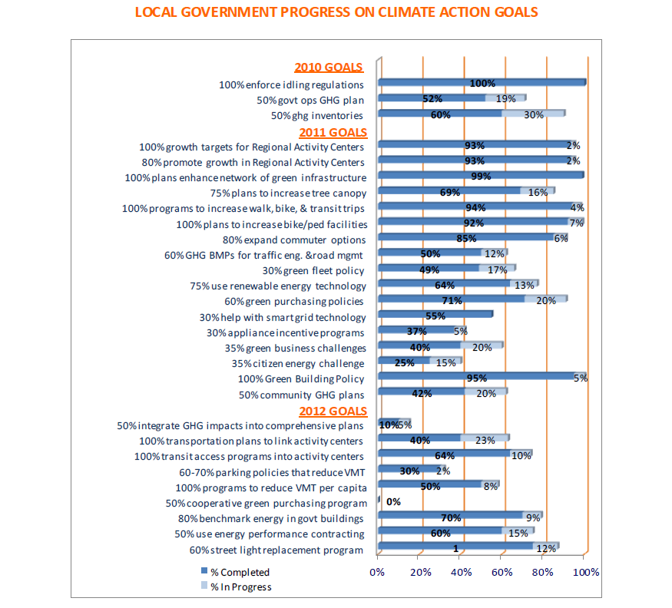
DRAFT - ILLUSTRATIVE DATA ONLY

Slide 7
ADDITIONAL
VISUAL CONCEPTS
Categorizing Data by:
  State
  Population
  Inner v Outer
  Jurisdiction

Slide 8
SINGLE MEASURE BY STATE
DRAFT - ILLUSTRATIVE DATA ONLY

Slide 9
SELECT MEASURES BY POPULATION
DRAFT - ILLUSTRATIVE DATA ONLY

Slide 10
SINGLE MEASURE BY POPULATION
DRAFT - ILLUSTRATIVE DATA ONLY
Completed Greenhouse Inventories?

Slide 11
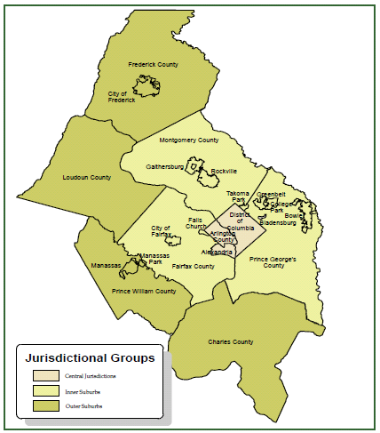
SINGLE MEASURE BY INNER v OUTER
DRAFT - ILLUSTRATIVE DATA ONLY
Adopted Anti-Idling Policies?
Jurisdictions in Metro DC Region
Central
Jurisdictions
33%
NO
57%
YES
43%
56%
Inner
Suburbs
11%
Outer
Suburbs

Slide 12
Individual Jurisdiction Comparisons
COG Report Examples:
Annual Report on Crime and Crime Control
Commercial Construction Indicators
How Safe are our Roads?
Obesity and Overweight

Slide 13
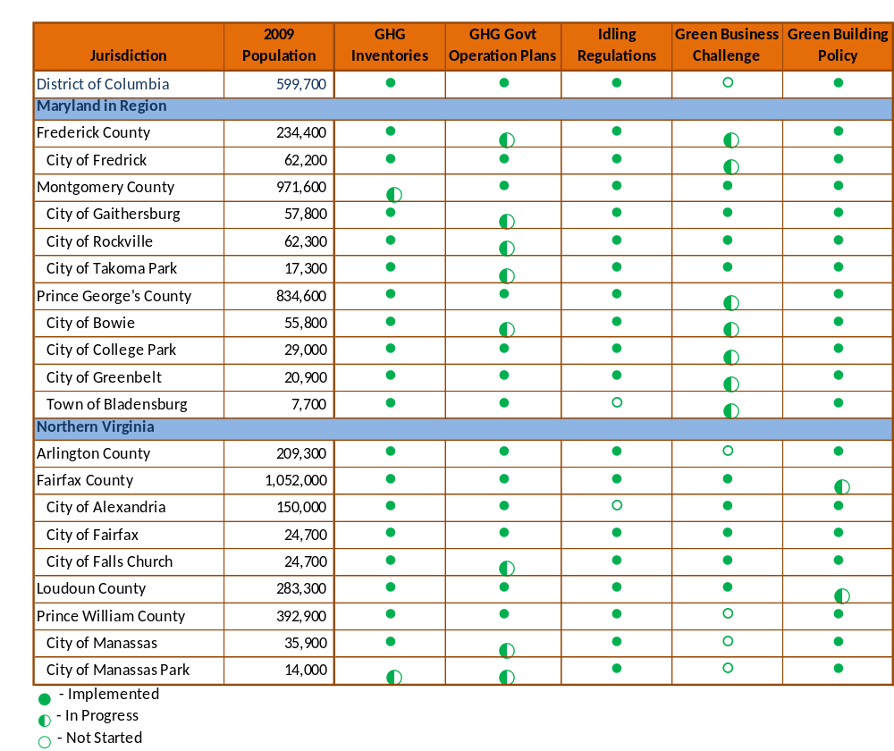
SELECT MEASURES BY JURISDICITON
DRAFT - ILLUSTRATIVE DATA ONLY

Slide 14
Discussion and
Feedback for CEEPC

