Slide 1
National Capital Region (NCR)
Closed Circuit Television (CCTV) Integration Framework Project
Phase I Final Report Summary and Phase II Update
June, 2011
John Contestabile
Asst. Program Mgr. Homeland Protection
john.contestabile@jhuapl.edu

Slide 2
Agenda
Nature of the video sharing problem
Project Overview / Team / Statement of Work / Study Participants
Study Accomplishments
Conceptual Interoperability Model / NCR Application
Video Sharing Ground rules
Recommended “To Be” Architecture
Recommended “To Be” Security Concept
Future / Follow on Recommendations
Next Steps

Slide 3
Nature of the Video sharing Problem
No policy or CONOPS for sharing
Video ownership and permissions to access issues
Permission to control Pan/tilt/zoom of the camera
No common network to access the video
Varying video formats that cannot be viewed by others
Varying bandwidth and file size issues
Limits on number of users that can access a particular camera feed without “crashing” the system
Most systems designed to “aggregate” video within an agency, not share it outside the agency

Slide 4
Video Project Overview
Goals:
    Interoperability – able to share video images
    Develop a Concept of Operations (CONOPS) with the practitioners
    Provide strategic direction for future video system investments
Critical Success Factors:
    Operating procedures to define and facilitate video sharing
    Technical Framework to enable video sharing
    Strategy and resources to implement and maintain a video sharing system.
Phase I study to investigate the problem and recommend a way forward (completed March, 2011)
Phase II to implement the proposed architecture between the regional Departments of Transportation (to be completed this summer)

Slide 5
Project Sponsor, Manager and Partners
Project Sponsor
    NCR Critical Infrastructure Protection Working Group
Project Manager
    DC Homeland Security and Emergency Management Agency
Project Partners
    Johns Hopkins University Applied Physics Laboratory
    SkyLine Network Engineering, LLC & Earth Security Electronics, LLC

Slide 6
Review Statement of Work
Five Tasks:
  Task 1: Finalize Conceptual Project Plan - Hold stakeholder meetings to identify a subset of CCTV systems that represent the region geographically, technologically, jurisdictionally and by discipline. Completed in April 2010
  Task 2: Conduct Video Systems Inventory - Develop data collection strategy, identify camera locations with GPS coordinates and retain in a database, and develop GIS presentation of the data. Completed in July 2010
  Task 3: Conduct Data Analysis - Identify camera coverage gaps, document “As Is” architecture, develop “To Be” video sharing alternatives, and provide illustrative ROM cost estimates to migrate. Completed October 2010
  Task 4: Develop Concept of Operations (CONOPS) – Review policies, standard operating procedures, and any existing CONOPS. Work with participant stakeholders to develop a draft video sharing CONOPS. Completed by November 2010. Phase I final draft report completed December, 2010
  Task 5: Additional Systems Integration (optional) - Include additional cameras or systems into the framework as requested. Tasked to build a prototype system between the regional transportation agencies. Initiated December 2010 through August 2011

Slide 7
Study Participants
  Arlington County
  DC Homeland Security and Emergency Management Agency (HSEMA)
  Fairfax County (Department of Police)
  Maryland Department of Transportation (MDOT)
  Maryland State Police
  Maryland State Highway Administration (SHA)
  Maryland Transportation Authority (MdTA)
  Metropolitan Washington Airports Authority (MWAA), National and Dulles Airports
  Montgomery County Department of Police
  Montgomery County Department of Transportation
  Prince Georges County
  United States Park Police
  Virginia Department of Transportation (VDOT)
  Washington Metropolitan Area Transit Authority (WMATA)
  Washington Suburban Sanitary Commission
  Capital Wireless Information Net (CapWIN) *
  Fairfax County Data Exchange Hub (DEH) *
  FEMA Office of National Capital Region Coordination *
  Maryland Coordination and Analysis Center (MCAC) * *indicates video consumer only

Slide 8
Study Accomplishments
Developed camera inventory of participating agencies
Produced a Concept of Operations for video sharing
Developed a map based display of cameras
Developed “As Is” and proposed “To Be” video sharing architecture
Developed a security framework for sharing video images
Develop order of magnitude cost estimates for implementation of the “To Be” architecture

Slide 9
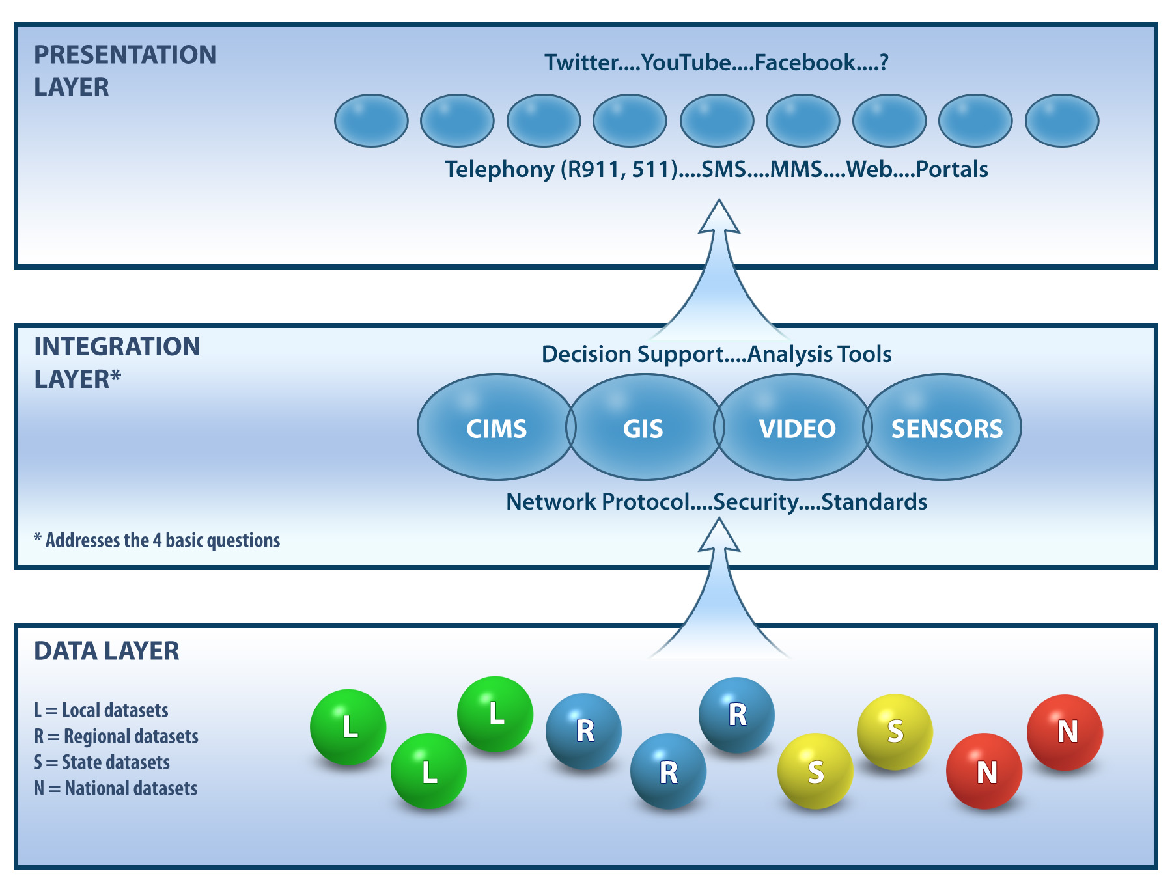
Conceptual Interoperability Model

Slide 10
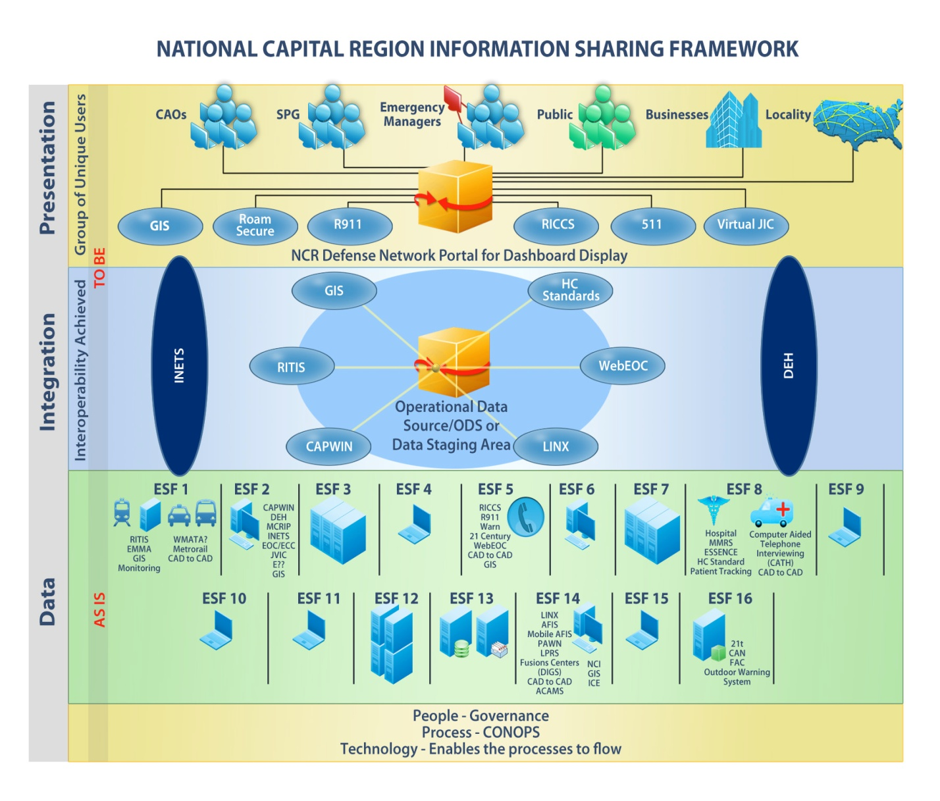
NCR Adaptation of the Conceptual Interoperability Model

Slide 11
Video Sharing Ground Rules
Overall Ground Rules
  Video sharing must be both horizontal and vertical
  The new system should support any sharing currently in place
  The new system should initially support real-time video sharing to various centers, who may then provide it to first responder/field units (i.e. Emergency Management Agencies, Fusion, and Operations Centers)

Slide 12
Video Sharing Ground Rules
Source Agency
  Decides what to share
  Video Remains under their control
    Exclusive Property, right to record, retention policy
  Determines Security Level for each Video
  Determines Permissions to see video
  Retains Pan/Tilt/Zoom (PTZ) camera control
  Ability to disable video feed or feeds to Receiving Agencies, based on Security level or user group
  Should not require major modifications to the current video systems
Receiving Agencies (Viewing Agencies)
  May request stored images from Source Agency
  May retain or share only with Permission from Source Agency
  MOU needed for recording video of source agency when they do not
  May request Agency to record images
  May request PTZ movement

Slide 13
Existing “AS IS” Video Sharing Capability
The current “As Is” architecture of the participating agencies has traditionally been limited to a combination of video sharing at the Data and Presentation Layers.
These methods have been successful for the short term and on a small scale, but have been very expensive and difficult to implement.
As we look towards a regional architecture for video sharing these current methods will need to be replaced with a more efficient and network friendly approach.

Slide 14
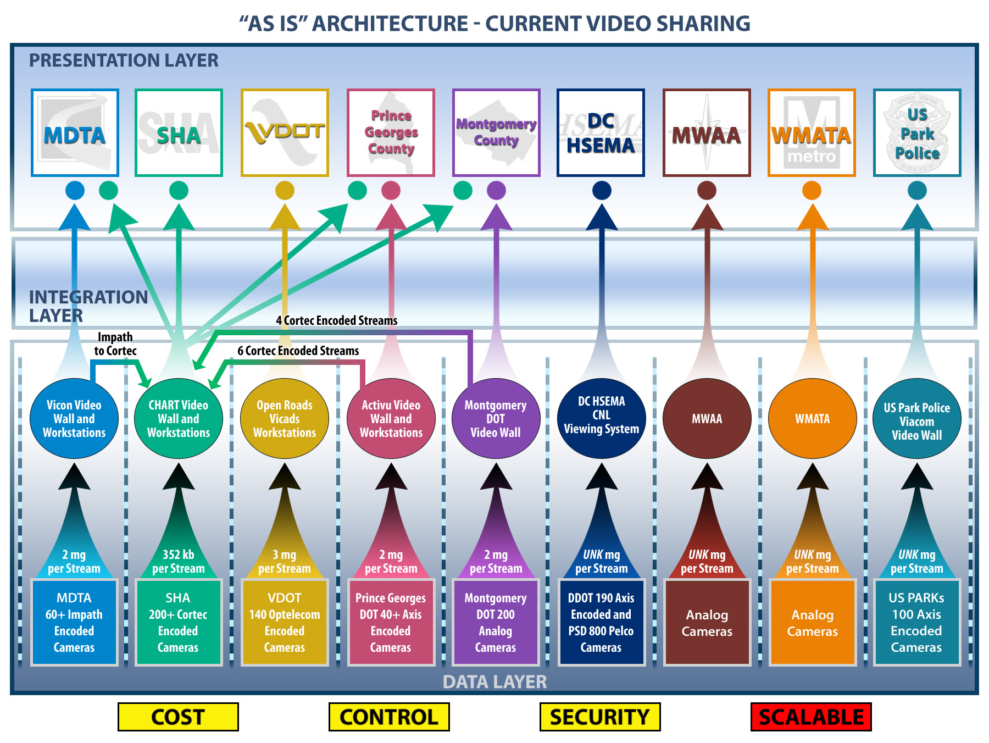
Notes:
Point out dotted lines are firewalls
Point our data and presentation layer examples
Explain why the costs

Slide 15
Potential Types of Video Sharing
Presentation Layer video sharing requires expensive infrastructure investment, distributes control, creates network security issues, and typically requires each connection to be a custom design. The user will typically have separate workstations for each application.
Data Layer video sharing allows for direct access to the video source, but increases the need for expensive, high bandwidth networks. Sharing at this level may also necessitate camera licenses for every camera connection, require extensive firewall rules, lead to major scalability issues, and require the source data to be a particular type of feed leading to the expense of new equipment.
Physical Security Information Management (PSIM) video sharing is a combination of the Presentation Layer and Data Layer models. This technique, while applicable to a limited number of EOCs, multiplies the issues of connectivity costs, network security, source control, and network bandwidth needs if applied regionally.

Slide 16
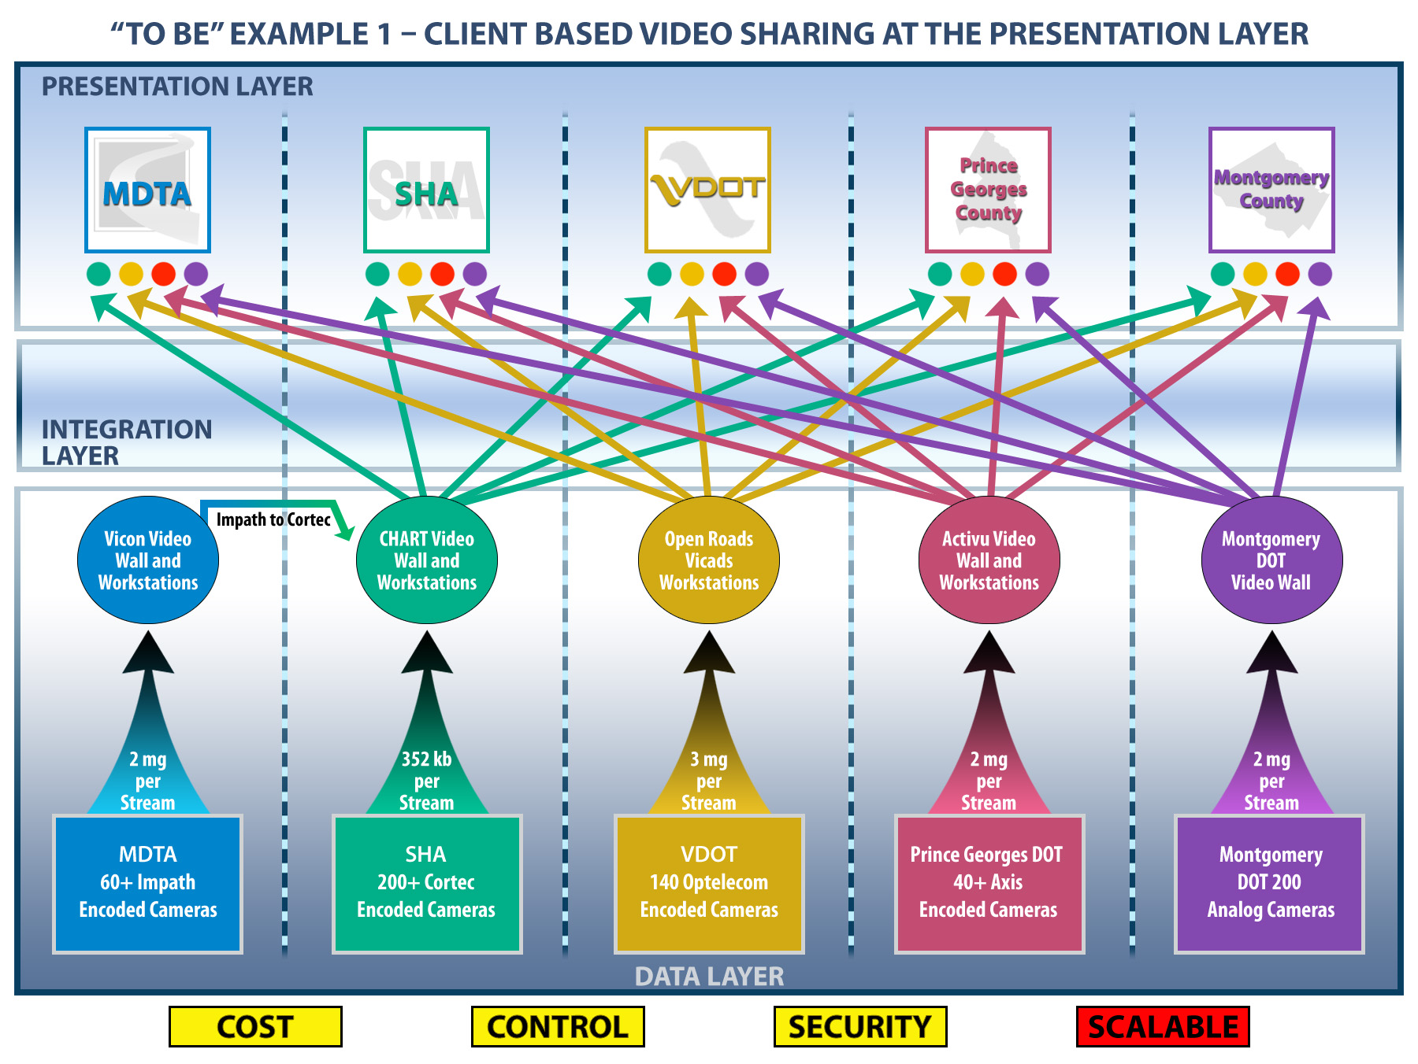
Notes:
Point out the multiple workstations
Point out fiber builds required
Point out need for a new workstation for every new system
Skipping integration layer
Size of video

Slide 17
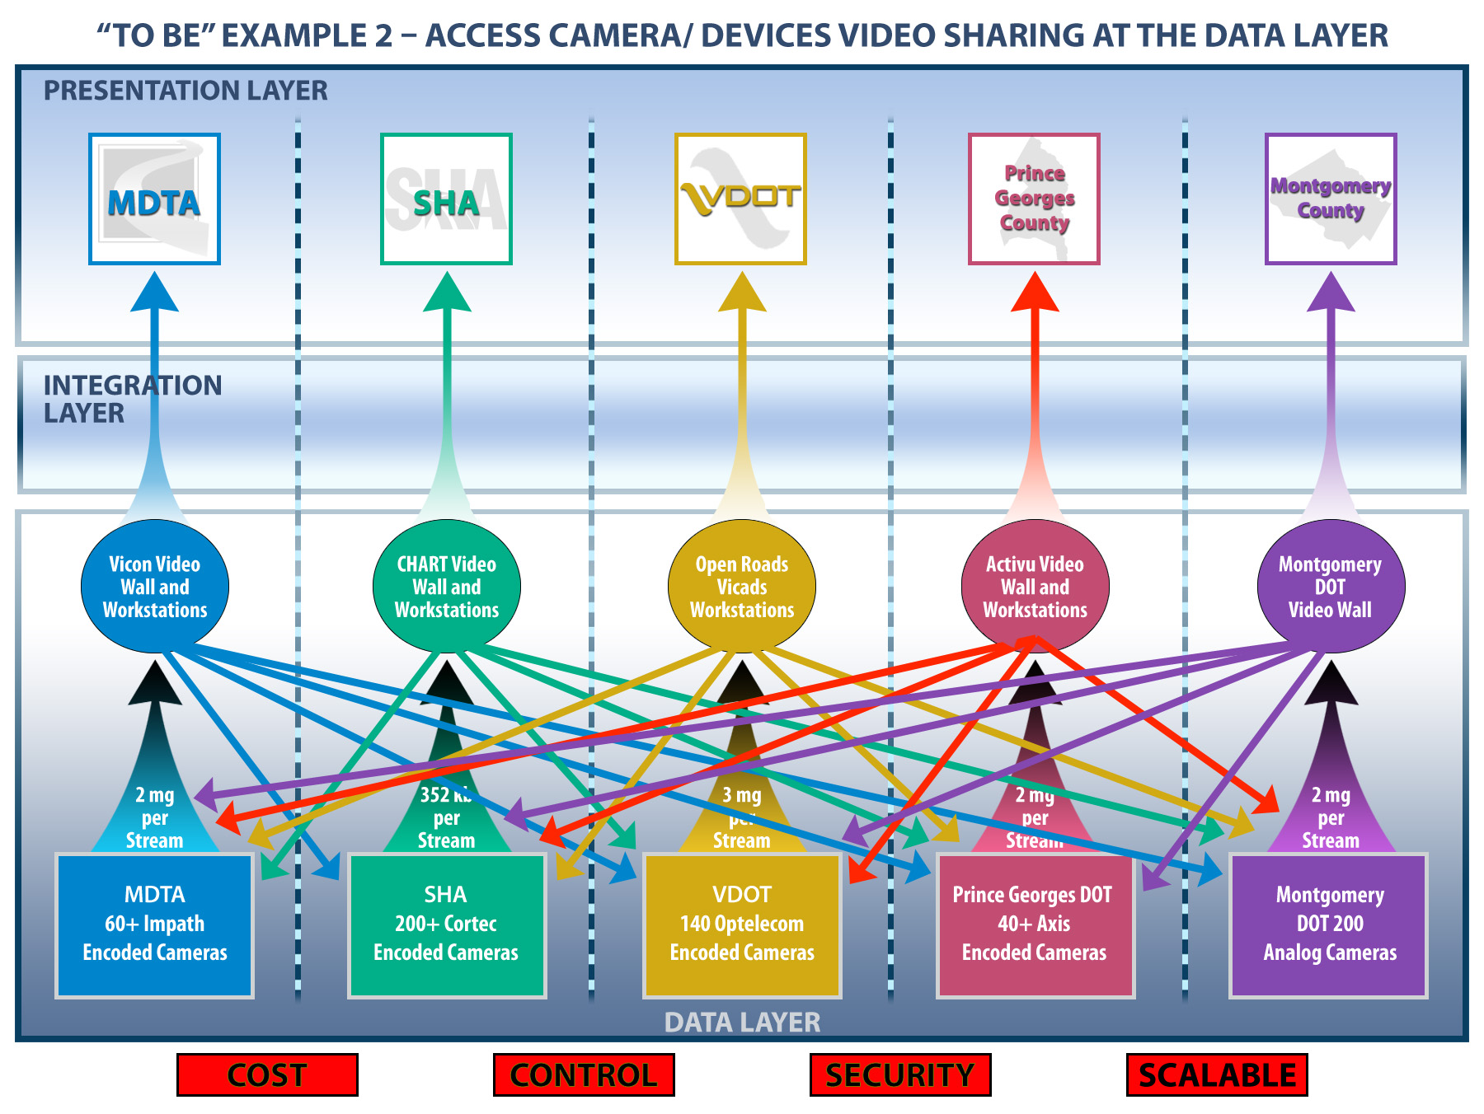
Notes:
Point out lack of source control
Expense with client licenses
Point out Firewall issues
Point out limitations are the edge, multiple streams
Lack of control on recording

Slide 18
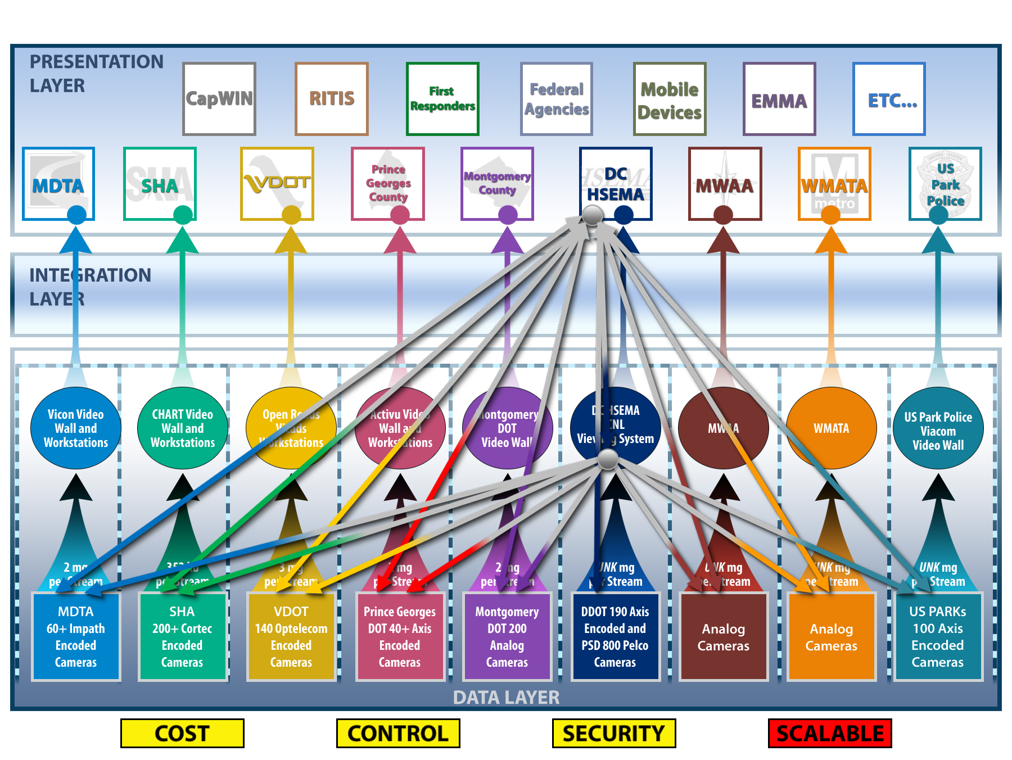
Notes:
Point out flow of the request
Point out firewall penetrations
Lack of source control
Camera connection limitations, every new request is a connection to the camera
Not scalable, good for one location

Slide 19
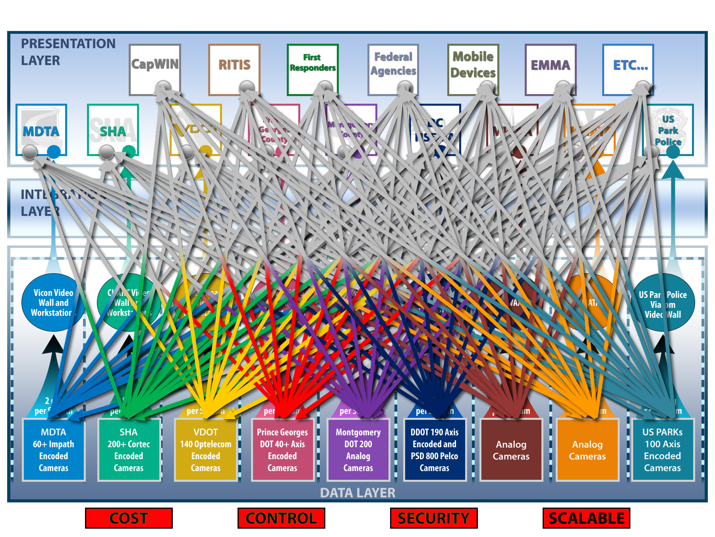
Notes:
If everyone used this system
Skipping the integration layer
Major firewall issues
Major bandwidth issues

Slide 20
Recommended “TO BE” Video Sharing Concept
Utilize a Layered Approach
  Interoperability is achieved in the Integration Layer
  Normalize the data
  Distribute the data utilizing a Secure Architecture
  Allow Data to be viewed in each Agency’s current Presentation Layer Application

Slide 21
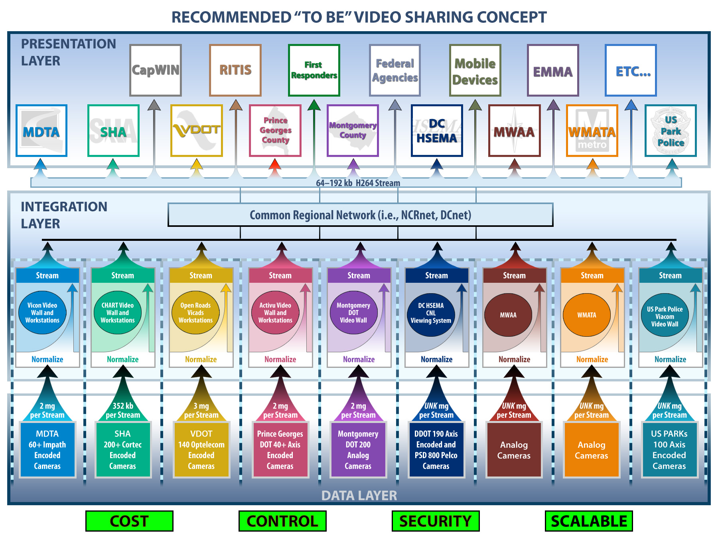

Slide 22
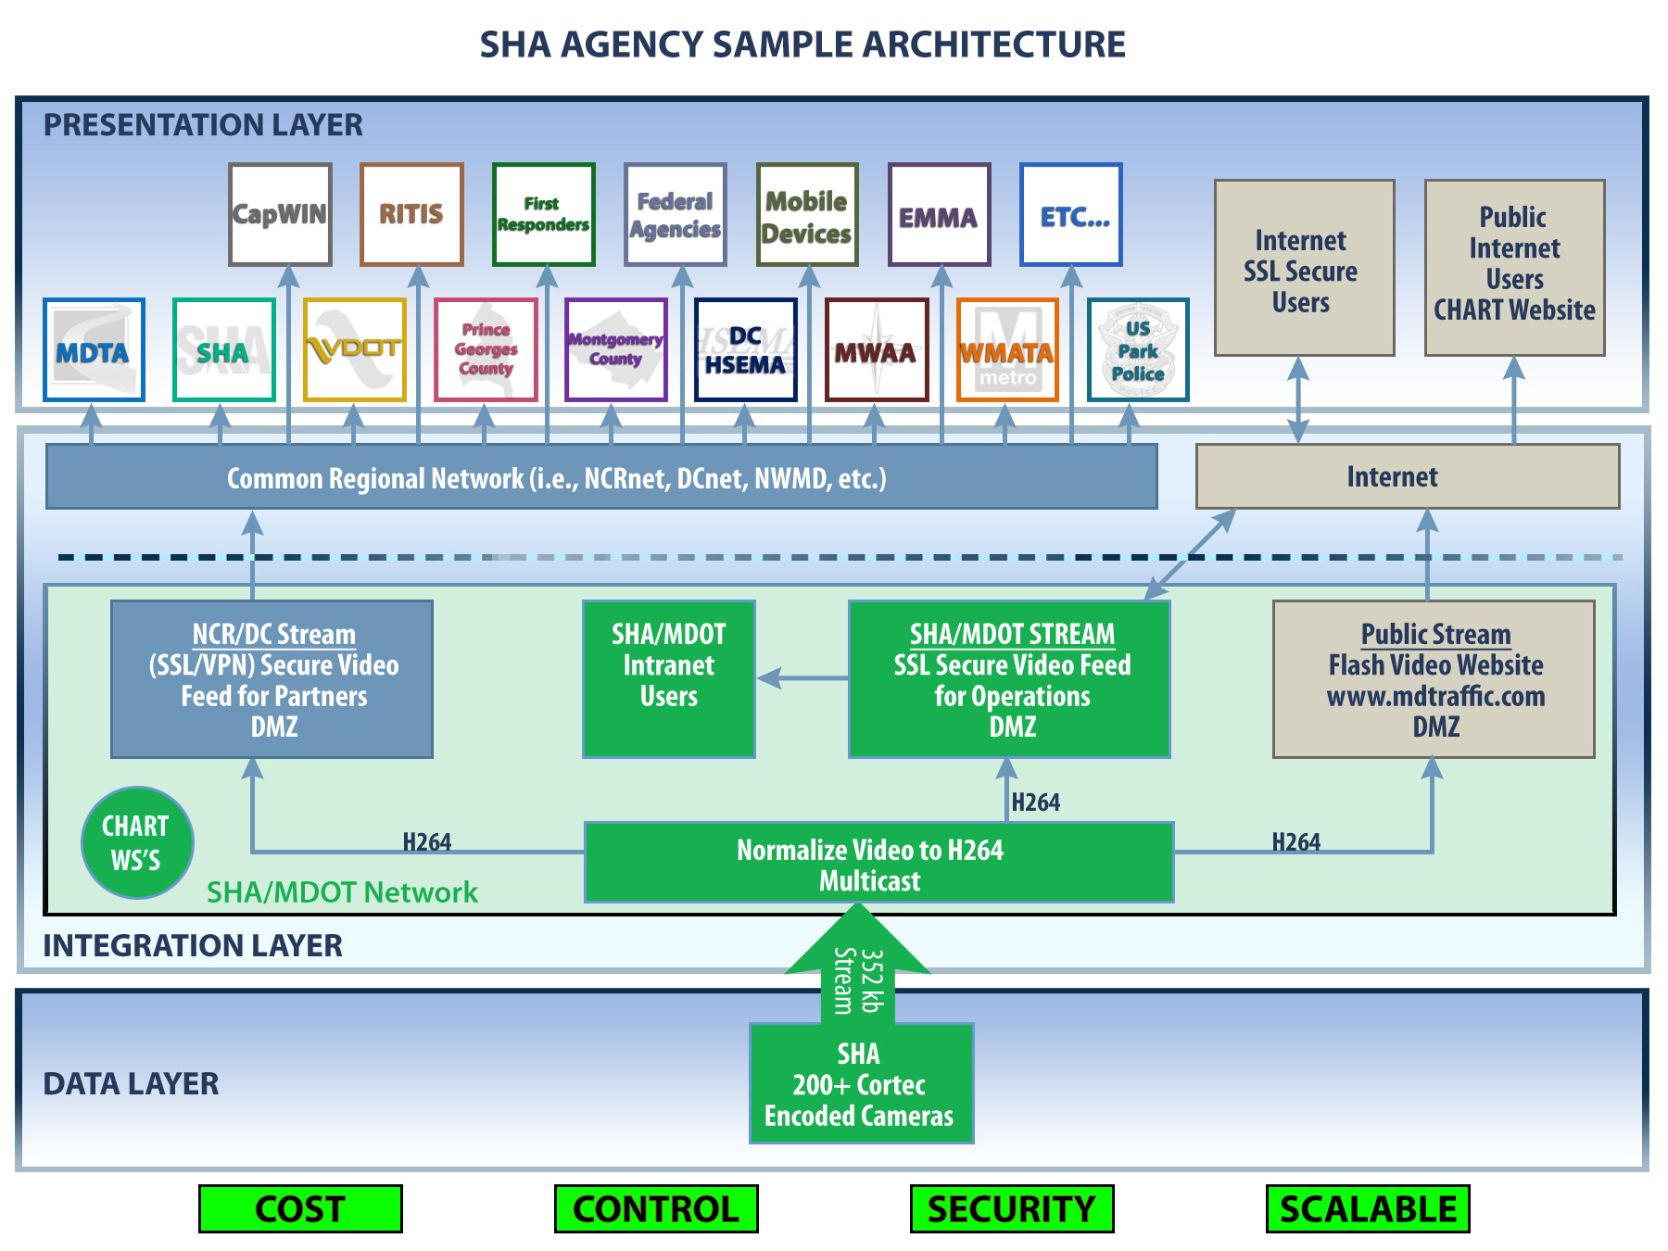

Slide 23
Recommended “TO BE” Video Sharing Concept
Pros:
Cons:
Provides Agency with source control and the ability to create multiple security domains
Camera and Intranet are only accessed once
Firewall Friendly
Eliminates Vendor Dependence
Allows Agencies freedom to choose VMS and Presentation Applications that meets their needs
Highly scalable
Low Bandwidth impact
Ability to share with Mobile devices
Ability to create instant access to video
No Client needed to see the video
Ability to Adjust Stream Bandwidth
Ability to Change Stream Output
Comparable Cost is low
Additional Configuration needed to extend PTZ control
Limited Access to Video Archives

Slide 24
Recommended “TO BE” Video Sharing Security Concept
Four Video Security Levels, set by the owning agency.
  Level 1 – Open access to partners - public/no MOU needed
        Ex. Highway Traffic video, public parking areas
  Level 2 – Open access to partners/regional MOU needed
        Ex. Rail platform video, lobbies, plazas
  Level 3 – Restricted access to partners/agency specific MOU needed
        Ex. Views of non-public areas, internal building video
  Level 4 – LEO only/restricted access/agency specific MOU needed
        Ex. Surveillance video, screening areas, possibly encrypted

Slide 25
Recommended “TO BE” Video Sharing Security Concept
Four User Security Levels, set by the owning/receiving agencies.
  Level 1 - Unlimited Access at the owning agency
        Unlimited Access at the receiving agency
  Level 2 - Unlimited Access at the owning agency
        Unlimited Access at the receiving agency
  Level 3 - Unlimited Access at the owning agency
        Access controlled by user ID/password or authentication at the receiving agency
  Level 4 - Access controlled by the owing agency
        Generally no access except by MOU, controlled by user
        ID/password or authentication at the receiving agency

Slide 26
Phase II Next Steps
Under “Optional Task 5”, Implement the “To Be” video sharing architecture between the regional transportation agencies (i.e. VDOT, DC DOT, MDOT/SHA)
    Sub Task 1 – Review Architecture with the transportation agencies in light of existing and proposed systems
    Sub Task 2 – Develop proposed systems design(s) and cost estimate(s)
    Sub Task 3 – Implement the selected proposed system design
Additional ‘08 UASI Funding - $200,000
Period of performance – December 2010 to August 2011

Slide 27
Phase II Next Steps
        Demonstration

Slide 28
Phase III - FY 2011 UASI Follow on Project - $740K
Expand the DOT pilot architecture to other partners (particularly MWAA and WMATA)…to include hardware
Integrate map based display of cameras with regional GIS systems (i.e. VIPER/EMMA/iSAVE/vUSA ) and other data sets
Develop systems documentation (i.e. DEH/NCRnet) as well as a long term governance and sustainment plan in association with the CIO Committee
Refine security framework based on implementation of the “To Be” architecture
Develop a plan for Private Sector participation in regional video sharing

Slide 29
Questions?
Many thanks to All who participated in this study!
      John Contestabile
      Johns Hopkins University/Applied Physics Lab
      John.contestabile@jhuapl.edu

Slide 30
Additional Slides

Slide 31
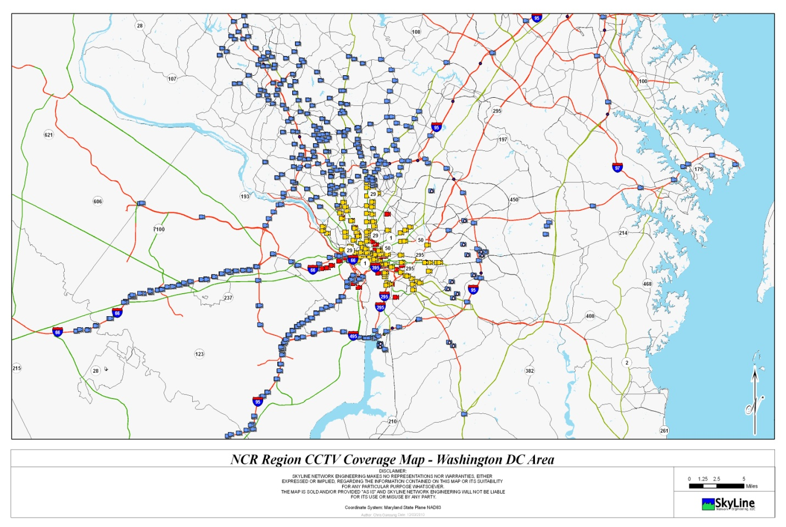
NCR CCTV Project Inventory

