Slide 1

TPB Technical Committee
10/1/2010, Item #8
Fall 2009 Spring 2010 Review
TPB Technical Committee
10/1/2010, Item #8

Slide 2
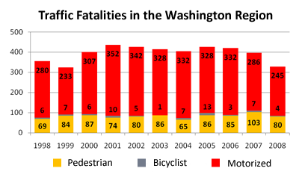
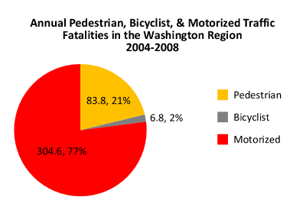

Slide 3
The “Street Smart” Campaign
Concentrated waves of Radio, Transit, Cable, and Internet advertising designed to change driver, pedestrian, and cyclist behavior
Supported by concurrent law enforcement
Funded by Federal Funds with voluntary matching contributions from WMATA, TPB Member Governments, since Fall 2002
Run twice annually since 2007
    Fall and Spring waves
    November 2009 and March-April 2010
FY 2010 budget was $658,000
  Spring 2010 $500,000
Details at http://bestreetsmart.net

Slide 4

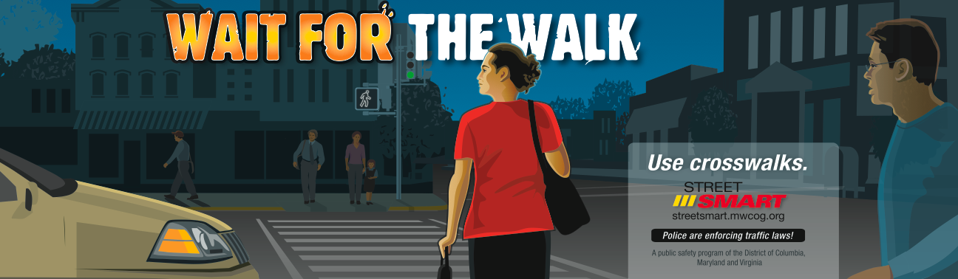
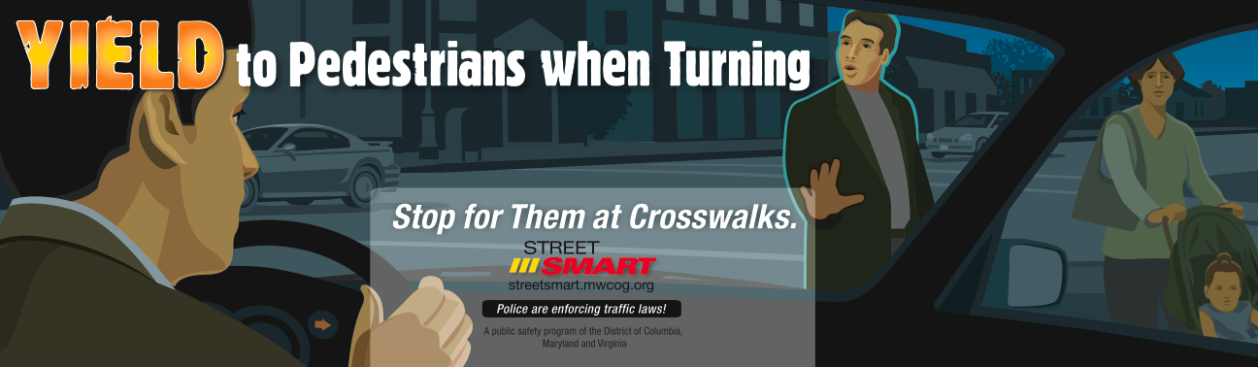

Fall 2009 Campaign

Slide 5
All Materials in English and Spanish

Slide 6

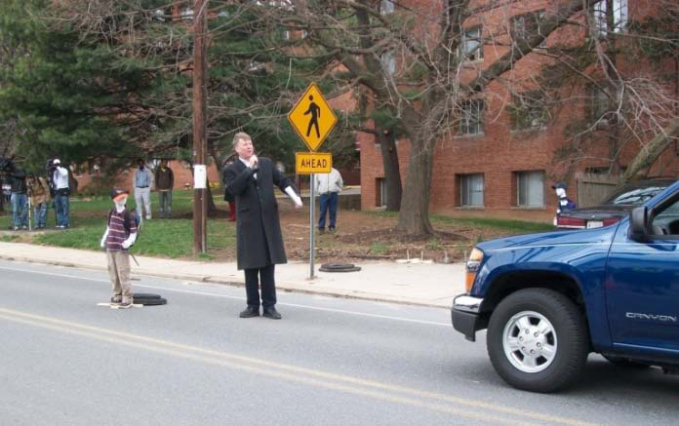
Spring 2010 Campaign
Every 8 minutes lives come to screeching halt.
Be ALERT - Be STREETSMART.
http://bestreetsmart.net
March 23 Speed Demo
“Bobby” steps in front of a truck going 25, 35, 40 mph
2.5 million people hear about it
USDOT will stage similar event, October 12th

Slide 7
Campaign Summary
Fall 2009 Campaign:
260 radio spots
24 transit shelters
74 bus backs
Internet
Posters and handouts from Spring 2009
Spring 2010 Campaign:
943 radio spots
168 Broadcast TV spots
91 Cable TV spots
85 transit shelter messages
123 bus backs
105 bus sides
110 Metrorail car cards
1,730 interior bus cards
  on Metro, Ride On, Fairfax Connector, Arlington ART and Alexandria DASH buses.
Internet advertising on wtopnews.com
Posters / handouts
http://bestreetmart.net
Spring 2009 Campaign:
1,010 radio spots
57 transit shelters
1,024 interior bus cards
200 bus backs
Internet advertising on wtopnews.com
4,400 posters / 105,000 handouts

Slide 8
added & earned media
Total Added and Earned Media: $724,902
Total Added Media Value = $555,773
This includes $88,332 in free radio spots and $467,441 in free outdoor messages on transit shelters, interior bus cards, bus backs and bus sides
Total Earned Broadcast, Print and Online Value = $169,129
  30 broadcast stories
  14 print and online articles
  3.5 million total media impressions

Slide 9
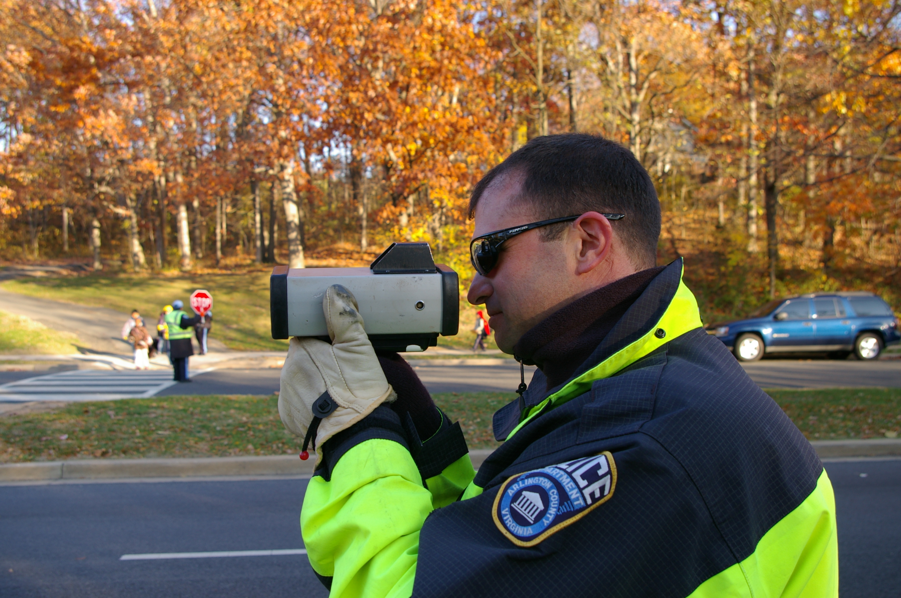
Enforcement
30,221 citations and 7,804 warnings were issued to motorists, pedestrians and cyclists.
Information came from Fairfax County, City of Rockville, City of Fairfax, Pentagon Force Protection Agency, Arlington County, Greenbelt, Manassas City, City of Alexandria, Prince William County, and Hyattsville City
*
* Actual numbers may be higher. This statistic was based on the actual number of Enforcement Reports received at the conclusion of the campaign.

Slide 10
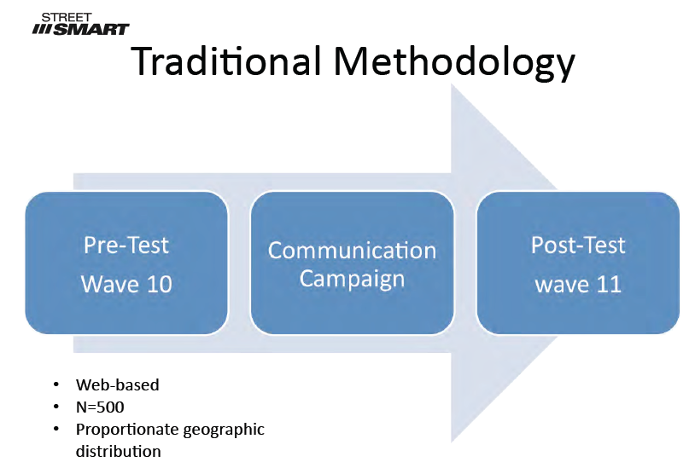
Evaluation:
Before and After Survey of 500 Motorists

Slide 11
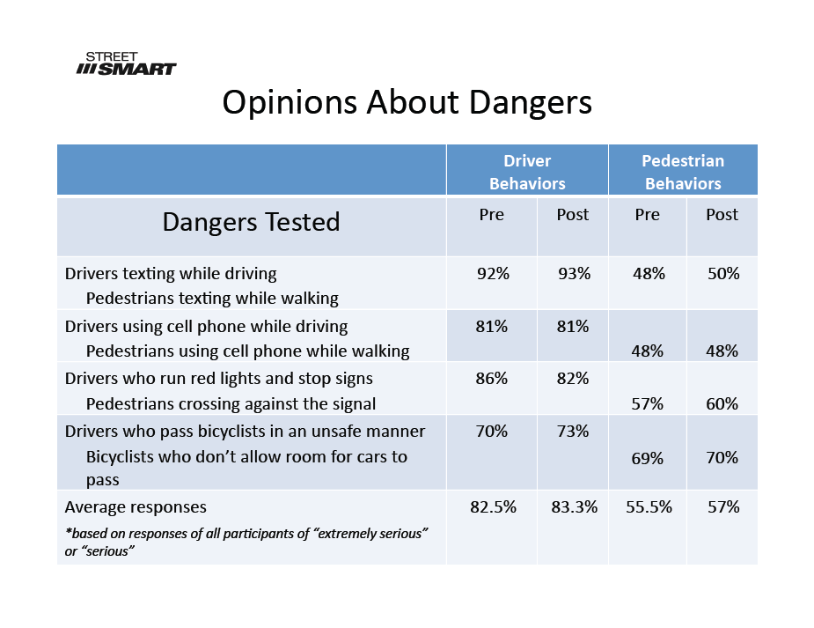
Findings: Driving while Texting is the Greatest Perceived Danger

Slide 12
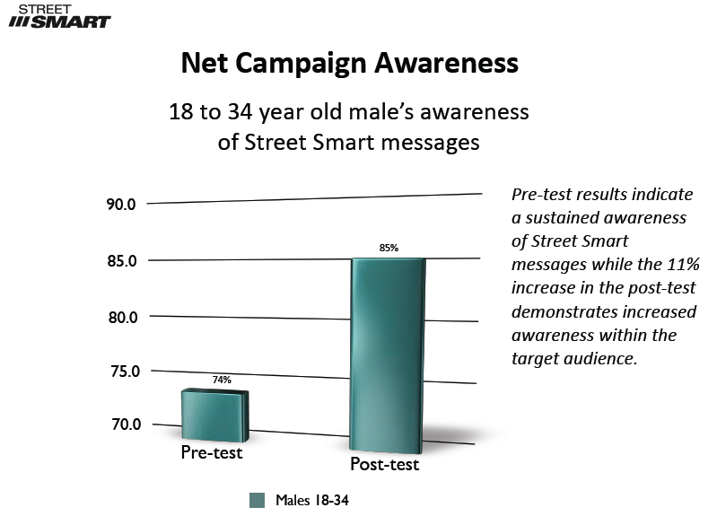
The Target Audience is Hearing and Remembering the Messages

Slide 13
Summary of Results
Driver behavior is perceived to be more dangerous than pedestrian behavior.
Texting while driving is perceived as more dangerous than talking on a cell phone.
The current Street Smart enforcement message is working especially well with males 18­34.
Image of woman with stroller being hit by car was most likely to be recalled.
All audiences remember messages about police enforcement
Messages about dangers around buses and safety for cyclists demonstrate only moderate recall in research.
Comparison of the post-test with the pre-test in the category of males 18-34 is generally positive in almost every category.

Slide 14
Street Smart Funding, 2002-2010
Source | Oct-02 | Apr-04 | Jun-05 | Mar-06 | Mar-07 | Fall 2007 & Spring 2008 | Fall 2008 & Spring 2009 | Fall 2009 & Spring 2010 | Fall 2010 & Spring 2011
DDOT* | $100,000 | $100,000 | $100,000 | $100,000 | $100,000 | $200,000 | $200,000 | $200,000 | TBD
DC MPD* |  |  | $80,000 |  | $30,000
Maryland SHA* | $115,000 | $100,000 | $58,000 | $50,000 | $100,100 | $130,300 | $130,000 | $143,000 | $100,000
Virginia SHSO | $100,000 | $100,000 | $75,000 | $100,000 | $75,000 | $100,000 | $100,000 | $100,000 | $110,000
WMATA |  |  |  |  |  | $150,000 | $150,000 | $150,000 | $150,000
Local Government | $100,000 | $90,000 | $80,000 | $91,300 | $113,700 | $158,500 | $120,600 | $54,800 | $37,800
Private |  |  |  |  | $10,000
Grand Total | $415,000 | $390,000 | $393,000 | $341,300 | $428,800 | $738,800 | $700,600 | $658,700 | $397,800
* Federal pass-through

Slide 15
Local Government Contributions
Source | Oct-02 | Apr-04 | Jun-05 | Mar-06 | Mar-07 | FY 2008 | FY 2009 | FY 2010 | FY 2011 to date
City of Alexandria | $5,000 | $5,000 | $5,000 | $6,800 | $6,800 | $6,800 | $6,800 | $7,000 | $7,000
Arlington County |  | $10,000 | $10,000 | $10,100 | $10,100 | $10,100 | $10,300 | $10,300 | $10,800
City of Bowie
Charles County, urbanized
City of College Park |  |  |  |  |  |  | $600
City of Fairfax |  |  |  | $1,100
City of Frederick
City of Falls Church |  |  |  | $500 | $500
Fairfax County | $50,000 | $50,000 | $50,000 | $52,800 | $52,800 | $52,800 | $54,800 | $5,000
Frederick County
City of Gaithersburg |  |  |  |  |  | $3,100 | $3,100
City of Greenbelt |  |  |  | $500
Loudoun County
City of Manassas
City of Manassas Park |  |  |  | $700 |  | $700
Montgomery County | $45,000 | $10,000 | $10,000 | $10,000 | $40,600 | $45,000 | $45,000 | $42,000 | $20,000
Prince George's County |  | $15,000 | $5,000 | $5,000 |  | $37,100
Prince William County
City of Rockville |  |  |  | $2,900 | $2,900 | $2,900
City of Takoma Park |  |  |  | $900 |  |  |  | $800
Total Local | $100,000 | $90,000 | $80,000 | $91,300 | $113,700 | $158,500 | $120,600 | $65,100 | $37,800

Slide 16
Funding
Letters were sent to the TPB Member jurisdictions requesting funding on March 15, 2010

Slide 17
FY 2011 Activities
Confirmed budget is $397,800
  Likely budget (with DDOT funds) is around $600,000 down from $658,000 last year
  Local funding support fell, Federal/State funds fell slightly
  Sufficient for Fall & Spring campaign waves
Fall Wave - November
  Media, Enforcement, Public Relations
  Will use existing materials
  Arlington will host the press event
  “Street Smart” Speed Demonstration at USDOT October 12th

