Slide 1
Briefing on the Round 8.0 Cooperative Forecasts
Robert E. Griffiths
Technical Services Director
Department of Transportation Planning
TPB Technical Committee
October 1, 2010

Slide 2
The Round 8.0 Cooperative Forecasts . . .
. . . include a new econometric benchmark forecasts based on revised assumptions of the U.S. economy.
. . . are being used in this year’s Air Quality Conformity Analysis
. . . will be used in conjunction with the new Household Travel Survey and the new Transportation Model
. . . include a new Traffic Analysis Zones (TAZs) structure (TPB TAZ 3,722) almost doubling the number of TAZs from the previous series.
. . . will be an initial basis for the update to the COG Regional Activity Centers and Clusters.

Slide 3
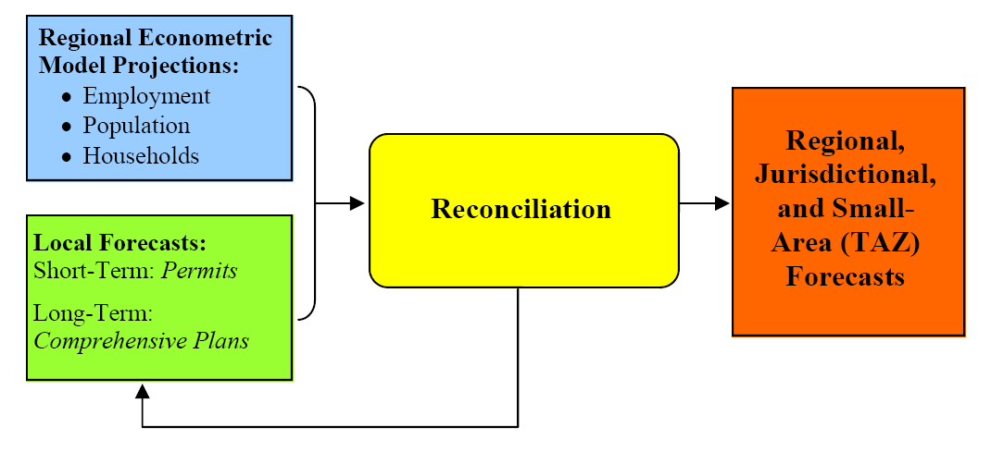
Cooperative Forecasting Process

Slide 4
Key Economic Factors Influencing the
Round 8.0 Growth Forecasts
The National Recession
Higher Rates of Unemployment
Foreclosures and Reduction in Home Values
Tight Capital Markets
Slower Pace of Housing Sales and Leasing of Office Space
BRAC and Stabilizing Presence of the Federal Government

Slide 5
Impact of Key Economic Factors on
Round 8.0 Growth Forecasts
(Millions)
The Regional Jobs/Housing improves slightly because the rate of employment growth slows more than the rate of household growth

Slide 7
Job Growth in Professional & Business Services Industries will account for about 2/3 the increase in the Service Providing Sector

Slide 8
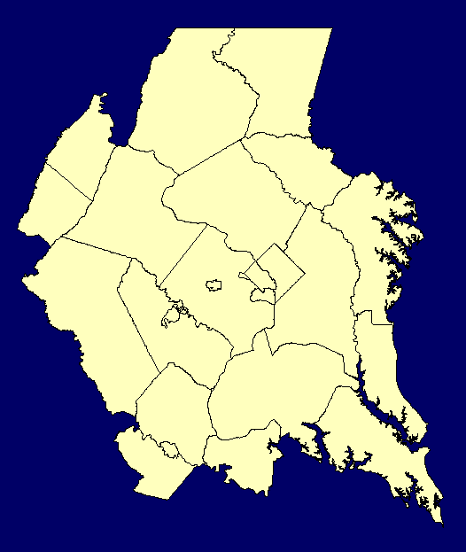
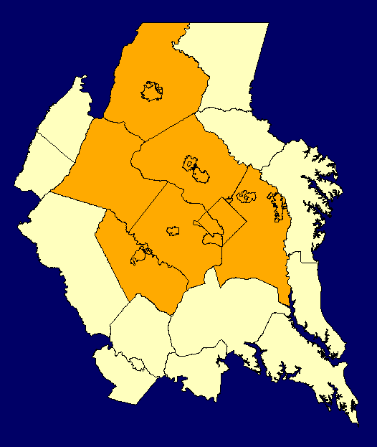
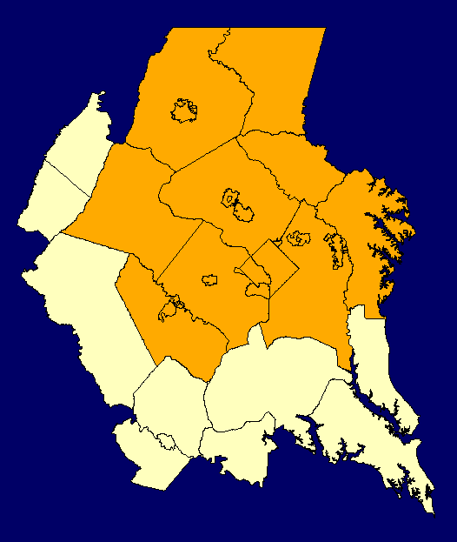
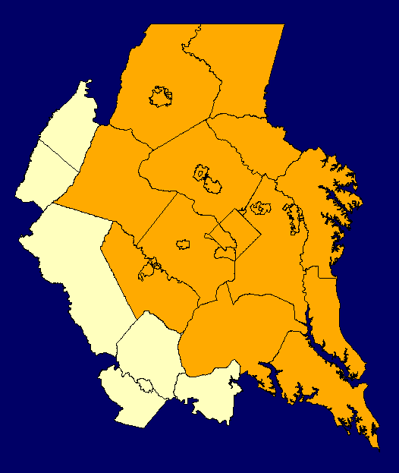
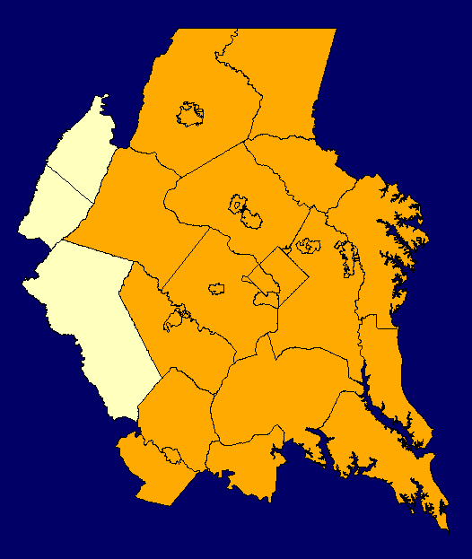
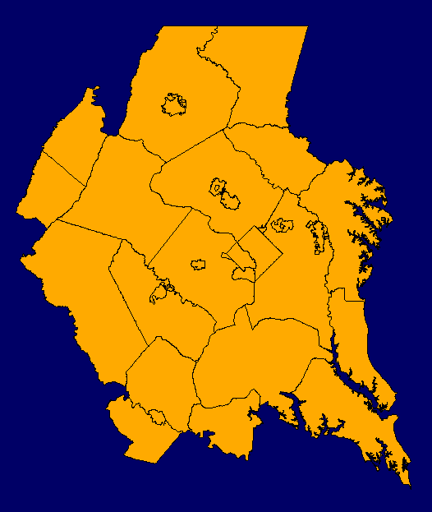
Growth Forecasts for All Jurisdictions in the TPB Modeled Area are included in Round 8.0.
COG Members
BMC Counties in TPB Modeled Area
  Anne Arundel, Carroll & Howard
Tri-County Council
  Calvert, Charles & St. Mary’s
FAMPO
  Fredericksburg, King George, Spotsylvania & Stafford
Others
  Clarke, Fauquier & Jefferson

Slide 9
Round 8.0 Growth Forecasts
TPB Modeled Area | 2005 | 2040 | Change 2005- 2040 | Percent Change
Jobs (in Millions) | 3.8 | 5.6 | +1.8 | +47%
Households (in Millions) | 2.3 | 3.3 | +1.0 | +43%
Population (in Millions) | 6.3 | 8.6 | +2.3 | +38%

Slide 10
Forecasts for Jurisdictions in TPB Modeled Area Have Been Grouped Geographically for Analysis Purposes in this Briefing.
Central Jurisdictions | Inner Suburbs | Outer Suburbs | Outer Ring - MD | Outer Ring – VA/WV
District of Columbia Arlington Alexandria | Montgomery Prince George’s Fairfax (County) Fairfax (city) Falls Church | Loudoun Prince William Manassas Manassas Park Calvert Charles Frederick County MD) Stafford | Anne Arundel Carroll Howard St. Mary’s | Fredericksburg King George Spotsylvania (portion) Clarke Fauquier Jefferson (WV)

Slide 11
Forecast Employment Growth (2005-2040)

Slide 12
Forecast Household Growth (2005-2040)

Slide 13
Forecast Population Growth (2005-2040)

Slide 14
Regional Activity Centers and Clusters
In 2007, the MDPC and COG Board approved Round 7.0 Regional Activity Centers and Cluster maps and data
These maps and data identified 61 Regional Activity Centers and 28 Activity Clusters
The identified Round 7.0 Activity Centers and Clusters together with new Round 8.0 Forecasts will be an initial starting point for the update of the COG Regional Activity Centers and Clusters by the Region’s Planning Directors, the MDPC and the COG Board

Slide 15
Preliminary Analysis of Round 8.0 Forecasts for Round 7.0 Regional Activity Centers
Preliminary Analysis of Forecast Round 8.0 Growth in Round 7.0 Regional Activity Centers show:
  2005 to 2040 Employment in these activity centers increasing by 48%, about the same as for the region as a whole
  2005 to 2040 Households in these activity centers increasing by 107%, more than twice that of the region as a whole
  By 2040, 55% of the region’s total jobs and 19% of the region’s total households are now forecast to be concentrated in the Round 7.0 Regional Activity Centers that constitute less than 5% of the region’s total land area.

Slide 16
Round 8.0 Cooperative Forecasts
Key Findings
Slightly slower rates of job and household growth are now forecast in comparison to the earlier Round 7.2A forecasts
Also, in comparison to Round 7.2A, a slightly improved regional Jobs/Housing Balance is seen. This will reduce the number of long-distance in-commuters from external areas
The greatest absolute increase in jobs is forecast for the Inner Suburbs and the greatest absolute increase in households is forecast for the Outer Suburbs
Preliminary analysis of forecast Round 8.0 Growth in Round 7.0 Regional Activity Centers suggests that significantly more higher density housing is now being planned for these centers making them more mixed-use.

Slide 17
Questions . . .

