Slide 1


Wi$e Energy by Capital Area Neighbors
Energy Advisory Committee – September 16, 2010

Slide 2
A regional energy outreach : context
Jan 2010: CEEPC adopts its work program with energy outreach as a high priority
Ad hoc workgroup appointed to design regional energy outreach program
  Identified drivers for behavior change:
    access to information (what can I do to save energy?),
    friendly competition (what are my friends / neighbors doing?),
    feedback to participants (what is the outcome of my actions?)
  Proposed concept : home energy challenge

Slide 3
What is WE CAN?
Pilot home energy challenge
  Will be expanded to the region in 2011
3 communities participate in the program from now until March 2011
WE CAN is a web-based AND community-based campaign
  Online platform allows participants to monitor their energy use and savings (powered by Earth Aid)
  Community outreach to encourage people to sign up.
  Our goal: recruit 50 households per community by Mid-October

Slide 4
Why should I join WE CAN?
Track all your utility bills in one place
Learn how your home performs compared to your neighbors
Learn how to save money on your utility bills by saving energy
Earn prizes based on how much energy you save
…PLUS: a FREE energy kit to help you get started (limited supply – first come, first served!)

Slide 5
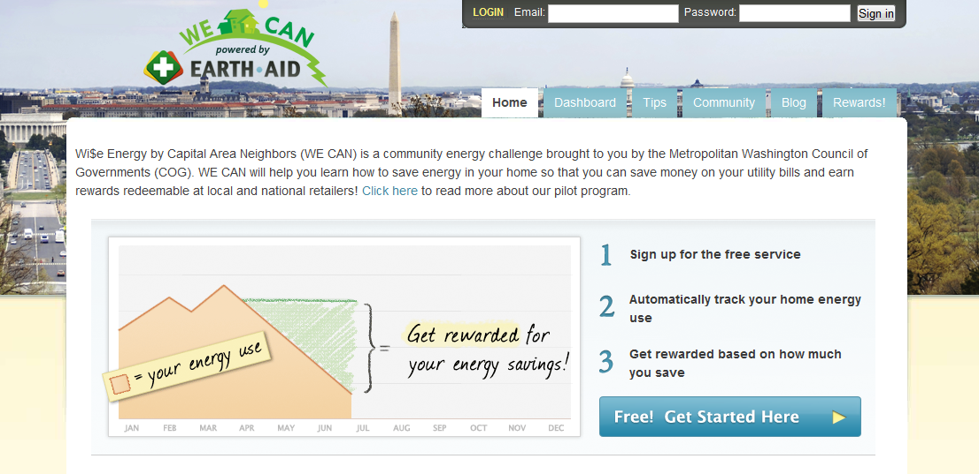
How can I join WE CAN?
1. Set up an online account with your energy utility
2. Sign up on www.WeCanSaveEnergy.org
3. Earn points by conserving energy and exchange for discounts and coupons of your choice

Slide 6
Progress to date
  Partnered with Earth Aid (RFP) for website development and reward program
  Selected campaign name and designed logo
  Developed website – www.WeCanSaveEnergy.org
    Version 1.0 is online
    Version 2.0 will be online October 1

Slide 7
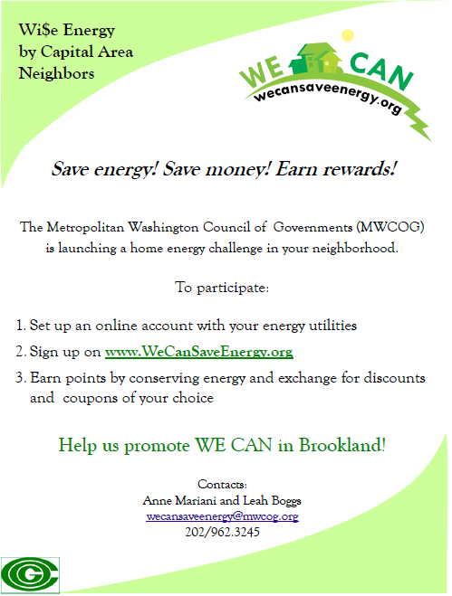


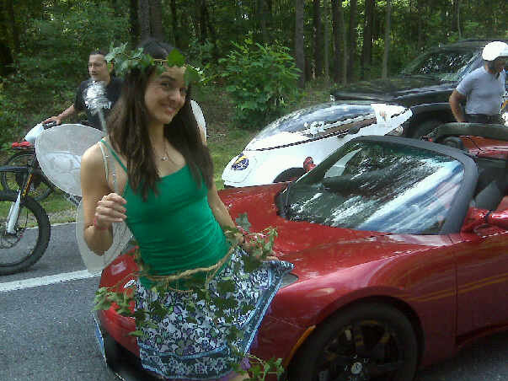
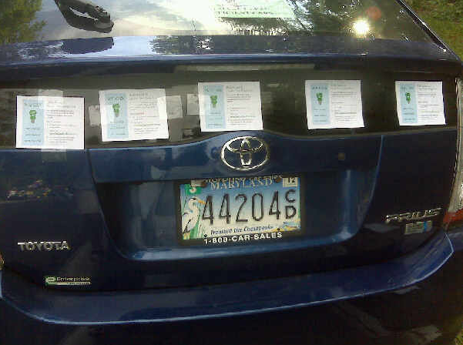
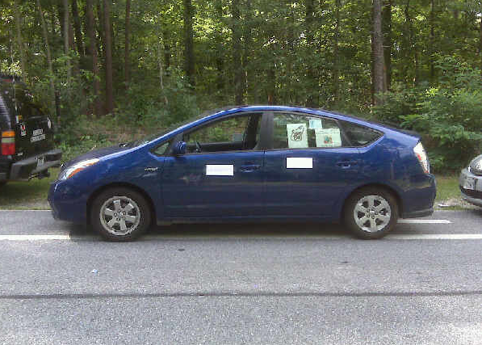
Progress to date (cont’d)
  Developed outreach materials
  Participated in first local events

Slide 8
Next steps
Continue to promote the program in communities:
  Reach out to schools, faith-based organizations, HOAs, community groups
  Participation in public meetings and local events
  Newsletters, email updates, social media, bill inserts
  Home energy workshops

Slide 9
Next steps (cont’d)
Expand network of business partners
  Engage local businesses in the reward program
  Recruit sponsors for recognition of best groups/ individuals at the end of the campaign

