Slide 1
Bike to Work Day 2013
ITEM #2
TPB Technical Committee
April 5, 2013

Slide 2
Bike to Work Day
Rolled out regionally by Commuter Connections over a decade ago
Will be held on Friday, May 17th to celebrate bicycling to work as a viable commute option
Participation has increased from several hundred participants in the beginning to almost 13,000 last year

Slide 3
Event Survey
Conducted every three years
  Measure impacts of event participation
  Assess use of bicycles for commute travel before and after event
Survey results used in TERM Analysis
Administered via e-mail to event participants
3,038 completed questionnaires
  34% response rate

Slide 4
Event Survey Findings
2010 was the first Bike to Work Day event for 32% of respondents.
17% of respondents never commuted by bike before participating in Bike to Work Day.
10% of participants started riding to work after the event, and 22% started riding more often.

Slide 5
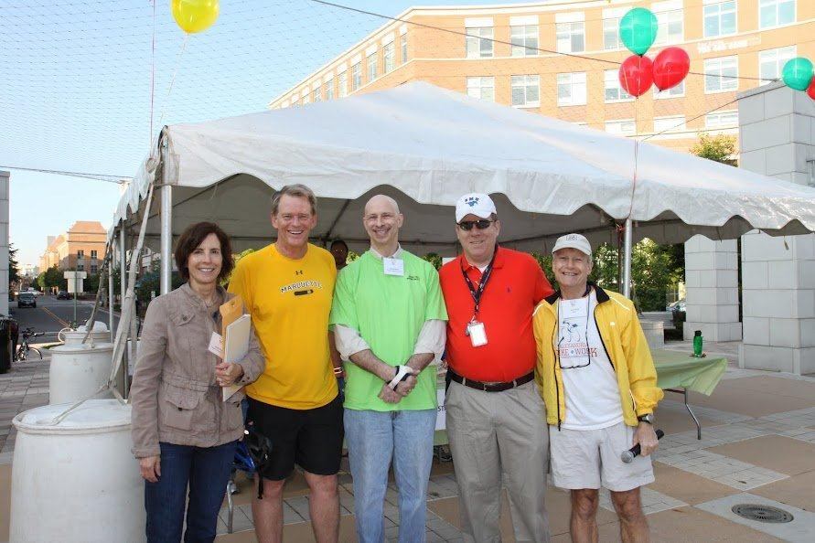
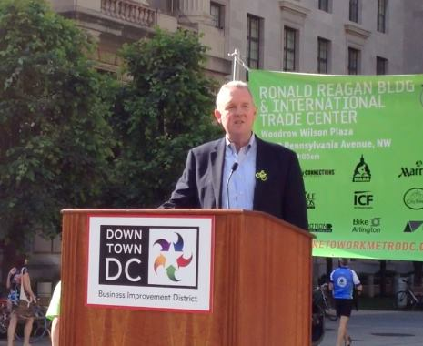
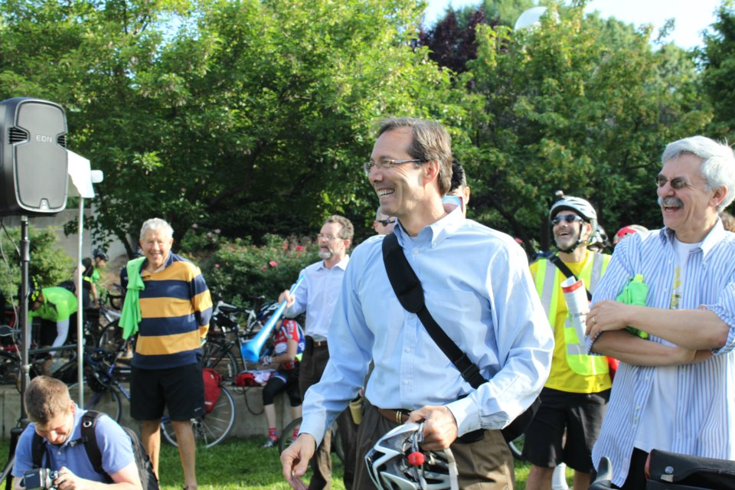
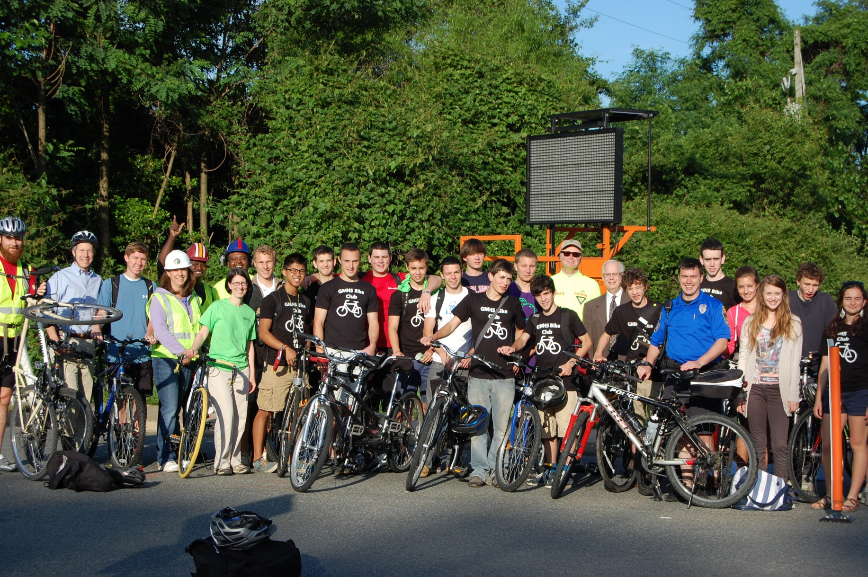
Elected Officials

Slide 6
Bike to Work Day
Coincides with National Bike to Work week
Goal for 2013 - 10% increase to 14,000
Proclamation at April 2013 TPB Meeting
A dozen new “pit stop” celebrations for 2013
Total of 72 “pit stops” throughout region

Slide 7

Event Participation Over 10 Years
Number of Registrants
Number of Pit Stops

Slide 8




Marketing Materials

Slide 9

Vinyl Banner

Slide 10
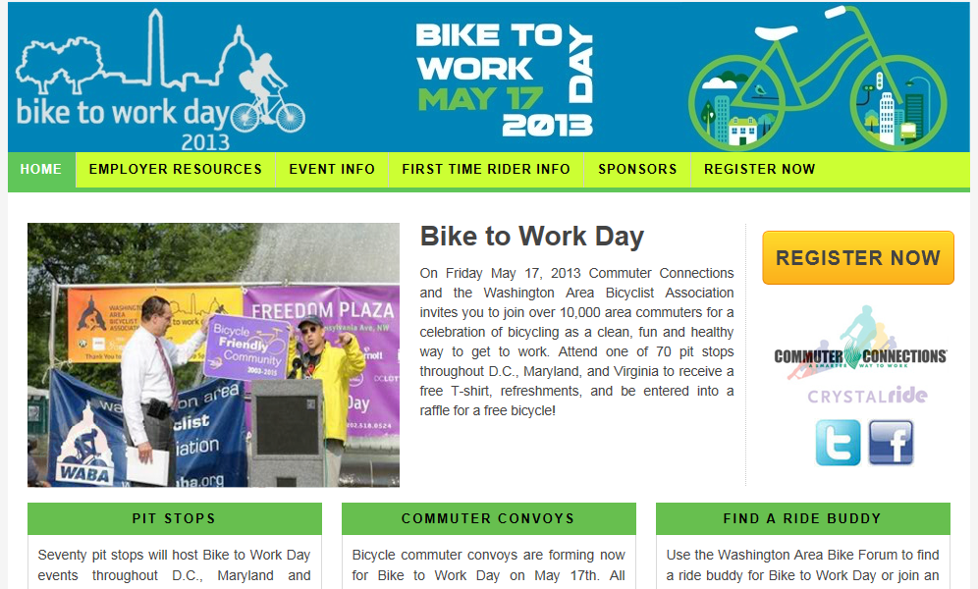
Event Web Site

Slide 11


Social Media

Slide 12

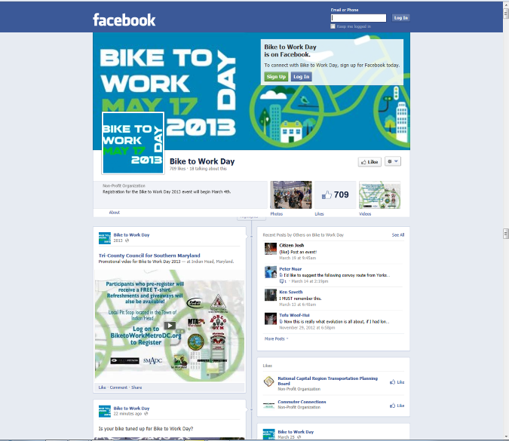
Social Media

Slide 13
Bike to Work Day 2013
Free and open to all commuters in the National Capital Region
Register at www.biketoworkmetrodc.org
Participants receive free T-shirts and refreshments at the pit stops
Sponsor donated giveaways and raffle prizes (bicycles and gear)

Slide 14
Employer Focus
Event encourages business community to support bicycle-friendly culture (bike racks, showers and lockers)
Bicyclists collectively work for over 1,000 different employers throughout region
Bicycling to work benefits employers through reduced parking overhead and better employee health and fitness
Employer Challenge luncheon
Donated bicycle rack raffle

Slide 15
Support for Bicyclists
Commuter Convoys led by experienced bicyclists
  helps empower commuters to try bicycling
Free Bike to Work guides available from Commuter Connections
Free Confident City Cycling classes offered by Washington Area Bicyclist Association
Bicycling covered by Commuter Connections’ Guaranteed Ride Home program

Slide 16
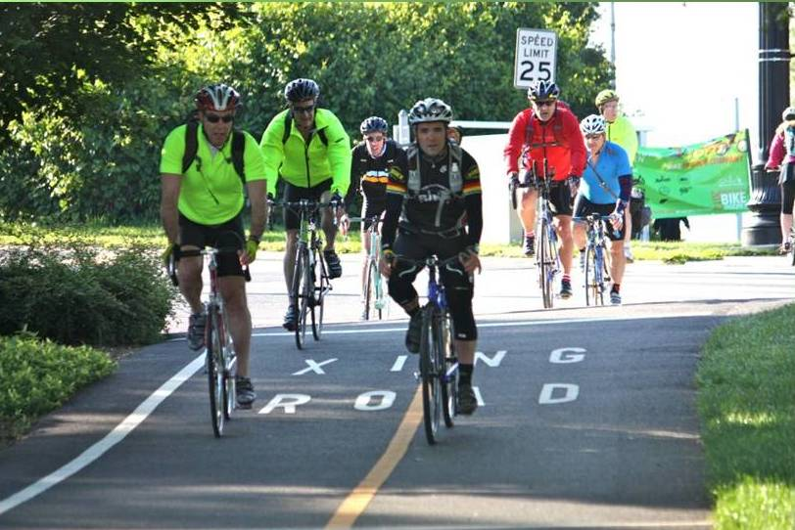
Questions?

