Slide 1

Integrated Planning/Permitting:
Past, Present and Future
Patrick Bradley
LimnoTech
January 2013

Slide 2
Just for Fun
“lex non intendit aliquid impossible”
“the law does not compel the doing of impossible acts” (AMSA 2004; NACWA)
“Sanitary sewer overflows must be eliminated” (EPA)

Slide 3
Quick History
1999-2000 – Almost SSO rule
2000 – EPA Watershed-based permitting policy
2002 – TMDL/Stormwater memo
2003 – 2007 Watershed-based Permitting Guidance
2003 – Proposed Blending Policy
2005 – Proposed Peak Flow Policy (Blending)
2007 – Compliance Schedule Policy Memo
2010 – New and Improved TMDL/Stormwater memo
2010-2011 – Listening Sessions
2012 – Integrated Planning Framework

Slide 4
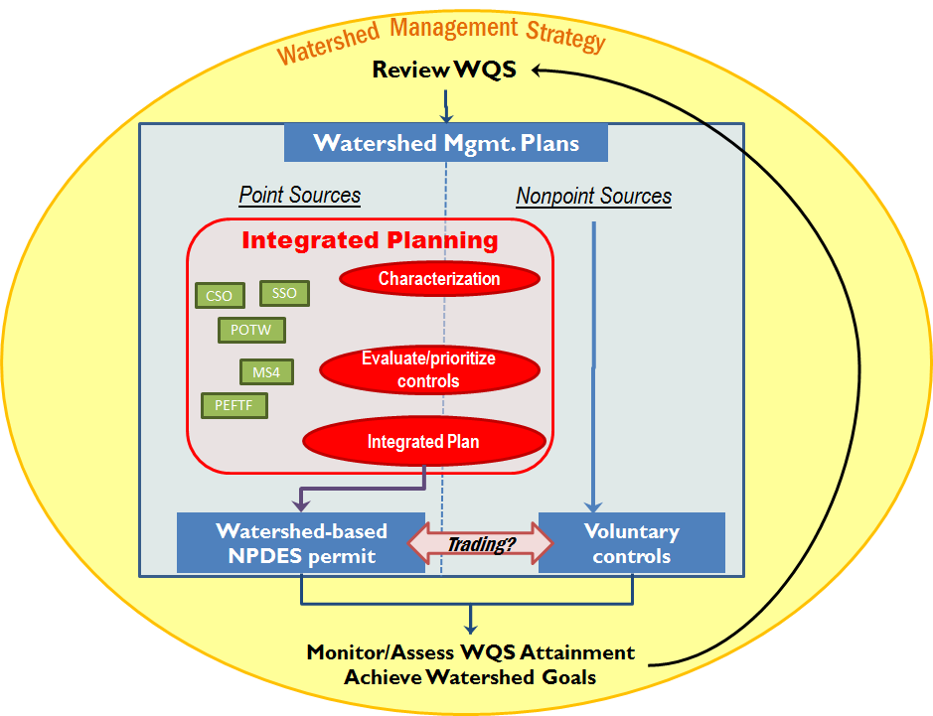

Slide 5
Nostalgia
Watershed-based permitting
  2002 Policy directive from Assistant Administrator for Water to all regions and Headquaters Offices
  2003 Watershed-based Permitting Policy
  2003 Implementation Guidance
  2007 Technical Guidance

Slide 6
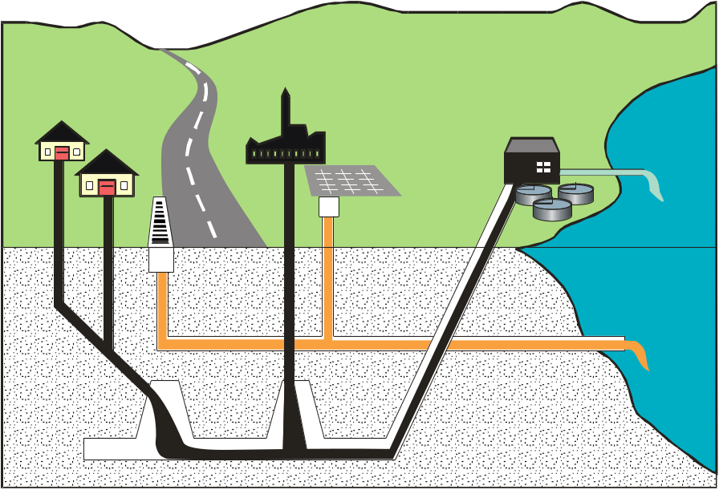
Permit Type: Consolidating Permits
Bundle all requirements from a single entity for multiple discharges (e.g, multiple wastewater plants) into a single permit
Municipal example:
  Secondary treatment limits
  TMDL WLA/WQBELs
  CSOs
  Storm water
  Biosolids
  Pretreatment
Notes:
As an example – let’s consider a large metropolitan area. There is a single watershed with 4 municipal Wastewater plants, some CSOs, urban storm water, etc.
In the past, this municipality has received 5 or 6 permits. Given it is all one watershed and one owner, could just have one permit.
This approach is transferable to other scenarios – multiple sources in the same watershed with similar pollutant dischargers. We will talk about some examples toward the end that will highlight different approaches to solve problems.

Slide 7
Framework History
Stoner/Giles Memo – October 27, 2011
  “Achieving Water Quality Through Integrated Municipal Stormwater and Wastewater Plans”
Stakeholder Meeting – December 13, 2011
Draft Framework – January 13, 2012
Stakeholder Workshops – January-February 2012
“Final” Framework – June 5, 2012

Slide 8
Stoner/Giles Memo to Regions
October 27, 2011
Encourages Regions to work with States and communities on implementing comprehensive, integrated planning approaches
  CWA and implementing regulations and guidance provide necessary flexibility
  Existing regulatory standards will be maintained
EPA is developing integrated planning framework
  Will obtain feedback from States, local governments, utilities and environmental groups
  Looking to identify municipal leaders to serve as models

Slide 9
Municipal CWA Programs
From October 2011 Memorandum
  A comprehensive and integrated planning approach to a municipal government’s CWA waste- and storm-water obligations offers the greatest opportunity for identifying cost effective and protective solutions and implementing the most important projects first.”
“waste- and storm-water obligations”
  Treatment plant effluent, blending, CSO, SSO, stormwater

Slide 10
What does the Framework say?
Following slides mostly from EPA presentation explaining the framework

Slide 11

Outline of Framework
Background
Principles
  Overarching Principles
  Guiding Principles
Elements of an Integrated Plan
  Scope
  Plan Elements
Implementation
  Permits
  Enforcement

Slide 12
Integrated Approach
Under an integrated approach, EPA and States would use the flexibility of EPA’s existing regulations and policies and encourage municipalities to evaluate how best to meet all of their CWA requirements and within their financial capability to better allow—
  sequencing wastewater and stormwater projects in a way that allows the highest priority environmental projects to come first, and
  innovative solutions, such as green infrastructure

Slide 13
Overarching Principles for
Integrated Approach
Integrated planning will maintain existing regulatory standards that protect public health and water quality
Integrated planning will allow a municipality to balance various CWA requirements in a manner that addresses the most pressing public health and environmental protection issues first
The responsibility to develop an integrated plan rests with municipalities

Slide 14
Guiding Principles for Plan Development
Integrated Plans should:
  Reflect State requirements and planning efforts and incorporate State input on key issues
  Provide for meeting water quality standards using existing flexibilities in the CWA and its implementing regulations
  Maximize the effectiveness of infrastructure dollars through analysis of alternatives and the selection and sequencing of actions needed to address water quality challenges and noncompliance
  Incorporate effective innovative technologies, approaches and practices (including green infrastructure)
  Evaluate and address community impacts and consider disproportionate burdens resulting from a municipality’s implementation of its plan
  Implementation of technology‐based and core requirements are not delayed
  Financial strategy is in place, including appropriate fee structures
  Opportunity for meaningful stakeholder input throughout the development of the plan

Slide 15
Integrated Plan Elements
Element 1: Water Quality, Human Health, Regulatory Issues
Element 2: Existing Systems and Performance
Element 3: Stakeholder Involvement
Element 4: Evaluating and Selecting Alternatives
Element 5: Measuring Success
Element 6: Improvements to Plan

Slide 16
Integrated Plan Implementation
Permits
Incorporate all or part of an integrated plan into NPDES permit where legally permissible
Considerations for incorporating integrated plans into permits
  Compliance schedules for meeting WQBELs need to be consistent with the requirements in 40 CFR 122.47
  Green infrastructure approaches and related innovative practices
  Appropriate water quality trading

Slide 17
Integrated Plan Implementation
Enforcement
All or part of an integrated plan may be able to be incorporated into the remedy of an enforcement action
Considerations for incorporating integrated plans into enforcement actions
  All parties needed to effectuate a remedy are involved
  History of compliance
  Where extended time is necessary to achieve compliance
  Using permitting and enforcement action in conjunction
  Enforcement orders should allow for adaptive management
  Green infrastructure approaches and related innovative practices
  Environmentally beneficial projects in plan that municipality is not otherwise legally required to perform may be included consistent with Supplemental Environmental Protects Policy

Slide 18
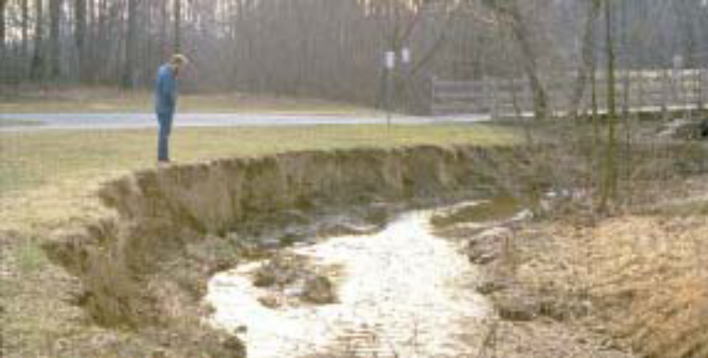
Next Steps for EPA
Work with interested municipalities
Share information about lessons learned
Management of Process
  Ongoing discussions with Regions

Slide 19
Integrated Planning, Integrated Permitting and Enforcement
Planning
Permitting
Enforcement

Slide 20
Integrated Planning, Integrated Permitting and Enforcement
Planning
  What are the goals?
    “use the flexibility of EPA’s existing regulations and policies and encourage municipalities to evaluate how best to meet all of their CWA requirements”
  What versus How?

Slide 21
Integrated Planning, Integrated Permitting and Enforcement
Planning
Permitting
  Preferred Approach for Municipalities
  Stormwater, CSO, SSO, WWTP – single permit
    Mix of numeric and BMP limits – based on watershed goals
  SSOs and Blending – A lot of questions, no answers

Slide 22
Integrated Planning, Integrated Permitting and Enforcement
Enforcement –
  Should only apply after permit approach has been used and noncompliance determined
A lot of questions; no answers

Slide 24
Based on 1994 CSO Policy
Where are we in EPA’s WQS coordination process?
STEP 5
STEP 4
STEP 3
STEP 2
STEP 1
Agree on the data
and analyses to
support LTCP
development and
Alternative
evaluation, and
WQS reviews
Collect data
and develop draft
LTCP, with the
public involved
Establish a
Coordination
team to oversee
LTCP development
and WQS review
Implement
NMCs and
evaluate their
efficacy
Issue permit requiring
implementation of Nine
Minimum Controls (NMCs)
and LTCP development
STEP 6
STEP 11
Implement
and, through WQ
monitoring, evaluate
effectiveness of priority
controls (e.g. for sensitive
areas) and controls
common to all
alternatives
Responsible Entity
Water Quality Agency(s)
(NPDES and WQS Authorities)
Implement
post-construction
compliance
monitoring to
evaluated
attainment of
WQS
Review and accept
draft LTCP and
NPDES Authority with
Coordination Team
evaluate attainability
of WQS
CSO Community
WQS Authority
WQS revisions may be needed
WQS attainable, no revision necessary
Propose revisions
and revise WQS,
if needed
Revise LTCP,
as appropriate
Review and
approve LTCP,
and modify permit
Implement
LTCP
STEP 7
STEP 8
STEP 9
STEP 10

Slide 25
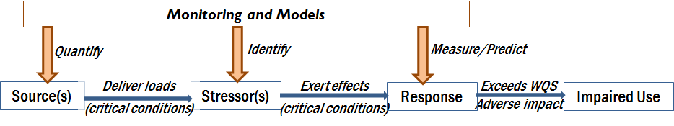
Conceptual Source-Stressor-Response Model

Slide 26
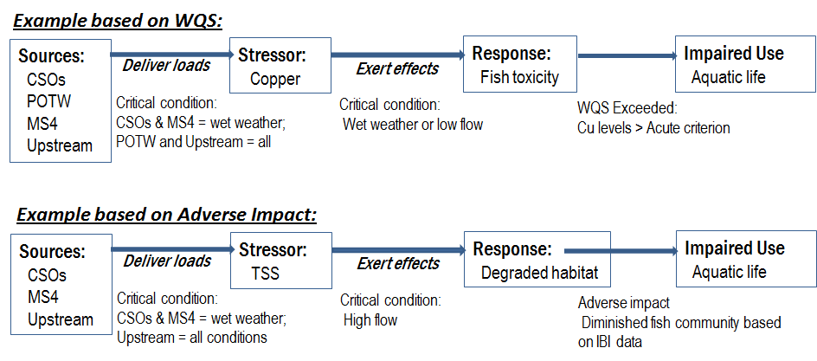
Applications of Source-Stressor-Response Model

Slide 27
Examples
Richmond, VA
Clean Water Services, OR
San Antonio, TX
Others not covered
Sanitation District #1, Kentucky
Milwaukee Metropolitan Sewer District

Slide 28

Early colonial map of Maryland and Virginia (from Ogilby, 1671). The map is oriented with north on the right, reflecting its original purpose as a port-finding chart for ship captains approaching the entrance of the Chesapeake Bay.

Slide 29
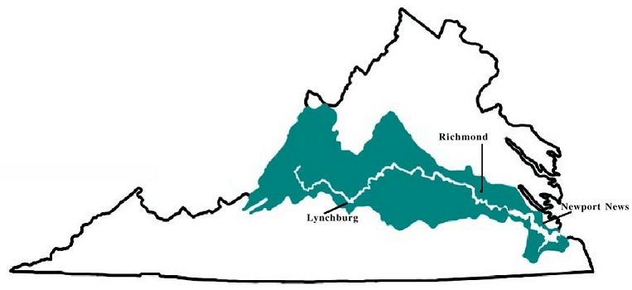
The James River watershed is Virginia’s largest. It covers about 10,236 square miles, nearly a quarter of the entire state. The 2000 James River watershed population was
2,604,246 people, most living in eastern region
Free flowing, Shallow pool and riffle, Dam restrictions, Source water, Swimming, kayaking and fishing
Tidal - Deep channel, Dredge maintenance, Source water, Fishing, power boating and commercial shipping

Slide 30
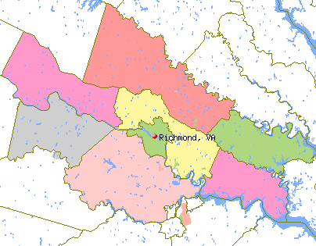

The City of Richmond, Virginia and the Middle James River Watershed - Service Territory
Ashland
Goochland
Hanover
Henrico
Powhatan
New Kent
Chesterfield
Charles City
Tri-Cities:
Colonial Heights
Hopewell
Petersburg

Slide 31
CSO LTCP Selection Bases
Percent of James River Miles Meeting WQS
2,400
G
2,000
Increase
34% to 92%
DEQ Closing
Water Quality
Gap
1,600
Increase
34% to 70%
Capital Cost ($ Millions)
1,200
F
800
Phase II
Investment
To Date
D
E
400
Most Cost
Effective
& End of
CSO Program
A
B
C
0
20%
30%
40%
50%
60%
70%
80%
90%
100%
Percent of James River Miles
Meeting Fecal Coliform Water Quality Standards

Slide 32
Integrated Municipal Permit: Clean Water Services; Washington County, OR
Problem:
Impaired watershed
CWS responsible for several NPDES requirements in Tualatin River Watershed
Why Does This Make Sense Here?
Multiple point source discharges under one jurisdiction
Watershed-Based Approach:
Conducts long-term monitoring and water quality modeling of watershed
Permit that integrates all NPDES requirements for the watershed
Expected Benefits:
Streamlined NPDES activities
Cross-trained staff
Better program management
Notes:
Points to Highlight:
Problem
Watershed receive discharges from POTW, sanitary sewers, and storm sewer outfalls. This watershed is listed for impairment due to pathogens and organic enrichment/low dissolved oxygen. A TMDL has been done.
CWS is the primary permittee for outfalls that discharge to the watershed. Requirements under the NPDES program include a permit for a wastewater treatment plant, a pretreatment program, and a Phase I municipal separate storm sewer system (MS4) permit.
Watershed-Based Approach
DEQ issued a permit to consolidate the 4 WWTPs and storm water permits – essentially went from 6 permits to one. Permit allows for trading and consolidated reporting, and watershed monitoring.

Slide 33
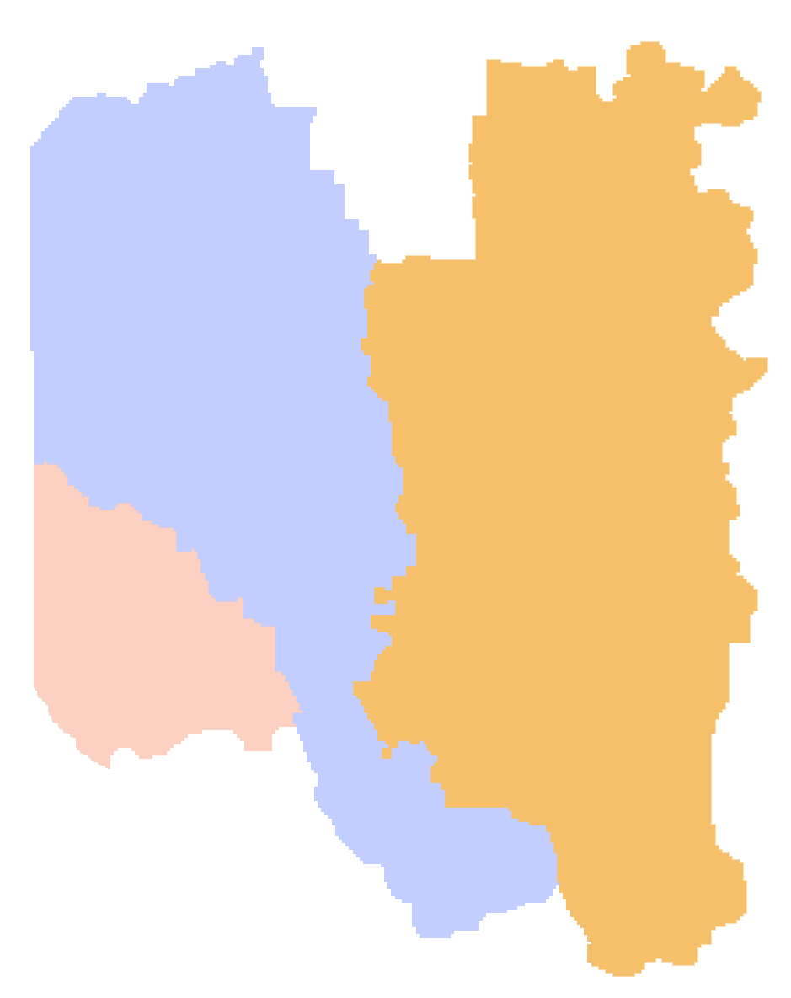
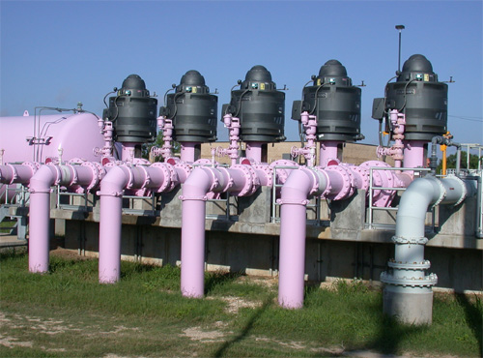
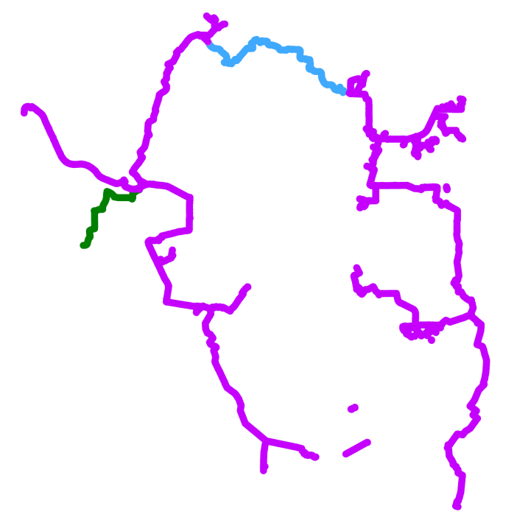
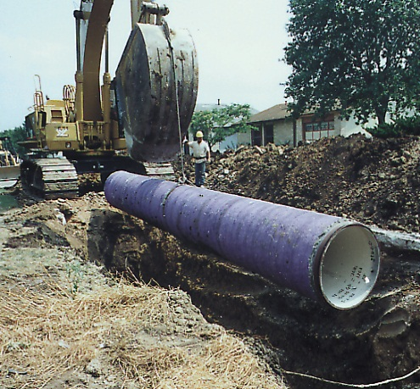
Medio Creek WRC
Leon Creek WRC
SAWS
Recycled
Water
System
I-10
Dos Rios WRC
Salado
Creek
Leon
Creek
WRC (Water
Recycling Center)
Discharge location
Helotes
Creek
Recycle system
initial phase
1604
281
Recycle system
interconnect
northern interconnect
35
Future
Olmos
Creek
410
future interconnect
I-10
Medio
Creek
Bexar County
Medio Creek WRC
90
35
Calaveras
Lake
Medina
River
Mitchell Lake
Braunig
Lake
Leon Creek WRC
Dos Rios WRC
0
5
10
1604
N
San Antonio
River
MILES
37
Notes:
Largest direct use system in the US – award winning plant performance
System went on line in 2001
Green County
Shaded Sewersheds
WRC’s and lakes
Purple pipes – 110 miles of mains - 35,000 acft/year capacity
Leon west DR east
Dual use system – round dots are river discharges
Interconnect – legislative bill 1922 – pipe is in place
Working to add Medio on to the system

Slide 34
What’s needed for Watershed-Based Permitting to move forward
D.C., Regions and State with same level of commitment
EPA educates the State on watershed concept
Modeling on a realistic basis, not unrealistic scenarios
Shared risk
Environmental enhancement vs. enforcement mentality
Recognition that if watershed permit fails, regulators can always fall back on traditional permits

Slide 35
Possible Approach
Need clear policy or regulatory clarification from EPA addressing wet weather discharges
SSOs are point sources, so address them through the NPDES program – similar to CSOs
Blending is not a bypass
Apply watershed management approach to assist with prioritization
Compliance schedules should be applied to wet weather issues that will take many years to solve – via NPDES permit not enforcement

Slide 36
Questions?
Patrick Bradley
Senior Scientist
LimnoTech
1705 DeSales St, NW Suite 600
Washington, DC 20036
202-833-9140
pbradley@limno.com

