Slide 1
Interstate 95 Corridor Improvement Program
June 20, 2012

Slide 2
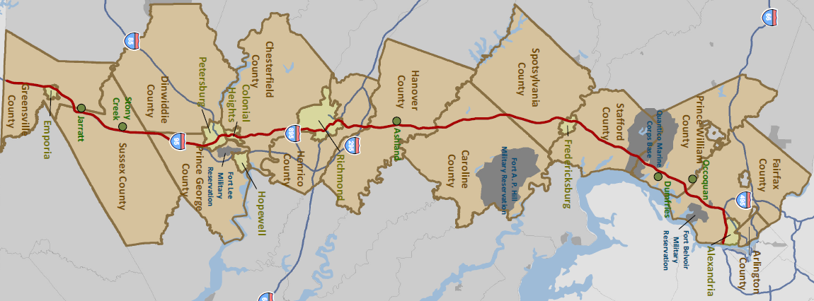

Virginia’s Interstate 95
Opened to Traffic in the 1950’s
178 Miles from NC to DC
Crosses 17 Jurisdictions
427 Structures
40% of the Interstate Traffic in Virginia
Some of the Worst Congestion in the US
67 Fatal Crashes from 2008 to 2010

Slide 3

I-95 is a Critical Link for Virginia’s Economy
Serves 45% of Population
Links 1.7 Million Jobs
Connects Virginians to the World’s Largest Regional Economy
Links 8 Million Square Feet of Warehouse/Distribution Facilities
Access to 3 International Airports
Serves Richmond and Norfolk Ports

Slide 4
I-95 Needs
80%
Mainline Bridges Over
40 Years Old
67%
Portion of I-95 at or above Capacity by 2035
72%
Mainline Pavement in Need of Maintenance
40%
Projected Increase in Travel Time by 2035
$12.1B
Projected 25-Year Need
$ 2.5B
Projected 25-Year Funding at Current Levels
($ 9.6B)
Funding Gap

Slide 5
Balanced Use of Funding
VDOT is committed to a balanced funding approach to advancing I-95 projects.

Slide 6
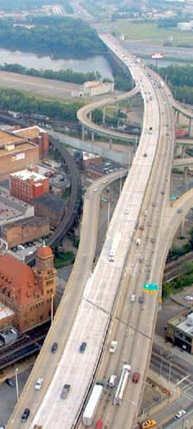
Tolling Proposal
Background
FHWA’s Interstate System Reconstruction and Rehabilitation Pilot Program (ISRRPP) permits a state to toll an interstate facility
  Limited to three facilities in three different states
April 2010: VDOT submitted a proposal to toll I-95
January 2011: VDOT submitted an expression of interest
September 2011: FHWA granted conditional provisional approval
The toll revenue will be used to make pavement, structural, operational, capacity, and safety improvements throughout the corridor

Slide 7
Outreach & Coordination
Outreach & Coordination (MPOs/PDCs/Local Governments)
  Kick-off (February 8th Winter meeting)
  Individual meetings with MPO & PDC staff
  Environmental coordination letters
  MPO Policy Board meetings
  Regional workshops
Business Stakeholders
  Virginia Trucking Association (Briefing June 14th)
  Virginia Chamber of Commerce
  Others
Continued Outreach - Public Meetings (Fall 2012)
  Residents
  Businesses

Slide 8
Outreach & Coordination
MPO Policy Board Briefings (elected officials) | Process, Scenarios, etc. | Traffic & Revenue, Tolling strategies, etc.
Richmond Area | April 12th | June 14th
Tri-Cities | April 12th | June 14th
Fredericksburg Area | April 16th | June 18th
National Capital Region | April 18th | June 20th
MPO/Local Government Staff Workshops | Date
Southern Workshop (Petersburg) | June 4th
Northern Workshop (Fredericksburg) | June 6th
Richmond Area MPO Transportation Advisory Committee | June12th

Slide 9
What Toll Rates to Employ?
If Virginia attempted to fund the entire $9.6 B gap over 25 years by tolls alone, the toll rate required would be:
  Utilizing two collection points, one north of Richmond and one south of Petersburg, the toll rate would be ~ $0.53 per mile*
  Using a barrier system with 6 collection points, the toll rate would be ~ $0.27 per mile*
  Using a closed system where all trips were charged based on actual miles traveled, the toll rate would be ~ $0.14 per mile
VDOT analyzed rates from $0.02 to $0.15 per mile
VDOT is requesting approval to initiate tolling at a reduced rate of ~ $0.02 per mile
* Note that diversion would be extremely high with rates of $0.27 to $0.53 per mile under these scenarios.

Slide 10
Toll Scenarios Analysis
Potential Locations:
A1: 1 Gantry System (tolling both directions)
A2: 2 Gantry System (one toll northbound; one toll southbound)
A3: 2 Gantry System (tolling both directions)
B: 6 Gantry System (tolling both directions at ~ 20 mile intervals)
C: Closed System (tolling at every interchange – ramps)
D: Hybrid System (mainline tolling + ramp tolling)
E: Closed System (tolling between every interchange)

Slide 11
How to toll?
(location and # of gantries)
Factors to consider (location):
Traffic Characteristics
  Local vs long-distance
  Truck %
Diversion
  Availability of routes for local trips
  Ability to reduce diversion (i.e. capacity for ramp tolling)
  Number and types of businesses in area (i.e. truck services, lodging, food services, etc.)
Factors to consider (# of gantries):
Implementation (ease and timeliness of construction, etc.)
Cost effectiveness of up-front capital costs
Operations and maintenance implications

Slide 12
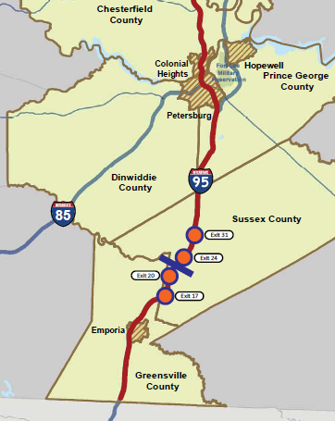
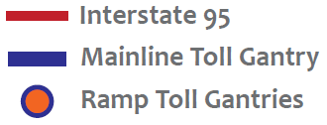
Option A-1: One Gantry System (tolling both directions)
Current Condition
ADT 36,000
15% trucks
48% of traffic continues through mile marker 100
Low commuter traffic
Low local trucks
High long-haul trucks
Items Under Further Review
Diversion
Toll Rate vs Revenue
Economic Review

Slide 13
Option A-1: One Gantry System (tolling both directions)
A-1: One Gantry System (tolling both directions)
Location: Gantry Between MP 20 and MP 24
Ramp Gantries to Minimize Diversion
Method: Open Road Tolling & Cash Collection
Rate: $4.00 2-Axle Mainline (~$0.02/mile)
$2.00 2-Axle Ramp
5-Axle Vehicle: 3X Base Rate
Duration: >30 Yrs
Operator: VDOT will own, operate, and maintain (option to contract)
Congestion Pricing: None, Fixed Rates
Rate Changes: Indexed to Inflation

Slide 14
Benefits of Tolling Revenue
Gross Revenue Projections:
Scenario A-1 ~ $35M - $40M/year (gross)
Other Scenarios ~ $55M - $160M/year (gross)
Acceleration of an identified need (SYIP, CLRP, STP, and other priorities) – Potential uses of Scenario A-1 six year revenue:
Safety
  I-95/I-64 Overlap Study – Short Term Improvements
Mobility/Economic Vitality
  I-95/I-85/460 Interchange upgrades
System Maintenance & Preservation
  Pavement Reconstruction (~ 35 Lane Miles)
  Bridge Reconstruction (~ 4 Bridges)

Slide 15
Preliminary Revenue Projections
Scenario A-1

Slide 16
Preliminary Schedule
Jan – April 2012 Data Collection/Analysis
Feb 2012 Vision Plan
April 2012 MPO/Locality Briefings
May 2012 Preliminary Traffic & Revenue Forecasts, tolling scenario analysis, etc.
June 2012 MPO/PDC/Locality Workshops
Summer 2012 Submit ISRRPP application to FHWA
Fall 2012 Public Hearings
Winter 2012 Execute Tolling Agreement

