Slide 1
Transportation Planning Board:
Background, Constrained Long-Range Plan, and Ongoing Work
Presentation to the
Board of Directors
Metropolitan Washington Council of Governments
April 11, 2012
Ronald Kirby
Director, Department of Transportation Planning

Slide 2
A. Transportation Planning Board (TPB)
Federally Mandated Role:
  The Metropolitan Planning Organization (MPO) for the Washington region
  Established 1965, affiliated with COG in 1966
  Responsible for coordinating planning and funding for the region’s transportation system
Members:
  Representatives of local governments
  State transportation agencies
  State and District of Columbia legislatures
  WMATA

Slide 3
A. Transportation Planning Board (TPB) (Cont.)
Principal Activities of the TPB:
Financially Constrained Long-Range Plan (CLRP)/ Transportation Improvement Program
Air Quality Conformity
Technical Modeling & Forecasting
Technical Assistance to Member Agencies

Slide 4
B. TPB’s Annual
United Planning Work Program (UPWP)
Single document incorporating all federally assisted state, regional, and local planning activities to be undertaken in the region
Required as a basis and condition for all federal funding for transportation planning
Integrated into COG’s fiscal year budget; COG membership dues provide 10 percent match to federal and state funds

Slide 5
B. TPB’s Annual UPWP (Cont.)
FY2013 total funding level is $12,089,300, the same as FY2012
Federal (80%), State (10%), Local (10%) from COG dues
Federal funds are allocated to MPOs by state DOTs using formulas based on urbanized area population

Slide 6
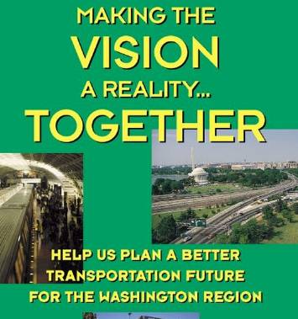
C. TPB Vision
Adopted in 1998
Policy framework for TPB
One of four building blocks for Region Forward
Vision Statement: In the 21st Century, the Washington metropolitan region remains a vibrant world capital with a transportation system that provides efficient movement of people and goods. This system promotes the region’s economy and environmental quality, and operates in an attractive and safe setting―it is a system that serves everyone. The system is fiscally sustainable, promotes areas of concentrated growth, manages both demand and capacity, employs the best technology and joins rail, roadway, bus, air, water, pedestrian and bicycle facilities into a fully interconnected network.

Slide 7
C. TPB Vision (Cont.)
Vision Goals:
Promote a Comprehensive Range of Transportation Options
Promote Transportation Connections, Walkability, and Mixed Use Development in Activity Centers
Ensure Adequate Maintenance, Preservation, and Safety of the Existing System
Maximize Effectiveness of the Transportation System
Enhance Environmental Quality, Protect Human Health, and Improve Energy Efficiency
Support International and Inter-Regional Travel and Commerce

Slide 8
D. Financially Constrained Long-Range Transportation Plan (CLRP)
Developed cooperatively by government bodies and agencies represented on the TPB
Contains all regionally significant transportation projects and programs
Over 750 projects, including major highway and transit investments such as Dulles Rail, Purple Line, DC Streetcar, and I-95 HOT Lanes
Updated every four years, amended annually
Funding must be “reasonably expected to be available”

Slide 9
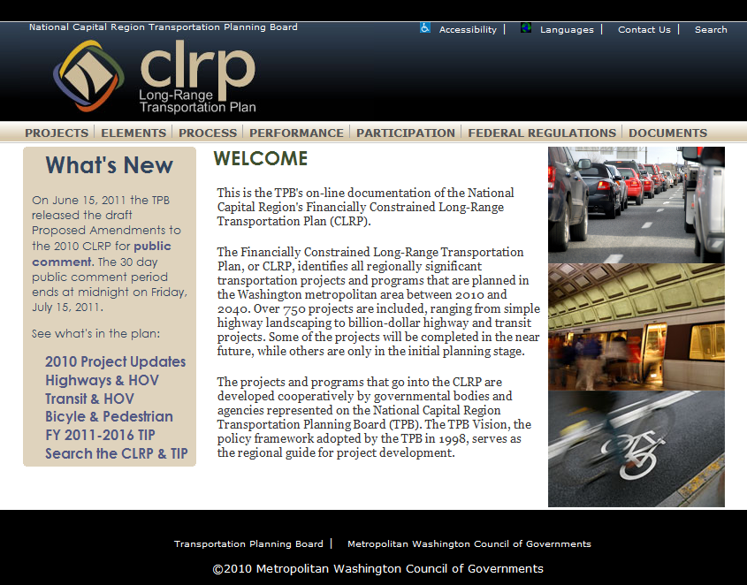
D. Financially Constrained Long-Range Transportation Plan (CLRP) (Cont.)
CLRP 2010 update
www.mwcog.org/clrp
Provides baseline data and forecasts through 2040

Slide 10

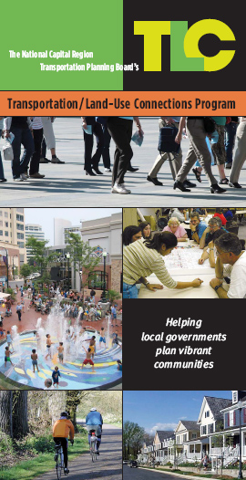
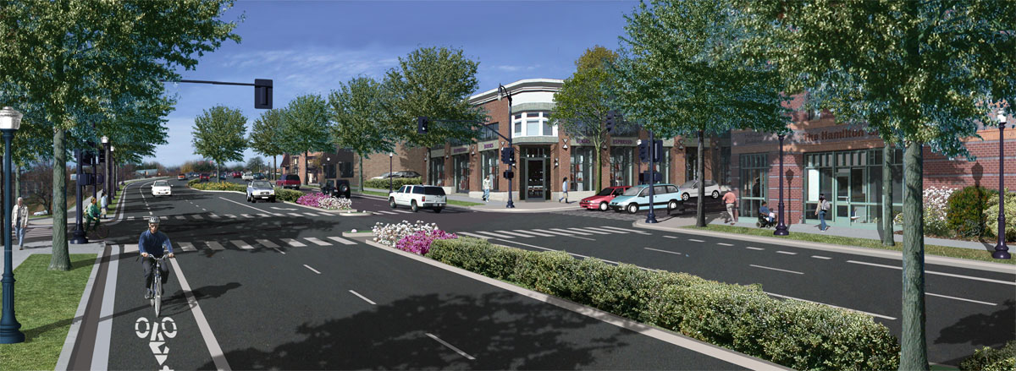

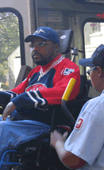
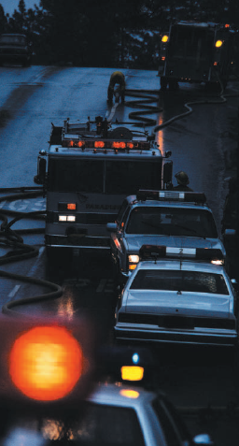
E. Ongoing TPB Programs
Commuter Connections
Transportation Land-Use Connections (TLC)
Job Access/New Freedom
Incident Management Coordination (MATOC)
Street Smart
Complete Streets (under development)

Slide 11
F. Regional Transportation Priorities Plan (RTPP)
TPB Citizens Advisory Committee requested that the TPB develop a Regional Transportation Priorities Plan
July 2011: TPB approved RTPP scope and schedule
  Purpose: Build consensus around key strategies (perhaps ten to fifteen at any one time) that people from all corners of the region can get behind
  Two-Year Schedule, FY 2012-2013
  Public participation at each stage

Slide 12
F. RTPP (Cont.)-Development Process
Vision
Challenges
Strategies, Programs, and Projects
Goals and Performance Measures

Slide 13
G. CLRP work that supports Region Forward and RTPP
Implementing the TPB’s Bicycle and Pedestrian Plan
Facility Type (in miles) | Existing Facilities in 2010 | Facilities in CLRP for 2040 | TPB's Bike/Ped Plan for 2040
Bicycle Lane | 91 | 450 | 541
Shared-Use Path | 543 | 630 | 1173
Total | 634 | 1080 | 1714
Challenge: Accelerate the rate of construction for TPB’s Bike and Pedestrian Plan, since at the current rate only 60% of the planned facilities will be built by 2040

Slide 14
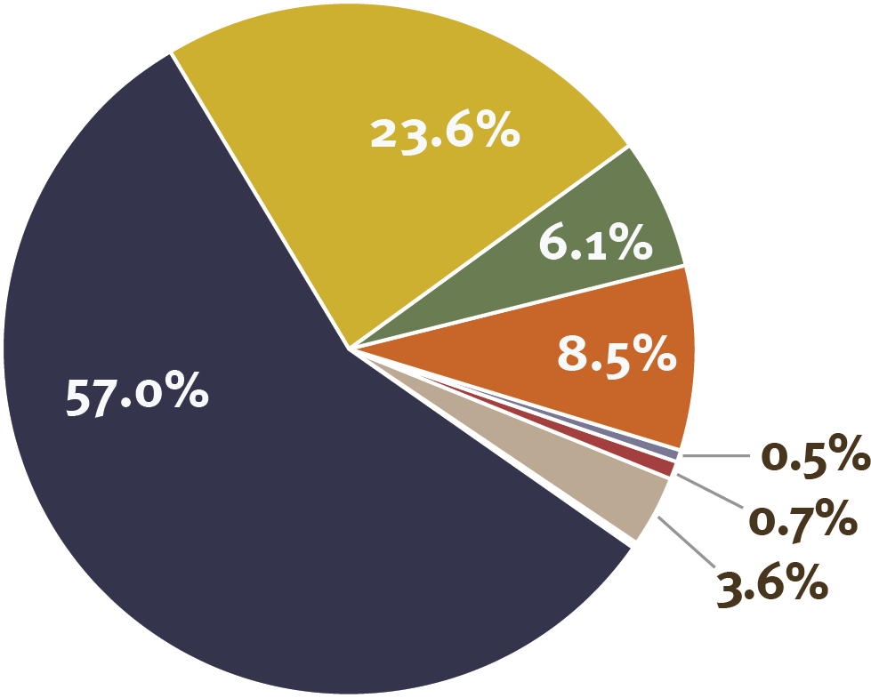
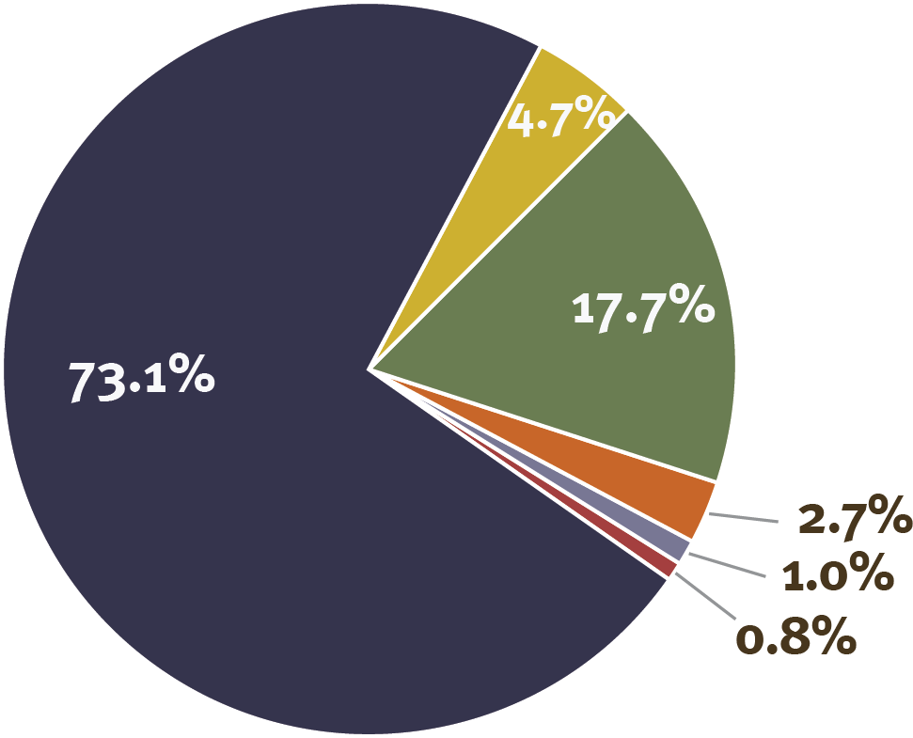

G. CLRP work that supports Region Forward and RTPP (Cont.)
Commute Mode Share 2007/08
Daily Mode Share 2007/08
Source: TPB 2007/2008 Household Travel Survey
Challenge: Increase use of alternatives to single occupant vehicle travel

Slide 15
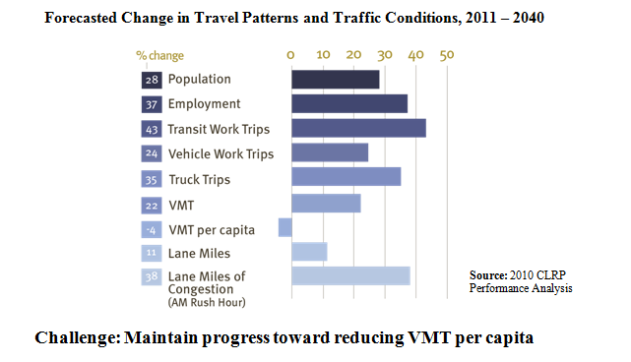
G. CLRP work that supports Region Forward and RTPP (Cont.)

Slide 16
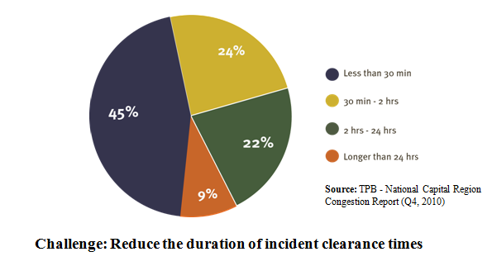
G. CLRP work that supports Region Forward and RTPP (Cont.)
Incident Clearance Time

Slide 17
H. Example Strategies/Goals Matrix for RTPP
 | Goal 1 | Goal 2 | Goal 3 | Goal 4 | Goal 5 | Goal 6
 | Provide a Comprehensive Range of Transportation Options | Promote Walkable and Mixed Use Activity Centers | Ensure System Maintenance Preservation, and Safety | Maximize Effectiveness of the Transportation System | Enhance Environmental Quality, Protect Human Health, and Improve Energy Efficiency | Support International and Inter‐Regional Travel and Commerce
Example Strategies
Seek continuation of funding to ensure the reliability and safety of the region's transit network | x | x | x | x | x
Support cost-effective programs for encouraging use of alternative modes | x |  | x |  | x
Use transportation resources to support mixed use development in the region's activity centers | x | x
Implement cost-effective management techniques and capacity improvements to address roadway congestion | x |  |  | x
Ensure adequate roadway and transit access to the region’s airports |  |  |  |  |  | x

Slide 18
I. Long-Range Scenario Studies
CLRP Aspirations Scenario: Initiated by the TPB in 2008
  1,500 lane-miles of variably-priced lanes
  500-mile regional bus rapid transit (BRT) network
  relocation of 50% of projected housing and job growth to areas around existing or planned rail transit/BRT
Greenhouse Gas Scenario
  What Would It Take to Reduce GHG by 40% by 2030 (to track COG Climate Goal of 80% reduction by 2050)?
Value Pricing Study (ongoing)
  Public Acceptability of Congestion Pricing

Slide 19
J. Future Prospects and Challenges
Federal reauthorization uncertain, and maintaining current funding levels may be the best we can hope for
State funding challenges continue
Increased focus on tolls, development districts, public/private partnerships (e.g. Dulles Rail, Beltway HOT Lanes)
Maintaining safe and reliable operations will be a continuing challenge
New transportation initiatives will require advocacy and (ideally) new funding sources

Slide 20
Questions?
Ronald Kirby
Director, Department of Transportation Planning

