Slide 1


Wi$e Energy by Capital Area Neighbors
Pilot Program Update
MWCOG
October 18, 2010

Slide 2

About WE CAN
WHO: Challenge is for households. Businesses and community groups can also participate
WHAT: WE CAN is a web-based AND community- based home energy challenge
WHERE: HERE! Pilot program in 3 Metro DC communities -
Greenbelt, Cascades (VA), Brookland (DC)
WHEN: NOW! (pilot program through March 2011)
WHY: Save Energy! Save Money! Earn Rewards!
HOW: Sign-up Online Today!
Notes:
Goal to have 50 sign up in each pilot community

Slide 3
WE CAN Outreach Plan
Audience and Messaging
Households
  Save energy, save money and earn rewards!
Businesses
  Sponsor sustainability in your community!
Community Groups
  Help spread the word in Greenbelt! Encourage participation
  (community groups include civic associations, HOAs and condo associations,
  low-income households, faith-based organizations, schools, etc)
Notes:
-Will be expanded to the region in 2011

Slide 4
WE CAN Outreach Plan
Goals
Recruit participants
Drive participants to the WE CAN web site to get information, news, incentives, tips.
Keep them involved over time (6-month challenge)
Provide them support toward achievement of actual energy savings
Recruit sponsors for reward program and final prizes.
Notes:
Will communicate and publicize results

Slide 5
WE CAN Outreach Plan
Outreach Material
Website (version 1 available, version 2 under development)
Social Media (Twitter, Tumblr, Facebook)
Monthly E-newsletter
WE CAN flyers and postcards
Home energy workshops
Suggested language for community groups’ newsletters, social media and emails

Slide 6
WE CAN Outreach Plan
Outreach Material (continued)
Business recruitment materials (under development)
Federal, state and utility energy tips and information (such as DOE Energy Saver booklet)
Utility web and email promotion
MEA energy booth?

Slide 7
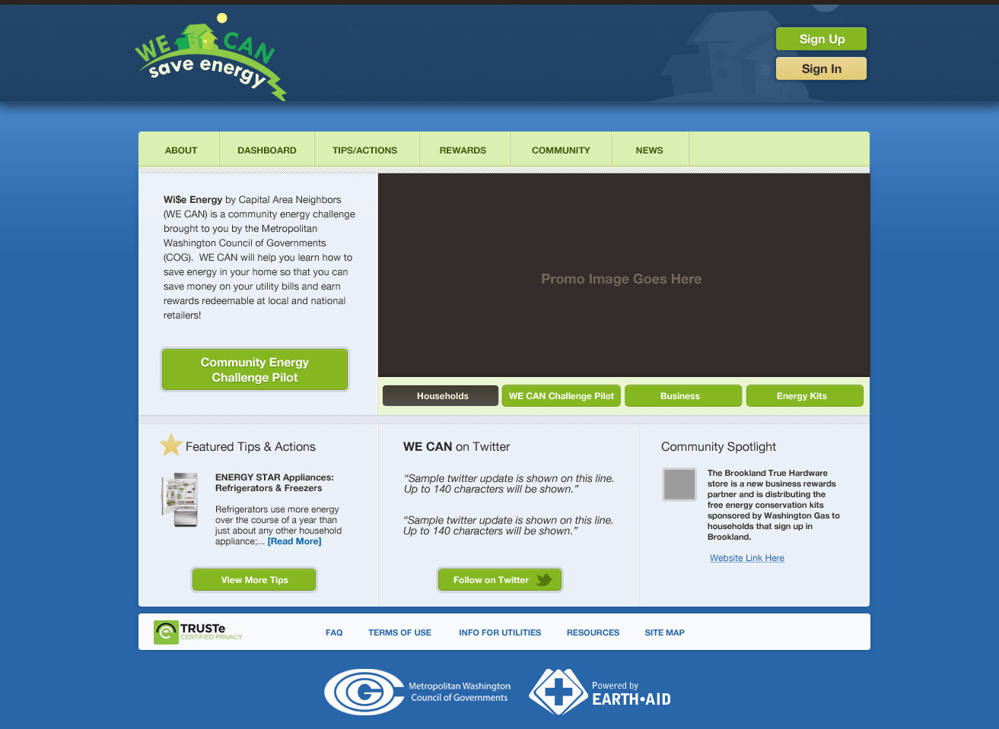

Slide 8


WE CAN Postcard

Slide 9


WE CAN Flyers

Slide 10
WE CAN Stats
Total homes signed up on wecansaveenergy.org = 89
  (includes homes outside of pilot communities)
Total homes signed up in pilot communities = 102
  Brookland = 23
  Cascades = 50
  Greenbelt = 29
  (includes homes that had Earth Aid account before WE CAN)
Total signed up on Earth Aid in region > 2,000

Slide 11
WE CAN Stats
Community Meetings = 18
WE CAN material distributed = 1,000
Newsletters/Articles = 15
Local Access TV = 2
Workshop = 1
Notes:
Greenbelt Brookland Cascades Totals
Meetings 9 6 3 18
Materials 800 150 50 1000
News 10 4 15 (1 for COG e-news)
TV 2
Workshops 1

Slide 12
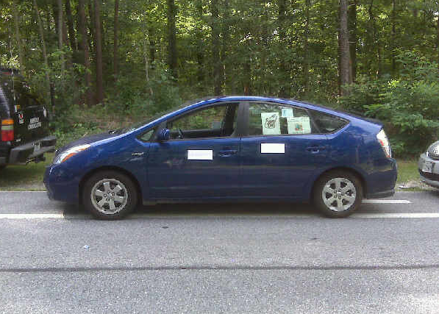
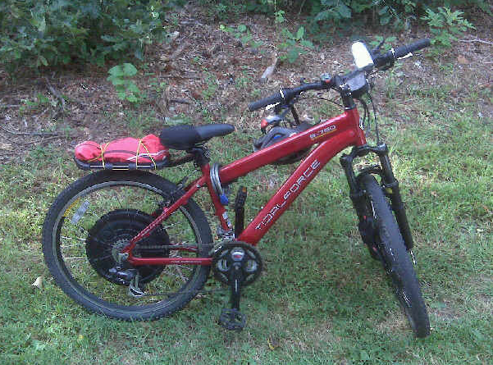
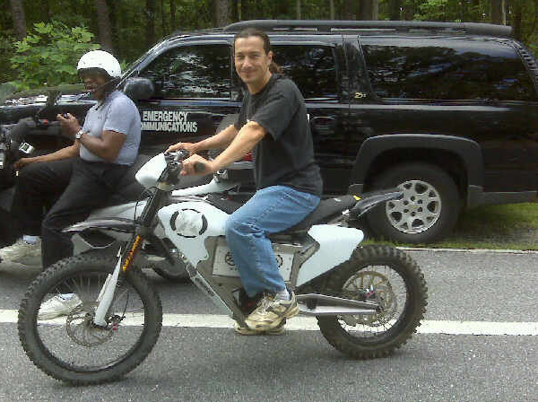
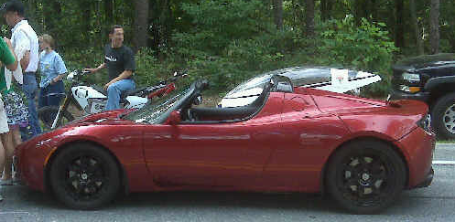
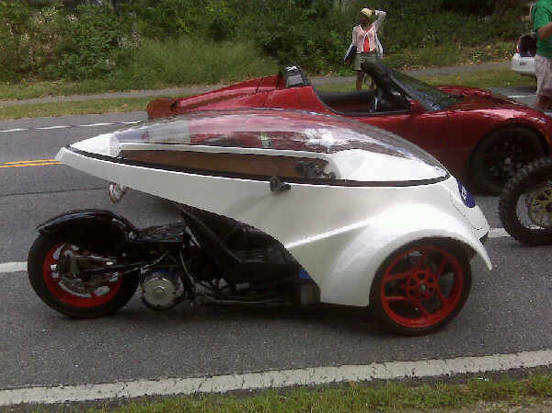
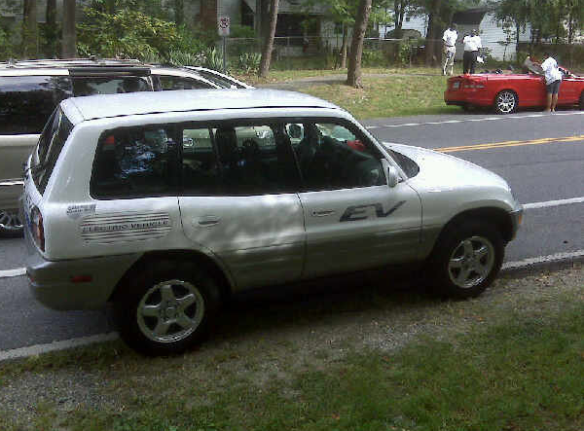
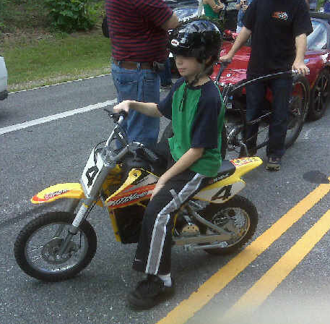
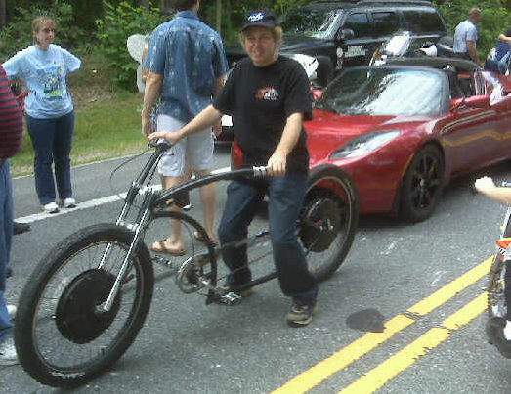
Notes:
Green Transportation Owners section of the 2010 Greenbelt Labor Day Parade. Won 2nd Prize!
Question for ACAPC – suggestions on how to reach out to youth, low-income and/or faith-based organizations?

