Slide 1

Bike to Work Day 2013
Commuter Connections Subcommittee
May 21, 2013

Slide 2


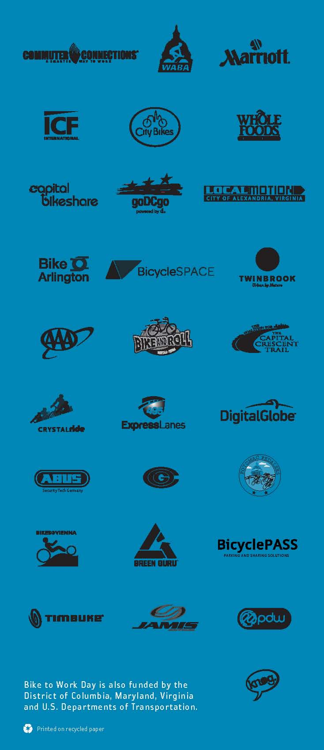
Marketing Materials

Slide 3
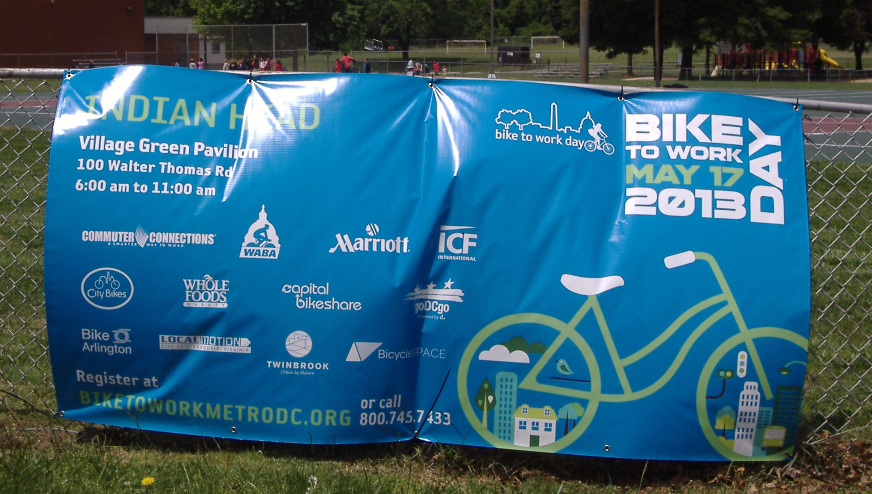
Vinyl Banner

Slide 4
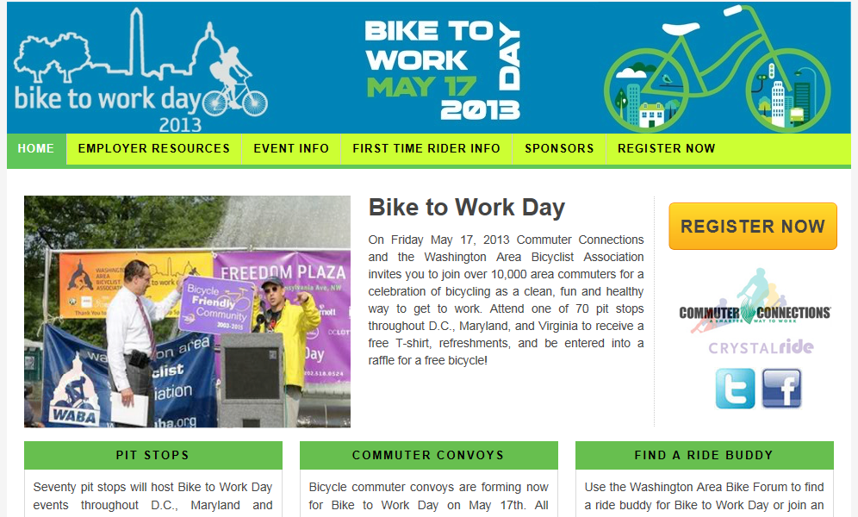
Event Web Site

Slide 5
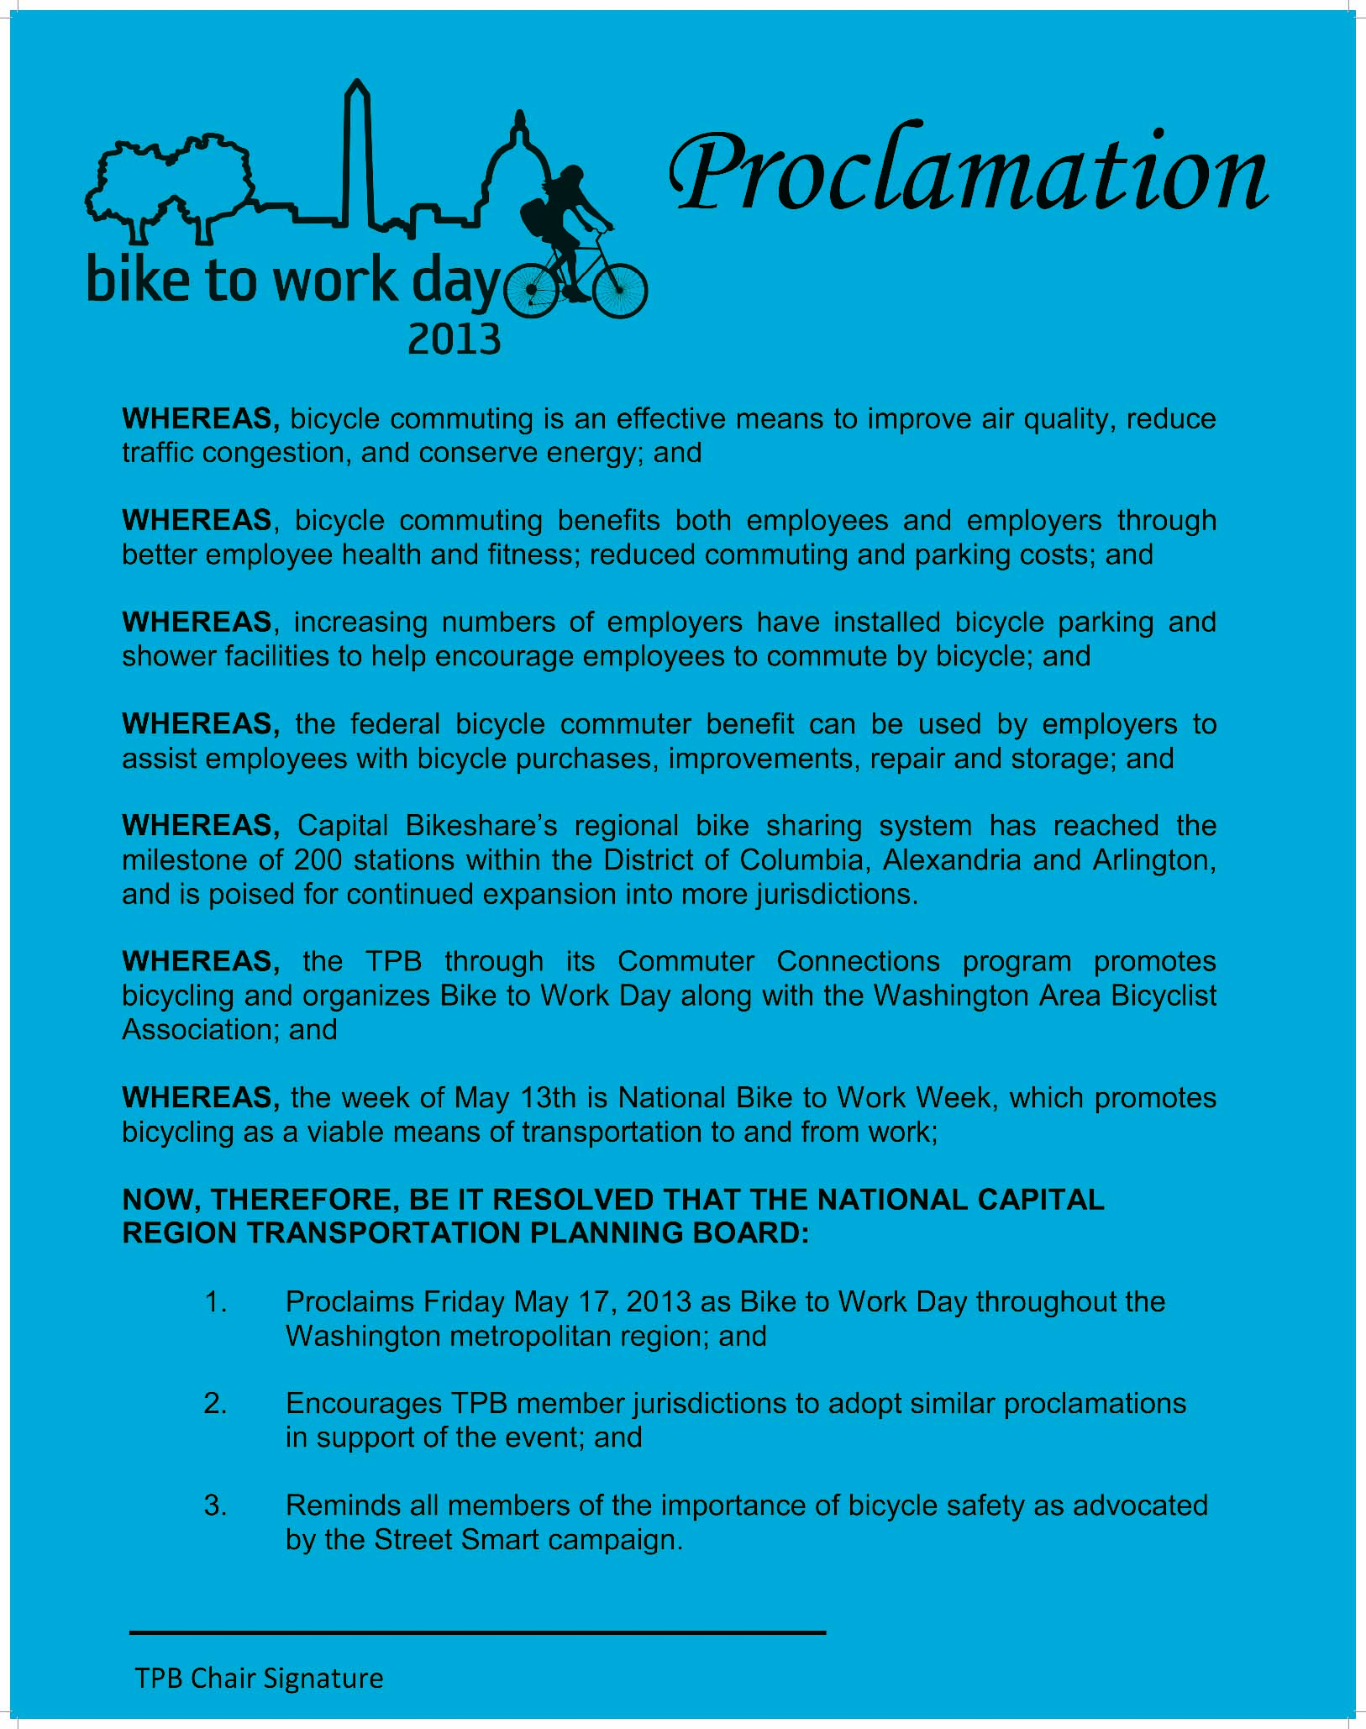
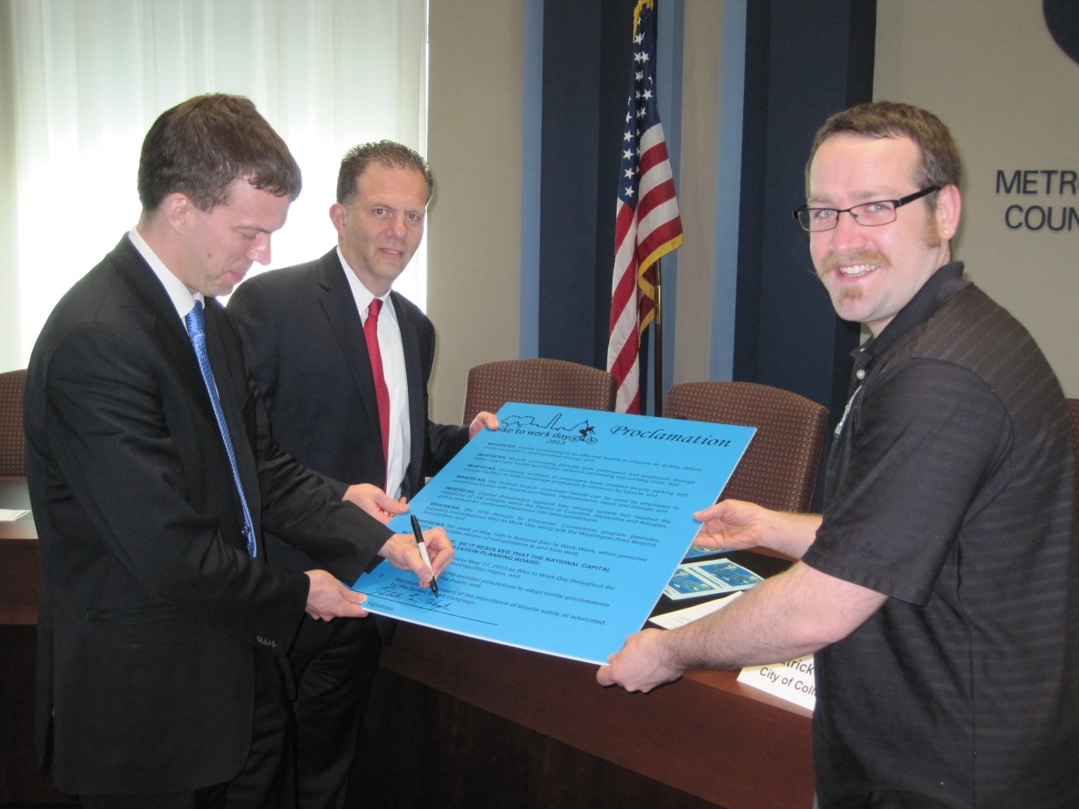
BTWD 2013 Proclamation Signing

Slide 6
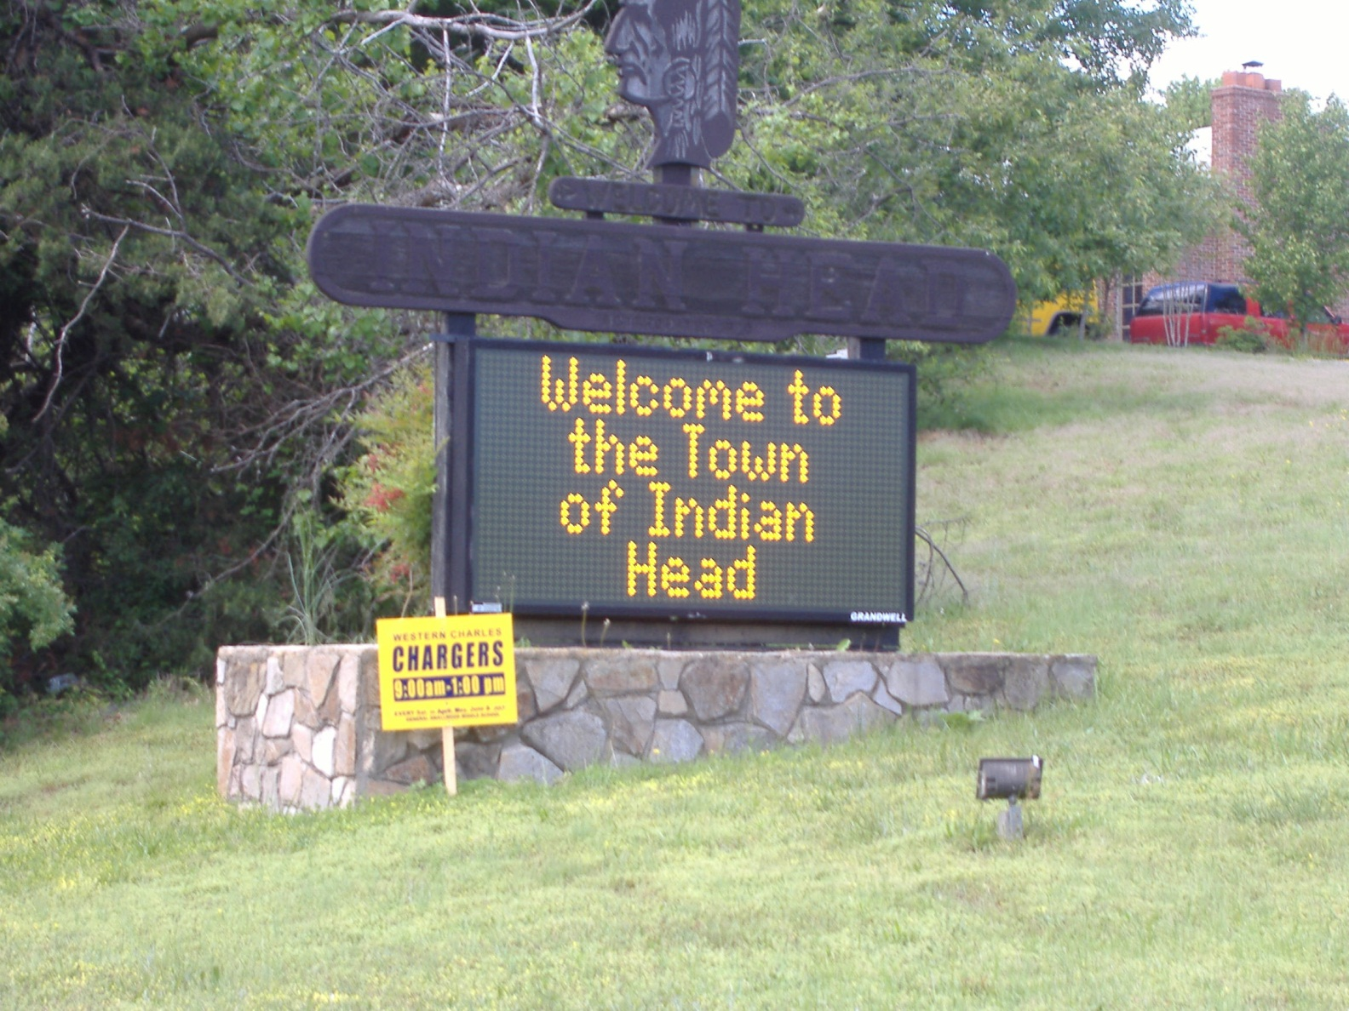
Local Promotion

Slide 7
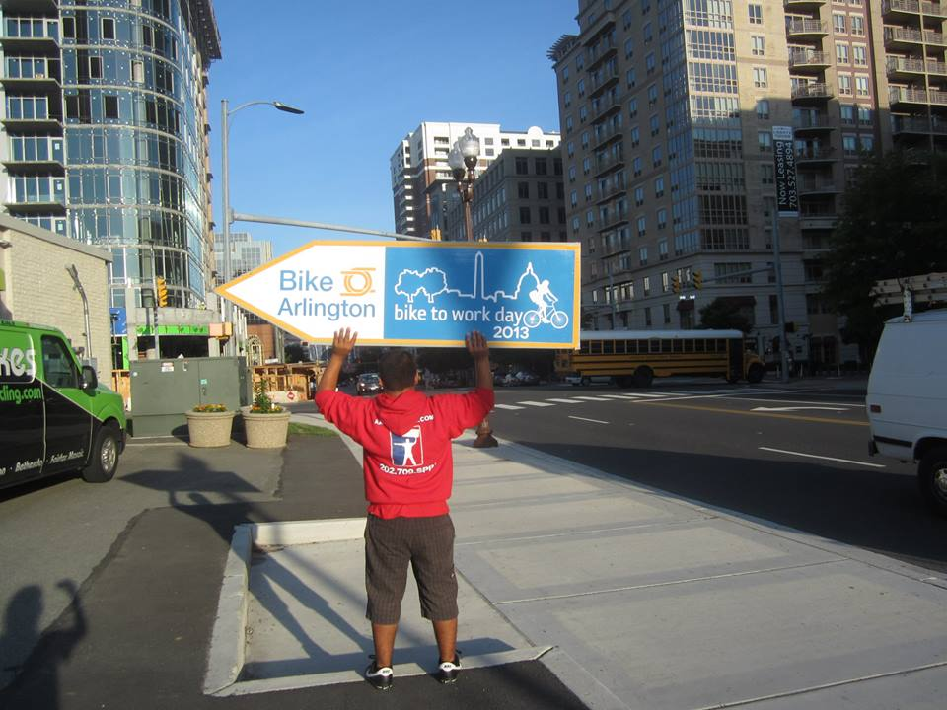
Local Promotion

Slide 8
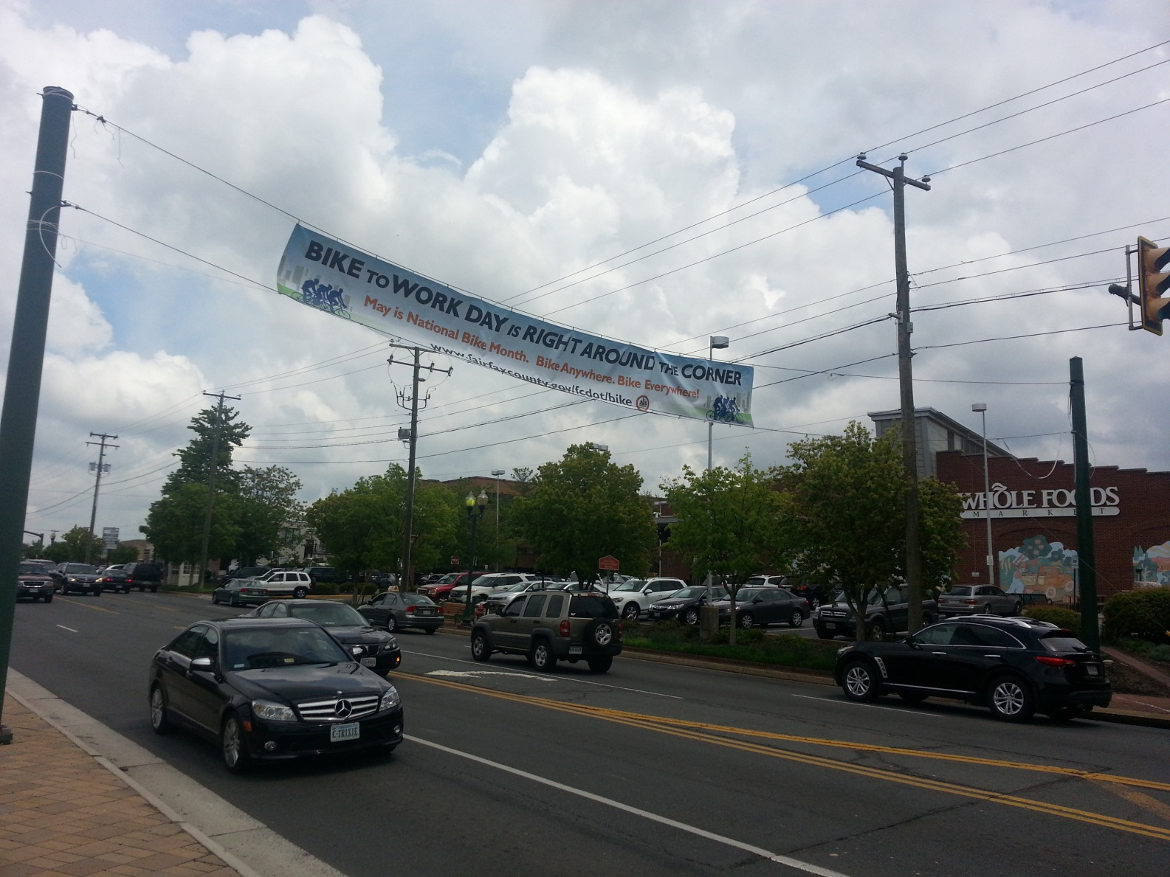
Local Promotion
Fairfax Gas Station TV

Slide 9
BTWD 2013 Confirmed Elected Officials and Dignitaries List
District of Columbia Mt. Vernon DC District of Columbia Councilmember Ward 6, Tommy Wells Freedom Plaza Federal Highway Administration Administrator, Victor Mendez District of Columbia Mayor, Vincent Gray District of Columbia Ward 2 Councilmember, Jack Evans District of Columbia Ward 4 Councilmember Muriel Bowser District of Columbia At-Large Councilmember, David Grosso Maryland Bethesda Maryland Comptroller, Peter Franchot Maryland State Delegate, Ariana Kelly Maryland State Delegate, Susan Lee Montgomery County Councilmember, Roger Berliner Maryland Department of Transportation, Director of Bicycle and Pedestrian Access, Michael Jackson League of American Cyclists Vice President Programs, Bill Nesper, Frederick Maryland Senator Barbara Mikulski’s Office, Julianna Albowitz City of Frederick Mayor, Randy McClement City of Frederick Alderman, Karen Young City of Frederick Alderman, Michael O’Conner City of Frederick Alderman, Shelley Aloi City of Frederick Alderman, Carol Krimm City of Frederick Alderman, Kelly Russell Frederick County Commissioner, C. Paul Smith Frederick County Commissioner, David P. Gray Frederick County Council of Tourism Executive Director, John Fieseler City of Frederick Bicycle/Pedestrian Advisory Committee Chairperson, MaryLynn Hinde | Maryland (con’t) Greenbelt City of Greenbelt Mayor, Judith Davis City of Greenbelt Mayor Pro Tem, Emmett V. Jordan City of Greenbelt Councilmember, Leta M. Mach Virginia Alexandria – Old Town City of Alexandria Mayor, William D. Euille Arlington - Ballston Arlington County Board Member, Jay Fisette Arlington - Crystal City Arlington County Board Member, Chris Zimmerman Arlington - East Falls Church Arlington County Board Member, Libby Garvey Arlington - Rosslyn Arlington County Board Chair, Walter Tejada Fairfax City Downtown City of Fairfax Councilmember, Dan Drummond City of Fairfax Councilmember, Ellie Schmidt City of Fairfax Councilmember, Steve Stombres Herndon Town of Herndon Mayor, Lisa Merkel Town of Herndon Vice Mayor, Connie Hutchinson Town of Herndon Councilmember, Melissa Jonas Town of Herndon Councilmember, Sheila Olem Town of Herndon Councilmember, Charles Waddell Rockville Fallsgrove and Rockville Town Center City of Rockville Council member, Mark Pierzchala

Slide 10
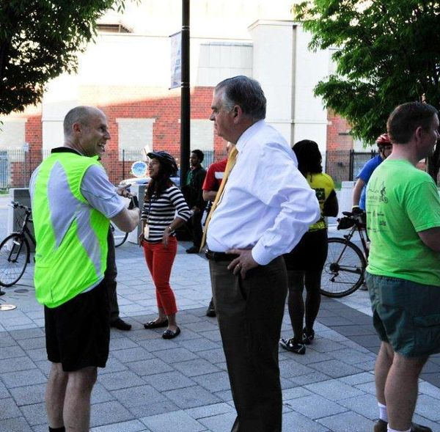
Ray LaHood

Slide 11
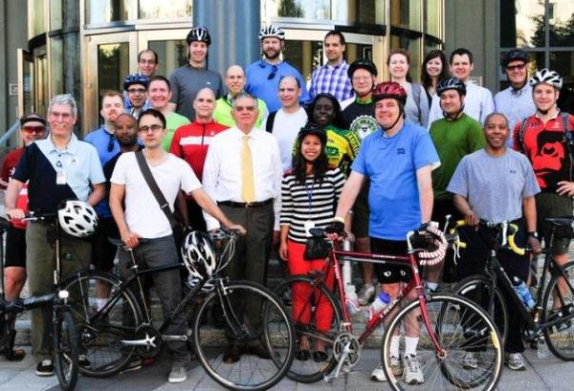
Ray LaHood

Slide 12
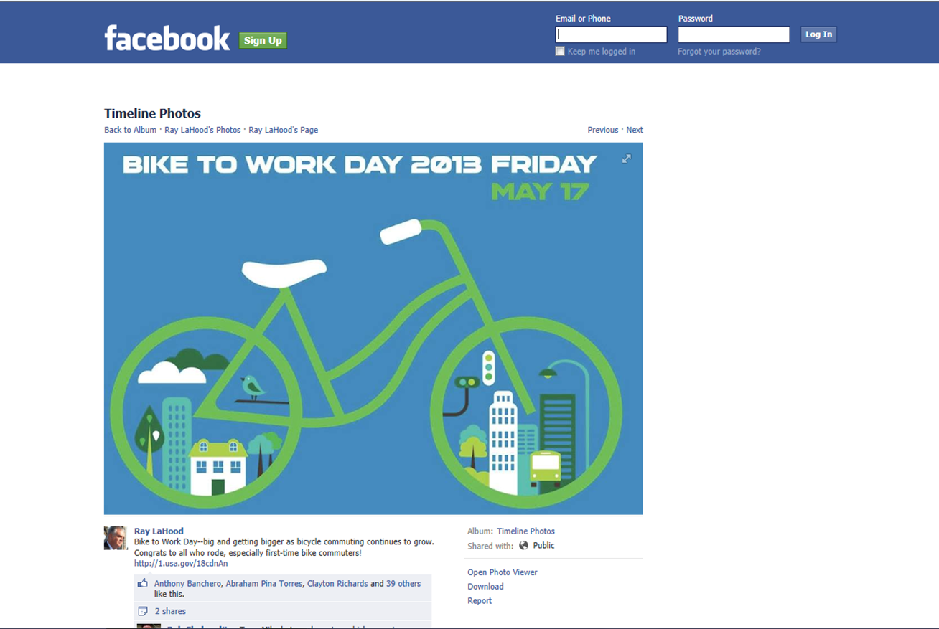
Ray LaHood

Slide 13
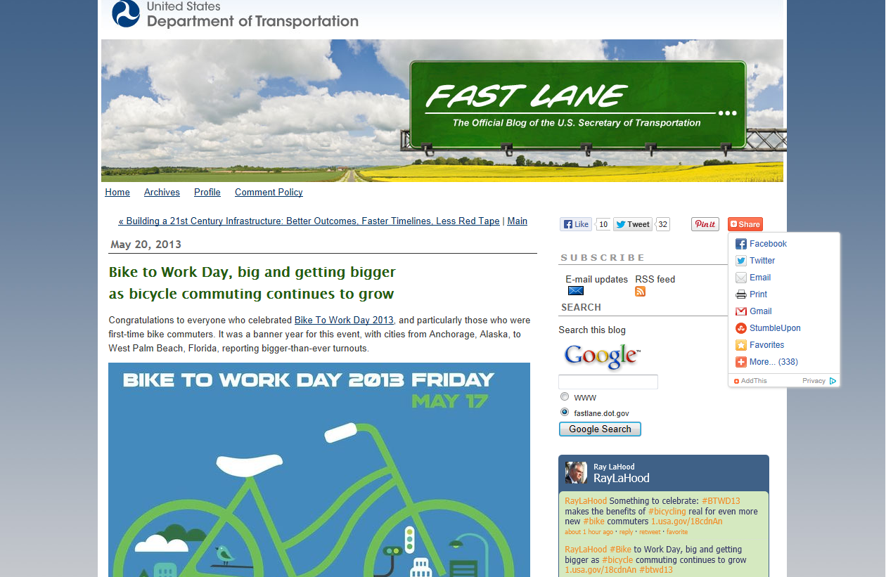
Ray LaHood

Slide 14
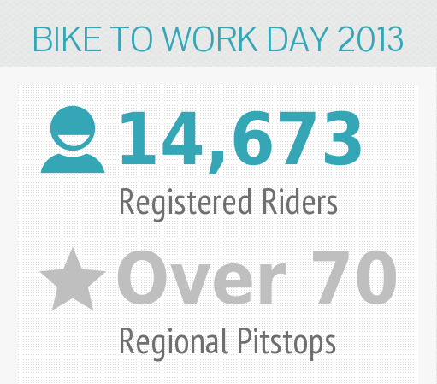
Total Registrants and Pit Stops

Slide 15
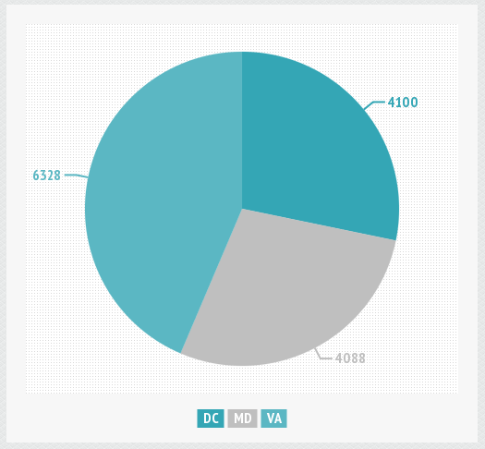
Registered Bicyclists by State

Slide 16
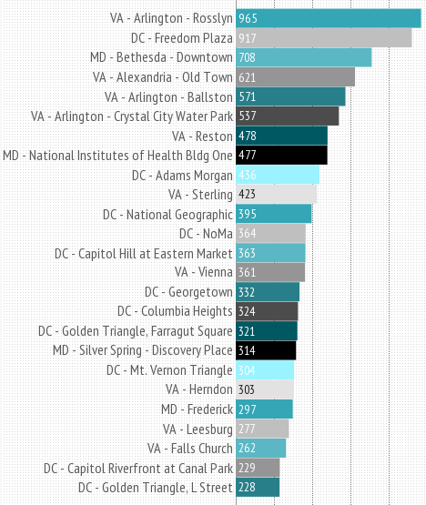
Top 25 Pit Stops by Size

Slide 17

Event Participation Over 12 Years
Number of Registrants
Number of Pit Stops

Slide 18

Bike to Work Day 2013 Event

Slide 19
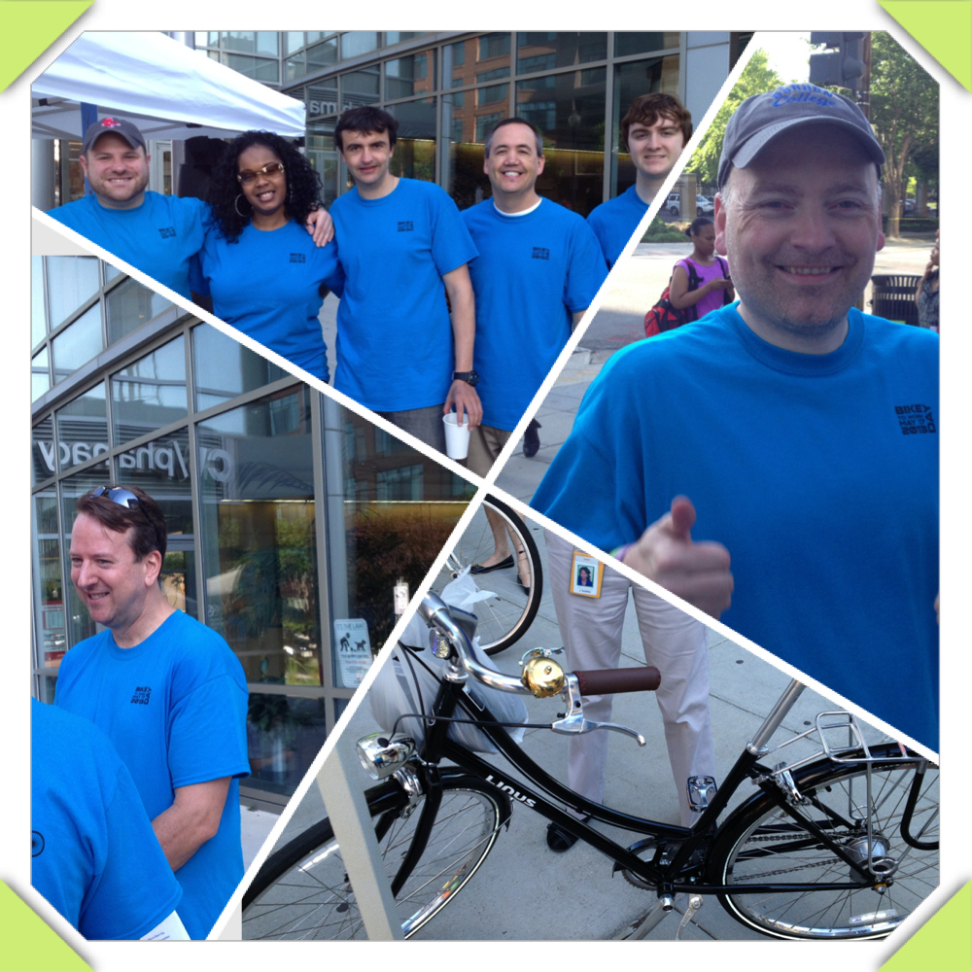
Questions

