Slide 1


Local Stormwater Fees & Taxes
Results of the Sept. 2010 Survey
Presented By
Heidi Bonnaffon
January 21, 2011

Slide 2
COG’s Stormwater Survey Methodology
Survey focused Stormwater Fees and Taxes
Sent August 2010 to members from all 21 jurisdictions in the COG region.
Survey conducted electronically, via SurveyMonkey.
Data analyzed by Heidi Schmitz, Water Resources Intern

Slide 3
COG’s Stormwater Survey Objective
    Snapshot of local stormwater fees and taxes at a critical juncture:
      Bay TMDL is expected to drive up stormwater management costs.
      Jurisdictions may need to raise stormwater charges to offset costs.
    Compare how taxes/fees are calculated, billed, and utilized.

Slide 4
Stormwater Fee/Tax
18 Jurisdictions responded to the survey
Notes:
Four of the 18 jurisdictions fall under the county’s stormwater permit (all included in the tax portion of the pie chart)
3 jurisdictions did not respond (Falls Church, city of fairfax and city of Frederick have not responded yet)

Slide 5
Stormwater Fee/Tax
For the jurisdictions with a stormwater fee/tax it:
  Accounts for 75-100% of their stormwater program funding
  Funds used for:
    Flood control
    Stream restoration
    MS4 Permit requirements
    Retrofits
    Operations & Maintenance
Notes:
Numbers in chart comes from the “Funding the MS-4 Permit and Beyond” presentation Steve Shofar, P.E. from Mont. Co. Dept. Environ. Protection presented

Slide 6
COG Jurisdictions’ Stormwater Taxes/Fees [draft, subject to revision]
Prince Georges County also includes Bladensburg, College Park, and Greenbelt under the County stormwater permit.
The city of Manassas Park and the City of Alexandria do not begin collecting the stormwater fee/tax until FY 2011.
Montgomery County also includes Gaithersburg within the County stormwater permit.
Notes:
*Alexandria’s information comes from their city website (alexandria.gov)
*Most of information is from the survey and city websites

Slide 7
Jan. 2011-Draft subject to revision

Slide 8
How a Stormwater Fee/Tax Is Calculated
  Flat Rate
    Least used method in our region
  Equivalent Residential Unit (ERU)
    Each Jurisdiction determines its own ERU
  Assessed Property Value
    Varies widely between jurisdictions

Slide 9
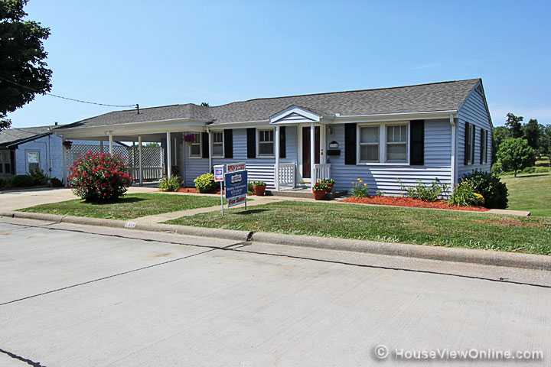
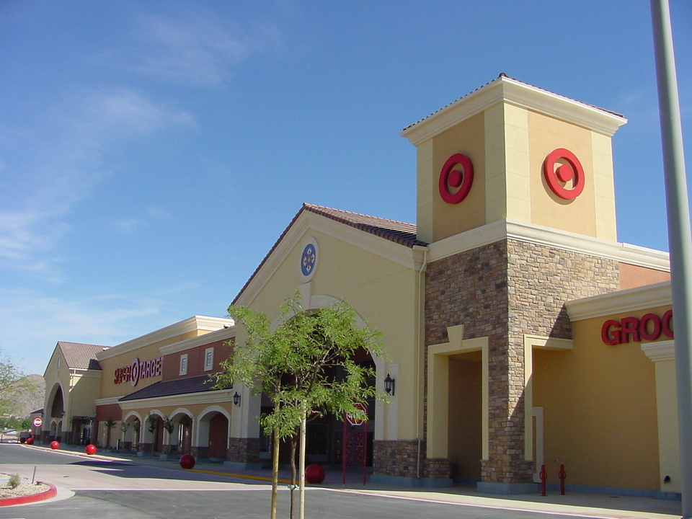
Equivalent Residential Unit
Rate (multiplier) for setting a fee across different types of properties (single family, multi-family and commercial) .
Based on sq. ft. of property or sq. ft. of impervious surface.
Used by about 1/2 of the member jurisdictions.
Often charge a flat (avg.) rate for Single-Family parcels (1 ERU), but may be tiered.

Slide 10
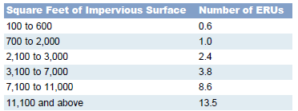
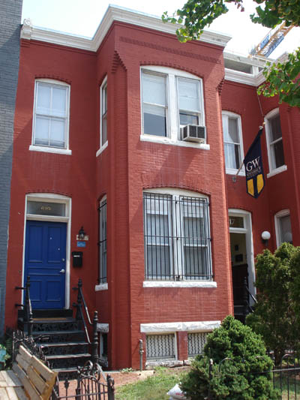
Single Family Residential “Tiers”
http://ddoe.dc.gov/ddoe/cwp/view,a,1209,q,498382.asp
District of Columbia’s single family residential “tiers” based on the amount of impervious area.
Notes:
Many jurisdictions are moving toward single family residential “tiers” based on property size
*Chart comes from DDOE’s website ddoe.dc.gov

Slide 11
ERUs Continued
Pros
Cons
Expensive to determine
  Aerial Photos
  GIS Component
  Needs to be updated
Not always accurate
  Multiple parcels per resident
  Multiple residents per parcel
Can be determined by a sample size of parcels (i.e., avg. single-family residential unit).
May also be tiered, which is more equitable.
More stable than the alternative : Basing charge on fluctuating assessed property values.

Slide 12

Assessed Property Value
Used by half our respondents.
Rate per $100 assessed value.
Often included as a line in property taxes.
Average local assessed property value for a single family dwelling is in the $400,000’s.
Notes:
*Might want to take out the $400,000’s since it was just an “average” of the assessed values we originally had. Possibly go into how much the values can vary annually

Slide 13

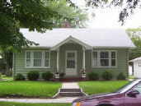
Assessed Property Value
Pros
Cons
Easy to calculate: Often pre-calculated for property tax use.
Easy to bill: Included as a line in the property taxes.
If average or median is used it does not always coincide with each parcel.
Not directly based on amount of impervious surface.
Assessed values can change annually.
vs.
High Assessed Property Value
Low Assessed Property Value

Slide 14
Changes in SWM Fees/Taxes
Taxes/fees will likely increase:
  More funding needed to meet EPA regulations.
  Retrofitting requirements in MS4 permits becoming more stringent.
  Systems are getting older and require more maintenance.

Slide 15
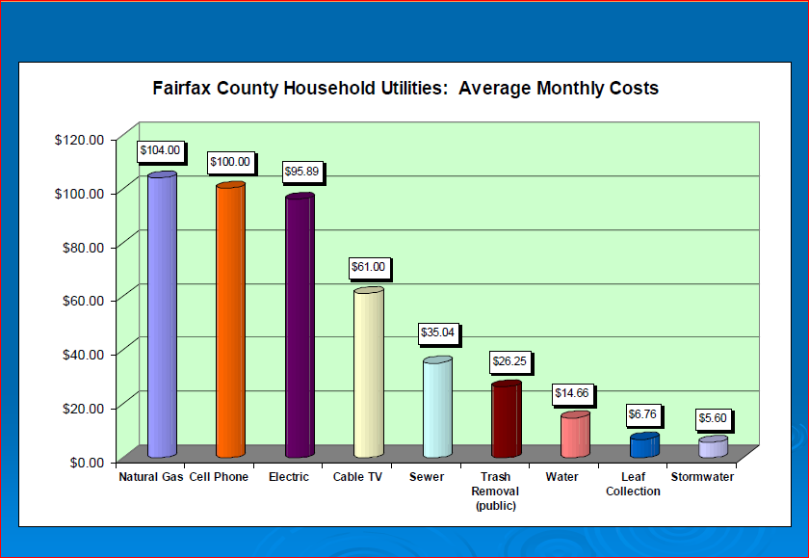
Putting Stormwater Fees/taxes into Perspective…
Notes:
From the “local perspective” presentation done by Fairfax county dept. of public works and environmental services

Slide 16
Next Steps:
  Present this information to the Chief Administrative Officers.
  Expand research on regional and national scope.
    Operations and maintenance costs
    Look into incentives and the role they play
  Track estimates of additional funding required to meet future retrofit requirements (Bay TMDL regulations).
  Summarize in a stormwater white paper.

Slide 17
Questions?
Heidi Bonnaffon
Environmental Planner III
hbonnaffon@mwcog.org
202.962.3216
Heidi Schmitz
Water Resource and Water Security Intern
hschmitz@mwcog.org
202.962.3318

