Slide 1

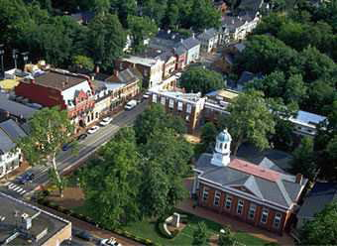
Loudoun County Energy Strategy
Energy Efficiency and Conservation Block Grant
Council of Government
January 21, 2010
Energy Advisory Meeting

Slide 2
County Energy Strategy
Developed with these goals in mind
Create a long-term roadmap for the county
  30-year timeframe
  Incorporate the 40% expected population growth
  Serve the changing needs of the community and businesses
Take a comprehensive approach
  Homes and buildings
  Transportation
  Clean and renewable energy
  Energy use, distribution and supply
Establish goals and layout a framework for successful implementation

Slide 3
“Loudoun County will always have reliable and affordable energy, be energy efficient and reduce greenhouse gases”.
Vision Statement

Slide 4
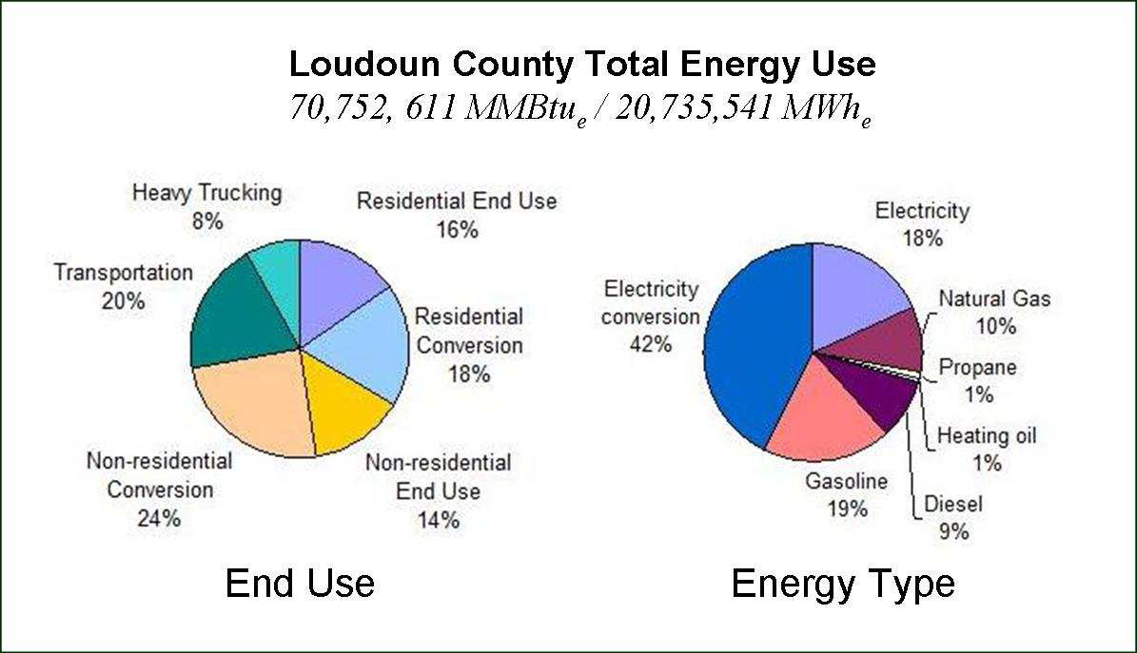
County-wide Energy Usage

Slide 5
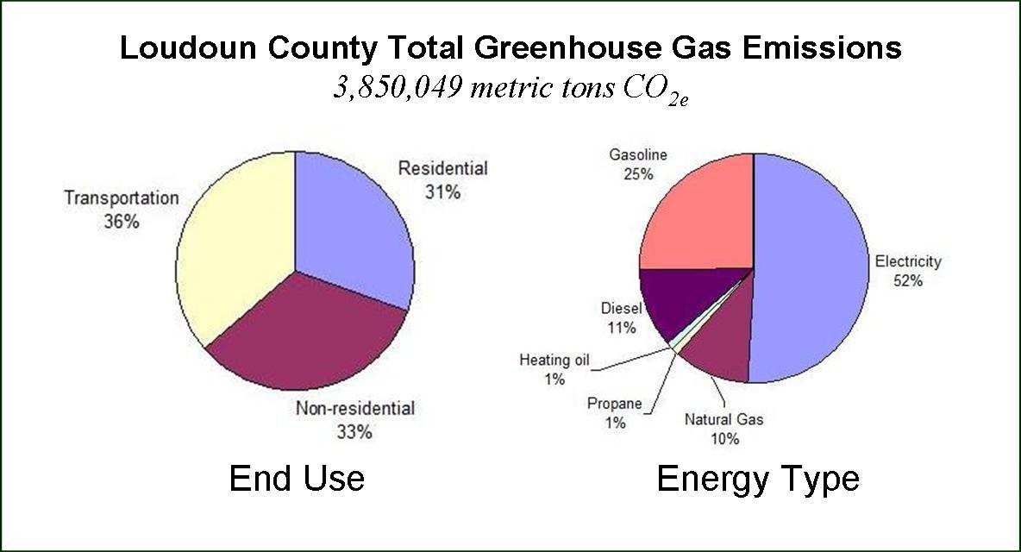
County-wide Greenhouse Emissions

Slide 6
CES Goals
Loudoun County will be recognized as a location of choice for investment in part because of its innovative energy strategy
Loudoun County will strive to have consistently lower energy costs relative to surrounding areas
Loudoun County will be recognized as a regional-state-national model of effective energy and climate management.
Loudoun County’s greenhouse gas emissions will be among the lowest in the country.
Major investments will visibly contribute to meeting the CES goals

Slide 7
12 Recommended Actions
Encourage above code efficiency for new buildings with ongoing updates starting in 2011.
Encourage efficiency standards for building renovations with ongoing updates from 2011.
Encourage Energy Performance Labels for all buildings.
Evaluate district energy in denser mixed-use neighborhoods and, if viable, encourage implementation.
Encourage efficient vehicle use through viable transit options and urban design.
Implement a total of 100 MW Combined Heat and Power distributed to serve District Energy and single large buildings.

Slide 8
12 Recommended Actions
Install up to 100 MW total of Solar Electricity.
Develop multiple Integrated Energy Plans for scale projects and encourage implementation of viable energy efficiency measures.
Create comprehensive public education and outreach programs to businesses and residents.
Collect and regularly report results against long term goals.
Prepare data for potential emissions reduction monetization.
Assess progress and update targets every 5 years.

Slide 9
Expected Results by Adopting CES
Loudoun County uses 21% less energy than 2007 baseline
Greenhouse gas emissions drop from 3.85 MT to 3.0 MT
Grid peak demand is 35% less than business as usual due to efficiency/CHP/Solar
A flexible infrastructure develops to incorporate new technologies or energy sources including biofuels
New energy related businesses – construction, clean and renewable energy products, and district energy products and services evolve
New energy-related jobs of all types, from construction retrofitters to energy supply designers and engineers
New inbound investment attracted by Loudoun County’s energy and climate strategy

Slide 10
EECBG Approved Projects
 | Project | Project Description | Requested Funds | Potential Matching Funds | Jobs Created | Benefits
A | Temporary Position Through Life of The Grant to Support Energy Efficiency Programs | Employ staff to implement CES and grant projects and provide reporting. | $196,560 | None | 1 job for duration of the grant | Necessary to meet the requirements of the grant.
B | Loudoun County Youth Shelter Expansion | Implement renewable energy solutions through solar and geothermal solutions. | $500,000 | None | 36 jobs for project duration | Provides 60% reduction for both energy and pollution, reduces peak demand on the grid, and provides an educational platform.
C | Scott Jenkins Memorial Park Solar Lights & Charging Stations | Implement renewable energy solutions for parking facilities by using 210 kW of solar powered lighting. | $300,000 | None | 4 jobs for project duration | Provides affordable public option for charging electric vehicles. Potential source of income for the County with excess electricity being sold to grid.

Slide 11
EECBG Approved Projects
 | Project | Project Description | Requested Funds | Potential Matching Funds | Jobs Created | Benefits
D | Education and Outreach to Business Community | Educate and promote efficient building standards and practices to the business sector. | $100,000 | Chamber of Commerce/Private Sector | 2.5 to 3 jobs for project duration | Provides potential 40% increased energy efficiency gains in commercial buildings.
E | Education and Outreach to Residents | Provide outreach and education to homeowners to promote home efficiency measures. | $240,000 | Department of Energy/Joint Regional Efforts | 2.5 to 3 jobs for project duration | Can deliver 20% residential energy efficiency gains with minimal 5% increase in construction costs.
F | Energy Solution for Moorefield Station Scale Project and Digital Realty Trust data center cluster | Develop Integrated Energy Master Plan for Mixed-use Transit Neighborhood | $300,000 | $100,000, Moorefield Foundation; In-kind support from Digital Realty Trust Corp. | 3 to 6 jobs for 6 to 9 months | Provides potential multi-sector energy savings of 40% to 50%.
G | Building standards and Energy Performance Labeling (EPL) | Educate and promote efficiency to key stakeholders in residential and commercial buildings. | $200,000 | None | 1 to 1.5 jobs for project duration | Ensures code compliance with an increased 5% efficiency gain over current code.
H | Loudoun County Home Improvement Program - Energy Improvements | Provide energy audits and retrofits for low to medium income family homes | $140,000 | None | 1.5 jobs for project duration | Leverages existing loan program for funding other types of home improvements
 | Total Project Cost |  | $1,976,560

Slide 12
Summary
Elements of the CES are:
  Integrated
  Build upon each other
  Recognize that efficiency is the cheapest, cleanest source of energy
  Involve the whole community
  A long-term direction with on-going implementation
CES developed by a team with local, regional and global expertise

