Slide 1
Item #12: Citizens Advisory Committee Recommendation for a Regional Complete Streets Policy
Michael Farrell
DTP
TPB Technical Committee,
July 8, 2011

Slide 2
CAC Recommendation
At its June 15 Meeting the CAC requested that the TPB Develop and Approve a Regional Policy on Complete Streets
The CAC Recommendation (see mail-out item):
  Suggested that the Bicycle and Pedestrian Subcommittee to take the lead in developing this policy
  Described the concept of Complete Streets and a number of reasons why we need a Complete Streets policy

Slide 3
What are Complete Streets?
“Complete Streets are for Everyone”
  They are designed, built, and operated to enable safe access for all users, including pedestrians, bicyclists, motorists, and transit riders of diverse ages and abilities.
  One size does not fit all. Different designs are appropriate to different places.

Slide 4
Reasons for a Regional Complete Streets Policy
Cost (cheaper than retrofitting)
Supports TPB Vision and Region Forward Goals
  Walkable, mixed-use activity centers
  Health and Fitness
  Economic/retail activity & tourism
  Climate/Environmental
  Environmental justice
If the Region supports Complete Streets, we should say so

Slide 5
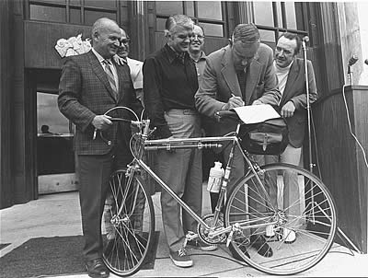
An Early Example: the Oregon Bicycle Bill (1971)
Key Provisions:
  “Routine Accommodation”
    “Footpaths and bicycle trails…shall be provided” as part of every transportation project
  Exceptions
    Public safety (freeways)
    “Cost excessively disproportionate to need or probable use”
    “sparsity of population or other factors indicate the absence of any need”
Oregon Governor Tom McCall signs the Bicycle Bill

Slide 6
Federal and State Policy Trends
1950’s – Prohibition on Building Sidewalks with Highway Money
1970’s - Permission
1990’s - Encouragement
  “Shall consider”
2000’s - Mandated
  “Routine Accommodation”
  “Complete Streets”

Slide 7
State Policies in the Washington Region
  DDOT: “Action Agenda” (2010)
    Create a “walk-centric, bike-centric” city
    Complete Streets Policy (October 2010)
      “network as a whole shall accommodate the safety and convenience of all users”
      Exceptions : Safety, Excessive Cost, Absence of Need
  VDOT: “Policy for Bicycle and Pedestrian Accommodation” (2004)
    “VDOT will initiate all highway construction projects with the presumption that the projects shall accommodate bicycling and walking”
      Exceptions: Safety, Excessive Cost, Lack of Demand, Environmental
    Secondary Street Acceptance Requirements 2009
  MDOT: “Strives” to provide facilities “wherever possible”
    Bicycle and Pedestrian Plan (2002)

Slide 8
Federal Policies
Currently no official Complete Streets Policy
FHWA guidance approaches a Complete Streets policy
  “In the planning, design, and operation of transportation facilities, bicyclists and pedestrians should be included as a matter of routine, and the decision to not accommodate them should be the exception rather than the rule.” (2007)

Slide 9
Proposed Actions
Study existing Federal, State, and Local Policies
  Most of our jurisdictions have some sort of Complete Streets Policy
  Identify issues/lessons learned
Examine other MPO Complete Streets Policies
  Emphasis on large, multistate MPO’s
  Interview selected MPO’s
  Strength of the policy: mandatory vs. voluntary
Develop a Draft Complete Streets language for the Washington region
  Present preliminary findings and sample language to the Bike/Ped Subcommittee July 19th, revisit in September
  Consult with TPB Technical Committee, Access for All, the Bus Subcommittee, the Citizens Advisory Committee, and the TPB Priorities Plan Task Force
  Update to TPB Technical Committee in September
  Goal: Ready for adoption by TPB in October

