Slide 1

EPA’s Final Chesapeake Bay TMDLs
Maryland & Virginia Phase I WIPs
Presentation to
Chesapeake Bay and Water Resources Policy Committee
January 21, 2011

Slide 2
Today’s Focus
TMDLs & WIPs (Watershed Implementation Plans)
  Schedules
  Key Features & Details
  Updates to Bay Models
  Response to Comments
Phase I WIPs
  Stormwater Comparison
Next Steps

Slide 3
Schedule for Bay TMDLs & WIPs
2010
July 1 – EPA issued Draft TMDL Allocations
September 1 - States/District issued Phase I WIPs
September 24 - EPA issued Draft Bay TMDLs
September 24 – November 8 – Public Comment Period
  (for TMDLs & WIPs) [COG Comments Submitted to EPA & MD/VA]
Late November/early December – States/DC Submitted Final Phase I WIPs
December 29 – EPA Issued Final Bay TMDLs in Federal Register & Responded to Formal Comments

Slide 4
Schedule for Bay TMDLs & WIPs
2011
June 1 – States/DC to submit Draft Phase II WIPs [Maybe modify deadline ~3 months?]
  Loads to be sub-allocated to local (county) level – MD plans to have county liaisons
November 1 – States/DC submit Final Phase II WIPs
December - EPA to potentially revise TMDLs - Based on refined Watershed Model (WSM)
December 31 – Bay States must complete first set of 2-Year Milestones [Local progress reporting reqd.?]
2017
Phase III WIPs to be Submitted – Draft by June 1, Final by November 1
EPA to assess implementation progress
  60% of WIP Implementation to be Achieved & Ensure practices in place to achieve 2025 goal
EPA to determine whether to use WSM updates for WIPs & revised TMDL – and Revise TMDL if necessary
2020
Maryland expects to achieve 100% WIP Implementation
2025
100% of WIP Implementation to be achieved Bay-wide

Slide 5
Key Features of Bay TMDLs
Final Allocations
  By State/District (e.g., Maryland, Virginia, District)
  Major Tributary Basins (i.e., Potomac River)
  By segment-shed (to match 92 separate Bay water quality segments)
  Generally same as the Target Load Allocations (issued 7/1/10) -- the WIPs sub-allocate these by sources categories (WLAs and LAs – i.e., wastewater/stormwater and air deposition/forests/agriculture)
  Includes EPA obligations for explicit Nitrogen Reductions
    Based on implementation of federal air regulations
Reasonable Assurance & Accountability Framework
  If state Phase II WIPs don’t adequately address ‘reasonable assurance’, then EPA intends to invoke previously identified federal ‘back-stops’
  2-Year Milestone reporting (1st set to be completed by Dec. 31, 2011)
  Potential for additional federal action

Slide 6
Key Features of Bay TMDLs
Margin of Safety
  Assumed to be implicit given models, water quality standards, & other TMDL assumptions
Growth
  Not accounted for beyond 2010 – except for wastewater plant permitted capacity (i.e., to extent that existing capacity addresses ‘future’ growth)
  Up to States/District to define how growth is to be addressed in WIPs (not much defined so far)
Air Deposition
  15.7 Mlb to be achieved by 2020 due to federal regulations - EPA responsibility
  Recent air quality regulations & newer modeling of controls are NOT accounted for (noted at Sept. 28th state air quality meeting w/ EPA)
    Not sure of actual impact to loads, but need to pursue/further evaluate implications

Slide 7
Key Features of Bay TMDLs
Climate Change
  To be addressed formally in 2017 reassessment
Federal Lands
  Only 5% Bay-wide (but 30% in District)
  Federal commitments cited in President’s Executive Order (but is it occurring?)
Recognition of Need for Offsets, Support for Water Quality Trading
  Applicability to COG Region? What options/scenarios are likely?
Future Modifications - Adaptive Management / Phased Approach
  But, only two options noted that might result in changes in TMDLs:
    ‘State’ exchanges of loads across tributaries – if local & Bay water quality standards still met
    Modifications of Watershed Model Phase 5.3 – if required
Changes in Modeling Assumptions - IF supported by Monitoring Data
  Susquehanna River Dam (sediments – i.e., what if sediments washed out)
  Filter Feeders (oysters, etc. – source of additional reductions &/or reqd. to restore water quality?)

Slide 8
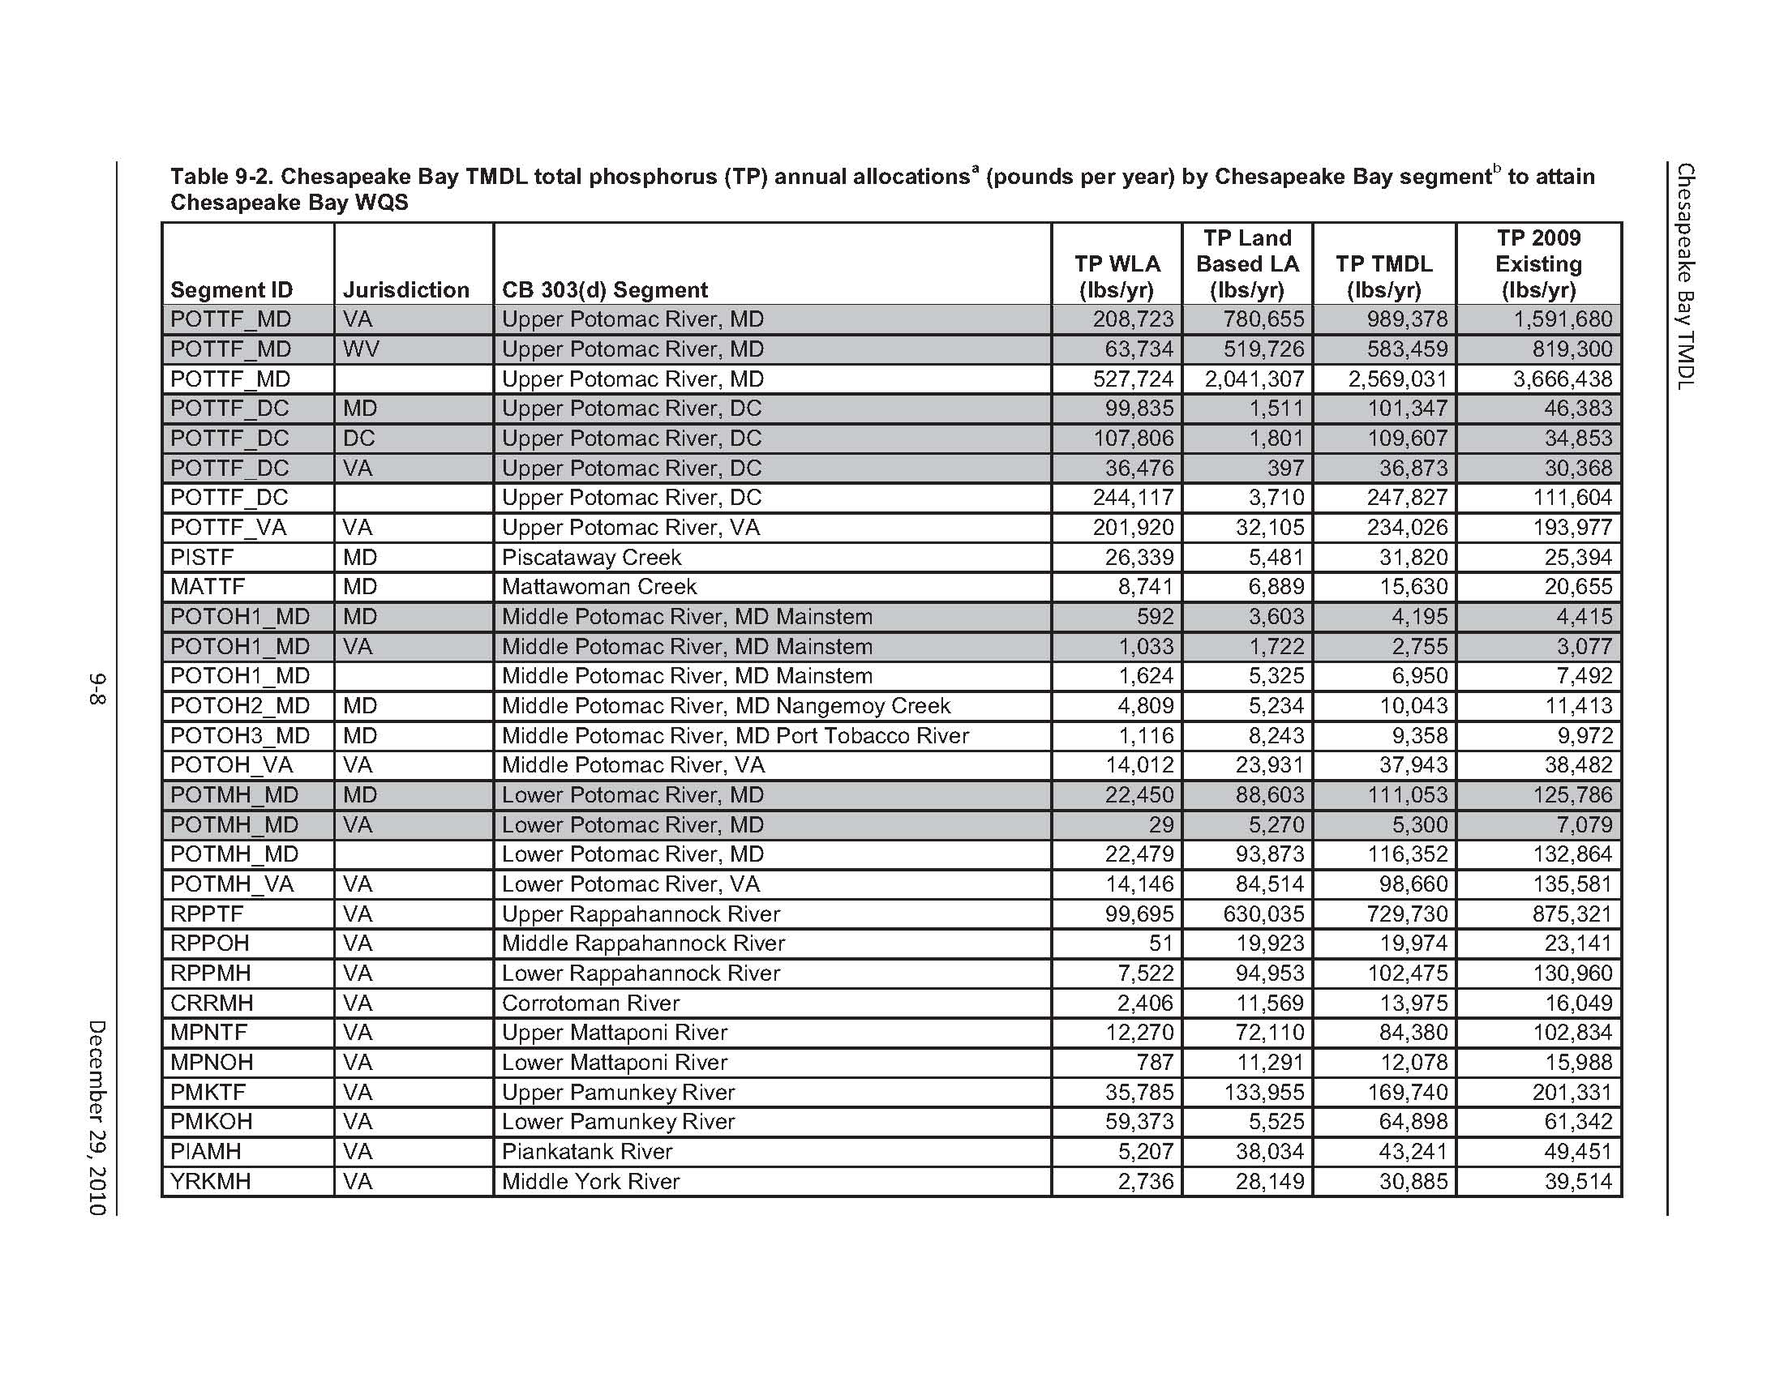
TMDL Details

Slide 9
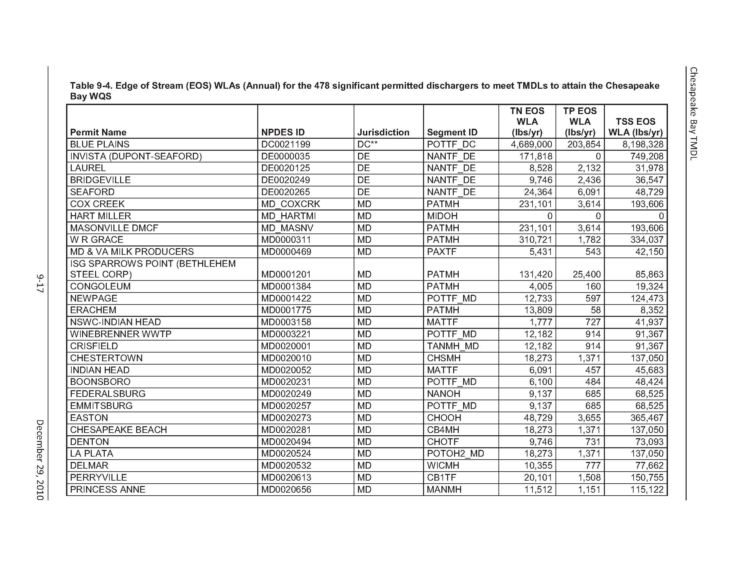
TMDL details

Slide 10
Updates to Bay Models
Phase 5.3.2 Watershed Model
Use - Single Nitrogen & Phosphorus ‘effectiveness’ factor, & Constant Basin Delivery Factor
  Reduces complexity for nutrient trading & makes credits more proportional to nutrient reduction efforts
  Responsibility will shift (slightly) from the headwater states to the tidal states, and from point sources to nonpoint sources
  Impact to calibrations? Potential implications for sub-allocations & permits? Need to assess
Land Use
  Estimated impervious (1st column of numbers) & pervious (2nd column) land has changed significantly again (see table next slide)
  Based on a combination of land cover, roads, housing, impervious and road width coefficients, and state mining data
  Ground truthing shows new method captures 94% of impervious surfaces in Montgomery County (vs. 74% with previous method)
  CBPO looking for more local data to use in ground truthing
Phase 5.4 Watershed Model Updates – Not sure when
Potomac Model – Portion of Water Quality Model
Finally ran (improved) Potomac version - It is able to replicate pH and algal values pretty well (???)

Slide 11
Updates to Bay Models
Model Version (Data Year) | Impervious Surface (acres) | Pervious Surface (acres)
Phase 5.2 (2002) | 799,989 | 3,591,799
Phase 5.3 (2002) | 675,917 | 1,885,935
Phase 5.3.1 (2001) | 1,587,575 | 5,896,707
Phase 5.3.1 (2001) (Excl wooded residential) | 1,569,377 | 3,442,346
Phase 5.3.2 (2001) (Excl wooded residential) | 1,265,488 | 3,366,565

Slide 12
TMDL Comments - Common Themes
EPA has failed to:
  Adequately engage affected entities
  Underestimated financial burdens & hence feasibility
  Set unrealistic implementation schedule (i.e., for 2017 and for 2025)
  Failed to allow sufficient time for input/comment
  Not provided sufficient details to assess actual responsibilities & impacts
Technical basis is flawed
  Watershed Model (WSM) assumptions & loads
    Percent impervious assumptions, land cover data – not valid
    AG sector study – USDA load estimates not consistent w/ EPA loads
    Tables not clear and all loads not accounted for (CSOs, errors for various WWTPs, practices missing, etc.)
  WSM fails to incorporate/credit all practices (Ag & Urban)
  Not all proposed practices are appropriate/feasible

Slide 13
TMDL Comments - Common Themes
Legal Issues – unreasonable or inappropriate action:
  Seeks to control growth and local/state prerogatives
  Exceeds EPA’s regulatory authority or assumes where no authority exists
    (e.g., SW – maximum extent feasible vs. proposed levels of effort)
  EPA shouldn’t be issuing the TMDL (states should)
  EPA has no implementation authority
  May not be appropriate as a ‘national model’
  Imposition of Backstops exceeds EPA’s authority
PA & VA Farm Bureau Lawsuit was filed
EPA Must:
  Assess cost/financial burden given scale/scope/impacts (i.e., TMDL is unaffordable, costs to implement (esp. SW & Ag) much higher than assumed)
  Ensure that flexibility (adaptive management) is used
  Ensure that Water Quality Trading is viable
  Allow sufficient time for input (e.g., extend Phase II WIP deadline)

Slide 14
EPA’s Response to TMDL Comments
Addresses limited number of corrections
Added text to explain rationale/defend actions taken
Funding Issues:
  Officially outside the scope of the TMDL
“EPA does not consider funding to be relevant to the TMDL,
but instead to the implementation of the TMDL.”
  Note increased EPA & SRF funding for Bay & cited studies showing the costs of different forms of current pollution (e.g. mercury contamination)
Engagement / schedule and deadlines
  Cite hundreds of meetings held, LGAC involvement
  May extend Phase II WIP deadline (???)

Slide 15
EPA’s Response to TMDL Comments
Retrofit Feasibility
  Sidestepped cost & site constraint concerns
“EPA believes that it will not be possible to meet allocations
for urban stormwater discharges without retrofit programs.”
Watershed Model Flaws
  Cited open process, peer review, etc.
  Do not acknowledge any model flaws (can’t given lawsuit)
Legal Issues
  Did not acknowledge that these have any validity
  Responded with detailed legal rationale/justification

Slide 16
Summary of Final Phase I WIPs
EPA and states/District worked to address EPA objections to draft WIPs
TMDL cites “specific improvements”
  More stringent TN and TP limits for James WWTPs
  Language pledging to pursue state funding legislation in Maryland & Virginia
As a result, EPA eliminated most backstops
  Only remaining ones are for NY wastewater, PA urban stormwater and WV agriculture
  However, EPA expressed concern about viability of certain pollution reduction pledges in various states (including VA) and may re-institute backstops (i.e., if Phase II WIPs don’t provide necessary ‘reasonable assurance’)

Slide 17
WIP Comparison - Stormwater
Maryland
Virginia
New Development
Continuation of current state stormwater program requirement (post-development runoff standard of “woods in good condition”
Re-Development
Continuation of current state stormwater program requirement (treat or remove 50 % of existing imperviousness)
Retrofit
Treat 20 – 30 % of pre-85 imperviousness, but “alternatives” will be considered
Nutrient Management
Includes fertilizer restrictions, plan requirements
New Development
No increase above allowable 2025 average load/acre
Re -Development
Anticipated reductions of 20% under new state stormwater management regulations
Retrofit
Not specified: “On developed lands, the implementation of additional BMPs will be necessary to meet the allocated pollutant reductions”
Nutrient Management
Includes fertilizer restrictions, plan requirements

Slide 18
WIP Comparison - Stormwater
Maryland
Virginia
Cost Impact
Preliminary analysis assumes retrofit cost of $18,000/acre including alternatives
Measuring Progress
Not clear if state will use CBP watershed model
By November 2011 pledge to implement electronic tracking of BMPs through new Maryland Chesapeake Bay Implementation Tracking center
Cost Impact
To be considered: “Adjustments to this plan will be considered based on cost effectiveness and other options”
Measuring Progress
Not clear if state will use CBP watershed model: “We will use the model as a management tool, but we will tailor our actions within real scientific, ec0nomic, social and political frameworks”
BMP tracking thru DCR’s new Stormwater Management Enterprise web site

Slide 19
COG Next Steps
Assist members in development of Phase II WIPs
  Model analysis: Watershed Model (as needed) / Potomac WQM
  Share findings in regard to data assumptions etc.
  Develop data on regional costs (e.g., for retrofits) & WWTP LOT costs for region (ref. VA-DEQ request)
  Evaluate initiatives to address offsets/growth
  Learn more about AG sector issues (lawsuit, commitments, study results, potential for trading, etc.)
Track legislative, regulatory & legal actions
  TMDL lawsuit
  Stormwater permitting & federal permit guidance/regulations for the Bay
  Virginia’s state stormwater management regulatory updates
  Farm Bureau Bay TMDL litigation
  WWTP permitting issues (e.g., request to go beyond ENR)

Slide 20
COG Next Steps
Pursue retrofit alternatives
  Viable trading mechanisms
  Residual designation authority - ?
Support for state, federal funding initiatives
  Maryland’s Bay Restoration Fund increase
  Stormwater funding in federal transportation bill
Presentations /workshops to address:
    Growth/offsets
    AG sector issues (share information, understand common concerns)
Other support? Other issues of concern?

