Slide 1

ITEM # 7
National Capital Region Transportation Planning Board
July 17, 2013

Slide 2
Car Free Day Background
Event started in Europe in 1995, went global in 2000
Part of International Mobility Week
One or more days during Mobility Week, cities set aside an area for pedestrians, cyclists and transit, ordinarily used by cars
Car Free Day is celebrated in 1,500 cities in 40 countries
World Car Free Day is September 22nd

Slide 3
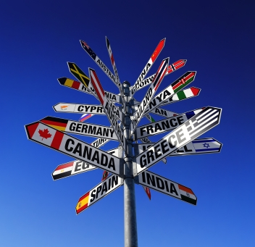

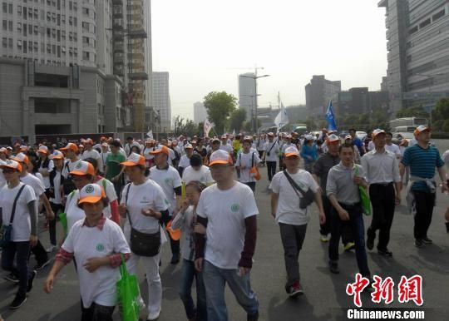
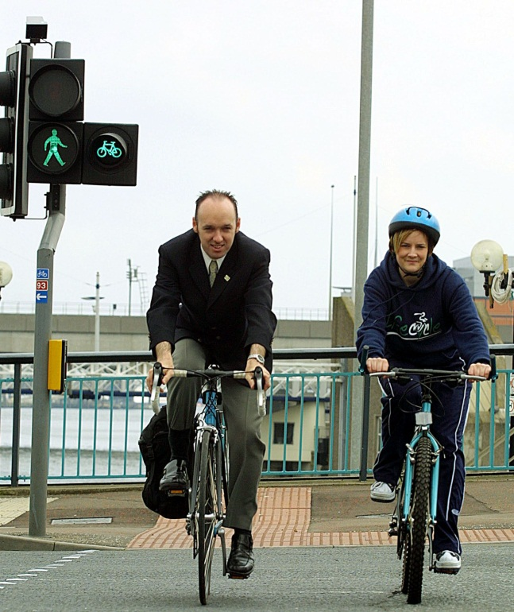
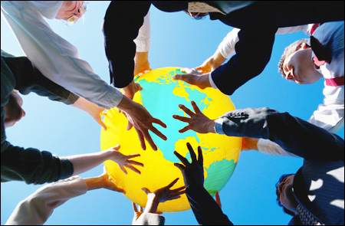
International

Slide 4
Car Free Day Background
First took place in the District in 2007
TPB supported regional rollout in 2008 with COG’s Commuter Connections program
Promotes and organizes the annual Car Free Day event along with its network members
Invites Washington region citizens to try alternative forms of transportation such as transit, bicycling and walking
Includes car-lite methods such as carpooling

Slide 5












2012 Media Coverage

Slide 6
2012 Media Coverage Headlines
A World Without Cars | Get Out and Explore DC with Car Free Day Sept. 22
Advocates urge D.C. to go car free for a day | Go Car Free Sept. 22nd
Attract New Customers on Car Free Day | Happy Car Free Day
Break Your Automobile Addiction | Park It - Go Car Free on September 22nd
Car Free Day - Reflect on Transportation Options | Safety and Awareness are Key for CFD 2012
Car Free Day is Saturday | Saturday is International Car Free Day
Car Free Day is Tomorrow | The Reason Car-Free Day is on Saturday
Car Free DC, at least for a day | There is Still Time to Pledge to Go Car Free
Ditch your car this week! We double-dog dare you | Washington Region to Join the World in Celebrating CFD

Slide 7
Open Participation
Pledge to be Car Free at www.carfreemetrodc.org
    Commuters
    Students
    Families
Primary targets are SOV drivers
Secondary group are those already in Car Free travel modes
7,000 pledges received in 2012

Slide 8
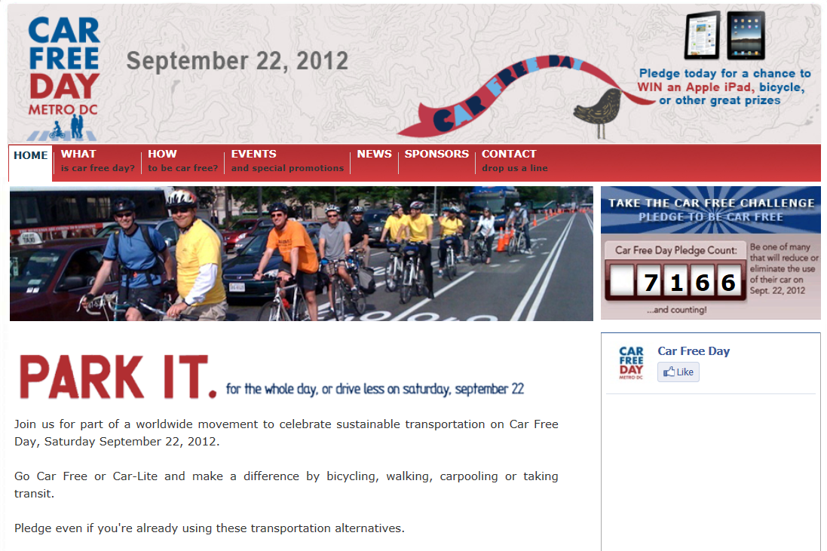
2012 Car Free Day Web Site

Slide 9
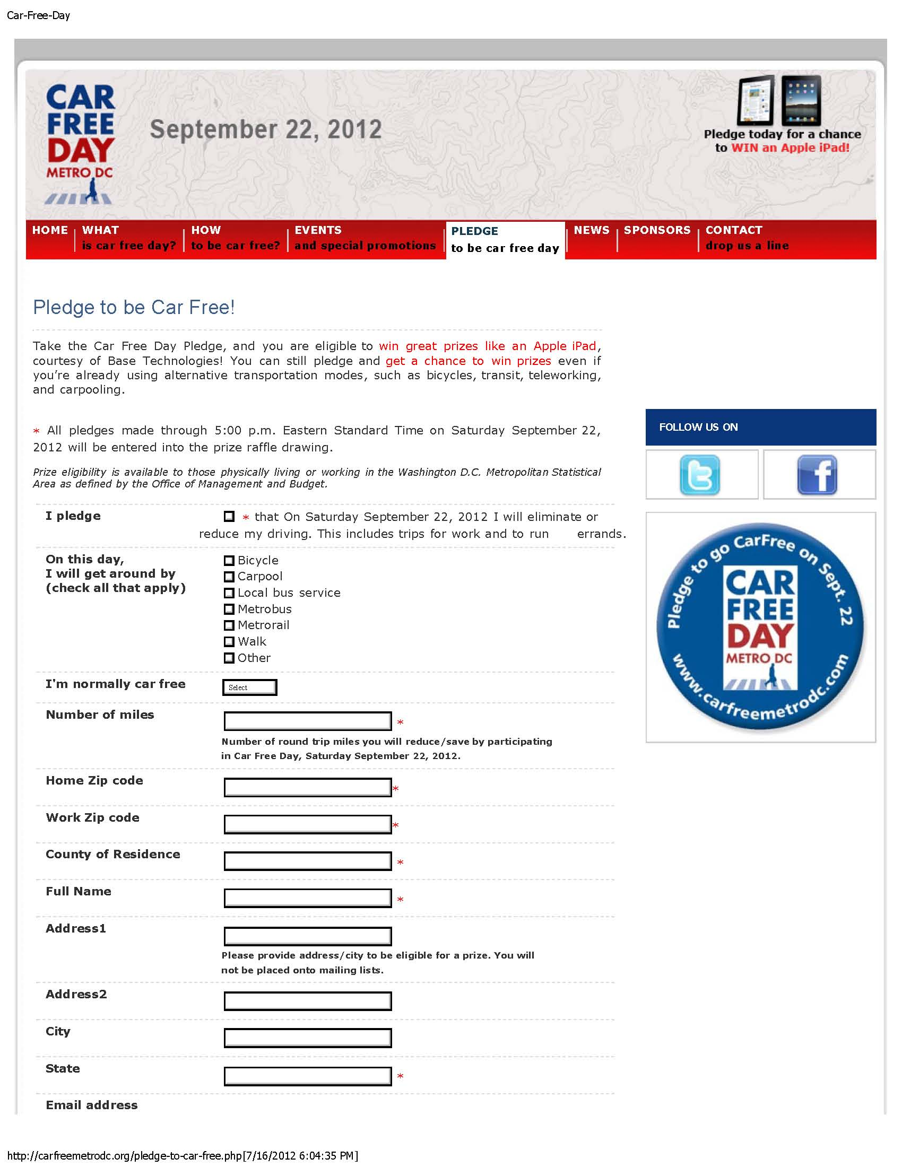
2012 Pledge Form

Slide 10

Promotion

Slide 11
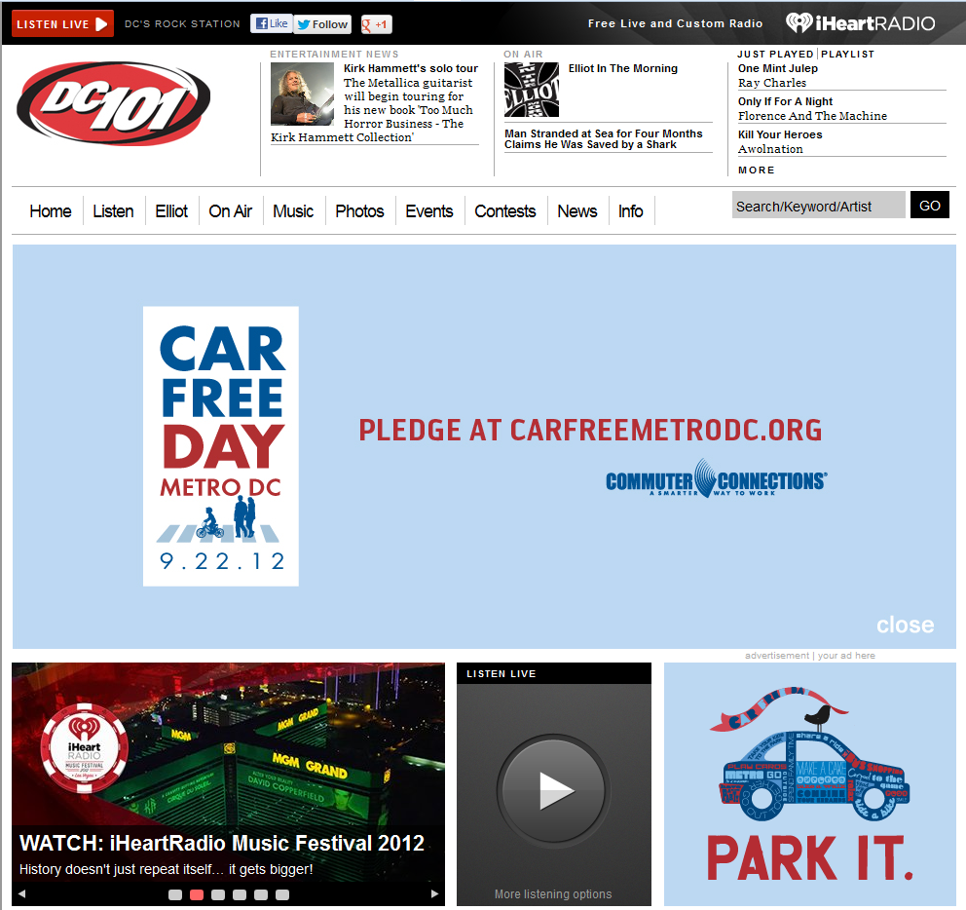
Website Takeover

Slide 12

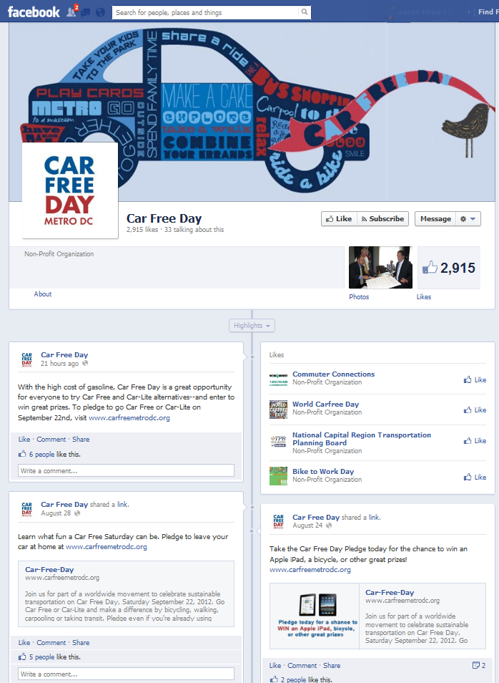
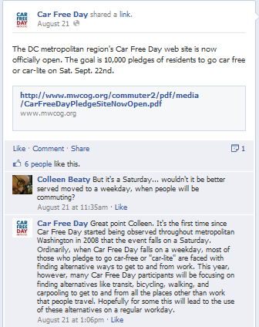
Social Media

Slide 13


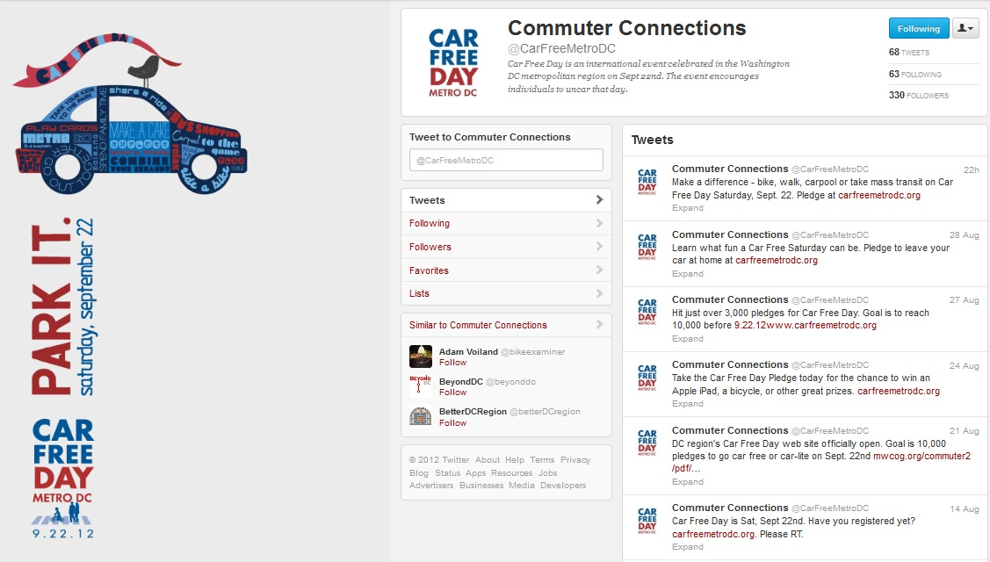
Social Media

Slide 14
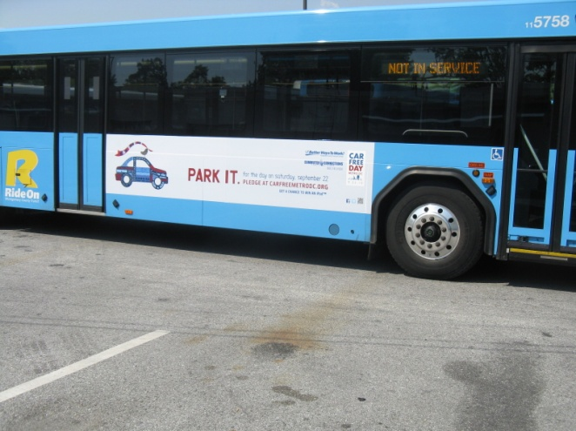
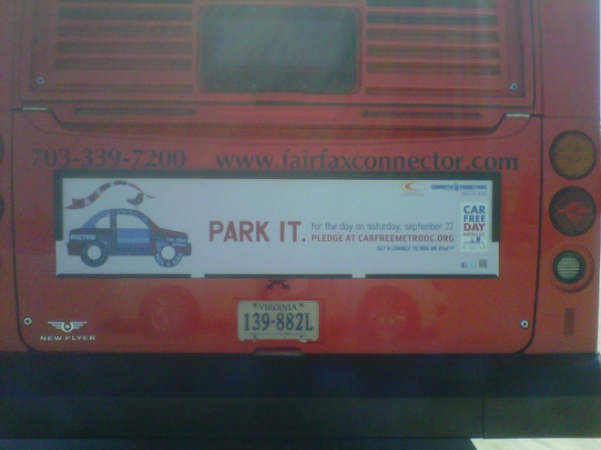
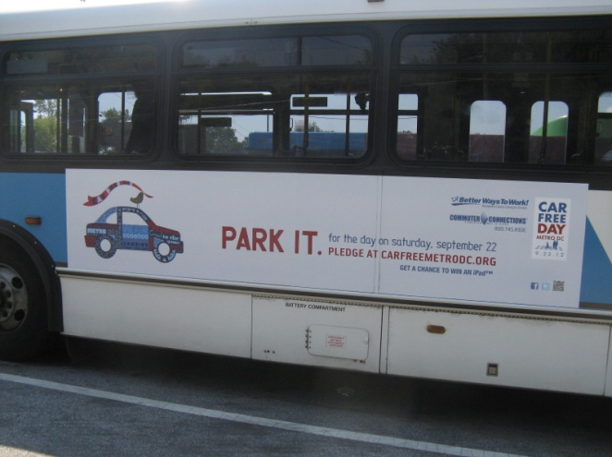
Transit Signage

Slide 15
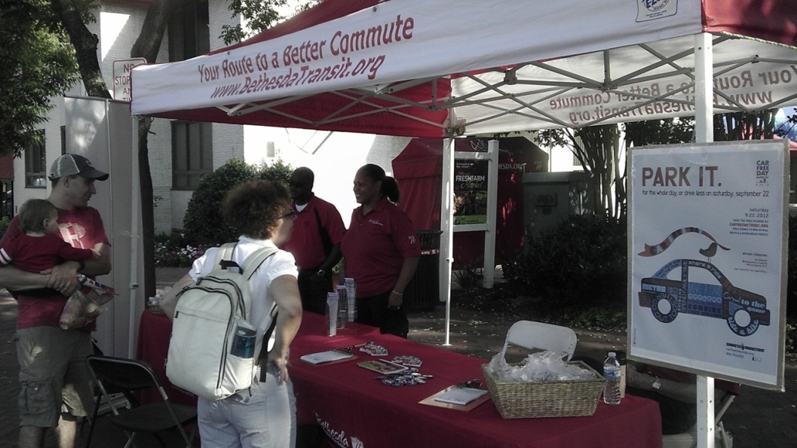
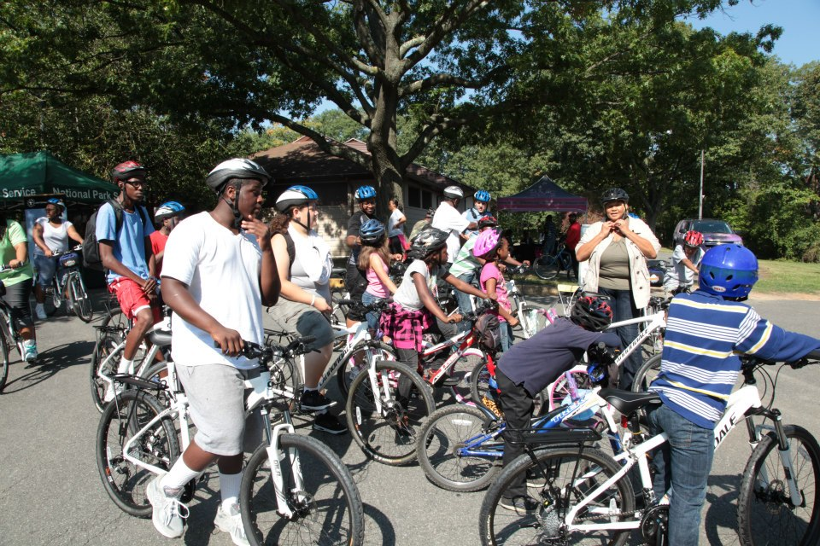
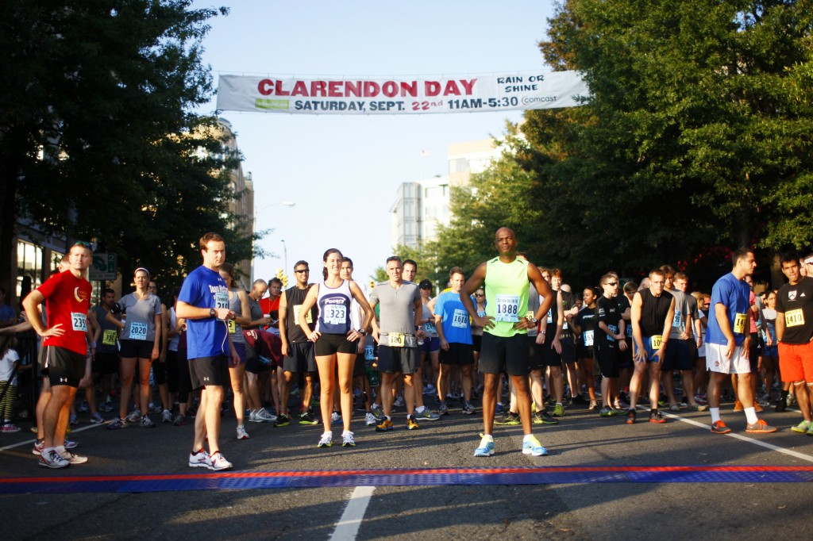
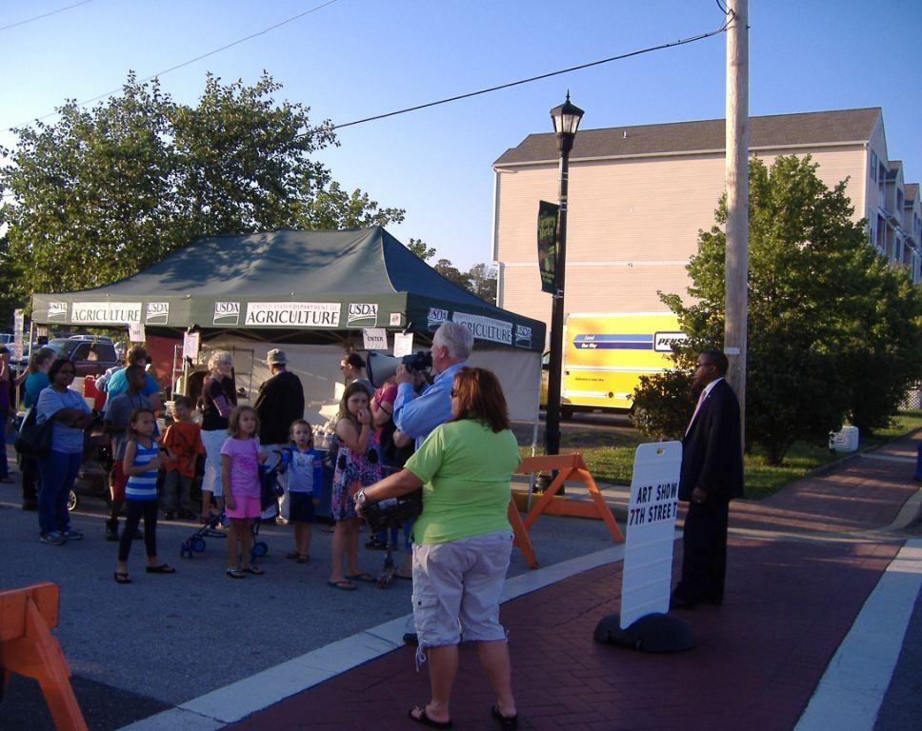
Local Events

Slide 16
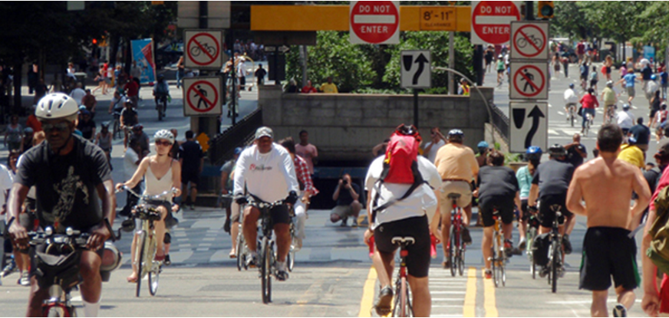
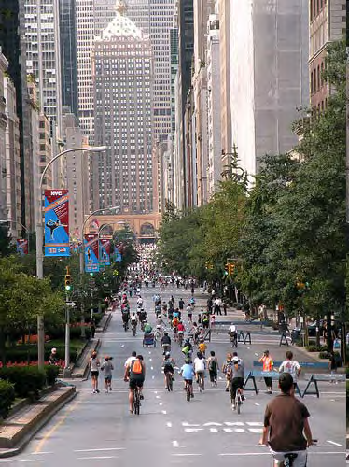
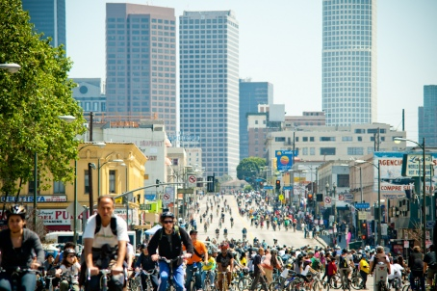
U.S. Street Closures

Slide 17
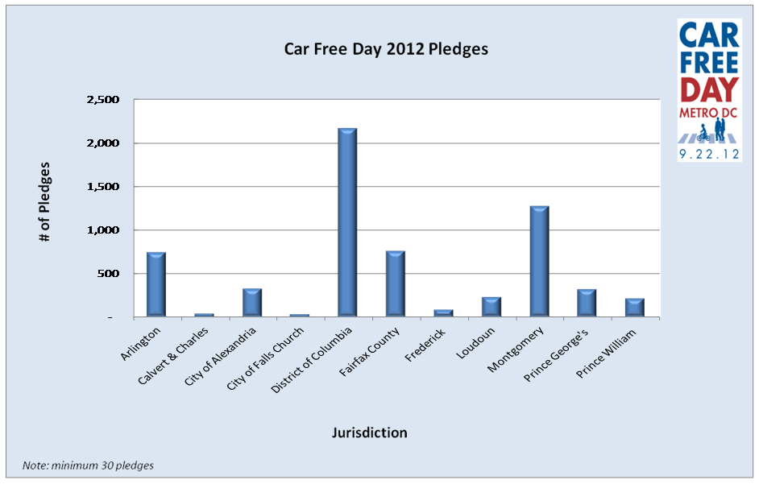
Pledges by Jurisdiction

Slide 18
2012 Pledges by Transportation Mode

Slide 19
2012 Call To Action
TPB Proclamation
Goal 10,000 participants
Pledges from TPB Members
Marketing/Media Outreach
Local Activities/Events
Pledge Data Analysis

Slide 20
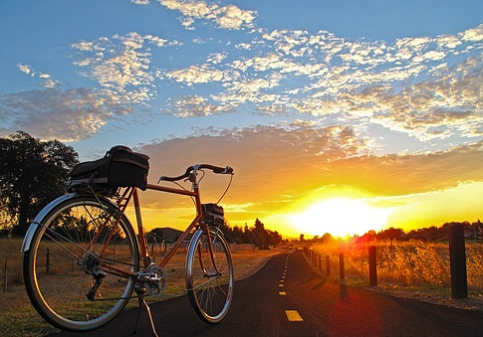
Questions
Nicholas Ramfos
nramfos@mwcog.org
(202) 962-3313

