Slide 1
Washington Metropolitan Area Transit Authority
Technologies and Programs that Encourage Metrobus Ridership
Transportation Planning Board
April 17, 2013

Slide 2
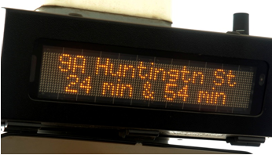
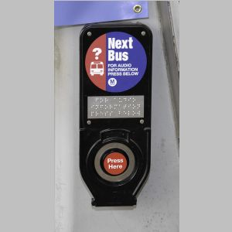
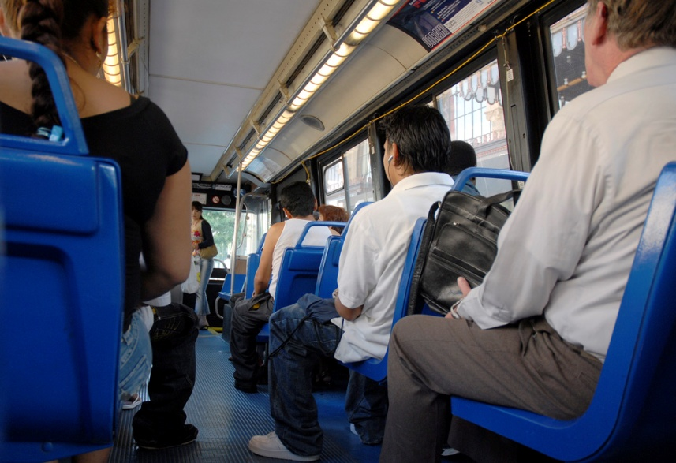
Metro Supports Bus Ridership by…
Using advanced technology to provide customer information & enhance bus operations
Conducting planning studies to evaluate and enhance bus service
Engaging public to assess and improve service quality
Notes:
This presentation is being given today in response to the request from the TPB for a general report on Next Bus and other technologies and efforts that Metro is undertaking to encourage bus ridership.
Metrobus carries between 10 and 12 million passengers a month, which equates to 435,000-450,000 per average weekday
Metrobus saw an increase in ridership of 6% from 2011 to 2102 and a 7.5% increase on routes where improvements were made.
We will talk about Nextbus on the next slide, but Metro continually is conducting planning studies in efforts to gather rider input and work with jurisdictions to improve services. Monday night I presented an update on planning efforts before the Bowie City Council . Staff holds over 100 public meetings a year in the planning process.

Slide 3
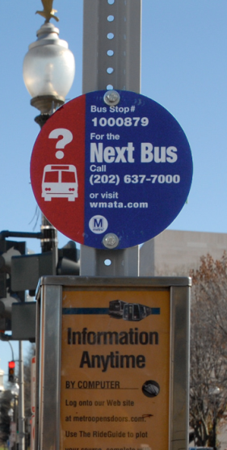
Customer Information System Technologies
Real-time bus arrival predictions
  Customer information server interfaced to CAD/AVL to receive bus schedule and adherence information
  Customers get bus arrival predictions through websites, text messages, voice calls, and smart phones
  NextBus receives more than 3M inquiries each month; 30% of trips
Notes:
WMATA has implemented a Transit Database that serves as the primary data interface between the various WMATA Intelligent Transportation Systems. The Transit Database contains all operational data (e.g. routes, schedules, operator assignments, etc) required by the CAD/AVL system. The CAD/AVL provides AVL and vehicle work assignment data to the Transit Database in support of the Customer Information System (CIS) that is operated under contract by NextBus. The CAD/AVL interface provides AVL data to the Transit Database which is then passed to the NextBus CIS to perform the bus arrival prediction function.
Nextbus was successfully launched in July 2009 on all 315 routes. Currently, 85% of the fleet is capable of tracking with a 2-minute polling interval.
Recent Next Bus issue in the media
Recent media reports created confusion among some customers regarding a third-party smart phone application ("app") that some customers used regularly to view NextBus prediction data. Some coverage may have led readers to assume that all NextBus information had become unavailable. In fact, the "NextBus DC" app mentioned in media reports is only one of many of third-party providers of real-time WMATA bus information. As WMATA noted in their public response, the NextBus DC app was not officially supported by WMATA, and WMATA was not a party to the private arrangement between the developer and NextBus Inc. (The "NextBus DC" app is not affiliated with NextBus, Inc., which provides WMATA's real-time prediction services. Rather, "NextBus DC" is a third-party developer who had a special arrangement, directly with NextBus Inc., to use a non-standard method of obtaining bus predictions.)
WMATA encourages customers to use other sources for NextBus data--either those provided by third parties as well as by WMATA--all of which remained operational and available to the public via smartphone apps or the web.
Nextbus receives more than 3 M inquiries per month

Slide 4
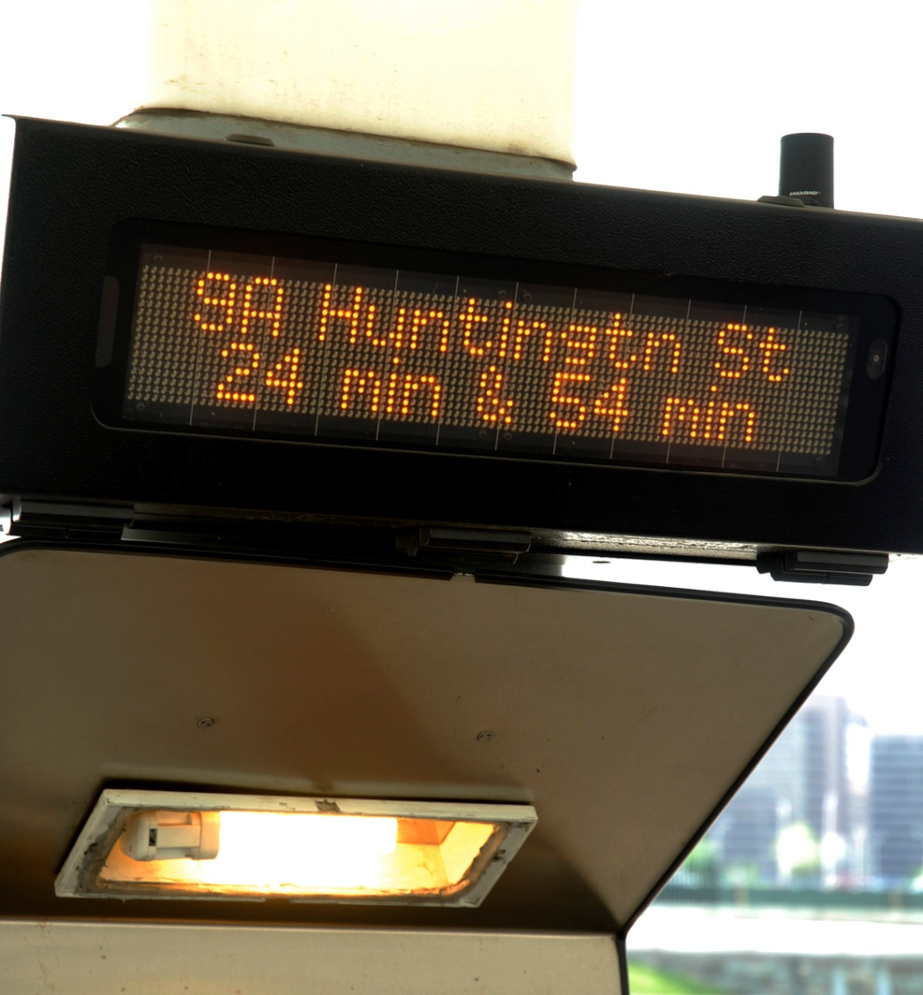
Customer Information System Technologies
Customer Information System Signage
  50 signs distributed throughout the operational area displaying bus arrival information
  Plans to install hundreds of LCD and LED signs at bus shelters and transit centers
Notes:
Customer Information System Signage
WMATA is in process of award of contract and is under final negotiation stage. It should be awarded by the end of April, 2013.
After initial design approval period of six months, the installation will begin – expected to be complete by the Fall. The installation locations are pre-selected for TIGER Grant as per grant application for WMATA and DDOT. Signs will be installed at on-street shelters as well as Metro-owned facilities.
Current sign locations include: Pentagon and Rosslyn

Slide 5
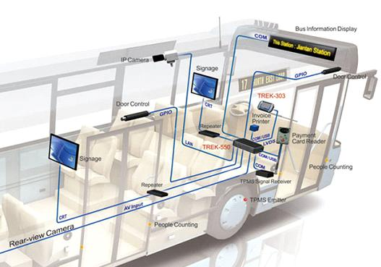
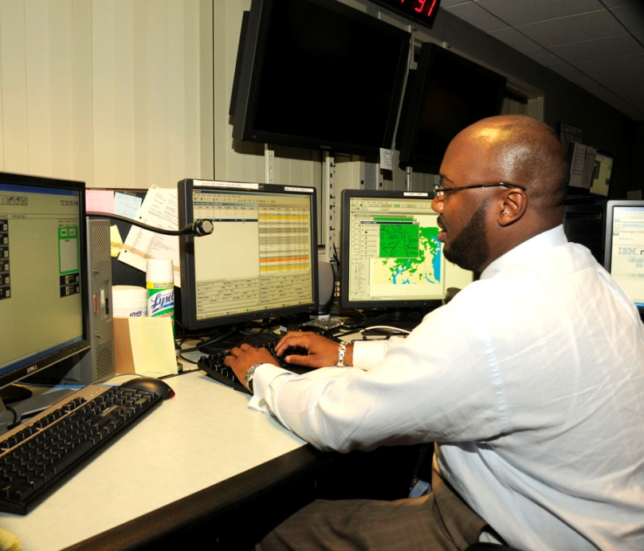
On-Board & Back-End Technologies that Support Metrobus Operations
In process of implementing Consolidated Ancillary Bus Equipment and Fixed-end Systems project
  Replaces on-board technologies and back-end CAD/AVL system in the bus operations control center
Back-End
On-Board
AVL- incident & on-time performance monitoring
  Next stop and public service annunciation, destination signs, AVL, automatic passenger counters, vehicle health monitors
Notes:
New Consolidated Ancillary Bus Equipment and Fixed-end Systems project
Currently, the WMATA fleet has several on-board systems which are capable of providing equivalent functionality. However, they were purchased from and managed by different vendors over the past 10 years. This has resulted in system integration issues between vendors and made technology upgrades costly.
WMATA is in the process of implementing a consolidated system from a single contractor which will encompass all of the current functionality under the Consolidated Ancillary Bus Equipment and Fixed-end Systems project. This system will also transition to the use of cellular communications for data communications between fixed-end and vehicle systems (away from 490MHz trunked radio system).
Functionality from a single contractor reducing integration issues and costs of technology upgrades
This has been a 3 year project; design is complete; completed successful testing on 40 buses; installation on the remainder of the fleet began the week of April 8th and the project should be completed by the Fall
From the customers perspective
This new technology will allow for 100% Next Bus prediction; Increased polling time (every 30 seconds) will enable the predictions to be more accurate

Slide 6
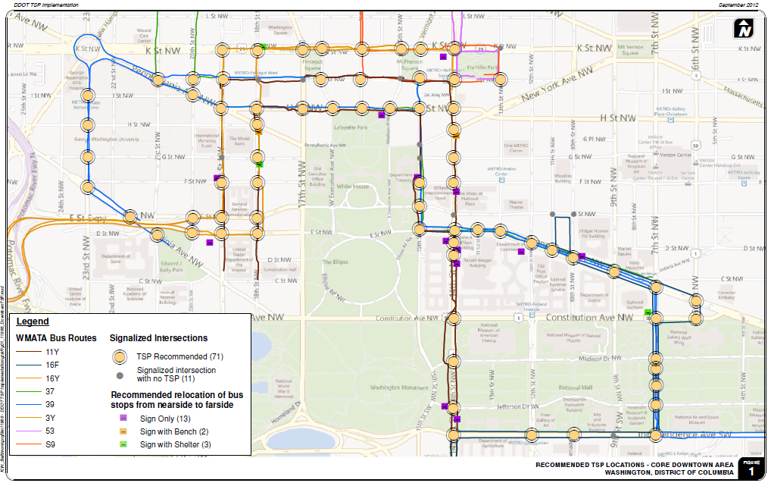
Improved Operations with Metrobus System Technology
Currently operating transit signal priority technology on Georgia Avenue and Columbia Pike
New transit signal priority installation
  Funded by TIGER Grant
  VA Rt. 7 and up to six additional corridors
Recommended TSP locations in the Downtown core
Notes:
New Transit Signal Priority
Metro has been working with local transportation departments on new standards for TSP that will support implementation of bus priority in many corridors.
The technical specifications were released to jurisdictions on April 12th and design specifications will be completed and distributed by May 15th.
WMATA’s TSP installation is a portion of a TIGER Grant awarded to the National Capital Region. In addition to the VA Route 7 corridor, up to six additional corridors within the region are identified for TSP implementation consisting of up to 80 additional signalized intersections and are within various jurisdictions in the Washington DC area.

Slide 7
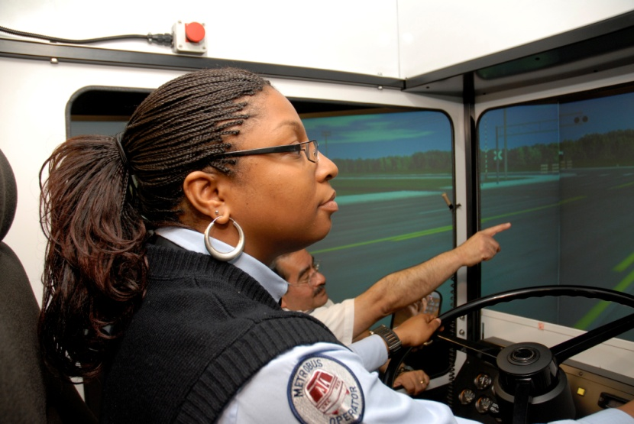
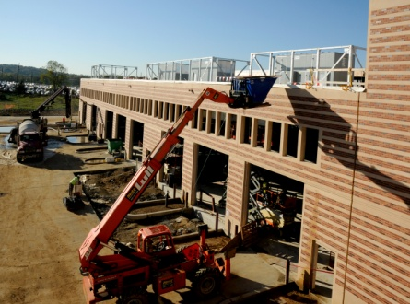
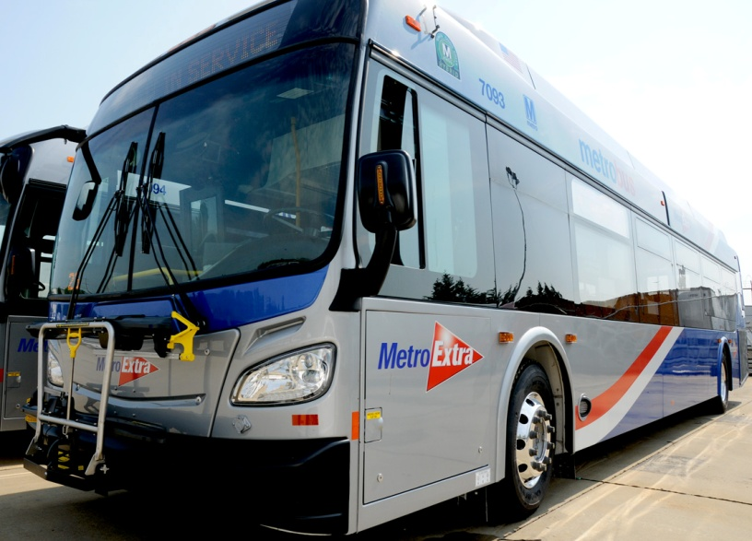
Additional Efforts that Encourage Metrobus Ridership
Bus driver training
On-board cameras
On-time performance
New Shepherd Parkway facility
Expanded service
Limited stop service
User surveys
New bus maps
Notes:
Improved Operations, Safety, and comfort
Customer service training for operators to improve communications with customers and assistance in avoiding confrontations is well under way with 46% of our operators having completed the training over the past 4 months. This program has been requested by local systems and others as it is proving to be very well received
CCTV cameras in all buses by July (currently short 30)
Improved Facilities
Recent opening of Shepherd Parkway Metrobus facility; Metro’s first new bus facility since 1989. The Shepherd Parkway facility consists of a maintenance and administration building, maintenance bays for repairs, inspections and servicing, bus wash, fueling station, and parking and storage for up to 250 buses.
Plans to replace Royal Street
Improved On-Time Performance
OTP has been improving and is currently ~78%
Improved Service Quality
$4M invested this fiscal year to improve running times, reduce congestion on routes throughout the system. Limited stop services have been added to the K9 in MD and the A9 in the District.
Improved Customer Interaction
Metro has recently conducted extensive outreach for the Board’s strategic planning effort:
Four in-person Momentum forums held (120 people)
Online crowd-sourcing tool (MindMixer) has received 13,700 visits, 8,500 from different users
Online survey was sent to bus and rail riders with 3000 responses received; Survey was also conducted at various regional bus-stops
The Washington Post and Metro conducted an on-the-record forum with 150 attendees, reaching 1,200 online viewers and 1.5M daily readers
To encourage widespread input, Metro launched a “Big Idea” advertising campaign which appeared in 17 local media outlets

Slide 8
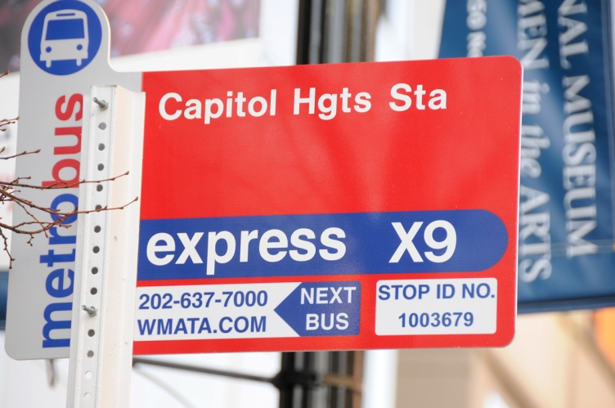
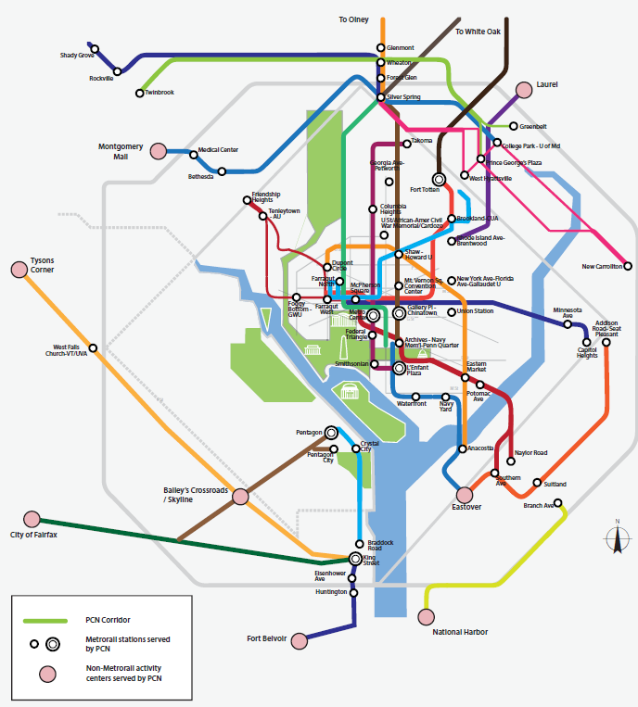
Metrobus Planning, Development, and Implementation
Regional Bus Study
Priority Corridor Network
  Crystal City/Potomac Yard Transit Improvement Project
Bus Priority Studies
  - H&I Streets Bus Lane Study
  - Service Evaluation Studies
Notes:
Regional Bus Study
Plan completed in 2003 by WMATA in cooperation with jurisdictions in the service area. The plan addresses both short and long term requirements for regional and non-regional bus service.
Priority Corridor Network
Metro developed the PCN, a set of strategies to improve bus service along 24 corridors which transport over 50% of Metrobus’ ridership. Priority treatments consist of both service adjustments as well as improvements to the runningway. Service adjustments proposed include: restructured routes and schedules, skip-stop operations and additional service overlays. Runningway improvements could include bus lanes, transit signal priority, queue jumpers, bus stop location, and off-board fare payment systems.
Planning studies have been completed or are underway on 17 of the 24 corridors. Service improvements have been implemented on over half, and Metro has introduced new limited-stop Metro Extra service in five of those corridors. Improvements have been made to bus stops, signs, maps, and customer information displays.
Crystal City/Potomac Yard Transit Improvement Project
The goal of the project is to provide high-capacity and high-quality transit service to residents, businesses and visitors in this fast developing corridor, particularly in Potomac Yard and Crystal City where major redevelopment efforts have been undertaken by the County and the City. Planned transit improvements in the CCPY corridor include bus-only transitway, station stops, frequent bus service, and passenger amenities.
Recent Branding Study
H&I Streets Bus Lane Study
The purpose of the study is to assess transit operability and traffic impacts on H and I Streets in order to develop alternatives for the H/I Bus Lane, a project in the region’s Constrained Long Rang Plan in collaboration with DDOT.
H and I Streets are highly congested, severely affecting bus operations - 26 Metrobus routes and eight commuter bus routes. Buses carry 40% of person throughput at 5% of vehicle traffic in the peak hour, and travel at 40-50% of vehicular speed. Bus-only lanes would increase their speed and reliability.
Service Evaluations
Monitor crowding and on-time performance

Slide 9
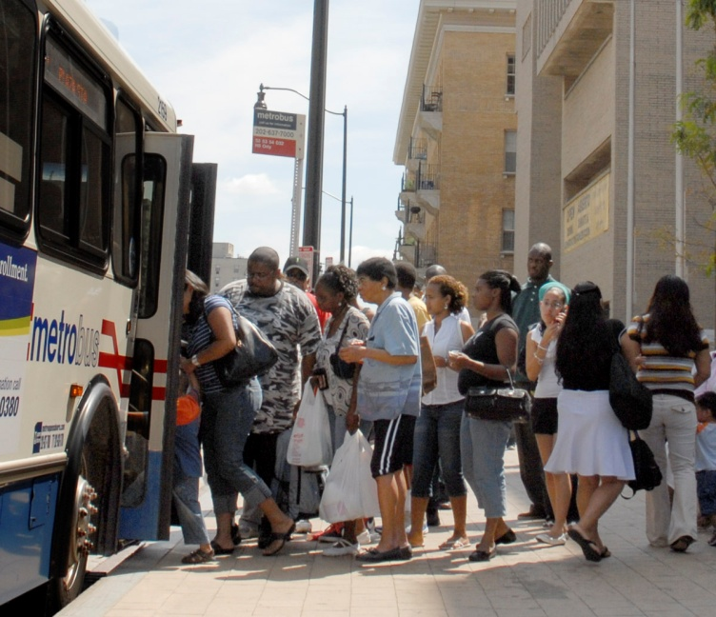
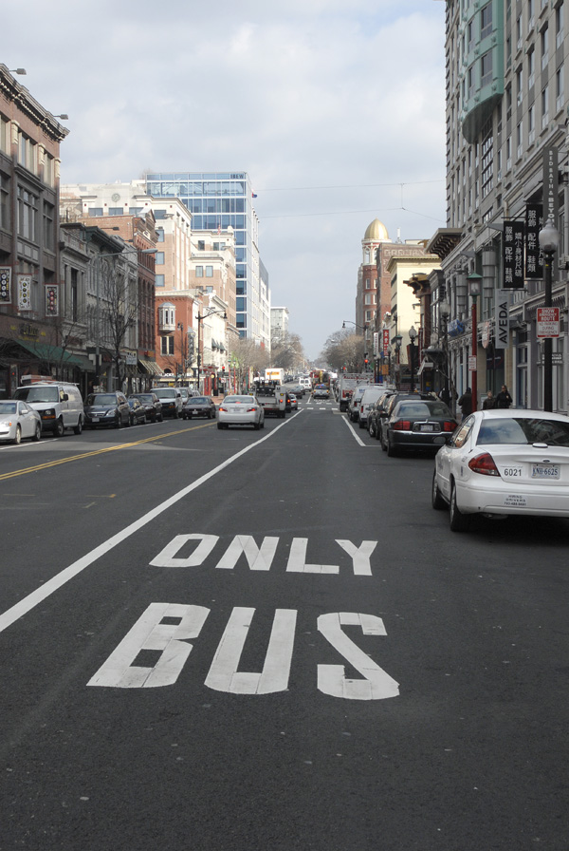
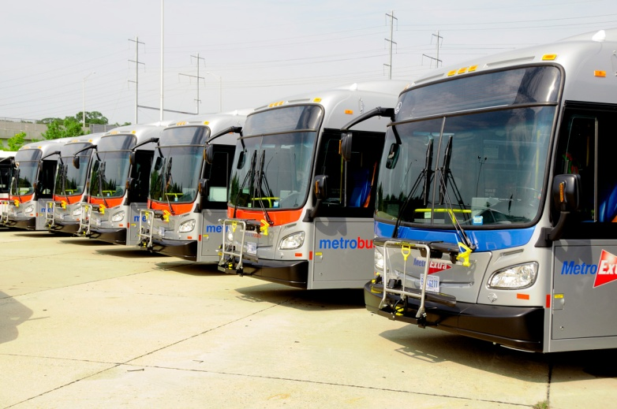
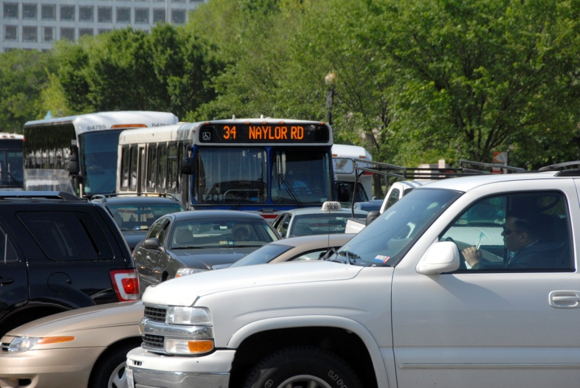
Challenges
Traffic congestion/reliability
Increased dwell times
Funding fleet expansion
Right-of-Way issues
Meeting demand
Notes:
Traffic congestion/reliability
Traffic congestion severely slows the movement of buses throughout the region, and in turn, reduces the reliability and on-time performance of bus operations.
Washington Metropolitan area rated #1 in US for worst traffic congestion
Funding fleet expansion
Metro will need to add buses to reduce customer wait times and crowding, but fleet and bus garage capacity is constrained.
Significant costs needed for garage space to house and maintain the estimated 172 new PCN buses needed to support the full PCN plan
Right-of-Way Issues
While the service adjustments component of the PCN implementation is entirely within the control of Metro, subject to the availability of funding regionally, nearly all runningway improvements require cooperation and coordination with the state and local departments of transportation who own and maintain the bus runningway and bus stop real estate.
Reserving street space exclusively for buses is often met with community resistance. Without a strong partner, the benefits of the PCN will not be fully realized.
Meeting Demand
Need new facilities where ridership is the greatest
Gap in fleet supply and demand continues to grow

Slide 10
Thank you for your attention…
Questions?

