Slide 1
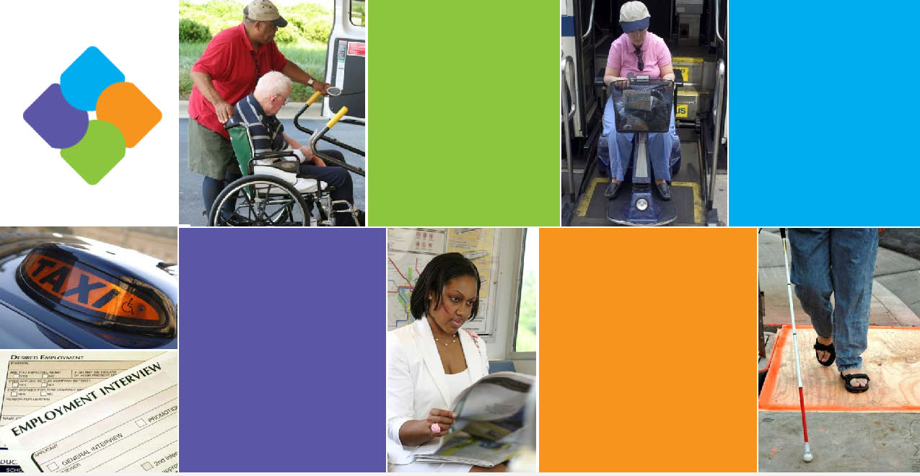
National Capital Region
Transportation Planning Board
NATIONAL CAPITAL REGION TRANSPORTATION PLANNING BOARD
Assessment of
JARC/New Freedom Programs
in the National Capital Region
Tasks 1 and 2
Presented by Connie Soper, Nelson\Nygaard Consulting Associates
October 14, 2011

Slide 2

Purpose of Presentation
Review assessment objectives, methodology and key findings
Next Steps
Comments from Task Force Members

Slide 3
Overview of Assessment

Slide 4
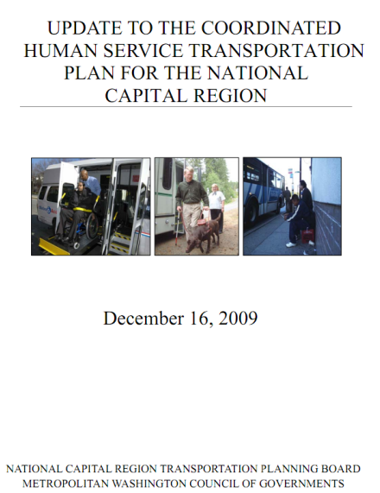
Overview of JARC and New Freedom Programs
Job Access and Reverse Commute (JARC) Program
  Grants offer job access services for persons with low income
New Freedom Program
  Grants to improve mobility for persons with disabilities
Program Details
  Administered by FTA
  Projects funded must be derived from Coordinated Plan
  Eligible activities include:
    Capital improvements
    Operations
    Mobility management
  Match required
    50% operating
    20% capital or mobility management

Slide 5
Purpose of Assessment
The Transportation Planning Board (TPB)
  Administers JARC and New Freedom Programs for Washington DC Urbanized Area
  Distributed more than $10 million combined federal and other sources to fund:
    35 grants funded between 2007-2010
    20 separate sponsors
This review intended to examine and assess:
  Program administration and oversight
  Effectiveness of projects in meeting mobility challenges for low-income and disabled persons
  Identify best practices locally and elsewhere

Slide 6
Assessment Methodology
Meetings and Interviews
  Interviews with key project stakeholders, including most project sponsors
  Attendance at pre-proposal conference
  Facilitation of two focus groups with program participants
  Meeting with Task Force members to discuss program challenges, benefits, observations, etc.
Review and Analysis
  Review of other relevant reports
  Analysis of available data reporting on project goals and outcomes
  Online survey of potential program sponsors who did not submit applications
  Peer Review

Slide 7
Administration of JARC and NEW Freedom (TPB’s Role)

Slide 8
TPB Program Administration and Oversight
With Task Force, prepares initial Coordinated Public Transit-Human Services Transportation Plan (JARC and New Freedom projects must be derived from Plan)
Serves as designated recipient for JARC and New Freedom funds
Passes funds through to local project sponsors (with exception of WMATA)
Task Force Chair facilitates project selection process
Staff receives quarterly reports and monitors projects
Serves as sponsor for:
  Wheelchair Accessible Taxi Project
  Regional Transportation Information Clearinghouse Project

Slide 9
Overview of funded grants 2007-2010

Slide 10
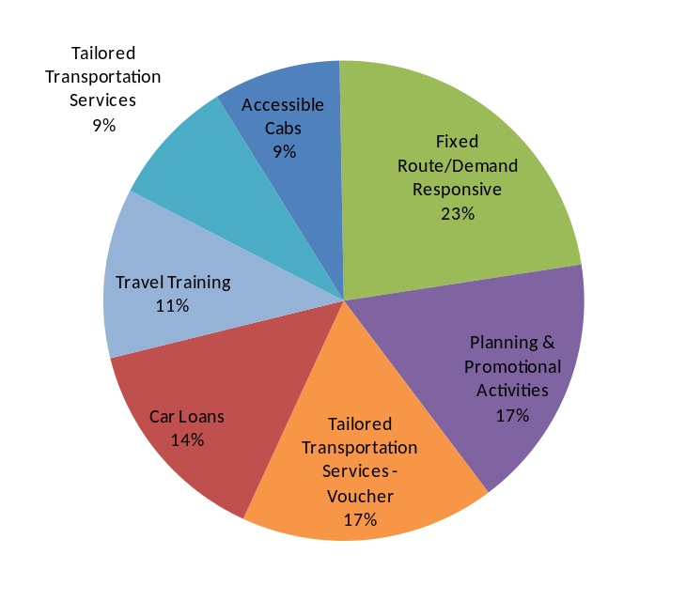
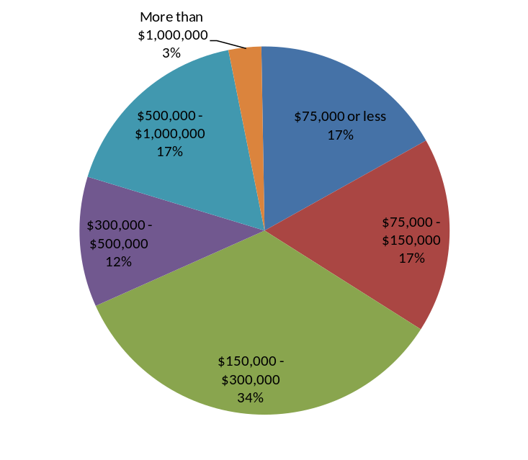
Characteristics of Grants Funded
Percentage of All Projects by Category
(Number of Grants)
Wide variety (7 categories) of grants funded
17% of the grants are completed. Another 25% are at least 50% completed (as determined by funding spent).
20% of the grants received over $500,000 while most were smaller in scale.
Grants by Funding Amount Category

Slide 11
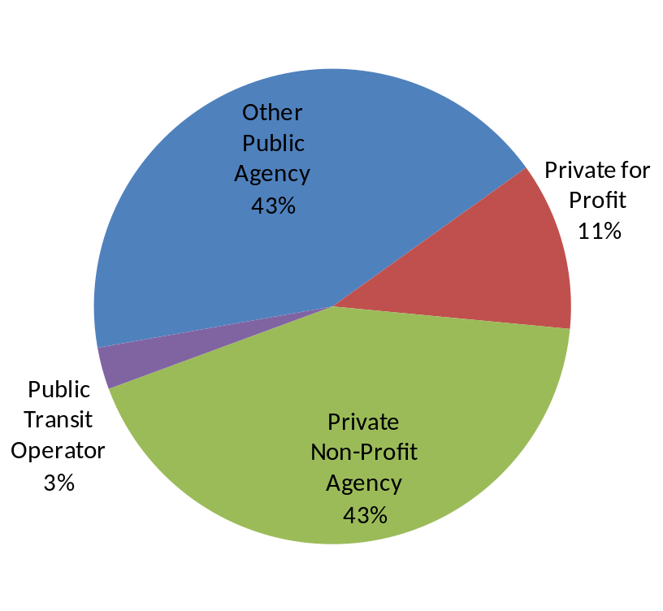
Key Findings: Sponsors
35 grants
20 sponsors
Eight sponsors received multiple grants
11 grants needed additional time beyond 2 years to spend federal grant
43% of sponsors are private non-profit agencies
43% are public agencies other than transit agencies
Three of the public agencies are County or DC Department of Transportation agencies
Grant Sponsor by Type

Slide 12
Peer Review and Key Findings: Administration of JARC and NEW Freedom (TPB’s Role)

Slide 13
Peer Systems
Atlanta Regional Commission (ARC)
Boston Region Metropolitan Planning Organization
Regional Transportation Authority (RTA-Chicago)
North Central Texas Council of Governments (NCTCOG-Dallas)
Delaware Valley Regional Planning Commission (DVRPC)
Metropolitan Council (Minneapolis)
Tri-County Metropolitan Transportation District of Oregon (TriMet-Portland)
Metropolitan Transportation Commission (MTC-San Francisco Bay Area)
Washington State Department of Transportation (WSDOT)

Slide 14
Key Findings: Program Administration and Oversight
Compared to its peers, the TPB:
  Takes a more proactive role in program administration.;
  Is one of only a few to undertake as assessment of this scope;
  Has been successful in obligating all of its JARC and New Freedom funds, unlike some of its peers;
  Funds a wider range of projects, and also has a wider variety of project sponsors;
  Is somewhat unusual in that it also serves as project sponsor (one other peer also does this)

Slide 15
Shared Challenges—Peer Programs
  FTA rules, regulations, and processes are difficult to understand
  Timelines can be cumbersome
  Identifying match is greatest challenge
  Small funding amounts make it difficult to attract a large pool of applicants

Slide 16
Other Findings
Current reporting mechanisms don’t capture qualitative benefits
There are no consequences for those sponsors who are not meeting original objectives stated in the grant application
About half of priority projects established by the Task Force have been funded, but 80% of resources are dedicated to these projects
No widespread changes or revisions in TPB administrative and oversight process are called for

Slide 17
Key Findings: GRANTS FUNDED (2007 to 2010)

Slide 18
Observations: Grants funded (2007-2010)
Services are pilot projects, untested, and not traditional
Many are labor intensive and not meant to be “efficient”
Need to consider both qualitative and quantitative measures
Comparing one project to another =“apples to oranges”
Grant data on costs and trips provided lacking or not consistently reported
Projects are considered “pilot projects” or intended to test new service delivery mechanisms--learning curve is higher.

Slide 19
Key Findings: Grants Funded (2007-2010)
Most grants’ actual outcomes did not meet original expectations as stated in the application
Most grants met challenges with implementation and 11 were not able to complete the project within the 2 year timeframe
Sponsors consider projects are successful because they improve mobility for low-income persons and for persons with disabilities
Out of those grants completed, none have found other funds to sustain them

Slide 20
Key Findings: Grants Funded (2007-2010)
The level of effort and learning curve to administer and oversee projects diminishes over time
Building evaluation into the project may help assess performance
  WMATA included an element intended to evaluate and document project outcomes. An independent research firm assesses the quantitative aspects of its travel training program
  The DC Accessible Taxi Pilot project requires on-going reporting on the number of wheelchair trips provided

Slide 21
Key Findings: Grants Funded (2007-2010)
Advance planning can help refine project goals and objectives
  Prince William County Area Agency on Aging, through a mobility management grant, conducted a comprehensive plan to evaluate mobility options for its clientele .
No widespread changes in how grants are administered, but changes to reporting of grant outcomes will be explored

Slide 22
Comments/Next steps

Slide 23


Next Steps
Receive comments from Task Force Members
Develop and review program recommendations with Task Force in November
Final Report presented to Tech Committee and TPB in January or February

Slide 24
Questions for Task Force
What do you think is the most significant finding that should inform the next step of developing recommendations?
What is the most significant issue that you as a grantee has faced that may have created delays in implementing projects?
Are there population groups or geographic areas that have not been served by the program to date?

