Slide 1
The 5TH Annual NCR
Interagency Chaplain Conference
May 25, 2011
Not Quickly Broken
(Ecclesiastes 4:12)
“Post Traumatic Stress Mitigation and Alleviation –
Movements in Theory and Practice”

Slide 2
Presented by
JFHQ-NCR/MDW
In Collaboration with the
Metropolitan Washington Council of Governments’ Public Safety Chaplains Subcommittee
Ft. McNair Baruch Auditorium
Industrial College of the Armed Forces (ICAF)
Washington, DC
Opening Prayer
Chaplain (COL) Steven Berry, Command Chaplain, JFHQ-NCR/MDW
Welcome
MG Karl R. Horst, Commanding General, JFHQ-NCR/MDW
Closing Remarks & Prayer:
Rev. Brian Wells, Co-Chair, MWCOG Public Safety Chaplains Subcommittee

Slide 3
Conference Panelists & Participants
Major General Karl Horst, Commander,
    U.S. Army Military District of Washington and JFHQ Region
Dr. William Nash, Editor:
    “Combat Stress Injury: Theory, Research, and Management.”
    “Stress First Aid: Tools to Preserve Life, Prevent Further Harm, and Promote Recovery”
Dr. Jonathan Shay, Author:
    “Achilles In Vietnam” and “Odysseus in America.”
    “Moral Injury”
Dr. Charles Hoge, Author:
    “Once a Warrior Always a Warrior: Navigating the Transition from combat to Home.”
    “Mitigating the psychological impact of war: An occupational and physiological perspective.”

Slide 4
Lunch Venue
Ft. McNair Officers Club – Bldg. # 60
Lunch Provided by
JFHQ
Lunchtime Music Provided by
U.S. Army Military Band

Slide 5
Afternoon Panel Discussions Included:
MAJ Randall Bowen, Senior Chaplain, DeWitt Hospital, Ft. Belvoir
CDR David Oravec, Deputy Command Chaplain, National Naval Medical Center
CDR Kim Donahue, National Intrepid Center of Excellence
CDR Gordon Ritchie, USMC Wounded Warrior Regiment Chaplain

Slide 6
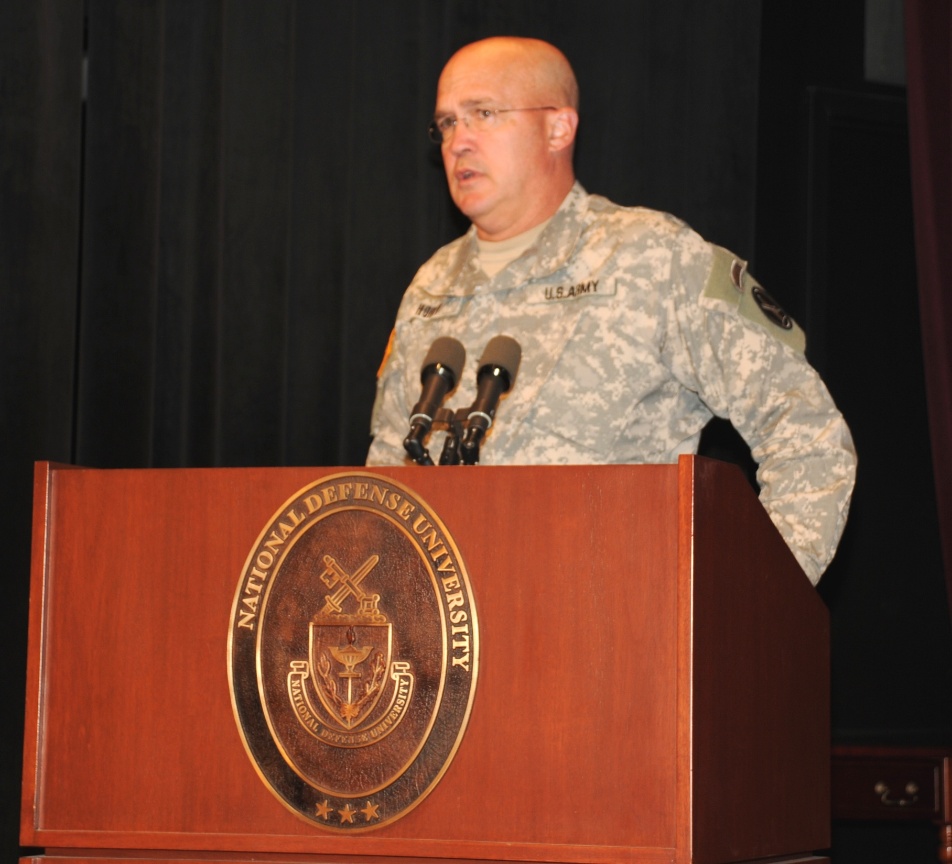

Slide 7
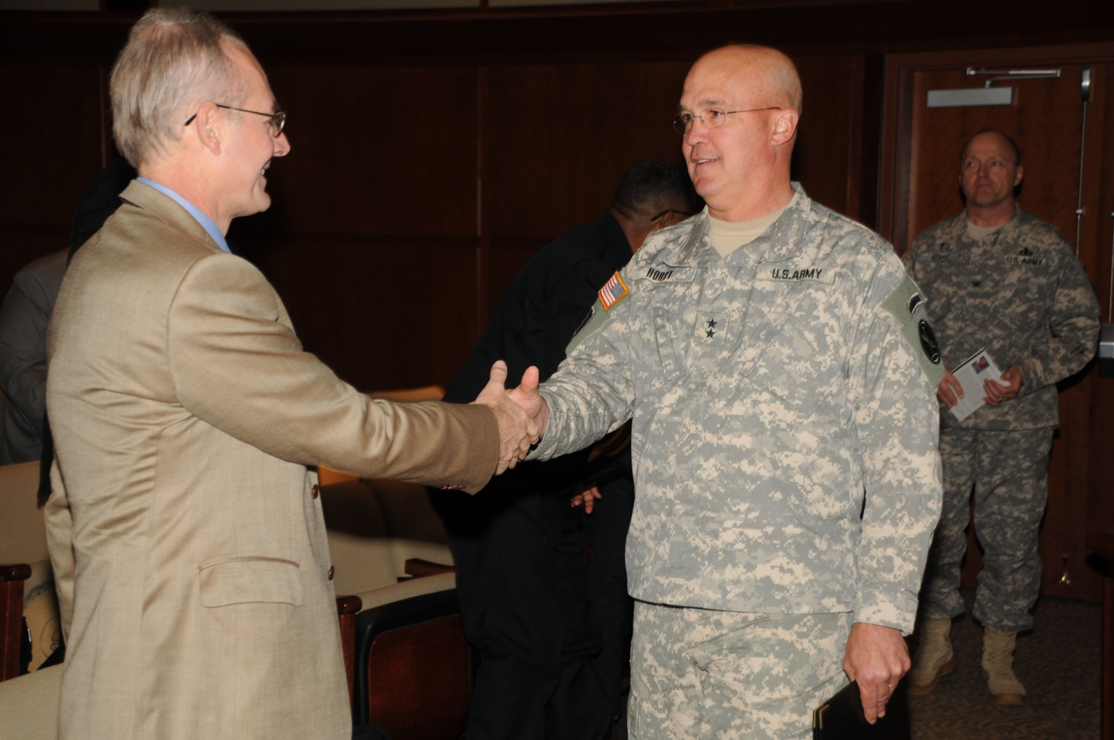

Slide 8
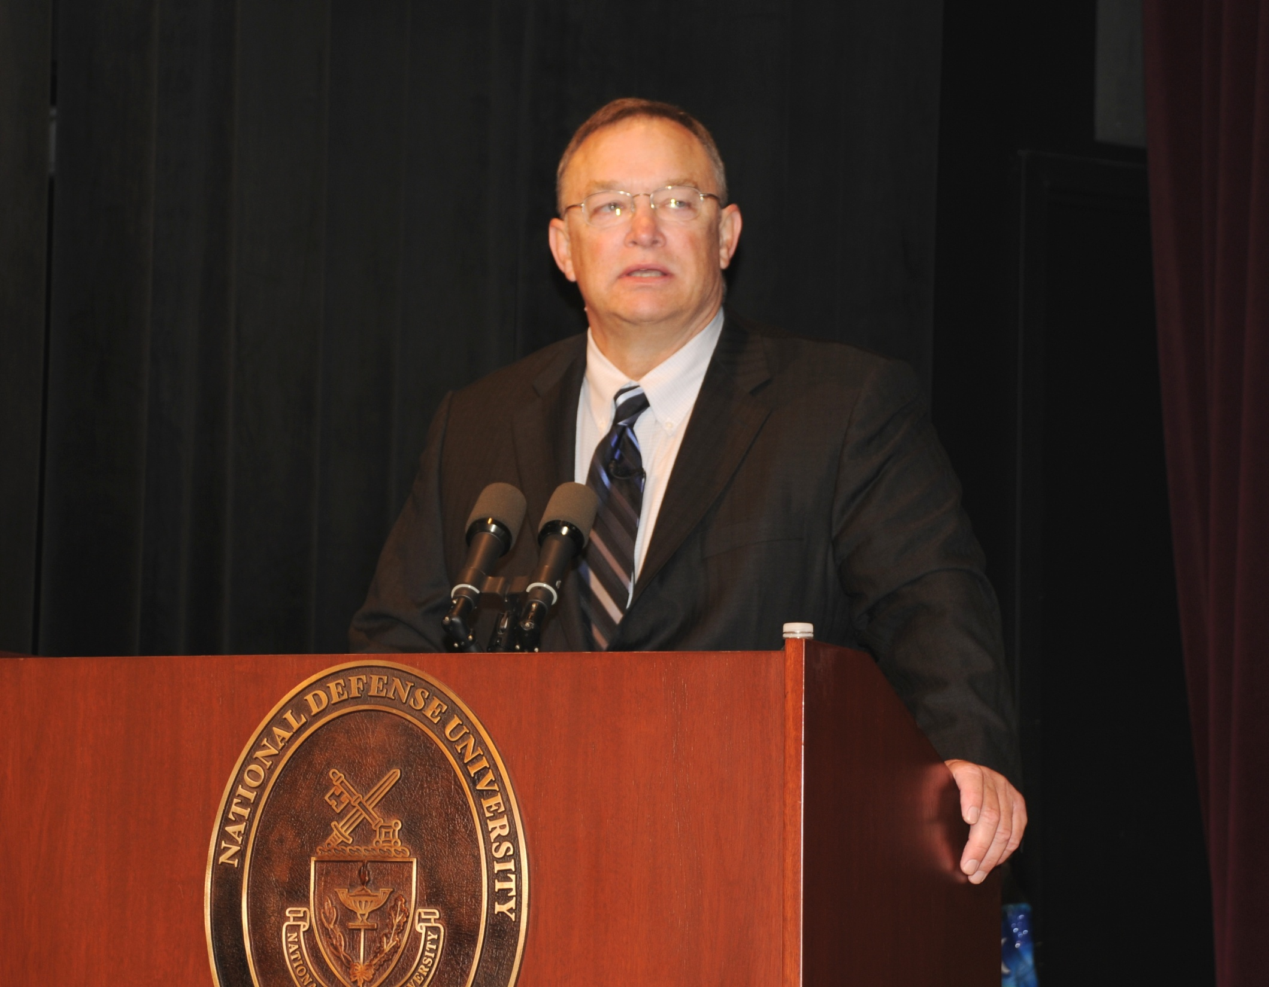

Slide 9
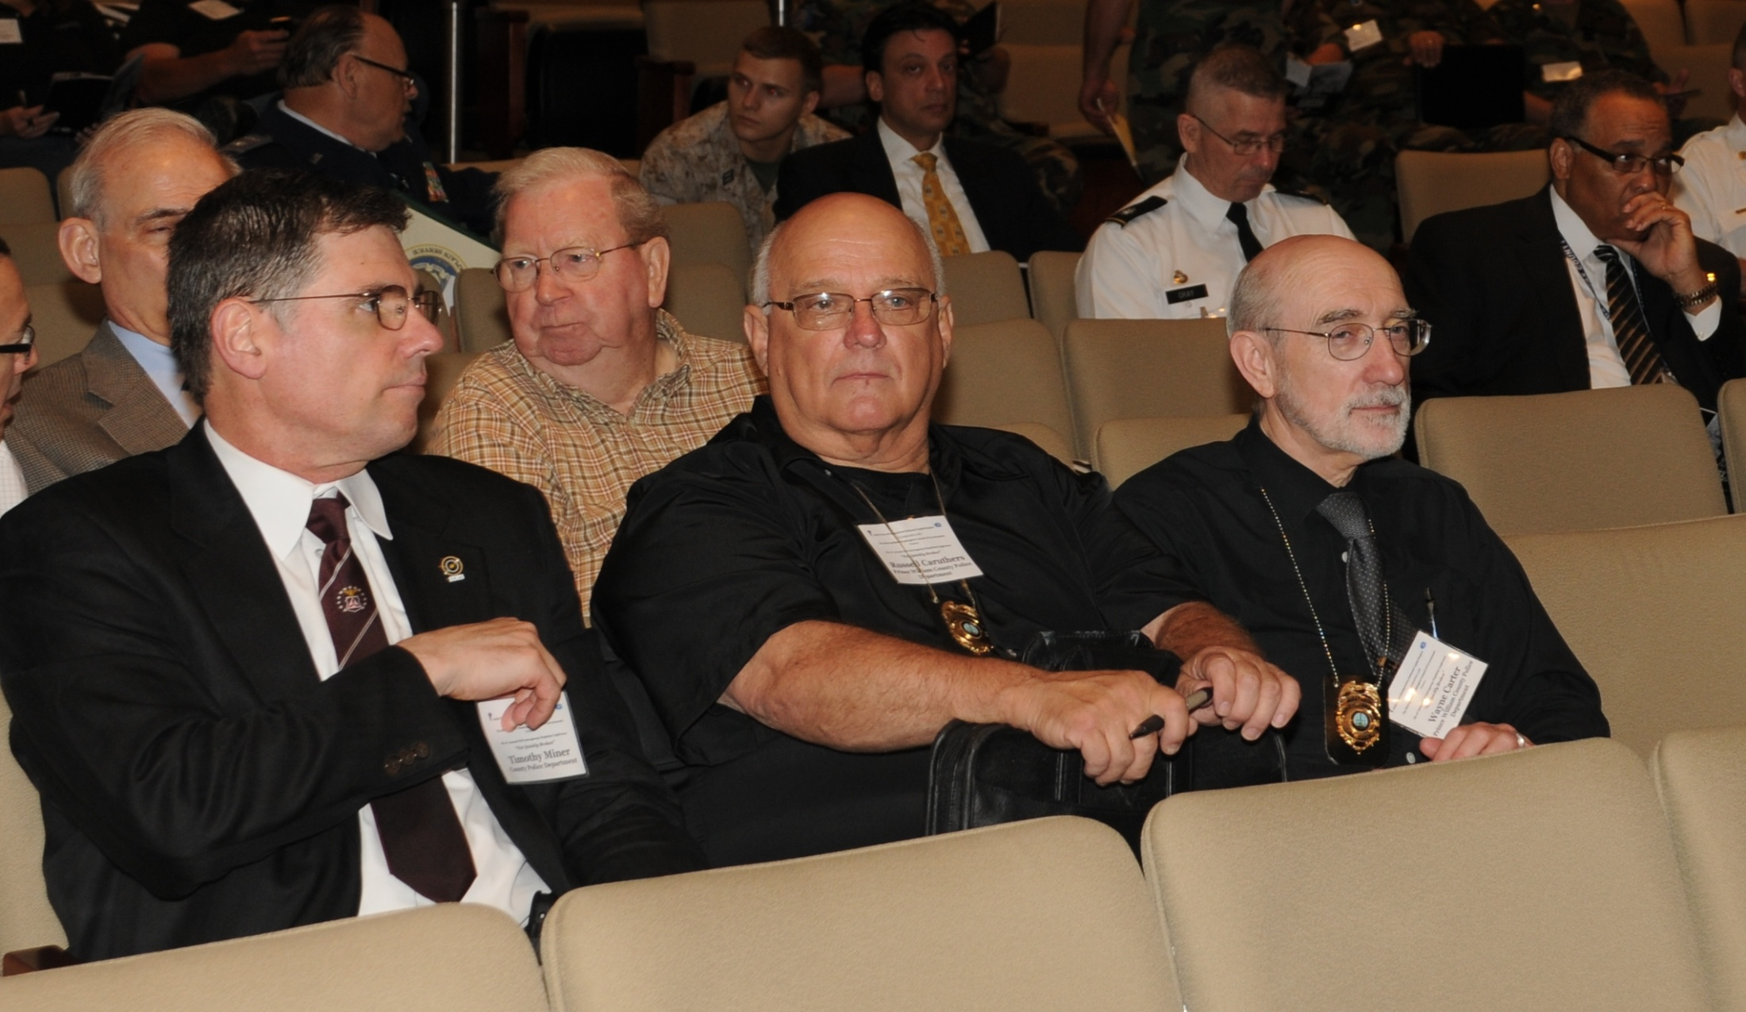

Slide 10
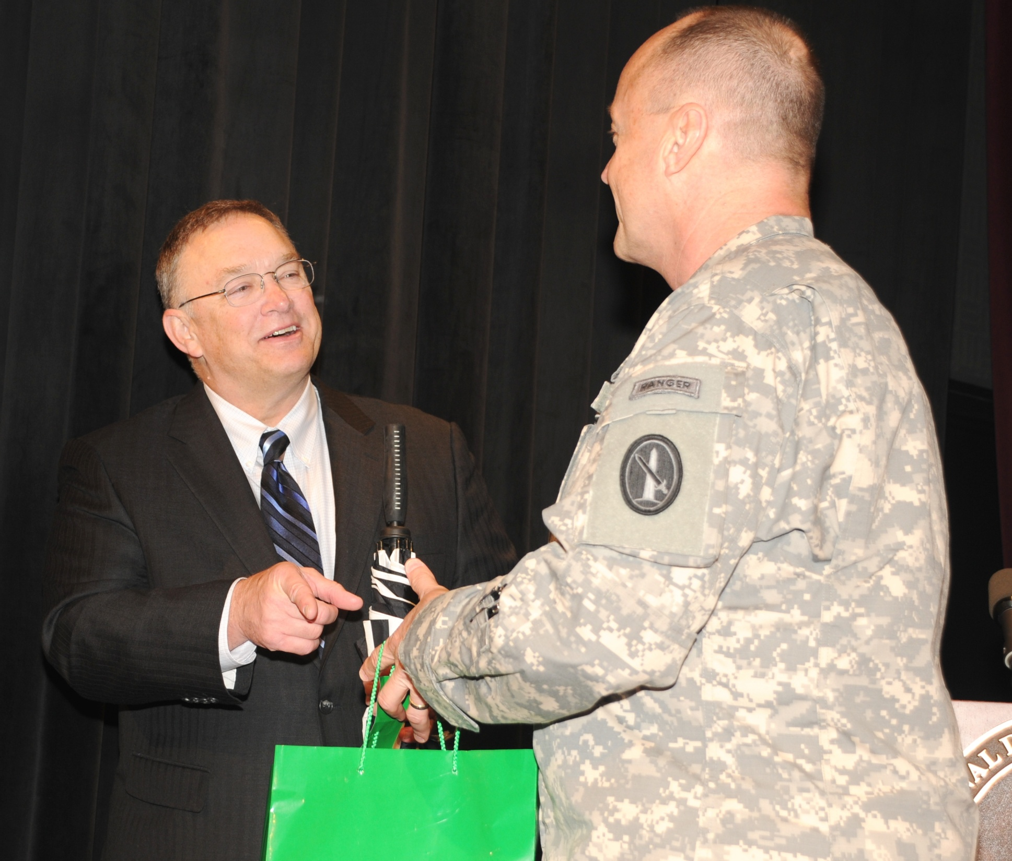

Slide 11
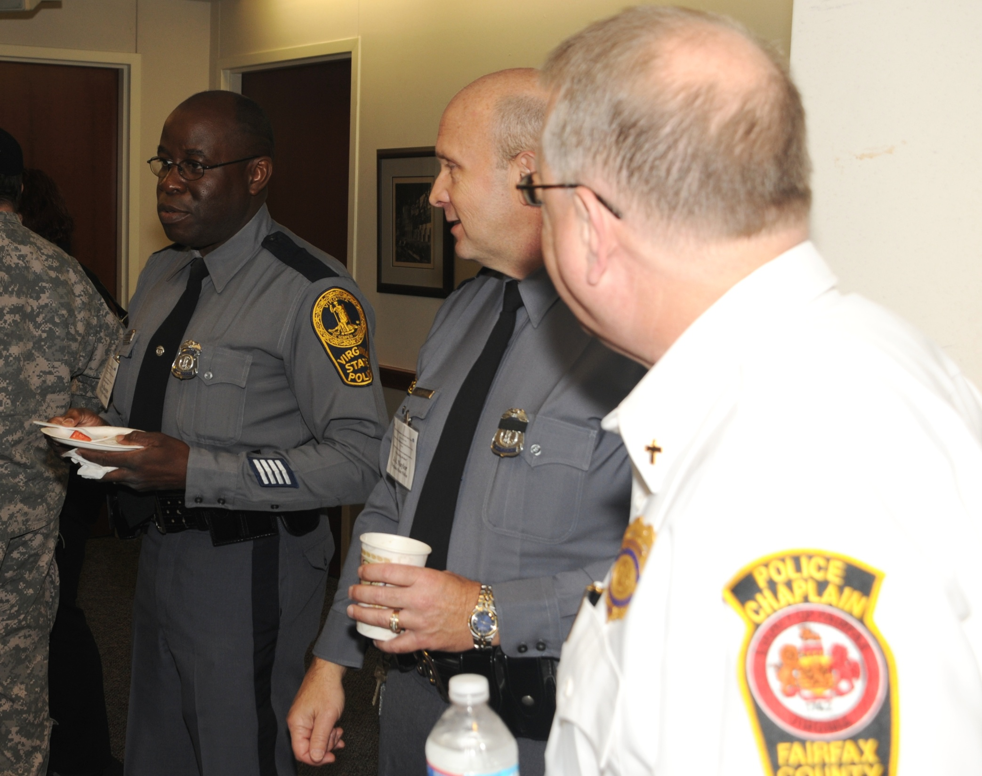

Slide 12
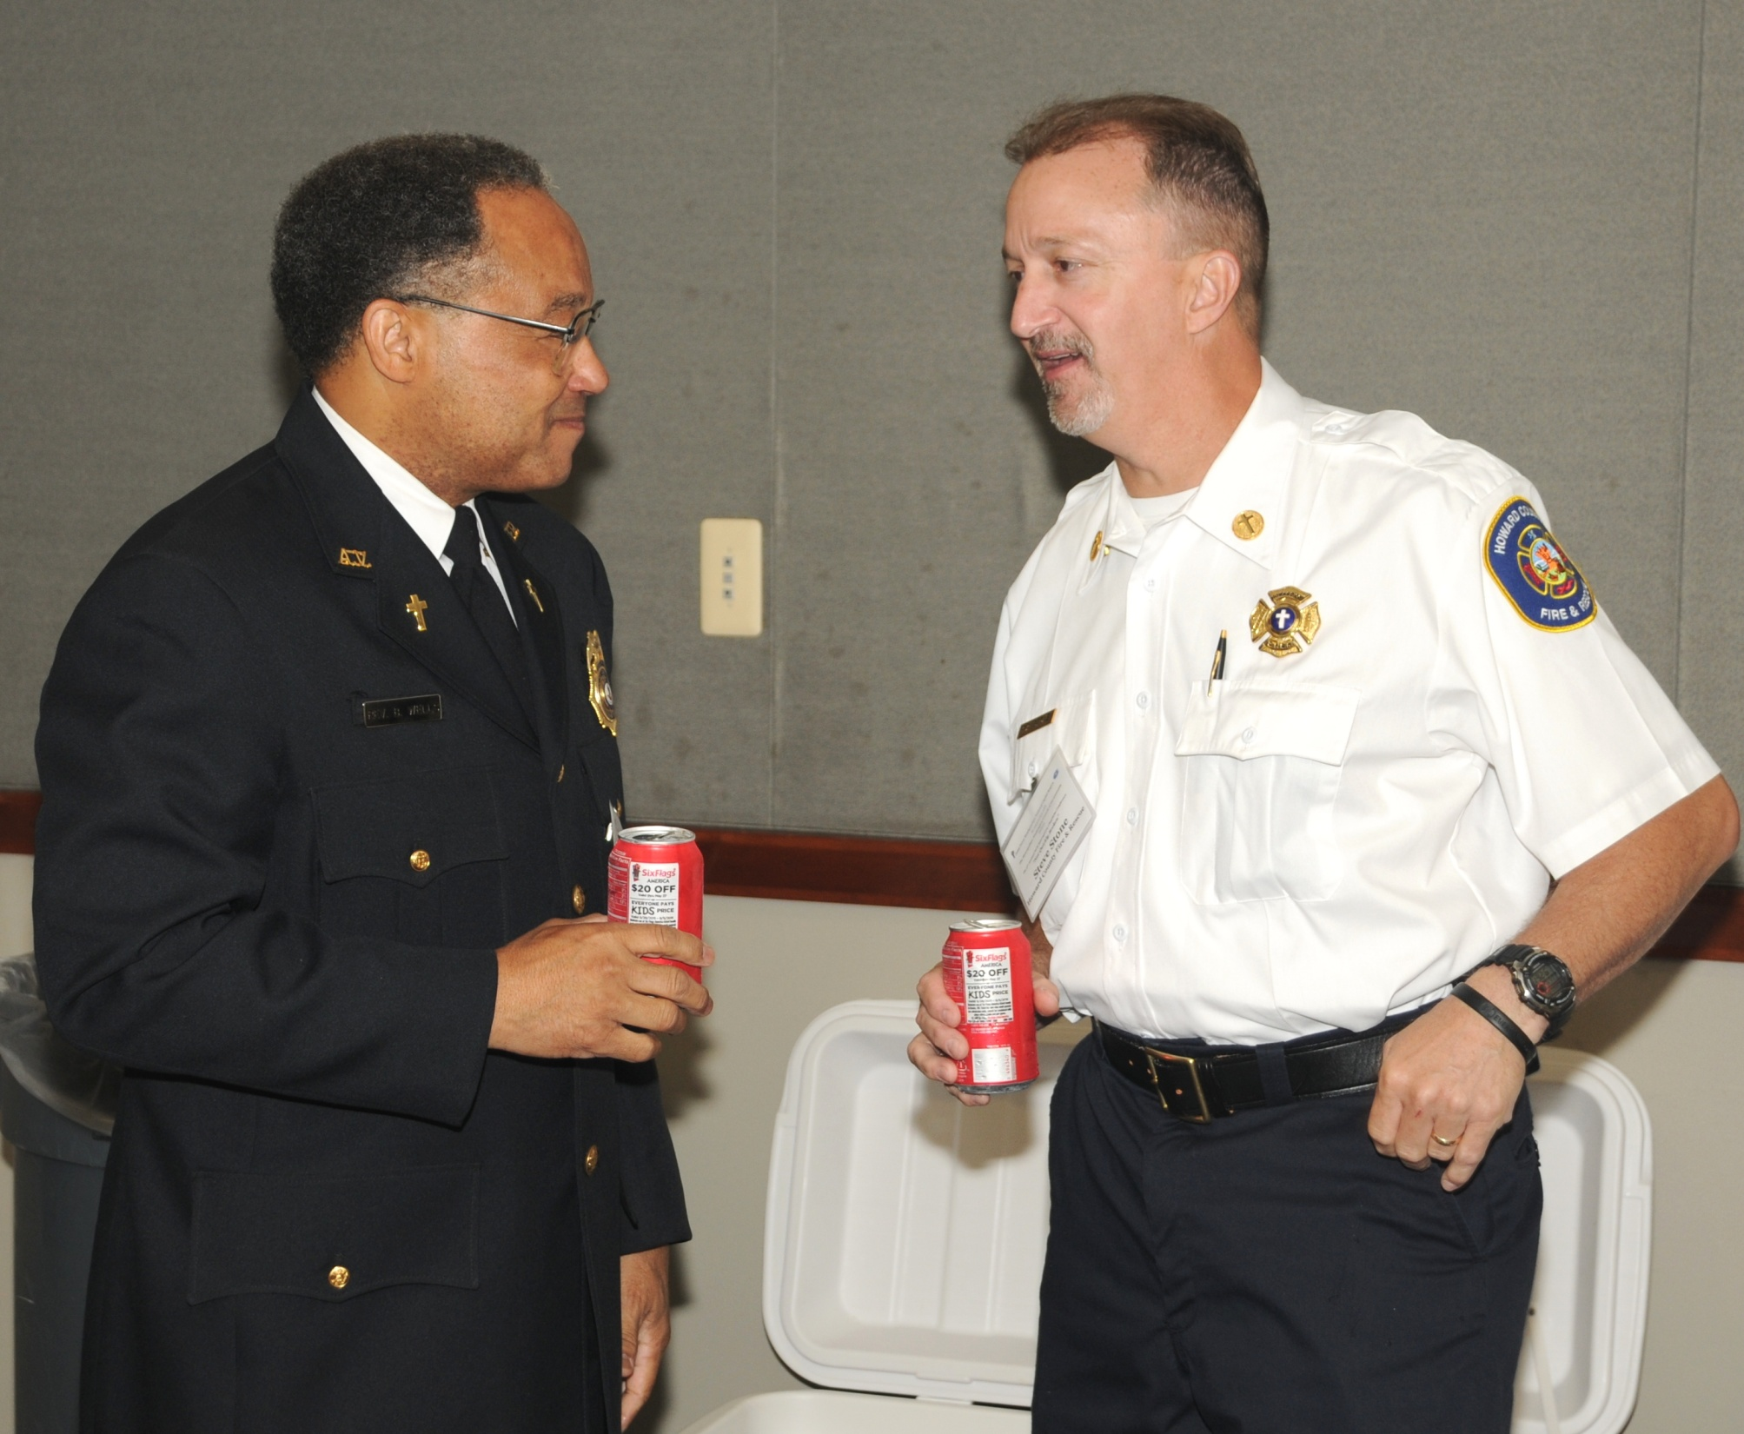

Slide 13
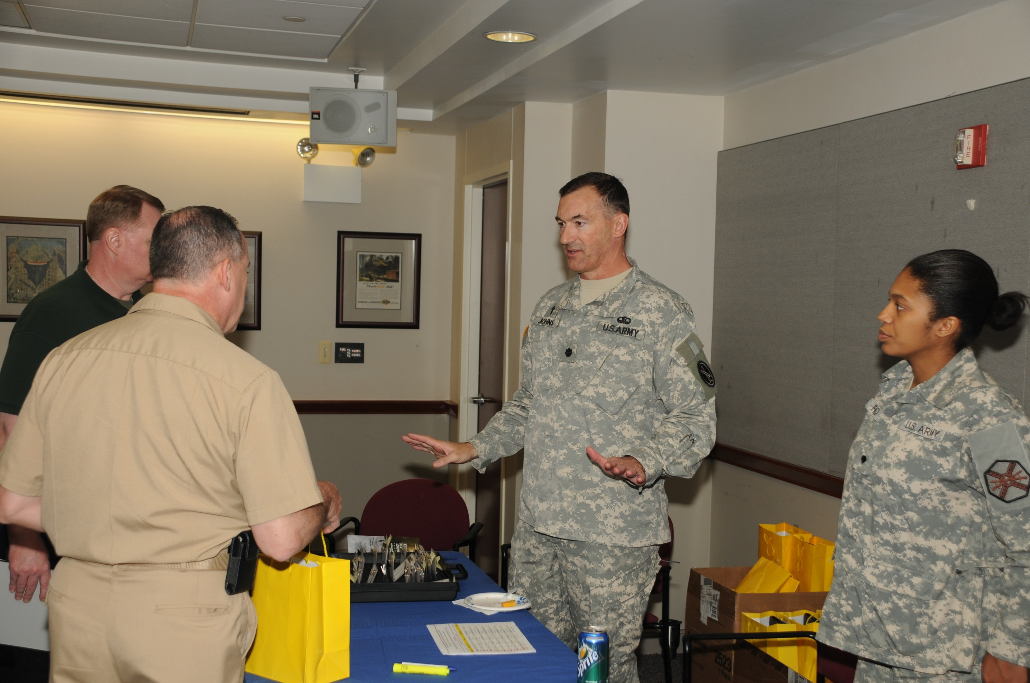

Slide 14
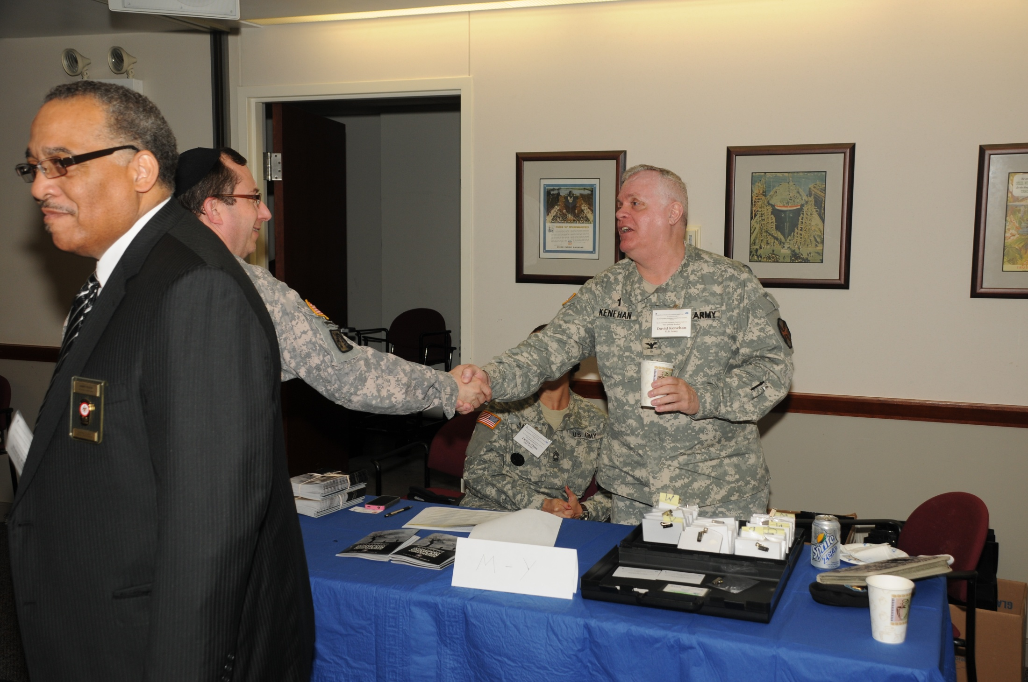

Slide 15
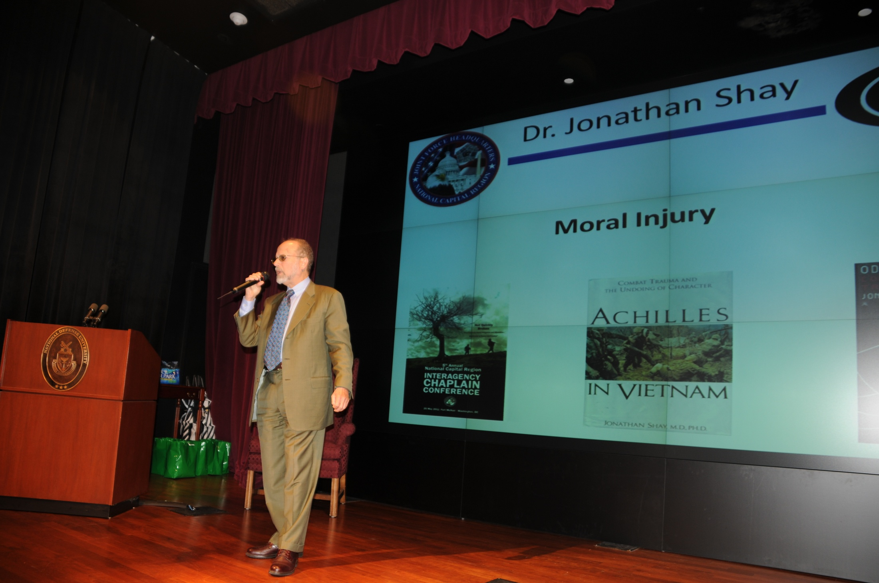

Slide 16
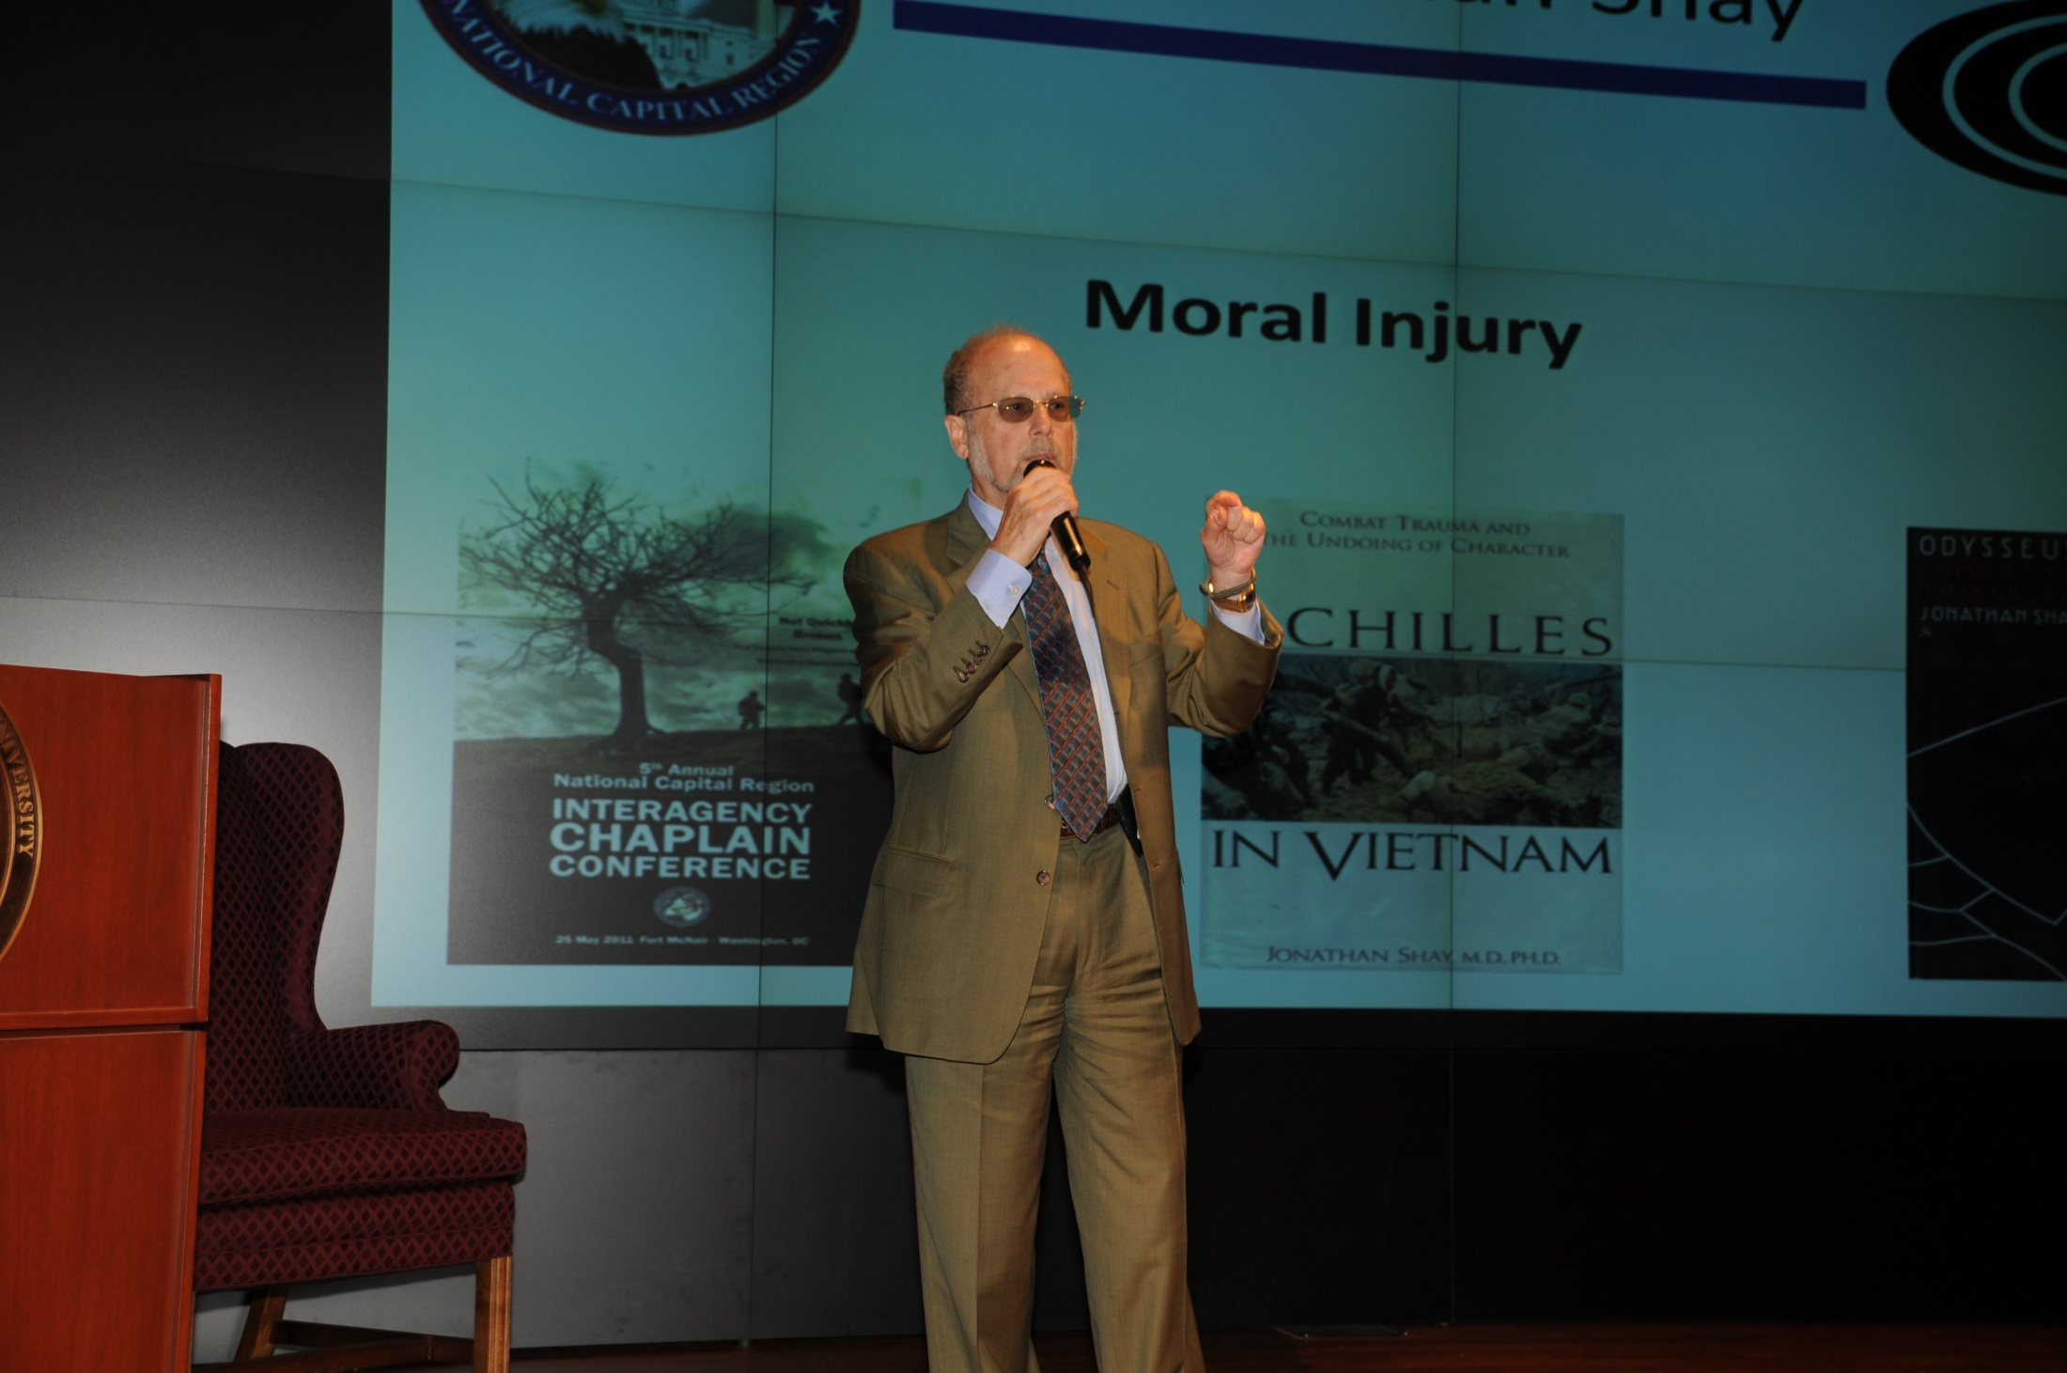

Slide 17
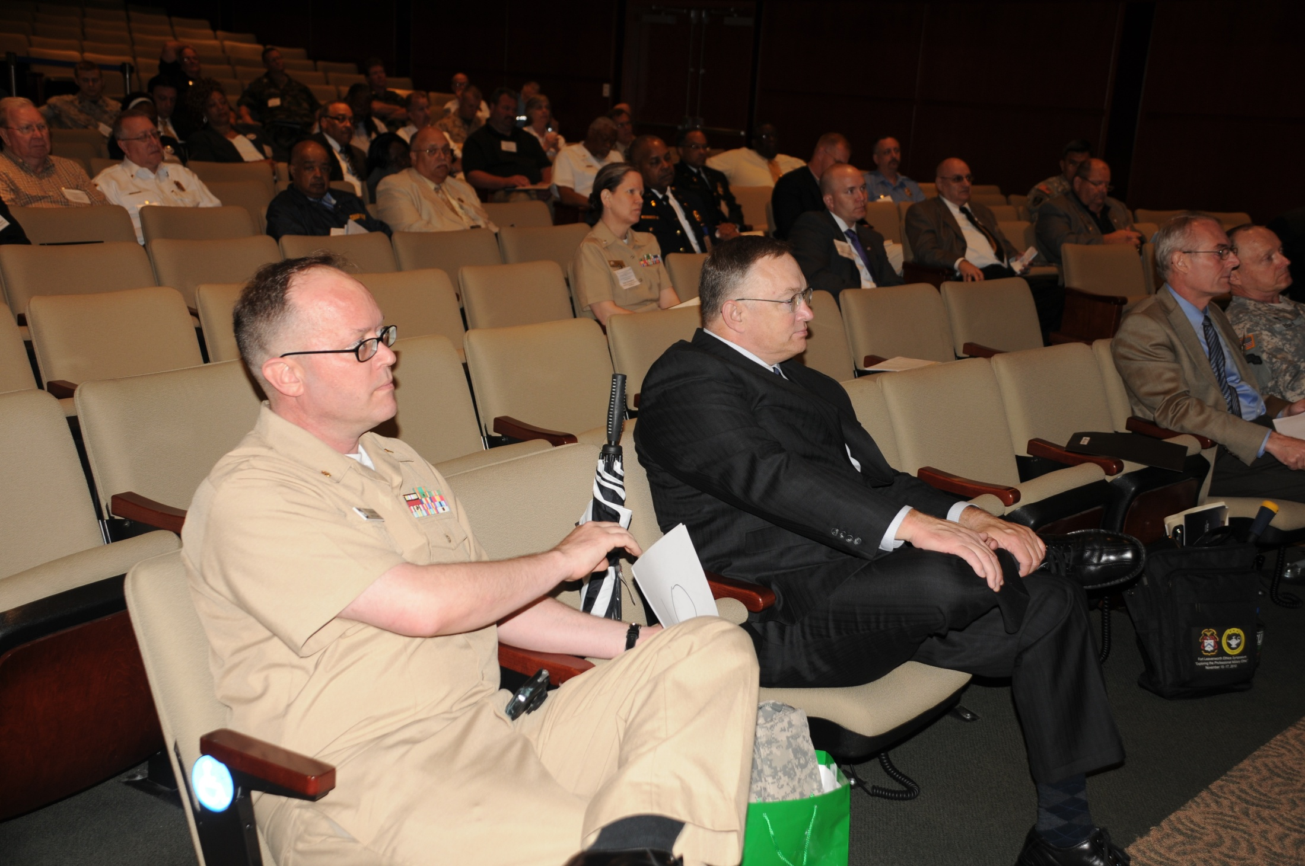

Slide 18
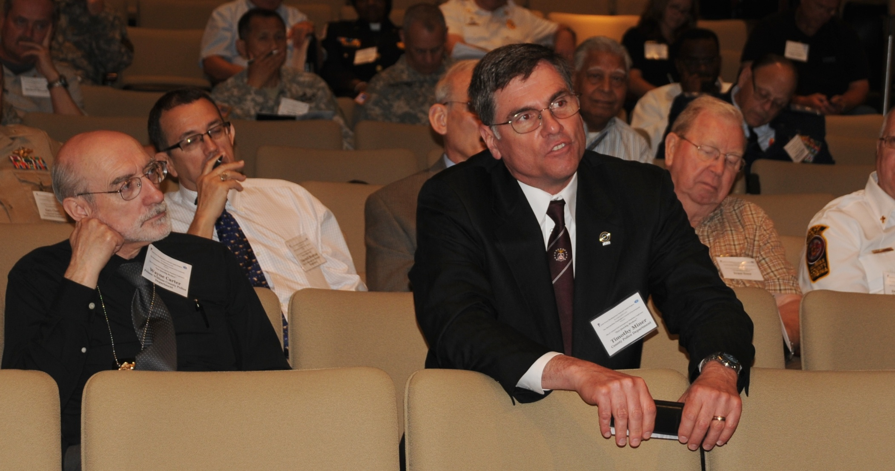

Slide 19
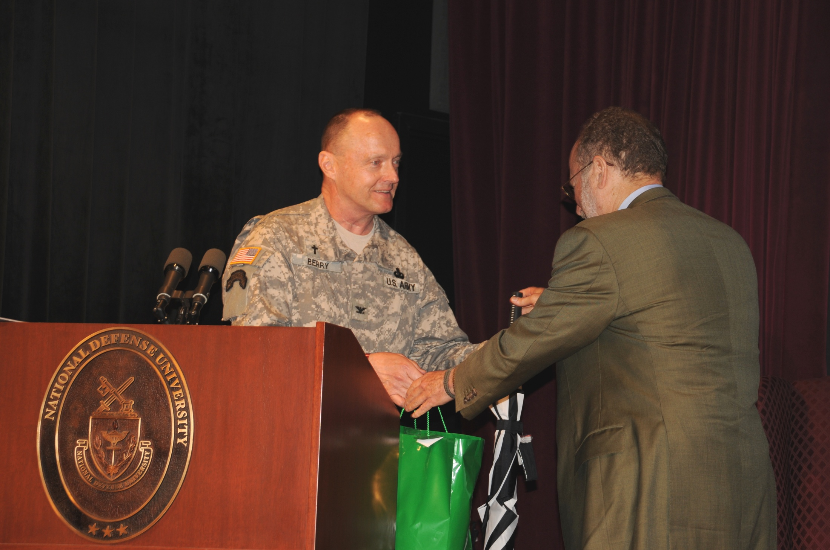

Slide 20
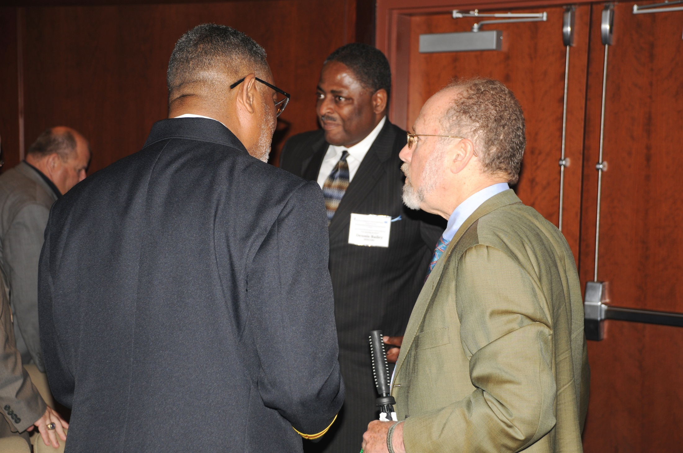

Slide 21
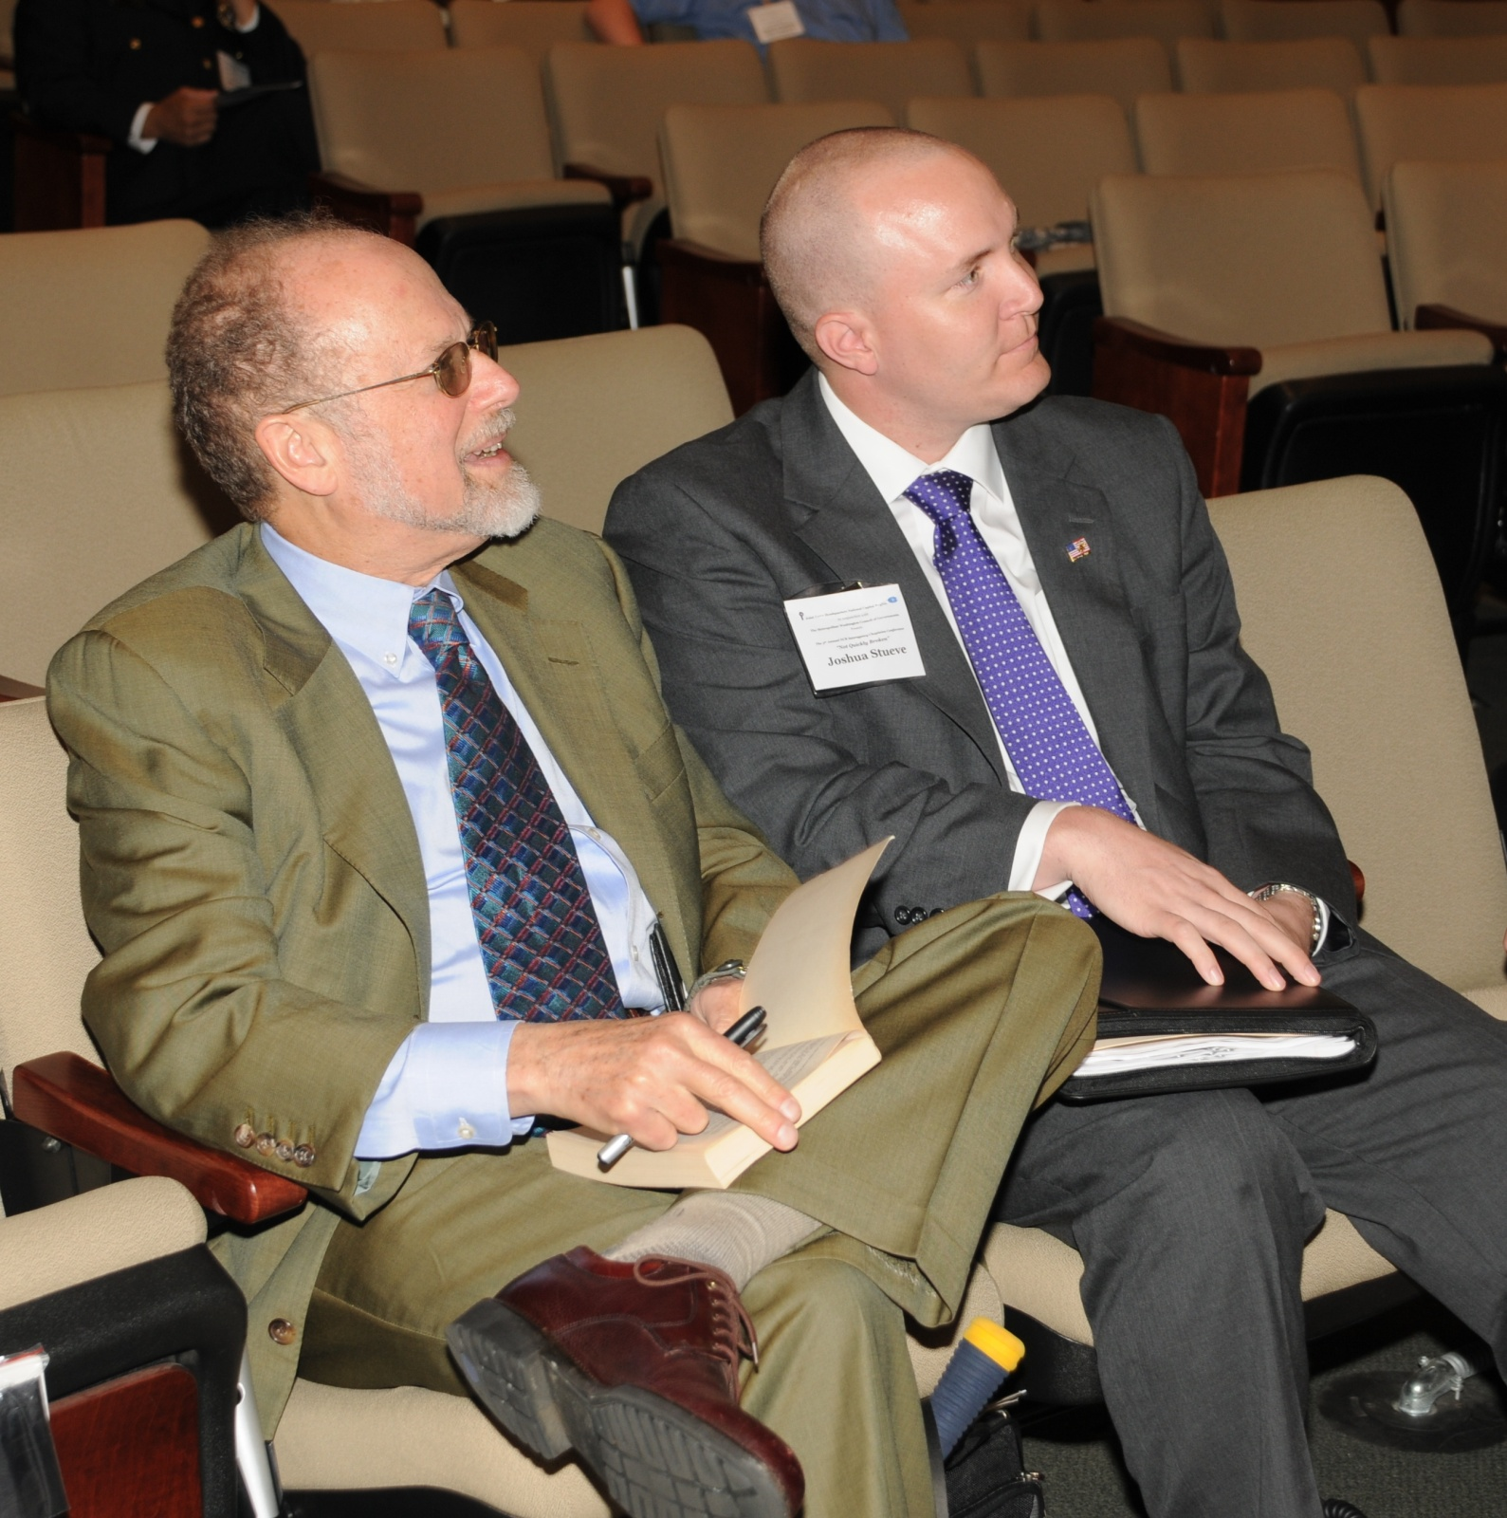

Slide 22
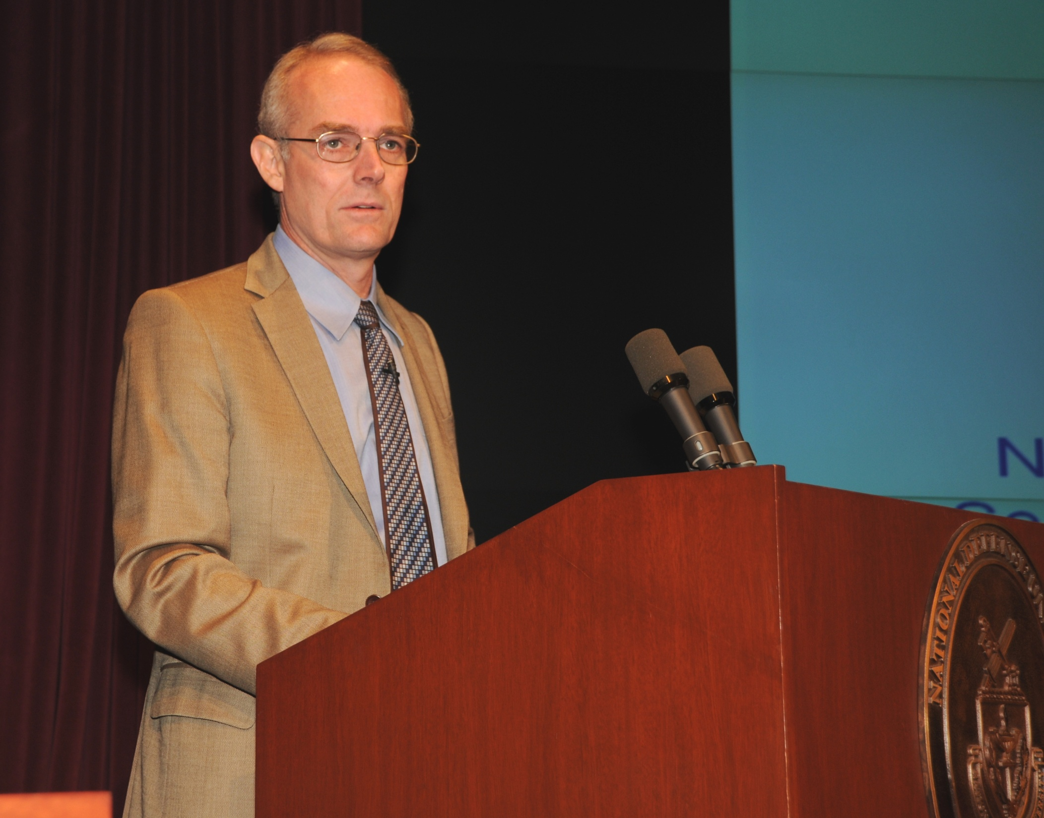

Slide 23


Slide 24
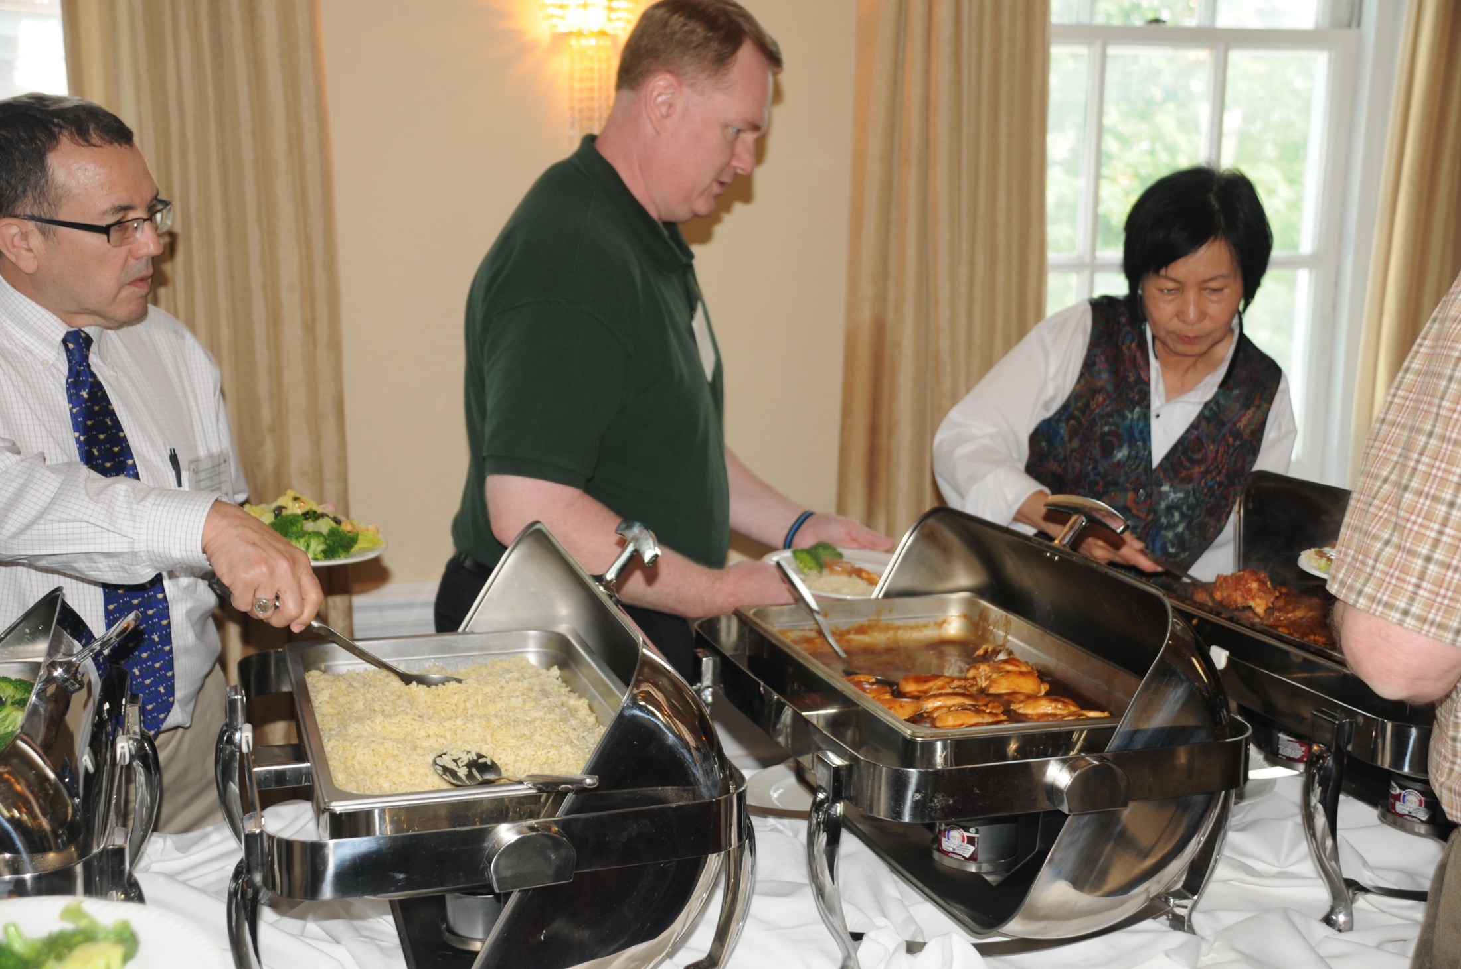

Slide 25
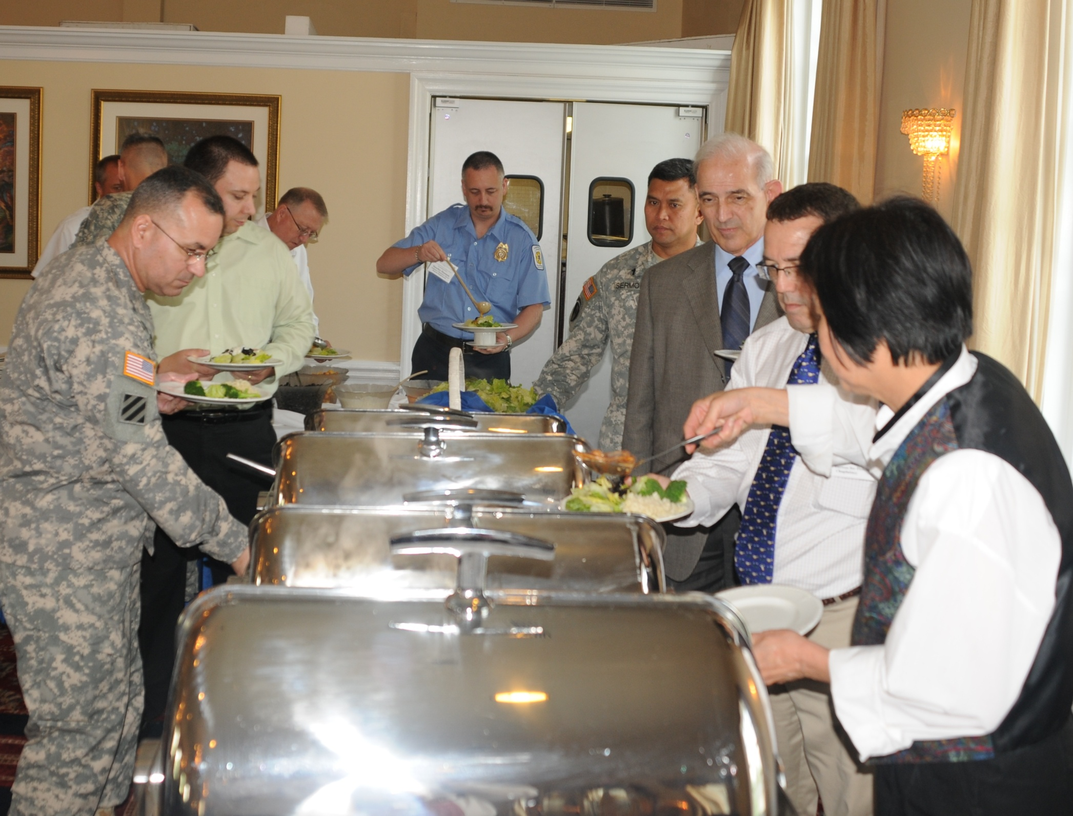

Slide 26
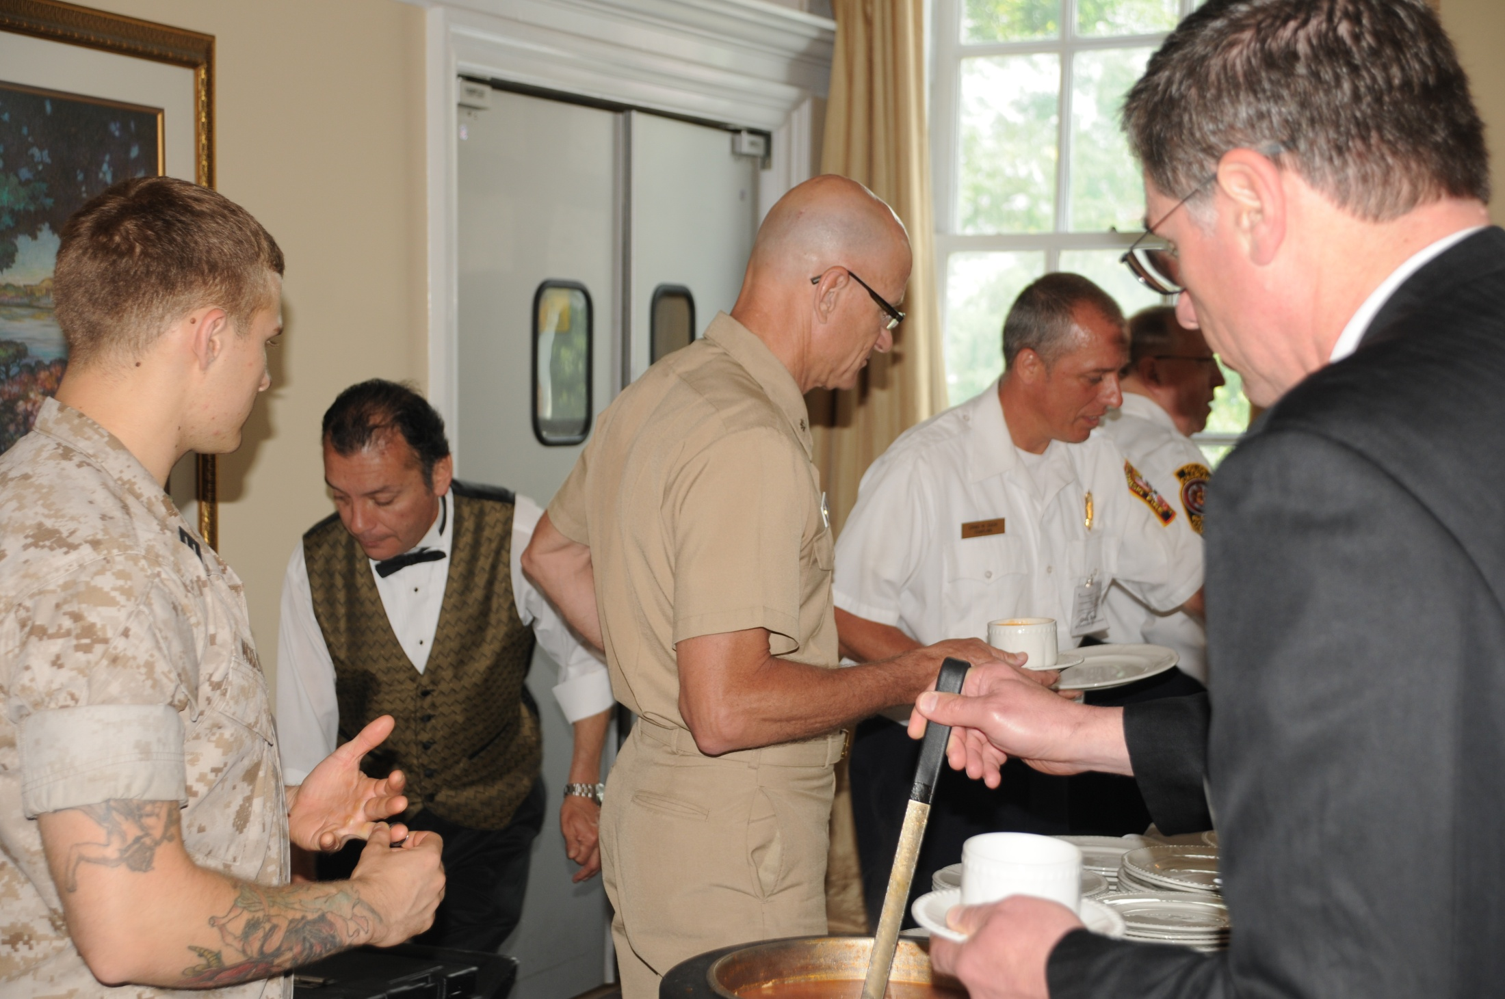

Slide 27
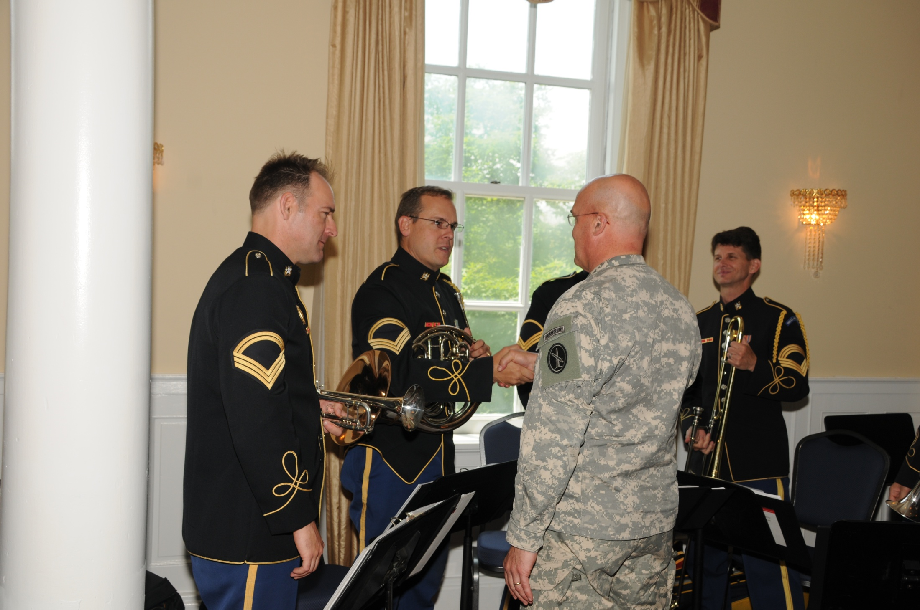

Slide 28
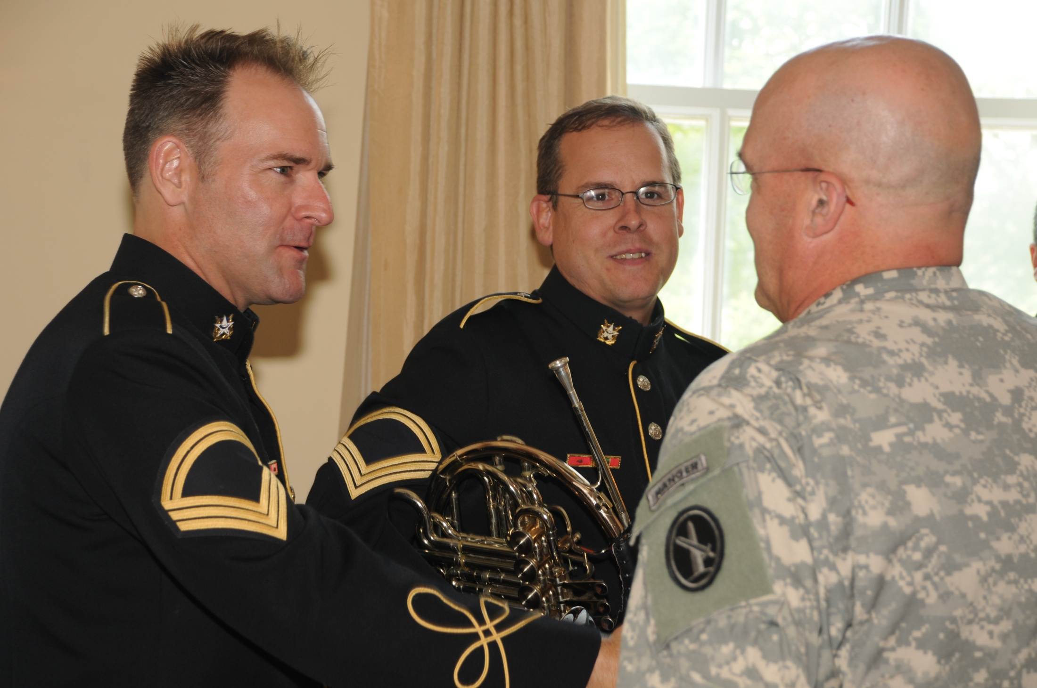

Slide 29
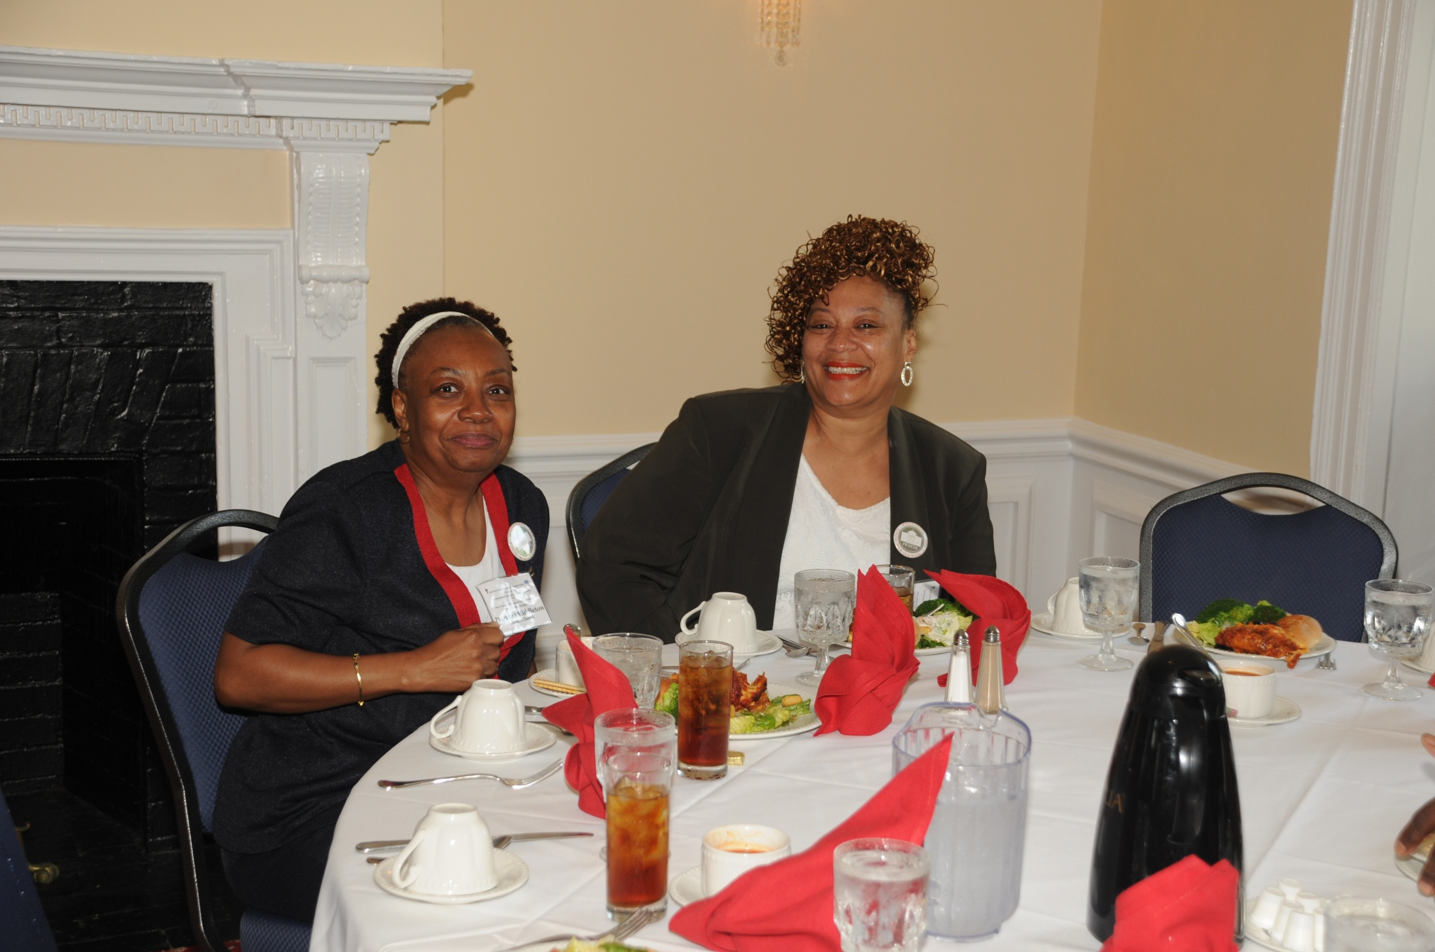

Slide 30
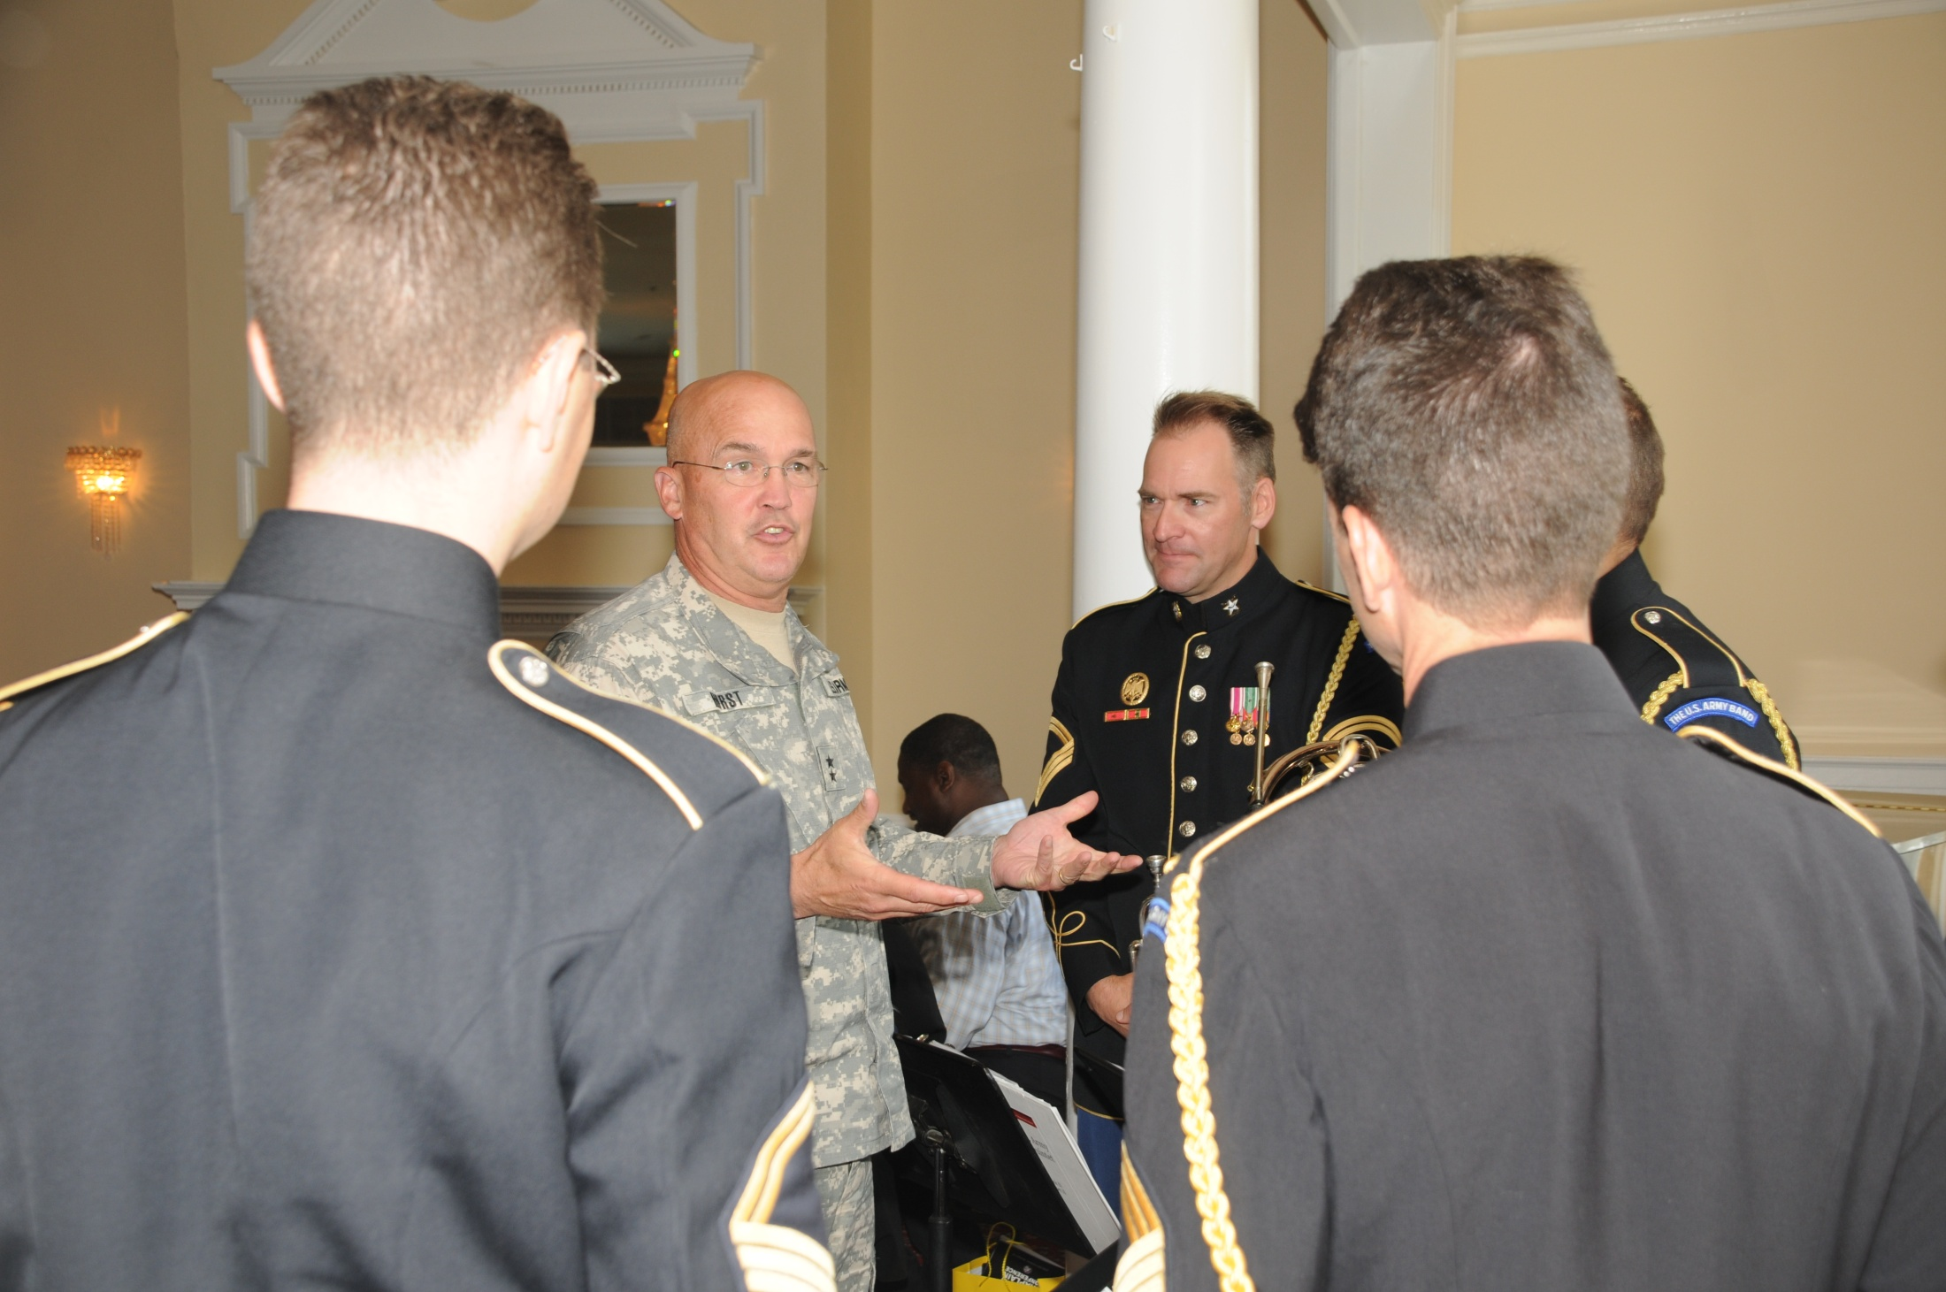

Slide 31
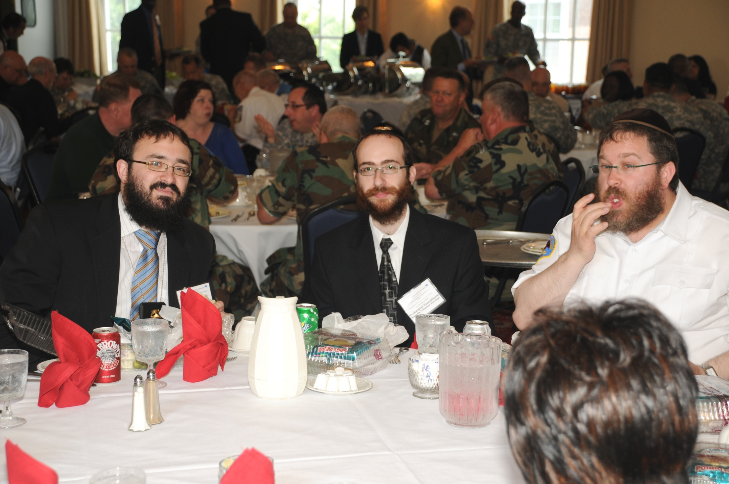

Slide 32
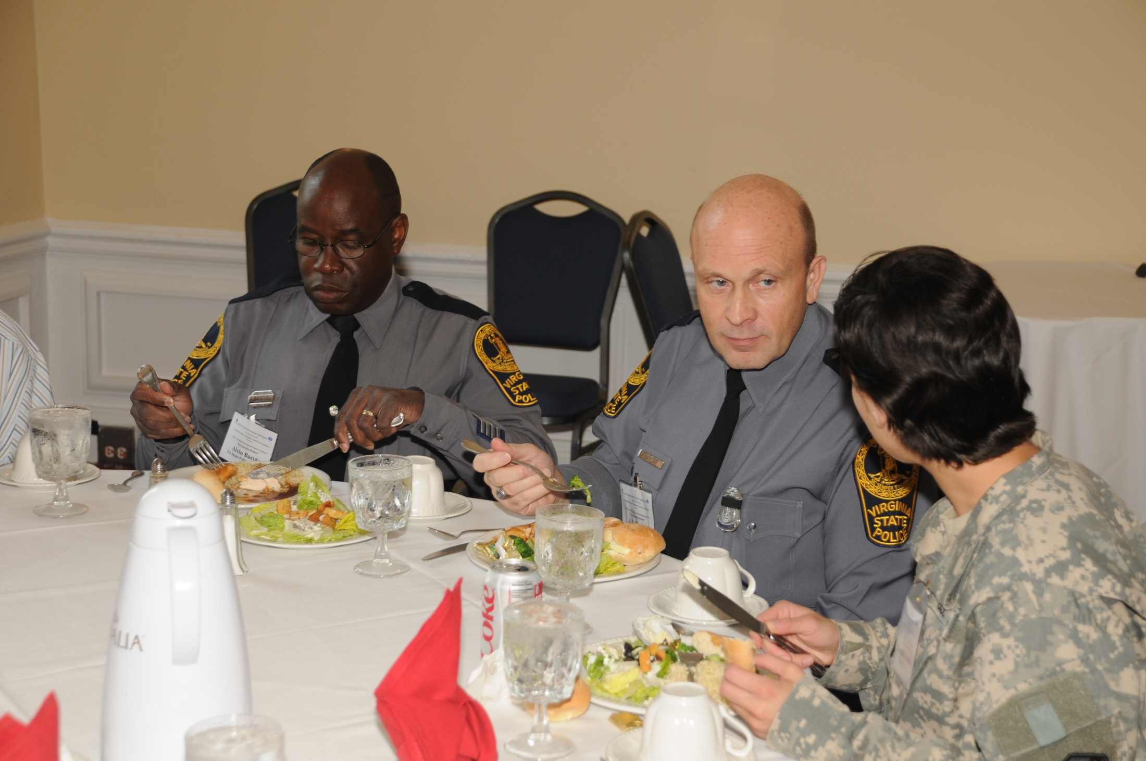

Slide 33
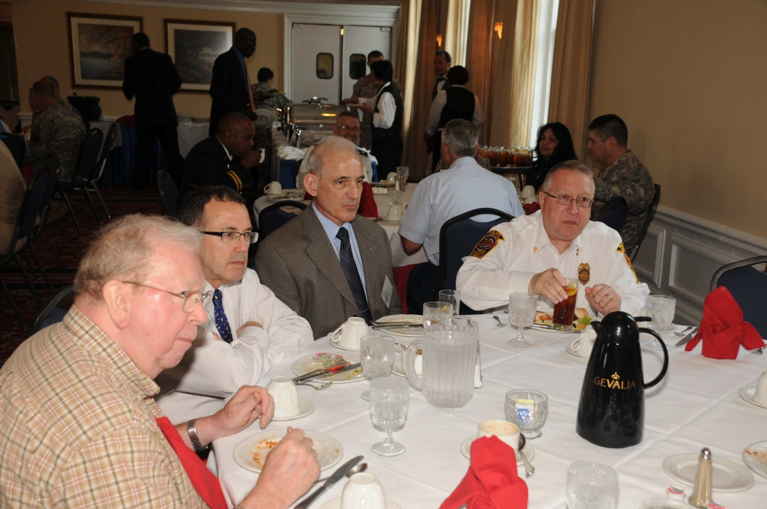

Slide 34
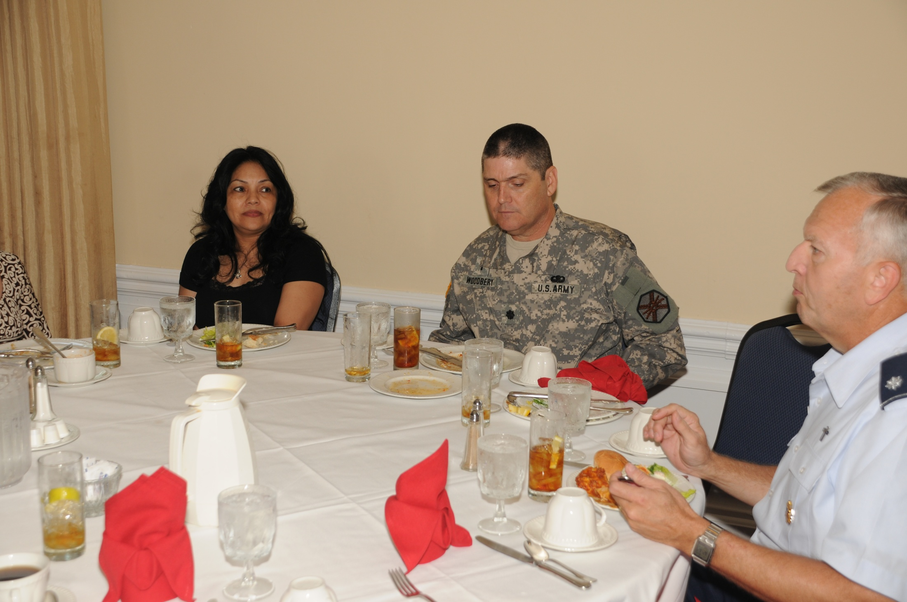

Slide 35
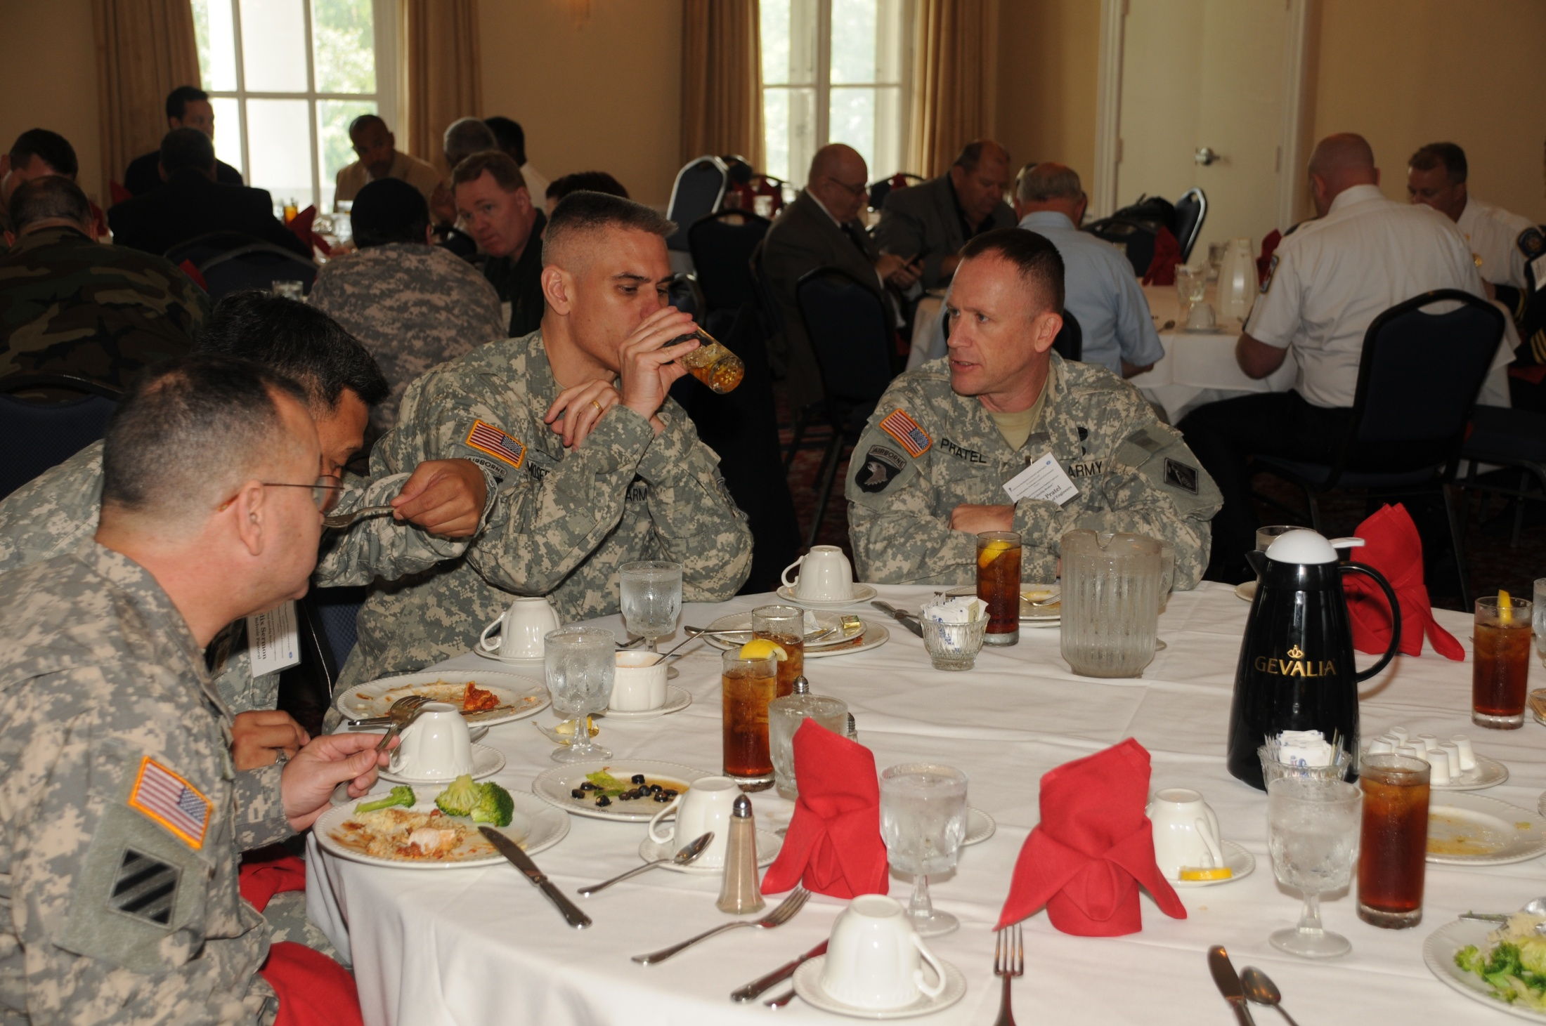

Slide 36
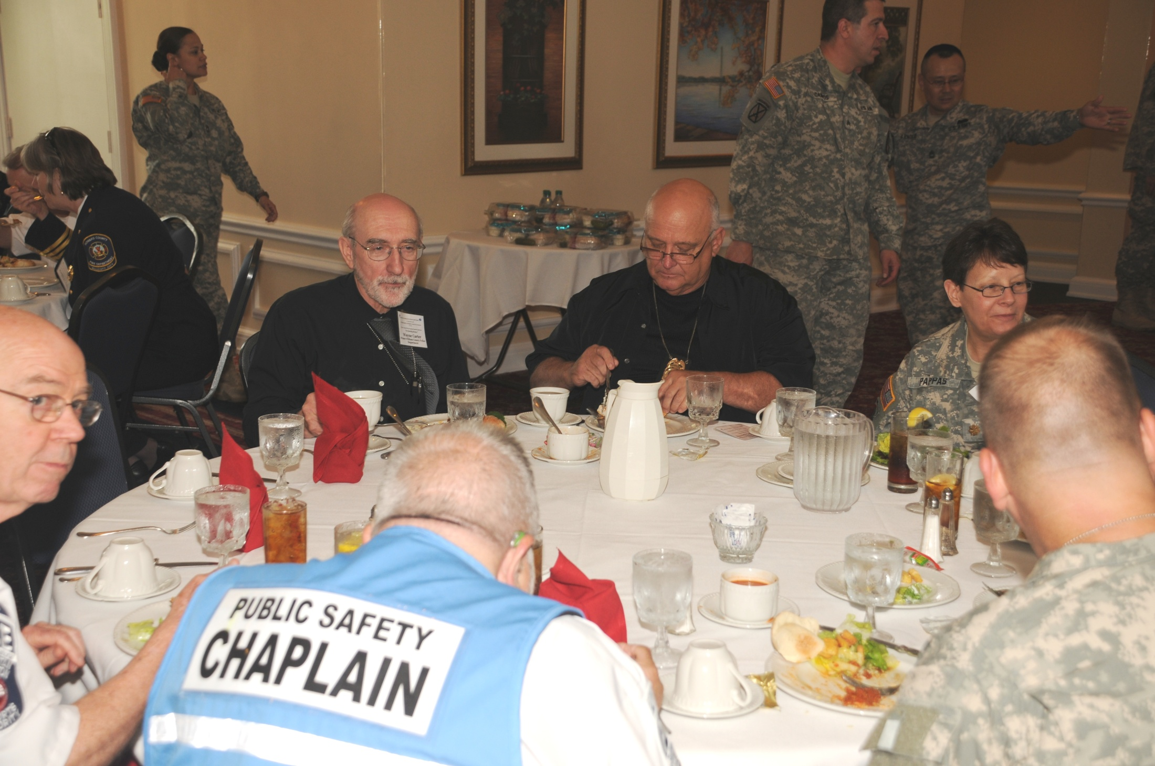

Slide 37
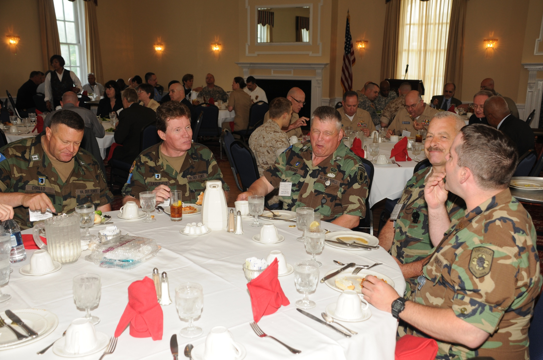

Slide 38
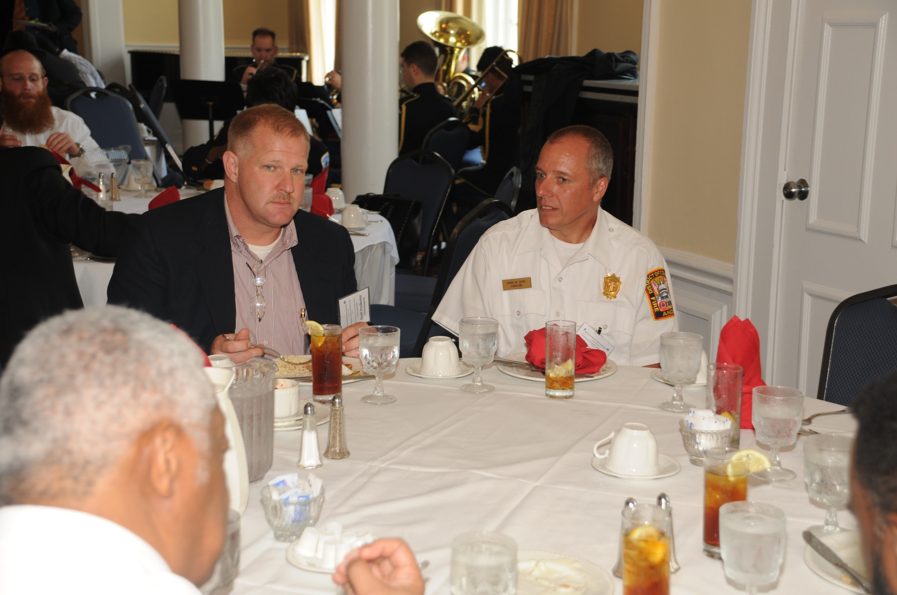

Slide 39
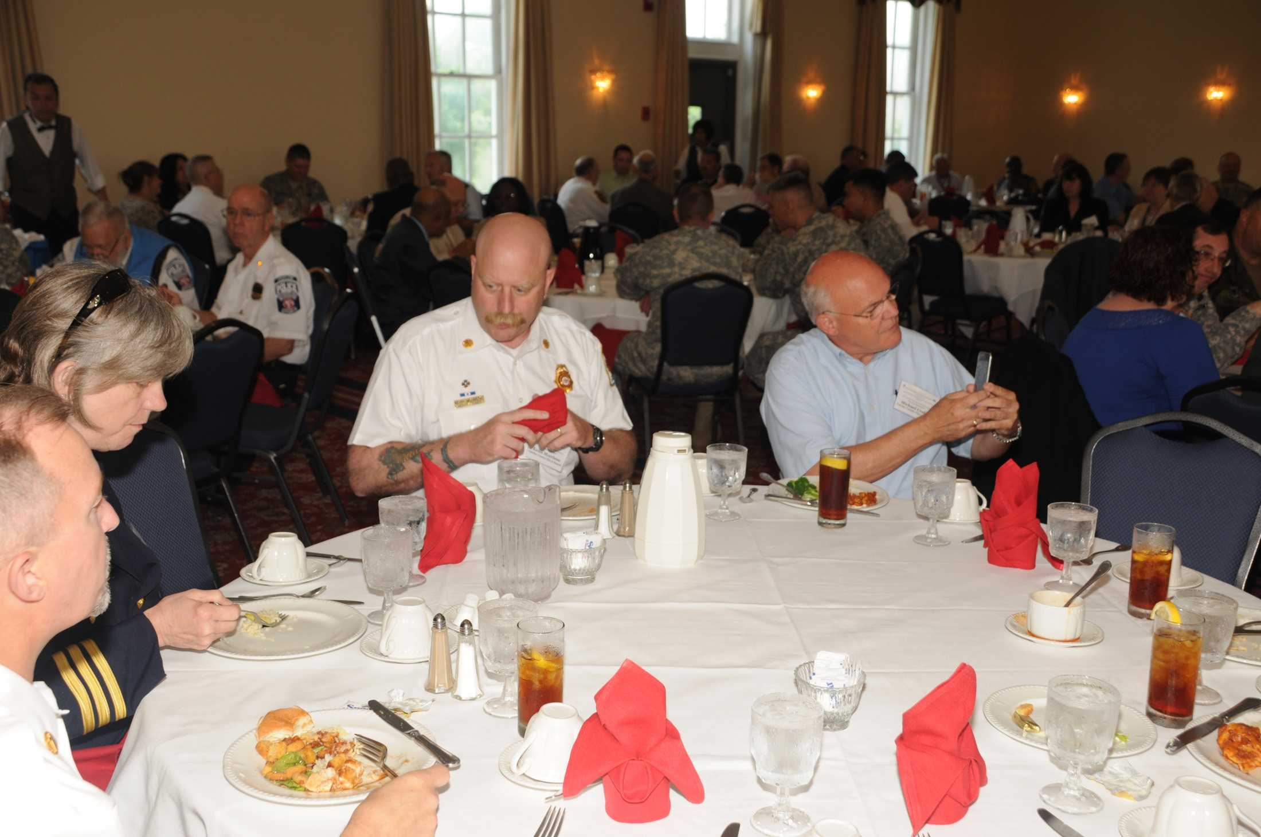

Slide 40
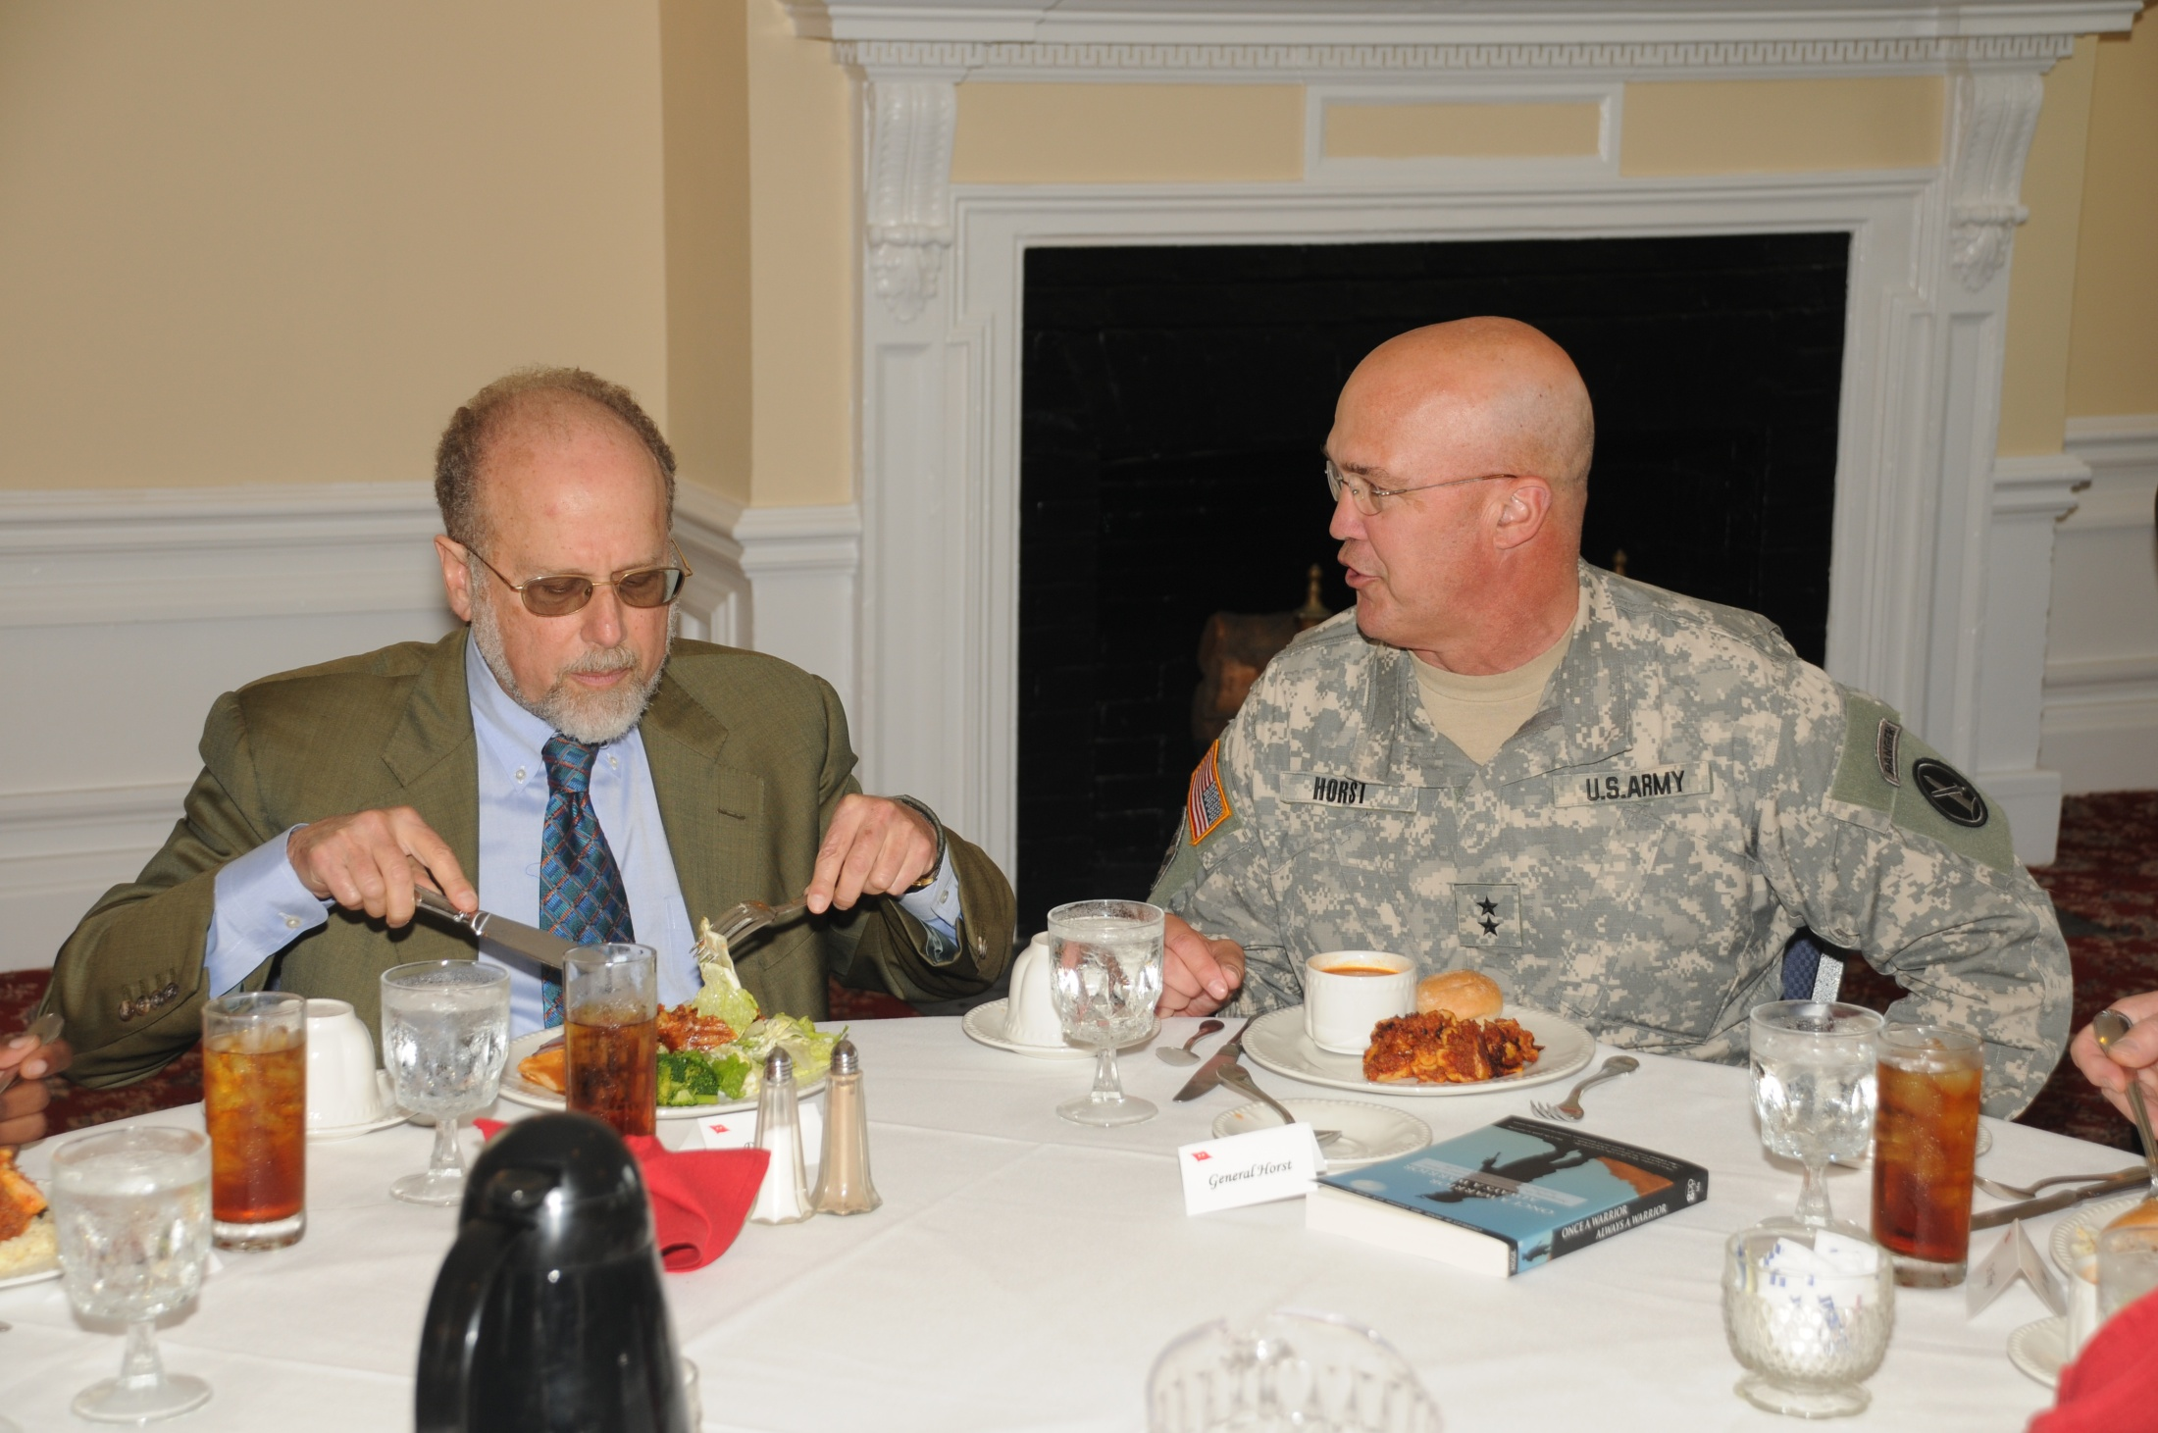

Slide 41
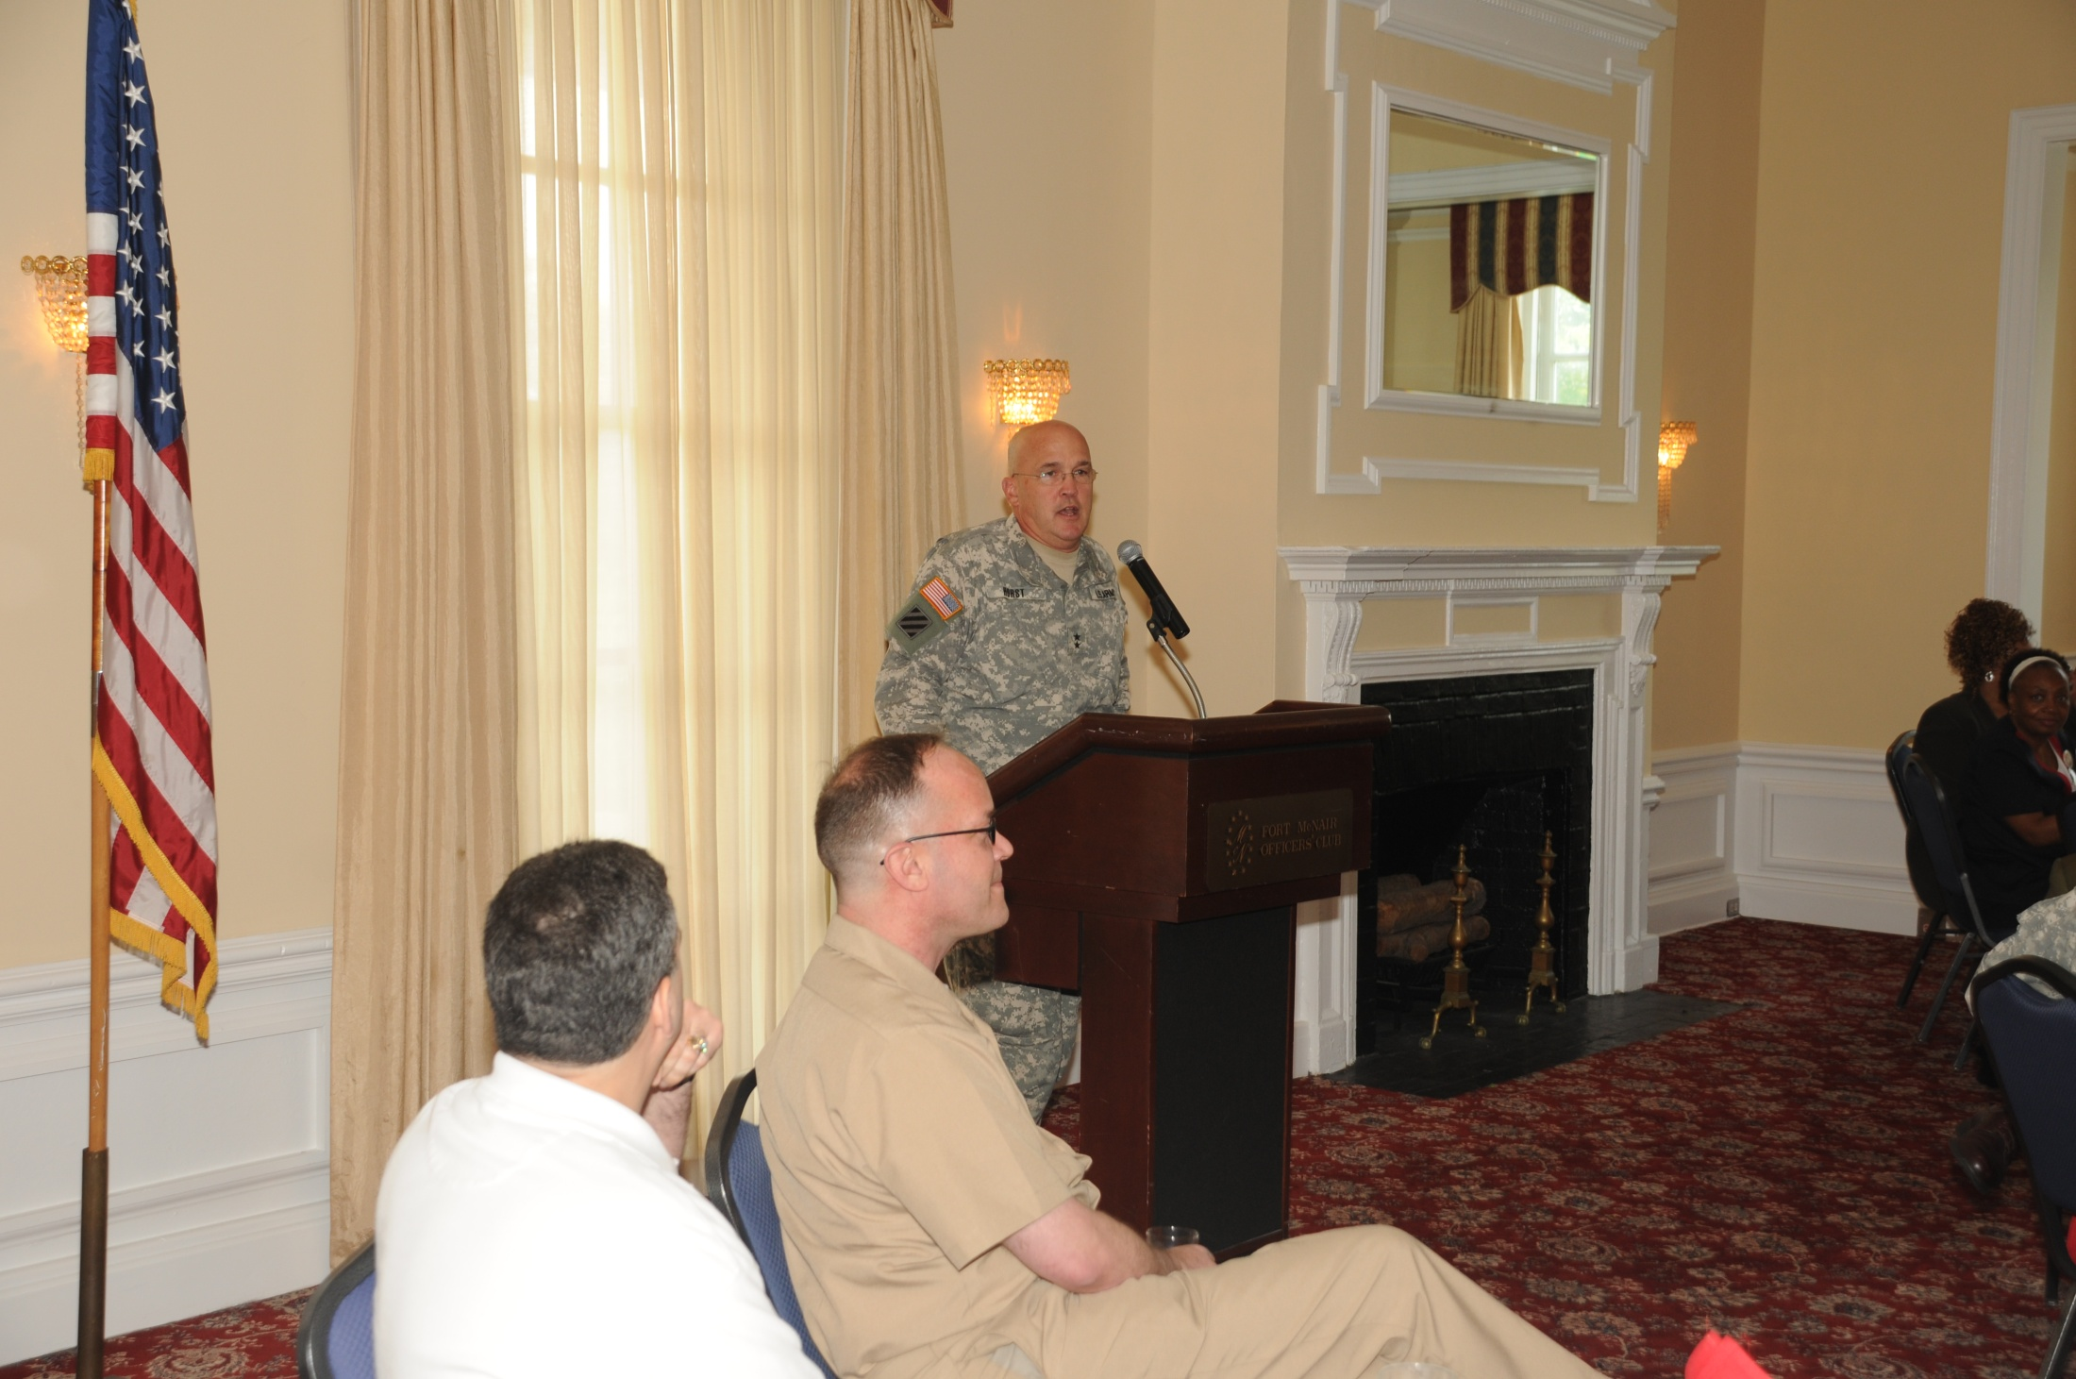

Slide 42
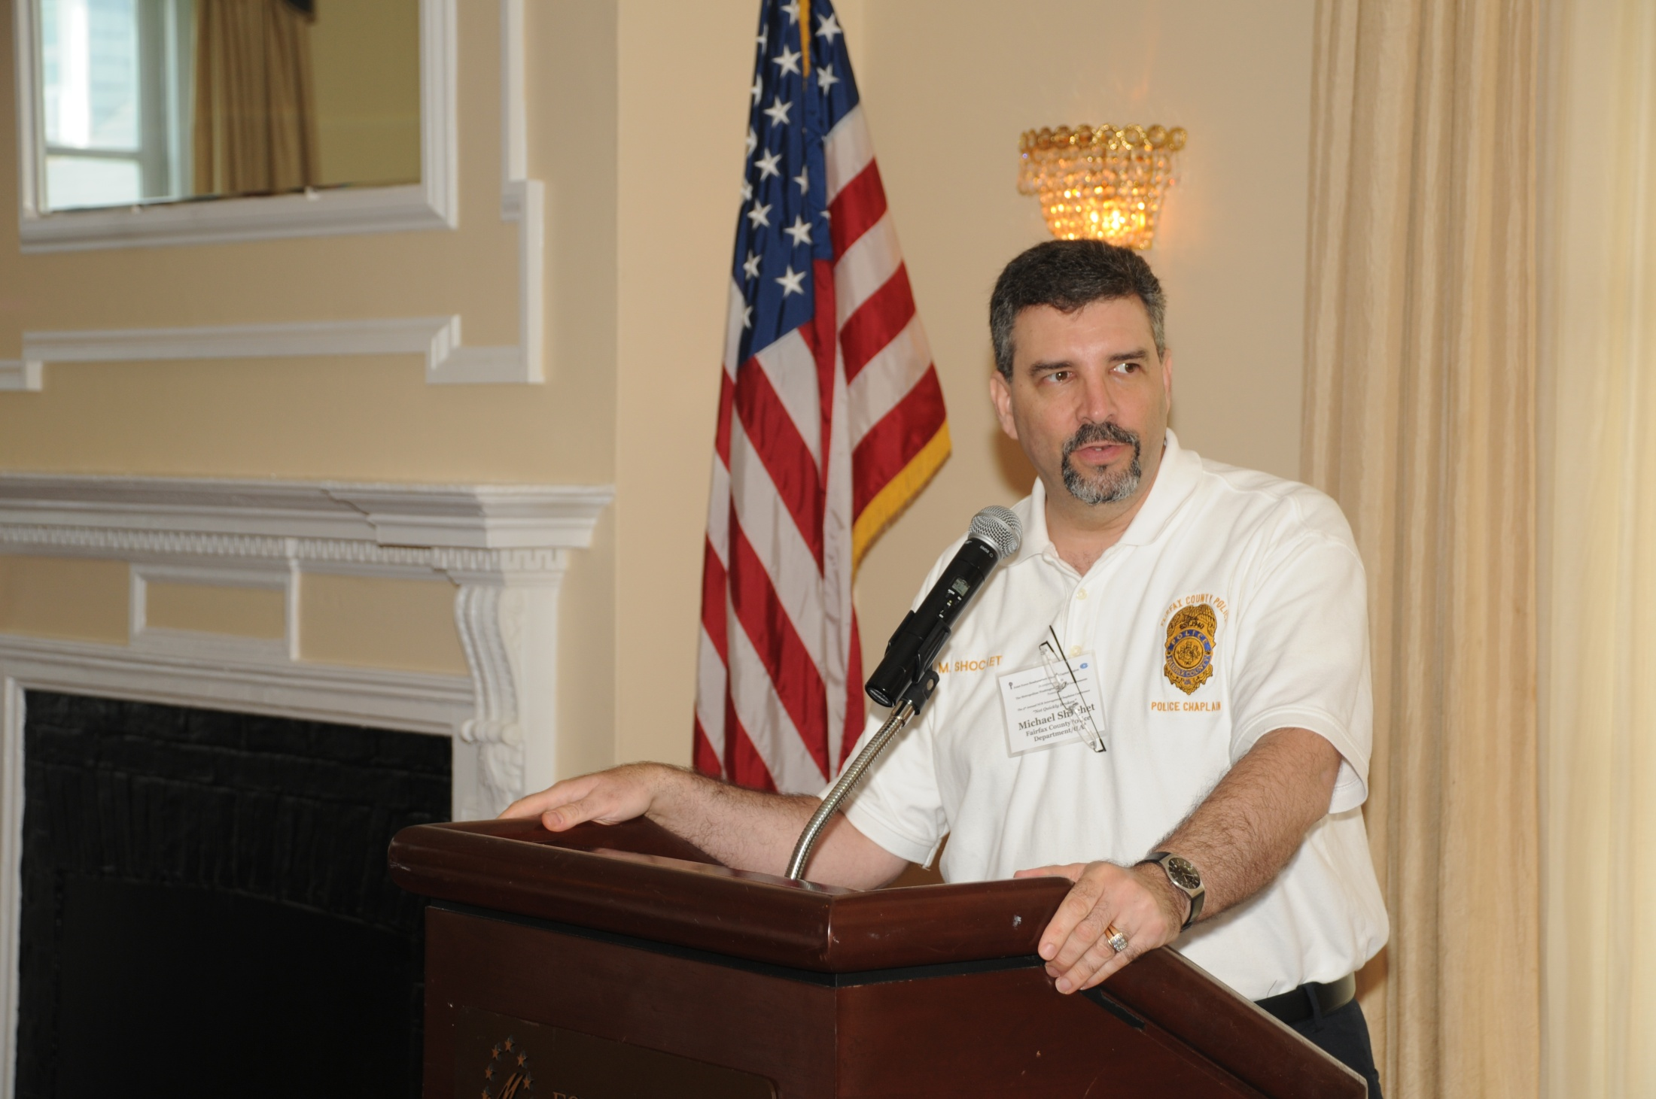

Slide 43
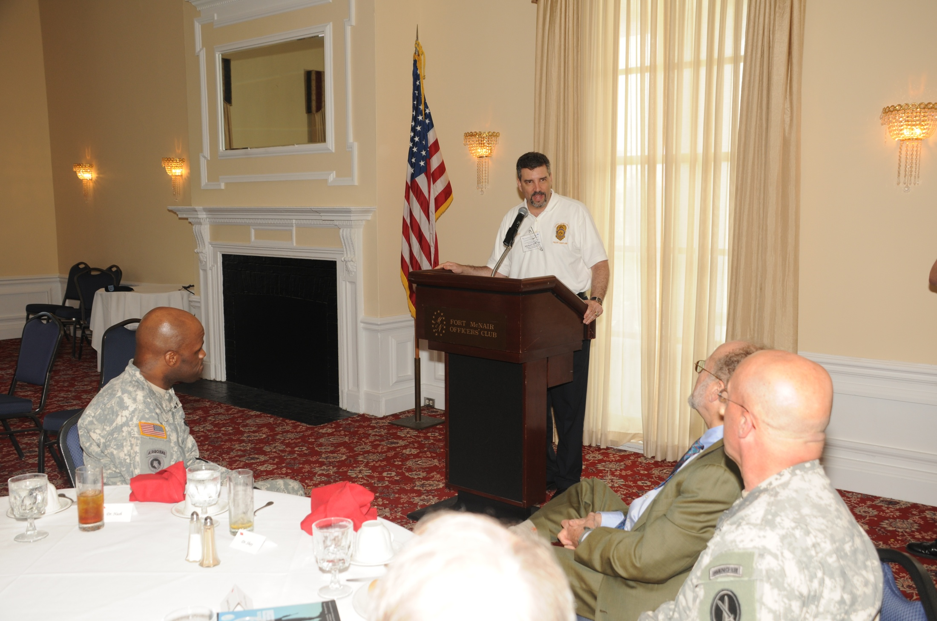

Slide 44
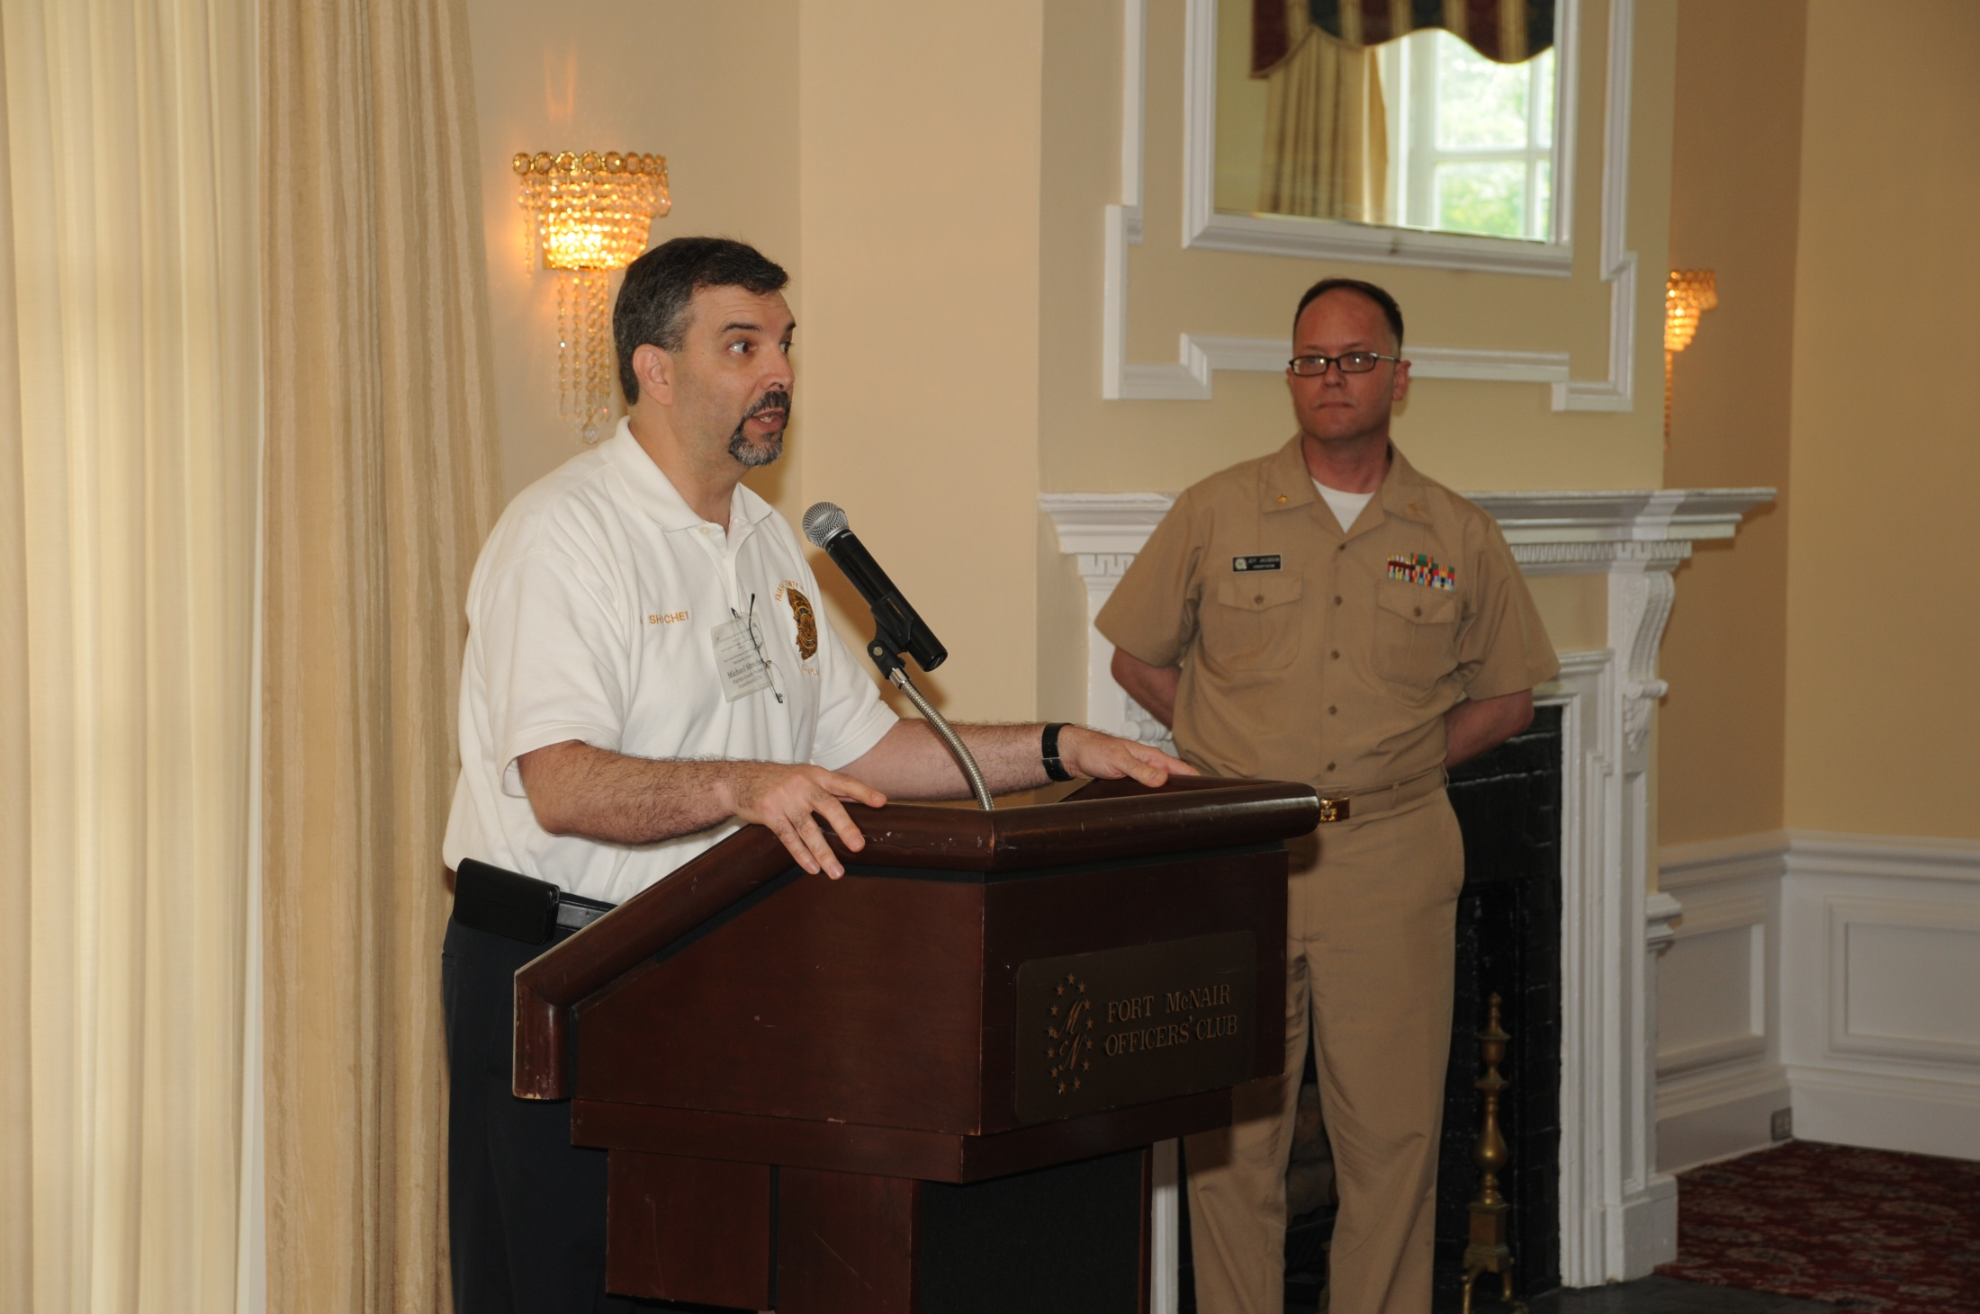

Slide 45
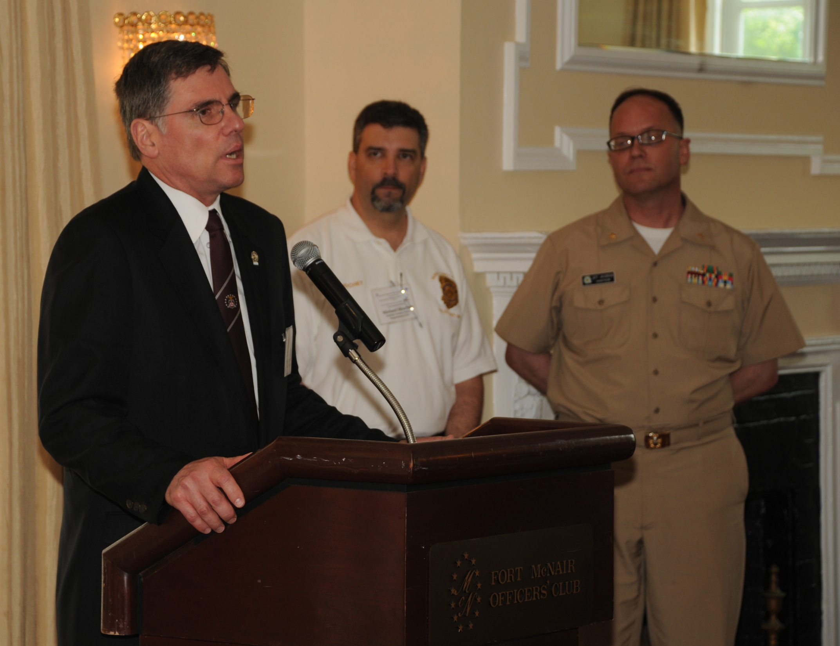

Slide 46
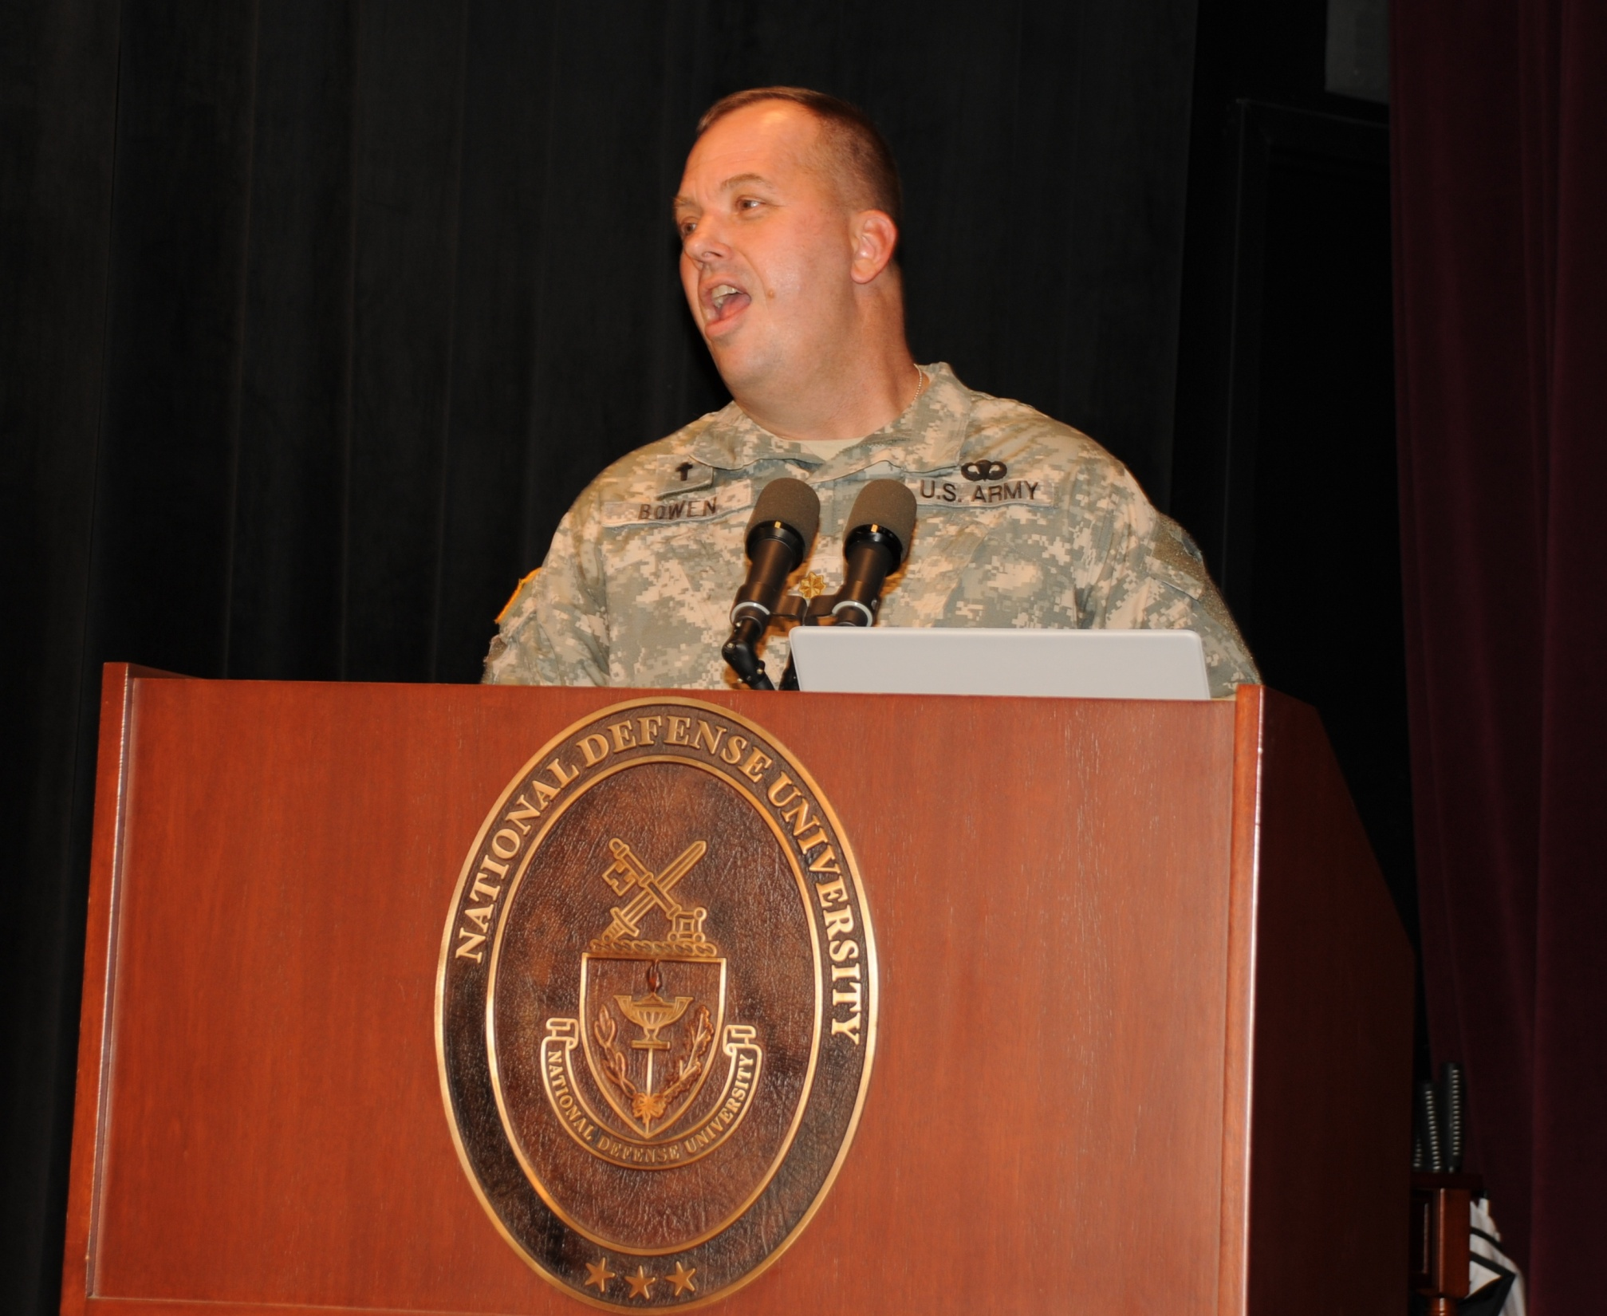

Slide 47
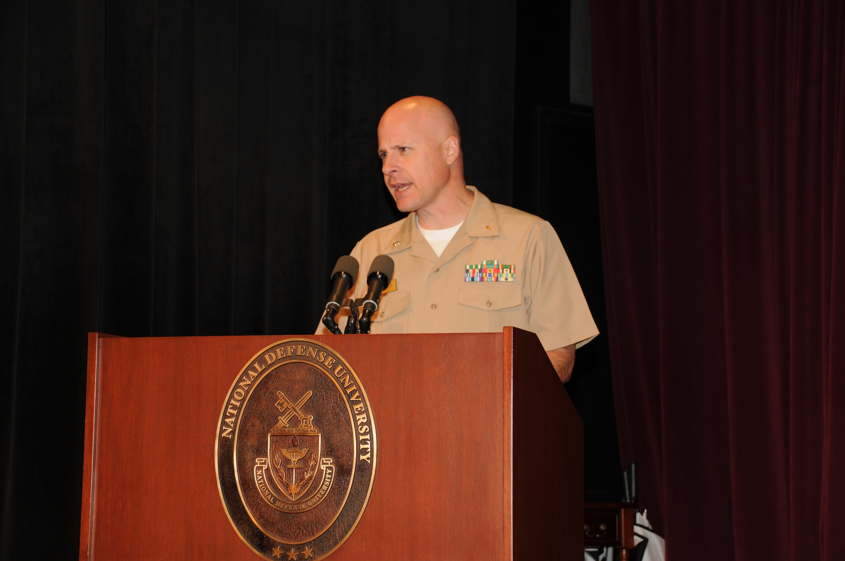

Slide 48
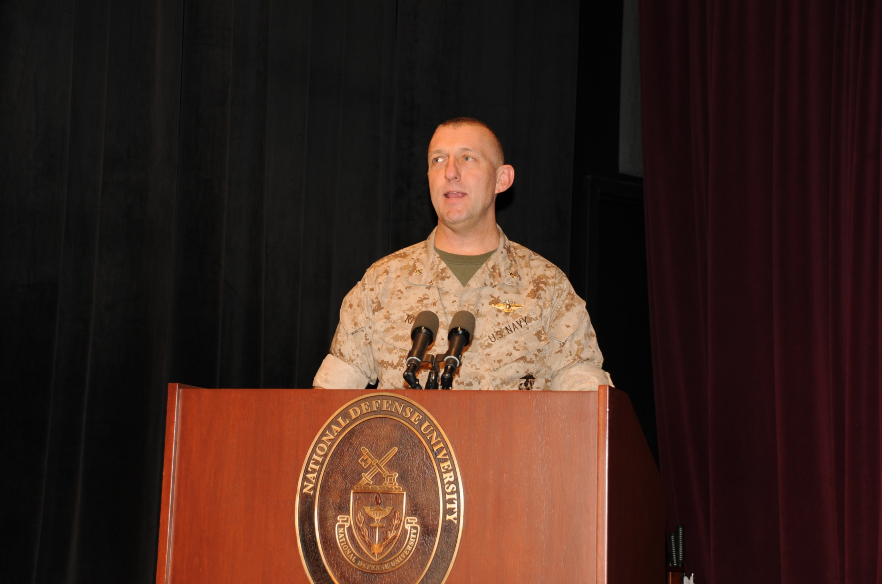

Slide 49
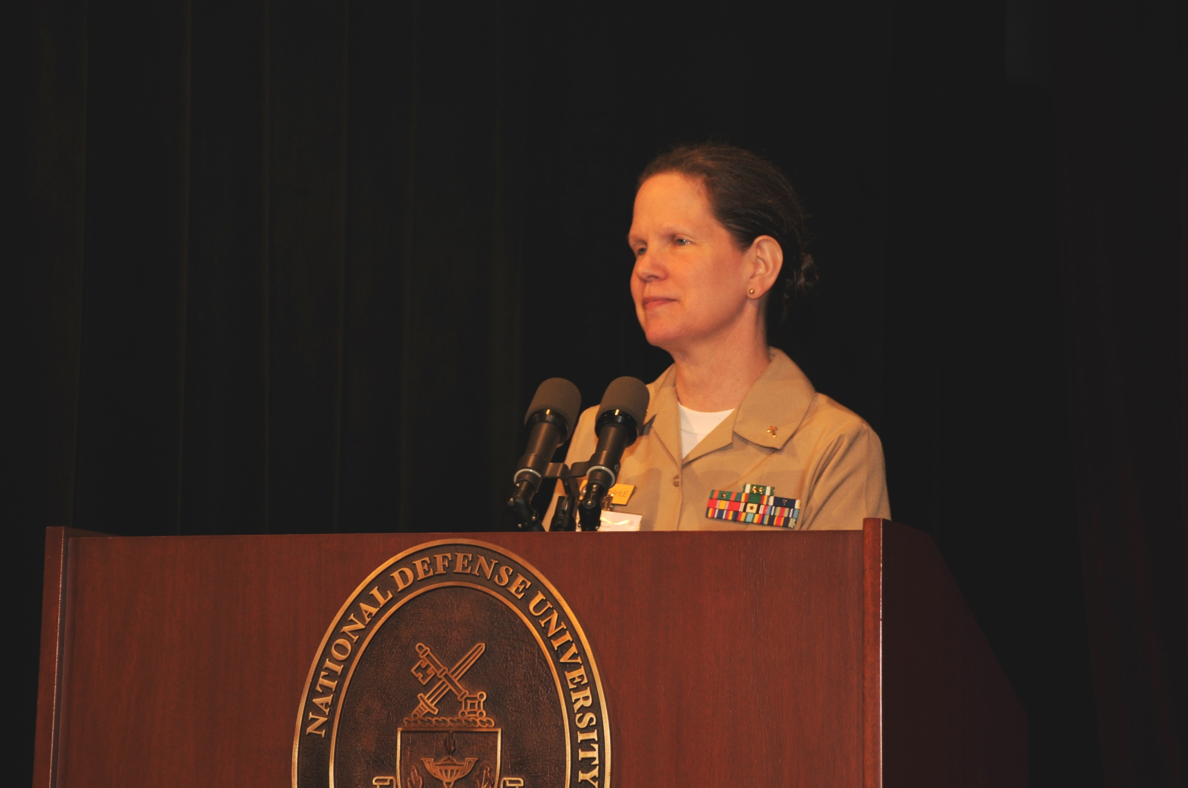

Slide 50
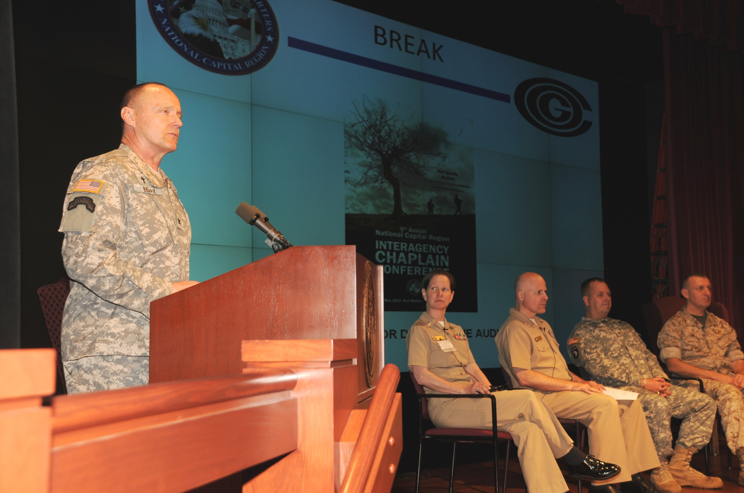

Slide 51
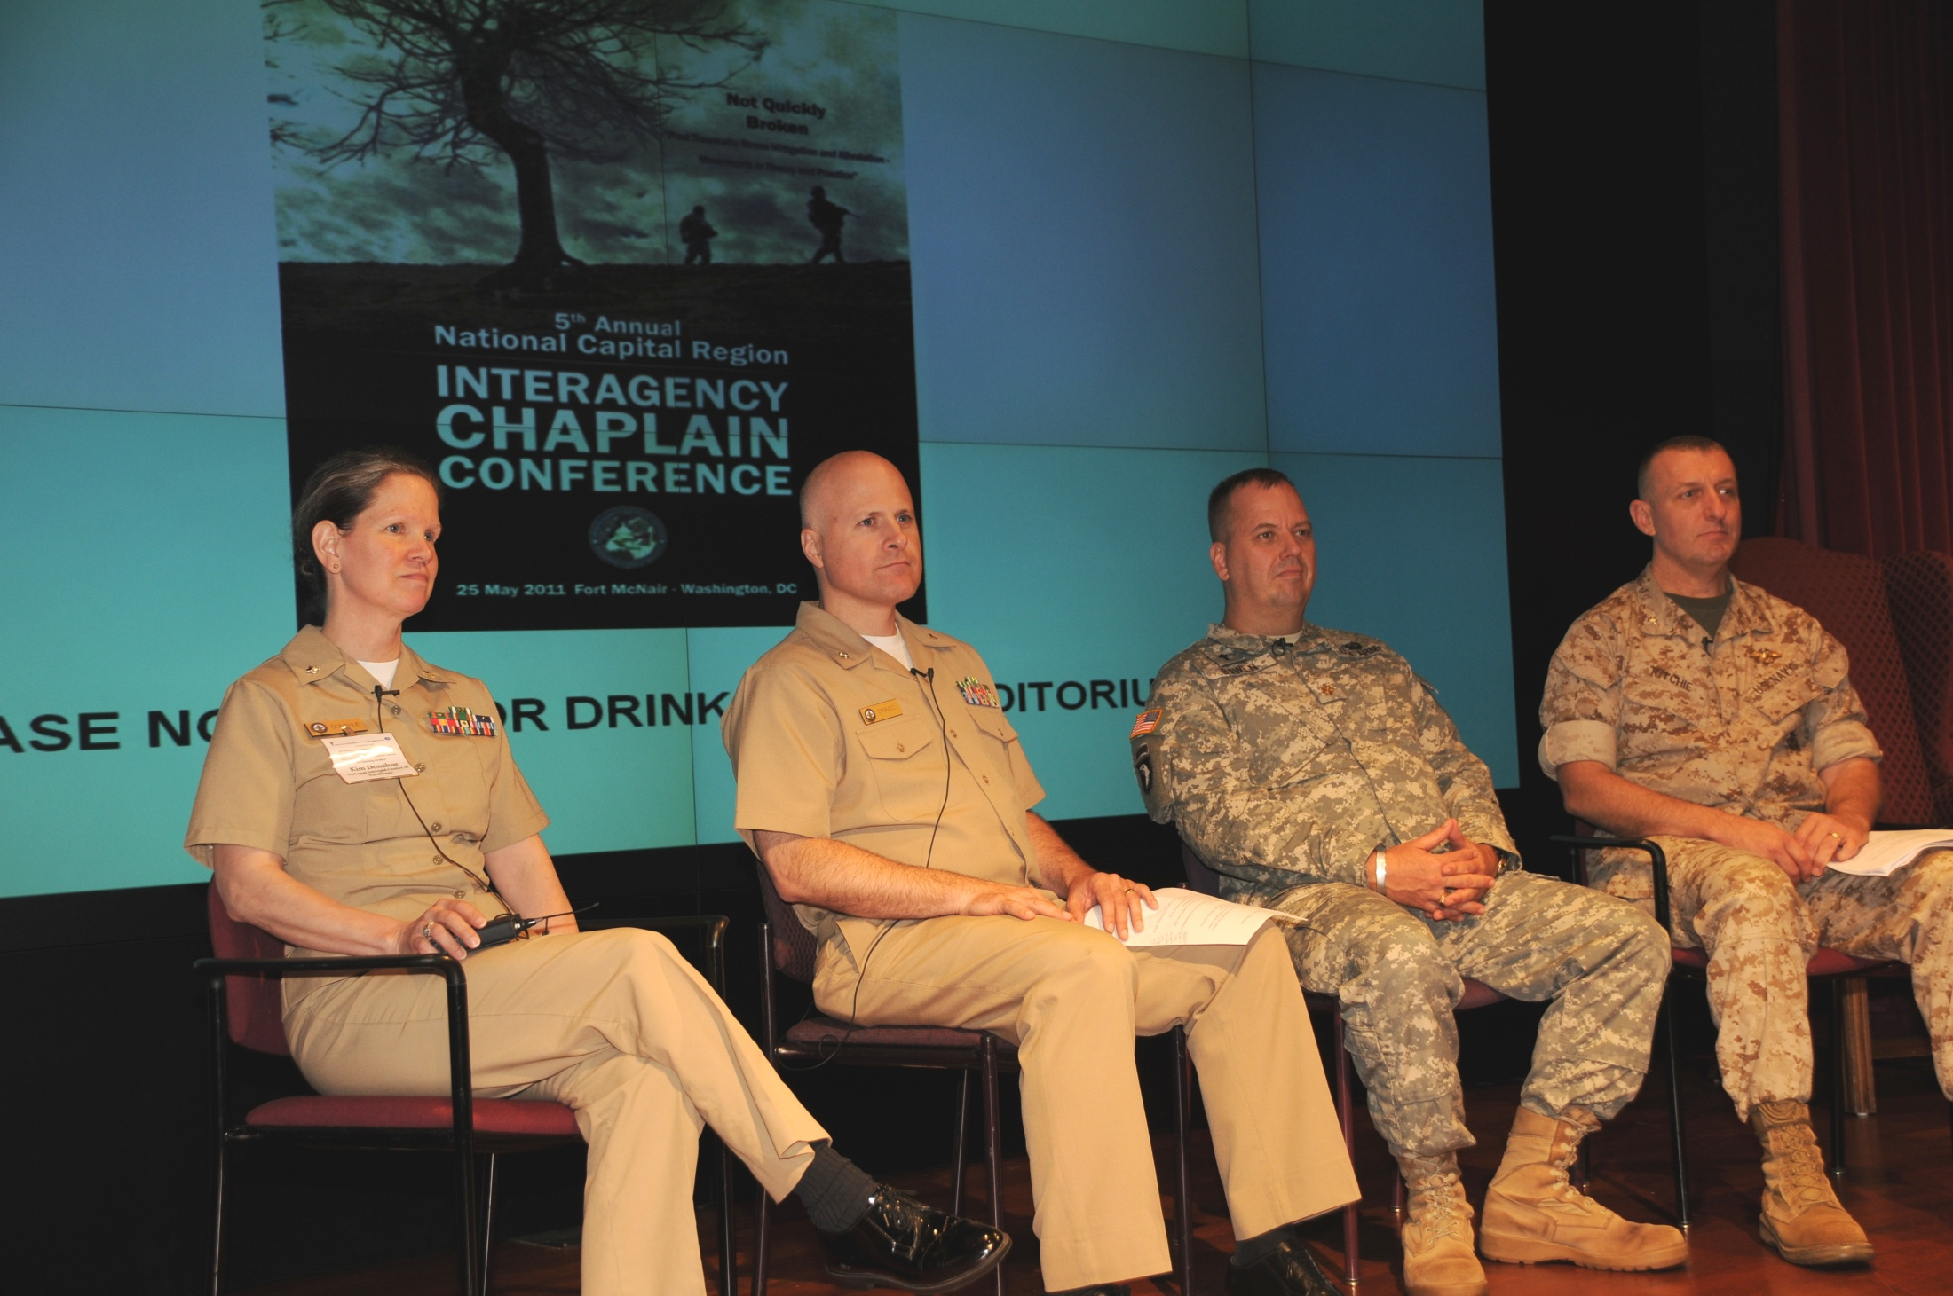

Slide 52
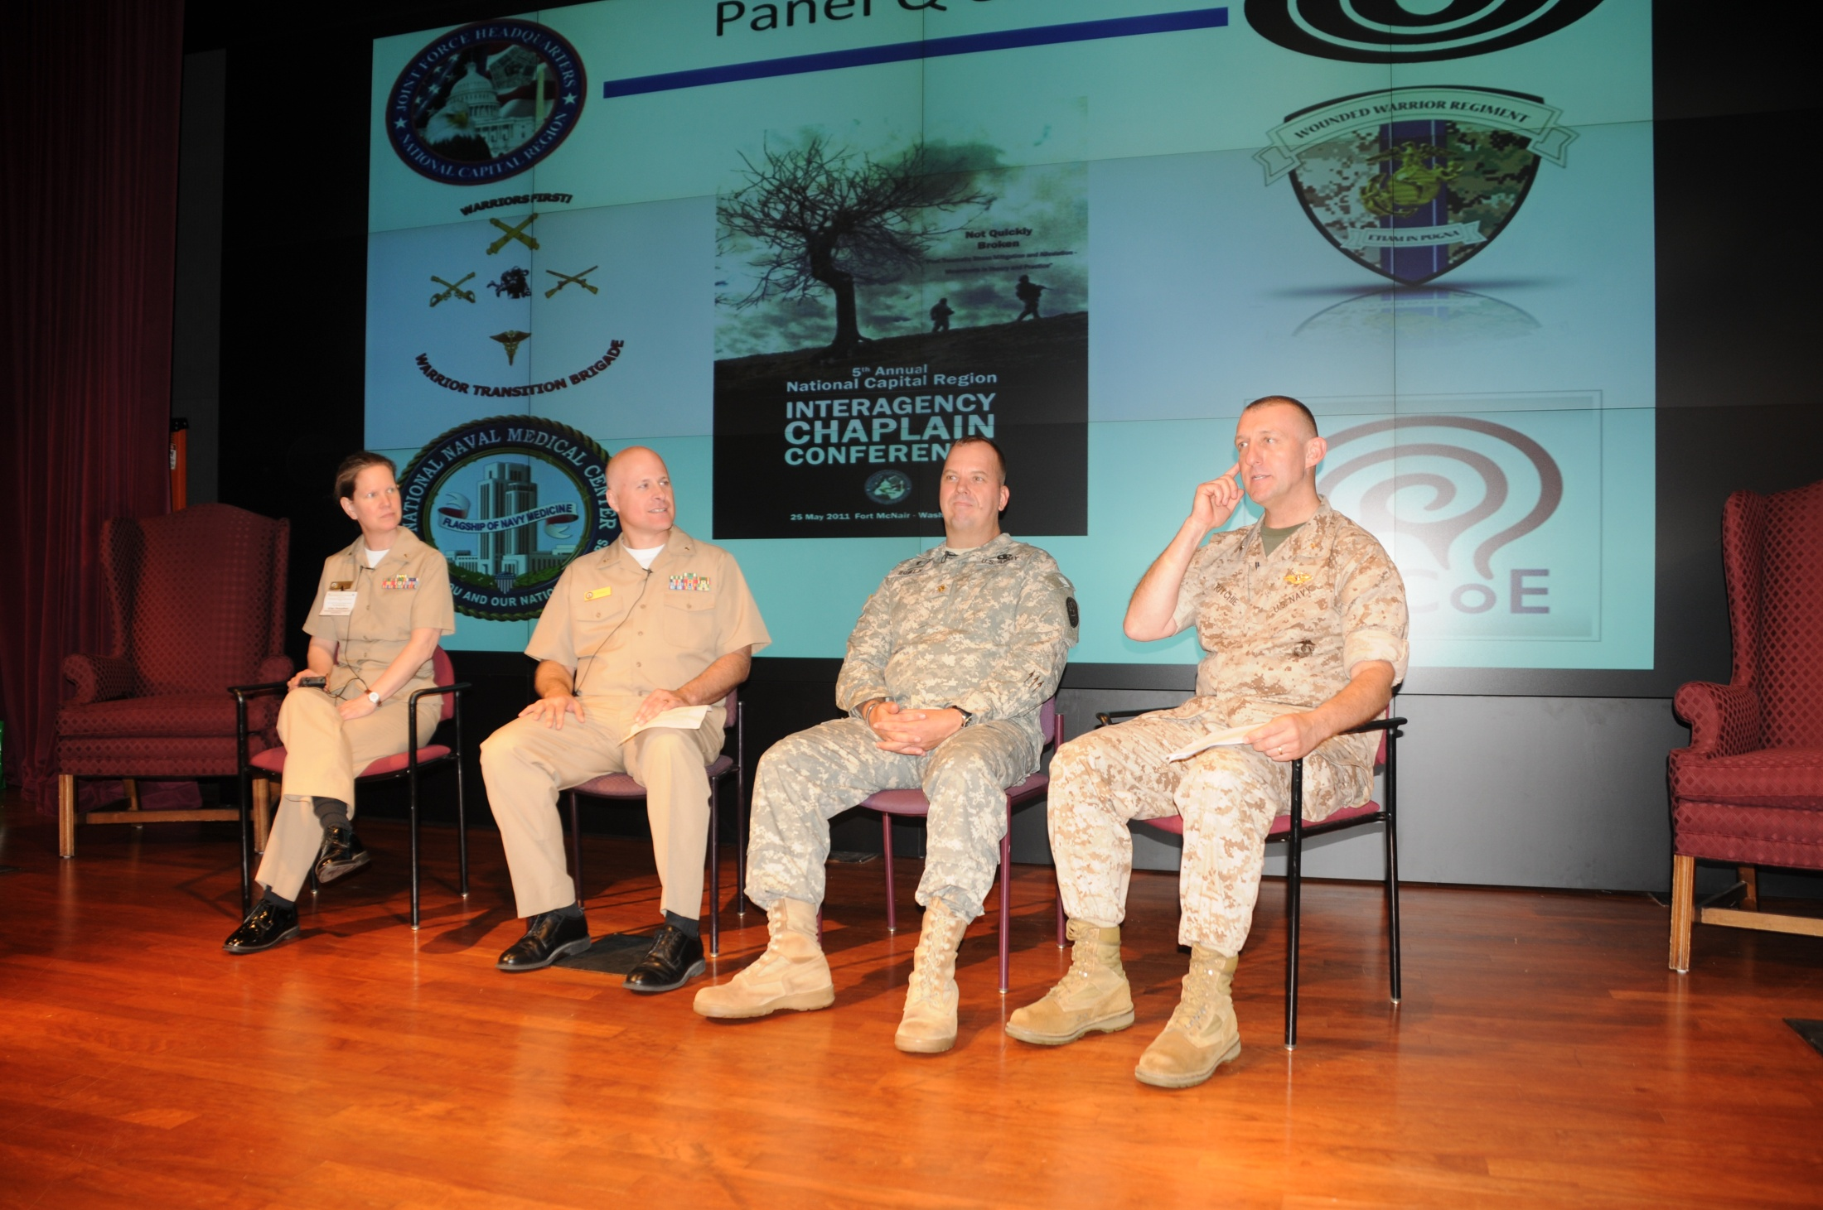

Slide 53
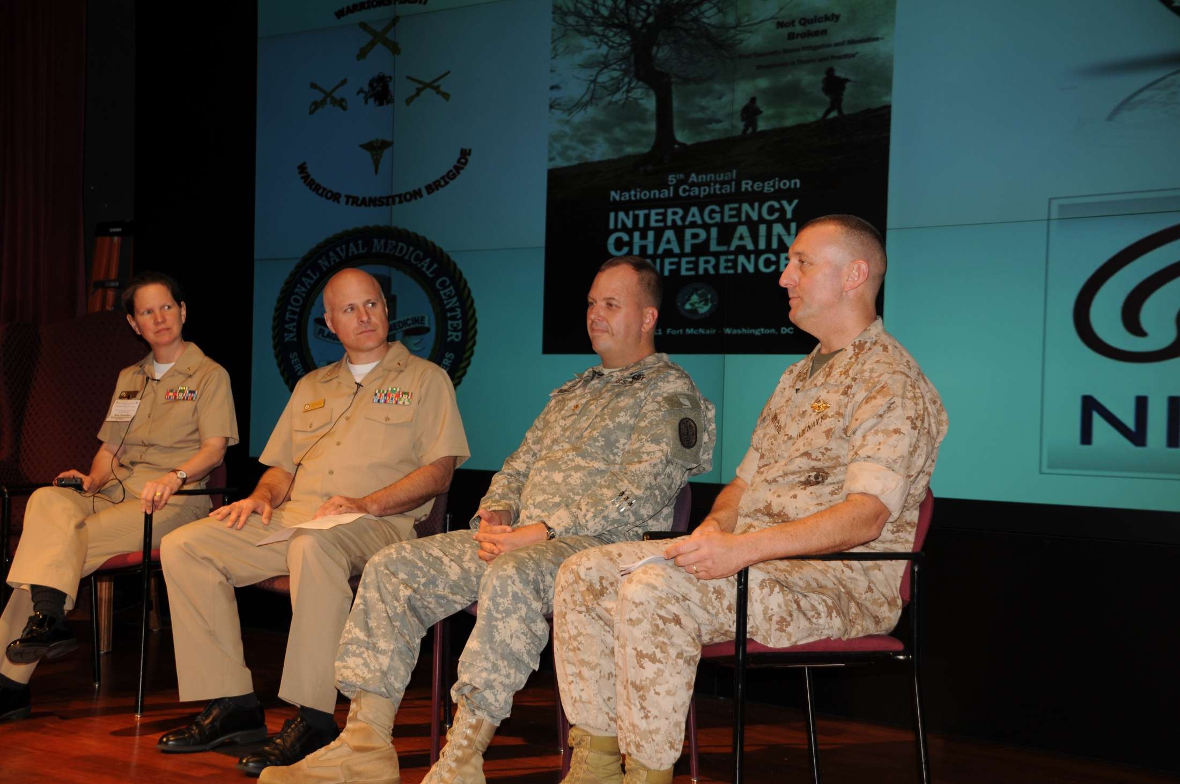

Slide 54
THANK YOU FOR JOINING US FOR THIS WONDERFUL AND IMPORTANT TRAINING!!
THE END

