Slide 1

Chesapeake Bay
EPA TMDLs & State WIPs:
Implications for Local Governments
Presentation to
Water Resources Technical Committee
November 12, 2010

Slide 2
Today’s Focus
Staff Overview
  TDMLs & WIPs – Schedules & Key Features
  Comments - Common Themes
WRTC Discussion
  Additional Questions/Info. Needs as WIPs Revised?
  Outreach to Local Govt. Elected Officials – WRTC Input
  Nutrient & Sediment Trading – Viable Options for COG Region?

Slide 3
Schedule for Bay TMDLs & WIPs
2010
July 1, 2010 – EPA issued Draft TMDL Allocations
September 1 - States/District issued Phase I WIPs
September 24 - EPA issued Draft Bay TMDLs
  October 4 – COG Special Sessions for WRTC & CBPC
  October 13 – COG Board Meeting
September 24 – November 8 – Public Comment Period
  (for TMDLs & WIPs) [COG Comments Submitted to EPA & MD/VA]
November 29 – States/DC Submit Final Phase I WIPs
December 31 – EPA Issues Final Bay TMDLs in Federal Register

Slide 4
Schedule for Bay TMDLs & WIPs
2011
June 1 – States/DC to submit Draft Phase II WIPs [Deadline could be modified]
  Loads to be sub-allocated to local (county) level – MD actually plans to have county liaisons
November 1 – States/DC submit Final Phase II WIPs
December - EPA to potentially revised TMDLs - Based on refined Watershed Model (WSM)
December 31 – Bay States must complete first set of 2-Year Milestones
2017
Phase III WIPs to be Submitted – Draft by June 1, Final by November 1
EPA to assess implementation progress
  60% of WIP Implementation to be Achieved & Ensure practices in place to achieve 2025 goal
EPA to determine whether to use WSM updates for WIPs & revised TMDL – and Revise TMDL if necessary
2020
Maryland expects to achieve 100% WIP Implementation
2025
100% of WIP Implementation to be Achieved Bay-wide

Slide 5
Key Features of Bay TMDLs
Draft Allocations
  By State/District (e.g., Maryland, Virginia, District)
  Major Tributary Basins (i.e., Potomac River)
  Same as the Target Load Allocations (issued 7/1/10)
  Includes EPA obligations for explicit Nitrogen Reductions
    Based on implementation of federal air regulations
  5% Temporary Reserve – Set-aside load defined for each State/District
    Purpose is to ensure that loads are set-aside in case WSM updates (~2017) indicate additional load reductions are required
Reasonable Assurance & Accountability Framework
  Includes 2-Year Milestone reporting – Dec. 31, 2011 (1st set completed)
  Potential for additional federal action

Slide 6
Key Features of Bay TMDLs
Margin of Safety
  Assumed to be implicit given models, water quality standards, & other TMDL assumptions
Growth
  Not accounted for beyond 2010 – except for wastewater plant permitted capacity
  Up to States/District to define how growth is to be addressed in WIPs
Air Deposition
  15.7 Mlb to be achieved by 2020 due to federal regulations - EPA responsibility
  Recent air quality regulations & newer modeling of controls are NOT accounted for (noted at Sept. 28th state air quality meeting w/ EPA)
    Not sure of actual impact to loads, but need to pursue/further evaluate implications

Slide 7
Key Features of Bay TMDLs
Climate Change
  To be addressed formally in 2017 reassessment
Federal Lands
  Only 5% Bay-wide (but 30% in District)
  Federal commitments cited in President’s Executive Order (but is it occurring?)
Recognition of Need for Offsets, Support for Water Quality Trading
  Applicability to COG Region?
  What options/scenarios are likely?
Future Modifications - Adaptive Management / Phased Approach
  But, only two options noted that might result in changes in TMDLs:
    ‘State’ exchanges of loads across tributaries – if local & Bay water quality standards still met
    Modifications of Watershed Model Phase 5.3 – if required
Changes in Modeling Assumptions - IF supported by Monitoring Data
  Susquehanna River Dam (sediments)
  Filter Feeders

Slide 8
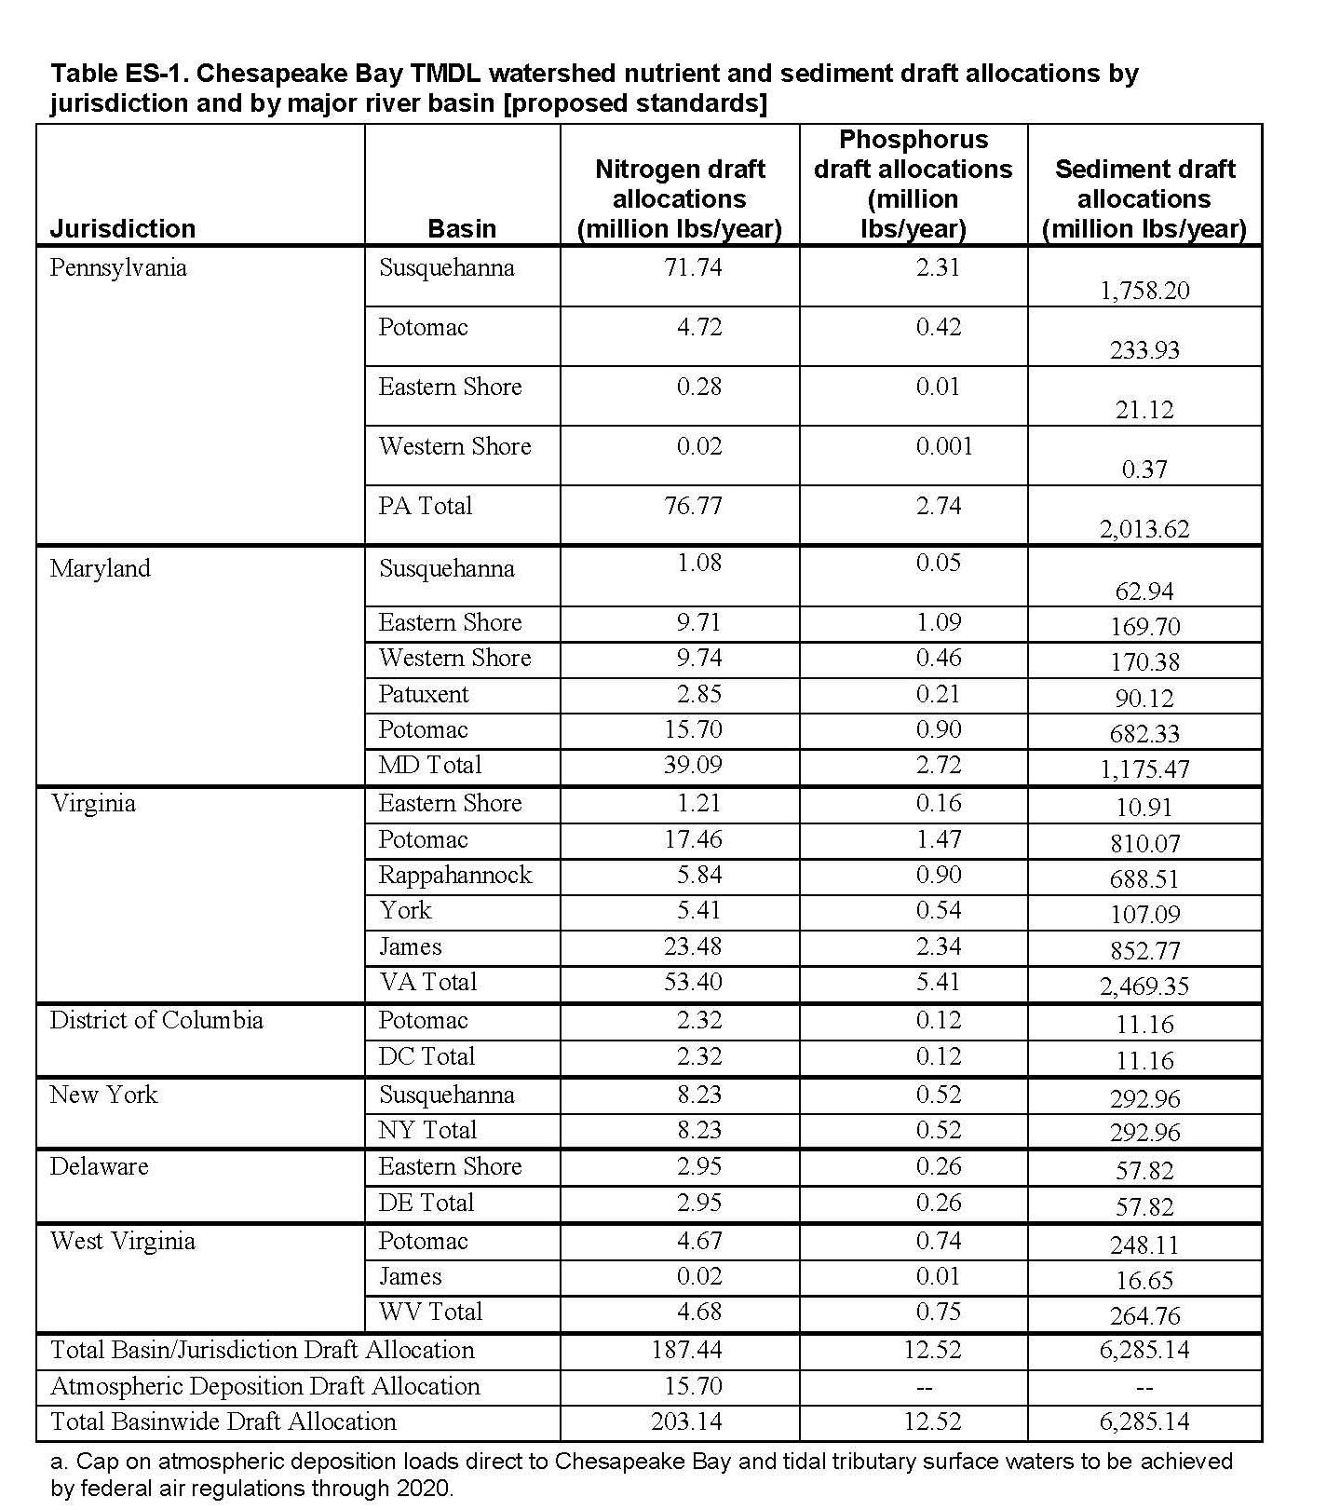
Draft TMDL Allocations - by State/Major Tributary Basins
Notes:
Loads are same as Target Loads (7/1/10);
This table does NOT include the 5% Temporary Reserve Loads set-aside for each State;
Loads are further sub-allocated to all 92 tidal segments; and
~24-25 segments apply to COG region.

Slide 9
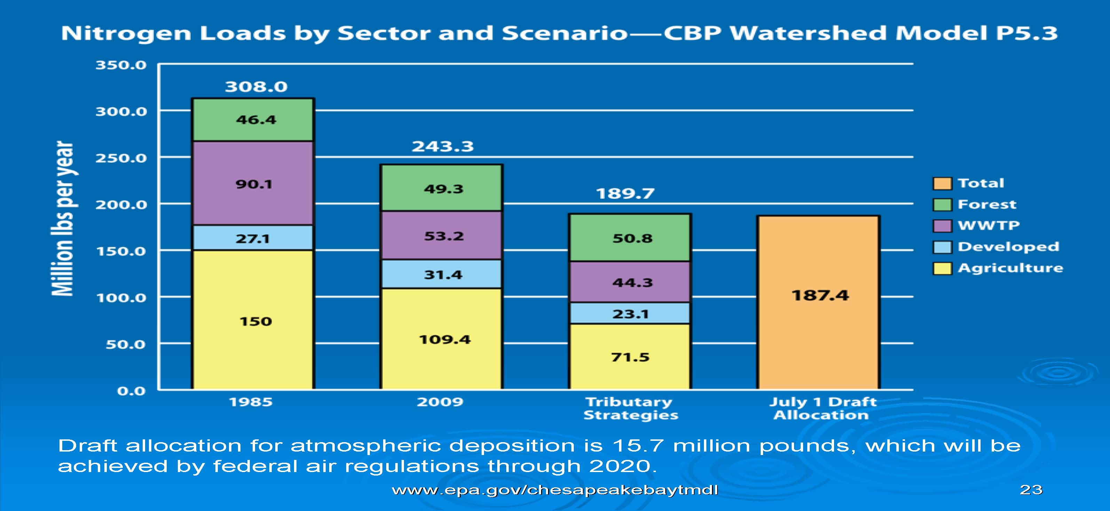
SETTING THE DIET

Slide 10
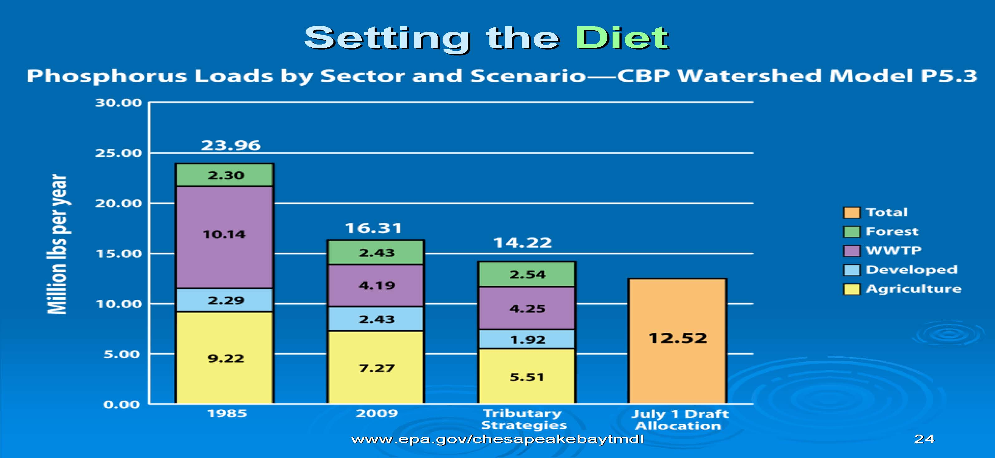

Slide 11
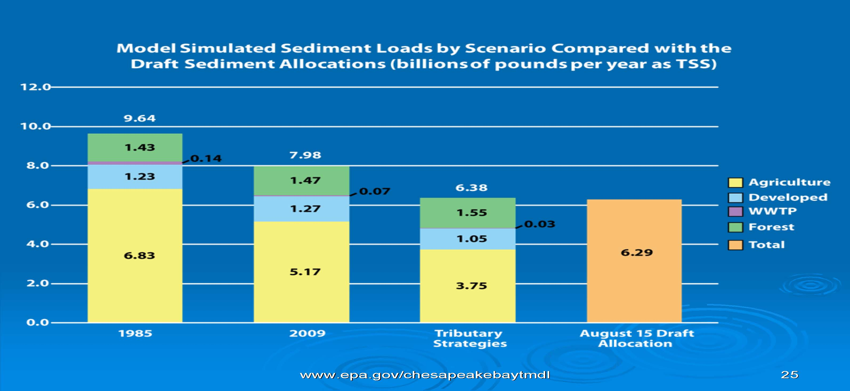

Slide 12
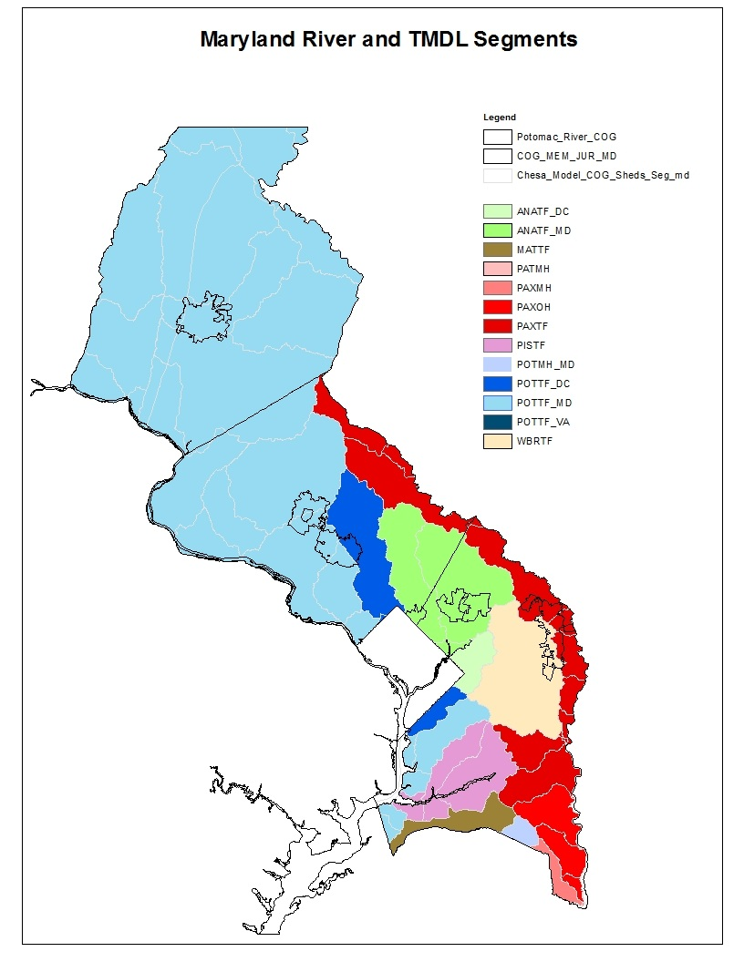
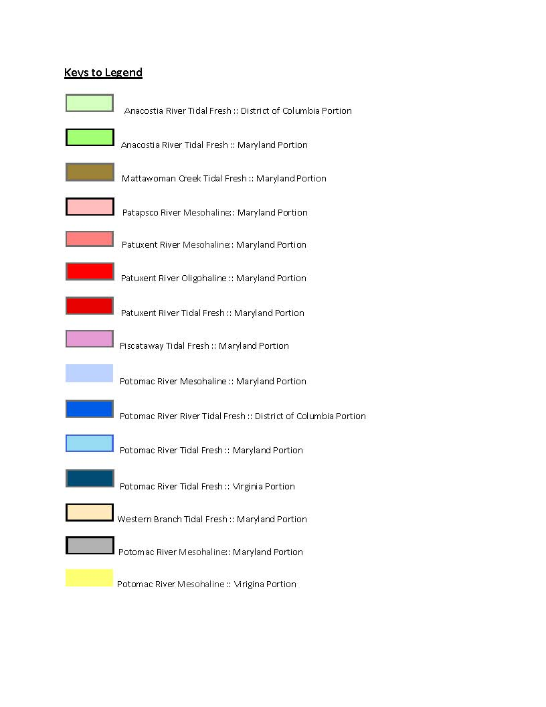
Segment-sheds in COG region

Slide 13
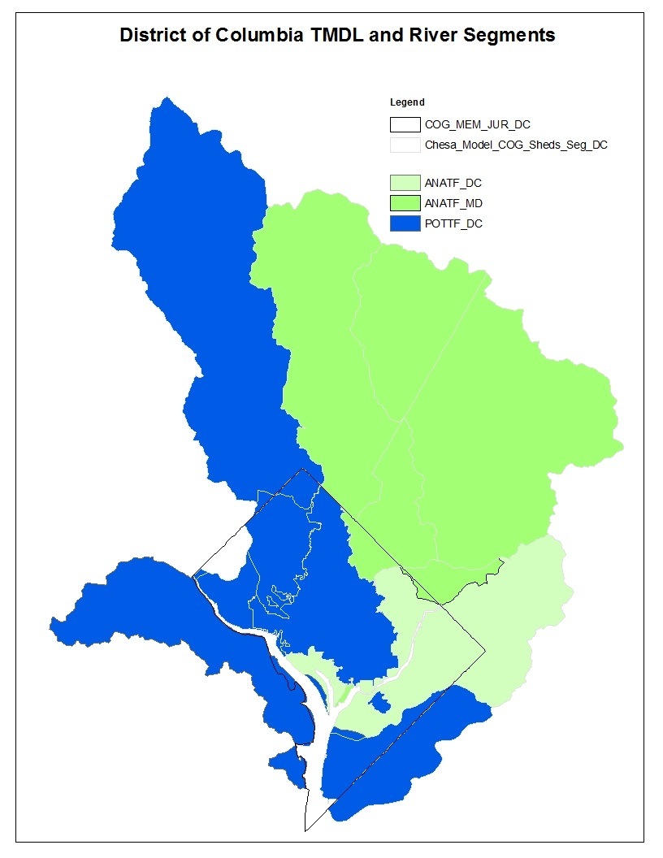
Segment-sheds in COG region
POTTF_MD

Slide 14
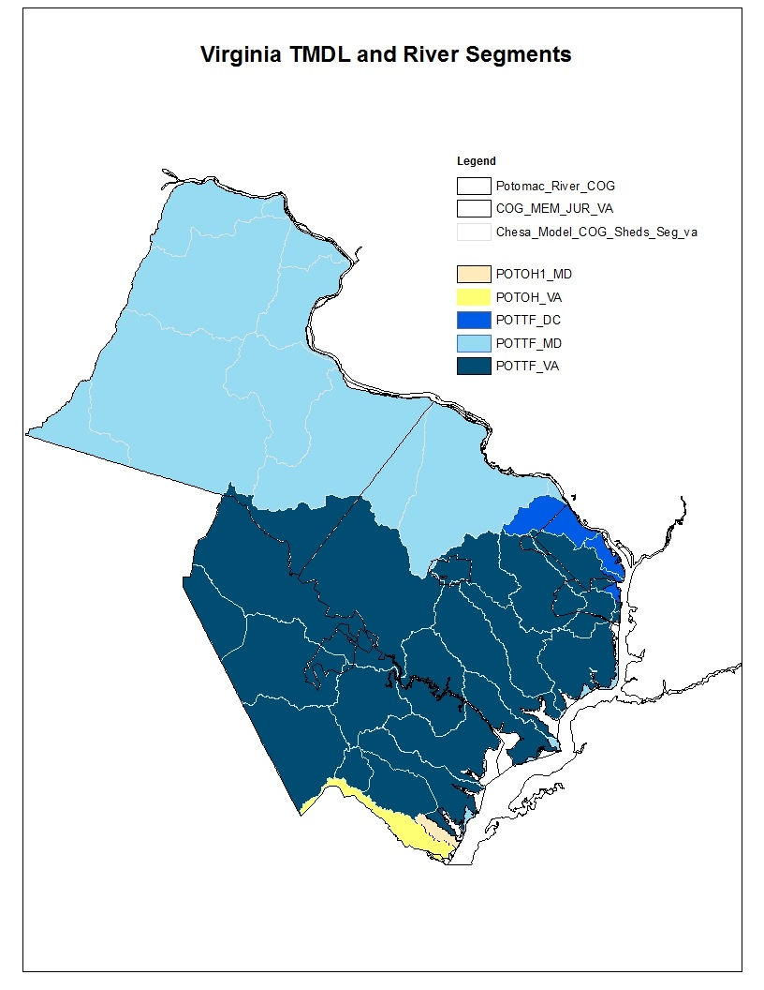
Segment-sheds in COG region

Slide 15
Segment-sheds – COG Region
Defined by impaired water-segments and its contributing watersheds
TMDLs defined for each segment-shed
Counties/District generally have multiple segment-sheds, e.g.,
  District (4)
  Montgomery (5)
  Prince George’s (7)
Segment-sheds | DC | MD | VA
ANATF_DC | X | X
ANATF_MD | X | X
POTTF_DC | X | X | X
POTTF_MD | X | X | X
POTTF_VA |  | X | X

Slide 16
Bay TMDL – WIP Evaluation
EPA evaluated WIPs
  Achieve targets?
  Provide “reasonable assurance”?
Overall assessment – WIPs not adequate *****
  Often don’t meet targets
  Inadequate gap strategies, limited enforceability/accountability, few dates for action, etc.
Federal ‘Backstops’ *****
  IF Final Phase I WIPs are not strengthened
  For which federal regulatory authority exists
        [Final Phase I versus Draft/Final Phase II WIPs]

Slide 17
Comments - Common Themes
EPA has failed to:
  Adequately engage affected entities
  Underestimated financial burdens & hence feasibility
  Set unrealistic implementation schedule (i.e., for 2017 and for 2025)
  Failed to allow sufficient time for input/comment
  Not provided sufficient details to assess actual responsibilities & impacts
Technical basis is flawed
  Watershed model (WSM) assumptions & loads
    Percent impervious assumptions, land cover data – not valid
    Tables not clear & all loads Not accounted for (CSOs, errors for various WWTPs, practices missing, etc.)
  WSM fails to incorporate/credit all practices (Ag & Urban)
  Not all proposed practices are appropriate/feasible

Slide 18
Comments - Common Themes
Unreasonable/Inappropriate
  Seeks to control growth and local/state prerogatives
  Exceeds EPA’s regulatory authority or assumes where no authority exists
    (e.g., SW – maximum extent feasible vs. proposed levels of effort)
  EPA shouldn’t be issuing the TMDL (states should)
  EPA has no implementation authority
  May not be appropriate as a ‘national model’
Cannot impose automatically federal ‘Backstop Measures’ (& some not w/in EPA’s authority)
Must assess cost/financial burden given scale/scope/impacts
  Unaffordable, costs to implement (esp. SW & Ag) much higher than assumed (based on attempts to quantify costs)
Must ensure that flexibility (adaptive management) is used
Must ensure that Water Quality Trading is viable
Must allow sufficient time for input (e.g., extend Phase II WIP deadline)

Slide 19
Next Steps
Public comment jointly and individually - Continue
  Evaluate Final Phase I WIPs vs. comments
  Key up issues for Phase II WIPs (June – Nov. 2011 or later)
  COG technical & policy work into 2011 …2017…2025
Pursue federal legislation
  Another look at Cardin bill ?
  Other alternatives
Pursue state legislation
  Support more regulation or funding for agriculture (‘Reasonable Assurance’)
  Support for viable trading mechanisms *****
Other/Litigation?
  Several actors rumored to be readying lawsuits challenging the terms of the TMDL

Slide 20
  Trading (TMDL/WIPs/other legislation)
Pollutants:
  Nutrients (Nitrogen & Phosphorus)
  Sediment
Viable Option for COG Region?
  WWTPs with other WWTPs? With Ag? With?
  SW with Ag? With ?
  When likely needed?
What features are good vs. bad for trading?
  TMDL/WIPs/other legislation
Existing & Expanded Programs
  Viable?
  Missing key elements?
  Other issues?

Slide 21
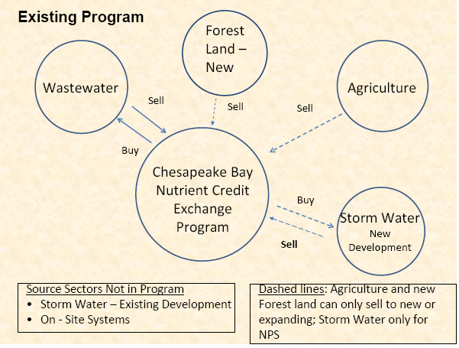
VA WIP - Reliance on Trading
Proposed Nutrient Credit Exchange Program

Slide 22
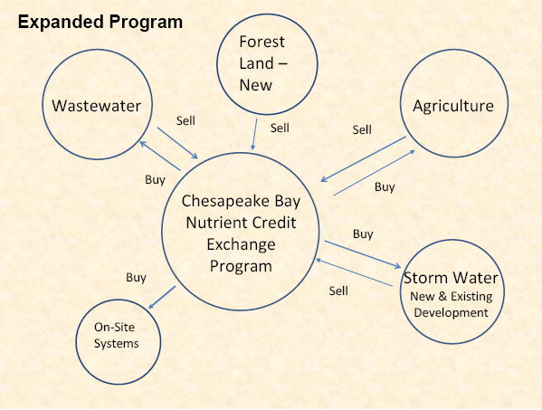
VA WIP - Reliance on Trading
Existing Nutrient Credit Exchange Program

