Slide 1

Overview of Water Infrastructure
In the National Capital Region
Challenges & Opportunities
November 8, 2012
Tanya T. Spano, Chief, Regional Water Quality Management Section
Dept. of Environmental Programs
Metropolitan Washington Council of Governments

Slide 2
Water Infrastructure Across the Region
    Drinking Water / Wastewater / Stormwater
Key Features:
  Service Areas & Facilities
    Physical Scope and Mixture of Entities
  Challenges & Opportunities
    Numerous (e.g., regulatory to climate change)
  Funding Sources & Needs
    Water Resource vs. Other Infrastructure vs. Other Societal Needs
    Current Economy
Q&A

Slide 3
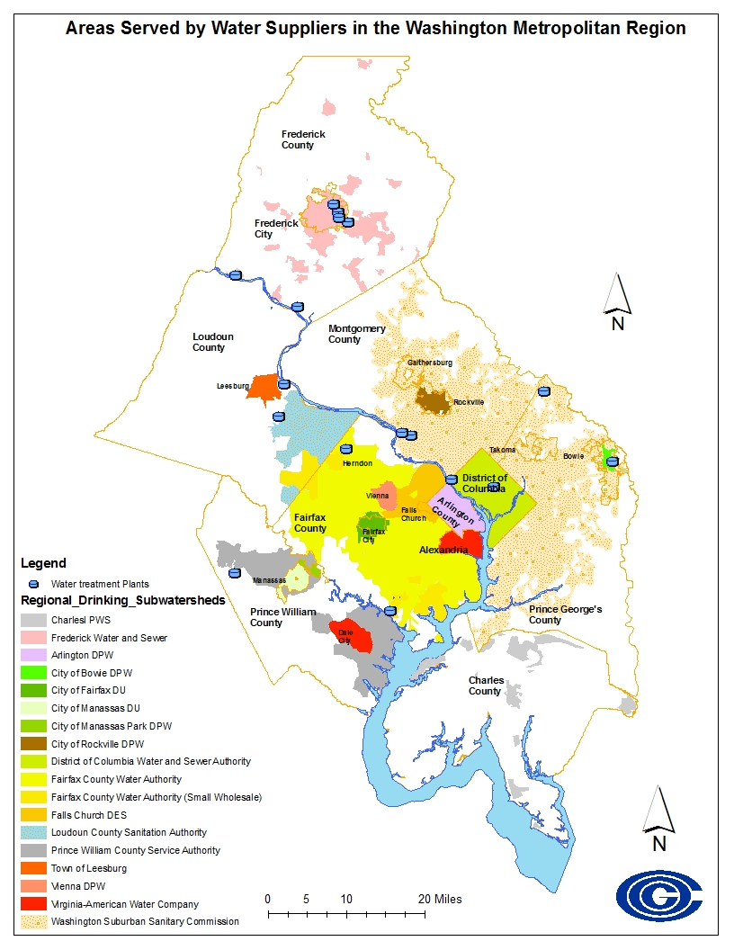
DRINKING WATER
Service Areas for Washington Metropolitan Region Water Suppliers & Distributors
13 suppliers
27 distributors
Mix of local governments, authorities, federal govt., & private firms
Water Sources: Potomac River, Occoquan and other reservoirs , and groundwater
Based on available data.
Areas should be interpreted with these caveats:
  May be people living in the colored distribution areas who derive water from ground water wells.
  People living in the non-colored areas outside of the distribution regions may derive water from groundwater wells or small community systems
  Boundaries last updated in ICPRB in 2000 Supply/Demand study
Map should not be used to establish what treatment agency actually provides water.

Slide 4
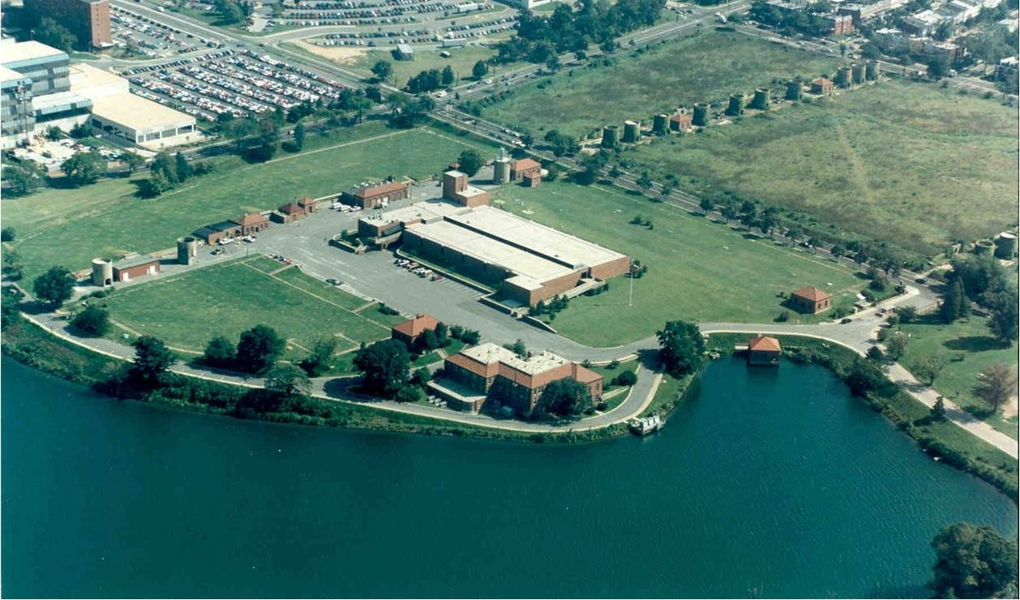
McMillan Water Treatment Plant (60-120 mgd)
Washington Aqueduct (WAD)
Wholesale Customers:
District of Columbia
Arlington County, Virginia
City of Falls Church, Virginia
Infrastructure, including:
Intake facilities on Potomac - Great Falls & Little Falls, MD
Two 10-mile long gravity conduit systems with combined 200 mgd capacity
A 525 mgd raw water pumping station & transmission system
Two major treatment plants - 320 mgd combined capacity
One raw water & two partially-treated water booster pumping stations
A 480 mgd finished water pumping station
Seven finished water reservoirs; and
Several large diameter transmission mains.
FY 2010:
Capital Costs - $16.4 Million committed (~3 major projects) plus $18.6 Million uncommitted (~10 projects) = $35 Million
O&M Costs - $38,261,757. including:
  Personnel compensation (36%) / Supplies and chemicals (20%) / Services (16%) / Energy (15%)
Produced & delivered 53,210 mgd

Slide 5
Drinking Water Infrastructure Costs
AGENCIES / Facilities | OPERATING & MAINTENANCE | CAPITAL IMPROVEMENTS
Fairfax Water (2 plants; 1 reservoir; 3,400 miles water mains) | $75 Million | $88 Million
Washington Aqueduct (2 plants; 5 reservoirs) | $45 Million | $14 Million
Washington Suburban Sanitary Commission (3 reservoirs; 2 plants; 5,500 miles of water mains) | $112 Million | $200 Million
Note: Figures based on actual/approved Fiscal Year 2011, 2012, or estimated 2013 budgets

Slide 6
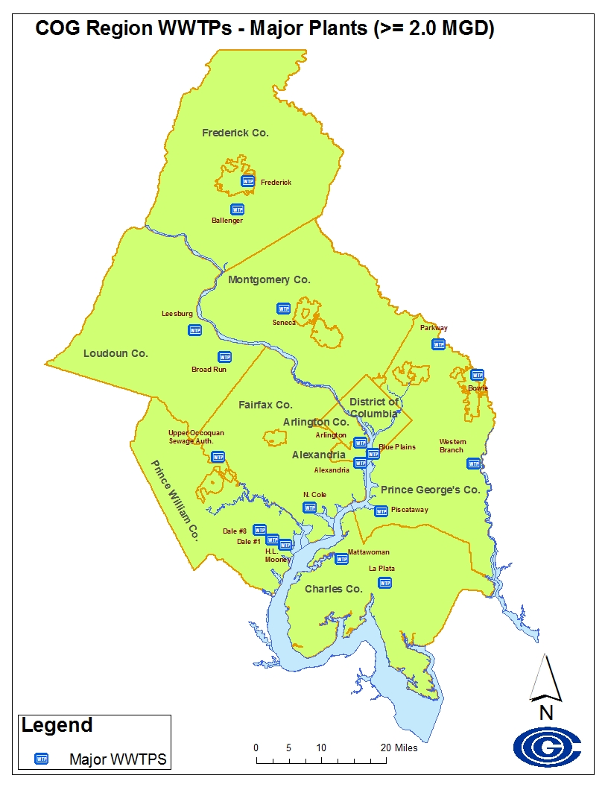
WASTEWATER
COG Region Major (>2 MGD) Wastewater Treatment Plants & Capacity
District:
Blue Plains – 370 {serves DC, & parts of VA& MD; & ~47% of overall region}
Virginia:
Alexandria – 54
Arlington – 40
Ballenger Creek – 6
Broad Run – 10
Dale City #1 – 4
Dale City #8 – 4
H.L. Mooney – 18
Leesburg – 5
Noman Cole – 67
UOSA – 54
Maryland:
Bowie – 3
Frederick – 8
Mattawoman - 20
Parkway - 30
Piscataway – 30
Seneca Creek – 26
Western Branch – 30
TOTAL – 779 MGD (Million Gallons per Day)
19 major WWTPs
16 collection providers
Mix of local governments, authorities, & federal govt.

Slide 7
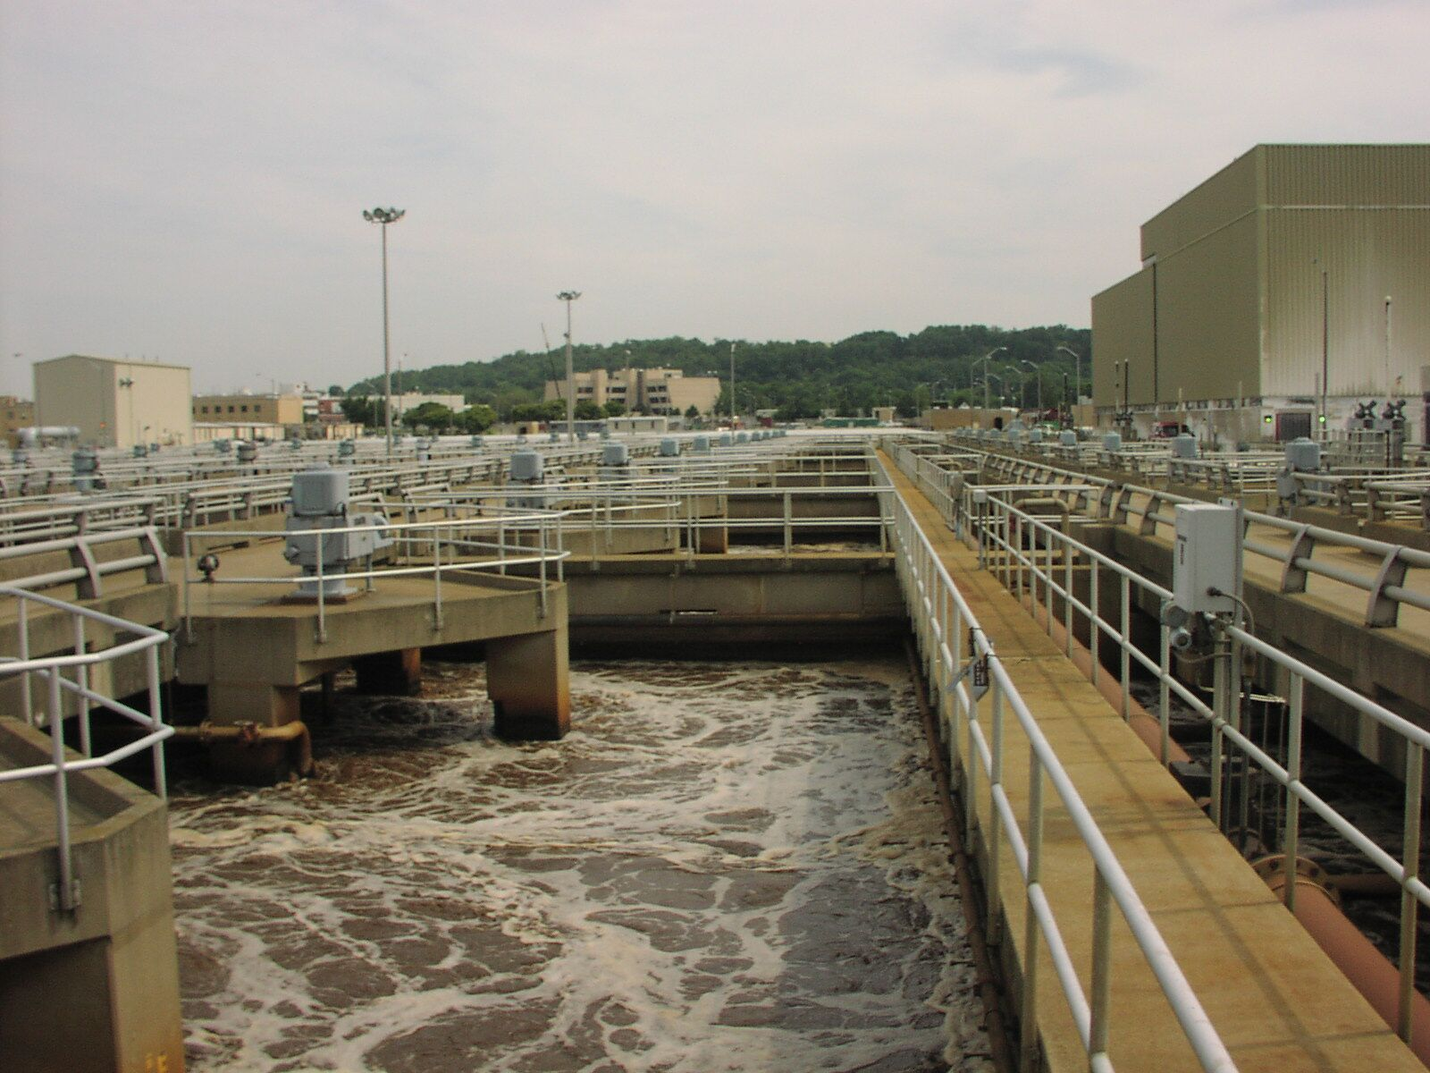
DC WASA: Water & Sewer Infrastructure
Capital Improvement Program (10-year spending plan) includes:
45% - regulatory required projects with environmental impacts
14% - infrastructure identified as nearing imminent failure
New Digestion Facilities- $400+ million (Green - Class A biosolids, reduced hauling costs, & generate 10 MW of electricity)
Enhanced Nitrogen Removal - $800 million to reduce nitrogen in effluent (By Year 2014 / lifetime cost $950 million)
Combined Sewer Overflow Long Term Control Plan – $1.1 billion (Lifetime cost of $2.7 billion)
Water & Sewer infrastructure projects - $300+ million

Slide 8
Wastewater Infrastructure Costs
AGENCIES / Facilities | OPERATING & MAINTENANCE | CAPITAL IMPROVEMENTS
DC Water (1 plant; 1,800 miles of sewer & combined mains) | $456 Million | $424 Million
Fairfax County (not counting Blue Plains costs) (1 plant & shares of 4 other plants; 3,390 miles of sewer mains) | $72 Million | $277 Million
Washington Suburban Sanitary Commission (not counting Blue Plains costs) (7 plants; 5,400 miles of sewer mains) | $105 Million | $202 Million
Note: Figures based on actual/approved Fiscal Year 2011, 2012, or proposed 2013 budgets

Slide 9
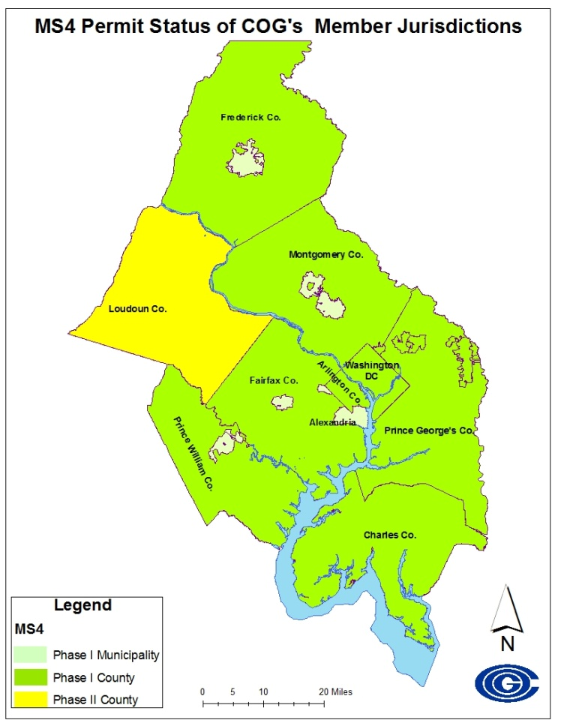
STORMWATER
  MS4 Stormwater
  Permits – COG Region
  Phase I (larger counties) or Phase II (smaller counties and towns)
  Phase I’s – Revised permits either in place (Montgomery, District) or being renewed now
  Phase II’s - Due for renewal in 2012, 2013
  Stormwater Management
Local Drivers:
Construction, & post-construction regulations
MS4 permits
Local TMDLs
Bay TMDL
Restoration Goals

Slide 10
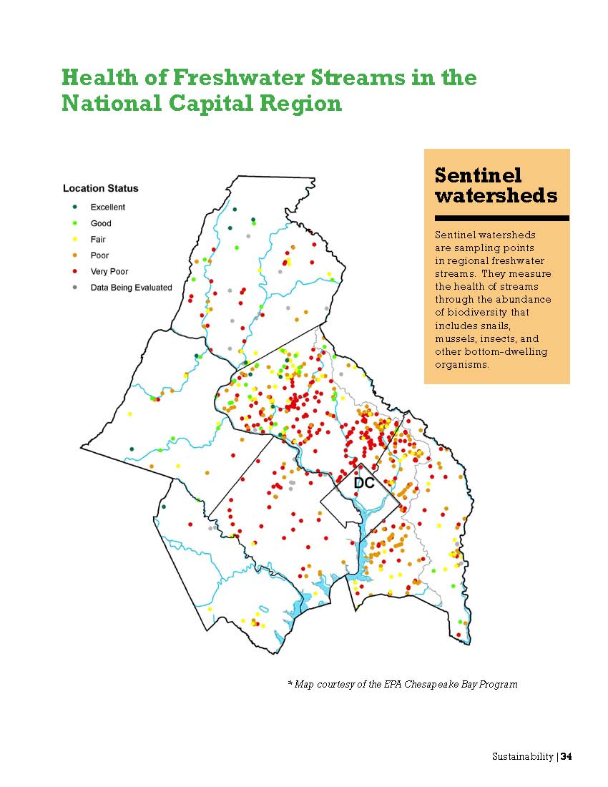
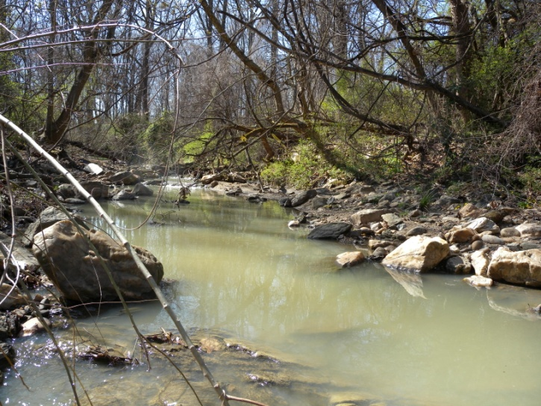
  Preliminary Capital Cost Estimates To Meet Bay TMDL Requirements
  (largely for urban stormwater retrofits)
  - Frederick County about $2.35 billion
  - Montgomery County about $1 billion
  - Fairfax County $845 million

Slide 12
Funding Sources & Needs
Rate payers (e.g., volumetric or flat fee charges)
Whole-sale customers
Fees (e.g., % impervious, stormwater utility, PILOT, rights of way, impact fees)
Taxes & General Revenue
State Revolving Loan Funds (SRLF)
Federal Funding (e.g., special appropriations)
State Grants/Cost-shares (e.g., VA Water Quality Improvement Fund; MD Bay Restoration Fund)
Financial Tools (e.g., municipal/utility bonds, debt proceeds, interest)
Reserve Funds & Rate Stabilization Funds
AWWA
$250 Billion more over next 20-30 years
WEF
Annual gap
$3-19.4 Billion
EPA
$335 Billion for DW
$298.1 Billion for WW
Just to maintain over next 20 years

Slide 13
Challenges & Opportunities
Sector / Challenge | Drinking Water | Wastewater | Stormwater
Replace Aging Infrastructure | X | X
Add New Infrastructure (or Retrofit) | X | X | X
Deal with Growth Impacts | X | X | X
Meet New Standards & Regulations | X | X | X
Address New Environmental Challenges & Risks | X | X | X
Address Work Force Issues | X | X | X
Address Major Funding Demands | X | X | X
Address Climate Change Implications | X | X | X
Restore & Protect Water Resources for Future | ✓✓✓ | ✓✓✓ | ✓✓✓
Integrate Planning, Be Innovative, Work Towards Multiple Environmental Benefits | ✓✓✓ | ✓✓✓ | ✓✓✓

Slide 14
Key Issues? Questions?
Panel Discussion at November 16th CBPC meeting
Proposed webinar for elected officials (Spring 2012)
What should we be conveying to the CBPC?
What should we be conveying to other elected officials (e.g., other COG committees, COG Board, elected officials).
Tanya T. Spano
tspano@mwcog.org
(202) 962-3776

