Slide 1
Montgomery County’s MS4 Permit Implementation Strategy: Using the Watershed Treatment to meet local and Bay restoration goals
Ted Brown, PE, Biohabitats, Inc.
and
Meo Curtis, Montgomery County DEP

Slide 2
Presentation Outline
Background
County’s MS4 Permit Implementation Strategy
Use of WTM as Assessment Tool
Lessons Learned and Challenges

Slide 3
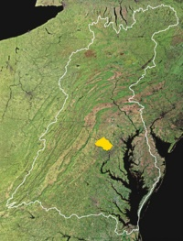
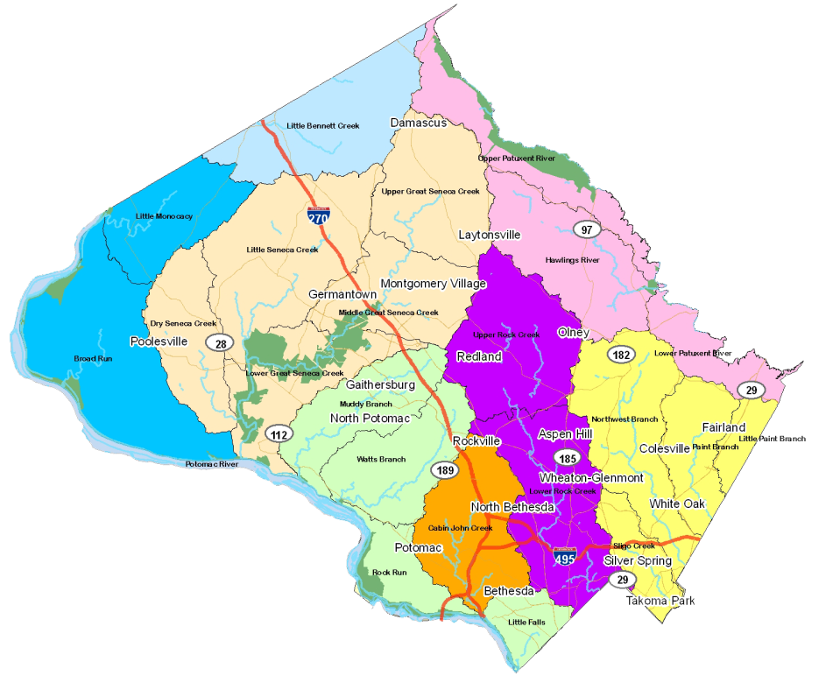
Montgomery County, MD
  500 sq. miles
  970,000 people
  About 12% impervious overall
  About 8,500 acres
  Equal to Area of Washington, DC
  Second only to Baltimore City
  within Maryland in average
  people per square mile
  >95% of land zoned for development
  has already been developed
  Two major basins:
  Potomac and Patuxent Rivers
  8 major local watersheds
Notes:
Brief history and tidbits about MoCo. Northern boundary not bordered by either river.
Explain level of diversity in MoCo and how that is important factor to consider for our programs and for addressing our water quality concerns.

Slide 4
Montgomery County Major Watersheds

Slide 5
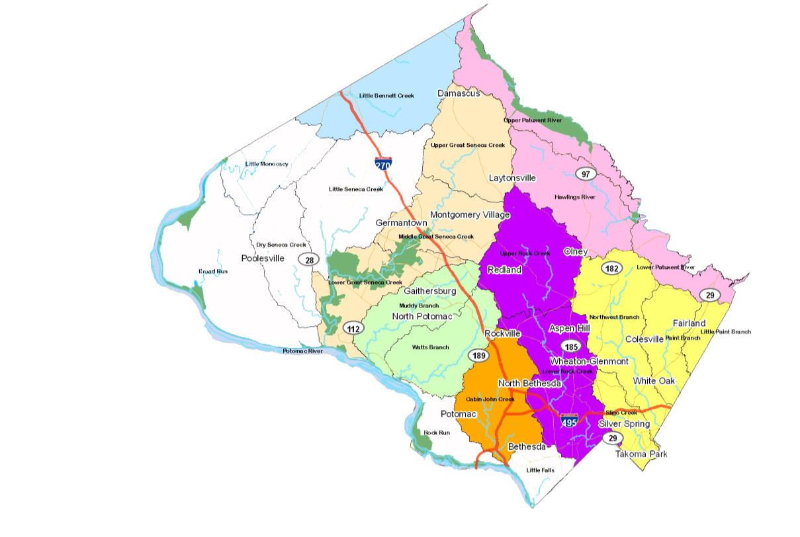
Countywide Coordinated Implementation Strategy
Meet MS4 permit goals
Watershed Implementation Plans
  Bay TMDL
Timeline
    Began in June 2009
    Submitted to MDE in February 2011
    MDE approved plans in July 2012
= No Implementation Plans
Notes:
5

Slide 6
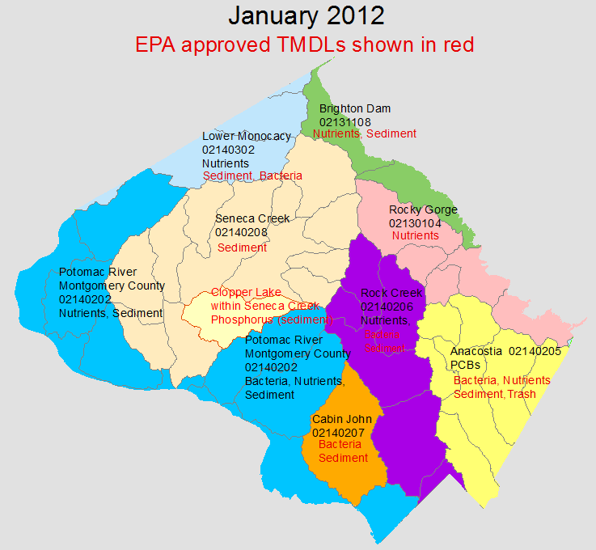
Total Maximum Daily Loads

Slide 7
Primary Driver: Restoration Goal
By February 2015, add stormwater management to an additional 20% of impervious area currently not treated to the maximum extent practicable (MEP)
Description | Area in Acres
Total | 324,552
Total Area of Impervious Surface | 35,965
County Subject to Stormwater Permit (1) | 138,649
Impervious Cover Subject to Stormwater Permit | 25,119
Adequately Treated Impervious Cover | 3,661
Inadequately Treated Impervious Cover | 21,458
20% of Inadequately Treated Impervious Cover | 4,292
(1) Exclusions include: Certain zoning codes, parklands, forests, municipalities with own stormwater management programs, state and federal properties, and state and federal maintained roads

Slide 8
Compliance Targets
Target Date | Compliance Target | Metric
2015 | 20% impervious cover treatment requirement | ~4,300 acres of Impervious Cover
2017 | Meet the interim dates and targets for the Chesapeake Bay TMDL | 9%, 12%, and 20% respectively for TN, TP, and TSS reductions from baseline conditions
2020 | Meet the full compliance and targets for the Chesapeake Bay TMDL Meet additional impervious cover treatment targets associated with next MS4 Permit cycle (assumes another 20% target) | 18%, 34%, and 37% respectively for TN, TP, and TSS reductions from baseline conditions ~3,400 acres of Impervious Cover (20% of impervious remaining after 2015)
2025 | Meet additional impervious cover treatment targets associated with next MS4 Permit cycle (assumes another 20% target) | ~2,750 acres of Impervious Cover (20% of impervious remaining after 2020)
2030 | Out year compliance with other watershed TMDLs | 100% compliance with MS4 Permit Area WLAs

Slide 9
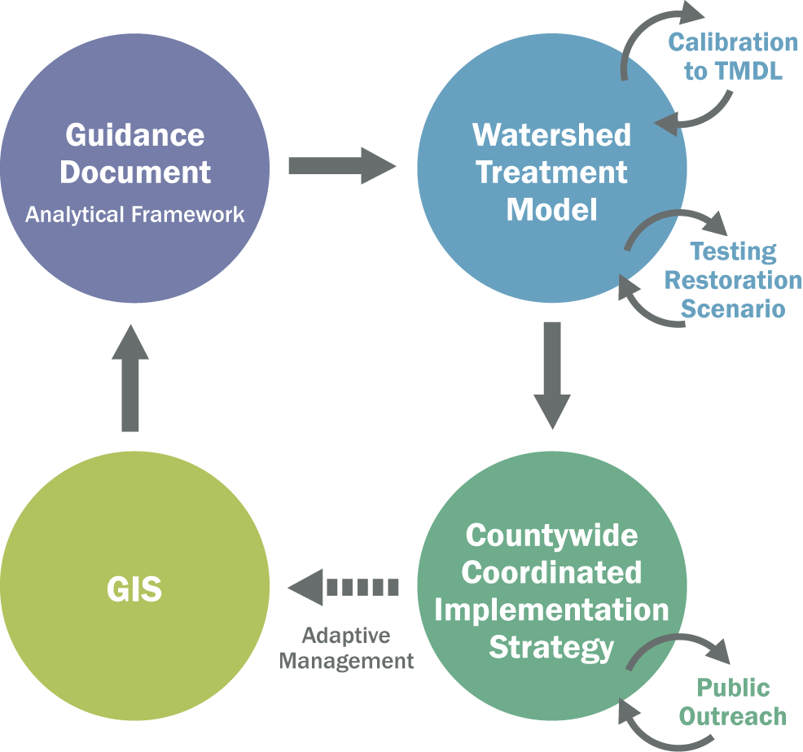
Modeling Framework

Slide 10
WTM Basis
Army Corps of Engineers used for Anacostia Study (2010)
Started with an updated version of the WTM which included volume reduction, received from Deb Caraco (Oct 2009)

Slide 11
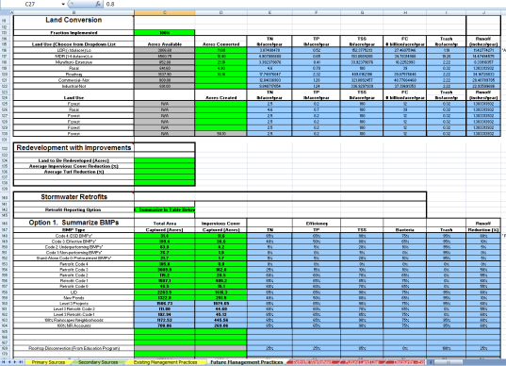
Watershed Treatment
Model
Analytical Approach
Land Use
EMC (Urban)
Unit Load (Non-urban)
Soils & Rainfall
Annual Runoff Volume
Pollutant Load
Before
treatment
BMPs
Performance Code
Removal Efficiency
Discount Factors
BMP specific
Pollutant Reduction
Applied to baseline load
Treatability Factor
Notes:
We used the Watershed Treatment Model (WTM) developed by the Center for Watershed Protection in Ellicott City MD. The WTM was used by the Corps of Engineers to estimate pollutant reductions for the Anacostia Watershed Restoration Plan, and we wanted our results for the Anacostia to correspond directly to the COE effort. The WTM is recognized as a planning level model which takes GIS output for land use and BMP drainage areas and then calculates pollutant loads from those land uses. The loads reductions are based on the type of BMP and the assigned reductions by pollutant by BMP type. The WTM approach also considers ‘discount factors’ from 100% since no BMP is 100% effective.
The WTM is currently programmed with conventional structural BMPs (like ponds), some ESD-type practices (like bioretention cells), and even some programmatic practices like alternative lawn care, streetsweeping, and pet waste management. The WTM was not set up to include trash reductions, but our consultant developed an approach that used the trash loadings rates by land uses based on the Anacostia Trash TMDL and then assumptions from literature review for trash capture or trash source removal.
11

Slide 12
WTM Process
WTM 1.0
WTM 2.0
WTM 3.0
ESD Strategies and Other Structural BMPs
Completed as of 2009; High Priority; Low Priority and Other Potential Projects
Baseline Conditions
WTM 4.0
Habitat Restoration
MS4 Programmatic Practices
WTM 5.0

Slide 13
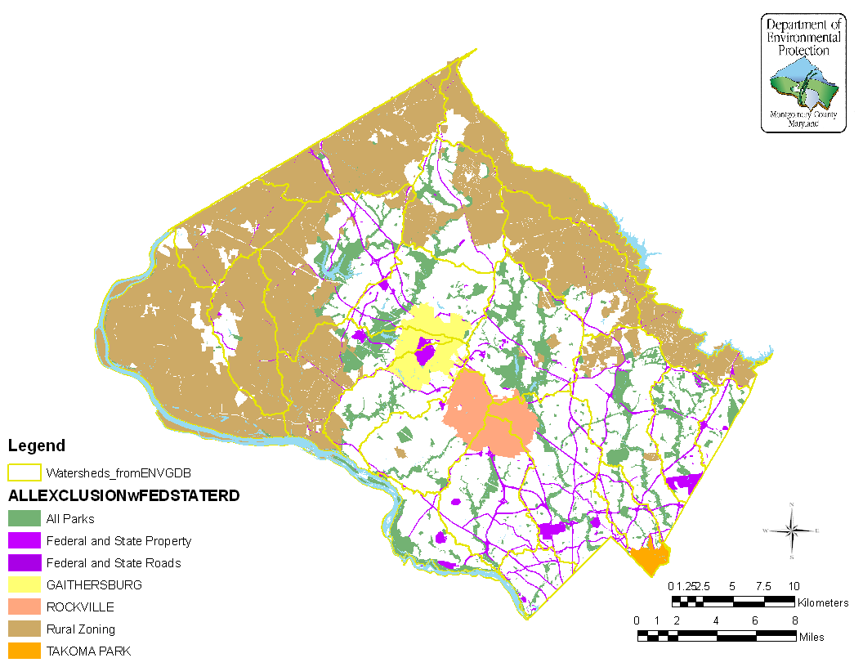
Watersheds and Excluded Areas

Slide 14
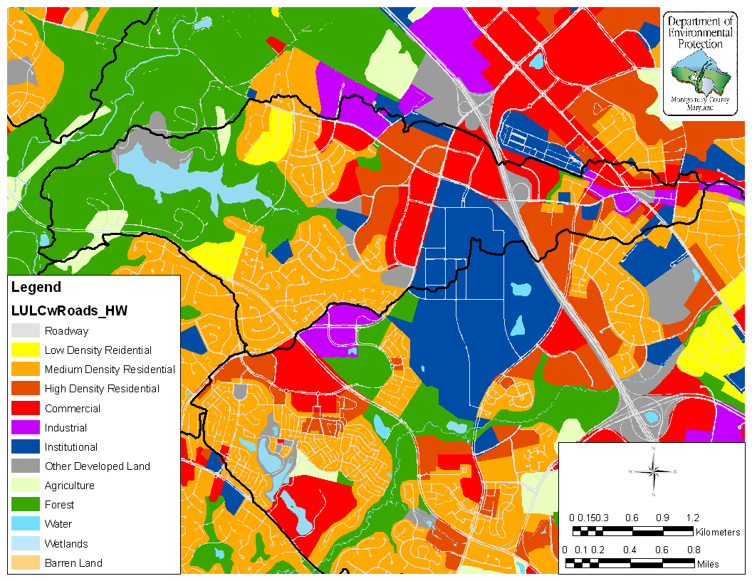
Land Use and Land Cover

Slide 15
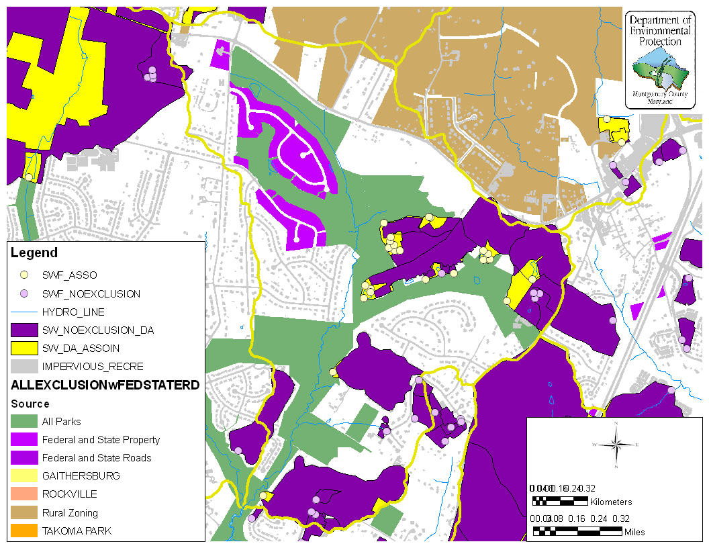
Urban BMP Database

Slide 16
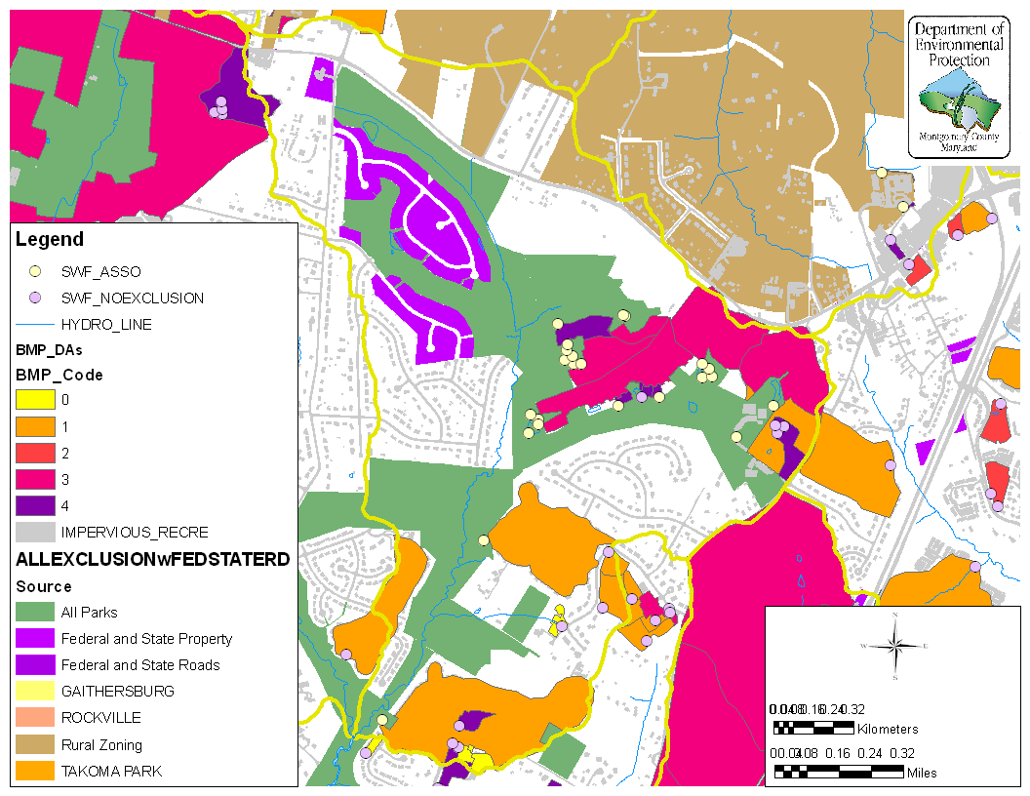
Managing the Urban BMP Database

Slide 17
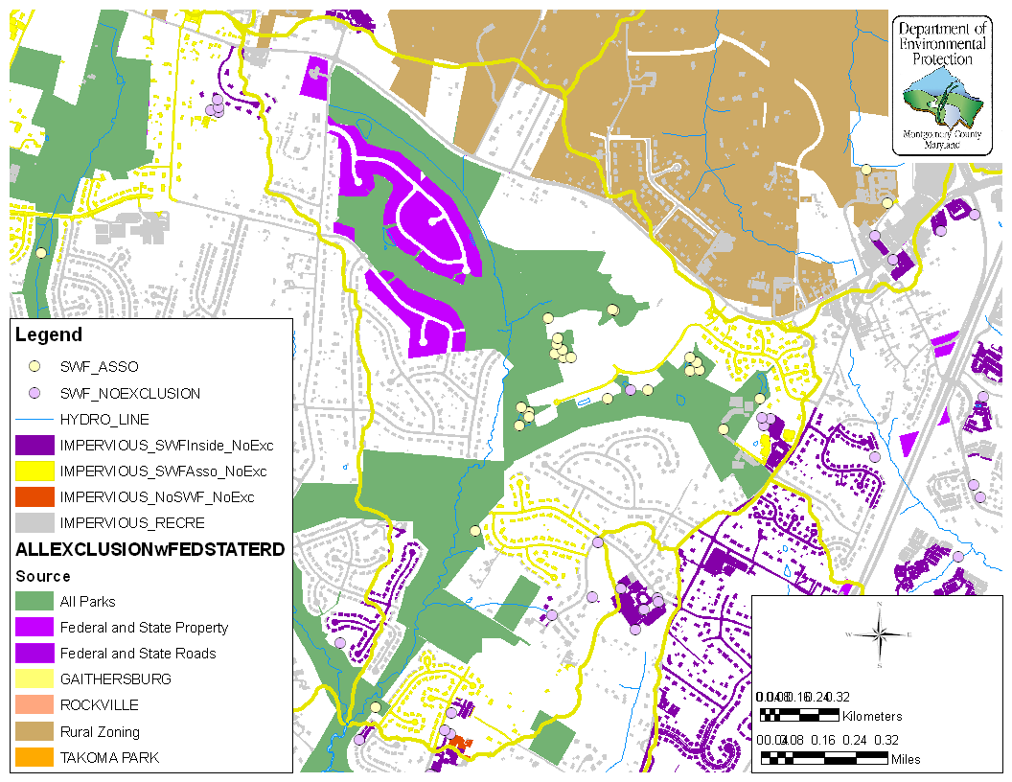
Impervious Cover
IMPERVIOUS_RECRE
  This information was updated by DEP staff on December 10, 2009

Slide 18
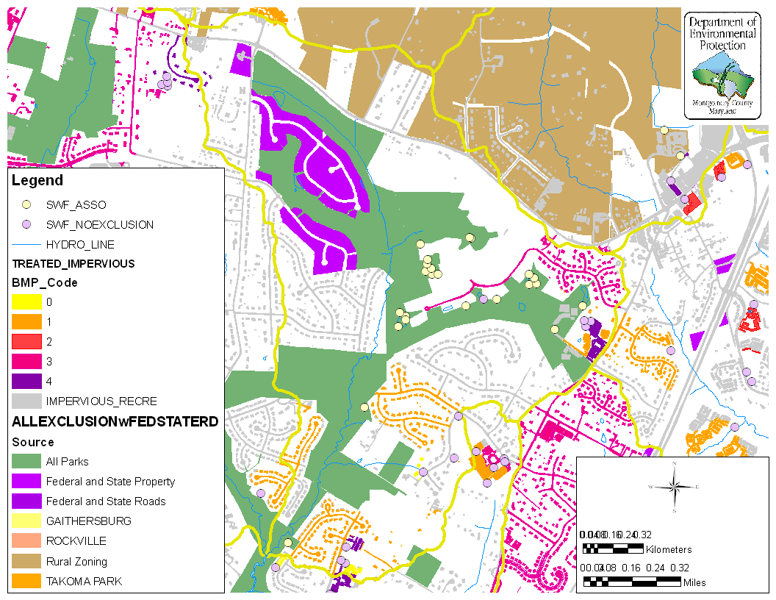
Tracking Impervious Cover
Treated Impervious

Slide 19

TMDL “Calibration”
TMDL Onion
  Land use discrepancies with Waste Load Allocations
  Watershed-specific EMCs or loading rates

Slide 20
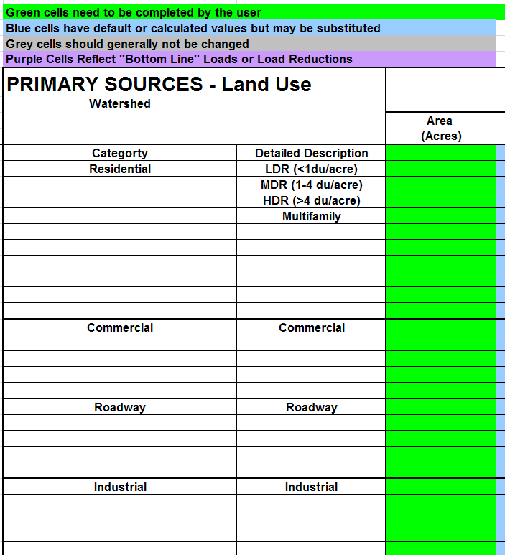
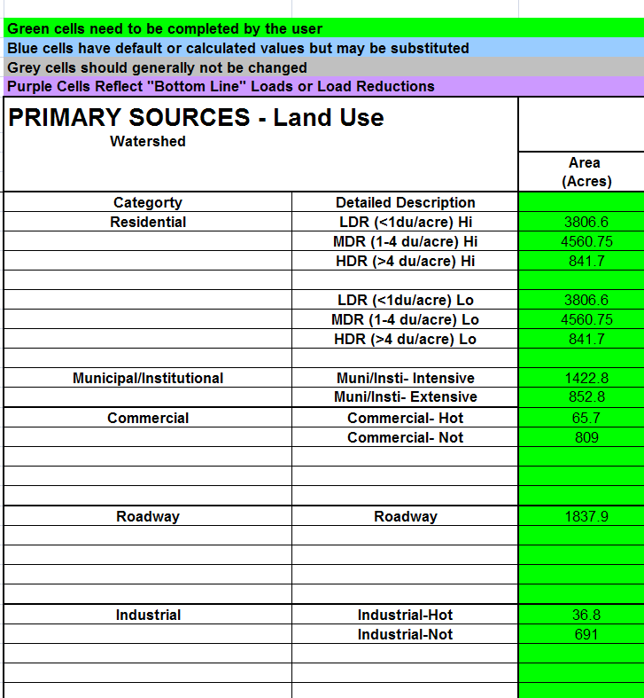
Primary Sources
The Land Use Categories were adjusted in the Primary Source tab according to the categories given in the Guidance Document.
BEFORE
AFTER

Slide 21
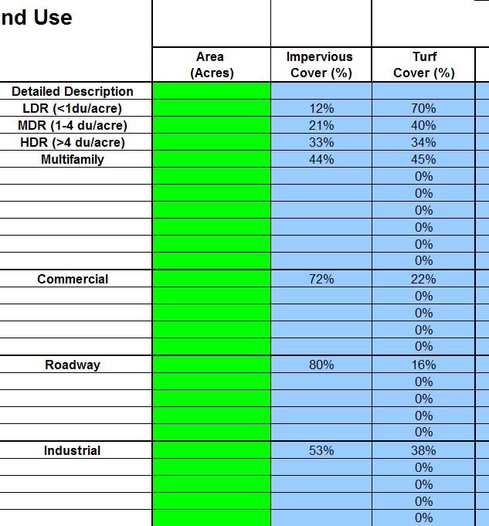
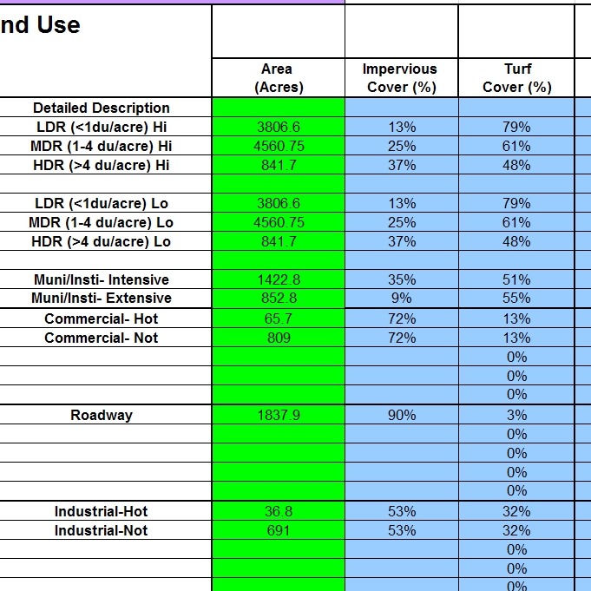
Primary Sources
The Impervious Cover % and Turf Cover % were adjusted in the Primary Source tab according to the values given in the Guidance Document.
BEFORE
AFTER

Slide 22
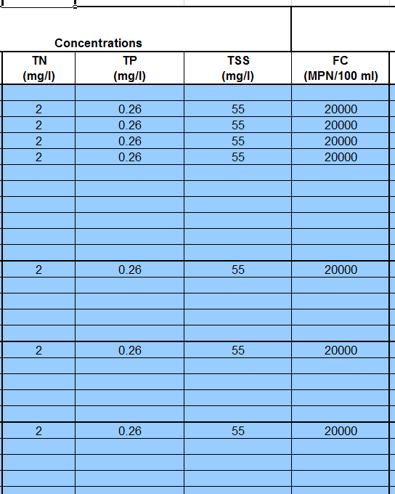
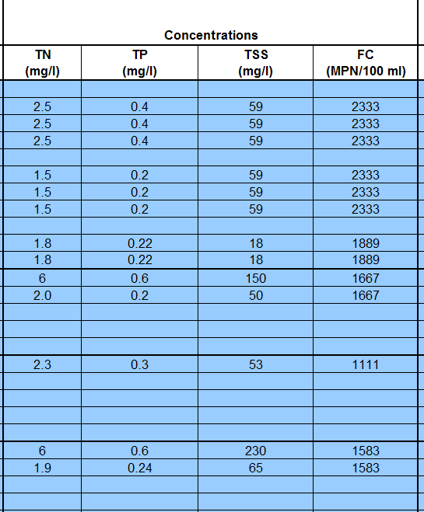
Primary Sources
The EMCs, Impervious Cover %, and Turf Cover % were adjusted in the Primary Source tab according to the values given in the Guidance Document.
BEFORE
AFTER

Slide 23
EMC Determination
Table B.1 EMCS for Use in WTM
Land Use | TSS (mg/L) | TP (mg/L) | TN (mg/L) | Bacteria¹ (MPN/100mL)
Residential | 59 mg/l | ALL: 0.3 | ALL 2.0 | 4200
 |  | HI: 0.4 | HI: 2.5
 |  | LO: 0.2 | LO: 1.5
Commercial | ALL: 55 | ALL: 0.22 | ALL:2.2 | 3000
 | HOT: 150 | HOT: 0.60 | HOT: 6.00
 | NOT: 50 | NOT: 0.20 | NOT: 2.00
Highway | 53 | 0.3 | 2.3 | 2000
Industrial | ALL: 73 | ALL: 0.26 | ALL: 2.1 | 2850
 | HOT: 230 | HOT: 0.60 | HOT: 6.00
 | NOT: 65 | NOT: 0.24 | NOT: 1.9
Municipal | 18 | 0.22 | 1.8 | 3400
All Land Uses | 62 | 0.27 | 2.0 | 4000
Source: Pitt, R. 2008. National Stormwater Quality Database Version 3. University of Alabama and CWP (2003) for TN ALL: Median for all land uses HI: High input turf, assumed to be 50% of all residential turf LO: Low input turf, assumed to be 50% of all residential turf HOT: Stormwater hotspot, area defined by Property database features selected by commercial/industrial land use and water quality complaint database. NOT: Not a stormwater hotspot, all areas not defined as HOT ¹ Concentrations shown are for fecal coliform bacteria as no stormwater monitoring data is available for enterococci (see Section 5.4)

Slide 24
EMC Determination
Landuse Designation | TN (mg/L) | TP (mg/L) | TSS (mg/L) | Source
Residential | 2.3 | 0.35 | 139 | Anacostia Model
 | 1.9 | 0.24 | 116.94 | NPDES Sampling
 | 2 | 0.3 | 59 | WTM; Pitt, 2008
Commercial | 3.5 | 0.2 | 132 | Anacostia Model
 | 3.64 | 0.17 | 55.35 | NPDES Sampling
 | 2.2 | 0.22 | 55 | WTM; Pitt, 2008
Industrial | 2.1 | 0.24 | 218 | Anacostia Model
 | 2.21 | 0.21 | 256.63 | NPDES Sampling
 | 2.1 | 0.26 | 73 | WTM; Pitt, 2008
Municipal | 1.3 | 0.11 | 125 | Anacostia Model
 | - | - | - | NPDES Sampling
 | 1.8 | 0.22 | 18 | WTM; Pitt, 2008

Slide 25
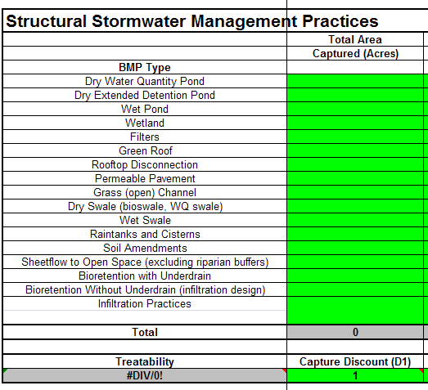
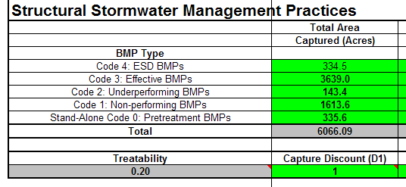
Existing Management Practices
Edits performed to BMP pollutant removal efficiencies according to Guidance Document.
BEFORE
AFTER

Slide 26
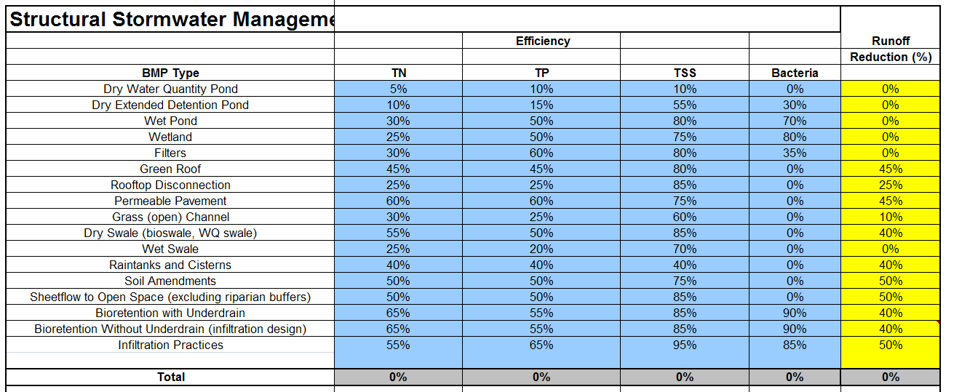
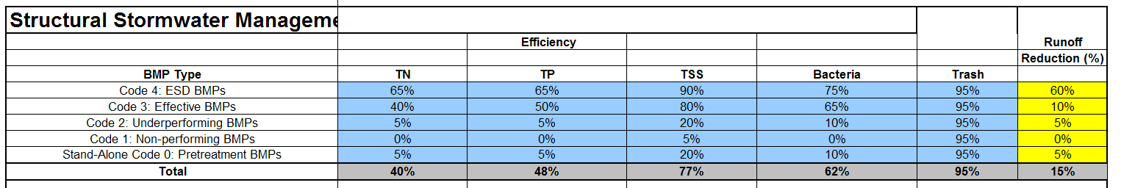
Existing Management Practices
Edits performed to BMP pollutant removal efficiencies according to Guidance Document.
BEFORE
AFTER

Slide 27
BMP Codes
Table B.16 General BMP Coding of Montgomery County BMP Database
Performance Code | Structure Type
Code 0: Pretreatment BMPs | Baysaver (BAYSAV), Interceptor (INT), Vortechnics (VORTEC), Oil/grit separator (SEP), Stormcepter (STC), Flowsplitter (FS), Plunge Pool (PP), V2B1 (V2B1), Vegetated Pool (VP), Aquaswirl (AQSW)
Code 1: Non-performing BMPs | Control Structure underground (CS), Pond-dry quantity control (PDQN), Underground detention (UG), Underground with stone bottom (UGINF), Pond-dry quantity control and extended detention (PDQNED)
Code 2: Under-performing BMPs | Pond-dry quantity control and sand filter base (PDQNSF), Pond-infiltration basin quality control (PDIB), Pond-infiltration basin with extended detention (PDIBED), Pond-infiltration basin quantity control (PDIBQN), Stormfilter (STFIL), Aquafilter (AQFIL)
Code 3: Effective BMPs | Pond-wet quantity control and extended detention (PDWTED), Pond-wet quantity control and extended detention (PDWTQNED), Pond-infiltration basin quantity control and extended detention (PDIBQNED), Sand filter (SF), Sand filter quantity control (SFQN), Oil/grit separator and sand filter (SEPSF), Sand filter underground (SFU), Pond-wetland (PDWD), Pond-wetland with extended detention (PDWDED), Pond-wetland quantity control and extended detention (PDWTQN), Pond-wet quality and quantity control (PDWT),
Code 4: ESD BMPs | Dry swale (DS), Bioretention quality control (BR), Bioretention quantity control (BRQN), Infiltration trench quality control (INF), Infiltrator (INFIL), Infiltration trench quality and quantity control (INFQN), Infiltration trench quality control underground (INFU), Infiltration trench quality and quantity control buried non-surface fed (INFUQN), Level Spreader (LS), Peat sand filter (PSF), and Vegetated Swale (VS).

Slide 28
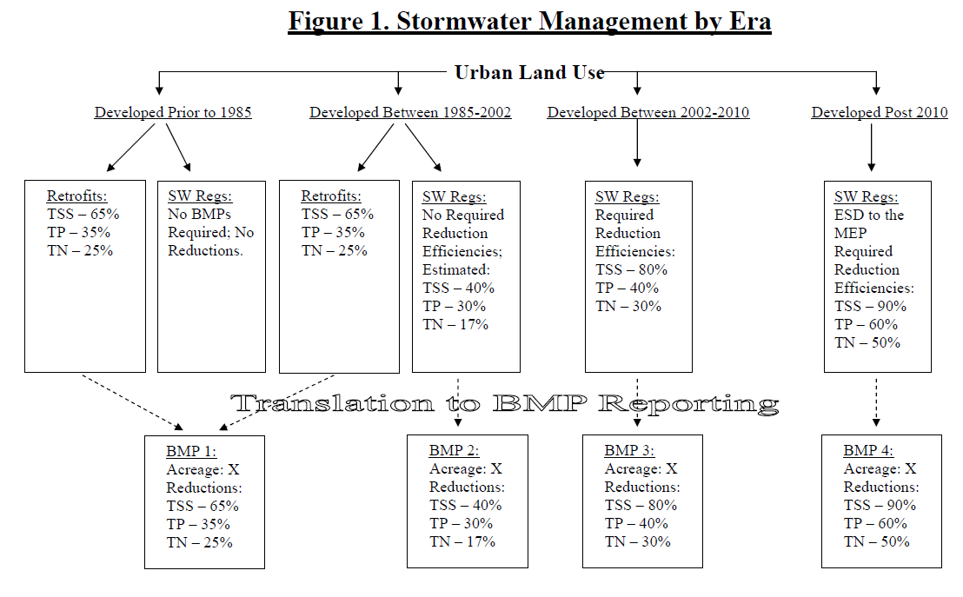

Slide 29
Removal Efficiencies
Performance Category | RR¹ (%) | Discount Factor² | TSS³ (%) | TN⁴ (%) | TP⁵ (%) | FC⁶ (%)
0 - Pretreatment BMPs | 5 | 0.15 | 20 | 5 | 5 | 10
1 - Non-performing BMPs | 0 | 0.05 | 5 | 0 | 0 | 0
2 - Underperforming BMPs | 5 | 0.15 | 20 | 5 | 5 | 10
3 - Effective BMPs | 10 | 0.75 | 80 | 40 | 50 | 65
4 - ESD Practices | 60 | 1.0 | 90 | 65 | 65 | 75
(from Schueler, 2010)
¹ RR: percent annual reduction in post development runoff volume for storms
² Discount Factor: Fraction of contributing impervious acres effectively treated to the Water Quality Volume, used to rate BMP treatability
³ TSS: Sediment Removal rate
⁴ TN: Total Nitrogen Removal Rate
⁵ TP: Total Phosphorus Removal Rate
⁶ FC: Fecal Coliform Removal Rate

Slide 30
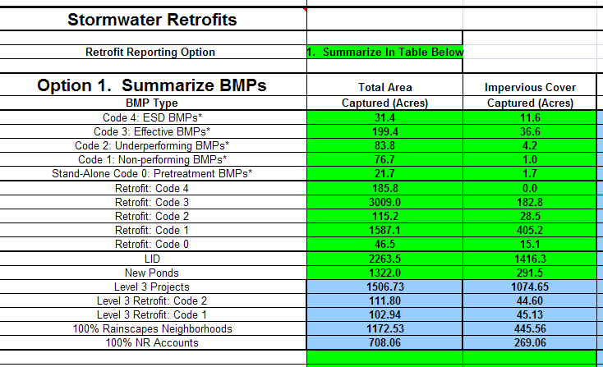
Future Management Practices
Post-TMDL BMPs from the Urban BMP database

Slide 31
Future Management Practices
Restoration Sites BMPs (WTM 2.0)

Slide 32
Future Management Practices
and Additional Retrofit opportunities (WTM 3.0) which include County lands (schools, buildings, roads, and parking lots) and targeted neighborhoods

Slide 33
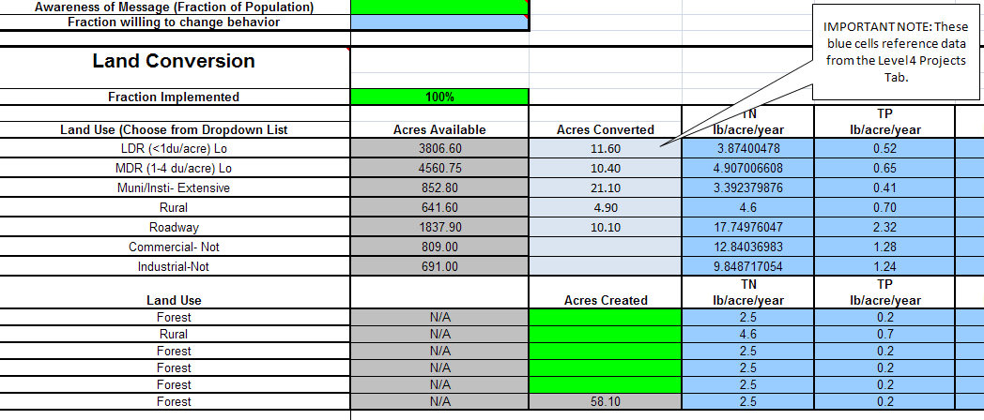
Future Management Practices
Expanded number of Land Conversion rows to accommodate different land types.

Slide 34
Other Restoration Practices
Table B.20. Nutrient and Sediment Removal Rates for Non-Retrofit Practices
Practice | TN Removal | TP Removal | TSS Removal | Reporting Units
Riparian Forest Planting | 25% | 50% | 50% | Acres
Upland Planting (on Turf) | A | A | A | Acres
Septic Denitrification | 55 | 0 | 0 | Systems
Septic Pumping | 5 | 0 | 0 | Systems
Septic connections/hookups | 55 | 0 | 0 | Systems
Emergent marsh restoration | 42 | 55 | 75 | Acres
Palustrine Forest wetland restoration | 43 | 58 | 75 | Acres
Stream restoration | 0.20 lbs | 0.068 lbs | 310 lbs | Linear Ft.
Riparian forest buffers (ag) | 60 | 70 | 75 | Acre treated
Stream fencing and off-stream watering | 60 | 60 | 75 | Acres treated
Residential Nutrient Management | B | B | B | Acres
Hotspot Management | C | C | C | Acres
Enhanced Street Sweeping | 5 | 15 | 20 | Acres
Note A: Shift from turf to forest cover in WTM and change EMC to forest (from turf) Note B: Shift from hi input EMC to low input turf EMC within WTM Note C: Shift from hotspot EMC to not hotspot EMC within WTM

Slide 35
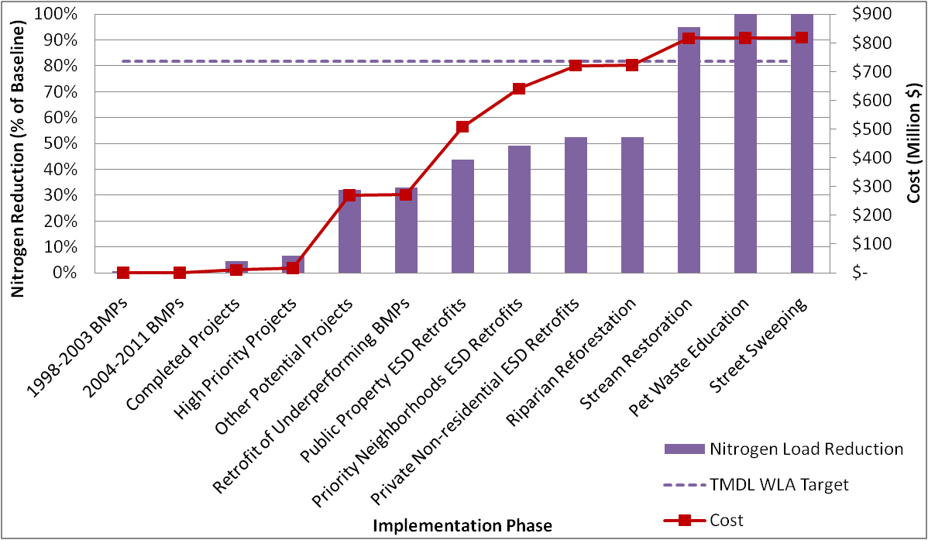
Anacostia Nutrient TMDL: removal per Strategy

Slide 36
Anacostia Nutrient TMDL: removal per unit cost
Rank | Restoration Strategy | TN reduction | Incremental Cost | Unit Cost
 |  | lbs/yr | Million $ | lbs/Million $
1 | Pet Waste Education | 15,169 | 0.88 | 17,193
2 | Retrofit of Underperforming BMPs | 1,769 | 1.20 | 1,475
3 | Stream Restoration | 72,423 | 93.04 | 778
4 | Completed Projects | 6,643 | 9.48 | 701
5 | High Priority Projects | 3,260 | 6.35 | 513
6 | Low Priority and Other Potential Projects | 43,276 | 254.30 | 170
7 | Habitat Restoration | 224 | 1.41 | 158
8 | Public Property ESD Retrofits | 18,270 | 236.55 | 77
9 | Priority Neighborhoods ESD Retrofits | 9,271 | 132.78 | 70
10 | Private Non-residential ESD Retrofits | 5,594 | 80.18 | 70
11 | Street Sweeping | - | 1.24 | -
Most reduction per unit cost

Slide 37
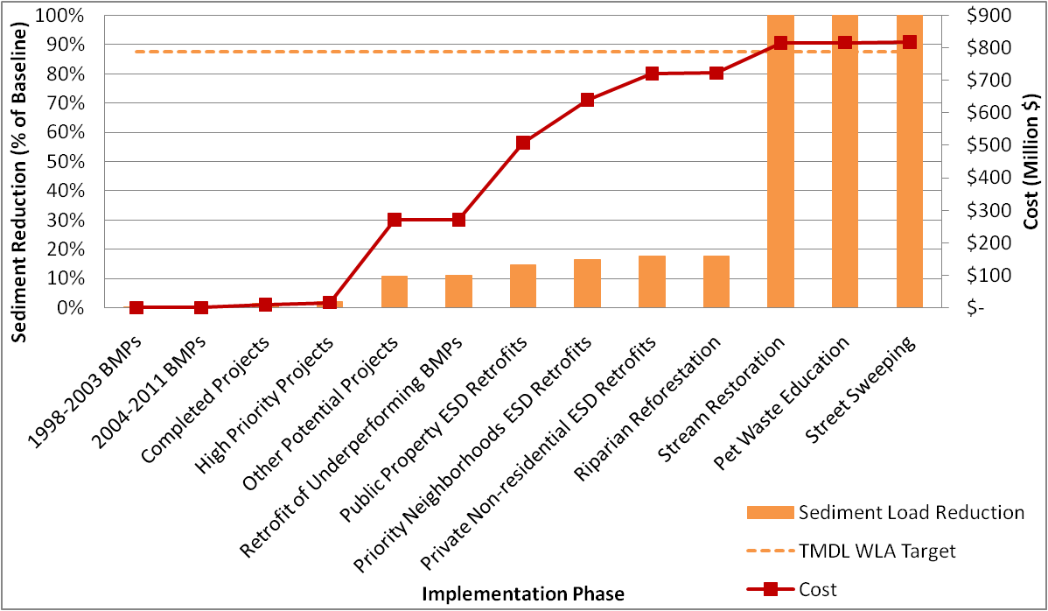
Anacostia Sediment TMDL: removal per Strategy

Slide 38
Anacostia Sediment TMDL: removal per unit cost
Most reduction per unit cost
Rank | Restoration Strategy | Sediment reduction | Incremental Cost | Unit Cost
 |  | tons/yr | Million $ | tons/Million $
1 | Street Sweeping | 800 | 1.24 | 645
2 | Stream Restoration | 25,057 | 93.04 | 269
3 | Retrofit of Underperforming BMPs | 25 | 1.20 | 21
4 | Completed Projects | 97 | 9.48 | 10
5 | High Priority Projects | 47 | 6.35 | 7
6 | Low Priority and Other Potential Projects | 660 | 254.30 | 3
7 | Public Property ESD Retrofits | 272 | 236.55 | 1
8 | Priority Neighborhoods ESD Retrofits | 139 | 132.78 | 1
9 | Private Non-residential ESD Retrofits | 84 | 80.18 | 1
10 | Habitat Restoration | 2 | 1.41 | 1
11 | Pet Waste Education | - | 0.88 | -

Slide 39
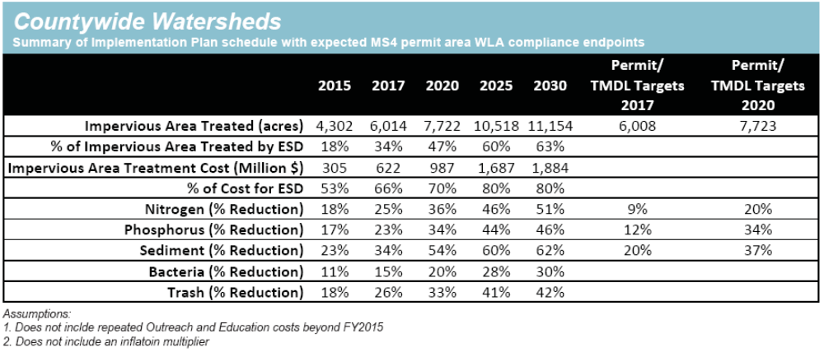
Countywide Strategy: Implementation and Pollutant Reductions
NOTE: Subsequent to Strategy publication in February 2011, Maryland revised timelines for Bay TMDL targets to meet 60% implementation by 2017 and 100% implementation by 2025

Slide 40
What did WTM not include?
Secondary Sources
  Channel Erosion
  SSOs, CSOs, Septic (not applicable, WSSC)
  Livestock (not applicable, NRCS)
  Marinas (not applicable)
  Road Sanding
  Point Sources (not applicable)

Slide 41
Challenges and Lessons Learned
Sharpen your accounting pencils
Sequential analysis is useful
Target pollutants may require external analysis
Non-structural strategies rely on limited research findings

Slide 42
Challenges and Lessons Learned (MAST-related)
MS4 permit area (acres)
Land cover (impervious vs pervious)
Pollutant Loadings and Total Loads
BMP assumptions
    Acres with some control
    Type
    Reduction Efficiency

Slide 43
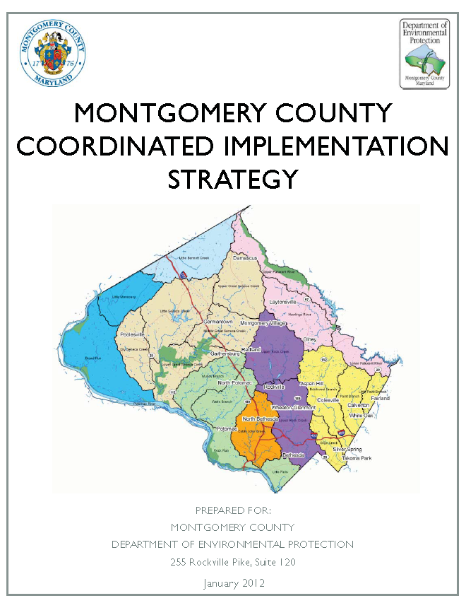
Questions?
Ted Brown
Biohabitats, Inc.
tbrown@biohabitats.com
Meo Curtis
Montgomery County, MD
Waterhshed Management Division
meo.curtis@montgomerycountymd.gov
Acknowledgements
Key County Co-collaborators: Steve Shofar, Craig Carson, and Dan Harper
Project team members: Tom Schueler, Horsley Witten Group, Versar, Resolve, and Carrie Capuco

