Slide 1
AFA Listening Session on Draft TPB Regional Transportation Priorities Plan (RTPP)
January 26, 2012
John Swanson and Gareth James
Department of Transportation Planning

Slide 2
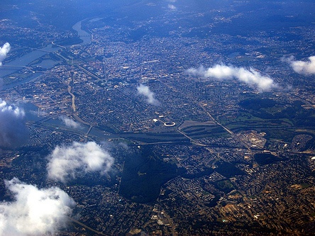
An Overview of the Region’s Transportation Goals

Slide 3
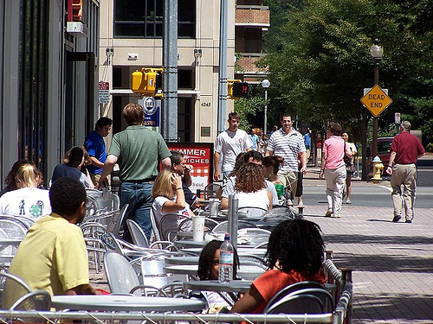
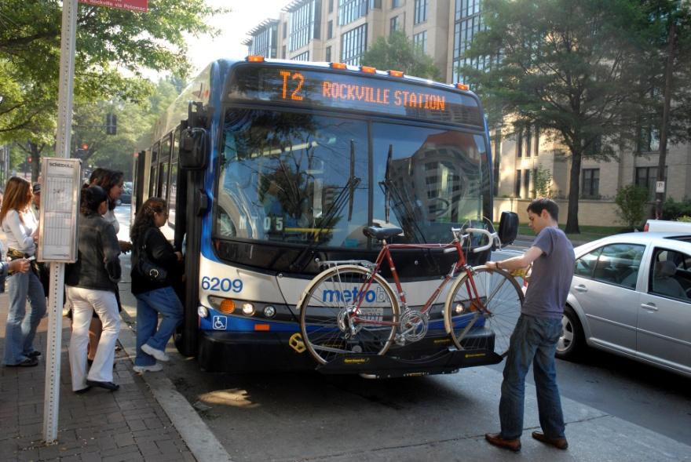
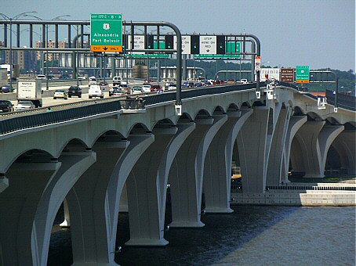
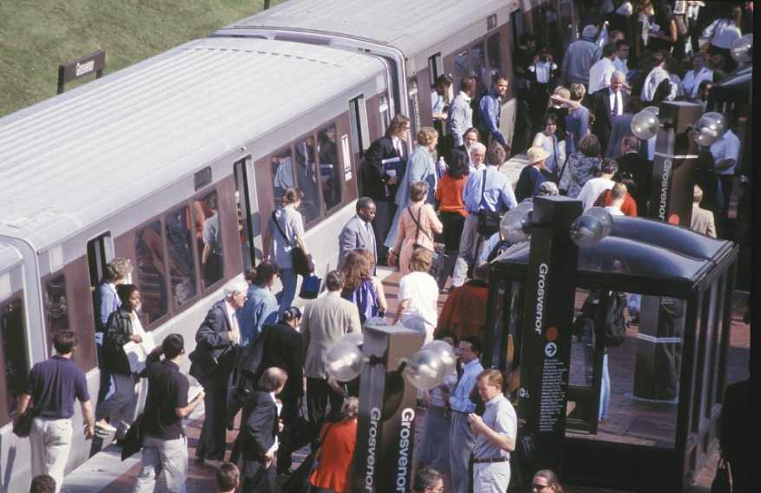
A Range of Transportation Alternatives

Slide 4
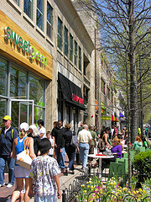
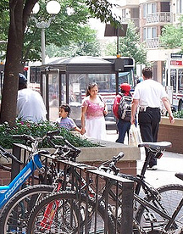
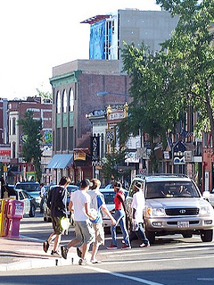
Activity Centers:
Concentrated, Mixed-use, Walkable

Slide 5
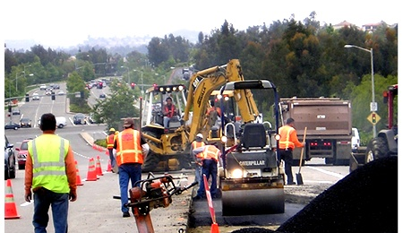
Maintenance and Safety

Slide 6
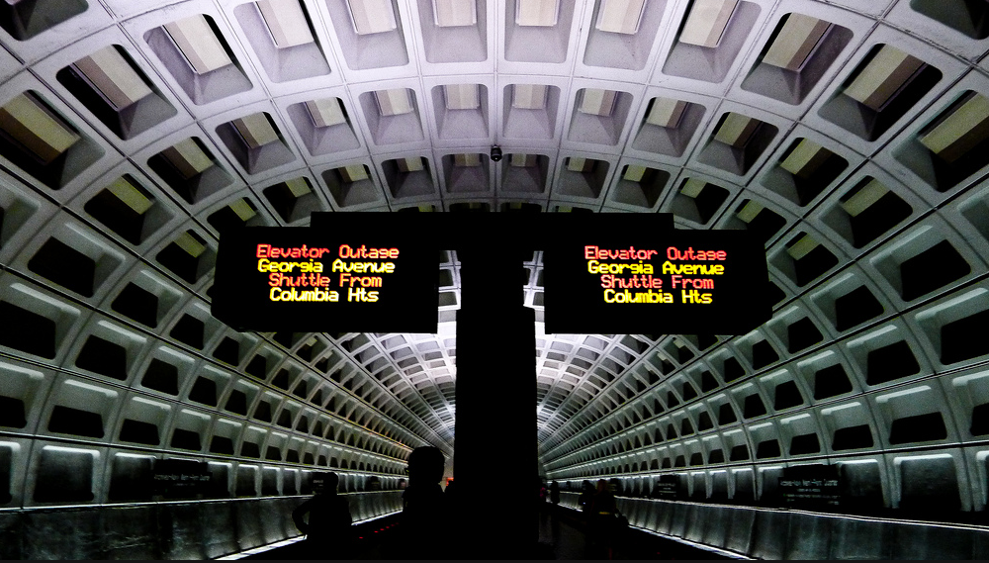
Maximize System Effectiveness

Slide 7

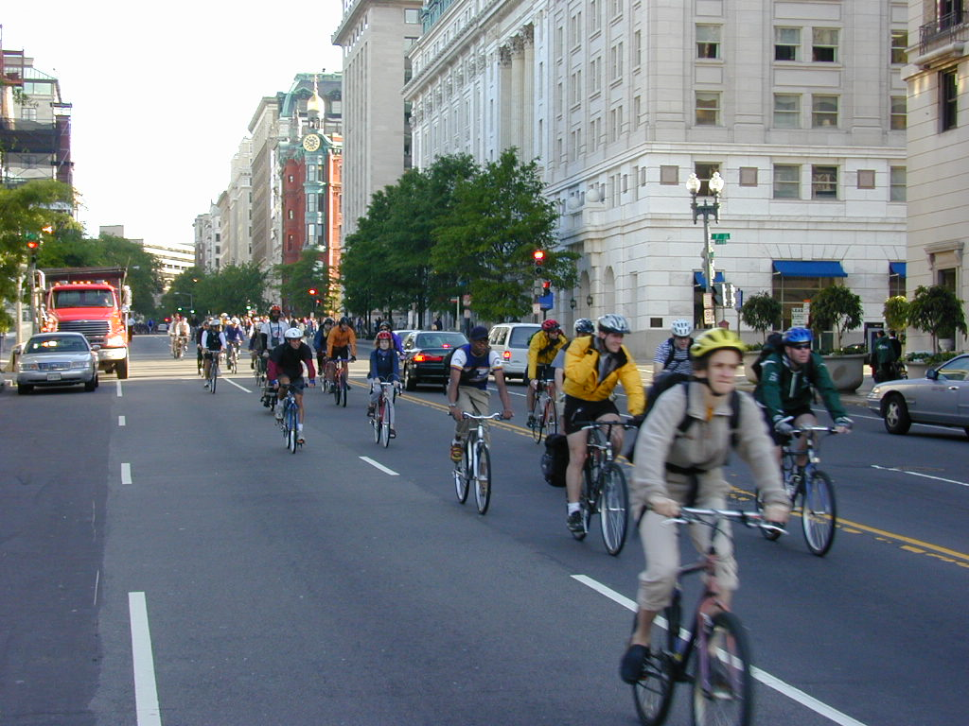
Environment, Energy, Health

Slide 8
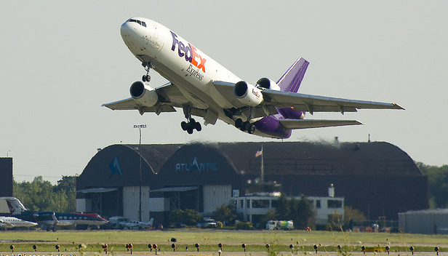
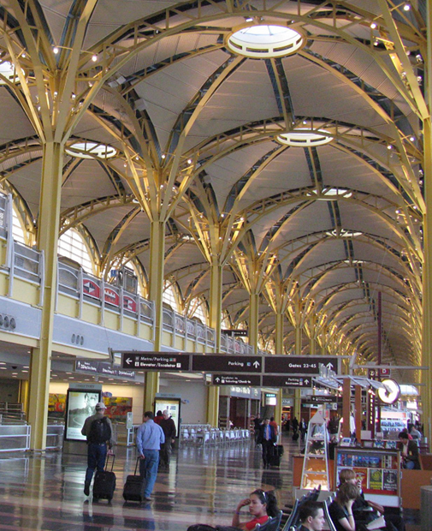
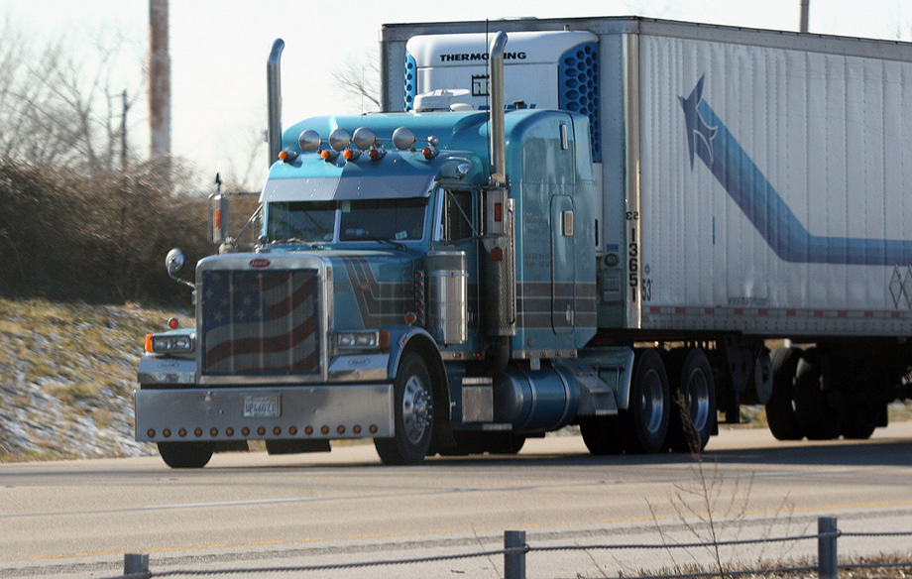
Commerce &
International/Inter-regional Travel

Slide 9
Background on the RTPP
May 2010: Conversation on Setting Regional Transportation Priorities, following CAC request for TPB to develop a “Regional Priorities Plan” and achieve consensus on a set of performance measures for the plan
July 2010: Formation of the TPB’s RTPP Scoping Task Force, including members of the TPB, CAC, Access for All, and the Technical Committee
July 2011: Approval of RTPP work scope, building on Regional Goals first identified in the TPB Vision and reaffirmed in Region Forward. The work scope outlined three main tasks:
  Reaffirm regional goals and agree upon performance measures to be used in identifying regional challenges and appropriate strategies
  Determine regional challenges and strategies to address them
  Develop regional priorities, both funded and unfunded

Slide 10
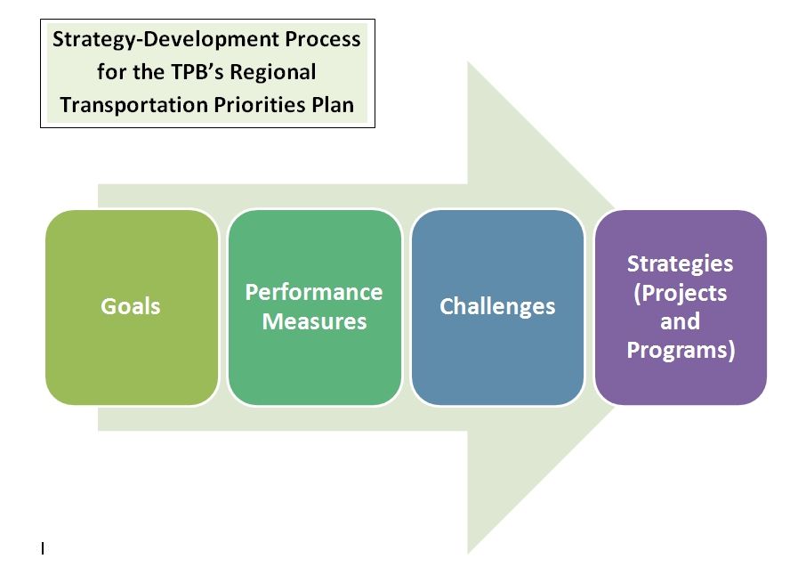

Slide 11
Next Steps
Jan/Feb 2012: Listening Sessions with Regional Stakeholders and Citizens, including CAC, Access for All, and ACPAC; web-based comment form (http://www.mwcog.org/transportation/priorities/)
February 2012: Final Interim Report 1, incorporating feedback received
April 2012: Focus Groups (members of the general public)
June 2012: Draft Interim Report 2 – A revised set of performance measures, challenges, and strategies based on feedback received; and a proposed public outreach schedule through June 2013
July 2012: Final Interim Report 2, incorporating feedback received from TPB, Technical Committee, and CAC

