Slide 1
Electric Vehicle Charging Stations and The Americans With Disabilities Act
Prepared by The Fairfax County Office of Human Rights and Equity Programs
November 29, 2011

Slide 2
What is the ADA?
The Americans With Disabilities Act (ADA) was enacted in 1990 and later amended in the ADA Amendments Act of 2008 (ADAAA), which became effective January 1, 2009.

Slide 3
What is the ADA?
The Findings and Purposes of the ADAAA provide that “…in enacting the Americans with Disabilities Act of 1990 (ADA), Congress intended that the Act “provide a clear and comprehensive national mandate for the elimination of discrimination against individuals with disabilities” and provide broad coverage….”

Slide 4
Title II Applies to Who?
Title II of the ADA covers all activities of State and local governments regardless of the government entity's size or receipt of Federal funding. Title II requires that State and local governments give people with disabilities an equal opportunity to benefit from all of their programs, services, and activities (e.g. public education, employment, transportation, recreation, health care, social services, courts, voting, and town meetings). Public entities are not required to take actions that would result in undue financial and administrative burdens.

Slide 5
Title II Applies to Who?
Private individuals may bring lawsuits to enforce their rights under title II and may receive remedies, including reasonable attorney's fees. Individuals may also file complaints with eight designated Federal agencies, including the Department of Justice and the Department of Transportation.

Slide 6
Title III Applies to Who?
Title III of the ADA covers businesses and nonprofit service providers that are public accommodations, privately operated entities offering certain types of courses and examinations, privately operated transportation, and commercial facilities. Public accommodations are private entities who own, lease, lease to, or operate facilities such as restaurants, retail stores, hotels, movie theaters, private schools, convention centers, doctors' offices, homeless shelters, transportation depots, zoos, funeral homes, day care centers, and recreation facilities including sports stadiums and fitness clubs. Private clubs and religious organizations are exempt from the ADA's title III requirements for public accommodations. Transportation services provided by private entities are also covered by title III.

Slide 7
Title III Applies to Who?
Public accommodations must comply with basic nondiscrimination requirements that prohibit exclusion, segregation, and unequal treatment. They also must comply with specific requirements related to architectural standards for new and altered buildings. Additionally, public accommodations must remove barriers in existing buildings where it is easy to do so without much difficulty or expense, given the public accommodation's resources. Barrier removal need be accomplished only when it is "readily achievable" to do so. Readily achievable mean "easily accomplishable and able to be carried out without much difficulty or expense."

Slide 8
What Standards Apply to EV Charging Stations
On March 15, 2012, compliance with the 2010 ADA Standards for Accessible Design will be required for new construction and alterations.

Slide 9
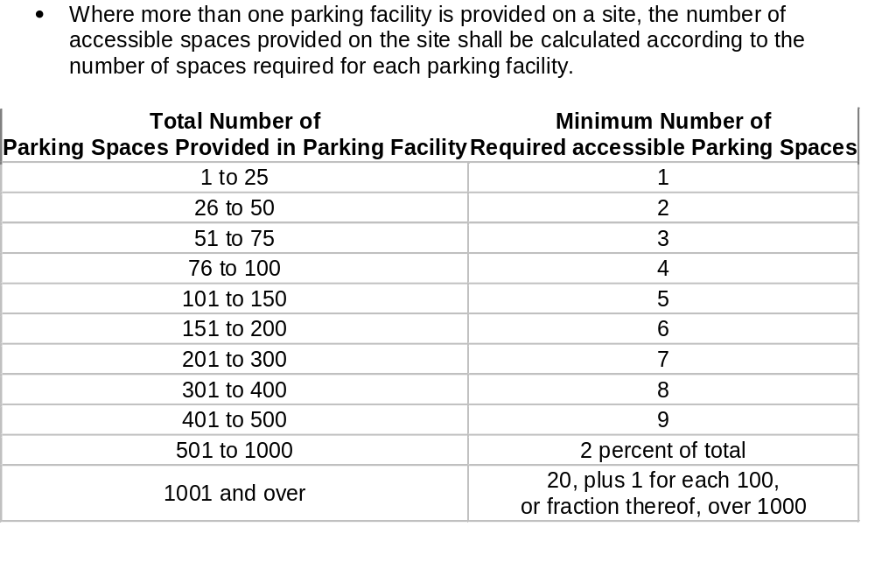
How Many Accessible Spaces Are Required Under the ADA?

Slide 10
What About Access Aisles?
Access aisles serving car and van parking spaces shall be 60 inches (1525 mm) wide minimum. Access aisles shall extend the full length of the parking spaces they serve. Access aisles shall be marked so as to discourage parking in them.

Slide 11
What About Accessible Routes?
Parking spaces that serve a particular building or facility shall be located on the shortest accessible route from parking to an entrance. Where parking serves more than one accessible entrance, parking spaces shall be dispersed and located on the shortest accessible route to the accessible entrances. In parking facilities that do not serve a particular building or facility, parking spaces shall be located on the shortest accessible route to an accessible pedestrian entrance of the parking facility.

Slide 12
Must EV Charging Stations Be Accessible?
Even though federal accessibility standards do not specifically address electric vehicle (EV) charging stations, it is required to incorporate ADA accessibility requirements to in the design of and installation of commercial charging stations. EV charging stations are required to be accessible because they offer a service to the general public.

Slide 13
What Accessibility Issues Need to Be Considered?
Connector and receptacle heights, special curb cutouts, and disabled parking access are some of the measures that may be necessary to make a charging station fully accessible for the disabled.

Slide 14
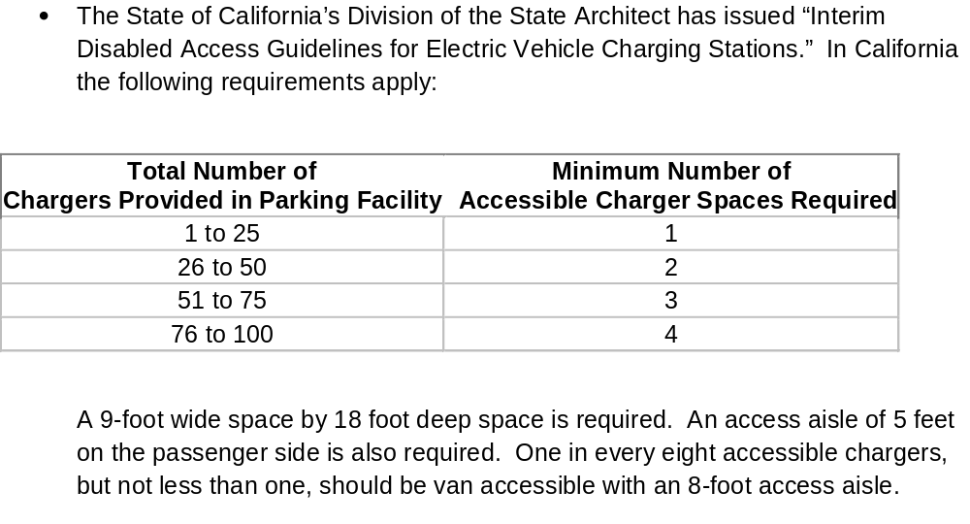
What Are Other Jurisdictions Doing?

Slide 15
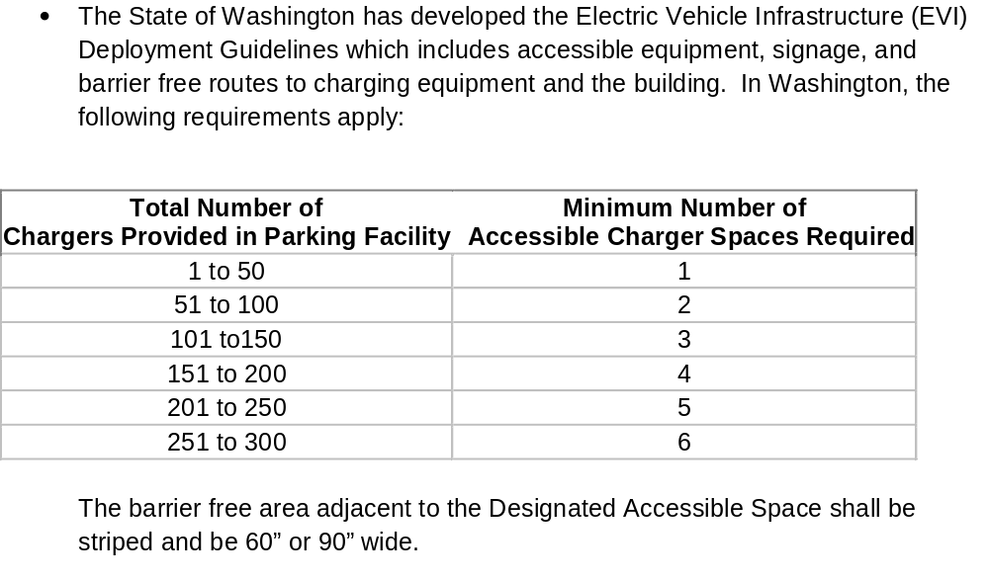
What Are Other Jurisdictions Doing?

Slide 16
What If It Costs Too Much?
Alterations made to provide an accessible path of travel to the altered area will be deemed disproportionate to the overall alteration when the cost exceeds 20% of the cost of the alteration to the primary function area.

Slide 17
EV Stations and The ADA
Design requirements provided by the 2010 ADA Standards for Accessible Design can and should be applied in the design and installation of all publicly available EV Charging Stations.

