Slide 1
Update on the
Congestion Management Process (CMP)
Freight Subcommittee
March 11, 2010
Wenjing Pu and Andrew Meese
National Capital Region Transportation Planning Board (TPB)

Slide 2
What is CMP
A Congestion Management Process (CMP) is a federal requirement in metropolitan transportation planning
  Identify congestion, develop and select appropriate strategies to reduce congestion.
  No single occupant vehicle (SOV) project capacity expanding project can receive federal funds unless it shows that the CMP has been considered.

Slide 3
CMP components

Slide 4
Three major CMP activities
CMP component of the CLRP
  www.mwcog.org/clrp/elements/cmp
  Identify congestion in the region
  Develop and document a process describing how congestion management is considered at critical stages in the metropolitan transportation planning process
Congestion Management Documentation Forms for the CLRP and TIP
  Supporting CMP reference material
  Reviewed and accepted by Travel Management Subcommittee and TPB Technical Committee
CMP Technical Report
  Supporting technical background document to the CMP

Slide 5
CMP Technical Report
Previous release: 2008 CMP Technical Report (June, 2008), available @ http://www.mwcog.org/commuter2/pdf/2008_CongestionManagement_Process.pdf
Status of the 2010 CMP Technical Report
  February: Preliminary draft finished
  Now: under internal review and revising
  April/May: Draft release for comments
  June: Final report release

Slide 6
Congestion monitoring in the National Capital Region
TPB freeway aerial photography survey
  300+ centerline miles of freeways surveyed every 3 years
  Spring 2008 survey report: http://www.mwcog.org/store/item.asp?PUBLICATION_ID=354
TPB arterial floating car travel time studies
  400+ miles of arterials surveyed every 3 years
  FY2009 study results: http://www.mwcog.org/uploads/committee-documents/aF5bVlpc20090920152341.pdf
I-95 Corridor Coalition (INRIX, Inc.) traffic monitoring
  200 centerline miles of freeways and 190 centerline miles of arterials in TPB member jurisdictions
  GPS-probe data
  Continuous monitoring (24/7/365)

Slide 7
Travel Time Index
Travel time index = actual travel time / free-flow travel time
The travel time index expresses the average amount of extra time it takes to travel relative to free-flow travel
Example: a travel time index of 1.3 indicates a 20-minute free-flow trip will take 26 minutes (1.3 times of free flow travel time) during the peak travel time periods, a 6-minute (30 percent) travel time penalty
Three perspectives of analysis:
  Spatiotemporal distribution
  Month-to-month variation
  Time of day and day of week variation

Slide 8
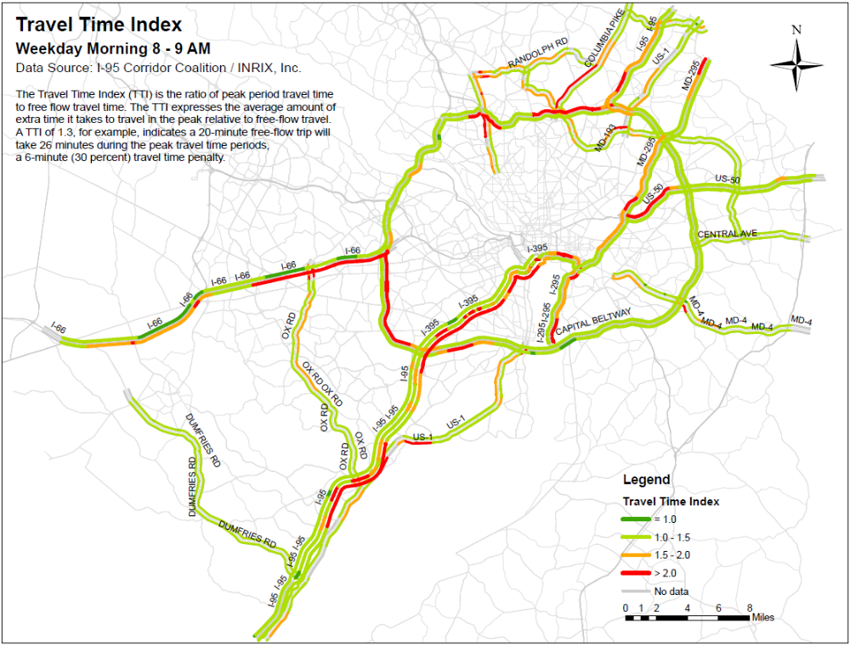

Slide 9
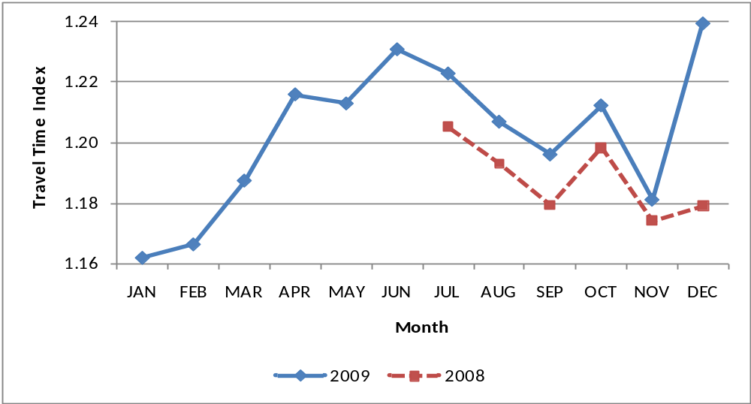
Month-to-month travel time index
Travel time index by month
for the I-95 Corridor Coalition covered highways

Slide 10
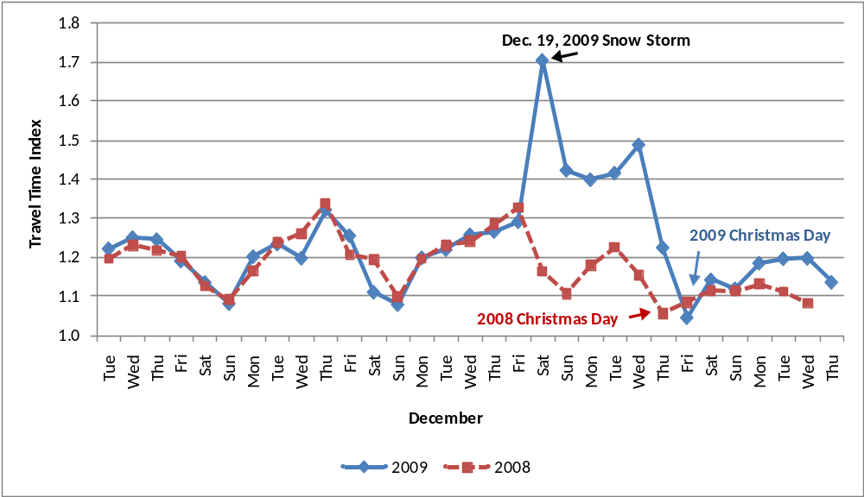
Comparison of Travel Time Index in December 2008 and 2009 for the I-95 Corridor Coalition Covered Highways

Slide 11
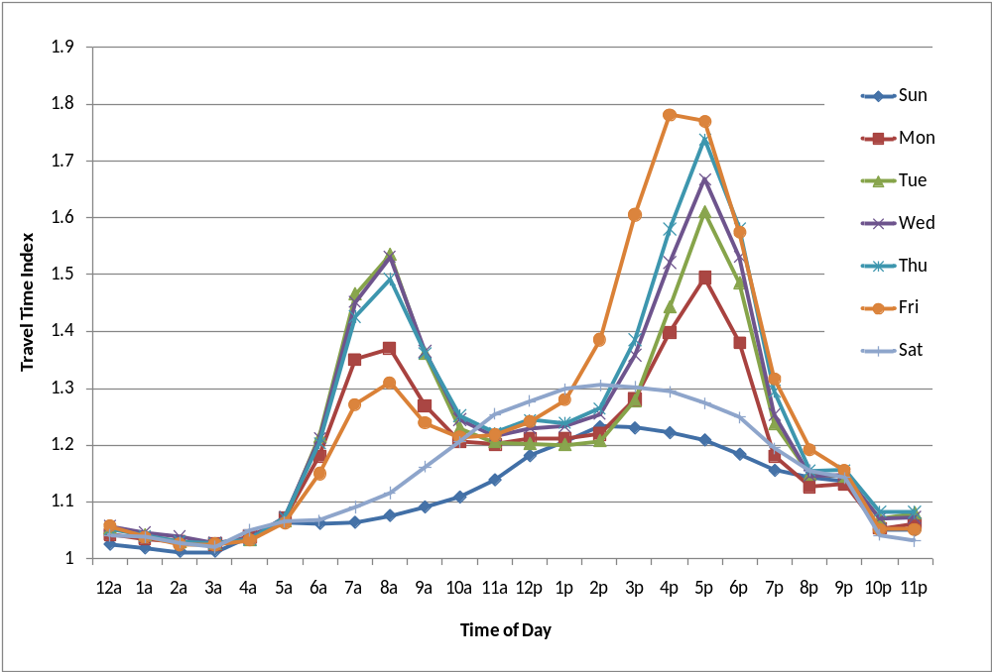
Time of day and day of week travel time index
Travel time index by time of day and day of week
for the I-95 Corridor Coalition covered highways

Slide 12
Planning Time Index
Planning time index = 95th percentile travel time / free-flow travel time.
It is the ratio of the total time needed to ensure on-time arrival 95% of the time as compared to a free-flow travel time.
Example: a value of 1.3 means that a traveler should budget an additional 6 minute buffer (total 26 minute) for a 20-minute free flow trip time to ensure on-time arrival for 95% of the time.

Slide 13
Buffer Time Index
Buffer time index = (95th percentile travel time – average travel time)/ average travel time
The Buffer Time Index (BTI) represents the extra time (or time cushion) that travelers must add to their average travel time when planning trips to ensure on-time arrival.
Example: a BTI of 0.3 means that for a trip that usually takes 20 minutes a traveler should budget an additional 6 minutes to ensure on-time arrival 95 percent of the time.

Slide 14
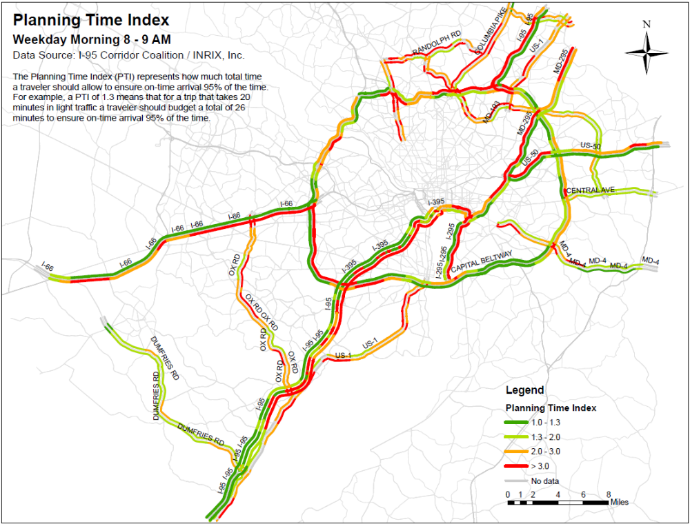

Slide 15
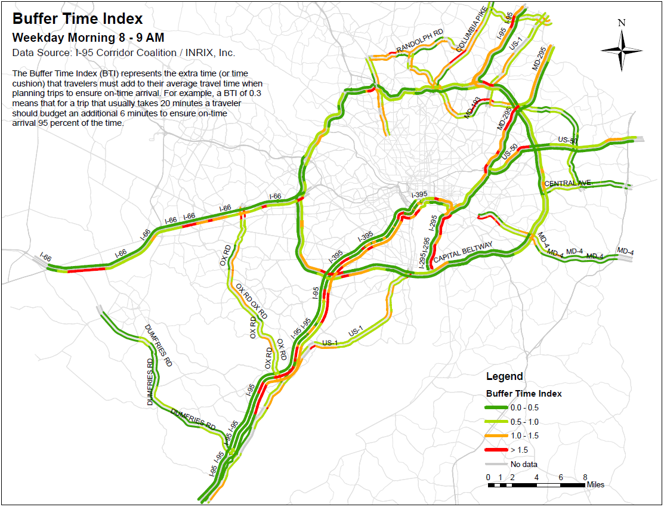

Slide 16
Outlook
Continuing work on CMP Technical Report
  Will return as needed to the Freight Subcommittee for further discussions
Continuing discussions of how CMP and Freight Subcommittee programs interact
  Freight congestion analysis
  Freight reliability analysis
  Congestion relief strategies
  Etc.

