Slide 1
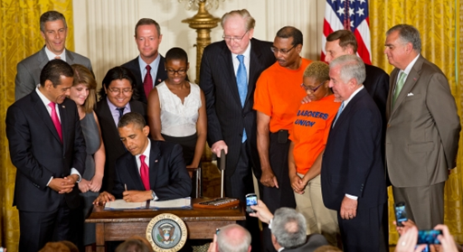
MAP-21 Performance-Based Planning:
A Focus on Congestion Mitigation and Air Quality
Moving Ahead for Progress in the 21st Century
Item #8
Presentation to the Transportation Planning Board
Ronald F. Kirby
Director, Department of Transportation Planning
April 17, 2013

Slide 2
Performance-Based Approach
MAP-21, Section 150. National Goals and Performance Management Measures
(a) Declaration of Policy―Performance management will…provide a means to the most efficient investment of Federal transportation funds by refocusing on national transportation goals…and improving project decisionmaking through performance-based planning and programming.
MAP-21, Section 1201. Metropolitan Transportation Planning
The metropolitan transportation planning process shall provide for the establishment and use of a performance-based approach to transportation decisionmaking to support the national goals…
Funding mostly formula, some USDOT discretion, no earmarks

Slide 3
Performance-Based Planning and Programming
New National Goals Under MAP-21
Metropolitan Planning Process continued from previous law
New National Goals from MAP-21
National Goals related to Scope of Metropolitan Planning Process
Title 23, Sec. 1201, Subsection 134(h)
Title 23, Sec. 1203, Subsection 150(b)

Slide 4
Performance Measures Required by MAP-21 Title 23, Section 150(c)-Highways
Secretary shall…limit performance measures only to those described in this subsection:
National Highway Performance Program
  Minimum standards…in developing and operating bridge and pavement management systems
  Condition of pavement on the Interstate System and on the National Highway System (NHS) (excluding Interstate)
  Condition of bridges on the NHS
  Performance of the Interstate System and the NHS (excluding Interstate)
  Minimum levels for the condition of pavement on the Interstate System
Highway Safety Improvement Program
  Serious injuries and fatalities per vehicle mile traveled and the number of serious injuries and fatalities
Congestion Mitigation and Air Quality Program
  Traffic congestion
  On-road mobile source emissions
National Freight Movement
  Assess freight movement on the Interstate System

Slide 5
Performance Measures Required by MAP-21 Title 49, Chapter 53-Public Transportation
Applies to all recipients. ‘Recipient’ means a State or local governmental authority, or any other operator of the public transportation system, that receives federal financial assistance
Transit Asset Management Plan
    Definition of ‘state of good repair’ that includes objective standards for measuring the condition of capital assets of recipients, including equipment, rolling stock, infrastructure, and facilities
    Secretary shall issue a final rule to establish performance measures based on the ‘state of good repair’ standards
National Public Transportation Safety Plan
    Safety performance criteria for all modes of public transportation
    Minimum safety performance standards for public transportation vehicles
    Public transportation safety certification training program
Public Transportation Agency Safety Plan
    States/transit recipients establish a comprehensive agency safety plan
    (1-year after the effective date of the performance measures on ‘state of good repair’ final rule)

Slide 6
PBPP Accountability/Penalties
State Performance Management
  States that do not achieve or make significant progress toward targets for two reporting periods must address in following report how the state will achieve the targets
Interstate System and National Highway System (NHS) Bridge Conditions
  If, for two reporting periods, the condition of the Interstate System…falls below the minimum condition level, the State shall be required to obligate and transfer funds to meet minimum conditions
  If greater than 10% of the deck area of bridges in the State on the NHS is located on bridges that have been classified as structurally deficient, a specified portion of funds…shall be set aside…only for eligible projects on bridges on the NHS
High-Risk Rural Road Safety
  If rural road fatality rates increase over the most recent 2-year period for which data is available, the State shall obligate in the next fiscal year an amount equal to at least 200% of the amount of funds the State received for fiscal year 2009 for high risk rural roads
MPO Certification
  If a metropolitan planning process serving a transportation management area is not certified (as required every 4 years), the Secretary may withhold up to 20% of the MPO’s funds under metropolitan transportation planning

Slide 7
Timeline on PBPP Requirements
MAP 21 PBPP Implementation Timeline
Date | Action
10/1/12 | MAP-21 date of Enactment
10/1/13 | Final rule for public transport state of good repair performance measures and standards
1/1/14 | Federal public transport recipients shall establish performance targets in relation to performance measures established by the Secretary, and report each year
Fall 2013, FTA est. | National Public Transportation Safety Plan
Fall 2014 | Public Transportation Agency Safety Plan (1 year after National Public Transportation Safety Plan)
4/1/14 | Secretary promulgates rulemaking that establishes performance measures and standards required under MAP-21, following 90-day comment period
4/1/15 | States set performance targets for measures established by Secretary
10/1/15 | MPOs establish performance targets 180 days after States/public transportation providers establish performance targets
10/1/16 | States submit to Secretary report on progress in achieving targets…
10/1/17 | Secretary submits to Congress a report on the effectiveness of the performance-based planning process of metropolitan planning organizations
KEY
Public Transportation
Highway
Metropolitan Planning
Federal Action

Slide 8
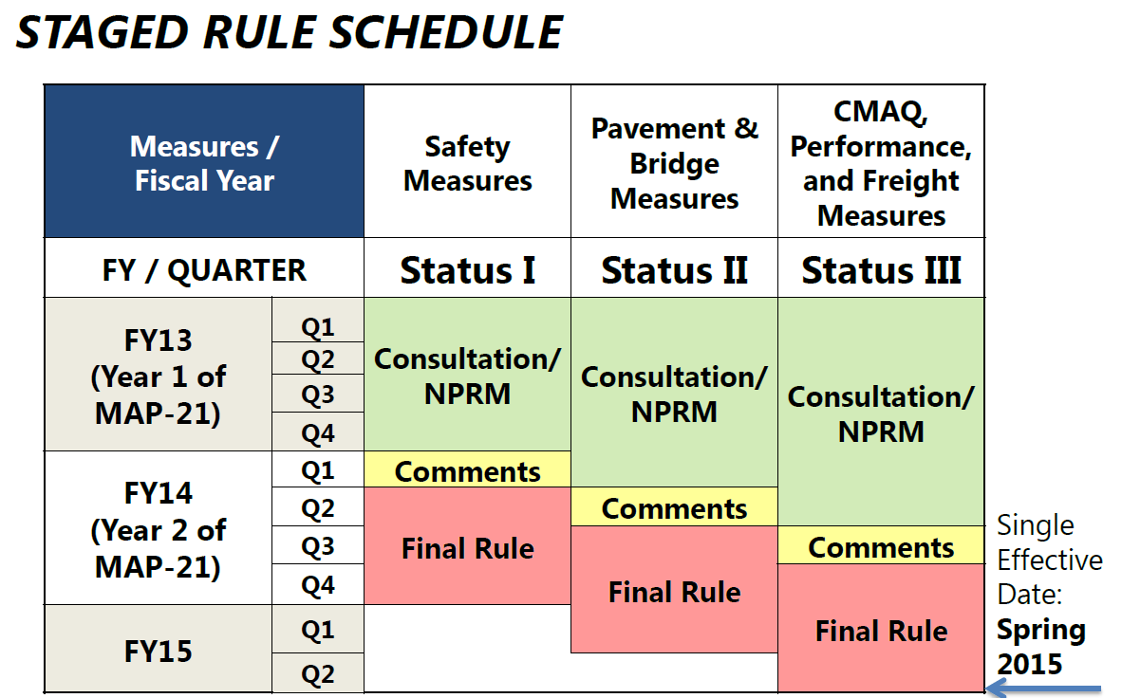
Performance Measures
3-Tier Staged Rule
Source: FHWA sponsored MAP-21 Webinar, March 18, 2013

Slide 9
PBPP Coordination Efforts Underway
  FHWA consultation meetings with states/MPOs/associations
  January 8th: FHWA MAP-21 Performance Management Listening Session on Target Setting: Facilitated “Conversations”: Considerations in Target Setting
  Targets are bound by available resources
  States and MPOs will need to be balancing performance in many areas
  Many entities may be key in achieving targets
  Unplanned events may impact the ability to achieve a target

Slide 10


PBPP Coordination Efforts Underway Cont.
Association letters for consideration by US DOT as part of rulemaking process
AASHTO Letter, November 26, 2012
AMPO Letter, December 7, 2012
A few themes:
  Reduce and Re-use
  “[N]ational-level performance measures should build upon existing performance measures, management practices, data sets and reporting processes”
  Communicate
  “Messaging the impact and meaning…to the public…is vital to the success of this [PBPP] initiative”
A few themes:
  Financial Constraint
  “MPOs will have to assess and balance the targets in context of the overall goals and financial capabilities of their individual metropolitan areas”
  Air Quality Conformity
  “Measurements chosen for on-road mobile source emissions should be consistent with existing federal air quality planning and conformity requirements”

Slide 11
PBPP Focus for the TPB
FY 2014 UPWP begins to address new PBPP responsibilities
Responsibilities to be coordinated with States/transit agencies
  State of Good Repair
  Safety
Explicit TPB Responsibilities for Congestion Mitigation and Air Quality
  MPO Performance Plan
  Requirement/opportunity for increased focus on congestion, with active engagement of all TPB member agencies and processes
  Mobile emissions likely to be governed largely by current air quality requirements

Slide 12
Congestion Mitigation and Air Quality (CMAQ) Program, Section 1113
(i) Evaluation and Assessment of Projects
(k) Priority for Use of Funds in PM 2.5 Areas
(l) Performance Plan

Slide 13
Congestion Mitigation and Air Quality (CMAQ) Program, Section 1113 Cont.
(i) Evaluation and Assessment of Projects
1. Database
“Secretary shall maintain and disseminate a cumulative database describing the impacts of the projects, including specific information about each project…based on reductions in congestion and emissions”
2. Cost Effectiveness
  “Secretary, in consultation with the Administrator of the EPA, shall evaluate projects on a periodic basis and develop a table…that illustrates the cost-effectiveness of a range of project types…as to how the projects mitigate congestion and improve air quality. The table shall show measures of cost-effectiveness, such as dollars per ton of emissions reduced.”

Slide 14
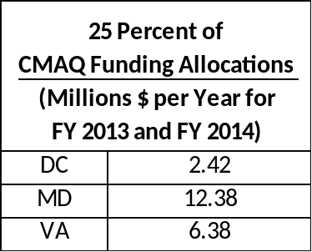
Congestion Mitigation and Air Quality (CMAQ) Program, Section 1113 Cont.
(k) Priority for Use of Funds in PM 2.5 Areas
Requirement
“For any State that has a nonattainment or maintenance area for fine particulate matter, an amount equal to 25 percent of the funds apportioned under section 104(b)(4) …shall be obligated to projects that reduce such fine particulate matter emissions in such area, including diesel retrofits”
2. Applicability to CMAQ funds for FY 2013 and FY 2014

Slide 15
Congestion Mitigation and Air Quality (CMAQ) Program, Section 1113 Cont.
Performance Plan-Each MPO…representing a nonattainment or maintenance area shall develop a performance plan that:
(A) Includes an area baseline level for traffic congestion and on-road mobile source emissions for which the area is in nonattainment or maintenance;
  (B) Describes progress made in achieving the performance targets; and
  (C) Includes a description of projects identified for funding under this section and how such projects will contribute to achieving emission and traffic congestion reduction targets.

Slide 16
Congestion Mitigation and Air Quality (CMAQ) Program, Section 1113 Cont.
Some TPB Programs have been designed to support congestion reduction and improve air quality
  Commuter Connections Program
  Metropolitan Area Transportation Operations Center (MATOC)
TPB already develops “baseline level for traffic congestion and on-road mobile source emissions”
Target-Setting will be a new undertaking
  Await establishment of performance measures by US DOT due by 4/1/2014, then targets must be set by 10/1/2015
TPB coordination with states and public transit agencies to describe how CMAQ-funded projects contribute to achieving emissions and traffic congestion reduction targets

Slide 17

Recent TTI Report on Congestion
  Texas Transportation Institute 2012 Urban Mobility Report
National Capital Region #1 in congestion with regard to average congestion delay per commuter
TTI Planning Time Index represents an unrealistically high level for “reliability planning”
Can we develop additional measures and targets to address congestion in our region with more specificity by location, direction, and time-of-day?
Our region also ranks high in transit, bicycle, pedestrian, and carpool measures, which help mitigate the impact of traffic congestion for many residents

Slide 18
Proposed TPB Comment to US DOT on Performance Measures and Target-Setting
Performance Measures should be:
  Based on readily available data and technical methods
  Meaningful to the general public
  Amenable to disaggregation to reflect local priorities
Target-Setting should be:
  Based on local cost-effectiveness and cost benefit analyses
  Bounded by available resources

Slide 19
Questions?
Ronald F. Kirby
Director, Department of Transportation Planning

