Slide 1

ITEM #7
National Capital Region Transportation Planning Board
July 18, 2012

Slide 2
Car Free Day Background
First took place in the DC region in 2007.
Event started in Europe in 1995, went global in 2000 and is part of Europe’s mobility week.
For at least one day during mobility week, cities set aside an area solely for pedestrians, cyclists and public transit that is ordinarily used by cars.
Car Free Day is celebrated in 1,500 cities in 40 countries.
This year World Car Free Day is on a Saturday.

Slide 3
Car Free Day Background
Regional rollout occurred in 2008 with TPB support.
COG’s Commuter Connections program promotes and organizes the annual Car Free Day event along with its network members.
Invites Washington region citizens to try alternative forms of transportation such as transit, bicycling and walking.
Includes car-lite methods such as carpooling.

Slide 4
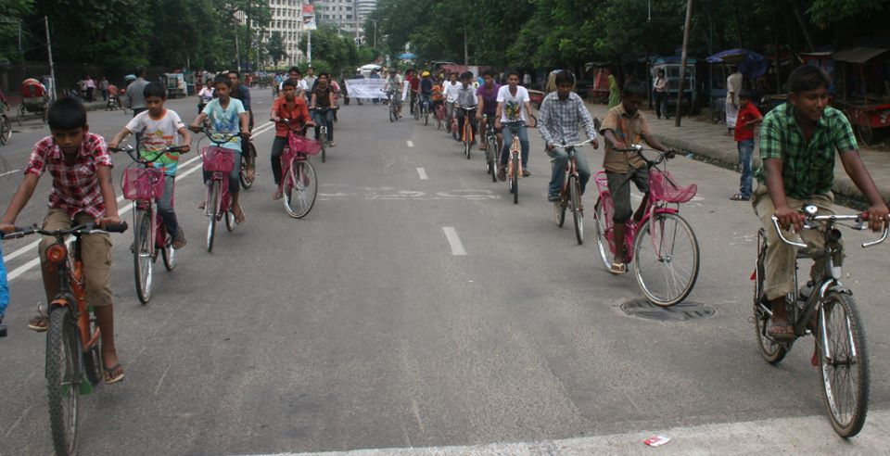
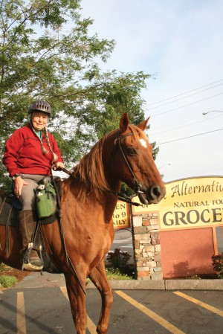
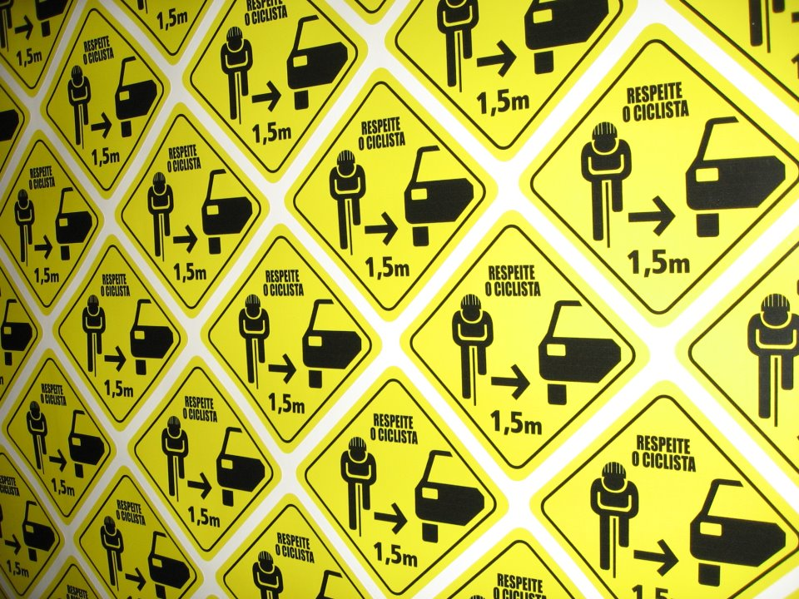

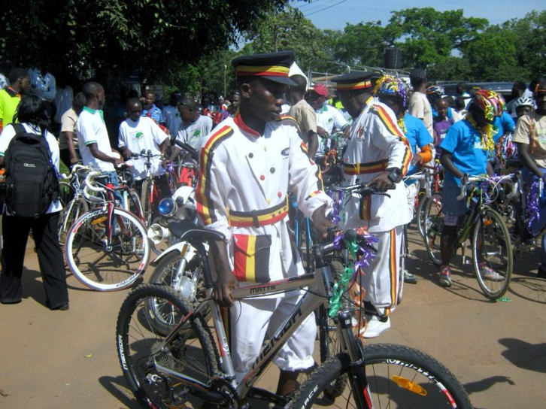

International

Slide 5









2011 Media Coverage Headlines
Commuter Connections Encourages Area Residents to Pledge for Car Free Day
Pledge to go Car Free for A Day
DC Area Universities Join Together to promote Environmental Stewardship
Flippin’ Pizza Wants You to Go Car Free Sept. 22 – September 16, 2011
Car-Free Day a Possibility for DC?
Ten Thousand People Pledge to Go Car Free on Thursday
Car Free Day Promotes Commuting Alternatives
Leave your car home, it’s world car-free day
Car Free Day Encourages People to Find Another way
Participate in Car Free Day 2011

Slide 6
Open Participation
Pledge to be Car Free at www.carfreemetrodc.org
    Workers
    Students
    Homemakers
    Seniors
  Primary targets are individuals who ordinarily travel alone by car for errands, leisure, classes and those working on the weekends.
  Secondary groups are those already in Car Free travel modes.
  11,800 pledges received in 2011, a 70% increase from 2010.

Slide 7
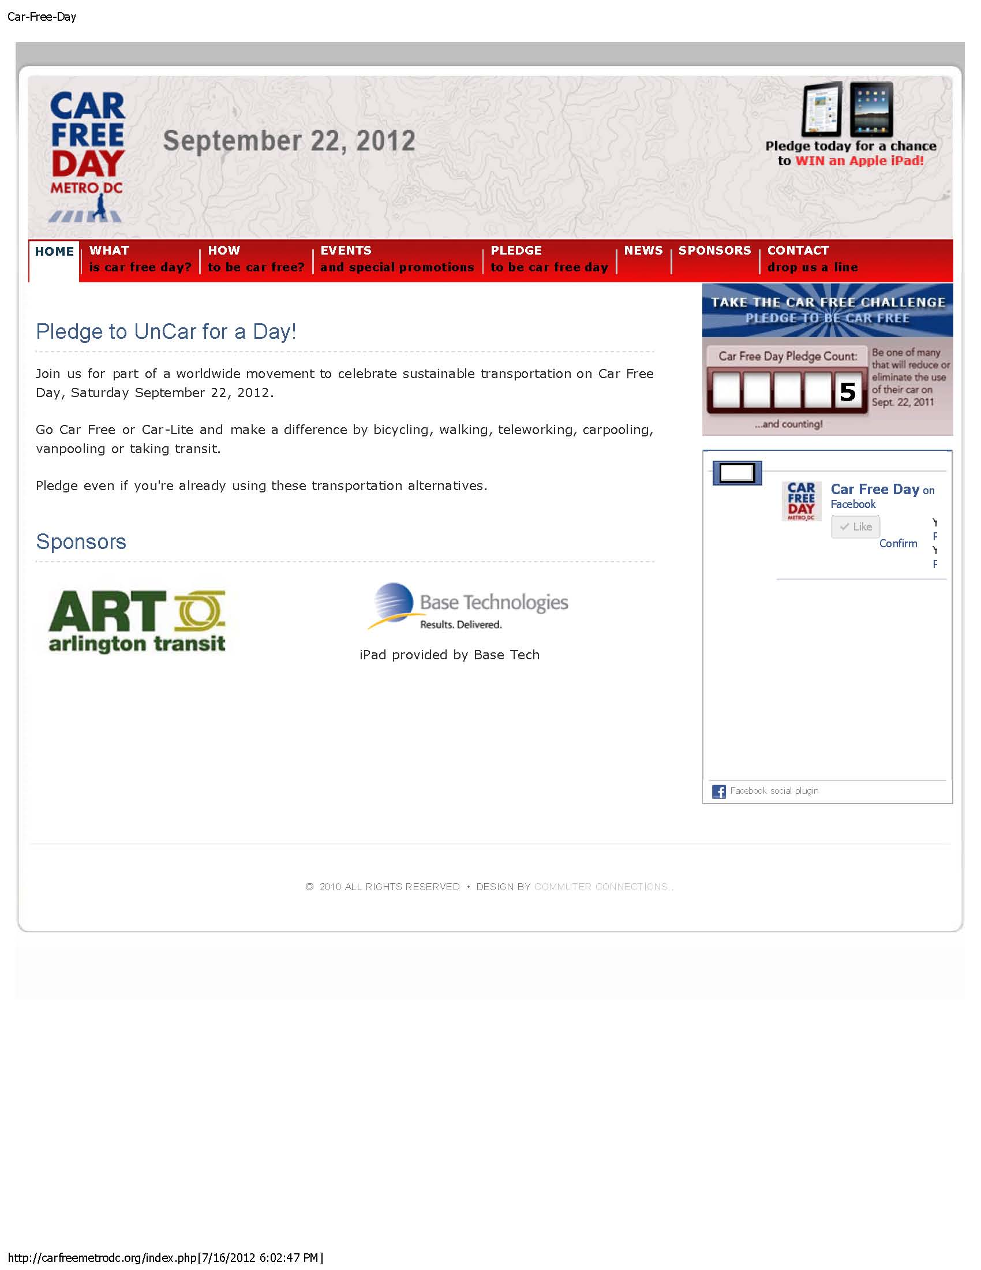
2012 Car Free Day Web Site

Slide 8
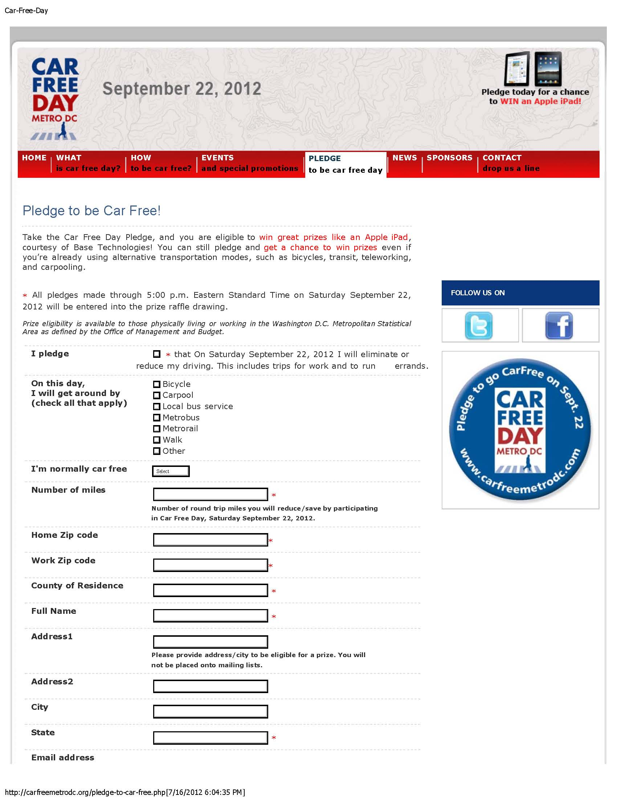
2012 Pledge Form

Slide 9
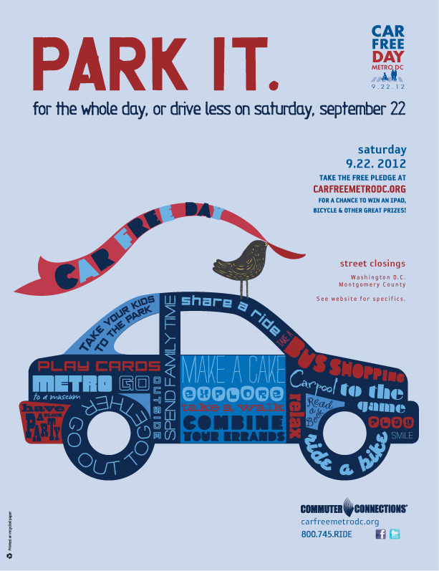




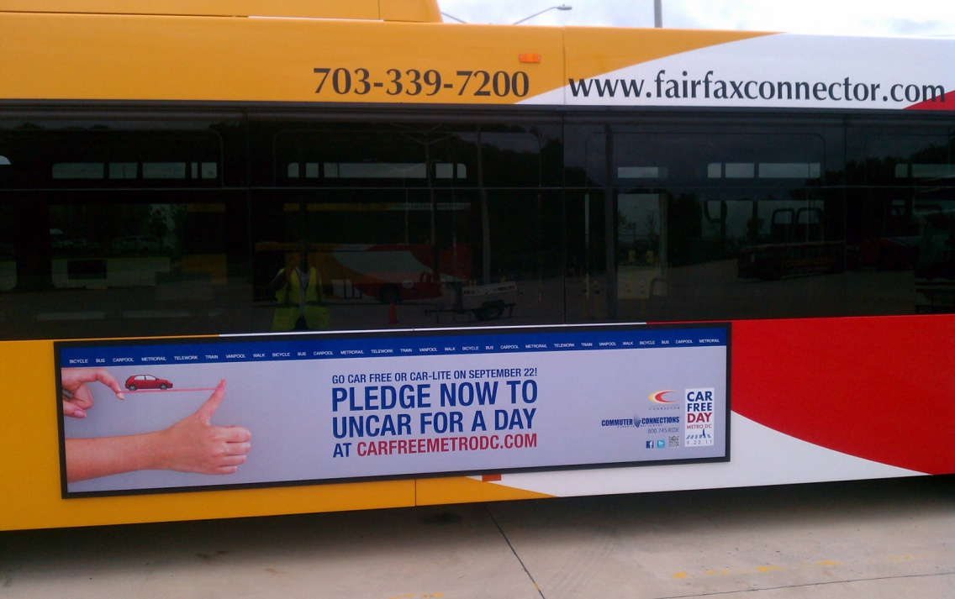
Promotion
Posters
Social Media
Radio Advertising
Transit Advertising

Slide 10
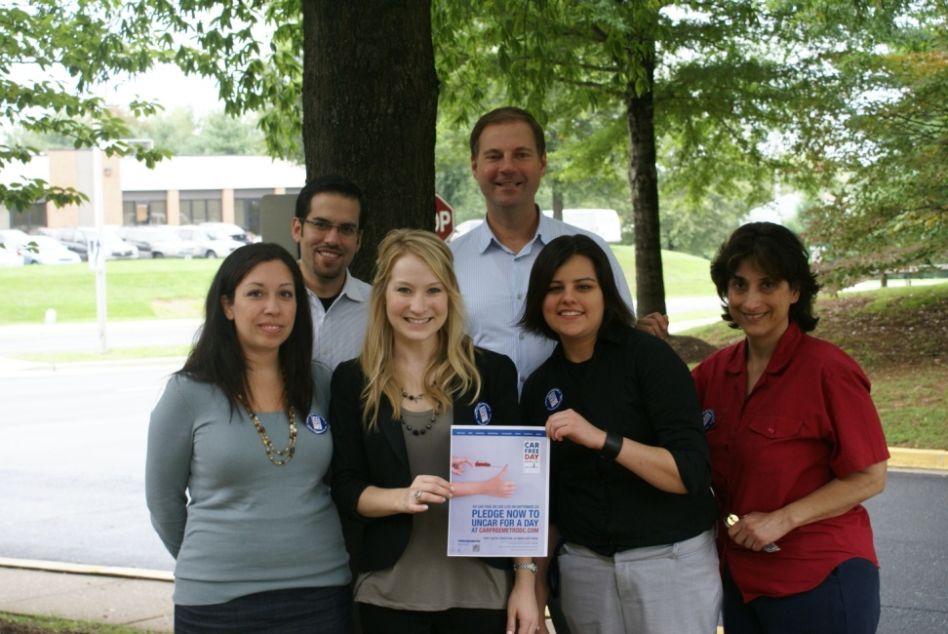
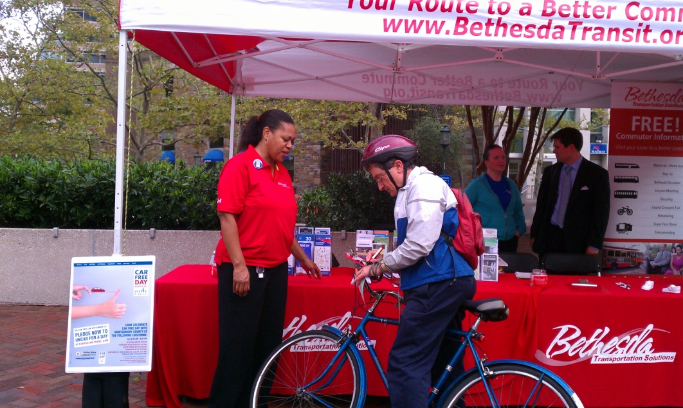
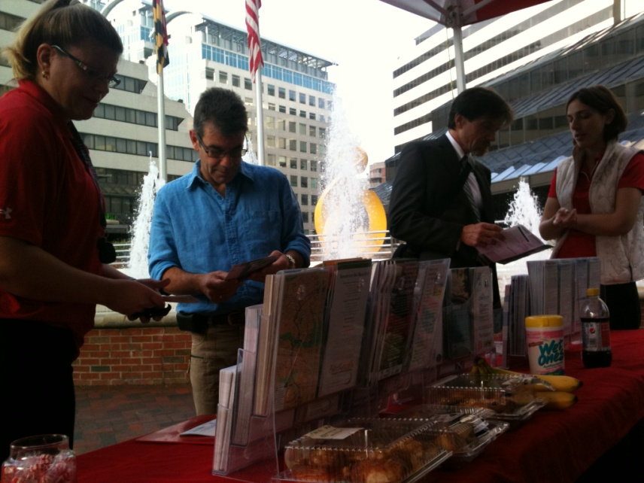
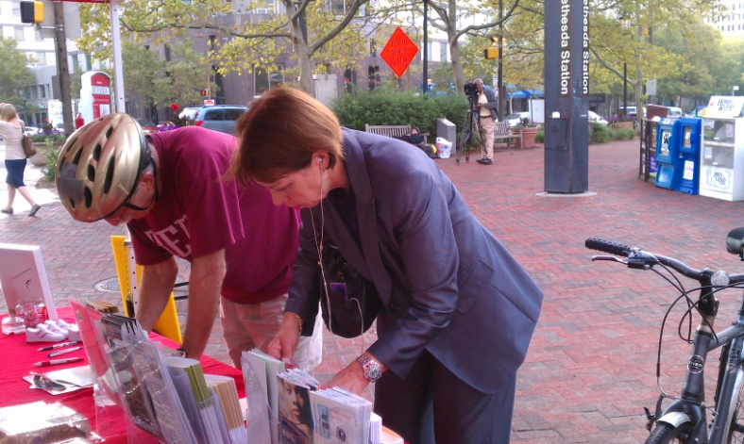
Local Events

Slide 11
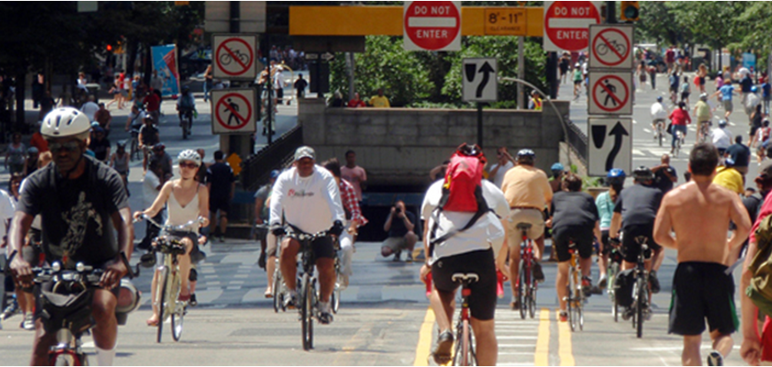
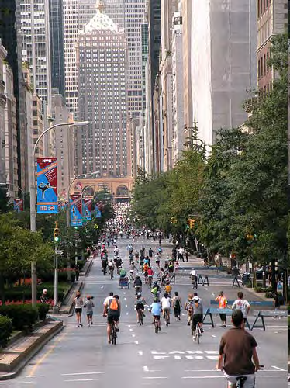
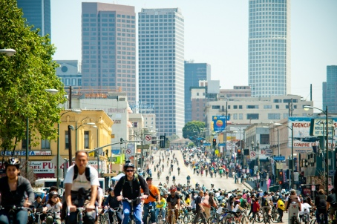
U.S. Street Closures, BIG…

Slide 12
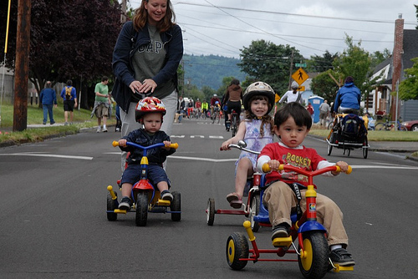
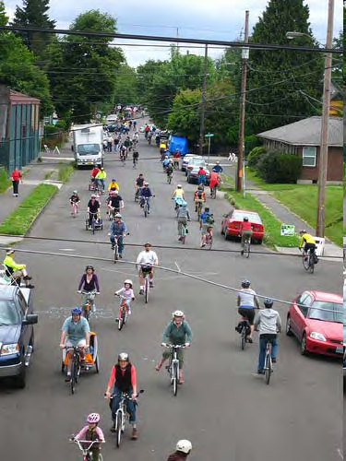
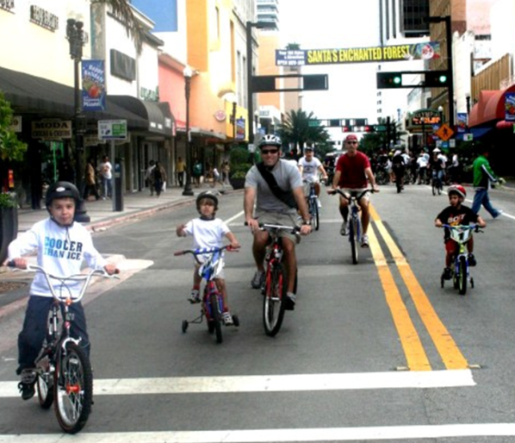
…and small

Slide 13
2012 CFD Call To Action
10,000 Pledges - Goal
TPB Proclamation
Pledges and Podcasts from TPB Members
Local Activities/Events/Street Closures
Media Coverage

Slide 14
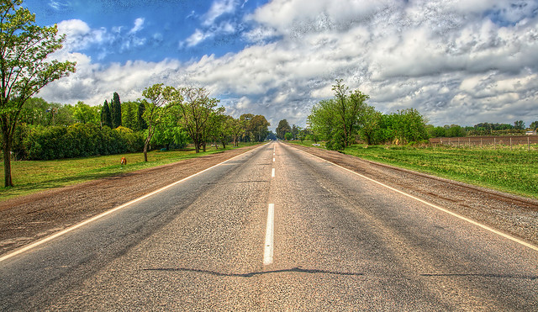
Questions?
Nicholas Ramfos
nramfos@mwcog.org
(202) 962-3313

