Slide 1

Item #12
Development of the
Regional Transportation
Priorities Plan
June 20, 2012
National Capital Region Transportation Planning Board
Metropolitan Washington Council of Governments

Slide 2

Regional Transportation Priorities Plan (RTPP)
Scope and Process approved by TPB on July 20, 2011
Will identify 10 to 15 near and long-term regional strategies that offer the greatest potential for addressing regional challenges
Notes:
Context:
Growing region → greater demands on our transportation network
Funding becoming more limited, uncertain
Regional transportation Vision and Goals
CLRP implements transportation projects and programs
Decision-makers will be challenged to make critical improvements to roads, public transportation and pedestrian and bicycle facilities.
The feedback gathered today will influence the development of a new Regional Transportation Priorities Plan (RTPP).
The purpose of the RTPP is to identify those transportation strategies that offer the greatest potential contributions to achieving the TPB’s goals for economic opportunity, transportation choices, system safety and efficiency, quality of life and environmental stewardship
Ultimately, it is envisioned that 10 to 15 strategies will be identified that the region can agree are the top priorities for meeting our shared goals and addressing regional challenges
These strategies would lead to projects and programs that are over and above what’s in the CLRP

Slide 3
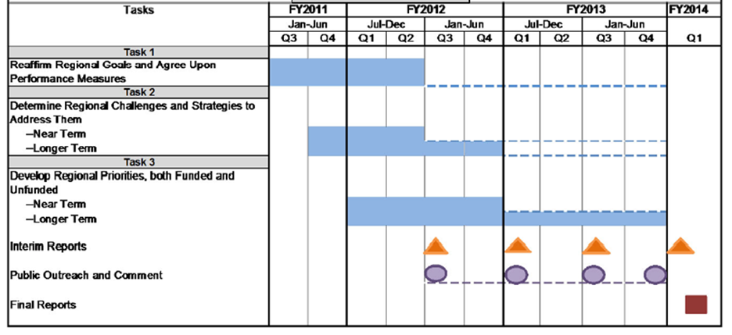
Schedule for Developing the RTPP
*
* Interim Report #1 presented to TPB on January 18, 2012

Slide 4
Activities Since
January 18, 2012
January/February 2012: Listening Sessions with Regional Stakeholders and Citizens Groups
June 2, 2012: Citizen Forum
July 2012: Interim Report 2, incorporating feedback received
Fall 2012: Outreach to broader public on challenges and strategies

Slide 5
Listening Sessions

Slide 6
Listening Session Schedule
Stakeholder/Citizen Group | Date
Citizens Advisory Committee (CAC) | January 12
Air and Climate Public Advisory Committee (ACPAC) | January 23
Regional Stakeholder Group 1 | February 22
Access for All Committee (AFA) | February 23
Regional Stakeholder Group 2 | February 24

Slide 7
Format and Results
Format: sessions were approximately 1 - 2 hours long
  Began with a presentation of performance measures and challenges
  When time allowed, a discussion of strategies followed
Results:
  People were somewhat confused by performance measures
  A different approach was needed to better communicate the RTPP

Slide 8
June 2 Citizen Forum

Slide 9


June 2 Forum
Independent firm
  Organized and facilitated forum
  Recruited participants
41 participants
  Largely representative sample of general public from the region
Forum included presentations, table discussions, dynamic participation and keypad polling

Slide 10
Forum Objectives
How best to communicate goals, challenges, and strategies to the general public?
Are the challenges and strategies presented meaningful, and are there additional challenges and/or strategies that should be included?

Slide 11
Presented Goals and Challenges
Six goals based on TPB Vision and Region Forward
Each goal had two challenges developed by TPB staff
Information provided in PowerPoint and Discussion Guide
Table discussion about goals and challenges
Voting on challenges
  Q: “How significant of a problem is this challenge to achieving Regional Goal X”

Slide 12
Presented Six
“Sample” Strategies
Presented a list of 6 sample strategies developed by TPB Staff across a spectrum of:
  Cost
  Time-frame
  Scale
  Specificity
Intended to spur discussion and test different approaches to strategies
Information provided in PowerPoint and Discussion Guide
Table discussion about strategies
Voting
  Q: “How important (scale: 1-5) is it that we pursue this strategy?”

Slide 13
Key Takeaways

Slide 14
Takeaway 1 –
Forum Participants’ Ideas
The participants had some new challenges that could be included in the RTPP
  Lack of transparency, trust in management, and maintenance oversight
  No forum for underdeveloped communities to articulate their needs
  Difficult to strike proper balance between development and environmental preservation

Slide 15
Takeaway 2 –
Challenges → Strategies
Continue to emphasize the importance of regional challenges as a context for developing strategies
RTPP materials and outreach tools should make it clear that strategies must emanate from challenges

Slide 16
Takeaway 3 – Strategies Need Funding Mechanisms
Participants understood that funding is tight
More complete funding information would have helped participants in evaluating strategies

Slide 17
Takeaway 4 – Clear and Concise Communication
Still room for improvement to effectively communicate the RTPP
  Simplify goal language
  Use examples to help explain challenges
  All strategies need full explanation
Employ more:
  Examples
  Pictures
  Simple charts and graphs

Slide 18
Next Steps

Slide 19

Next Steps
TPB Agenda Item (June 20)
Present Interim Report 2 (July 2012)
Seek broader feedback from general public (September to November 2012)
Refine strategies & conduct benefit-cost analysis (November 2012 to Spring 2013)
  RTPP will include 10 to 15 selected strategies that have higher benefits than costs and have broad regional appeal

Slide 20
Fall Public Outreach
Utilize a web-based tool
Get input from:
  A large (~600 person) representative sample of the region
  Stakeholder groups
  Citizen groups (CAC, ACPAC, etc)

