Slide 1

Bay Pollution Limits & Their Job Impacts
- One Local Perspective
Presented to COG Chesapeake Bay & Water Resources Policy Committee
ALEXANDRIA SANITATION AUTHORITY
Karen Pallansch, General Manager
March 2012

Slide 2
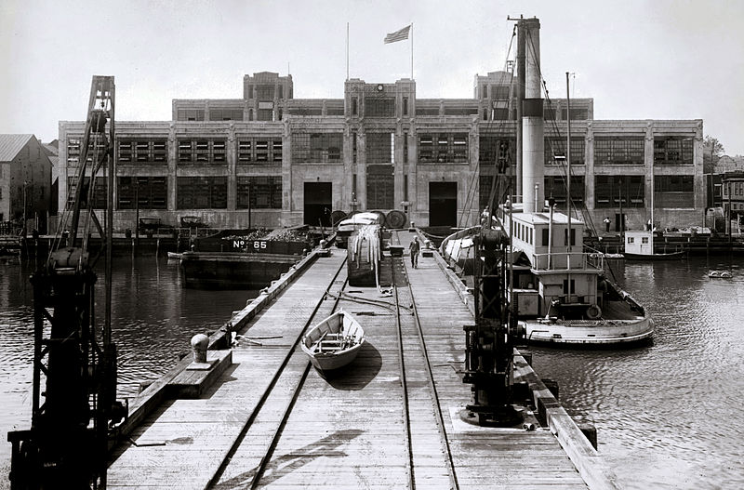
Where We’ve Come From…
Torpedo Factory, Alexandria Water Front, circa 1940’s
Notes:
Why important?
Industry of city was war time, need to build sewage treatment, no resources
Moratorium

Slide 3
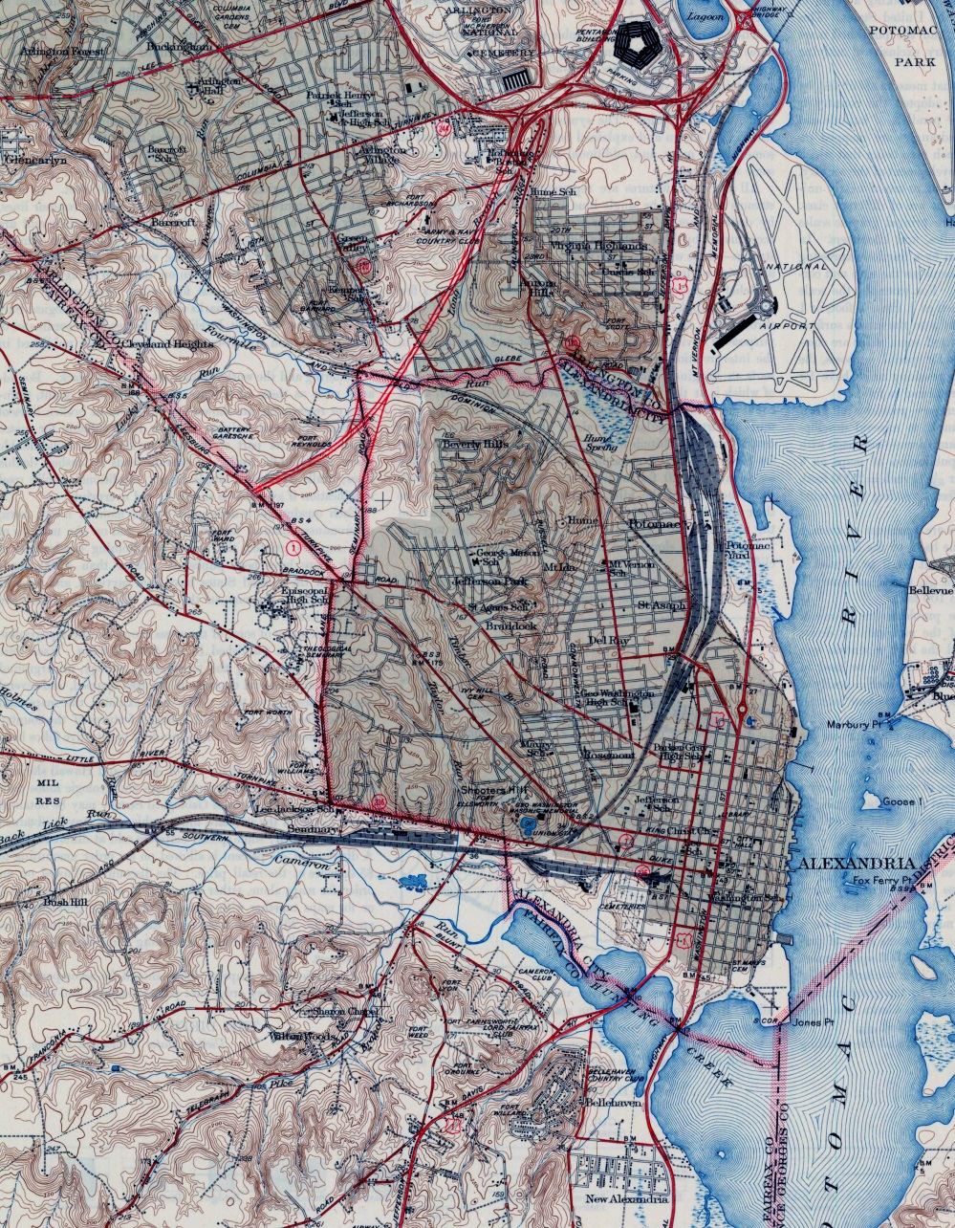
Where We’ve Come From…
Notes:
Forefathers looked at watershed; needs of entire area
Determined path forward was integrated
Annexation allowed City to pay their share of facility

Slide 4
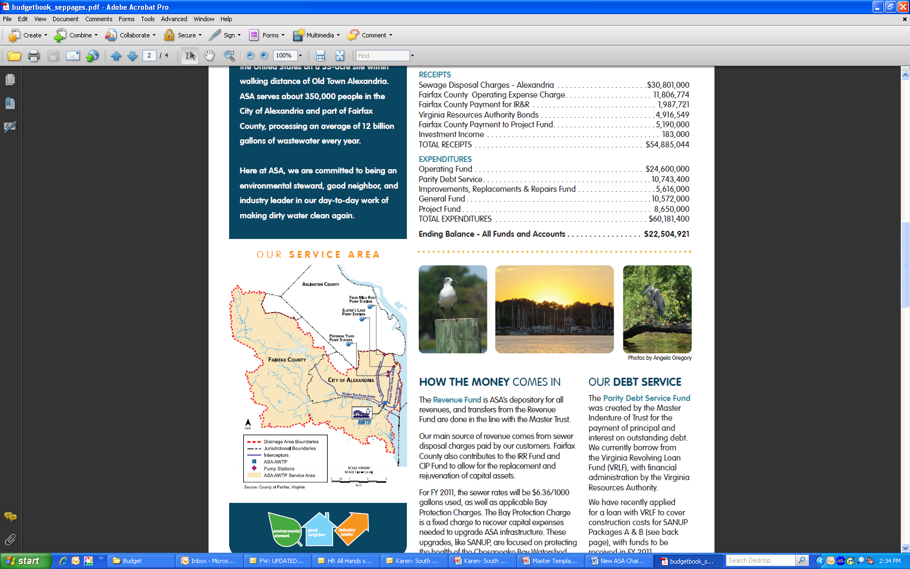
Where We’ve Come From…
Notes:
Forefathers looked at watershed; needs of entire area
Determined path forward was integrated
Annexation allowed City to pay their share of facility

Slide 5
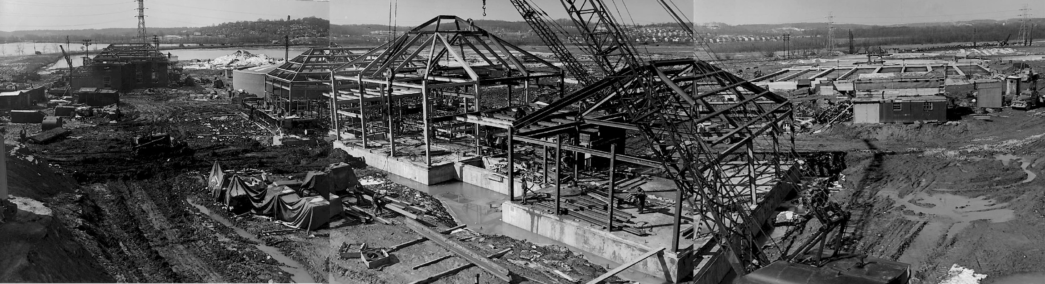
Where We’ve Come From…
First ASA construction, 835 South Payne Street, circa 1953
Notes:
New plant – about 10 permanent jobs added

Slide 6
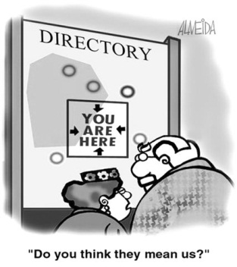
Where We Are Going…
New Economic Reality
High Debt Burden
Capital Intensive Infrastructure
Aging Workforce
Regulatory Imbalances

Slide 7


Where We Are Going…
Chesapeake Bay 2000
EPA in 2003 – Nutrient Criteria
VA 2005 – Adopts Nutrient WQ Criteria
Nutrient General Permits in 2007
Xchange Created by Statute
Bay TMDL Requirements 2011

Slide 8
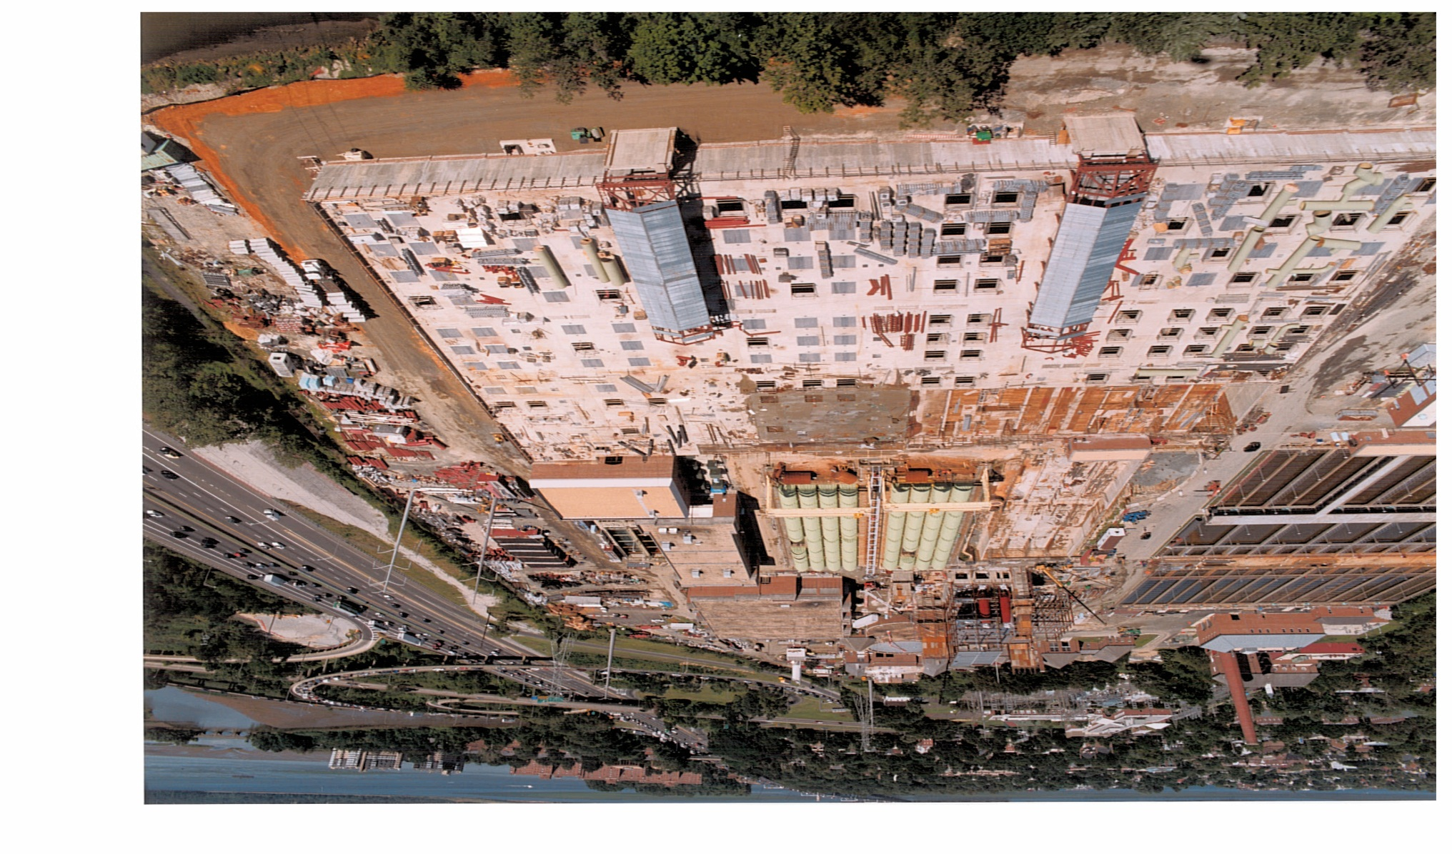
Where We Are Going…
ASA circa 2001, $350M invested for Nutrient Removal

Slide 9
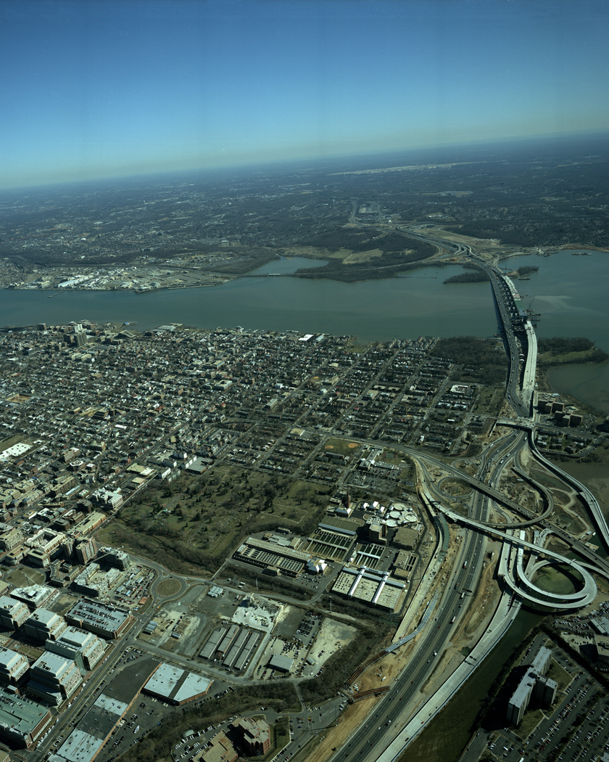
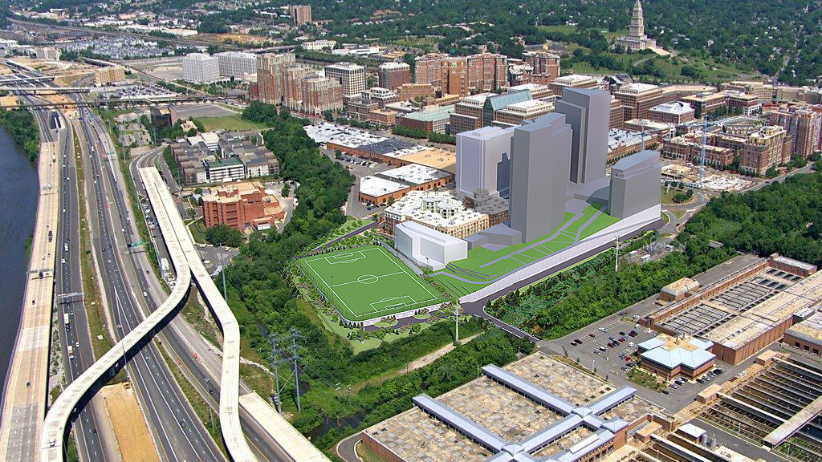
Where We Are Going…
ASA circa 2016, $150M invested

Slide 10
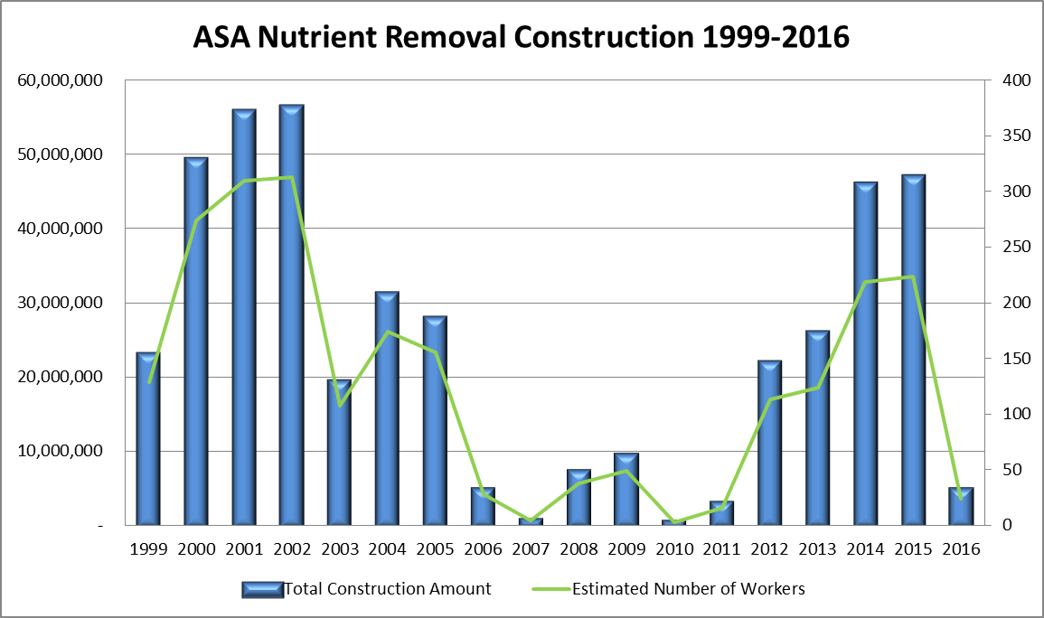
Requirements & Jobs Over Time

Slide 11

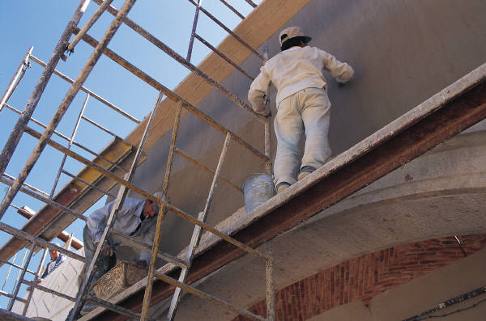
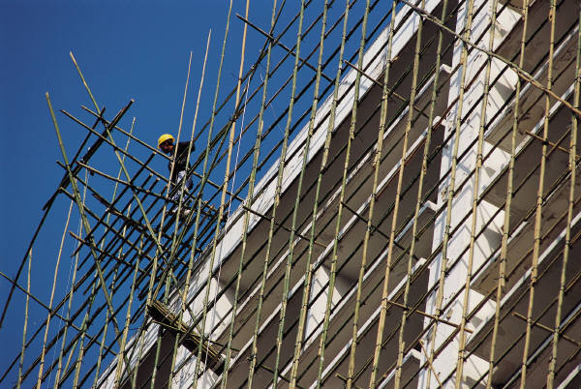
Job Results…
Large Group Unskilled to semi skilled
Transient
Short Term
Sustainable?

Slide 12
Requirements & Jobs Over Time
20
15
10
5
Nitrogen Reduction Requirements
TN Discharged
1995
2000
2005
2010
2015
2020
50
100
150
200
EMPLOYEES
# of ASA Employees

Slide 13
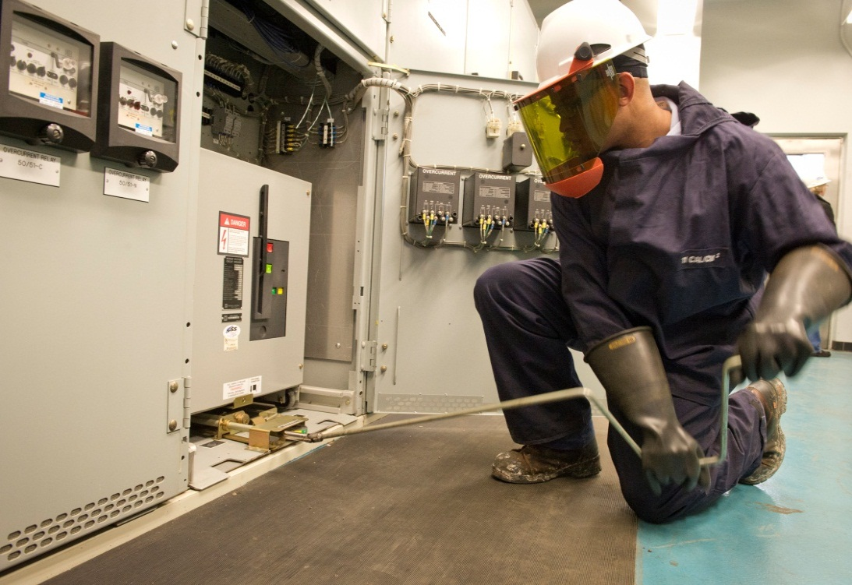

Water Profession Needs…
Because of Increased Regulation:
Highly skilled trades people
Require additional annual training

Slide 14
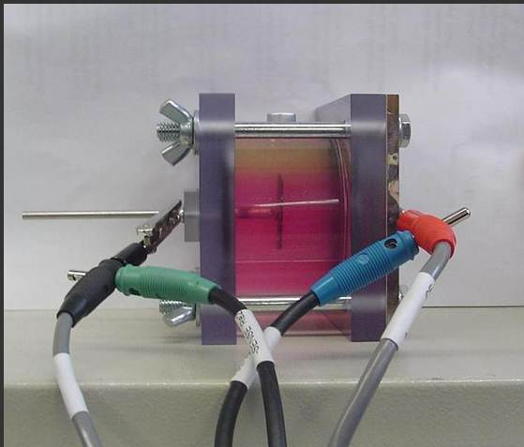
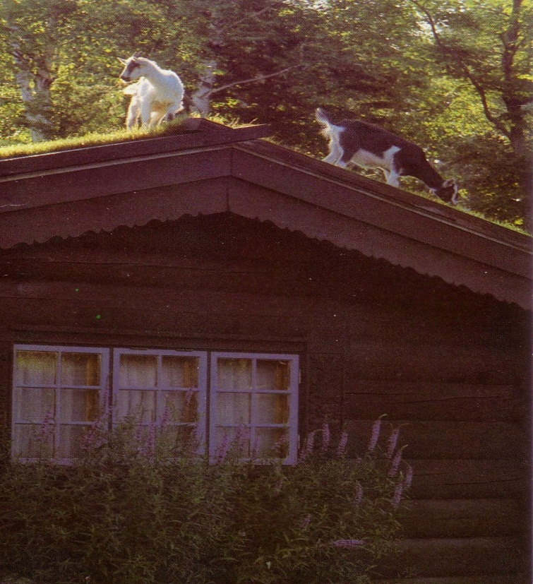

Water Profession Needs…
Because of Increased Regulation:
Researchers and Research $$
Engineers – limited pool
Wastewater Fuel Cell
Green Roof

Slide 15



Water Profession Needs…
Because of Increased Regulation:
Business & Financial
Legal

Slide 16
Water Profession Challenges
Opportunity Costs….$ spent on wastewater…

Slide 17
Water Profession Challenges
Rates…Public doesn’t understand the Value of Water…

Slide 18

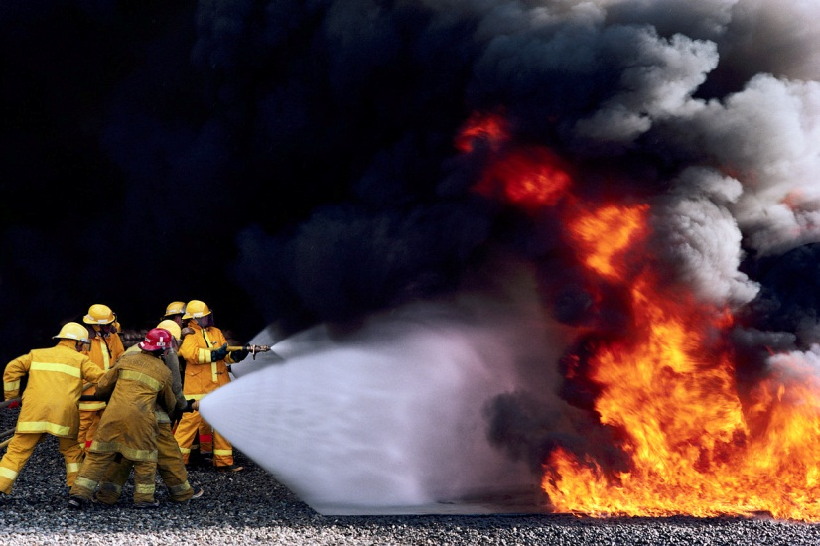
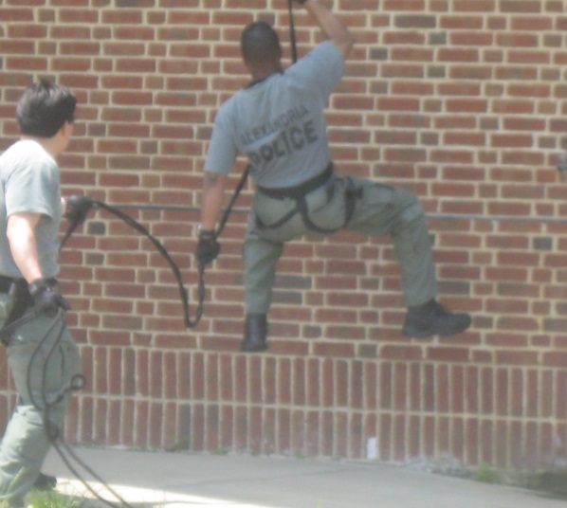
Water Profession Challenges
Opportunity Costs….$ spent on wastewater and stormwater…
Community Choices Limited….

Slide 19
Water Profession Challenges
Urbanization
Lack of training programs
Clean Water Act
Competition for Limited Resources
Intensive Capital Needs

Slide 20
Additional Thoughts?

