Slide 1
Metropolitan Washington Council of Governments
Commuter Survey Results – September 9, 2011

Slide 2
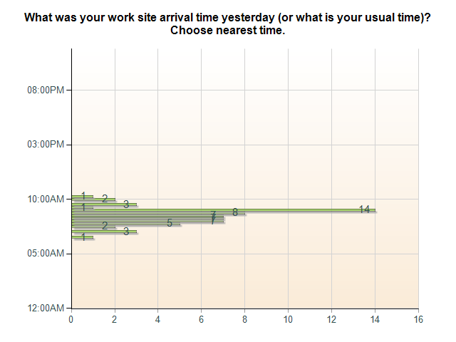
Commuter Survey: What was your work site arrival time yesterday (or what is your usual time)? Choose nearest time.
What was your work site arrival time yesterday (or what is your usual time)? Choose nearest time.
12:45AM
01:15AM
01:45AM
02:00AM
0 (0 %)
02:30AM
0 (0 %)
0 (0 %)
03:00AM
0 (0 %)
03:15AM
0 (0 %)
03:30AM
0 (0 %)
03:45AM
0 (0 %)
04:00AM
0 (0 %)
04:15AM
0 (0 %)
04:30AM
0 (0 %)
04:45AM
0 (0 %)
05:00AM
0 (0 %)
05:15AM
0 (0 %)
05:30AM
0 (0 %)
05:45AM
0 (0 %)
06:00AM
0 (0 %)
06:15AM
0 (0 %)
06:30AM
1 (2 %)
06:45AM
0 (0 %)
07:00AM
3 (5 %)
07:15AM
0 (0 %)
07:30AM
2 (3 %)
07:45AM
5 (8 %)
08:00AM
7 (11 %)
08:15AM
7 (11 %)
08:30AM
7 (11 %)
08:45AM
8 (13 %)
09:00AM
14 (23 %)
09:15AM
1 (2 %)
09:30AM
3 (5 %)
09:45AM
0 (0 %)
10:00AM
2 (3 %)
10:15AM
1 (2 %)
10:30AM
0 (0 %)
10:45AM
0 (0 %)
11:00AM
0 (0 %)
11:15AM
0 (0 %)
11:30AM
0 (0 %)
11:45AM
0 (0 %)
12:00PM
0 (0 %)
12:15PM
0 (0 %)
12:30PM
0 (0 %)
12:45PM
0 (0 %)
01:00PM
0 (0 %)
01:15PM
0 (0 %)
01:30PM
0 (0 %)
01:45PM
0 (0 %)
02:00PM
0 (0 %)
02:15PM
0 (0 %)
02:30PM
0 (0 %)
02:45PM
0 (0 %)
03:00PM
0 (0 %)
03:15PM
0 (0 %)
03:30PM
0 (0 %)
03:45PM
0 (0 %)
04:00PM
0 (0 %)
04:15PM
0 (0 %)
04:30PM
0 (0 %)
04:45PM
0 (0 %)
05:00PM
0 (0 %)
05:15PM
0 (0 %)
05:30PM
0 (0 %)
05:45PM
0 (0 %)
06:00PM
0 (0 %)
06:15PM
0 (0 %)
06:30PM
0 (0 %)
06:45PM
0 (0 %)
07:00PM
0 (0 %)
07:15PM
0 (0 %)
07:30PM
0 (0 %)
07:45PM
0 (0 %)
08:00PM
0 (0 %)
08:15PM
0 (0 %)
08:30PM
0 (0 %)
08:45PM
0 (0 %)
09:00PM
0 (0 %)
09:15PM
0 (0 %)
09:30PM
0 (0 %)
09:45PM
0 (0 %)
10:00PM
0 (0 %)
10:15PM
0 (0 %)
10:30PM
0 (0 %)
10:45PM
0 (0 %)
11:00PM
0 (0 %)
11:15PM
0 (0 %)
11:30PM
0 (0 %)
11:45PM
0 (0 %)

Slide 3
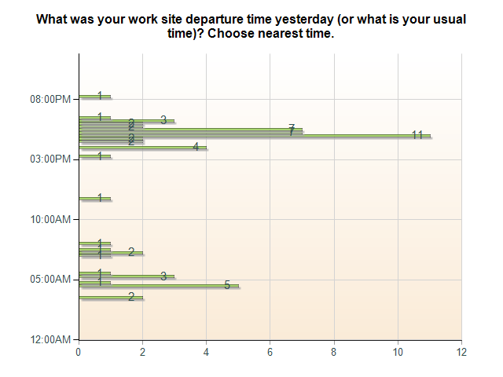
Commuter Survey: What was your work site departure time yesterday (or what is your usual time)? Choose nearest time.

Slide 4
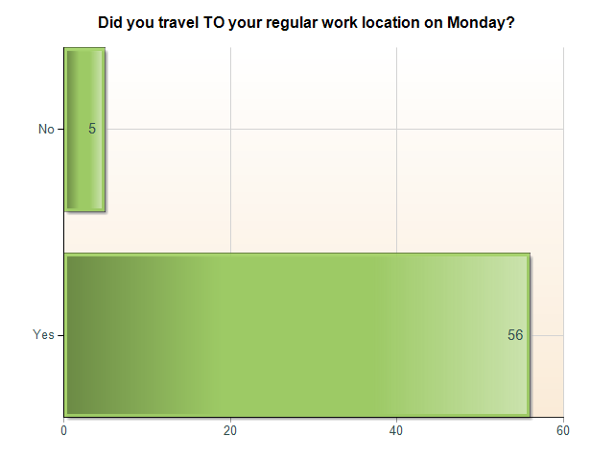
Commuter Survey: Did you travel TO your regular work location on Monday?
Did you travel TO your regular work location on Monday?
Yes | 56 (92 %)
No | 5 (8 %)

Slide 5
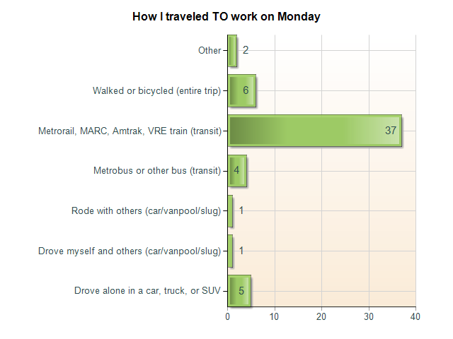
Commuter Survey: How I traveled TO work on Monday
How I traveled TO work on Monday
Drove alone in a car, truck, or SUV | 5 (9 %)
Drove myself and others (car/vanpool/slug) | 1 (2 %)
Rode with others (car/vanpool/slug) | 1 (2 %)
Metrobus or other bus (transit) | 4 (7 %)
Metrorail, MARC, Amtrak, VRE train (transit) | 37 (66 %)
Walked or bicycled (entire trip) | 6 (11 %)
Other | 2 (4 %)

Slide 6
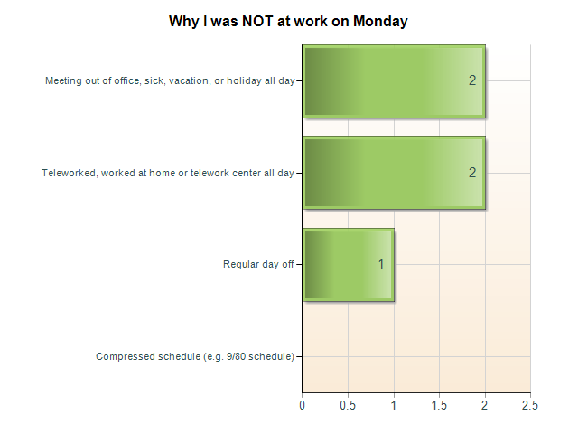
Commuter Survey: Why I was NOT at work on Monday
Why I was NOT at work on Monday
Compressed schedule (e.g. 9/80 schedule) | 0 (0 %)
Regular day off | 1 (20 %)
Teleworked, worked at home or telework center all day | 2 (40 %)
Meeting out of office, sick, vacation, or holiday all day | 2 (40 %)

Slide 7
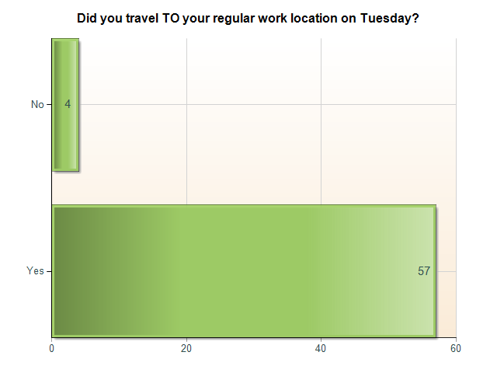
Commuter Survey: Did you travel TO your regular work location on Tuesday?
Did you travel TO your regular work location on Tuesday?
Yes | 57 (93 %)
No | 4 (7 %)

Slide 8
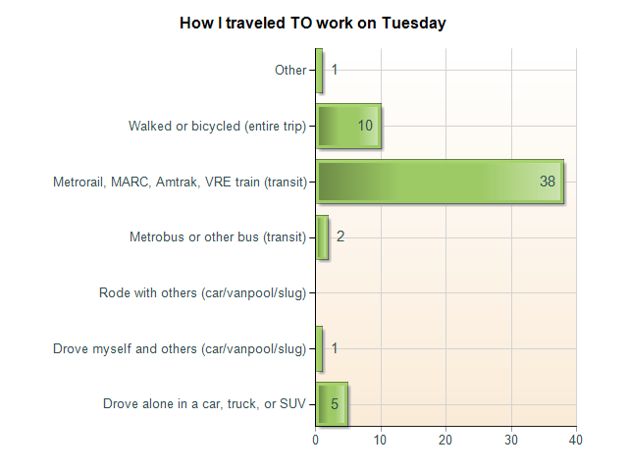
Commuter Survey: How I traveled TO work on Tuesday
How I traveled TO work on Tuesday
Drove alone in a car, truck, or SUV | 5 (9 %)
Drove myself and others (car/vanpool/slug) | 1 (2 %)
Rode with others (car/vanpool/slug) | 0 (0 %)
Metrobus or other bus (transit) | 2 (4 %)
Metrorail, MARC, Amtrak, VRE train (transit) | 38 (67 %)
Walked or bicycled (entire trip) | 10 (18 %)
Other | 1 (2 %)

Slide 9
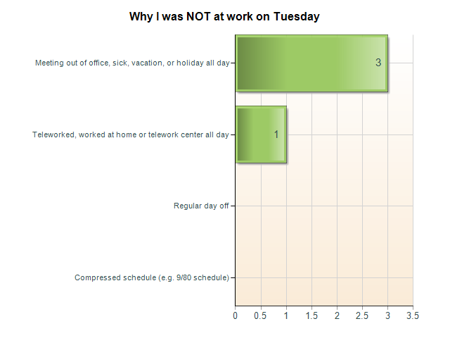
Commuter Survey: Why I was NOT at work on Tuesday
Why I was NOT at work on Tuesday
Compressed schedule (e.g. 9/80 schedule) | 0 (0 %)
Regular day off | 0 (0 %)
Teleworked, worked at home or telework center all day | 1 (25 %)
Meeting out of office, sick, vacation, or holiday all day | 3 (75 %)

Slide 10

Commuter Survey: Did you travel TO your regular work location on Wednesday?
Did you travel TO your regular work location on Wednesday?
Yes | 58 (95 %)
No | 3 (5 %)

Slide 11
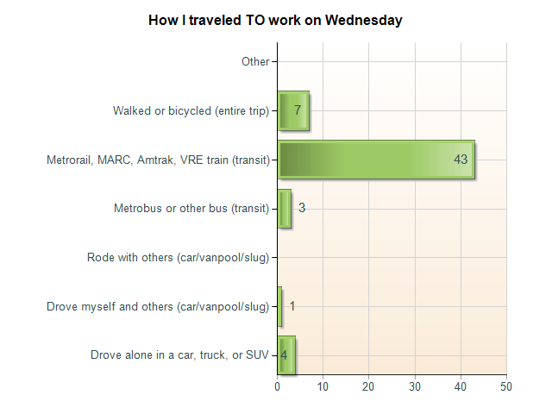
Commuter Survey: How I traveled TO work on Wednesday
How I traveled TO work on Wednesday
Drove alone in a car, truck, or SUV | 4 (7 %)
Drove myself and others (car/vanpool/slug) | 1 (2 %)
Rode with others (car/vanpool/slug) | 0 (0 %)
Metrobus or other bus (transit) | 3 (5 %)
Metrorail, MARC, Amtrak, VRE train (transit) | 43 (74 %)
Walked or bicycled (entire trip) | 7 (12 %)
Other | 0 (0 %)

Slide 12
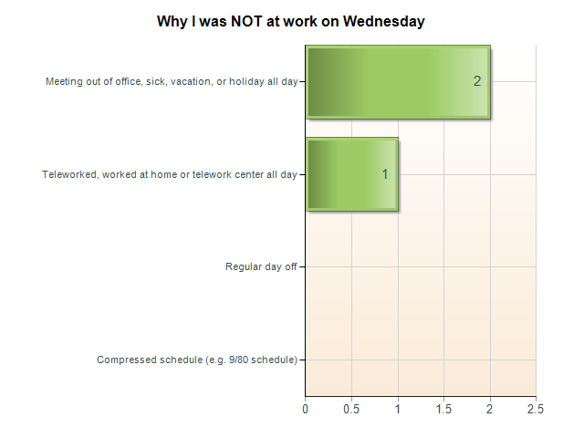
Commuter Survey: Why I was NOT at work on Wednesday
Why I was NOT at work on Wednesday
Compressed schedule (e.g. 9/80 schedule) | 0 (0 %)
Regular day off | 0 (0 %)
Teleworked, worked at home or telework center all day | 1 (33 %)
Meeting out of office, sick, vacation, or holiday all day | 2 (67 %)

Slide 13
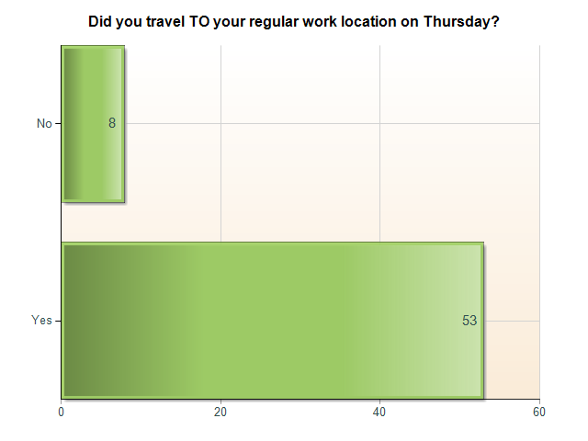
Commuter Survey: Did you travel TO your regular work location on Thursday?
Did you travel TO your regular work location on Thursday?
Yes | 53 (87 %)
No | 8 (13 %)

Slide 14
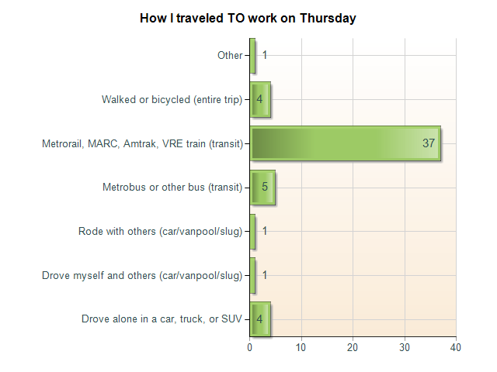
Commuter Survey: How I traveled TO work on Thursday
How I traveled TO work on Thursday
Drove alone in a car, truck, or SUV | 4 (8 %)
Drove myself and others (car/vanpool/slug) | 1 (2 %)
Rode with others (car/vanpool/slug) | 1 (2 %)
Metrobus or other bus (transit) | 5 (9 %)
Metrorail, MARC, Amtrak, VRE train (transit) | 37 (70 %)
Walked or bicycled (entire trip) | 4 (8 %)
Other | 1 (2 %)

Slide 15
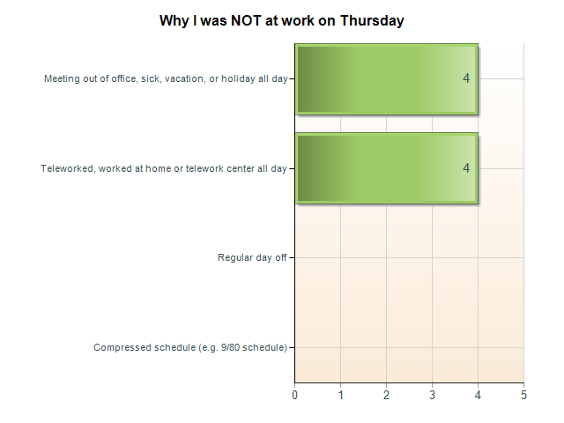
Commuter Survey: Why I was NOT at work on Thursday
Why I was NOT at work on Thursday
Compressed schedule (e.g. 9/80 schedule) | 0 (0 %)
Regular day off | 0 (0 %)
Teleworked, worked at home or telework center all day | 4 (50 %)
Meeting out of office, sick, vacation, or holiday all day | 4 (50 %)

Slide 16
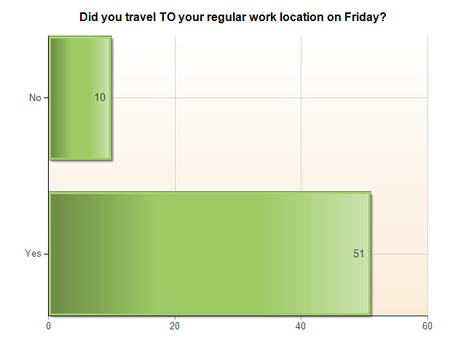
Commuter Survey: Did you travel TO your regular work location on Friday?
Did you travel TO your regular work location on Friday?
Yes | 51 (84 %)
No | 10 (16 %)

Slide 17
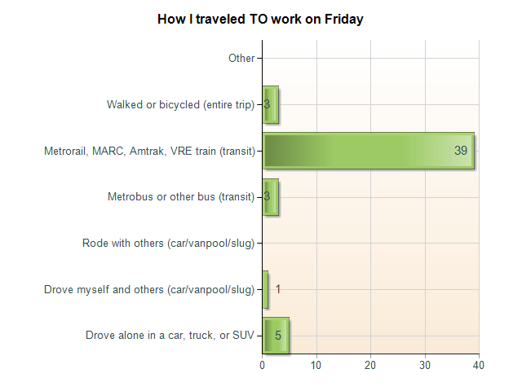
Commuter Survey: How I traveled TO work on Friday
How I traveled TO work on Friday
Drove alone in a car, truck, or SUV | 5 (10 %)
Drove myself and others (car/vanpool/slug) | 1 (2 %)
Rode with others (car/vanpool/slug) | 0 (0 %)
Metrobus or other bus (transit) | 3 (6 %)
Metrorail, MARC, Amtrak, VRE train (transit) | 39 (76 %)
Walked or bicycled (entire trip) | 3 (6 %)
Other | 0 (0 %)

Slide 18
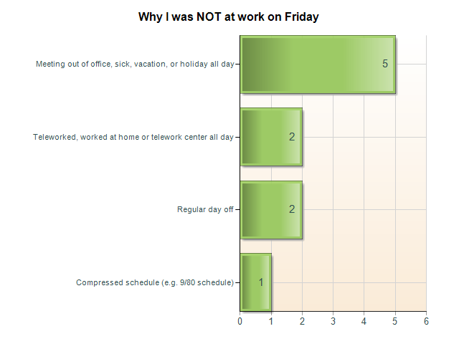
Commuter Survey: Why I was NOT at work on Friday
Why I was NOT at work on Friday
Compressed schedule (e.g. 9/80 schedule) | 1 (10 %)
Regular day off | 2 (20 %)
Teleworked, worked at home or telework center all day | 2 (20 %)
Meeting out of office, sick, vacation, or holiday all day | 5 (50 %)

Slide 19
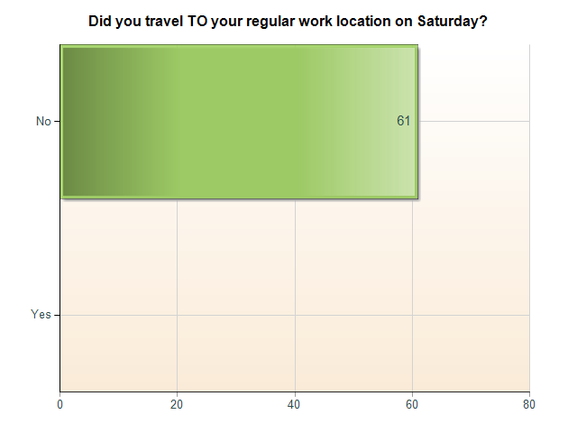
Commuter Survey: Did you travel TO your regular work location on Saturday?
Did you travel TO your regular work location on Saturday?
Yes | 0 (0 %)
No | 61 (100 %)

Slide 20
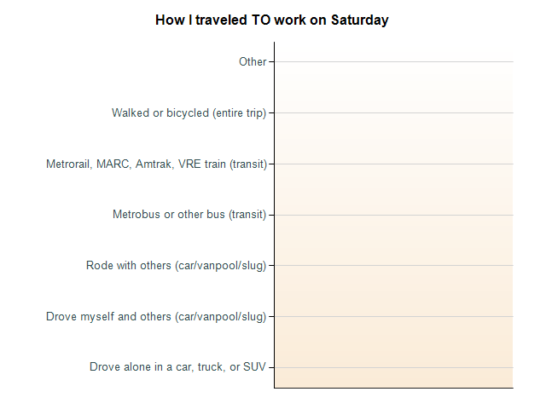
Commuter Survey: How I traveled TO work on Saturday
How I traveled TO work on Saturday
Drove alone in a car, truck, or SUV | 0 (0 %)
Drove myself and others (car/vanpool/slug) | 0 (0 %)
Rode with others (car/vanpool/slug) | 0 (0 %)
Metrobus or other bus (transit) | 0 (0 %)
Metrorail, MARC, Amtrak, VRE train (transit) | 0 (0 %)
Walked or bicycled (entire trip) | 0 (0 %)
Other | 0 (0 %)

Slide 21
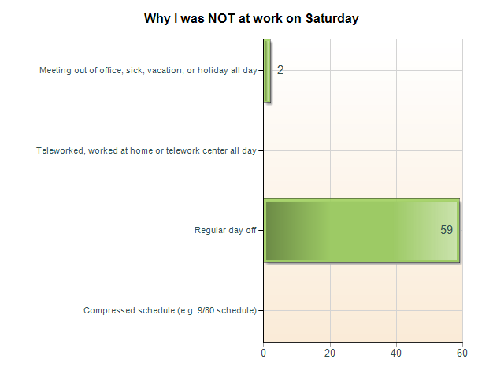
Commuter Survey: Why I was NOT at work on Saturday
Why I was NOT at work on Saturday
Compressed schedule (e.g. 9/80 schedule) | 0 (0 %)
Regular day off | 59 (97 %)
Teleworked, worked at home or telework center all day | 0 (0 %)
Meeting out of office, sick, vacation, or holiday all day | 2 (3 %)

Slide 22
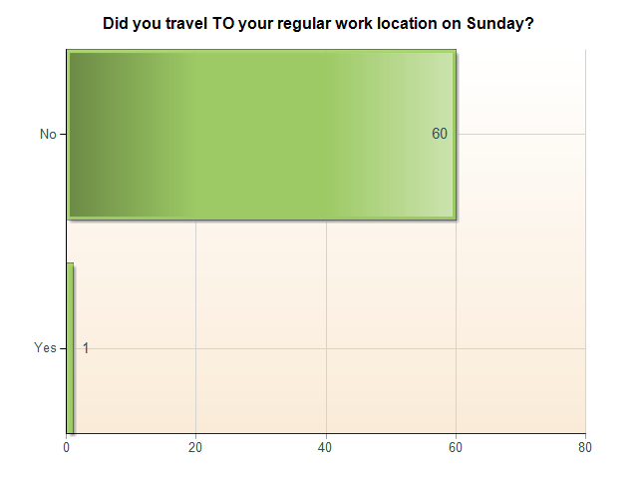
Commuter Survey: Did you travel TO your regular work location on Sunday?
Did you travel TO your regular work location on Sunday?
Yes | 1 (2 %)
No | 60 (98 %)

Slide 23
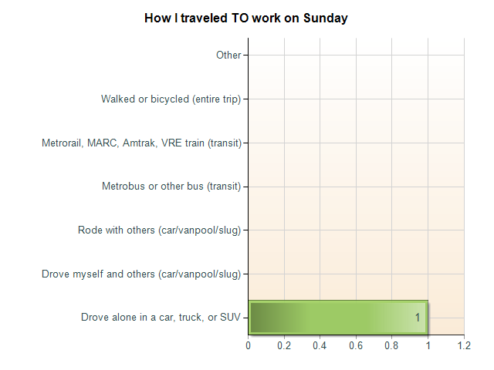
Commuter Survey: How I traveled TO work on Sunday
How I traveled TO work on Sunday
Drove alone in a car, truck, or SUV | 1 (100 %)
Drove myself and others (car/vanpool/slug) | 0 (0 %)
Rode with others (car/vanpool/slug) | 0 (0 %)
Metrobus or other bus (transit) | 0 (0 %)
Metrorail, MARC, Amtrak, VRE train (transit) | 0 (0 %)
Walked or bicycled (entire trip) | 0 (0 %)
Other | 0 (0 %)

Slide 24
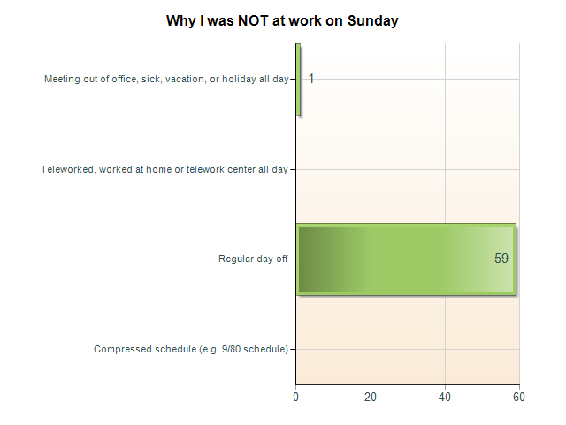
Commuter Survey: Why I was NOT at work on Sunday
Why I was NOT at work on Sunday
Compressed schedule (e.g. 9/80 schedule) | 0 (0 %)
Regular day off | 59 (98 %)
Teleworked, worked at home or telework center all day | 0 (0 %)
Meeting out of office, sick, vacation, or holiday all day | 1 (2 %)

Slide 25
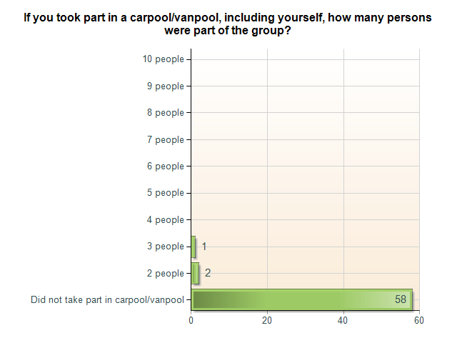
Commuter Survey: If you took part in a carpool/vanpool, including yourself, how many persons were part of the group?
If you took part in a carpool/vanpool, including yourself, how many persons were part of the group?
Did not take part in carpool/vanpool | 58 (95 %)
2 people | 2 (3 %)
3 people | 1 (2 %)
4 people | 0 (0 %)
5 people | 0 (0 %)
6 people | 0 (0 %)
7 people | 0 (0 %)
8 people | 0 (0 %)
9 people | 0 (0 %)
10 people | 0 (0 %)

Slide 26
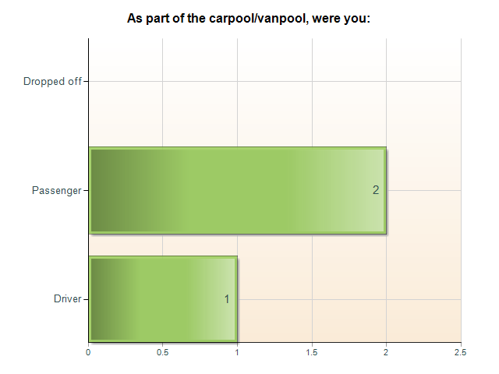
Commuter Survey: As part of the carpool/vanpool, were you:
As part of the carpool/vanpool, were you:
Driver | 1 (33 %)
Passenger | 2 (67 %)
Dropped off | 0 (0 %)

Slide 27
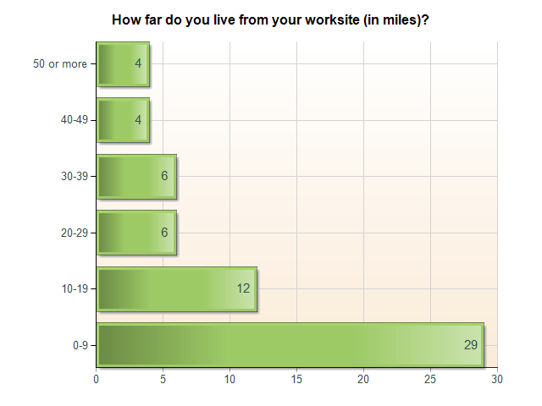
Commuter Survey: How far do you live from your worksite (in miles)?
How far do you live from your worksite (in miles)?
0-9 | 29 (48 %)
10-19 | 12 (20 %)
20-29 | 6 (10 %)
30-39 | 6 (10 %)
40-49 | 4 (7 %)
50 or more | 4 (7 %)

Slide 28
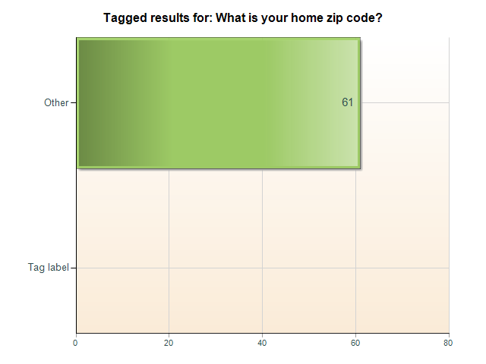
Commuter Survey: Tagged results for: What is your home zip code?
Tagged results for: What is your home zip code?
Tag label | 0 (0 %)
Other | 61 (100 %)

Slide 29
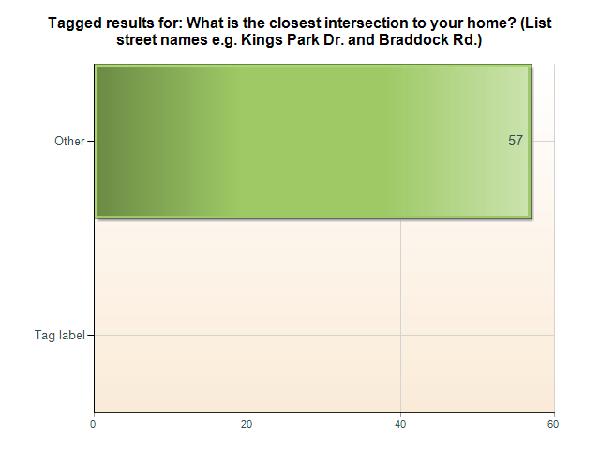
Commuter Survey: Tagged results for: What is the closest intersection to your home? (List street names e.g. Kings ...
Tagged results for: What is the closest intersection to your home? (List street names e.g. Kings Park Dr. and Braddock Rd.)
Tag label | 0 (0 %)
Other | 57 (100 %)

Slide 30
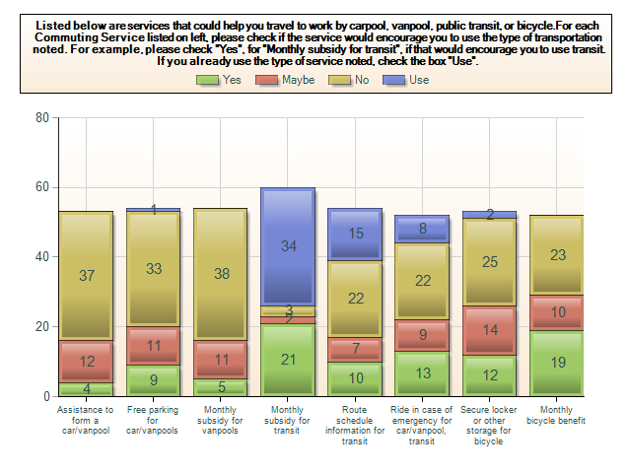
Commuter Survey: Listed below are services that could help you travel to work by carpool, vanpool, public transit, ...
Listed below are services that could help you travel to work by carpool, vanpool, public transit, or bicycle.For each Commuting Service listed on left, please check if the service would encourage you to use the type of transportation noted. For example, please check "Yes", for "Monthly subsidy for transit", if that would encourage you to use transit. If you already use the type of service noted, check the box "Use".
 | Yes | Maybe | No | Use
Assistance to form a car/vanpool | 4 (8 %) | 12 (23 %) | 37 (70 %) | 0 (0 %)
Free parking for car/vanpools | 9 (17 %) | 11 (20 %) | 33 (61 %) | 1 (2 %)
Monthly subsidy for vanpools | 5 (9 %) | 11 (20 %) | 38 (70 %) | 0 (0 %)
Monthly subsidy for transit | 21 (35 %) | 2 (3 %) | 3 (5 %) | 34 (57 %)
Route schedule information for transit | 10 (19 %) | 7 (13 %) | 22 (41 %) | 15 (28 %)
Ride in case of emergency for car/vanpool, transit | 13 (25 %) | 9 (17 %) | 22 (42 %) | 8 (15 %)
Secure locker or other storage for bicycle | 12 (23 %) | 14 (26 %) | 25 (47 %) | 2 (4 %)
Monthly bicycle benefit | 19 (37 %) | 10 (19 %) | 23 (44 %) | 0 (0 %)

Slide 31
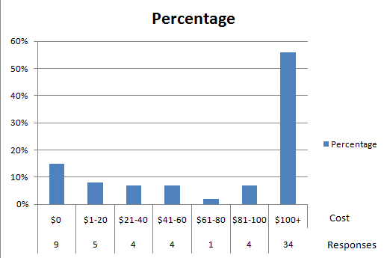
How much do you pay each month to park at your worksite?
Tagged results for: How much do you pay each month to park at your worksite?
Tag label | 0 (0 %)
Other | 48 (100 %)

