Slide 1
Clean Air Partners
ACPAC Meeting
Harriet West

Slide 2
Public Awareness and Outreach
Outreach to local TV meteorologists (Baltimore/Washington)
Annual public awareness campaign (radio and transit ads, media pitching)
Website/Social Media
On the Air curriculum and summer outreach
Materials (brochure is being replaced with refrigerator magnet and bookmarks)
2010 campaign resulted in 66 million media impressions
For 2011 – EPA iphone/Droid aps

Slide 3

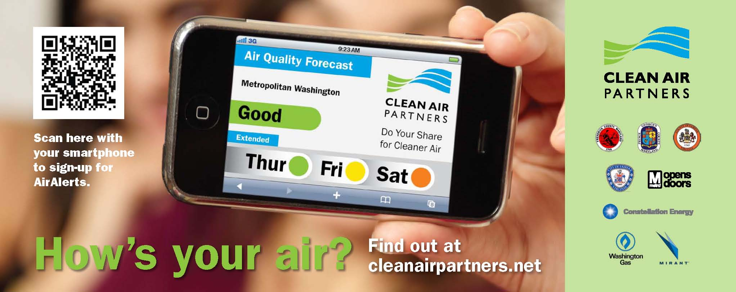
Transit Advertising

Slide 4
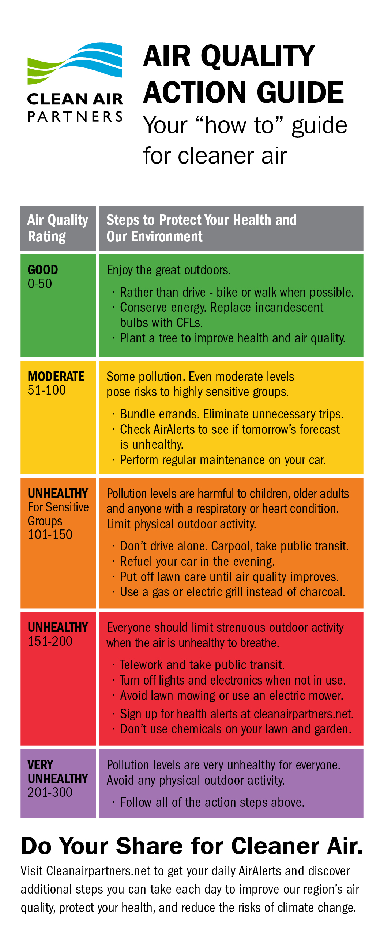
The Air Quality Action Guide
Based on the EPA’s Air Quality Index
Encourage voluntary actions to help reduce air pollution
Also used to inform the public on health issues and air quality forecasts

Slide 5
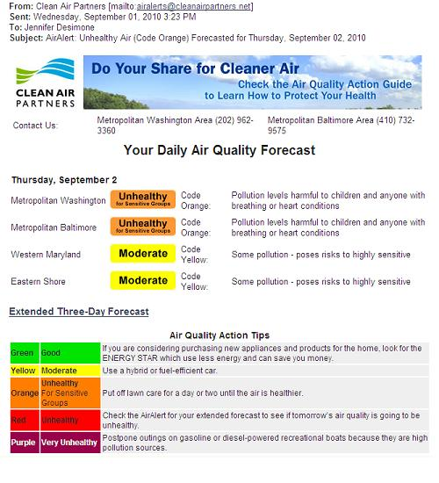
Clean Air Partners’ AirAlerts
Available for 4 regions:
  Metro Washington
  Metro Baltimore
  Western MD
  Eastern Shore
Forecasts: Daily or Unhealthy
Real-Time Health Notifications: Code Orange or Code Red
Includes health messages and action to improve air quality

Slide 6
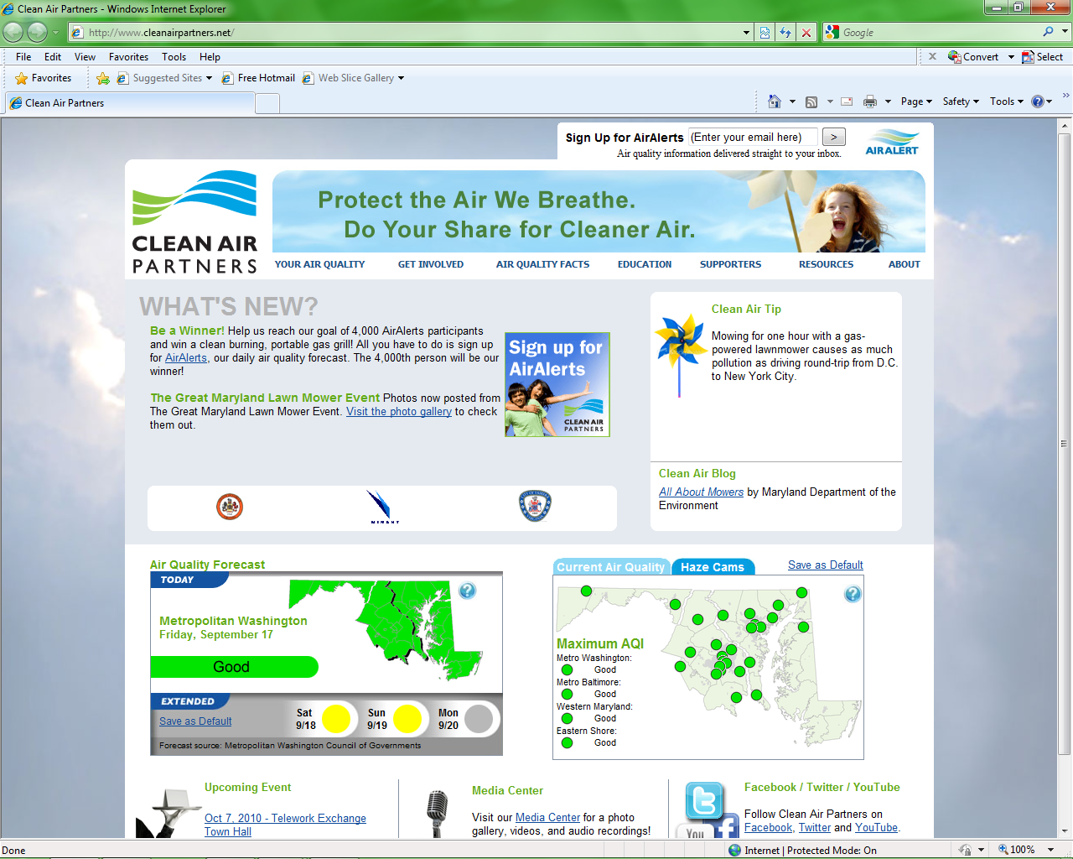

Slide 7
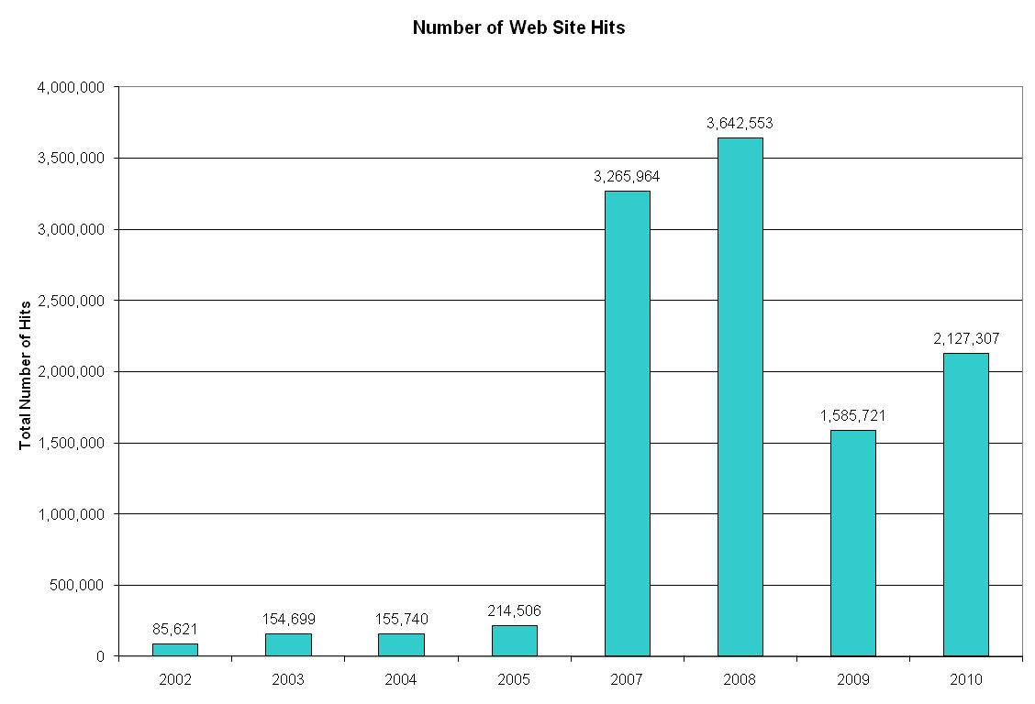
Web Site Hits
*2010 data through August

Slide 8
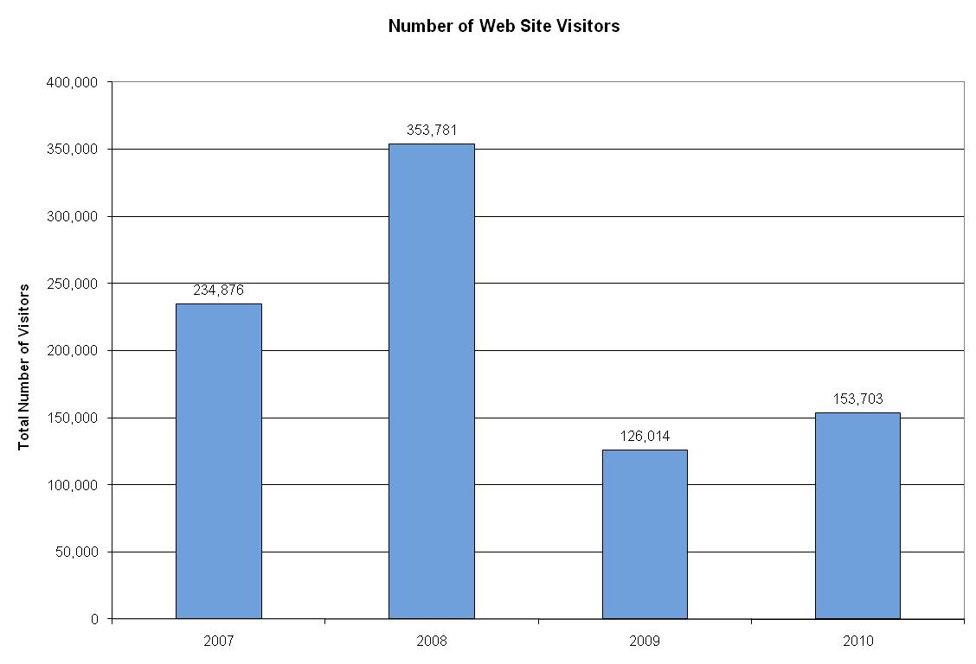
Web Site Visitors
*2010 data through August

Slide 9
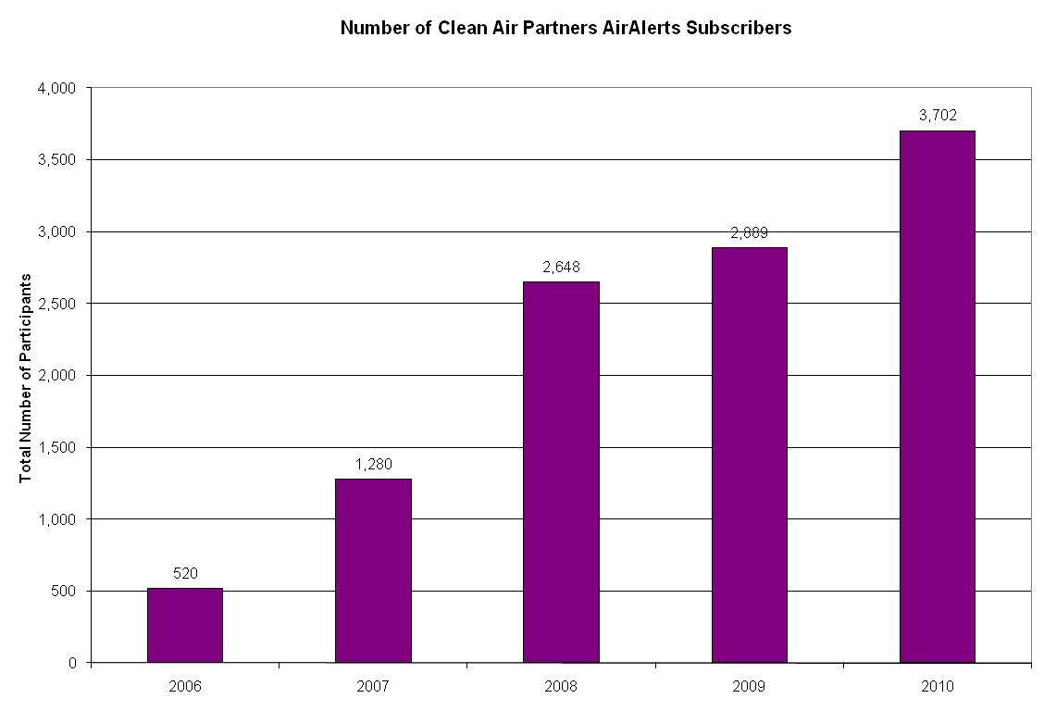
AirAlerts Subscribers
*Subcribers through September 7, 2010

Slide 10
Non-Event vs. Event Web Hits
Non-Event Week : July 18 – 24, 2010
Event Week: August 29 – September 4, 2010

Slide 11
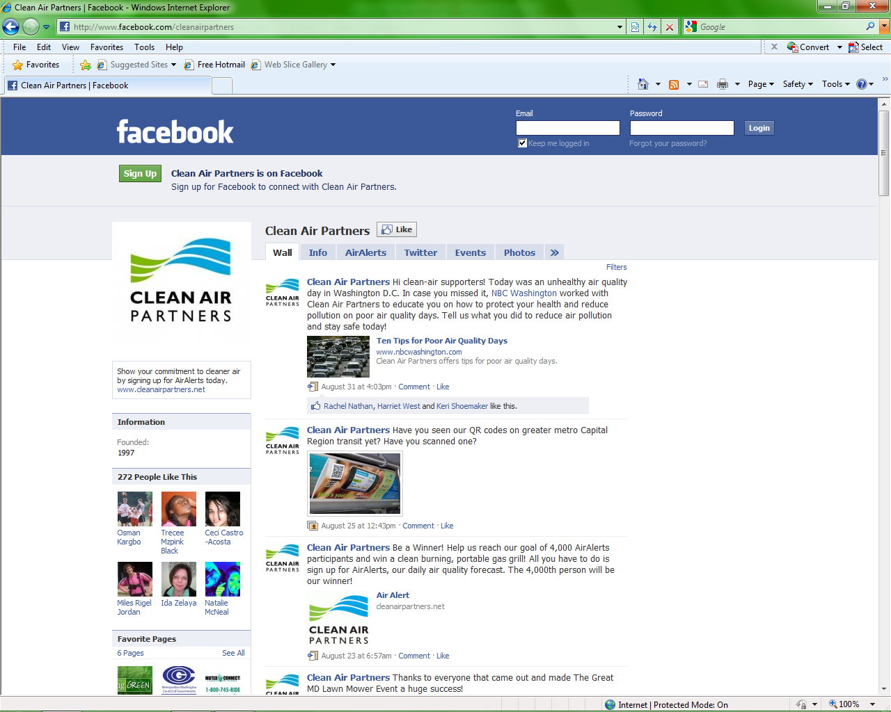
Facebook

Slide 12
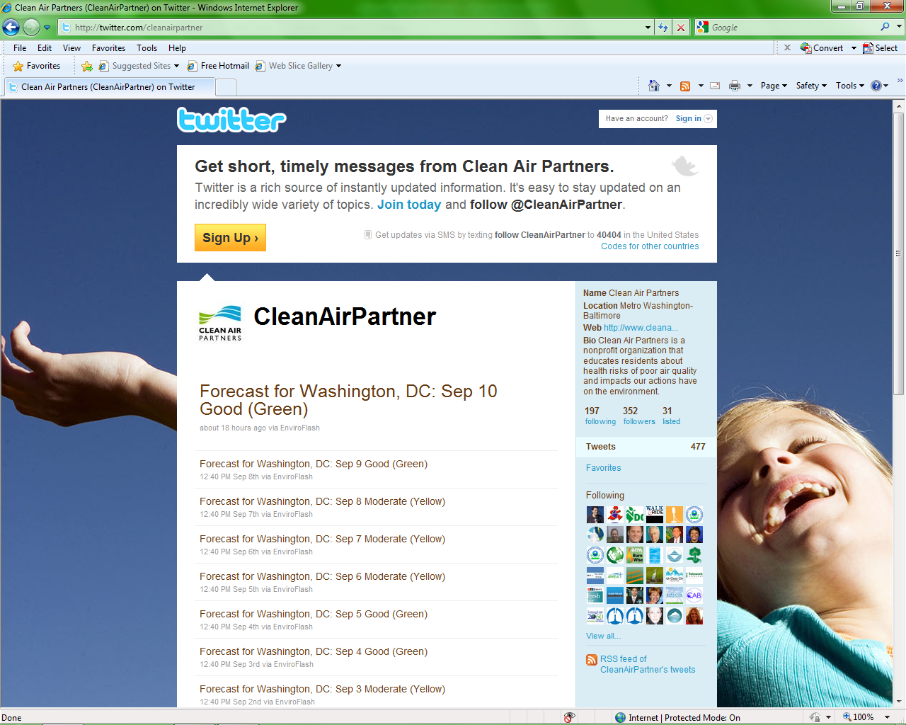
Twitter

Slide 13
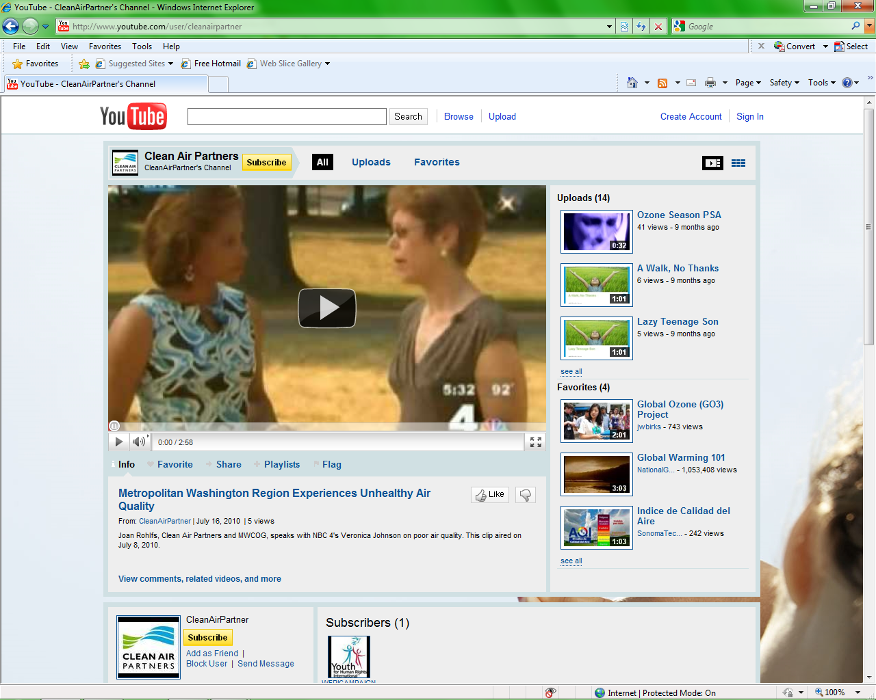
YouTube

