Slide 1

National Institutes of Health
Recycling Program
LTJG Kazu Okumura
US Public Health Service
(301) 496-7990
kazuhiro.okumura@nih.gov
Take Action To Protect the Future

Slide 2
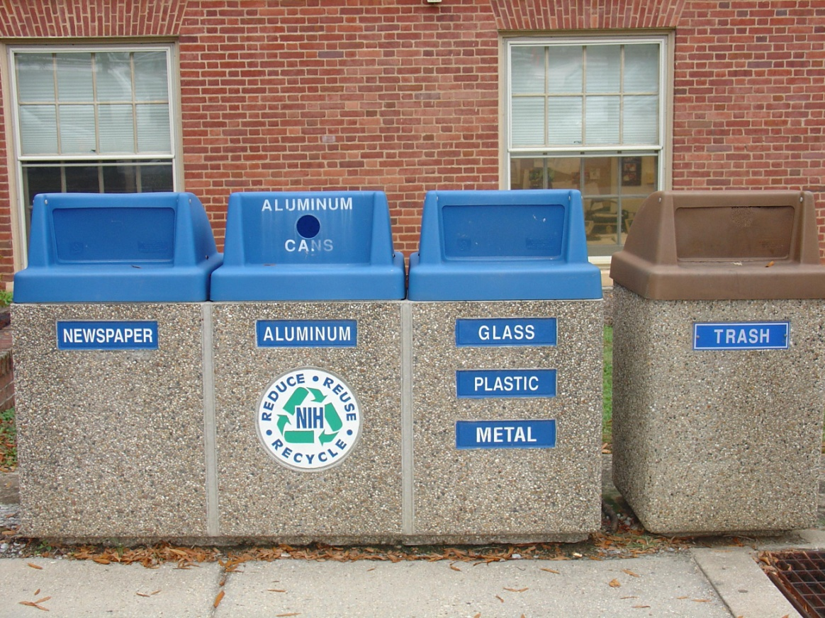
NIH Recycling Program
Agenda
Current Program and Succes
Challenges
Stimulating Recycling
Future Goals

Slide 3
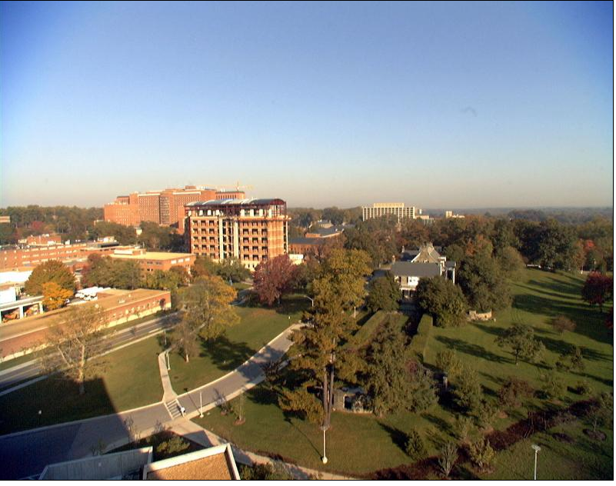
NIH Recycling Program
NIH
27 Institutes and Centers
Main campus in Bethesda
Approximately 300 acres and 60 buildings
Montgomery and Frederick County, Baltimore, Montana, North Carolina, Arizona

Slide 4
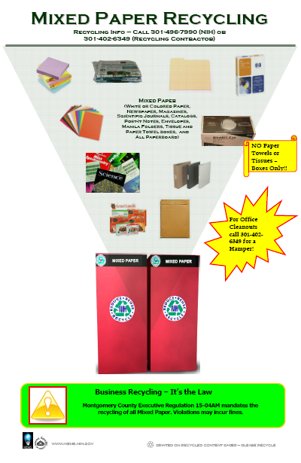
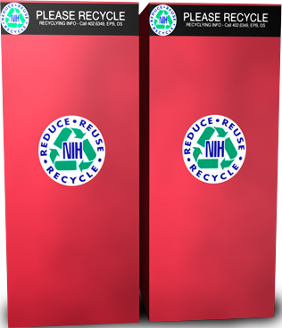
NIH Recycling Program
Mixed Paper
  Shredded Paper
  White or Colored Office Paper
  Newspaper
  Telephone Directories
  Paper and Hardback Books
  Magazines/Catalogs
  Binders
  Post It Notes
  Envelopes
  Manila Folders
  Tissue and Paper Towel Boxes
  Paperboard (Frozen meal packaging)

Slide 5
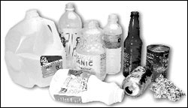
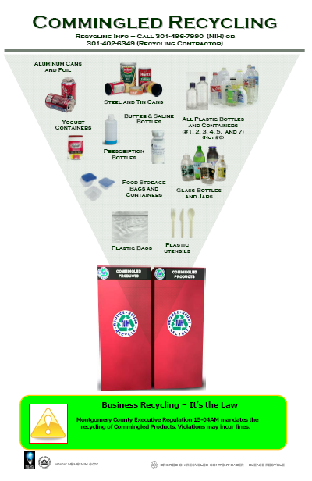
NIH Recycling Program
Commingled
  Aluminum Cans and Tin Foil
  Steel and Tin Cans
  All Plastic Bottles, Cups, and Containers
  Yogurt Containers (Rinsed)
  Prescription Bottles
  Glass Bottles and Jars (No Pyrex)
  Food Storage Containers
  Plastic Bags
  Plastic Utensils (Clean)

Slide 6
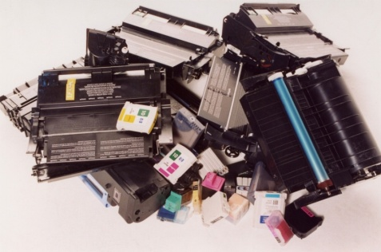
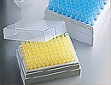
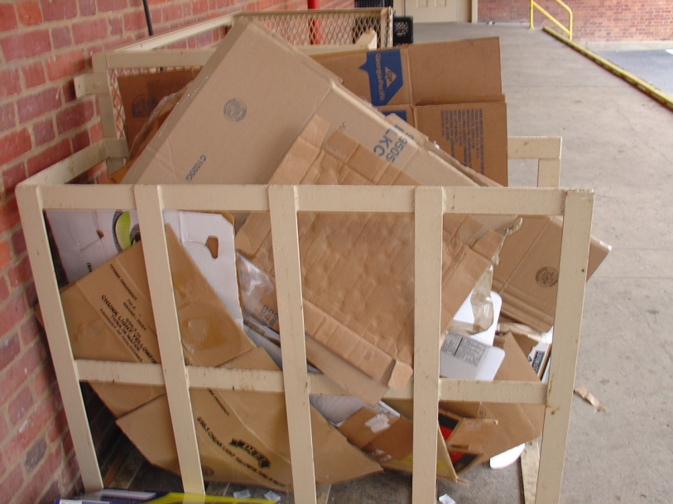
NIH Recycling Program
Toner Cartridges
  Laser, inkjet, and copier cartridges
  NIH Charities receive $1 for each recycled cartridge
Pipette Tip Racks
  #5 Polypropylene
Cardboard
  Stacked in corridors or on loading dock

Slide 7
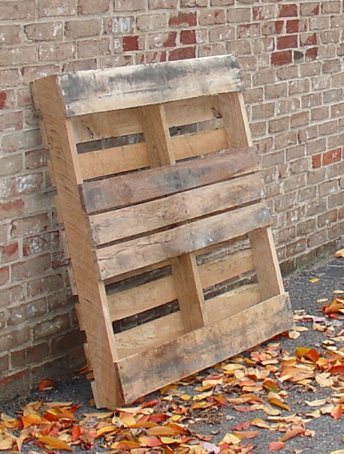
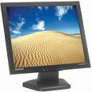
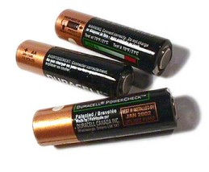
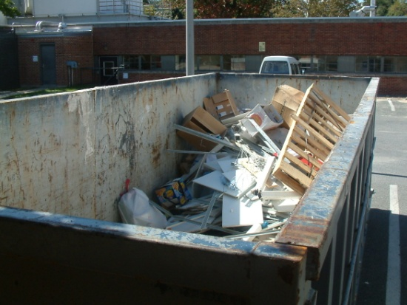
NIH Recycling Program
Other Recycling Efforts
  Tyvek Suits
  Wooden Pallets
  Construction and Demolition Debris
  Electronic Waste
  All Batteries
  Scrap Metal

Slide 8
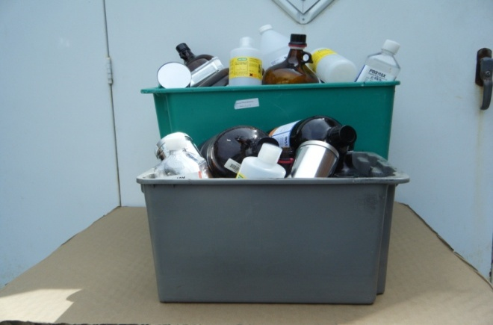
NIH Recycling Program
Empty Chemical Bottles
All glass, plastic, and metal bottles that previously contained chemicals (hazardous or non-hazardous)
Picked up by Chemical Waste Services for recycling
New!

Slide 9

NIH Recycling Program
  Revenue from Recyclable Materials
    Cardboard - $2000
    Mixed Paper - $500
    Scrap Metal - $4000
    Wood Pallets - $1400
  *For an average year this equates to nearly $95,000
  Proceeds Benefit
  NIH Charities
    The Children's Inn at NIH
    Special Love Inc. - Camp Fantastic
    Friends of the Clinical Center
  Inkjet and Toner Cartridges:
  Approximately $400/month has been donated in 2010
  Over $6,000 has been donated since 2007

Slide 10
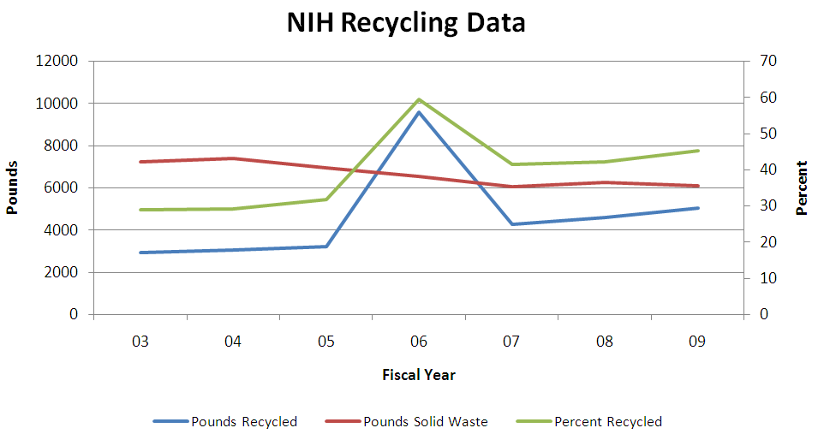
NIH Recycling Program

Slide 11
NIH Recycling Program
Challenges
Large campus and population
Terminology
Education and Outreach

Slide 12
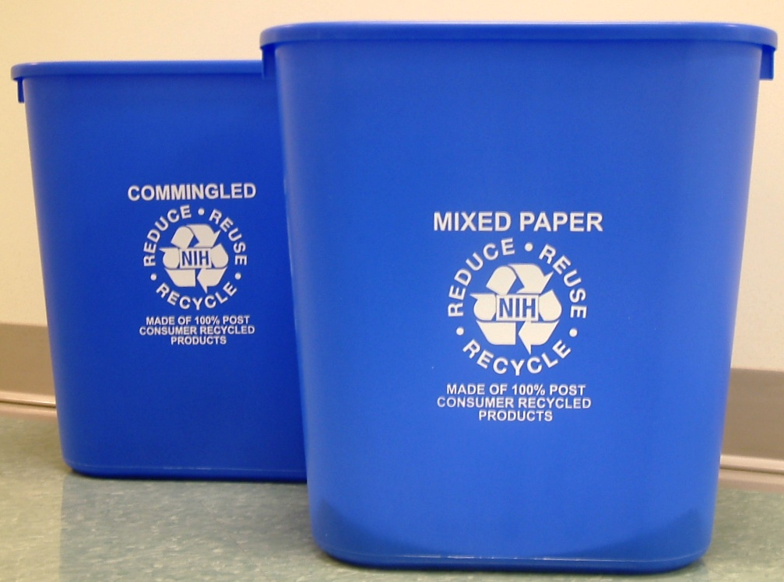
NIH Recycling Program
Outreach
  Green Teams
  Orientation
  Waste Audit
  NEMS Newsletter
  Green Listserve
  America Recycles Day
  Earth Day
New!
Notes:
A routine waste audit that was done in June of 2007 for building 13 revealed that over 42% of what was found in a representative sample from a solid waste compactor were mandatory recyclables.
A follow up audit done in July of 2008 for building 13 found that 38% of the contents were mandatory recyclables weighing over 2540 pounds with the majority of it being mixed paper (2340 lbs).

Slide 13
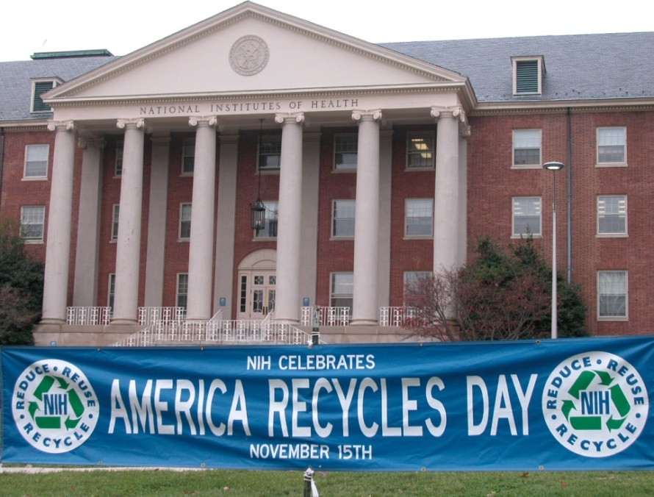
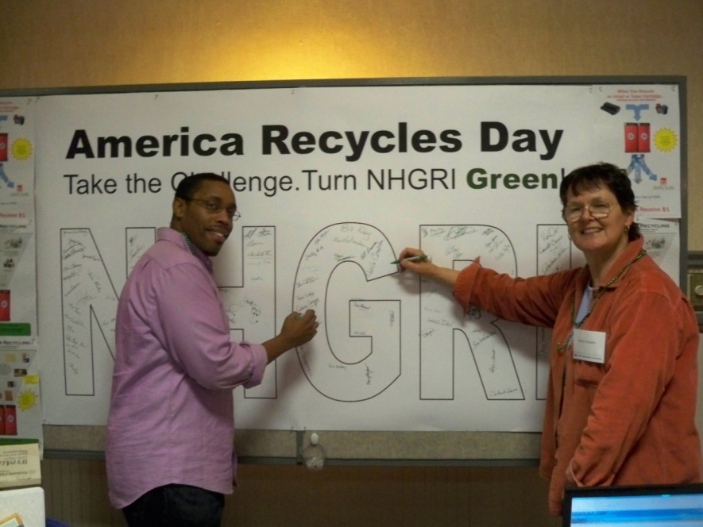
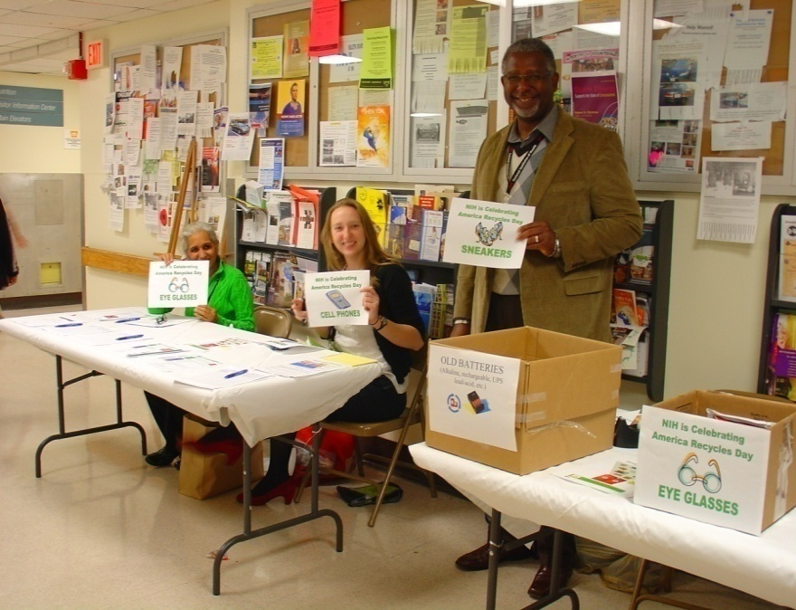
NIH Recycling Program
Outreach Events
Recycling Competition
Collection Days
Informational Tables

Slide 14

NIH Recycling Program
Future Goals
Zero Waste
  Individual recycling at workstations
  Composting of food scraps from cafeterias
  Composting of animal bedding
  Promote zero waste for special events held on campus
  Green Cafeteria
  Reduce waste through “Green Purchasing” and source reduction

Slide 15

NIH Recycling Program
Contacts:
LTJG Beth Osterink
Recycling Coordinator
US Public Health Service
(301) 496-7990
osterinkba@mail.nih.gov
LTJG Kazuhiro Okumura
US Public Health Service
(301) 496-7990
kazuhiro.okumura@nih.gov

