Slide 1

TPB CLRP Aspirations Scenario
2012 CLRP and Version 2.3
Travel Forecasting Model
Update
Initial Results
Item 10
Ron Kirby
Department of Transportation Planning
Presentation to the Transportation Planning Board
April 17, 2013

Slide 2

Scenario Planning
Updated planning assumptions and new modeling tools, most notably the Version 2.3 Travel Forecasting Model, are now available for scenario analysis
The CLRP Aspirations Scenario, last presented to the TPB in October 2011, has been updated
The updated work allows for the testing of variations on the CLRP Aspirations Scenario

Slide 3
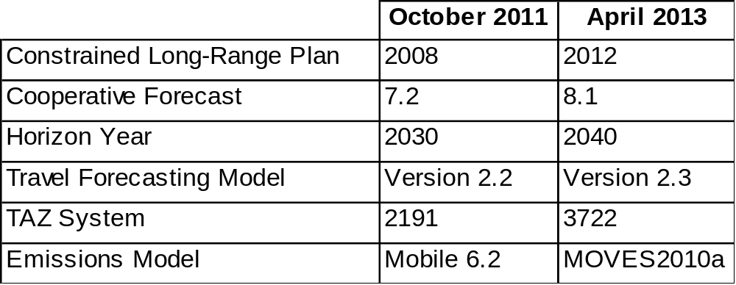
What’s New?

Slide 4
Version 2.3 Model
Developed with the latest travel survey data available
Developed using a more detailed zone system
Several technical refinements have also been made…
  Greater specificity of travel markets by trip purpose and by time of day
  More detailed treatment of travel with regard to individual transit modes and non-motorized (walking and bicycle) modes

Slide 5
What is the CLRP Aspirations Scenario?
Developed under the TPB Scenario Study Task Force based on financially constrained long range plan (CLRP) adopted by the TPB in 2008
Included strategies explored in previous scenario studies such as the Regional Mobility and Accessibility Study and the Value Pricing Study
Scenario should be “within reach” both financially and administratively, while pushing the envelope in terms of improving conditions in relation to a CLRP baseline

Slide 6
CLRP Aspirations Scenario Timeline
September 2010: First results presented to the TPB
October 2011: “Streamlined” Variably Priced Lane Network Sensitivity Test Presented to the TPB
April 2013: Presentation of updated analysis using the latest planning assumptions and modeling tools, and reflecting MAP-21 legislation

Slide 7
Section 1512 “Tolling” of MAP-21
Allows for “initial construction of 1 or more lanes…that increase the capacity of a highway…if the number of toll-free non-HOV lanes, excluding auxiliary lanes, is not less than the number of toll-free non-HOV lanes, excluding auxiliary lanes, before such construction”

Slide 8
Growth between 2015 and 2040
Round 8.1 Cooperative Forecasts; 2012 CLRP
Households | 26%
Population | 23%
Employment | 32%
Vehicle Miles Traveled (VMT) | 24%
VMT per Capita | 0.8%
Average Trip Length | 1.2%
Auto Person Trips | 23%
Transit Trips | 26%
Non-Motorized Trips | 35%
Vehicle-hours of Delay | 98%

Slide 9
CLRP Aspirations Scenario
Land Use
Shifts
Regional VPL
Network
Supportive
Transit
Concentrating projected growth in activity centers and existing/planned transit stations
Consistent review and refinement by planning directors
Address congestion through pricing of 740 new lane miles and 186 existing lane miles
Provide alternatives through enhanced transit
Use menu of transit options from past scenarios
Connect activity centers
Bus Rapid Transit (BRT) and circulator service with 274 new buses and approximately a 20% increase in service hours

Slide 10
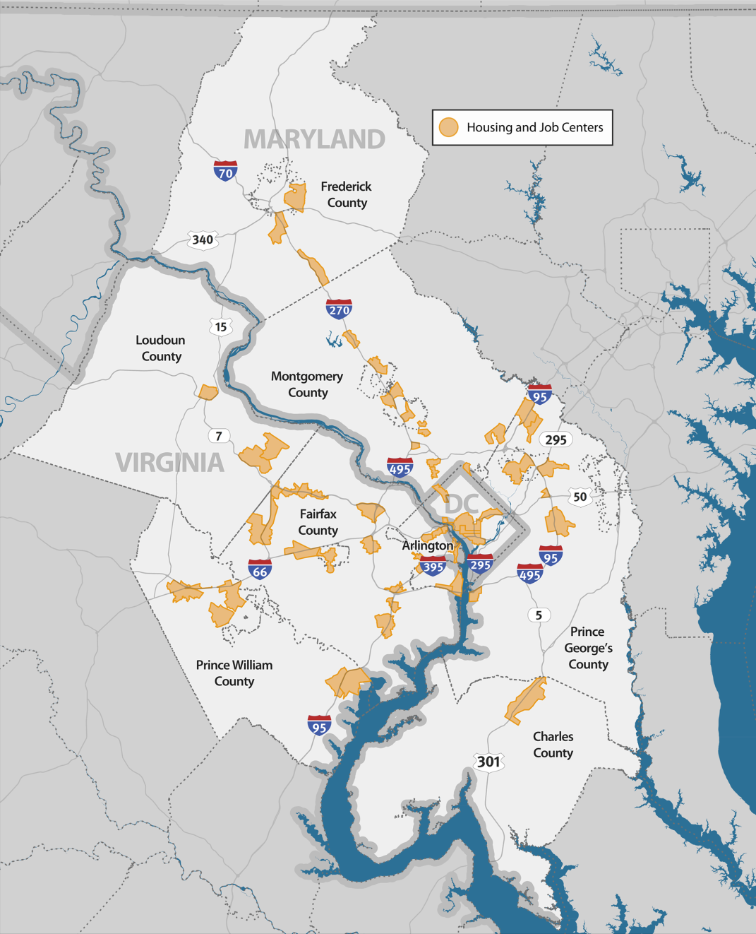
Land Use Shifts
Jobs and households are shifted within the region into targeted growth areas (TGA)
Additional jobs (0.6%) and households (2.6%) are brought into the region
Round 8.1 Cooperative Forecast: from 2015 – 2040, 25% of new households and 35% of new jobs are located in TGAs
CLRP Aspirations: from 2015 – 2040, 57% of new households and 58% of new jobs are located in TGAs

Slide 11
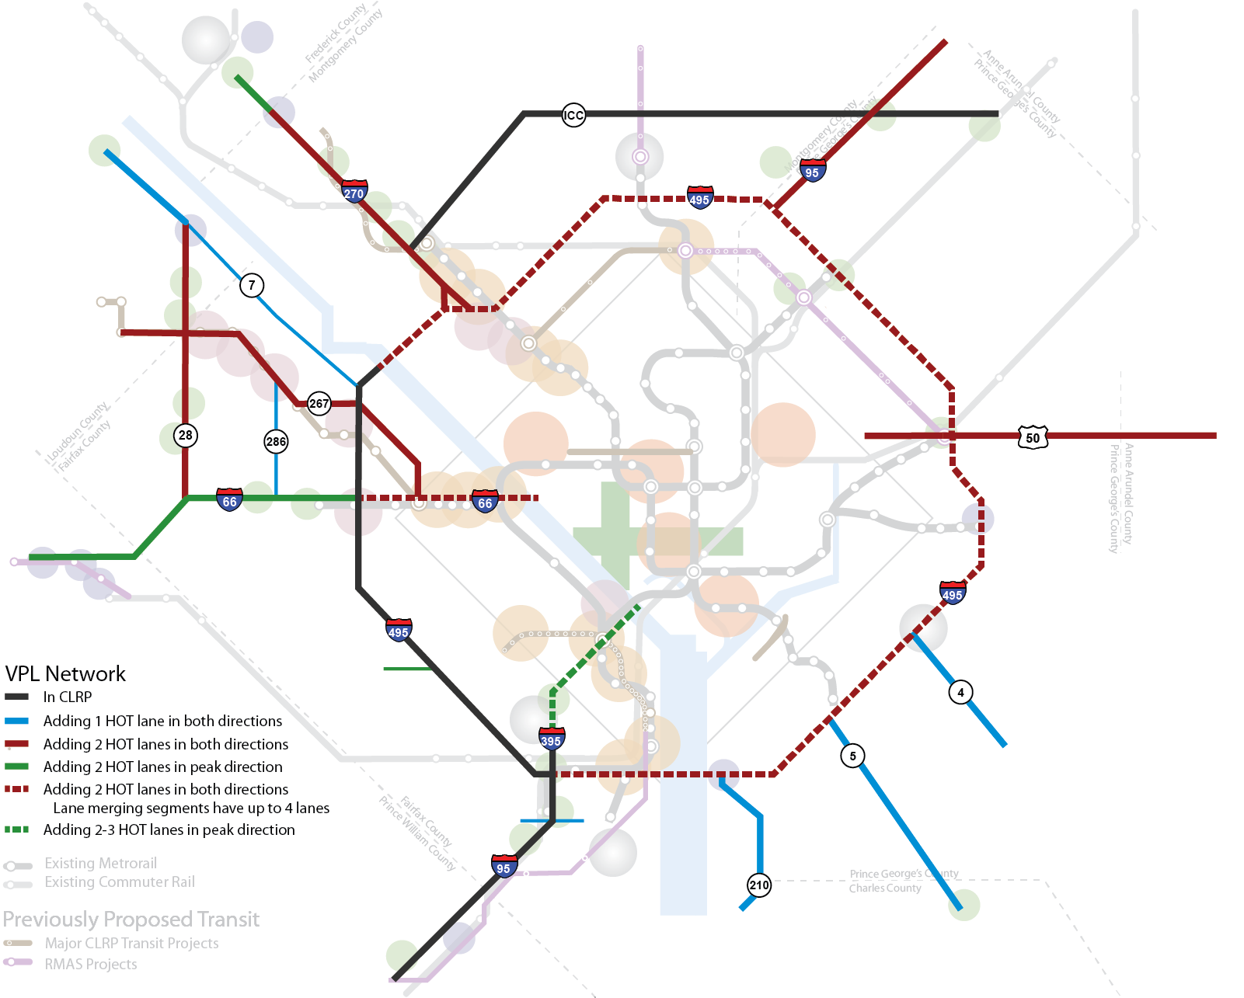
Variably Priced Lane Network

Slide 12
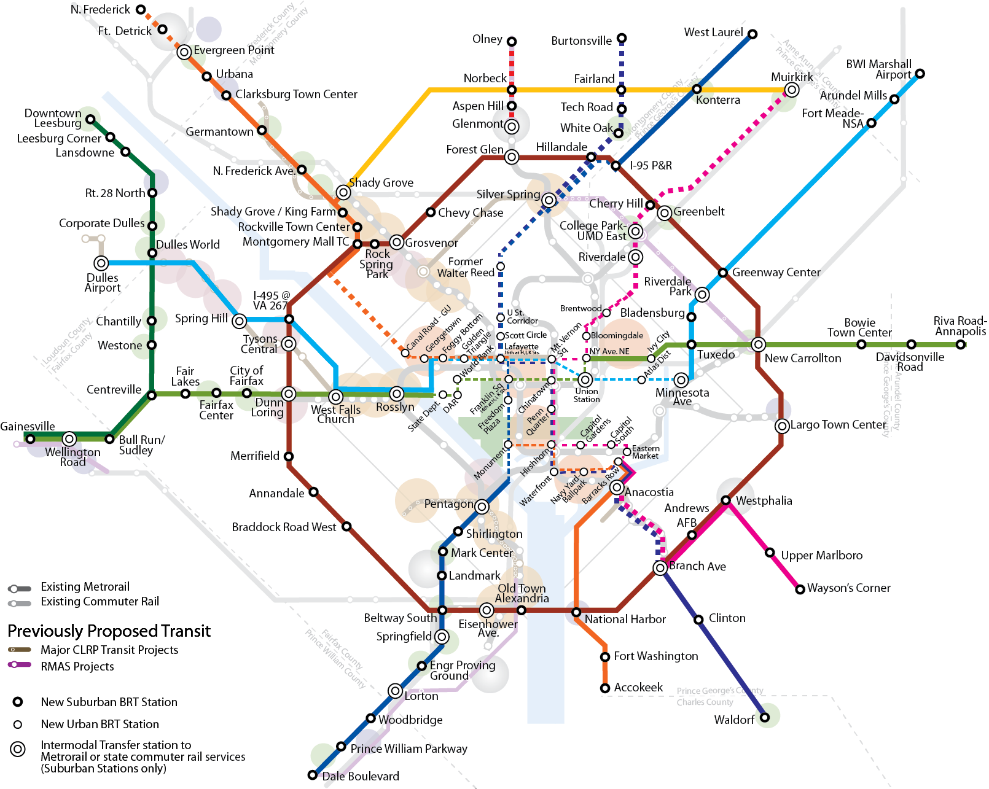
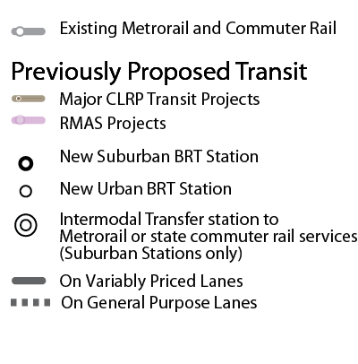
Bus Rapid Transit Network

Slide 13
Three Scenarios
 | Land Use | Transportation
2040 Baseline | Round 8.1 Cooperative Forecast | 2012 CLRP
Scenario 1: Transportation Component-only | Round 8.1 Cooperative Forecast | CLRP Aspirations
Scenario 2: Land use Component-only | CLRP Aspirations | 2012 CLRP
Scenario 3: CLRP Aspirations Scenario | CLRP Aspirations | CLRP Aspirations

Slide 14
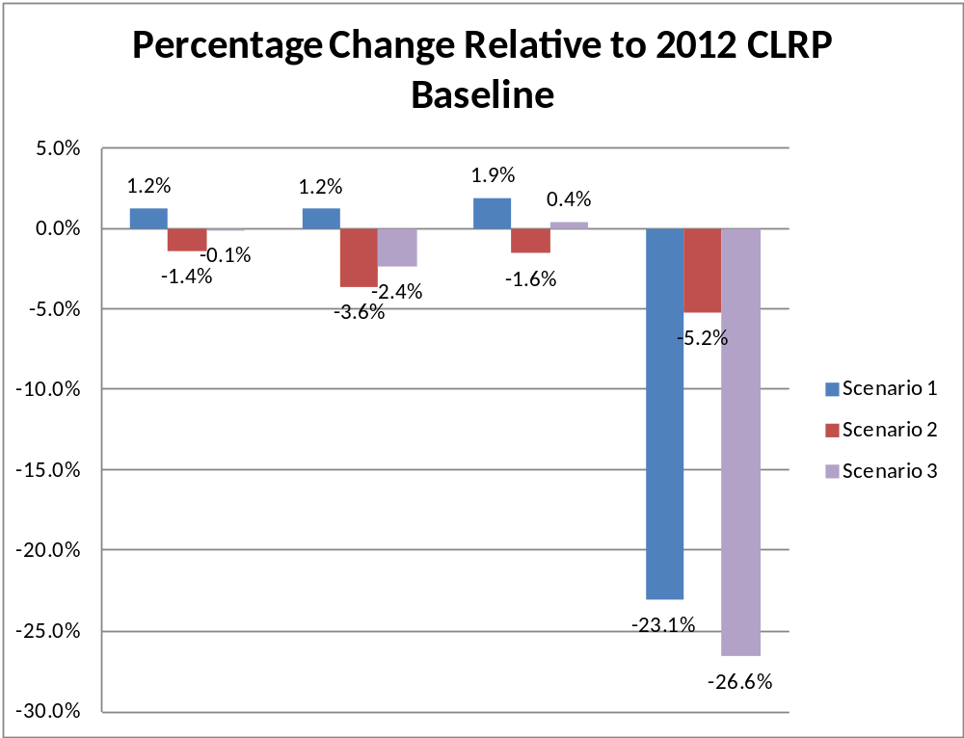
Regional Travel
Vehicle Hours of Delay
VMT
VMT per
Capita
Average
Trip Length

Slide 15
Regional Mode Choice
Percentage Change in Person Trips Relative to 2012 CLRP Baseline
9.0%
8.2%
8.1%
8.0%
7.2%
7.0%
6.0%
5.0%
4.7%
Scenario 1
4.0%
Scenario 2
Scenario 3
3.0%
2.0%
1.7%
1.5%
1.3%
1.0%
-
-
0.1%
0.1%
0.0%
Auto Person Trips
Transit Trips
Non
-
Motorized Trips
-
1.0%

Slide 16
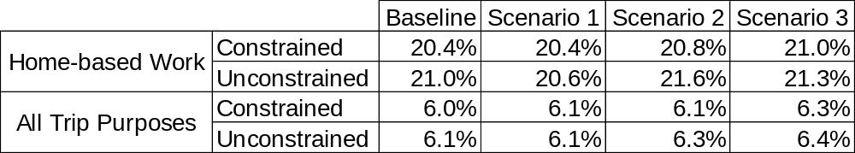
Regional Transit Mode Share
To address the lack of identified funding for WMATA’s future rehabilitation and maintenance needs beyond 2020, transit ridership to or through the core area was constrained to 2020 levels for both the CLRP and the three scenarios.
Percent Transit Mode Share
The increases from the constrained to the unconstrained transit mode shares would be more pronounced in the core and inner suburbs served by Metrorail.

Slide 17
Commuter Mode Choice
HOV3+
Bus Only
Non-Motorized
Metrorail Only
SOV
HOV2
Bus/Metrorail
Commuter Rail

Slide 18
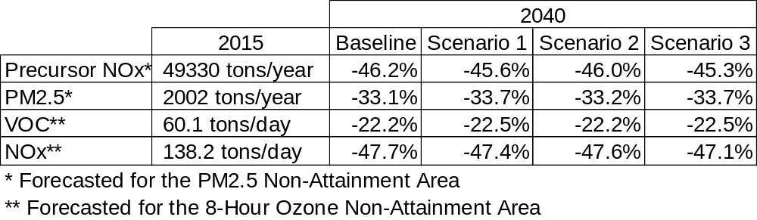
Air Quality
Change in Emissions Relative to 2015 Forecasted with MOVES2010a

Slide 19
Financial Analysis
Sketch-level analysis of Scenarios 1 and 3 show revenue to cost ratios of 0.40 and 0.38, respectively
Results presented in October 2011 showed much higher revenue to cost ratios. Removing tolls on existing general purpose lanes, most notably the parkways, significantly reduced the revenue from the VPL network.

Slide 20
What’s Next?
Update of CLRP Aspirations Scenario Study will allow for future analysis of
  Variations on land use and VPL network
  Analysis of smaller geographies, such as subareas or corridors

