Slide 1

National Capital Region
Transportation Planning Board
Significant Additions
and Changes to the
2013 Update to the CLRP
Item #11
January 23, 2013

Slide 2
Significant Additions and
Changes to the 2013 CLRP
District of Columbia
Lane Reductions and Reconfigurations:
C St. NE, East Capitol St., I St. NW,
New Jersey Ave. NW, Pennsylvania Ave. SE,
South Capitol St., 17th St. NE and SE
Bike Lane Pilot Projects – 9th St. NW,
L St. NW, and M St. NW I-395
Virginia
Widen I-395 Southbound between
Duke St. and Edsall Rd.
Change of I-495, Capital Beltway
Auxiliary Lanes Project Limits
Widening of Northern Segment of
I-495, Capital Beltway HOT Lanes
I-495, Capital Beltway Ramps at Dulles Airport Access Hwy. and Dulles Toll Rd.
Widen US 1, Jefferson Davis Hwy. from Lorton Rd. to Annapolis Way
Widen VA 7, Leesburg Pike
from I-495 to I-66
Construct Collector-Distributor Roads along Dulles Toll Rd. between
Spring Hill Rd. and Wiehle Ave.
Construct Dulles Toll Rd. Ramps in Tysons
Construct Dulles Greenway Ramp in Leesburg
Alt. A: Construct Dulles Air Cargo, Passenger and Metro Access Highway
Alt. B: Construct New Limited Access US 50 and VA 606, Loudoun County Parkway
Study VA 28, Manassas Bypass
from VA 234, Sudley Rd. to I-66

Slide 3
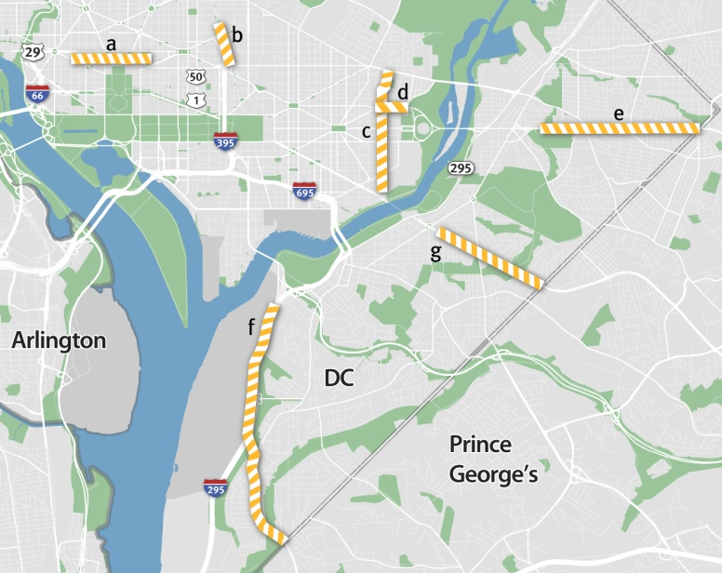
1. District of Columbia Lane
Reductions and Reconfigurations
DDOT is proposing a number of federally and locally funded projects that will make changes to the number and direction of travel lanes in selected locations, as described in the following:
C St. NE from 16th St. NE to Oklahoma Ave. NE
Remove one of two travel lanes in each direction. Complete: 2013. Cost: $4.5 million.
East Capitol St. from 40th St. to Southern Ave.
Remove one of three travel lanes in each direction. Complete: 2015. Cost: $5 million.
I St. NW Peak Period Bus-Only Lanes
13th St. NW to Pennsylvania Ave. NW
During peak periods, designate one of five
westbound travel lanes as a bus-only lane.
Complete: 2013. Cost: $500,000.
New Jersey Ave. NW from H St. NW to N St. NW
Reconstruct New Jersey Ave. NW from four lanes,
one-way northbound to two lanes in each direction.
Complete: 2015. Cost: $7.5 million.
Pennsylvania Ave. SE from 27th St. SE to Southern Ave. SE
Reduce the number of lanes from 5 to 4. Completed in 2011.
S. Capitol St. from Firth Sterling Ave. SE to Southern Ave. SE
Construct a paved bicycle and pedestrian trail along
S. Capitol St. and reduce the number of lanes from 5 to 4.
Complete: 2015. Cost $5 million.
17th St. NE/SE from Benning Ave. NE to Potomac Ave. SE
Reconstruct 17th St. NE/SE from two lanes southbound to one lane southbound. Complete: 2013. Cost $1.95 million.

Slide 4
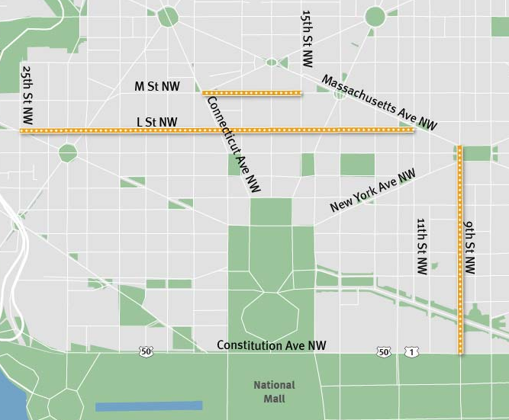
2. District of Columbia
Bike Lane Pilot Studies
In 2010, DDOT submitted five bike lane projects for inclusion in the CLRP as pilot studies. Two of these projects – 15th St. NW from Constitution Ave. NW to W St. NW and Pennsylvania Ave. NW from 3rd St. NW to 14th St. NW – were completed in 2010. The
15th St. Bike Lane removed one vehicle lane, while the Pennsylvania Ave. Bike Lanes did not remove any vehicle lanes. This year, DDOT is updating the status of the remaining pilot projects as follows:
L St. from 11th St. NW to New Hampshire Ave. NW. Completed in 2012, one travel lane removed.
M St. from 15th St. NW to 25th St. NW complete in 2013, one travel lane removed
9th St. NW from Constitution Ave. NW to K St. NW – project withdrawn
b
a
c

Slide 5
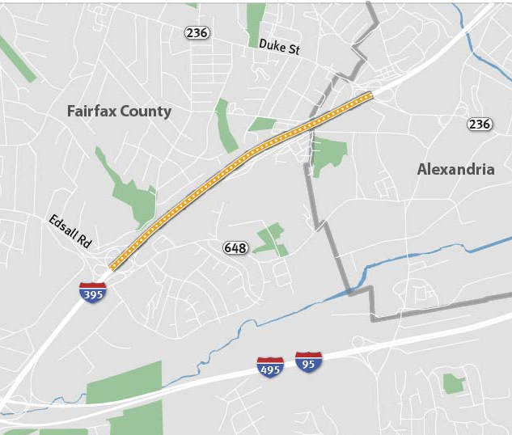
3. Widen I-395, Southbound from Duke St. to Edsall Rd.
Add a fourth lane to southbound I-395 between Duke St. and Edsall Rd.
Complete: 2018
Length: 1.5 miles
Cost: $58.5 million
Funding: Federal, State, Other

Slide 6
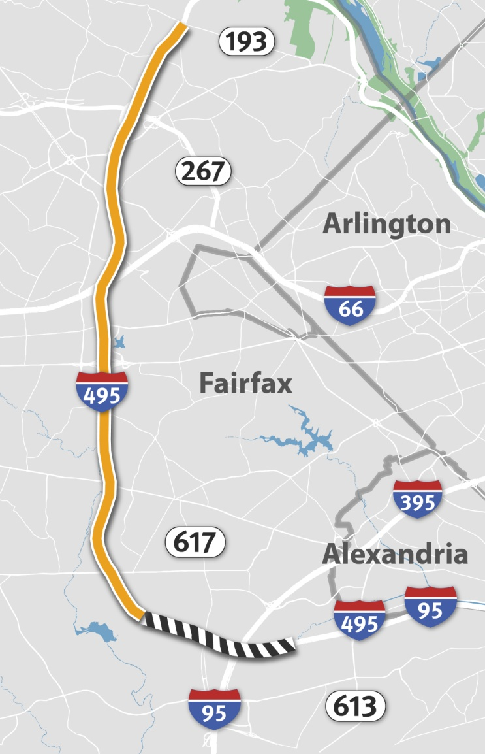
4. I-495 Auxiliary Lanes
Change of Project Limits
The CLRP includes the addition of one auxiliary lane in each direction on I-495 between VA 193, Georgetown Pike and 1 mile east of the I-95/ I-395/ I-495 Interchange. The southernmost segment between Heming Ave. and 1 mile east of the I-95/395/495 Interchange was scheduled to be complete in 2013, but is now being withdrawn from the CLRP. The remaining segments are scheduled to be complete in either 2013 or 2030, depending upon location. See the Air Quality Conformity Inputs for more details.

Slide 7
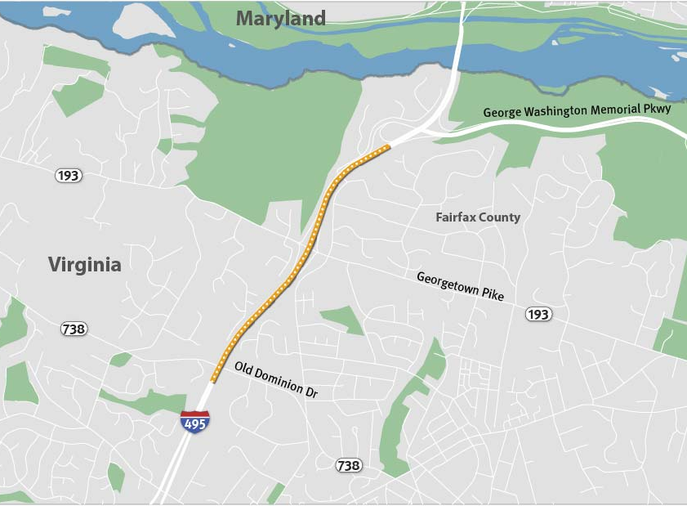
5. Widen I-495 HOT Lanes from South of the George Washington Pkwy. to South of Old Dominion Dr.
The CLRP includes the construction of
a system of HOT Lanes on I-495. The segment of HOT Lanes between south of the George Washington Pkwy and south of Old Dominion Dr. was planned to be 2 lanes wide. VDOT proposes to make this segment 4 lanes wide.
Complete: 2014
Length: 1.5 miles

Slide 8
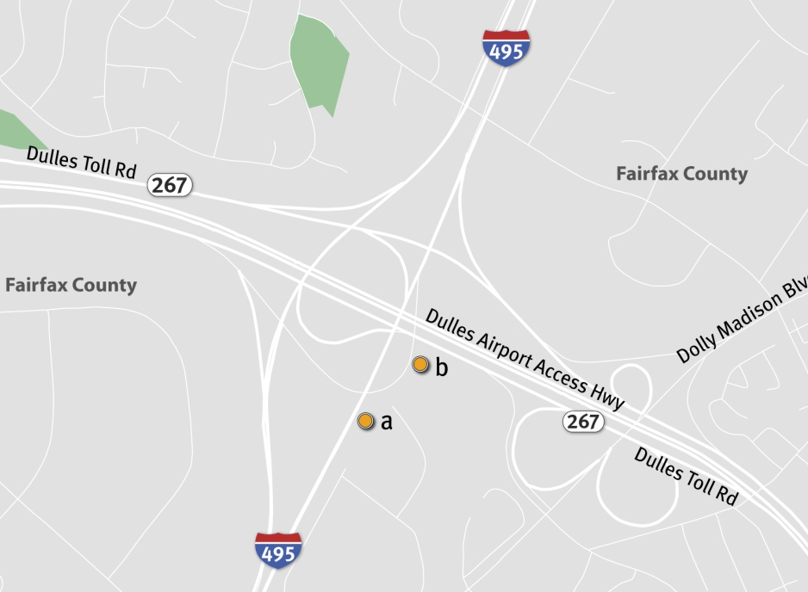
6. Construct and Improve I-495 Ramps at Dulles Airport Access Highway and Dulles Toll Road
Construct a new ramp connecting the northbound general purpose lanes on
I-495 to the inner lanes of westbound Dulles Airport Access Highway
Complete: 2030
Length: 0.8 mile
Cost: $7 million
Funding: Federal, State, Private…
Widen the ramp connecting eastbound Dulles Toll Road to the northbound general purpose lanes on I-495 from
1 to 2 lanes.
Complete: 2030
Length: 0.7 mile
Cost: $10 million
Funding: Federal, State, Private…

Slide 9
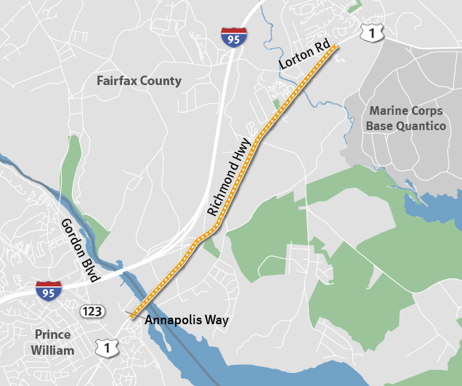
7. Widen US 1, Jefferson Davis Highway from Lorton Rd. to Annapolis Way
Widen US 1 from 4 to 6 lanes within the project limits.
Complete: 2035
Length: 3.5 miles
Cost: $125 million
Funding: Federal, State,
Local

Slide 10
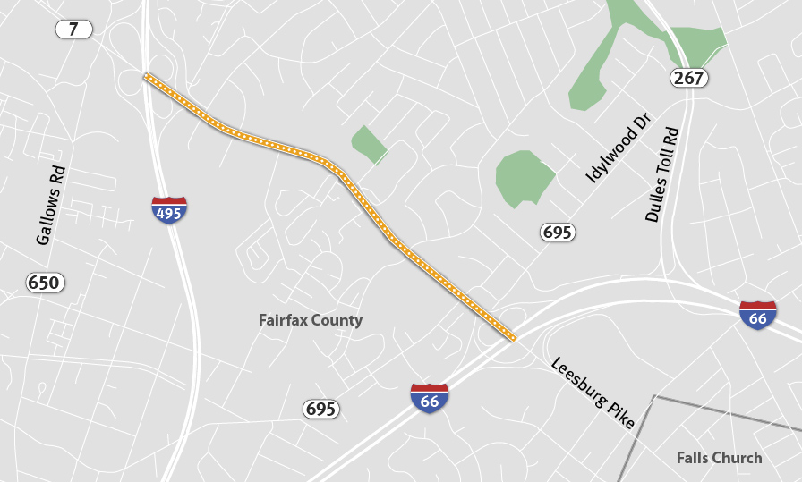
8. Widen VA 7, Leesburg Pike from I-495 to I-66
Widen VA 7 from 4 to 6 lanes within the project limits.
Complete: 2035
Length: 1.3 miles
Cost: $71 million
Funding: Federal, State,
Local

Slide 11
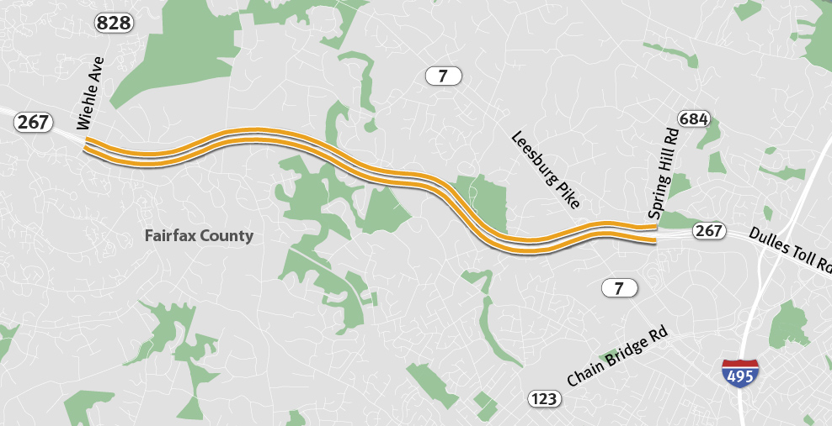
9. Construct Collector-Distributor Roads
Parallel to Dulles Toll Road between Spring Hill Rd. and Wiehle Ave.
Construct new, two-lane collector-distributor roads on either side of the Dulles Toll Rd. eastbound and westbound between VA 684 and VA 828. These new facilities will allow for additional closely-spaced interchanges to be constructed in Tysons.
Complete: 2036, 2037
Length: 6 miles
Cost: $186 million
Funding: Federal, Local,
Private, Bonds

Slide 12
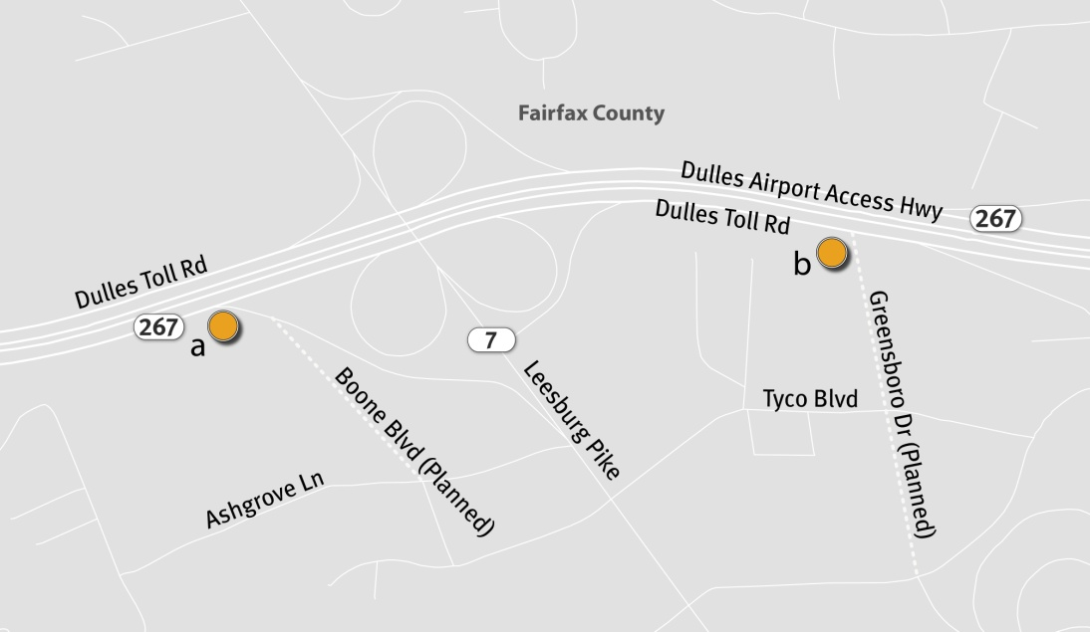
10. Dulles Toll Road Ramps in Tysons at Boone Blvd. and Greensboro Dr.
Construct a ramp to and from the Dulles Toll Rd. to the new Boone Blvd. extension at Ashgrove Lane.
Complete: 2037
Cost: $79 million
Funding: Federal, State,
Private, Bonds
Construct a ramp to and from
the Dulles Toll Rd. to the new Greensboro Dr. extension at Tyco Rd.
Complete: 2036
Cost: $28 million
Funding: Federal, State,
Private, Bonds

Slide 13
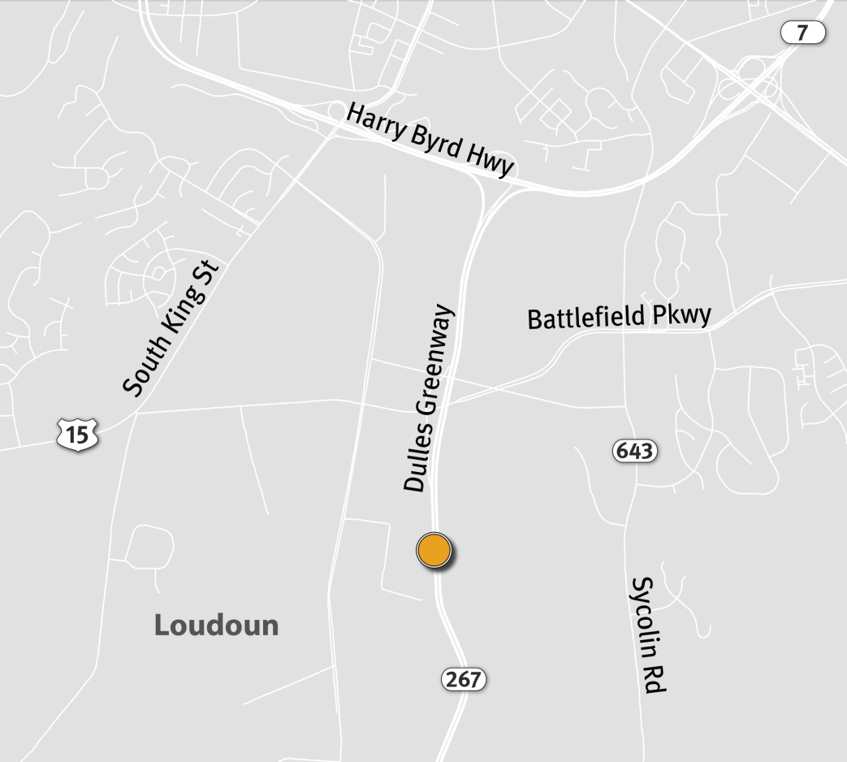
11. Dulles Greenway Ramp at
Hawling Farm Blvd. near Leesburg
Construct a new egress ramp from the Dulles Greenway to the planned Hawling Farm Blvd.
Complete: 2015
Cost: $850,000
Funding: Private

Slide 14
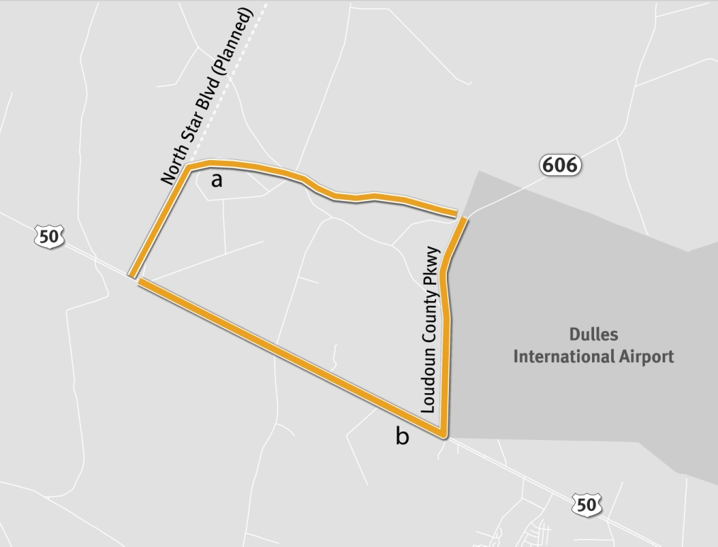
12-a. Dulles Air Cargo, Passenger and
Metro Access Highway from US 50to VA 606
Construct a new four-lane facility
(on a six-lane right of way) between the intersection of the planned
Tri-County Parkway at US 50 and
the Loudoun County Parkway at the western end of the Dulles Airport grounds first heading north, then east just south of Broad Run.
Complete: 2025
Length: 3 miles
Cost: $153 million
Funding: Federal, State, Local, Private, Bonds, Other

Slide 15
12-b. Construct New Limited Access Routes along US 50 and VA 606
Construct a new, grade-separated,
4-lane limited access facility along US 50 (within existing right-of-way) between the planned Tri-County Parkway and the Loudoun County Parkway (VA 606). Also construct a new, at-grade, 4-lane limited access Loudoun County Parkway between the new grade-separated US 50 and 1.5 miles north of that interchange.
Complete: 2025
Length: 4 miles
Cost: $813 million
Funding: Federal, State, Local, Private, Bonds, Other

Slide 16
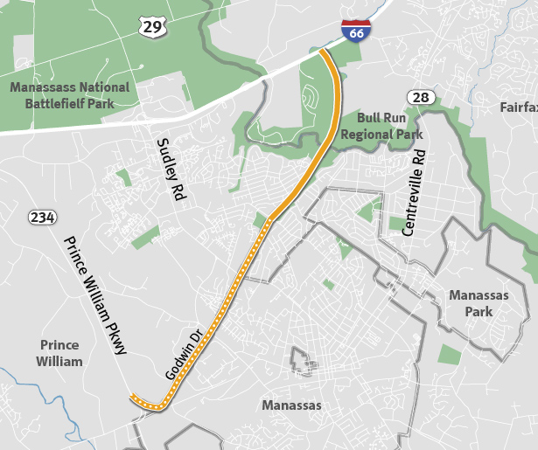
13. VA 28 Manassas Bypass Study
From VA 234 to I-66
Study a proposed 4 to 6 lane bypass from the intersection of VA 234, Sudley Rd. and VA 411, Godwin Drive through Prince William and Fairfax Counties. This project is proposed as a study and will not be included in the air quality conformity analysis of the CLRP.
Complete: 2018
Length: 6 miles
Cost: $500,000
Funding: Federal, State, Local

Slide 17
Schedule for the 2013 CLRP
February 16 Public comment period closes
February 20 TPB reviews comments and is asked to approve project submissions and draft Scope of Work for Air Quality Conformity Analysis
June 13 Draft CLRP, FY 2013-2018 TIP amendments and Conformity Assessment released for
30-day public comment period
June 19 TPB briefed on draft CLRP, TIP amendments and Conformity Assessment
July 17 TPB reviews comments and responses and is presented with the Draft CLRP, TIP and Conformity Assessment for adoption

