Slide 1
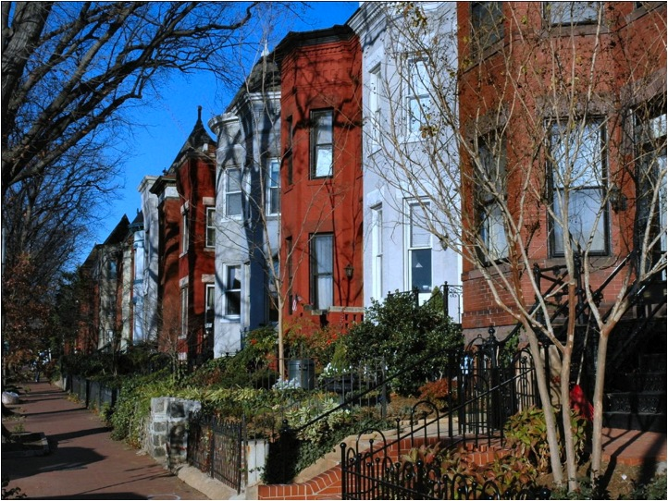

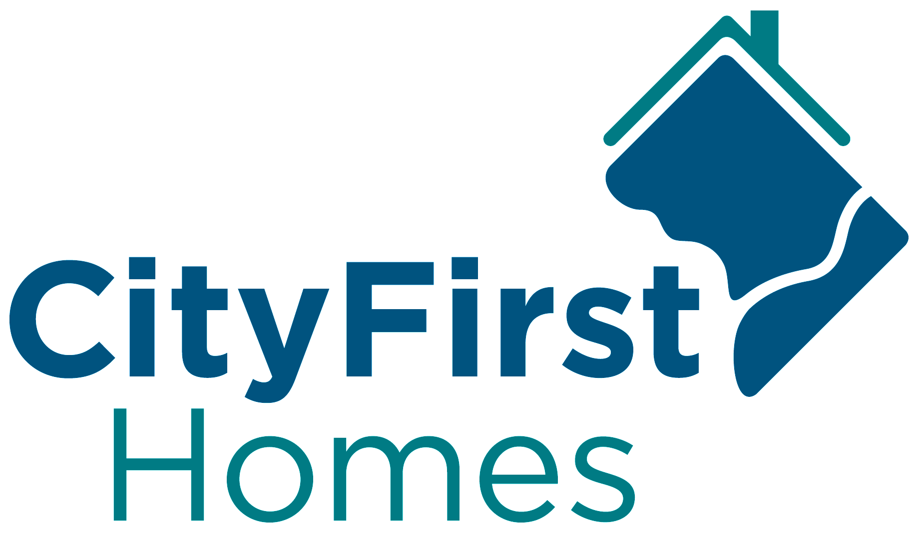
Supporting DC Families & Preserving Washington’s Affordable Housing

Slide 2
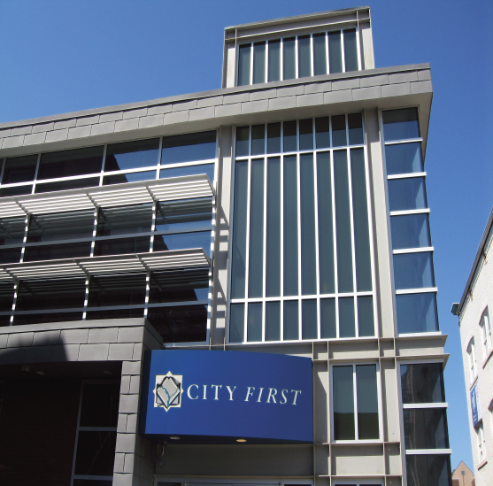
City First Family of Organizations
    City First Enterprises
    City First Bank
    City First New Markets
    City First Homes
    Cumulatively:
    Assets of $200MM
    Mission finance: $750MM
    NMTCs: $370MM
    Jobs created: 4,000
    Aff. homes created: 5,000

Slide 3
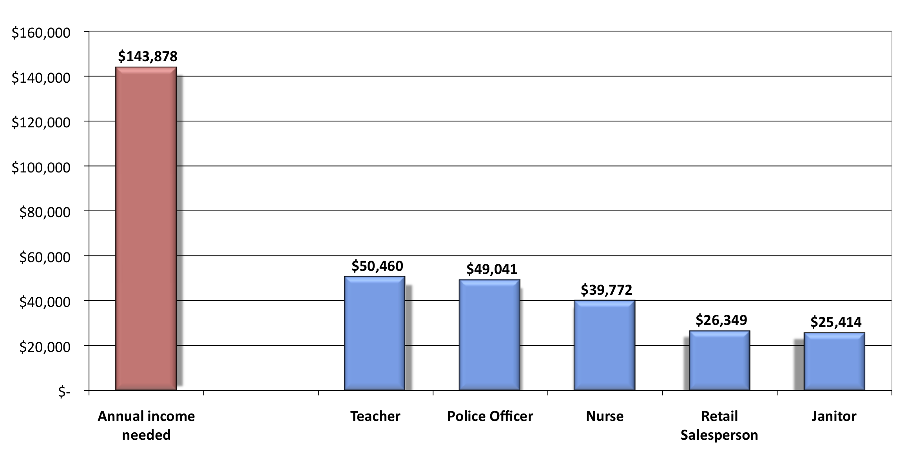
Income need to purchase a home in DC Cost in DC
Working families priced out of Homeownership
Source: Fannie Mae / Urban Institute State of Housing in the Nation’s Capital
Notes:
Raised grant subsidy – did R&D work and built coalition of supporters to tackle this problem.

Slide 4



City First Homes
Program Highlights:
Permanent Affordability
Wealth-building
Work with private sector
Homebuyer Support

Slide 5

Homeowner Support:
Homebuyer Education Classes
Assistance Attaining Mortgage
Post Purchase Support

Slide 6
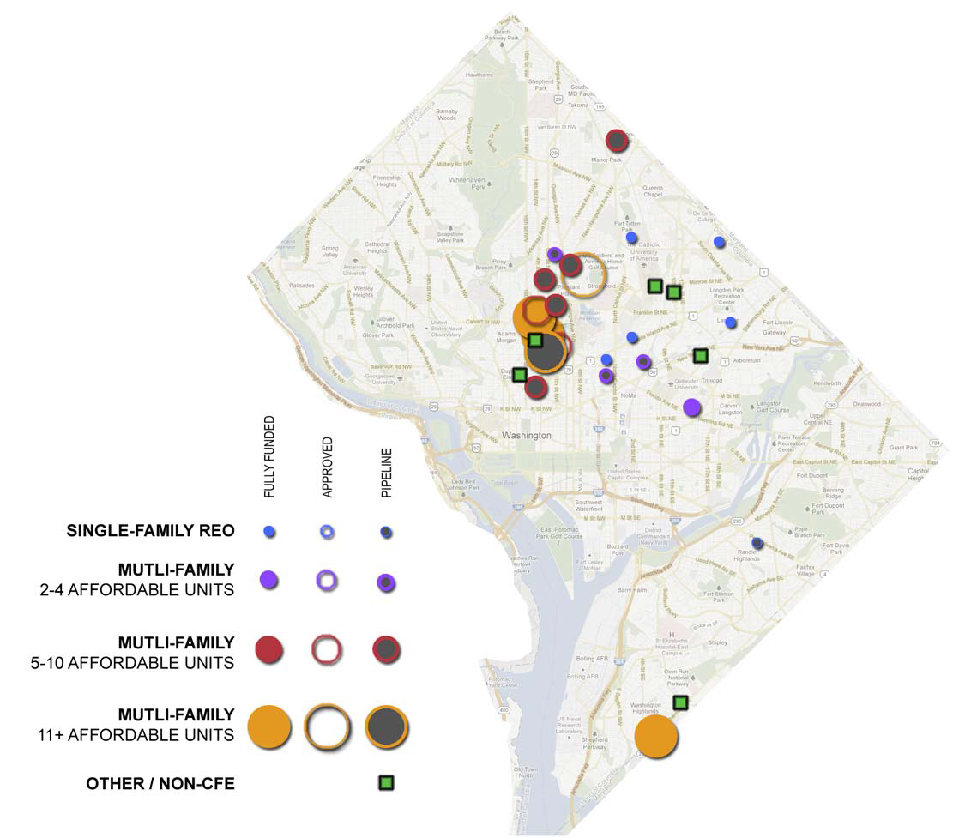
Creating mixed-income communities

Slide 7

CFHomes: Units Created
Year Two: Portfolio Snapshot
Completed
Sold/Occupied
Pipeline units
79
48
40
120
Permanently Affordable Homes

Slide 8

Social Innovation Fund: 2012 - 2017
Social Innovation Fund
CFE selected as one of the nation’s most innovative & high impact nonprofits
One of 10 affordable homeownership programs selected nation-wide
Objective: grow program while proving impact through metrics driven-approach
Federal funds matched by Ford Foundation

Slide 9


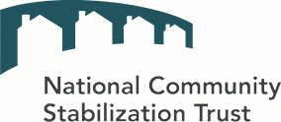



Additional Recognition, Accomplishments
Notes:
INSERTED BY TAHIRA

Slide 10
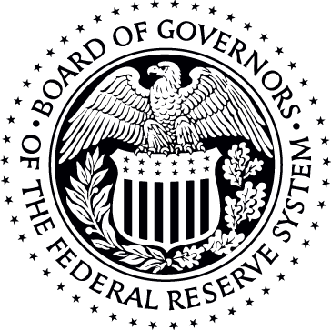
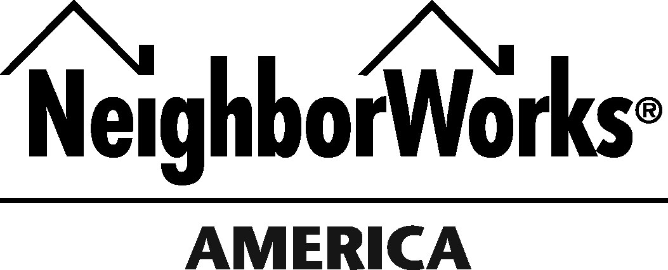

Sector Leadership & Technical Assistance
Notes:
INSERTED BY TAHIRA

Slide 11
IZ’s Challenges: Banks, Sales, Stability
Lenders
Reject Deed Restrictions Surviving Foreclosure
Require Substantial Technical Support
Sales
Substantial fall-out
Requires very hands-on buyer support
Stability
High rates of foreclosure in some cases
Mitigate through stewardship

Slide 12
Responding to IZ Challenges: What Works
Winning Lenders
Remove Foreclosure Survival Requirement
  Or fund short sale reserve
Require Substantial Technical Support
  Formally introduce to program
  Walk through secondary market compliance requirements
  Detail how their own policies will need to be adjusted
  Walk through approval process

Slide 13



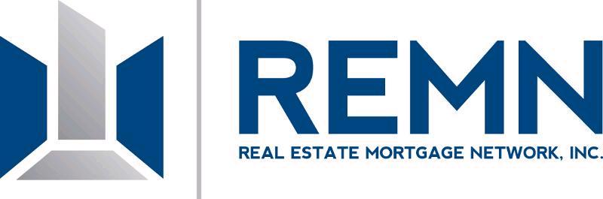




City First Partner Mortgage Lenders
Notes:
INSERTED BY TAHIRA

Slide 14
Responding to IZ Challenges: What Works
Enabling Sales
Buyers require very hands-on support
  Build personal relationships
  Detailed and rigorous training
  Walk through mortgage approval process
    Simplify a confusing process for buyer
    Banks already know us, buyers come preapproved

Slide 15
Responding to IZ Challenges: What Works
Promoting stability, preventing foreclosures
Owners benefit from post-purchase support
  Maintain personal relationships
  Post-purchase homebuyer support
    Affirmative: Financial planning, Home maintenance
    Crisis prevention: Monitoring, Early intervention
  Property condition & compliance monitoring
  Manage resale & enforce restrictions

Slide 16
Denver, CO IZ Example
Since 2005, Denver created 1,000 IZ units
over 3 projects…
FORECLOSURE RATES
Community 1 | Community 2 | Community 3
22% | 14% | 0%
No Stewardship
No Stewardship
Stewardship

Slide 17
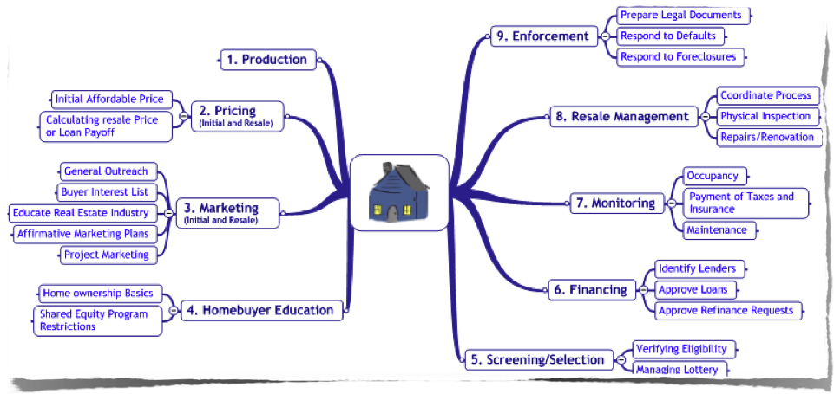
Stewardship Functions

Slide 18
What Works: Stewardship
Foreclosure Rates: Stewarded Housing vs. National Average
Source: National Community Land Trust Network, Mortgage Bankers Association
Notes:
Raised grant subsidy – did R&D work and built coalition of supporters to tackle this problem.

