Slide 1

Horizons
Horizons
Sustainability Information System
MWCOG Energy Advisory Committee meeting
Jim Yienger
Climate Action Associates LLC

Slide 2
Goals For Today
Introduce the Horizons Sustainability Information System
Discuss applicability for MWCOG’s regional GHG initiative
Solicit feedback from the EAB
Discuss our current plans

Slide 3
Sustainability Strategy
Government Operations
Buildings, facilities, fleet, etc.
H
Entire Community
Energy and emissions related to everyone,
all residents and businesses

Slide 4
Communities need LOTS of consistent and reliable DATA on:
Utility Energy and Fuel Oil Consumption
Vehicle Miles Traveled
Transit Ridership Metrics
Waste Generation
Water Consumption and Quality
Materials Consumption
Climate and Weather Data (HDD CDD)
Education, Housing Density, and Crime
Economic Indicators

Slide 5
Communities must seek data
Transportation Demand
?
Utility Data
?
“Scope 3” Sources
Consumption, etc
?
Community
?
?
Fuel Oil
?
Solid and sewage waste
Census Information
NOAA / weather service

Slide 6

Horizons Sustainability Information System
  Local-regional-state-nationwide common publishing platform for communities, utilities, MPOs, and others to share community aggregate sustainability data.
  Standardizes energy consumption and transportation data across different utilities and MPOs
  Managed by a COG, the Horizons Regional GHG module can automate GHG inventories to all communities.
  Communities go there and simply “get” their data and inventory- saving them time and energy.
  Multi-user. COG can manage and upload data, or as part of a regional initiative train utilities to upload data themselves as part of a long term cooperation agreement.
  Scalable- immediately work with other regions on the same platform
  Saves everyone money and time.

Slide 7
Data Supply
Data Demand
Utilities
(more than 3000 in USA)
Local Governments
Counties, Cities, Towns, Villages
Metropolitan Planning
Organizations
H
State and Federal
Agencies
EEPS and SBC Program monitoring
Transit Agencies
Horizons
State and Federal
Agencies
Academia, non-profits, businesses, etc.
Academia, non-profits, etc.

Slide 8
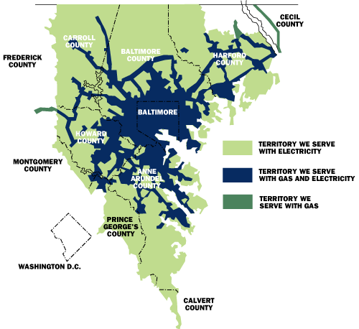
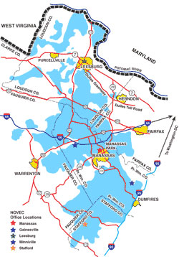
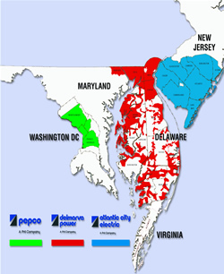
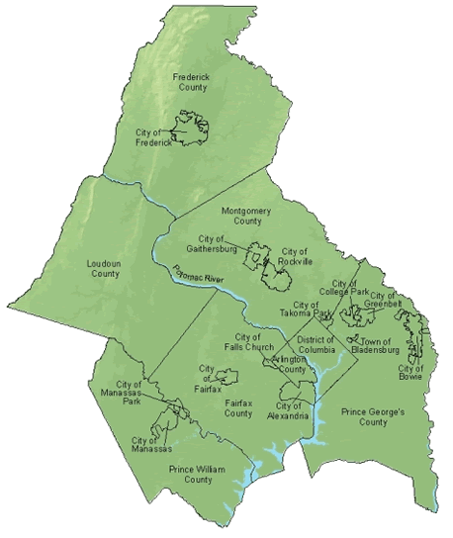
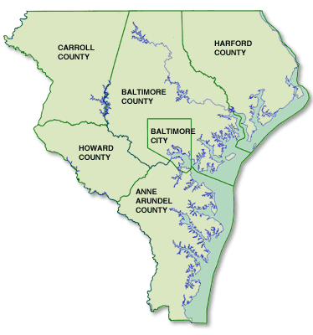
The “Great Mapping Problem”
B&GE
NOVEC
PEPCO

Slide 9
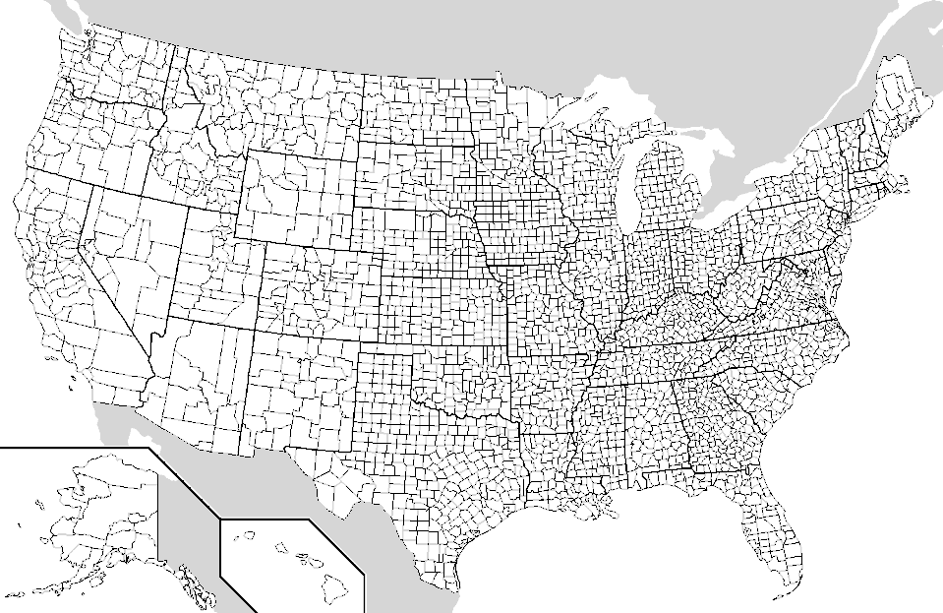
Horizons Community Map
The MWCOG region is a subset of the larger Horizons Community
Map and includes all Counties, Cities, Towns, and Census Designated Places in the region.

Slide 10
NOVEC
(Energy consumption)
Publishing

Slide 11
MWCOG
(Total VMT)

Slide 12
PEPCO
(Energy Consumption)

Slide 13
Any Statewide
Publisher
(Fuel Oil Consumption)

Slide 14
Community Energy Analysis…
Advanced

Slide 15
Community GHG Baselines…
Automated
GHG Emissions
Transportation VMT
Utility Energy Consumption
Fuel Oil Consumption
Waste (generation rate)
Apples to Apples
Community level
MWCOG-wide
Multi-region
State-wide
National
The more data providers,
the broader the scale of collaboration

Slide 16
Horizons
Sustainability Information System
Product Demonstration
http://climatetools.com/horizons

Slide 17
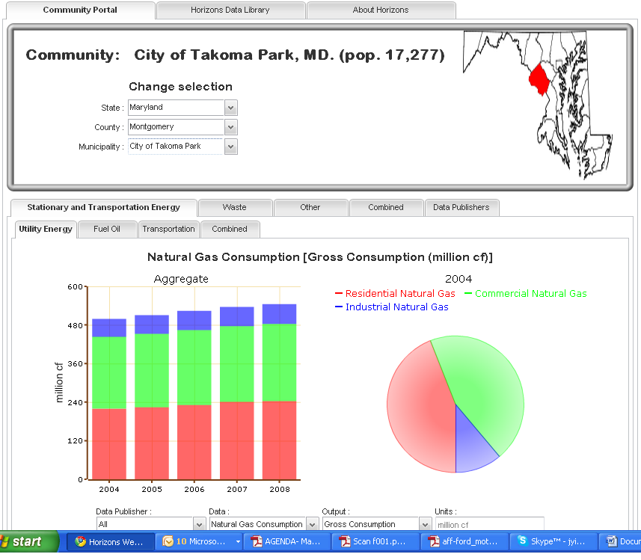

Slide 18
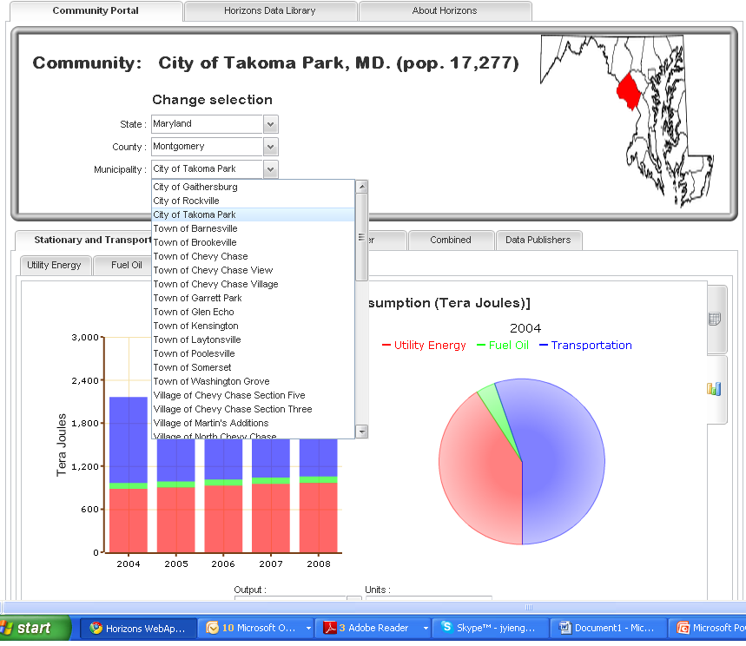

Slide 19
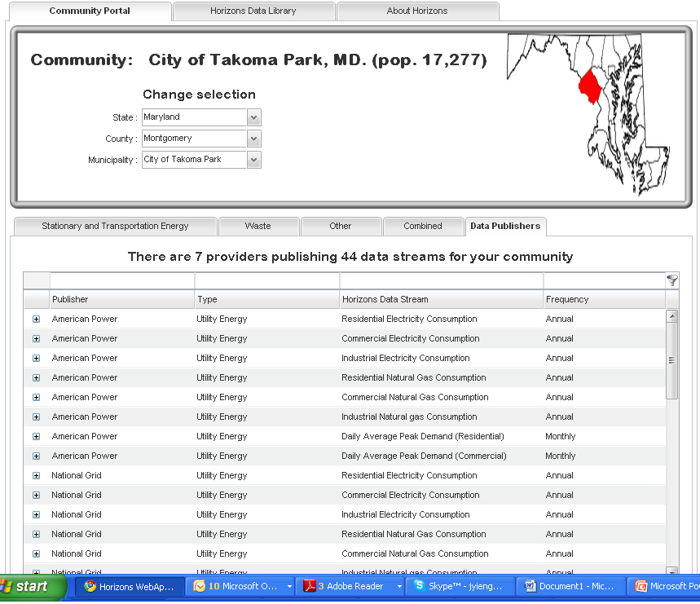

Slide 20
