Slide 1
Green Building Trends: 2003-2009
Presented to the
Climate, Energy and Environment Policy Committee
March 23, 2011

Slide 2
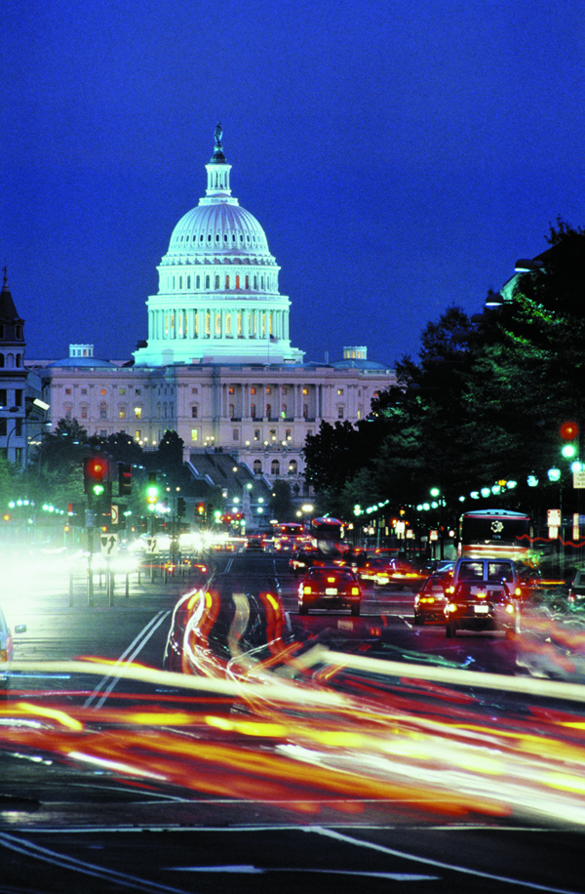
Key Points
22.9 million Square Feet of Green Building from 2003-2009
86 % of LEED construction from 2003- 2009 was located in Regional Activity Centers
64 % of all 2003–2009 LEED construction was within ½ mile of a Metrorail station

Slide 3
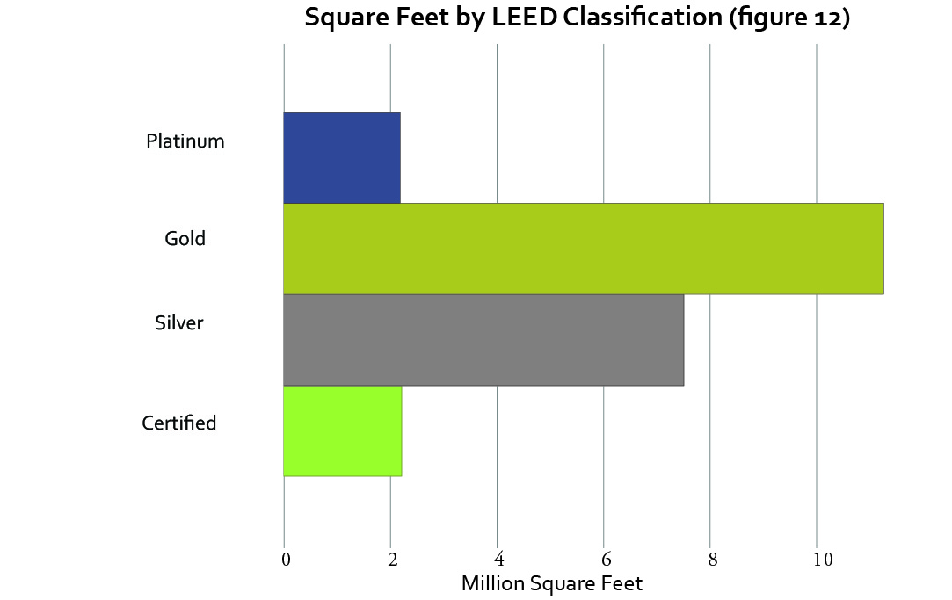
LEED certification
84% of LEED certified projects certified between 2003 and 2009 were LEED Silver or higher
Gold and Silver certifications were most common in Metropolitan Washington

Slide 4
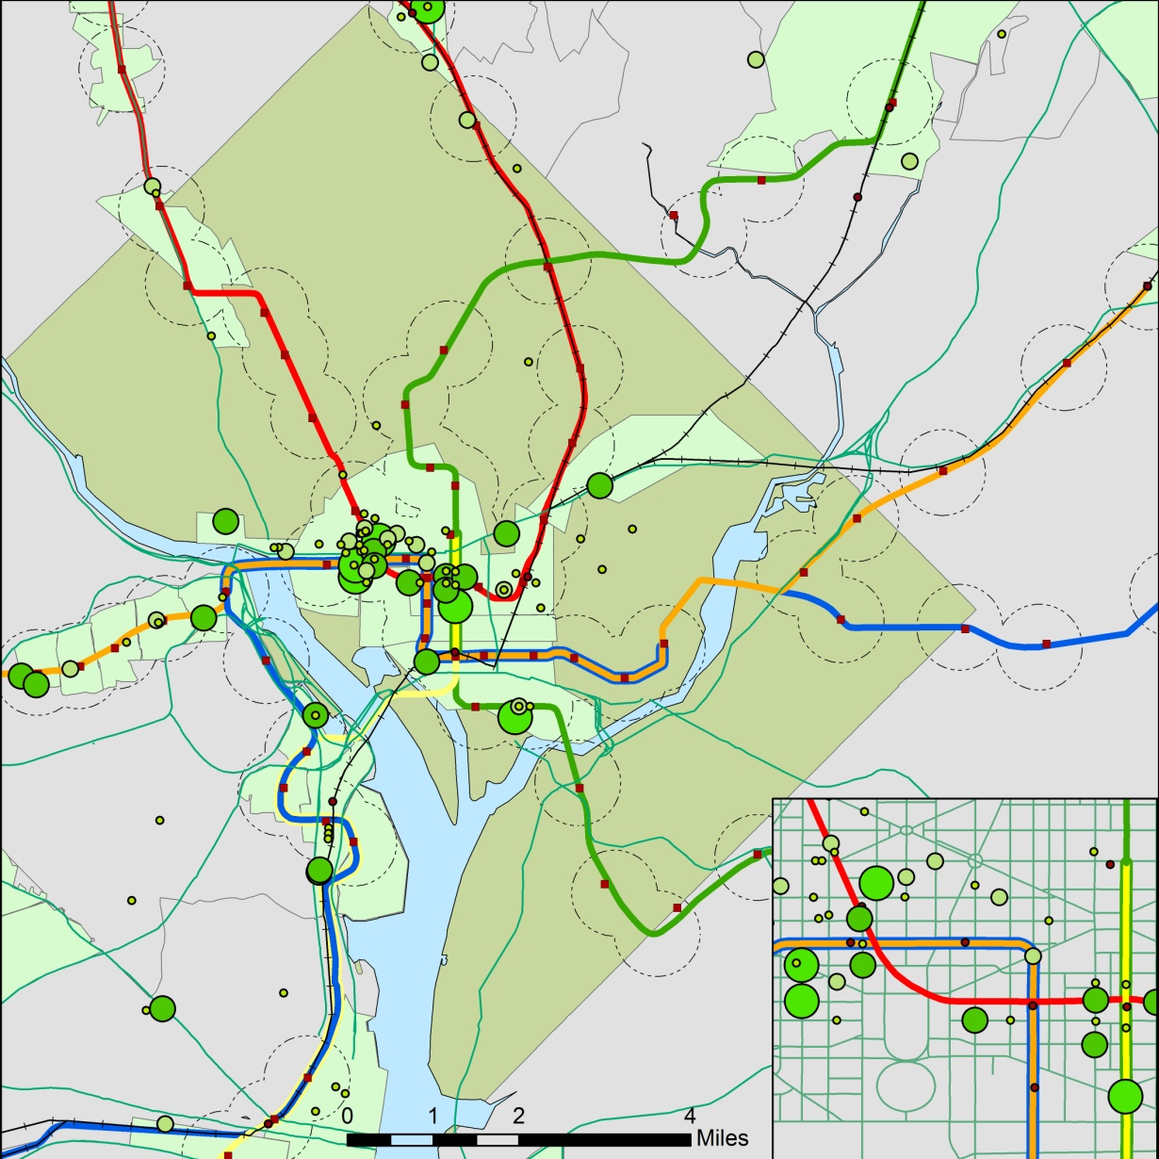
The District of Columbia
72 LEED certified projects
12.5 million square feet of LEED certified projects
64 Projects in Regional Activity Centers
The International Monetary Fund Center was the largest project

Slide 5
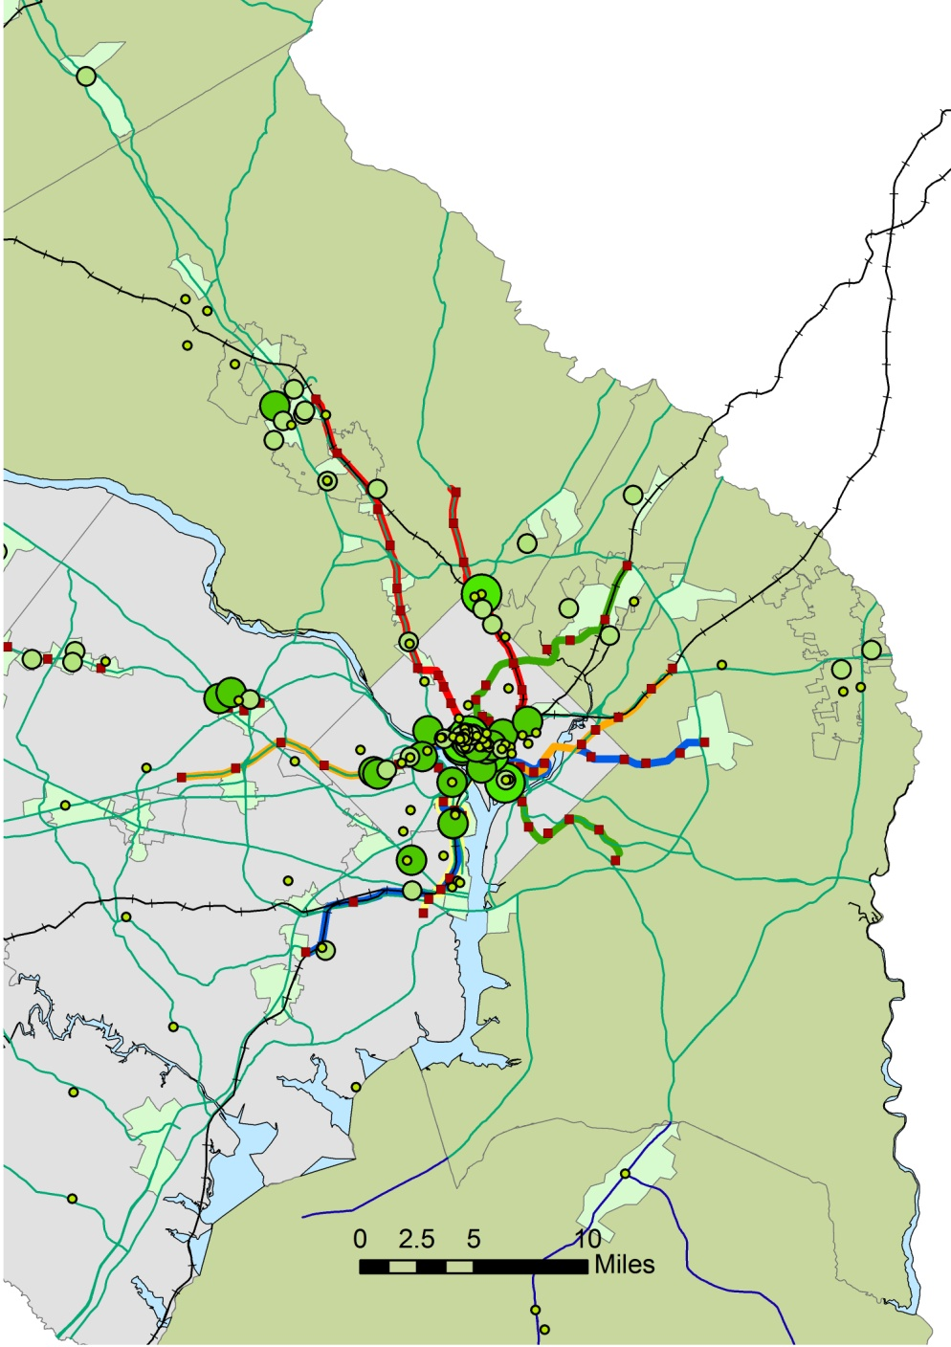

Maryland
40 LEED certified projects
3.8 million square feet of LEED certified projects
15 Projects in Regional Activity Centers
The Discovery Communications Global Headquarters building was the largest project

Slide 6
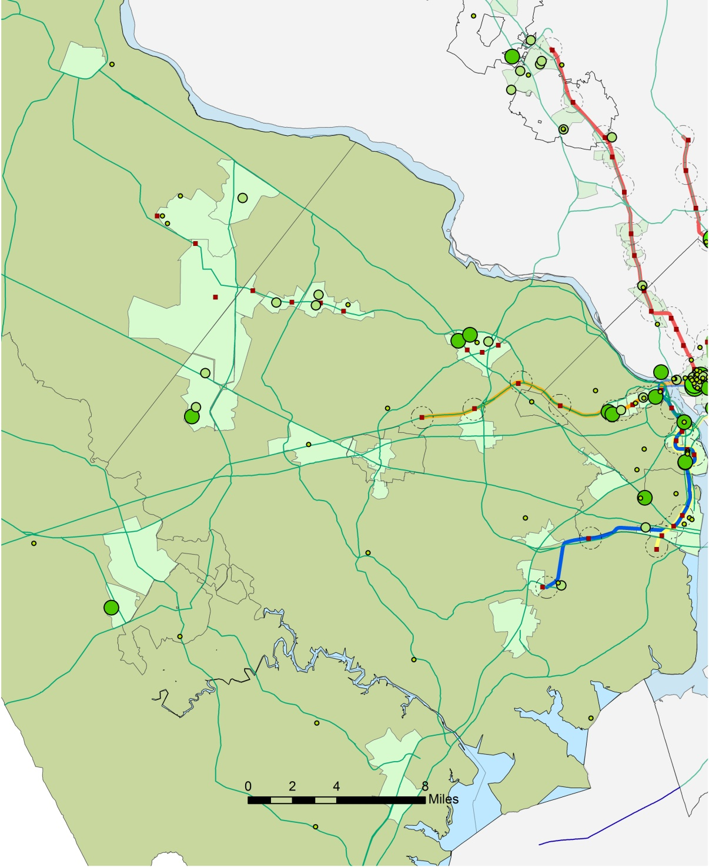
Virginia
59 LEED certified projects
6.6 million square feet of LEED certified projects
41 Projects in Regional Activity Centers
T.C. Williams High School was the largest project

Slide 7
Questions
A Report Completed by:
COG’s Departments of Community Planning & Services and
Environmental Programs
COG Staff: Ryan Hand, John Mataya and Leah Boggs

Slide 8
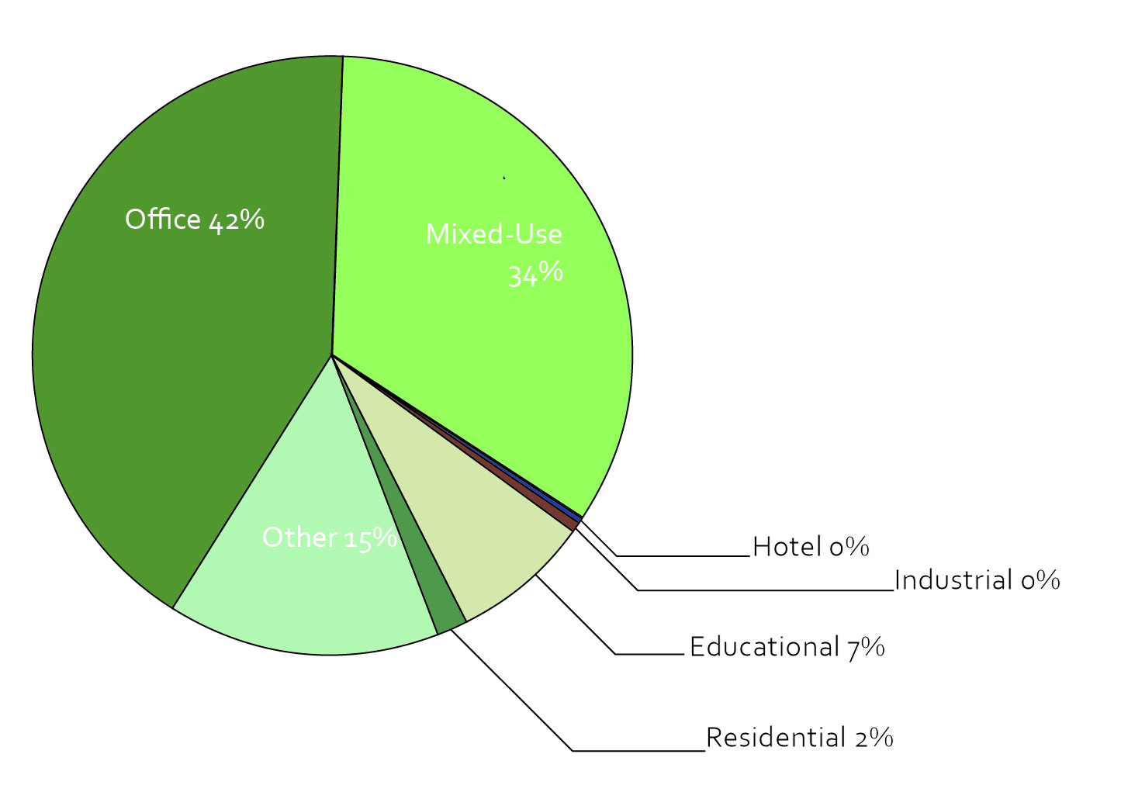
Building Type
Office and Mixed-Use buildings led LEED Certification
LEED scoring criteria incentivizes infill projects that are in existing urban areas

Slide 9
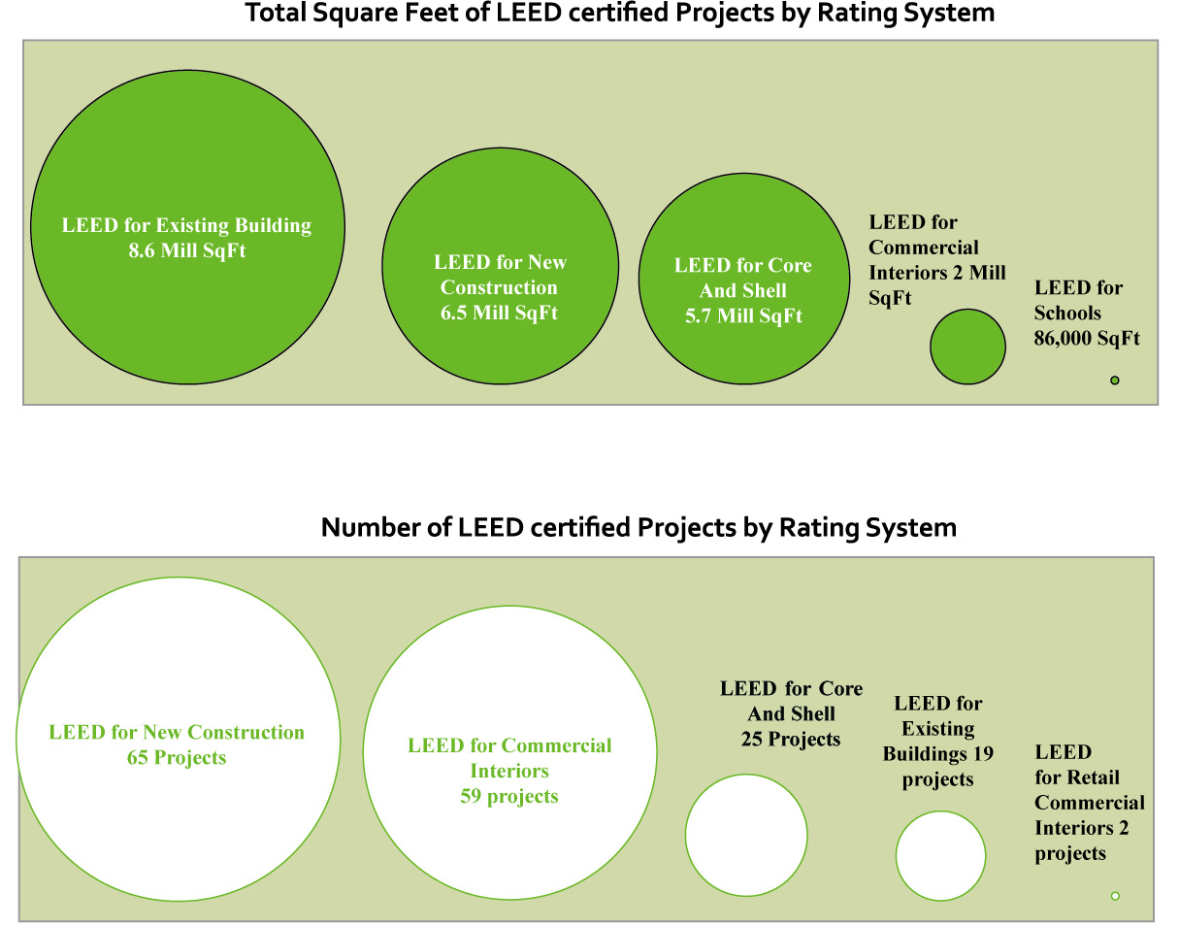

Slide 10
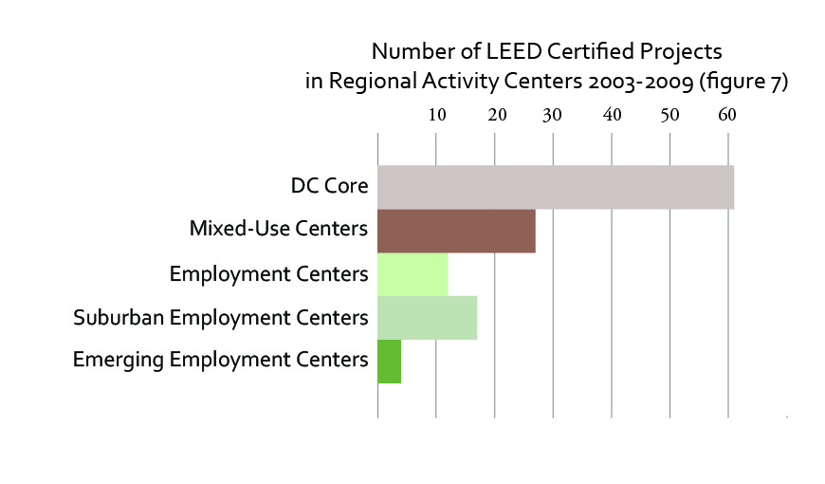
Regional Activity Center Type
LEED certified projects are most common in DC core and Mixed-Use centers
LEED projects tend to be located in well established commercial areas

