Slide 1

Ozone Season Summary
2010
Joan Rohlfs
ACAC Meeting, COG
July 19, 2010

Slide 2
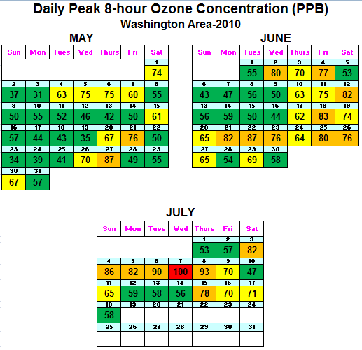
Ozone Season Summary (2010)
Peak 8-Hour Ozone Concentrations (ppb)
Data based on the 8-hour standard set at 75 ppb.
1 Code Red Day
17 Code Orange Days
22 Code Yellow Days
39 Code Green Days
* Analysis is based on draft data until July 19, 2010. Data is subject to change.

Slide 3
2010 Ozone Exceedances
Date | # of Monitors Exceeding | Highest Monitor | Highest Concentration (ppb)
5/21/2010 | 1 | Rockville | 76
5/27/2010 | 4 | HU-Beltsville | 87
6/2/2010 | 1 | HU-Beltsville | 80
6/4/2010 | 1 | HU-Beltsville | 77
6/12/2010 | 1 | Rockville | 82
6/18/2010 | 2 | Franconia | 83
6/21/2010 | 3 | Calvert Co. | 82
6/22/2010 | 5 | HU-Beltsville | 87
6/23/2010 | 1 | Calvert Co. | 76
6/25/2010 | 1 | Prince Georges Co. | 80
6/26/2010 | 1 | HU-Beltsville | 76
7/3/2010 | 3 | HU-Beltsville | 82
7/4/2010 | 5 | River Terrace | 86
7/5/2010 | 3 | Calvert Co. | 82
7/6/2010 | 10 | Prince Georges Co. | 90
7/7/2010 | 13 | McMillan Reservoir | 100
7/8/2010 | 3 | Frederick Co. | 93
7/15/2010 | 3 | Aurora Hills | 78
* Analysis is based on draft data until July 19, 2010. Data is subject to change.

Slide 4
July 3rd to July 7th Poor Air Quality Event
High pressure & temperature.
Limited clouds allowed for intense sunlight (and record temperatures.
Usually re-circulating light winds kept bringing polluted air back into the region.
All three factors above led to conditions favorable to high ozone levels.

Slide 5
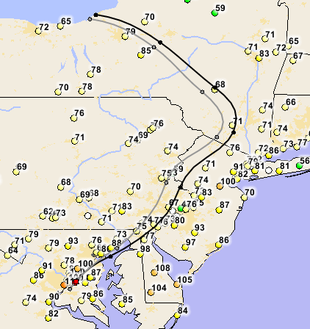
July 7th Code Red
Wind Trajectory at 3 PM (July 7)
(500 &1000 m)
# of Monitors in Exceedance: 13
2 Monitors in Code Red (McMillan & River Terrace, DC)
Maximum 8-Hour Ozone: 100 ppb (McMillan, DC)

Slide 6
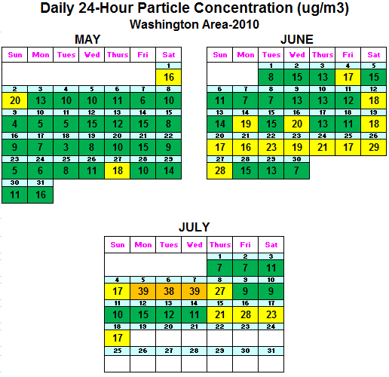
Fine Particle Summary (2010)
24-Hour PM2.5 Concentrations (ug/m3)
Data based on the 24-hour standard set at 35.5 ug/m3.
3 Code Orange Days
22 Code Yellow Days
54 Code Green Days
* Analysis is based on draft data until July 19, 2010. Data is subject to change.

