Slide 1
Cooperative Forecasting Program: Background and draft Round 8.2 Estimates
Greg Goodwin, Regional Planner
Metropolitan Washington Council of Governments
Blue Plains Technical Subcommittee Worksession
April 25, 2013

Slide 2
Cooperative Forecasting Program
Provides consistent local and regional household, population and employment projections based on common assumptions about future growth
  Established by COG in1975
  Prepared under the direction of the Planning Directors Technical Advisory Committee (PDTAC)
  Reviewed and approved by the COG Board
  Official local government projections
Inputs for transportation, water and air quality modeling by COG and TPB, local government planning, and private sector market analysis
Major series or “Round” approximately every 4 years

Slide 3
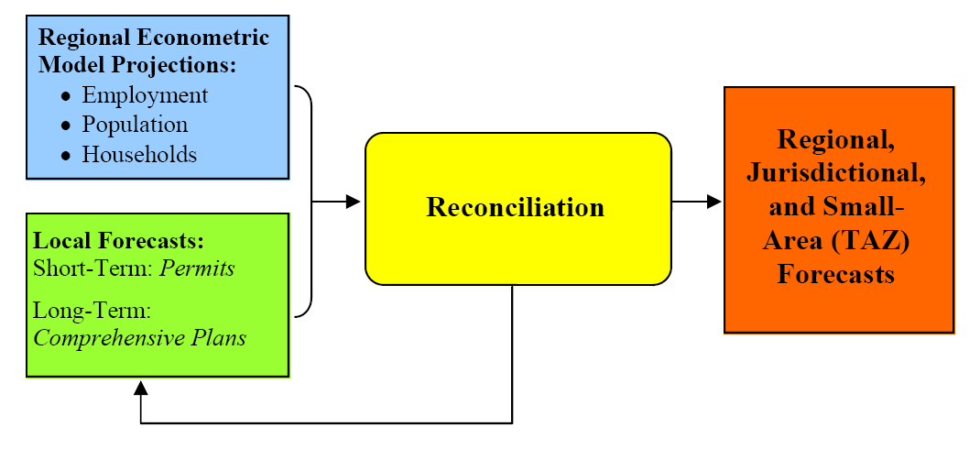
Cooperative Forecasting Process

Slide 4
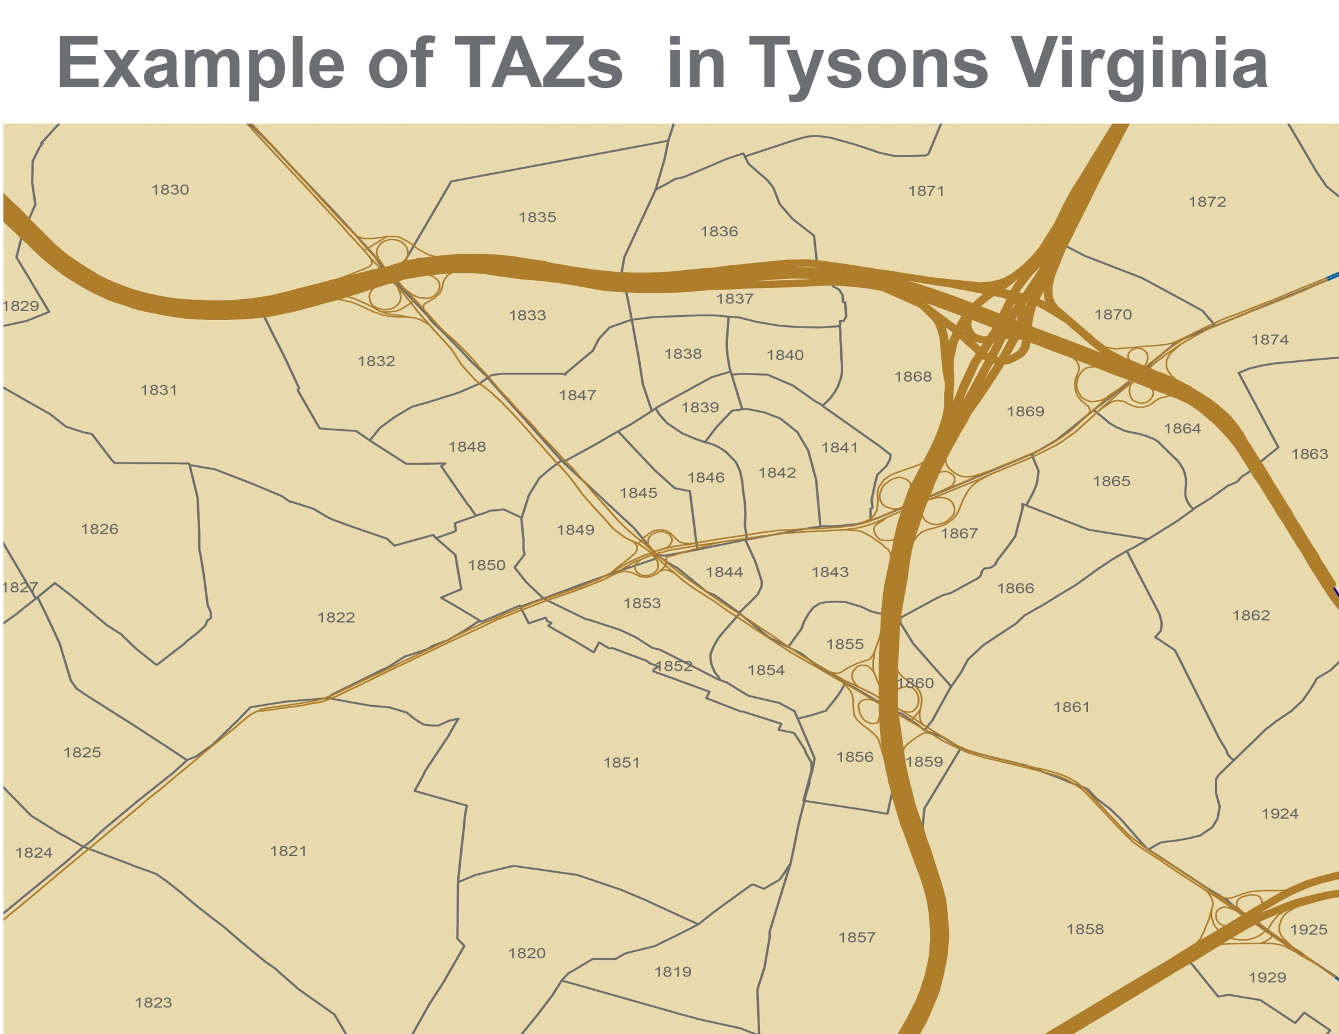
4

Slide 5
Annual Updates
COG Board policy (since 1992, ISTEA and CAA) which permits – but DOES NOT REQUIRE – annual updates (8.1, 8.2, etc.)
  Local governments review and explicitly consider major federally-funded transportation facilities to document their likely land use impacts
  Annual process also captures local land use and comprehensive plan changes

Slide 6
Cooperative Forecasting History
ROUND 1 - 1976
ROUND 2 - 1979
ROUND 3 - 1983
Round 3.5 - 1985 Update
ROUND 4 - 1987
Round 4-1 – 1991
ROUND 5 - January 1994
Round 5.1 - May 1994
Round 5.2 - 1995
Round 5.3 - 1996
Round 5.4 - 1997
ROUND 6a - 1998
Round 6.1 - 1999
Round 6.2 - 2000
Round 6.3 - 2003
Round 6.4 - Never Adopted
Round 6.4A - 2004
ROUND 7.0 - 2005
Round 7.0a - 2006
Round 7.1 - 2008
Round 7.2 - 2009
Round 7.2A - 2009
ROUND 8.0 - 2010
Round 8.0a - 2011
Round 8.1 - 2012

Slide 7
Regional Econometric Model Projections
Top Down: Benchmark projections of future growth are generated from an econometric model that predicts the total amount of growth that the region as a whole can expect over a 30-year forecasting period.
  For Round 8, regional benchmark projections were generated from a comprehensive econometric model developed by IHS Global Insight, a private sector firm that provides economic forecasting and analysis services to more than 3,800 clients in industry, finance and government.
  The IHS Global Insight econometric model incorporates nearly 2,000 economic, financial, and demographic factors in generating its projections. Each region of the US is modeled individually and then linked into a national system.
  The IHS Global Insight model provides 5-to-30 year regional projections for:
    Employment by industry sector (NAICS)
    Population by age group
    Households by household head age group
  Projections of total regional employment are generated by multiplying IHS Global Insight projections of wage and salary employment projections by a factor developed from US Census data to account for self-employed workers who are not included in the econometric model projections

Slide 8
Local Forecasts
Bottom Up: Jurisdictional and small-area TAZ-level employment, household, and population forecasts are prepared independently by local planning staff in each COG member jurisdiction for the 30-year forecasting period.
  Short-term local forecast are based on:
    Current construction, building permits, approved development plans, rezoning applications
  Longer-term local forecasts are based on:
    Adopted and approved area master plans, jurisdictional comprehensive or general plans, current zoning capacity and past and current trends in market absorption rates.
  COG staff also provide local planning staff with current small area employment data files and Census data at the Transportation Analysis (TAZ) level to assist in the development of local jurisdiction base year estimates.
  Local jurisdictions describe their methodology and the assumptions made in preparing their local forecasts as part of the Cooperative Forecasting process

Slide 9
Reconciliation
Reconciliation: Local planners working through COG’s Cooperative Forecasting Subcommittee reconcile the regional sum of the independently prepared local forecasts with the regional projections from econometric model.
  Subcommittee members carefully review the forecasts of each jurisdiction and have the opportunity to question the reasonableness of methodology and assumptions used to prepare these forecasts.
  Assumptions regarding the regional balance of households, workers, jobs and in-commuting from outside the region are reviewed for reasonableness.
    In Round 7, an additional 130,000 households were added to the local forecasts
  Reconciliation and modification of the local forecasts continue until the sum of local government forecasts are within about 3 percent of the econometric model projections

Slide 10
Consistency with the TPB Constrained Long Range Plan (CLRP)
  In many Rounds the Cooperative Forecasts have been updated and modified to take into account for major transportation projects:
    In Round 6.2, the local forecasts for the NoMa area in the District were increased in conjunction with the addition of the New York Ave Metrorail Station to the CLRP
    In Round 6.4A, the local forecasts of Montgomery and Prince George’s County were increased and the District of Columbia’s local forecasts were decreased in conjunction with the addition of the Inter-County Connector (ICC) to the CLRP
    In Round 7.2A, the local forecasts for Light Rail Purple Line corridor connecting Silver Spring and New Carrollton were increased
    In Rounds 7 and 8, the local forecasts of Fairfax County and Loudoun County began to include increased development around planned Metrorail Silver Line stations in Fairfax and Loudoun County as the Silver Line proceeded through various stages of approval
    In Round 8.2, significant increases in households and population were added to Fairfax County forecasts to reflect the recently adopted Plan for Tysons

Slide 11
How Accurate Have the Household and Population Forecasts Been?
Households
 | Round 5.1 1990 | Round 5.1 2010 | Forecast | Actual | Actual Growth
Jurisdiction: | Base Year | Forecast Year | % Growth | % Growth | 1990 - 2010
District of Columbia | 249,600 | 252,100 | 1% | 7% | 17,100
Arlington Co., VA | 78,500 | 96,300 | 23% | 25% | 19,600
City of Alexandria, VA | 53,300 | 64,400 | 21% | 28% | 14,800
Montgomery Co., MD | 282,000 | 368,500 | 31% | 28% | 79,000
Prince George's Co., MD | 258,000 | 326,400 | 27% | 18% | 46,000
Fairfax Co., VA | 303,900 | 398,700 | 31% | 31% | 95,600
Loudoun Co., VA | 30,700 | 65,300 | 113% | 241% | 73,900
Prince William Co., VA | 81,400 | 131,600 | 62% | 82% | 66,400
Frederick Co., MD | 52,600 | 92,500 | 76% | 61% | 32,200
Charles Co., MD | 33,000 | 55,900 | 69% | 55% | 18,000
Total | 1,423,000 | 1,851,700 | 30% | 33% | 462,600
Population
 | Round 5.1 1990 | Round 5.1 2010 | Forecast | Actual | Actual Growth
Jurisdiction: | Base Year | Forecast Year | % Growth | % Growth | 1990 - 2010
District of Columbia | 606,900 | 606,300 | 0% | -1% | -5,200
Arlington Co., VA | 170,900 | 201,100 | 18% | 21% | 36,700
City of Alexandria, VA | 111,200 | 131,200 | 18% | 26% | 28,800
Montgomery Co., MD | 757,000 | 940,000 | 24% | 28% | 214,600
Prince George's Co., MD | 729,300 | 884,900 | 21% | 18% | 134,100
Fairfax Co., VA | 847,800 | 1,097,400 | 29% | 29% | 243,700
Loudoun Co., VA | 86,100 | 181,400 | 111% | 263% | 226,200
Prince William Co., VA | 250,400 | 400,400 | 60% | 81% | 203,700
Frederick Co., MD | 150,200 | 243,600 | 62% | 55% | 83,200
Charles Co., MD | 101,200 | 161,500 | 60% | 43% | 43,400
Total | 3,811,000 | 4,847,800 | 27% | 32% | 1,209,200
11
Round 5.1 Forecasts were adopted in 1994
Fairfax County includes Fairfax city and Falls Church city
Prince William County includes Manassas city and Manassas Park city

Slide 12
How Accurate Have the Employment Forecasts Been?
12
Employment
 | Round 5.1 1990 | Round 5.1 2010 | Forecast | Actual | Actual Growth
Jurisdiction: | Base Year | Forecast Year | % Growth | % Growth | 1990 - 2010
District of Columbia | 747,300 | 885,900 | 19% | 5% | 36,200
Arlington Co., VA | 183,100 | 264,600 | 45% | 22% | 40,200
City of Alexandria, VA | 92,200 | 125,000 | 36% | 15% | 13,800
Montgomery Co., MD | 465,500 | 625,000 | 34% | 10% | 44,600
Prince George's Co., MD | 310,400 | 426,600 | 37% | 10% | 32,200
Fairfax Co., VA | 443,900 | 653,300 | 47% | 53% | 236,100
Loudoun Co., VA | 39,300 | 85,800 | 118% | 266% | 104,400
Prince William Co., VA | 84,500 | 151,400 | 79% | 70% | 59,100
Frederick Co., MD | 54,000 | 106,000 | 96% | 83% | 44,700
Charles Co., MD | 38,700 | 52,500 | 36% | 61% | 23,500
Total | 2,458,900 | 3,376,100 | 37% | 26% | 634,800
Round 5.1 Forecasts were adopted in 1994
Fairfax County includes Fairfax city and Falls Church city
Prince William County includes Manassas city and Manassas Park city

Slide 13
The Round 8.2 Cooperative Forecasts . . .
. . . second update of the Cooperative Forecasts to include results of the 2010 Census
. . . within 3 percent of the Round 8.0 Econometric Model benchmark regional forecasts for Employment, Population, and Households
. . . based on a Transportation Analysis Zone (TAZ) structure (COG TAZ 3,722) almost doubling the number of TAZs from the previous series
. . . will be used by the TPB in this year’s Air Quality Conformity Analysis
. . . will be an element in analyzing the Regional Activity Centers
Notes:
COG established Cooperative Forecasting in 1975
First series or “Round” was adopted in 1976
Because of federal air quality legislation (ISTEAA, SAFE-TEA LU, MAP-21etc.) COG has policy ALLOWING but NOT REQUIRING annual updates

Slide 14
Draft Round 8.2 Forecast - Tysons
2010 |  |  |  | 2040 |  |  | 2010 to 2040 Growth
Households |  | Population | Employment | Households | Population | Employment | Households | Population | Employment
8,342 |  | 17,122 | 86,304 | 37,670 | 74,319 | 151,925 | 29,328 | 57,197 | 65,621
In Round 8.2, forecast 2040 households and population totals for the Tysons area were increased by 20,700 households and 43,000 persons compared to the previous Round 8.1 forecasts These increases were added to the Cooperative Forecasts to reflect the recently adopted Fairfax County Plan for Tysons that significantly increased the planned residential density around the Tysons Metrorail Silver Line stations

Slide 15
Key Trends in Employment Forecasts for Round 8.2
1983 MSA Region
15
  1.3 million new jobs forecast between 2010 and 2040
    Central Jurisdictions will add 349,500 jobs (+32% )
    Inner Suburbs will add 626,300 (+42%)
    Outer Suburbs will add 360,900 (+68%)
  Job growth rate in Northern Virginia (+55%) will outpace growth anticipated in Suburban Maryland (Includes Prince George’s and Montgomery Counties)(+39%) and the District of Columbia (+25%).
  Fairfax County, Montgomery County and the District of Columbia would add the largest number of new jobs to the region, followed by Prince George’s, Loudoun and Prince William Counties.

Slide 16
Key Trends in Population Forecasts for Round 8.2
1983 MSA Region
16
  1.7 million more people forecast between 2010 and 2040
    Central Jurisdictions will add +292,800 people (+31%)
    Inner Suburbs will add +659,400 (+22%)
    Outer Suburbs will add +703,300 (+52%)
  Population growth in Northern Virginia (+40%) will outpace growth anticipated in Suburban Maryland (+24%), and the District of Columbia (+28%).
  Fairfax County, Montgomery County, and Prince William County would add the greatest number of new people to the region, followed by Loudoun County and the District of Columbia.
Notes:
Subregional pop trends
Household forecasts are the basis for the population projections
strongest growth in region’s suburbs but growth in D.C

Slide 17
Key Trends in Household Forecasts for Round 8.2
1983 MSA Region
17
  Sub-region and Jurisdictional Level
  695,000 new households between 2010 and 2040
    Central Jurisdictions will add +130,500 (+30%)
    Inner Suburbs +298,300 (+28%)
    Outer Suburbs +266,600 (+58%)
  Growth in Northern Virginia (+43%) will outpace Suburban Maryland (+30%), and the District of Columbia (27%).
  Fairfax County, Montgomery County, Prince William County would add the largest numbers of new households, followed by Prince George’s County and the District of Columbia.
Notes:
Household forecasts are basis for population projections
Again, strongest growth in region’s suburbs but steady increase in D.C.

Slide 18
Typical Schedule for a
Cooperative Forecasting Round Update
May/June 2012 – Announcement of the schedule for the Cooperative Forecasting Round update
September 2012 - Local jurisdictions submit a Letter of Intent (from the Planning Director) to update the Cooperative Forecasts for their jurisdiction
October 2012 - Preliminary local jurisdictional totals are due to COG Staff by the October Cooperative Forecasting meeting
November/December 2012 – Preliminary “sum of local jurisdictional totals” are reconciled with the benchmark econometric regional projections and reviewed by the Cooperative Forecasting Subcommittee and Planning Directors Technical Advisory Committee
January 2013 - The Planning Directors Technical Advisory Committee approves the final reconciled local jurisdictional totals and recommends that the COG Board approve the use of the updated Cooperative Forecasts in the TPB Constrained Long Range Plan (CLRP) Update and Air Quality Conformity Analysis
February 2013 - Round 8.2 TAZ level forecasts are due to COG staff by February 1, 2013. COG Board approves Round 8.2 as inputs for TPB’s CLRP Update and Air Quality Conformity Analysis. After the COG Board action, TAZ level forecasts are transmitted to Transportation Planning Staff
July 2013 – The COG Board formally adopts Round 8.2 Forecasts as the official growth forecasts for the region and the TPB adopts the updated CLRP upon determination that the updated CLRP conforms with established regional air quality mobile emissions budgets

Slide 19
Future Growth in the in Metropolitan Washington Region
The Cooperative Forecasts are the “most probable” projections based on existing trends and current local plans and policies, and not necessarily an inevitable or preferred future growth end state
  Changes in long-term global and national macro-economic conditions, as well changes in federal government spending and policies, will affect both the overall level and pace of future growth in the region
    The top-down regional econometric model and benchmark projections of future growth for a 30-year period are updated approximately every 3 to 4 years and begin a new Cooperative Forecasting Round
  Trends can change as different demographic cohorts in the population age and express different preferences and lifestyles from previous generations
    Periodic Census Data and Household Travel Surveys provide a means to examine how these preferences and lifestyles are changing over time and are used to update the Cooperative Forecasts and TPB Travel Models
  State and Local governments can also change their current plans and policies through investments in infrastructure, changes in existing land use plans and zoning, and new economic development strategies
    These changes are captured in the annual Cooperative Forecasting updates

Slide 20
Next Steps
20
COG staff, Planning Directors, Cooperative Forecasting Subcommittee continue to monitor regional and local changes for future updates
    Comprehensive plan changes
    Significant rezonings
    Future development of a new econometric model
    Regional economic trends – Impact of the “Fiscal Cliff” including sequestration
    Contact Information:
    Greg Goodwin, Regional Planner, MWCOG
    202.962.3274
    ggoodwin@mwcog.org
Notes:
Process

