Slide 1

Freight Around the Region
TPB Citizens Advisory Committee
Karin Foster
Transportation Planner
Metropolitan Washington Council of Governments
March 14, 2013

Slide 2

Overview
What is “Freight”?
Freight in the National Capital Region
Freight and Transportation Planning
TPB Freight Program
TPB Freight Subcommittee
Example: Top 10 Freight Projects
Upcoming Freight Initiatives
Trending Freight Topics
Notes:
Multi-State Coordination at every level of Freight Program
End with a specific Freight Program example of working closely with state partners

Slide 3
What is “Freight”
What is Freight?
What Drives Freight?
Freight Definition
  “Goods and cargo transported for pay, whether by water, land, or air.” (Source: Cambridge Dictionary)
Goods movement
Freight-dependent industries
People and business demands drive freight
National Capital Region heavy service industry (government-related employment and services)
U.S. consumption requires the movement of 50 tons of freight per person each year!
  Example: 777 North Capitol Street receives 15 trucks per day

Slide 4
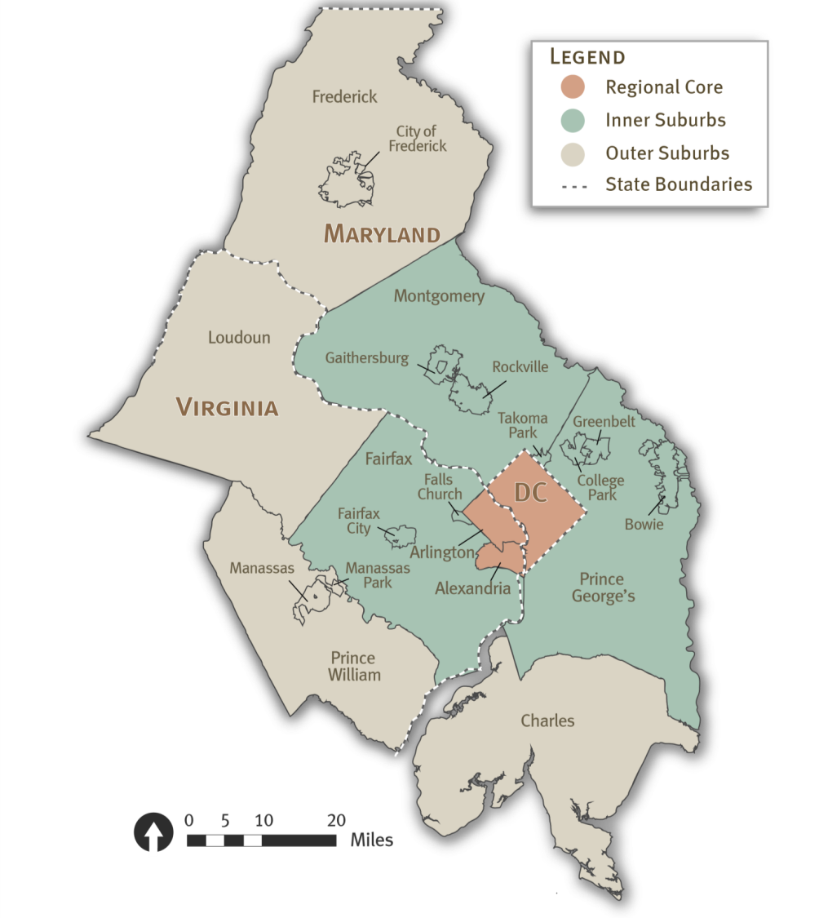
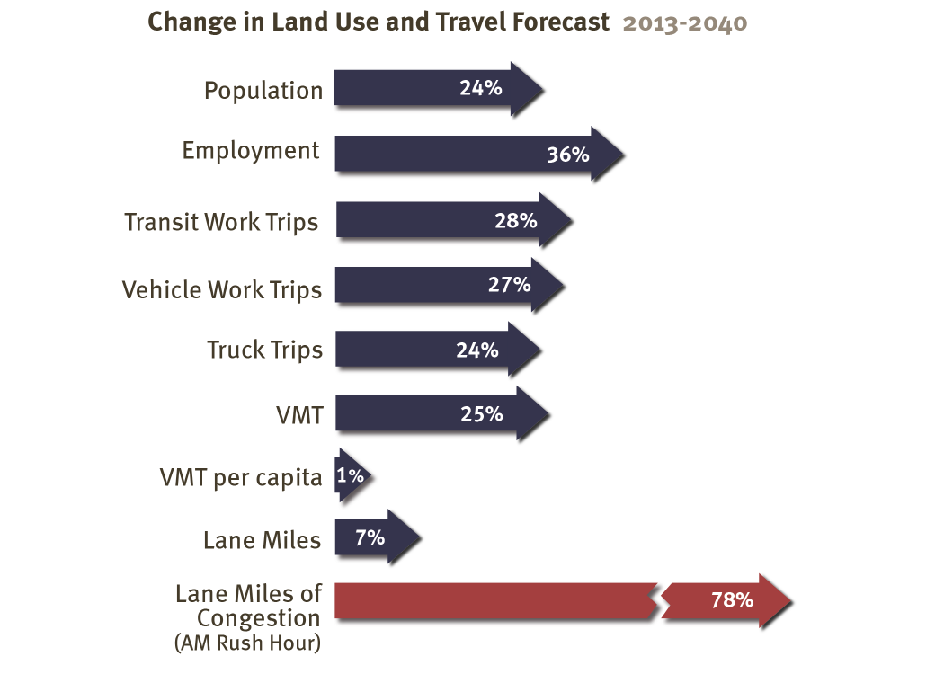
Freight in the National Capital Region
Our Region’s Unique Freight Story
Notes:
3 states
Regional core, inner suburbs, outer suburbs
1 dedicated freight staff

Slide 5
Freight in the National Capital Region Regional Freight Mode Split 2011
Trips To, From, Within Region
Source: FHWA Freight Analysis Framework, 2013
Notes:
Through trips about 60 percent when last examined in 2002.
According to our model, about 5% of trips are through trips.
But with new trends, people buying cars later and less, more use of ecommerce, that percentage is anticipated to be on the decline.

Slide 6
Freight and Transportation Planning
Freight transportation planning “encouraged” in transportation legislation, but growing focus
MAP-21 Transportation Legislation
  National Goals
New National Goals from MAP-21

Slide 7
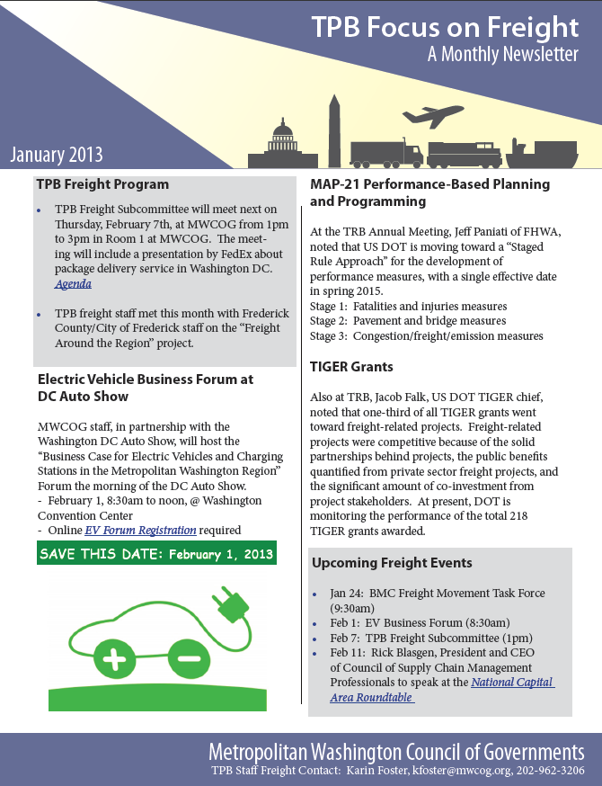
TPB Freight Program
TPB Freight Program Components
  TPB Freight Subcommittee
  National Capital Region Freight Plan 2010
  Focus on Freight Monthly Newsletter
  www.mwcog.org/freight
  Content to the Constrained Long-Range Plan/Transportation Improvement Program/TPB Publications
Notes:
Five years ago, kicked off our Freight Program
Freight Subcommittee is the ongoing component of the Freight Program
Our state partners helped us to shape the Freight Subcommittee and the work under the Freight Program
-State partners are regular Freight Subcommittee participants, Chairman reps, help drive the agenda items
Freight Plan
Top 10 Highlighted Projects
Both due to be updated this year

Slide 8
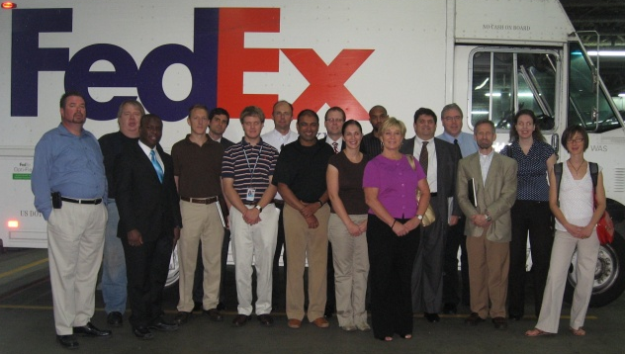

TPB Freight Subcommittee
TPB Freight Subcommittee Role
  Stakeholder presentations/tours on regional/national freight topics
TPB Freight Program products/activities vetted by TPB Freight Subcommittee members
  National Capital Region Freight Plan, 2010
  Top 10 Highlighted Freight Projects, 2011
Inform/involve members about complementary MPO programs/policy
  Complete Streets Policy input
  Transportation Land-Use Connections Grant Program
  (Frederick County Freight and Land-Use Plan, 2011)
  Electric Vehicle Business Forum participation
Members approach TPB via Freight Subcommittee for Letters of Support
  CSX TIGER Grant
  NS TIGER Grant
  DDOT Off-Hours FHWA Grant

Slide 9
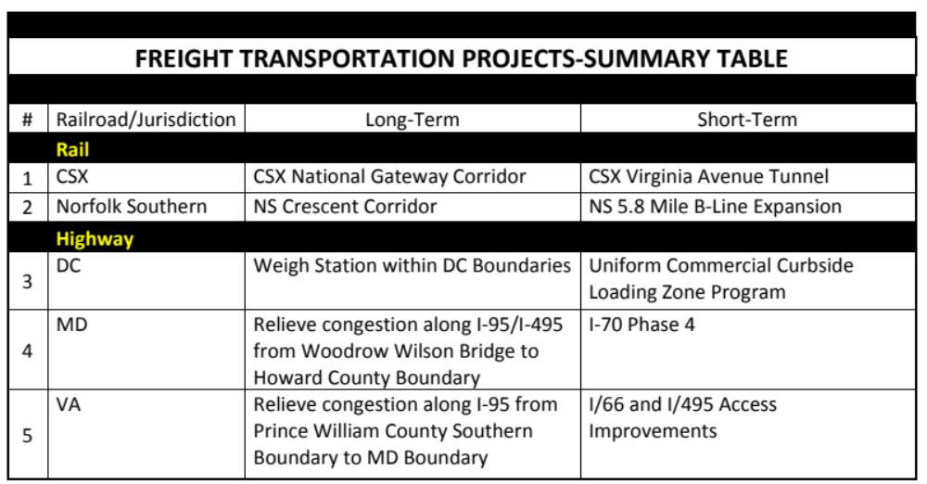
Example: Top 10 Freight Projects, 2011
~ One way the National Capital Region TPB can champion freight projects ~

Slide 10
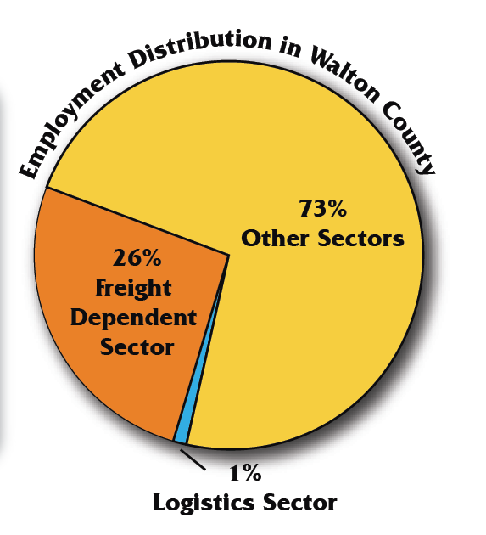
Upcoming Freight Initiatives
TPB Freight Around the Region project, underway
  Reveal the unique freight story of each of our jurisdictions
    Identify traditional freight assets
    Jobs in transportation/freight-dependent sectors
    How much contribution does this sector make to our local economies?
Top 10 Freight Projects, spring 2013
Freight Plan update, fall 2013

Slide 11
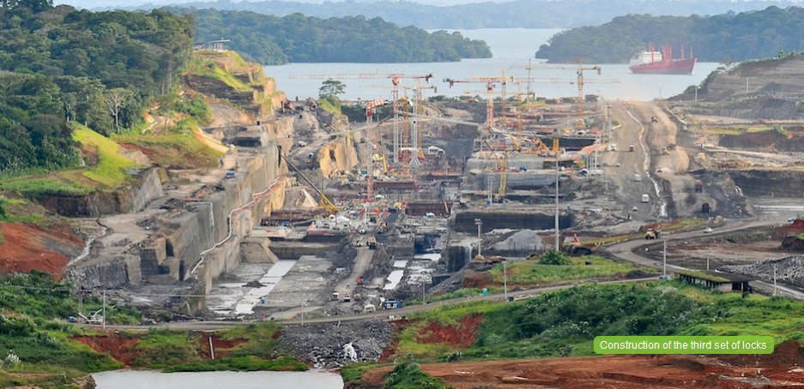


Trending Freight Topics
Panama Canal expansion 2014 (Ports race to be Panmax ready)
Growth in domestic fuel production (Bakken Shale in ND)
Supply chain risk (Weather, political stability, product theft, counterfeits)
Relocation of manufacturing to the US/nearby
E-commerce globally (Changing consumer/lifestyle trends/changing traffic)
Notes:
CSX Intermodal Terminal being built in Baltimore City
Dredging

Slide 12
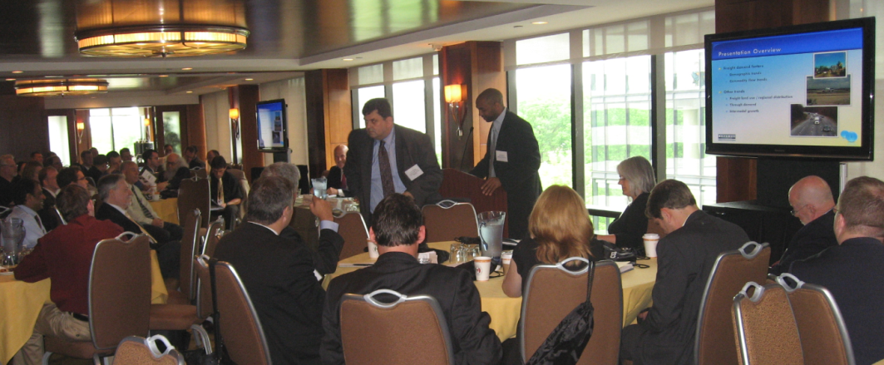
Karin Foster
Transportation Planner
Metropolitan Washington Council of Governments
National Capital Region Transportation Planning Board
March 14, 2013 kfoster@mwcog.org www.mwcog.org/freight
Thank You
Questions?

