Slide 1
EPA’s New Fine Particle Standard
&
Metropolitan Washington Region
Item #3
Sunil Kumar
MWAQC, December 18, 2012
MWCOG

Slide 2
New Fine Particle (PM2.5) Standard
December 14, 2012 - EPA announced a new PM2.5 standard
PM2.5 Standards
  Annual Standard - Revised from 15.0 µg/m³ (1997) to 12.0 µg/m³
  Daily (24-Hour) Standard – Retained existing 35 µg/m³ (2006)
Attainment/nonattainment designations - December 2014
  Designations likely effective from early 2015
Attainment date – 2020 (5 years after effective designation date)
Notes:
Revision based on
A number of scientific studies
Analysis by EPA experts
Input from Clean Air Scientific Advisory Committee (CASAC)
Public comments

Slide 3
Why Did EPA Make PM2.5 Standard Tighter ?
Multiple studies - negative health impacts at lower levels than previously understood
Chronic bronchitis, Asthma attacks
Respiratory symptoms (cough, wheezing, etc.), Decreased lung function
Heart attack, Cardiac arrhythmia, Changes in heart rate and heart rate variability
Premature death
Prevention of 40,000 premature deaths, 32,000 hospital admissions , 4.7 million days of work lost due to illness from diesel vehicle & equipment control measures alone
Reduced hospital admissions, treatment cost , and loss of work hours will lead to benefits of $4b-$9b per year
Notes:
Return of $12 to $171 for every dollar invested in pollution reduction

Slide 4
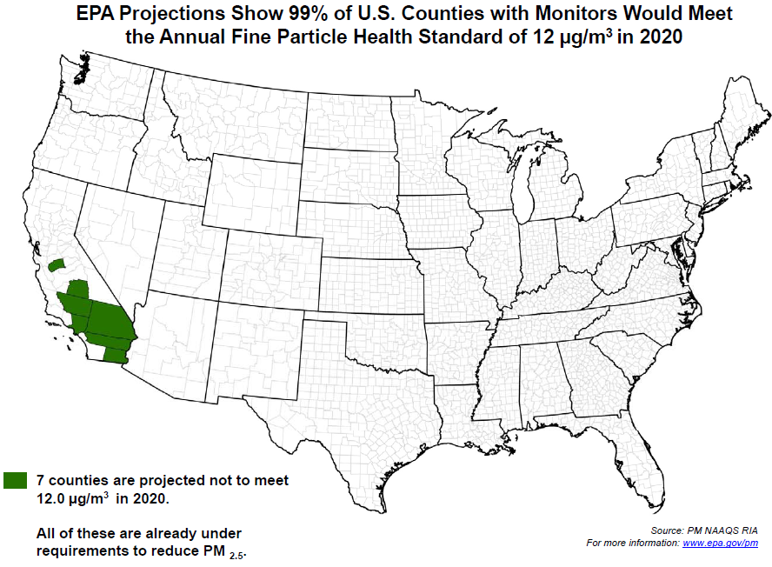
EPA Projections for PM2.5 Attainment in 2020
Notes:
Revision based on
A number of scientific studies
Analysis by EPA experts
Input from Clean Air Scientific Advisory Committee (CASAC)
Public comments

Slide 5
Implementation of New PM2.5 Standard
Requirements for near-roadway monitoring of PM2.5 at one location in Washington region
  Existing monitor can be relocated to meet this requirement
EPA revised Air Quality Index (AQI) to be consistent with new standard
Notes:
Revision based on
A number of scientific studies
Analysis by EPA experts
Input from Clean Air Scientific Advisory Committee (CASAC)
Public comments

Slide 6
Annual PM_{2.5} Design Value Trend

Slide 7
24-Hour PM_{2.5} Design Value Trend

Slide 8
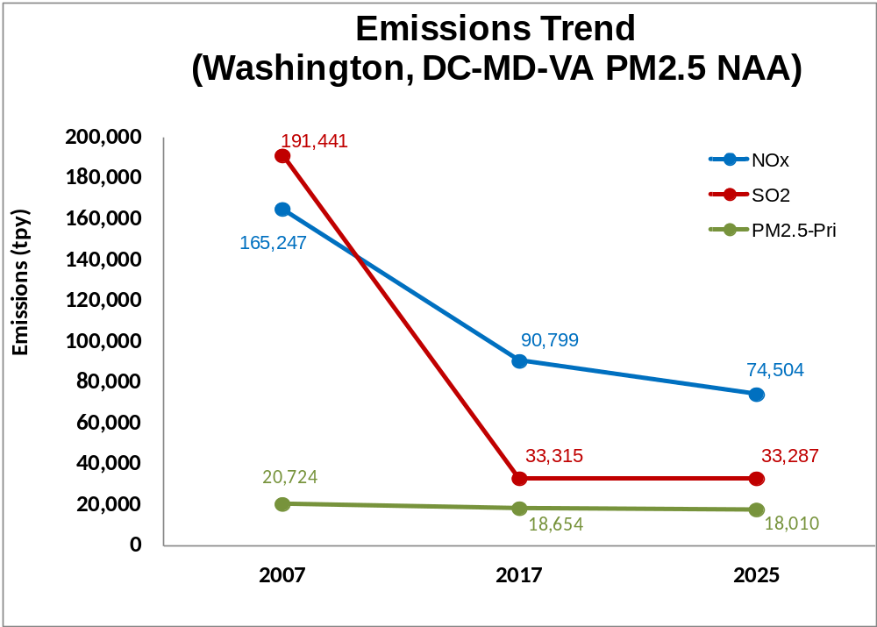
Emissions Trends, NOx, SO2, PM2.5
(2007-2025)

Slide 9
New PM2.5 Standard & PM2.5 Maintenance Plan
Washington region scheduled shortly to submit PM2.5 Maintenance Plan for 1997 annual PM2.5 standard (15.0 µg/m³)
Maintenance Plan demonstrates continued attainment in future years of
  Annual PM2.5 Standard - 15.0 µg/m³ (1997)
  24-Hour PM2.5 Standard - 35 µg/m³ (2006)
Current downward PM2.5 design value and emissions trends show likely continued attainment of
  Revised annual (12.0 µg/m³ ), and
  Existing 24-hour (35 µg/m³ ) standards

Slide 10
Conclusion
  New PM2.5 Standard improves public health
  Metro. Washington region is already below the new standard (meets the tighter standard)
  Metro. Washington region expects to be in attainment of the new standard in 2020 and beyond.

