Slide 1


Slide 2
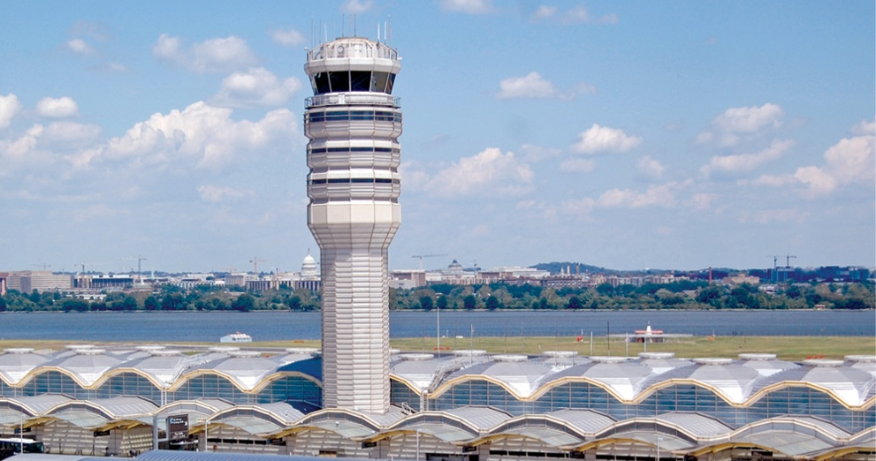
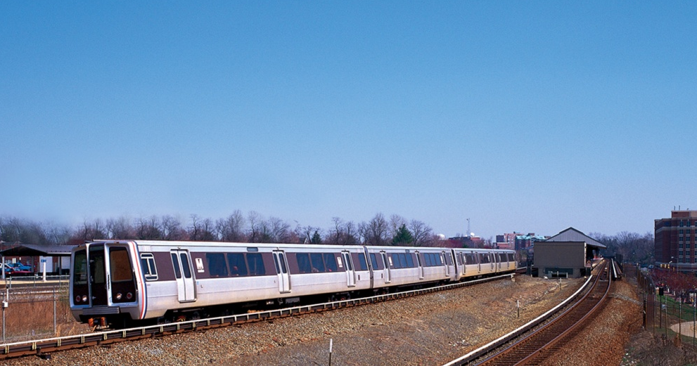
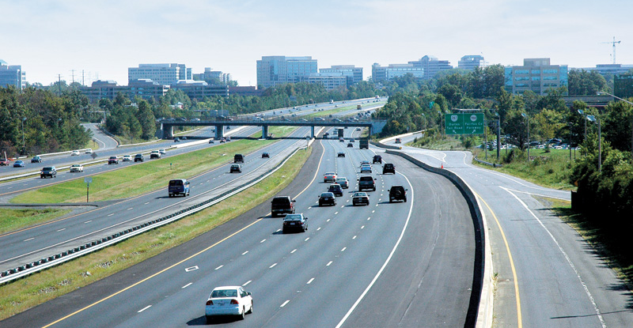

M E T R O P O L I T A N W A S H I N G T O N A I R P O R T S A U T H O R I T Y
Metropolitan Washington
Council of Governments – Board of Directors Briefing
Mark Treadaway, Vice President, Air Service Planning & Development
May 9, 2012
Ronald Reagan Washington National Airport
Dulles Corridor Metrorail Project
Dulles Toll Road
Washington Dulles International Airport

Slide 3
Total Impact of Aviation Activities
Total Job Impact
MSA – 311,000 jobs and $13.9 billion in labor income.
VA – 196,810 jobs, $8.4 billion in labor income.
DC – 74,830 jobs, $3.6 billion in labor income
MD – 47,330 jobs, $2.2 billion in labor income
Benchmark: Total Employment
MSA: 3.2M; VA: 3.9M; DC: 0.8M; MD: 2.5M

Slide 4

M E T R O P O L I T A N W A S H I N G T O N A I R P O R T S A U T H O R I T Y
Washington Dulles International Airport
The Capital Region’s World Gateway
4

Slide 5
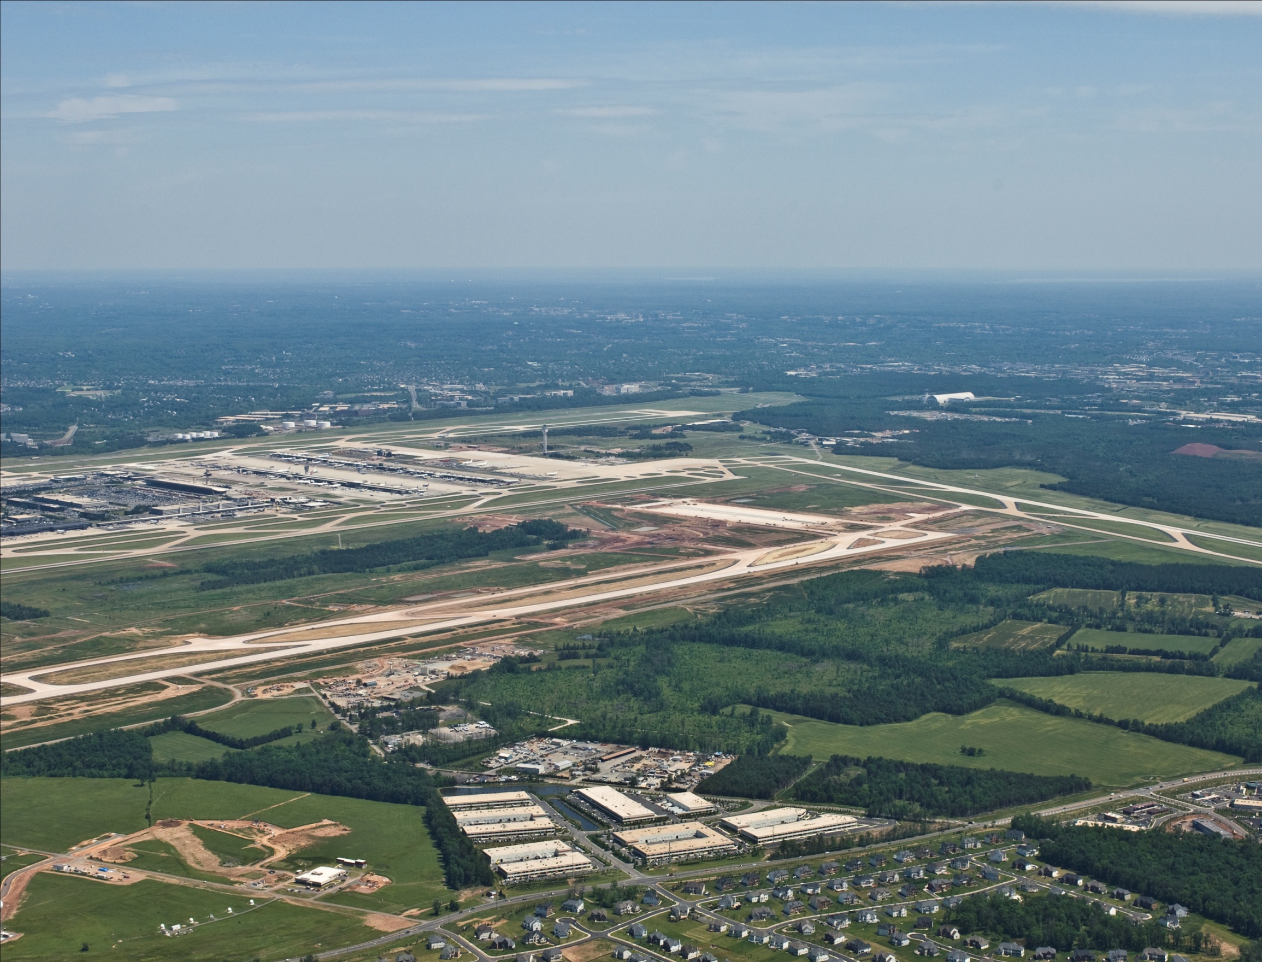
Dulles International is the Only East Coast Gateway with Significant Room for Expansion
5

Slide 6

Dulles International Infrastructure
M E T R O P O L I T A N W A S H I N G T O N A I R P O R T S A U T H O R I T Y
11,830 acres
Four Runways
    Two 11,500 feet
    One 10,500 feet
    One 9,400 feet
CAT III Certified
24-Hour Operations
U.S. Customs and Border Protection
140 Airline Gates
Cargo Ramp
    1 million sq. feet
Warehouse Space
    500,000 sq. feet in 7 cargo buildings
Leading Global Freight Forwarders
and Ground Handling Companies
6

Slide 7
Domestic and International Passenger Traffic Grew
Unevenly at Dulles International in 2011
International Traffic Hit a New Record While Domestic Traffic Declined
Total Passengers at Dulles International (in millions)
27.1
24.7
23.8
23.8
23.2
22.9
23.0
23.2
19.8
20.1
18.0
17.2
17.0
Passengers (millions)
Source: Metropolitan Washington Airports Authority, 2011
7

Slide 8
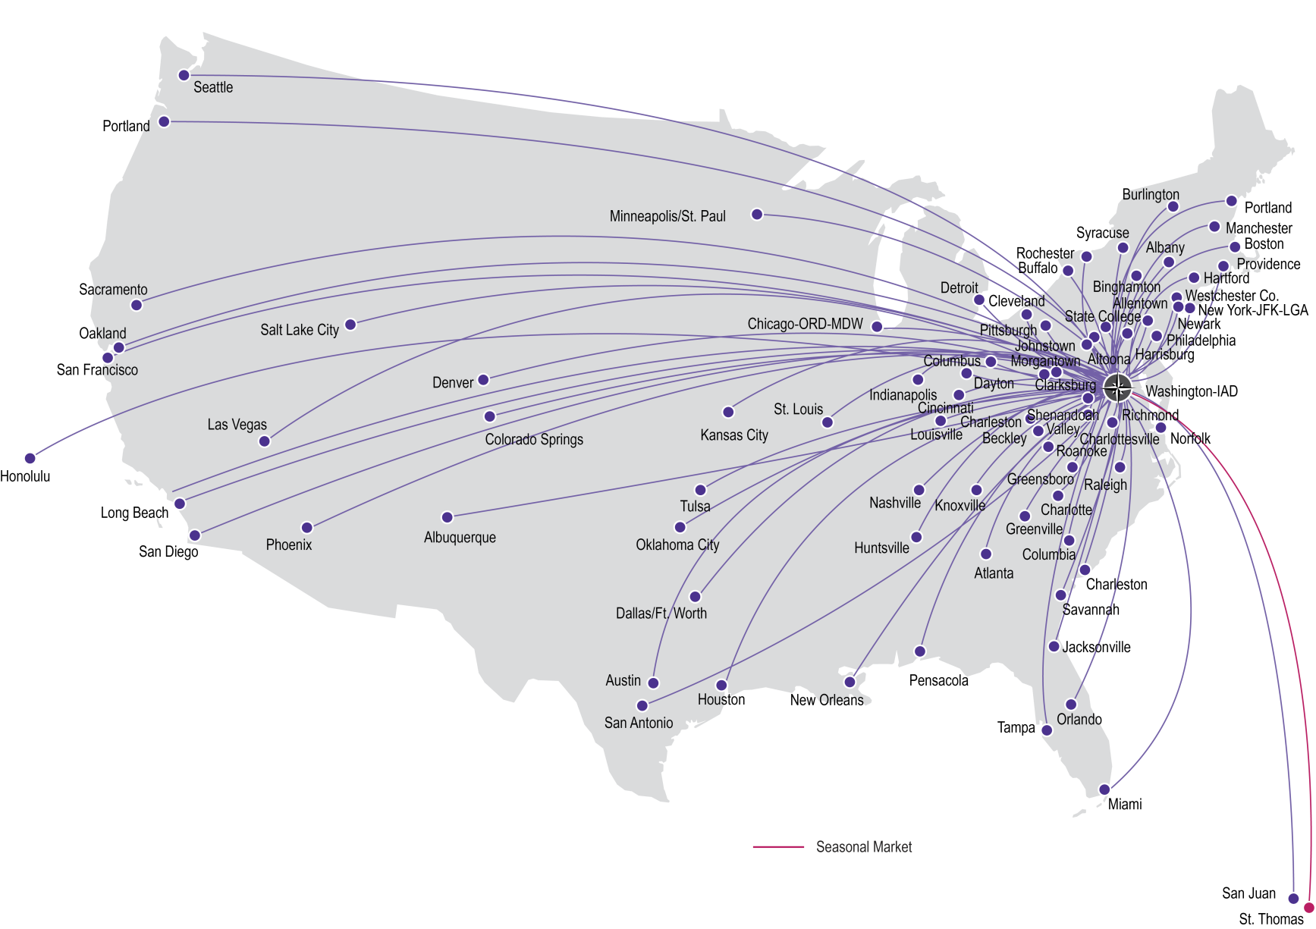
Domestic Nonstop Service at Washington Dulles
Domestic U.S.
83 Destinations
7 Carriers
319 Daily Departures
Source: OAG, June 15-21, 2012

Slide 9
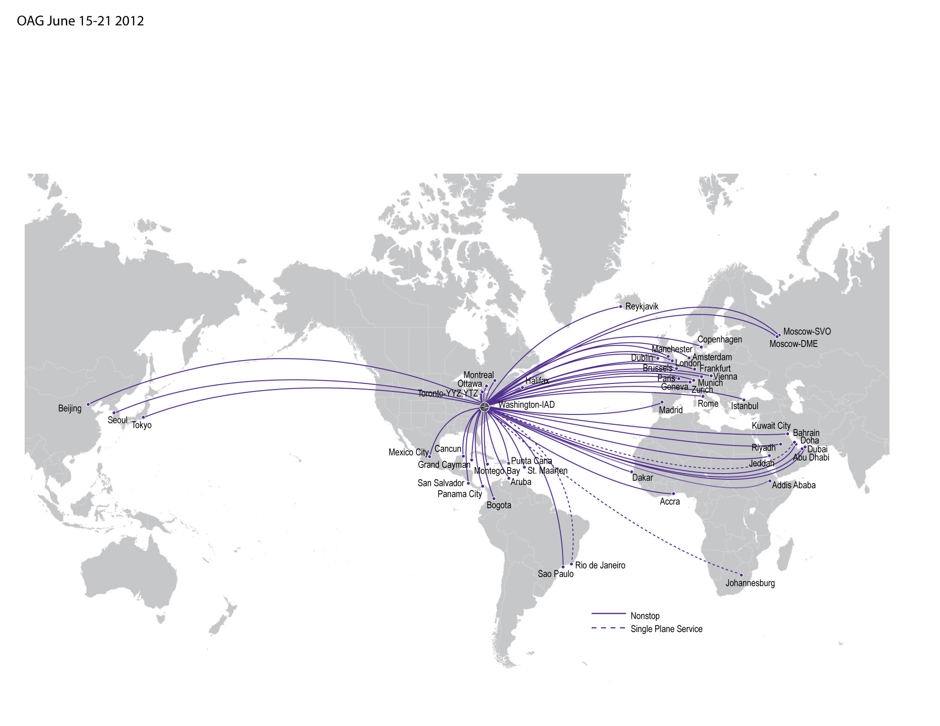
International Air Service at Washington Dulles
Abu Dhabi
Accra
Addis Ababa
Amsterdam
Aruba
Bahrain
Beijing
Bogota
Brussels
Cancun
Copenhagen
Dakar
Doha
Dubai
Dublin
Frankfurt
Geneva
Grand Cayman
Halifax
Istanbul
Jeddah
Johannesburg
Kuwait City
London
Madrid
Manchester
Mexico City
Montego Bay
Montréal
Moscow-DME
Moscow-SVO
Munich
Ottawa
Panama City
Paris
Punta Cana
Reykjavik
Rio de Janeiro
Riyadh
Rome
San Salvador
São Paulo
Seoul
St. Maarten
Tokyo
Toronto-YTZ
Toronto-YYZ
Vienna
Zürich
International
49 Destinations
24 Carriers
495 Weekly Departures
Airlines
Aeroflot
AeroMexico
Air France
ANA
Austrian
Avianca/TACA
British Airways
Cayman Airways
COPA
Emirates
Ethiopian
Etihad
Icelandair
KLM
Korean Air
Lufthansa
Porter
Qatar Airways
SAS
Saudi Arabian
South African
Turkish
United
Virgin Atlantic
Red denotes new airlines, new destinations, or airlines with new service.
Notes:
1. United service to Doha via Dubai starts April 30, 2012.
2. Emirates begins new daily service to Dubai on Sep 12, 2012.
3. Etihad has announce to launch daily nonstop service to Abu Dhabi on March 31, 2013, subject to regulatory approvals.
Source: OAG, June 15-21, 2012

Slide 10
Reagan National
Growth only through slot exemptions from US Federal Government
Facility constrained growth
Limited new outside perimeter flights as a result of recent congressional action

Slide 11




Air Service Outreach
Cooperative Promotional Programs
Cooperative work environment
Economic Development Agencies
Tourism Development

Slide 12


Slide 13
Air Cargo is Forecasted to Grow
M E T R O P O L I T A N W A S H I N G T O N A I R P O R T S A U T H O R I T Y
Based on World Average Annual Growth Rate Projected By Boeing 2009 - 2029
Total Cargo Tonnage
Source: Boeing World Air Cargo Forecast 2010 – 2011

Slide 14
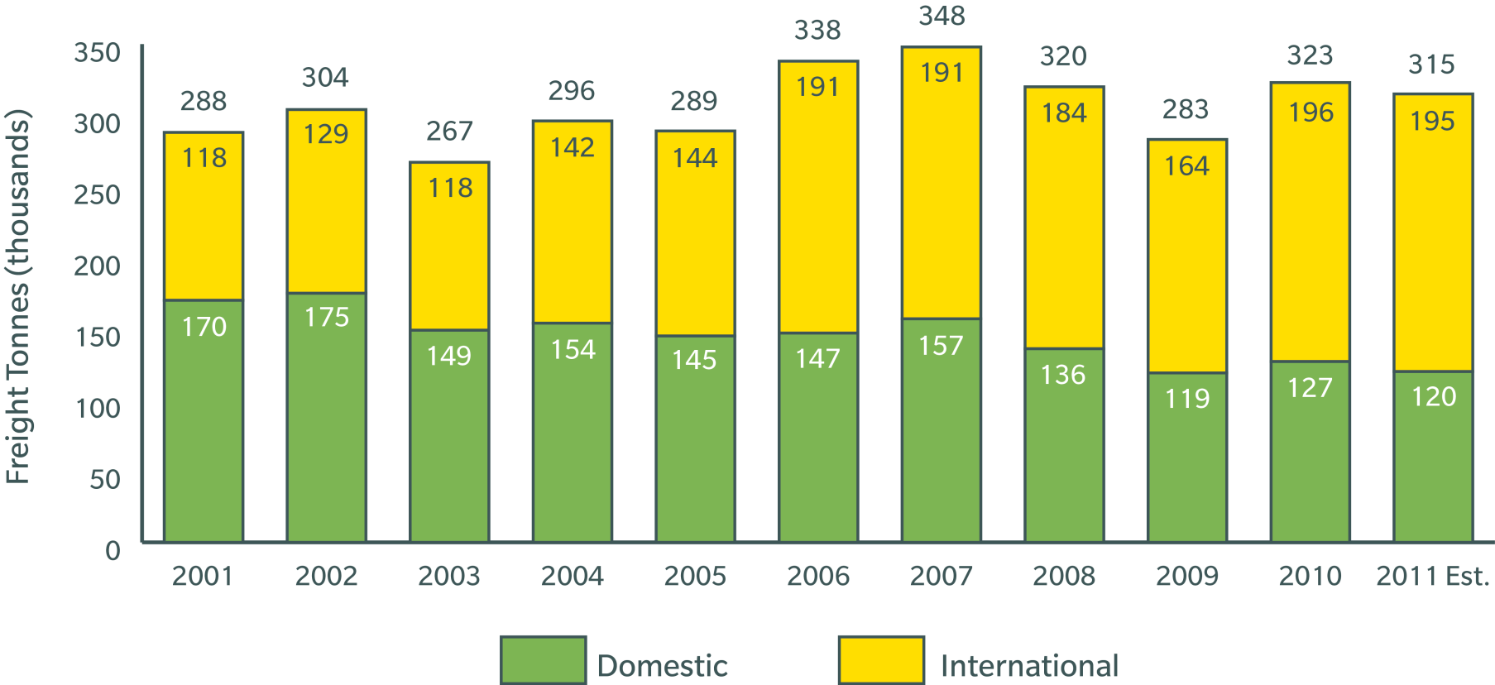
Air Cargo at Dulles International
Coming Off a Strong 2010 Which Boosted Traffic Above Pre-Recession Levels,
Air Cargo Tonnage Receded in 2011, Although International Cargo Remained Relatively Steady
M E T R O P O L I T A N W A S H I N G T O N A I R P O R T S A U T H O R I T Y
Dulles International Freight Excluding Mail
Source: Metropolitan Washington Airports Authority
14

Slide 15
Marketing Dulles International’s Cargo Advantages
M E T R O P O L I T A N W A S H I N G T O N A I R P O R T S A U T H O R I T Y
Cost advantages
World-class facilities
Cooperative work environment (Economic Development Agencies)
Cooperative Promotional Program for airlines
Catchment area which covers entire east coast within one-day drive, combined with extensive nonstop international network
Freighter Incentive Program

Slide 16
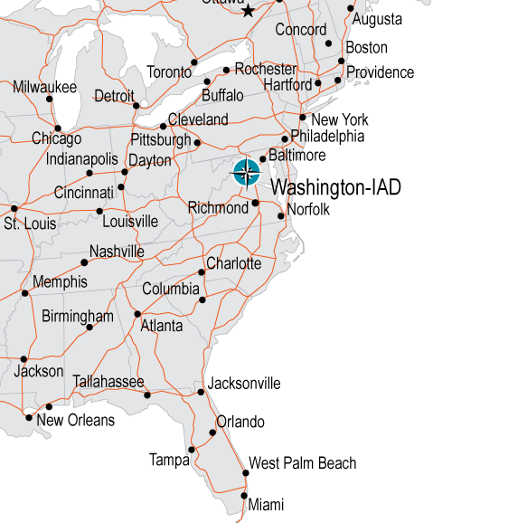
The Dulles Air Cargo Catchment Area Covers
25 States and Canada with Next Day Service
M E T R O P O L I T A N W A S H I N G T O N A I R P O R T S A U T H O R I T Y
Dulles International is strategically located at the heart of the East Coast air cargo market
Based on RFS Schedules, Dulles serves
25 East Coast states and Canada in one day
From Dulles International, airlines will reach all major Eastern, Midwestern and Canadian markets overnight
Approximately 56% of the U.S. population resides in areas with overnight delivery from Dulles International
Transit Distance/Time
from Dulles International
Boston: 747 km 8:00 hours
New York: 401 km 5:00 hours
Atlanta: 1049 km 11:00 hours
Miami: 1731 km 16:25 hours
12-hour drive time map

Slide 17
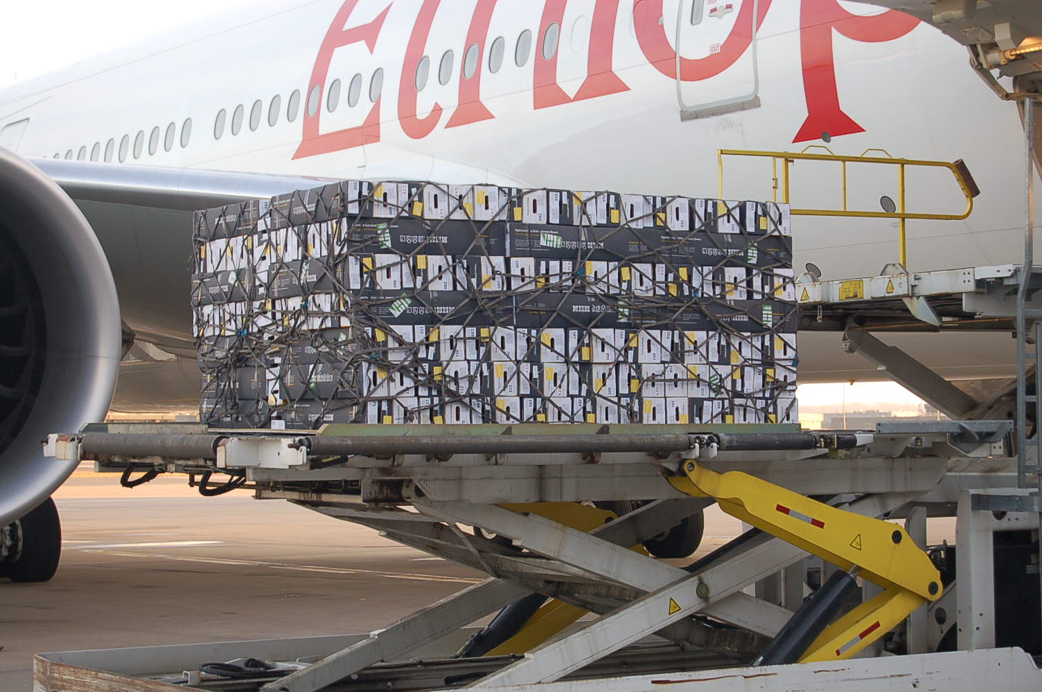
Cargo Success
Ethiopian Airlines unloads the first of many weekly flower shipments.
January 25, 2012

Slide 18
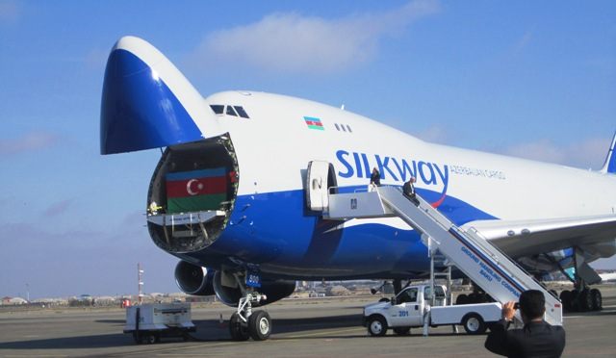
Cargo Success
Silk Way Airlines to operate B747F two times per week in early 2013

Slide 19

Dulles International is not an island.
Multi-Modal Transportation insures being intrinsically linked to the global marketplace.
M E T R O P O L I T A N W A S H I N G T O N A I R P O R T S A U T H O R I T Y

Slide 20
What Can COG and the Region Do?
Support tourism initiatives through the US Travel Association
  Visa Waiver expansion
  Improved Customs experience
Support improved airport access and intermodality
  Road Access
  Rail to Dulles and Loudoun County

Slide 21

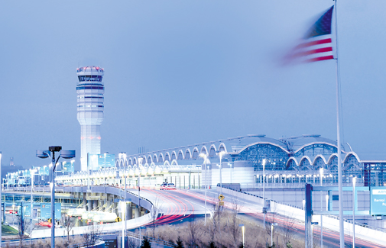
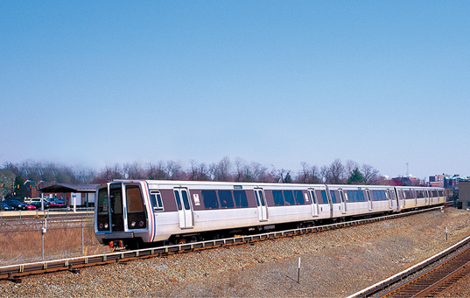

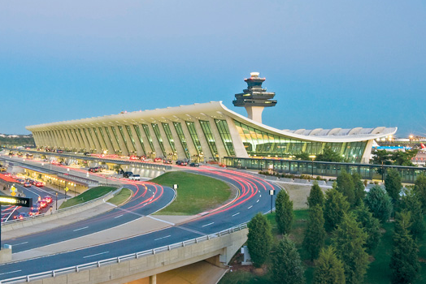
Ronald Reagan Washington National Airport
Dulles Corridor Metrorail Project
Dulles Toll Road
Washington Dulles International Airport

