Slide 1

COG Activity Center Update
Climate, Energy, & Environment Policy Committee
May 23rd, 2012

Slide 2
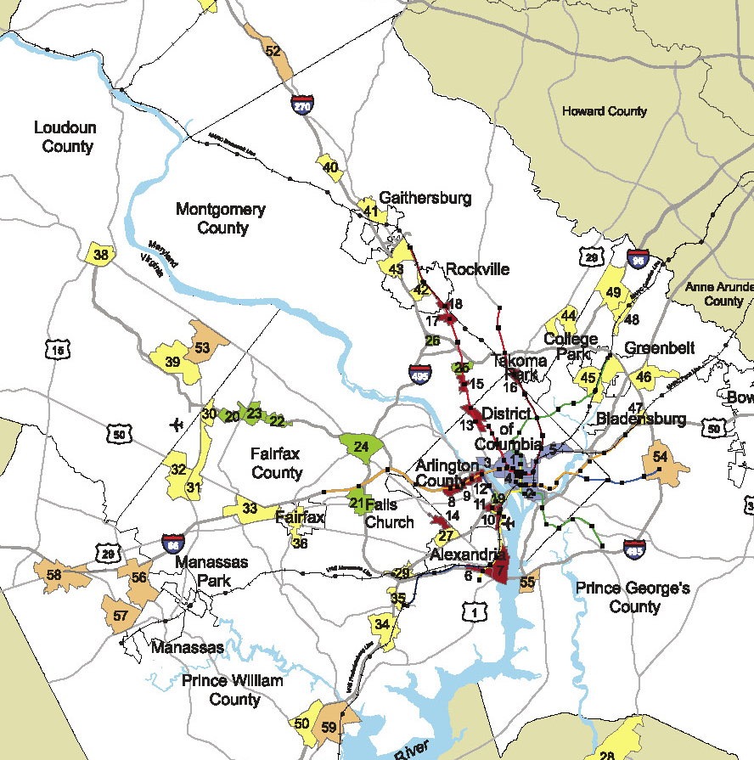
Activity Centers 101
Past – Technical Exercise
Technical exercise looking at where growth is expected
Based strictly on COG’s Cooperative Forecasting Results
Scenario/Analysis Tool for Transportation Planning Board
Notes:
Activity Centers include areas that are significant now as well as priority growth areas that will be in the future.
Done at regional level, indicates regional consensus around priority growth areas.
Perception that they may lead to opportunities for federal funding.
With RF in place, core of implementation strategy.
In the past, based on Coop. Forecasting results – would be designated a center if you met the threshold for future employment. Jobs/acre – encourages large centers.
Used mainly for technical purposes: transportation planning, air quality conformity
This approach didn’t always reflect the places local governments through were most significant so didn’t have full buy in
2

Slide 3
Activity Centers 101
Now – Technical and Policy Tool
Existing urban centers or priority growth areas
Spatial component of Region Forward
Decision tool for local governments, businesses, nonprofits, and other stakeholders to “think regionally and act locally”
Notes:
Centers are spatial component of RF, and many targets reference centers
RF impetus for rethinking the way we identify centers
COG Board instructed RFC to update centers, to be able to use centers as a policy tool
3

Slide 4
Why Update the Map?
Align with local planning
Align with Region Forward
  Spatial component of the plan
  Focus growth and investment to centers
  Provide better connectivity within and between centers
Living Process – 3rd Update in 11 Years
Notes:
Need to align local and regional planning
Centers need to reflect RF priorities; previous process didn’t always do this (e.g. many centers not served by transit)
Provide an example of the living process, centers that may show up in the future.
4

Slide 5
Key Questions
How can we use the updated Activity Centers in new ways to implement Region Forward targets? What are possible applications for:
  Affordable Housing
  Economic Development
  Transportation
  Public Health
How can you use the updated Activity Centers in your work?
Notes:
Here are the key questions we’re going to discuss at end of the presentation.
Can reference Complete Communities concept – this is about place-making
Examples:
-Making sure that our centers with major job concentrations (e.g. R-B Corridor, NoMA) also provide places for people, including lower-income workers, to live, and the services to support that
-On eastern side of region, many of centers have market affordable housing, but lack the range of services – retail, grocery
-On western side of region, many centers have large job concentrations, but lack adequate workforce and affordable housing
-Centers may be good places to concentrate stormwater mgmt and energy efficiency features – economies of scale
-Making sure that new investment in transit network and station areas doesn’t displace residents and small businesses
-Making sure that transportation network and new investments are fully utilized – concentrating jobs and housing around stations and corridors to increase ridership
5

Slide 6
Activity Center Update Process
Notes:
Introduce Activities
6

Slide 7
Step One (Policy):
Identify Activity Centers
Progress to-date:
Developed draft guidelines (attribute menu)
Gathered input from Planning Directors Technical Advisory Committee
Analyzed local plans and results for each jurisdiction, and met one-on-one to present results and get feedback
Developed draft Activity Centers map
Notes:
Going to walk through centers update process – 2 part process
First, is getting consensus on where the centers are in region
Developing guidelines a very iterative process – have modified based on feedback from Planning Directors
Start by getting dots on the map – not concerned with boundaries yet – ½ mile radius
Looked individually at how our proposed criteria would affect each jurisdiction – centers that would result
Then we held one-on-one meetings with each of our jurisdictions to present these results, hear about what’s happening locally and get feedback on things that need to be modified
Incorporated those changes, and now have a draft Activity Centers map
Next – begin working on establishing boundaries so we can continue to use the centers for technical purposes – transportation analysis zones, census tracts, etc.
7

Slide 8
Step Two (Technical):
Develop Technical Boundaries
Establish analysis geographies (TAZs, Census tracts, etc.)
Notes:
Going to walk through centers update process – 2 part process
First, is getting consensus on where the centers are in region
Developing guidelines a very iterative process – have modified based on feedback from Planning Directors
Start by getting dots on the map – not concerned with boundaries yet – ½ mile radius
Looked individually at how our proposed criteria would affect each jurisdiction – centers that would result
Then we held one-on-one meetings with each of our jurisdictions to present these results, hear about what’s happening locally and get feedback on things that need to be modified
Incorporated those changes, and now have a draft Activity Centers map
Next – begin working on establishing boundaries so we can continue to use the centers for technical purposes – transportation analysis zones, census tracts, etc.
8

Slide 9
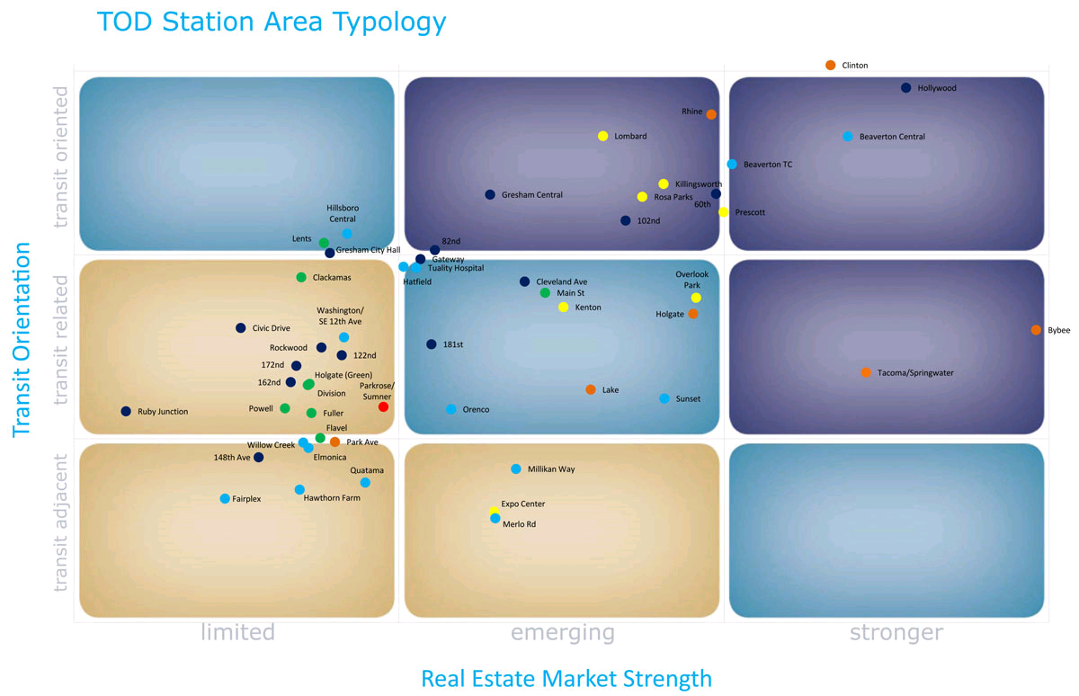
Step Two:
Create Implementation Tools for Activity Centers
High
Infill/Enhance
Catalyze and Connect
Moderate
Physical Characteristics
Plan and Partner
Low
Limited
Emerging
Stronger
Real Estate Market Strength
Notes:
Second step in this process is turning these centers into tool to implement RF goals –
In this step we will be developing tools to assess each center:
Analyze physical characteristics and market strength of centers
Identify place types based on shared characteristics
Develop economic development strategies for each place type to guide investment in Activity Centers
Harriet will be talking about this later in the meeting
9

Slide 10
Schedule
June: PDTAC approval of Activity Centers
June – July: COG staff works with PDTAC to develop analysis geographies
July: Region Forward Coalition Approval
July: Introduce Activity Centers to COG Board at retreat
Late Summer: Launch typology work
Fall: COG Board approval of Activity Centers
Notes:
10

Slide 11
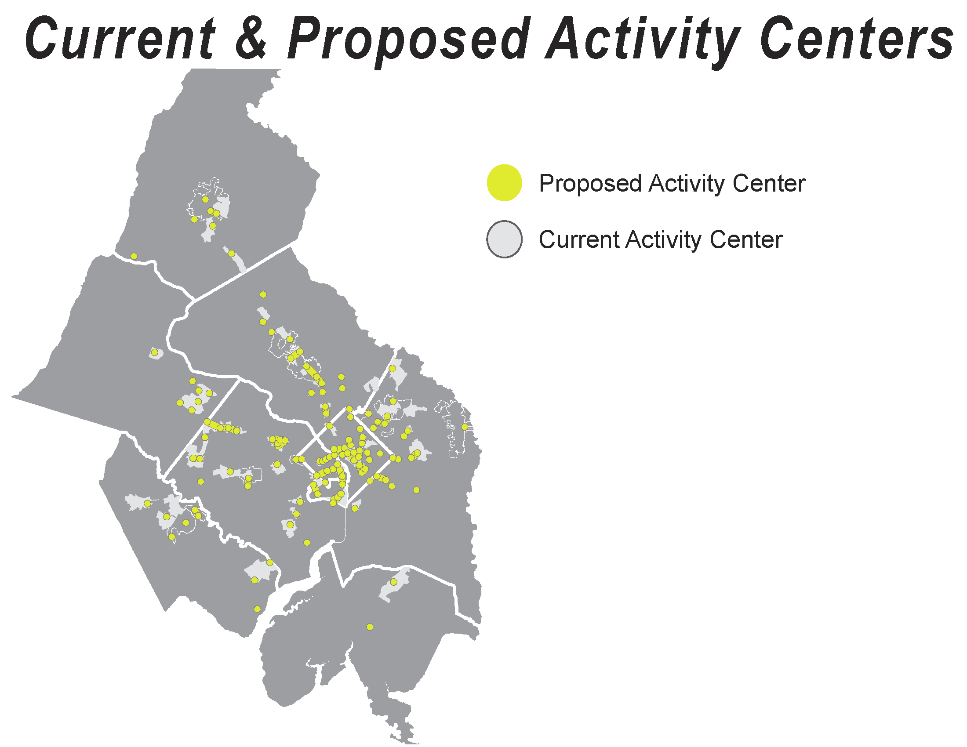
Notes:
This is what we’ve come up with
Can see the centers in greater detail in your packets

Slide 12
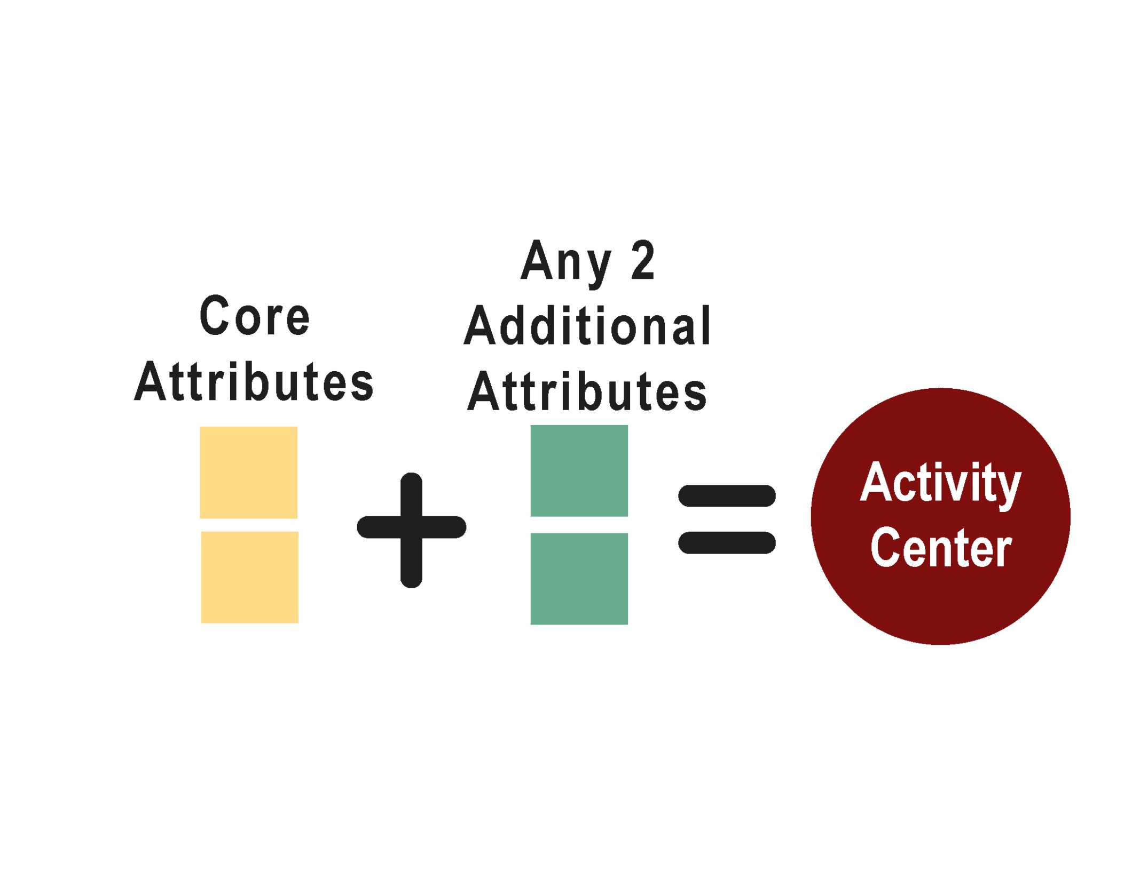
Menu of Options to Identify Centers
Notes:
Hybrid Approach – Policy and Analytical
Provides flexibility – the attributes work as a system
12

Slide 13
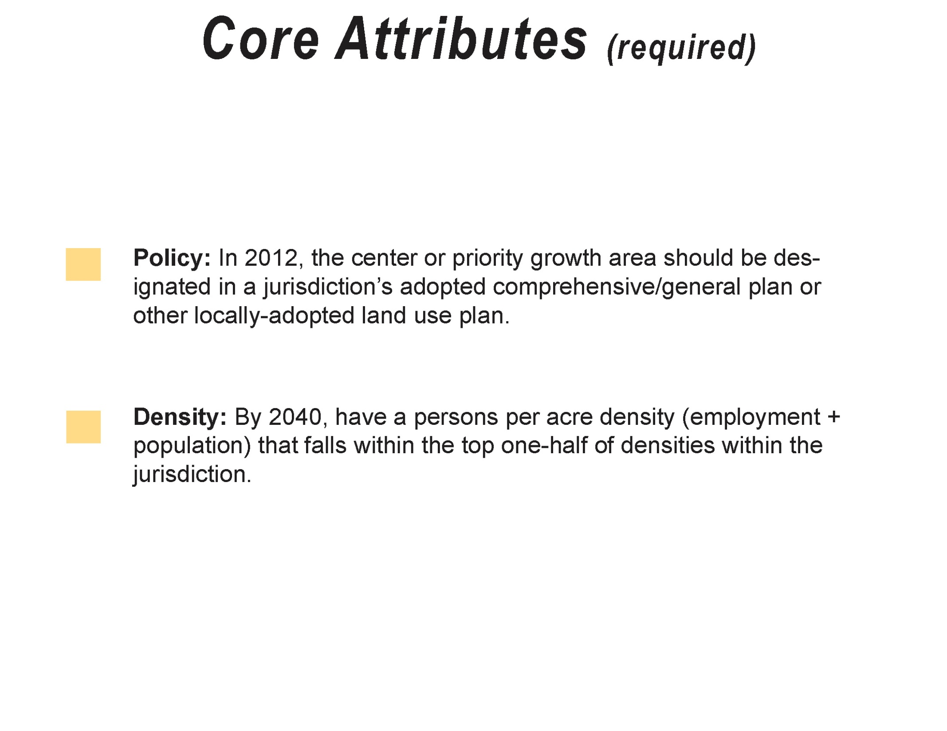
Notes:
About setting a floor/envelope for eligible areas
Locally-focused – captures what’s happening within the jurisdiction – comp plans, infrastructure, enviro protection areas
Policy-oriented
Mainly forward looking – so includes places that are significant now, and places that are planned to be in the future
13

Slide 14
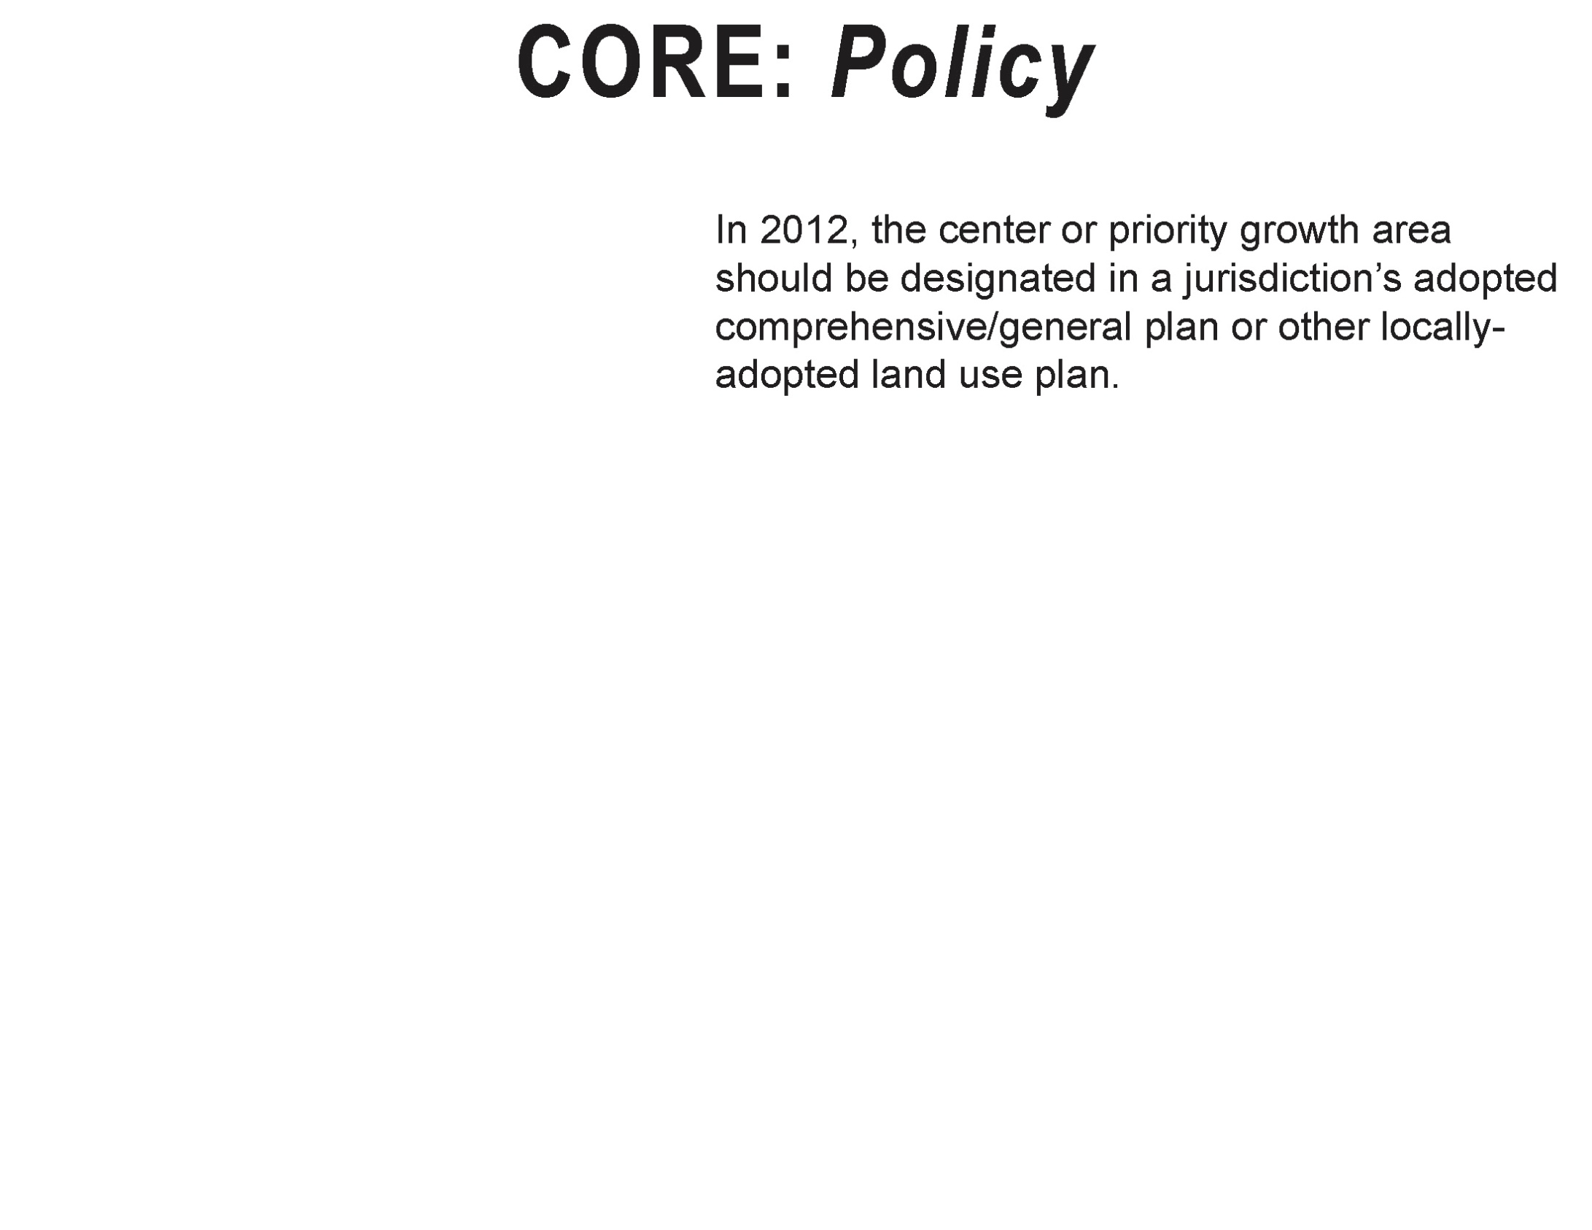
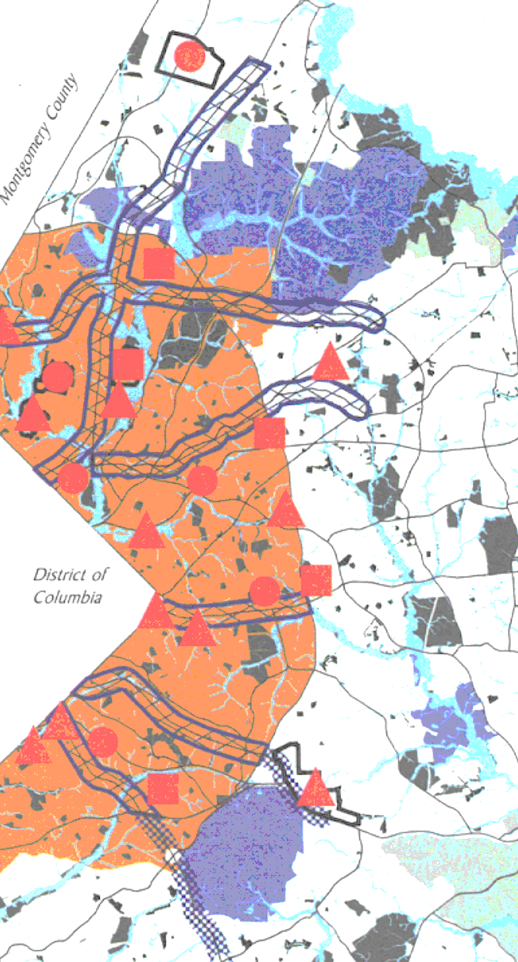
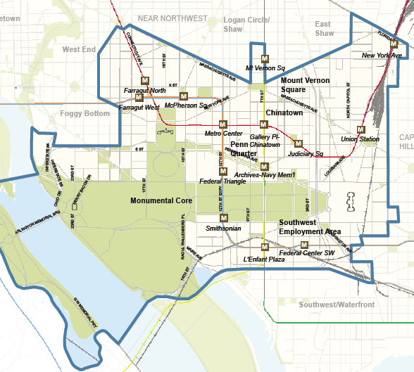
Notes:
In that past when centers were developed based solely on coop forecasts, we often didn’t get the buy-in we needed from all of the local government stakeholders – this time, most important to align centers with local plans
14

Slide 15
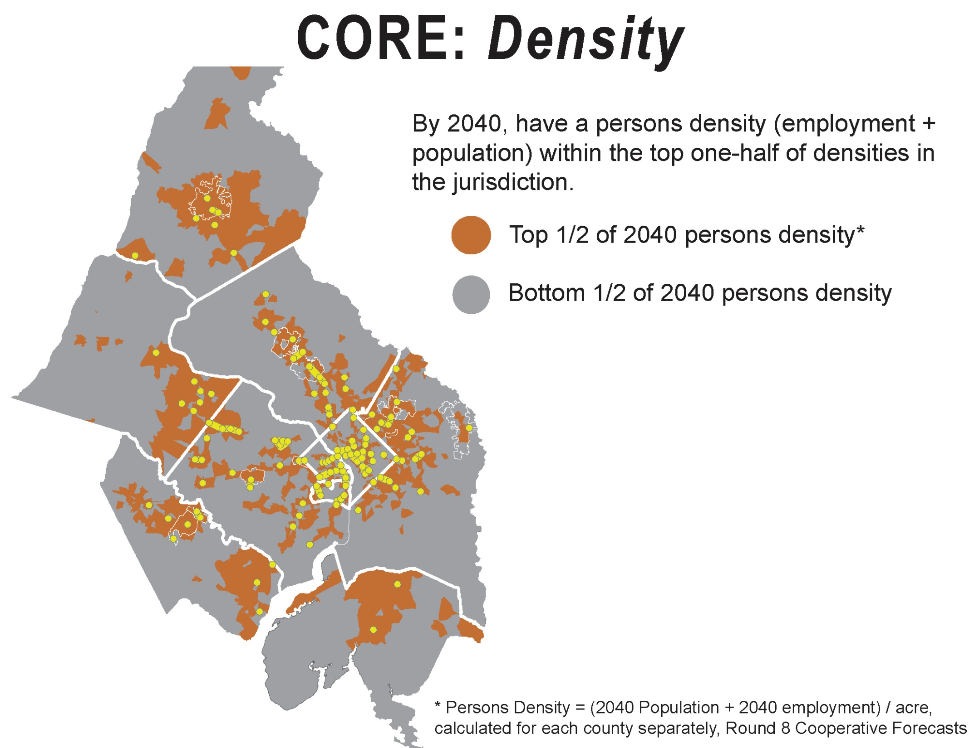
Notes:
Normalized by county
Eliminates very low density and environmentally sensitive/protected areas that jurisdictions don’t want developed
15

Slide 16
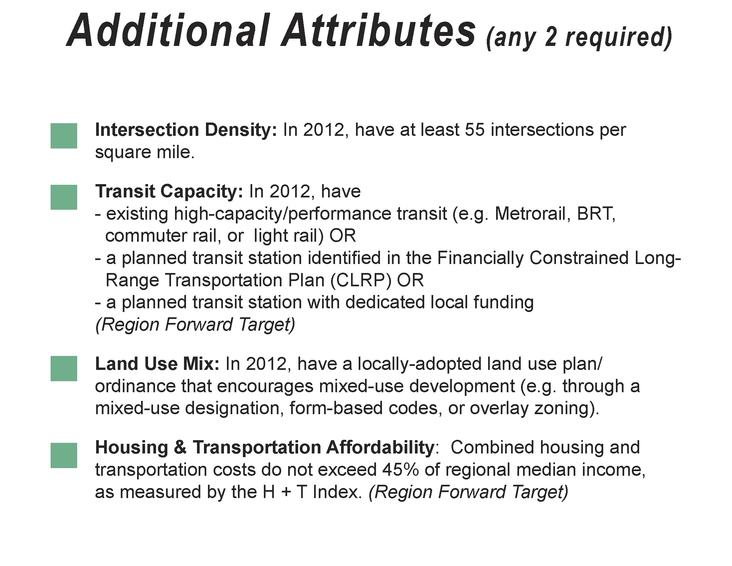
Notes:
Incorporates RF targets
16

Slide 17
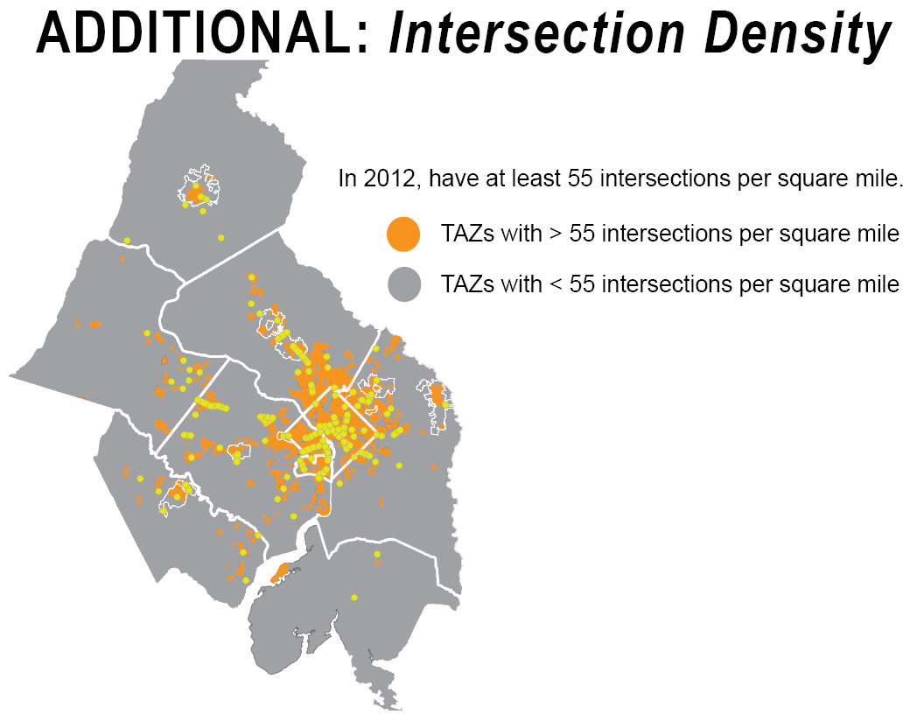
Notes:
Came from LEED-ND prerequisite
17

Slide 18
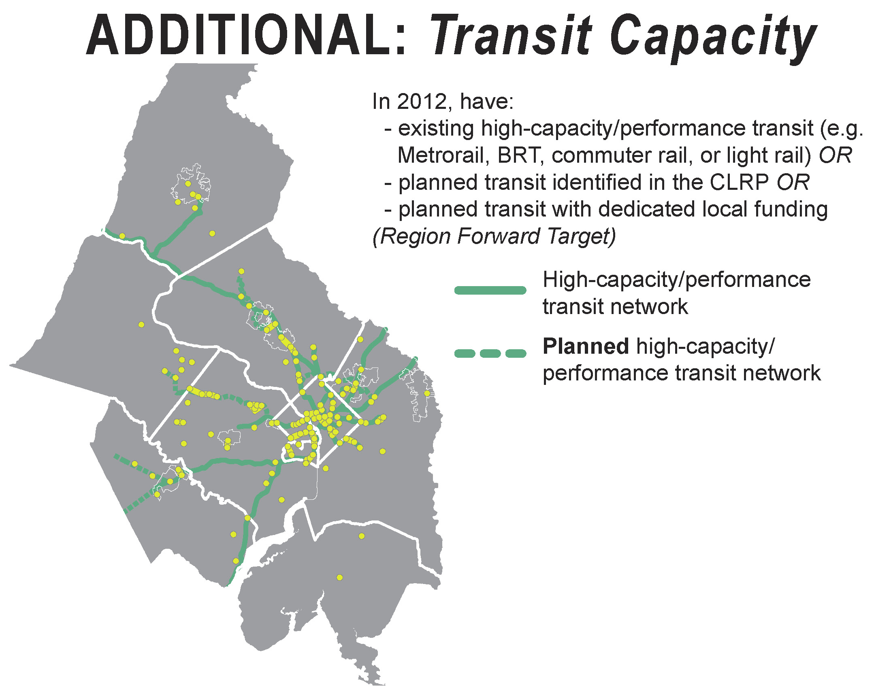
Notes:
18

Slide 19
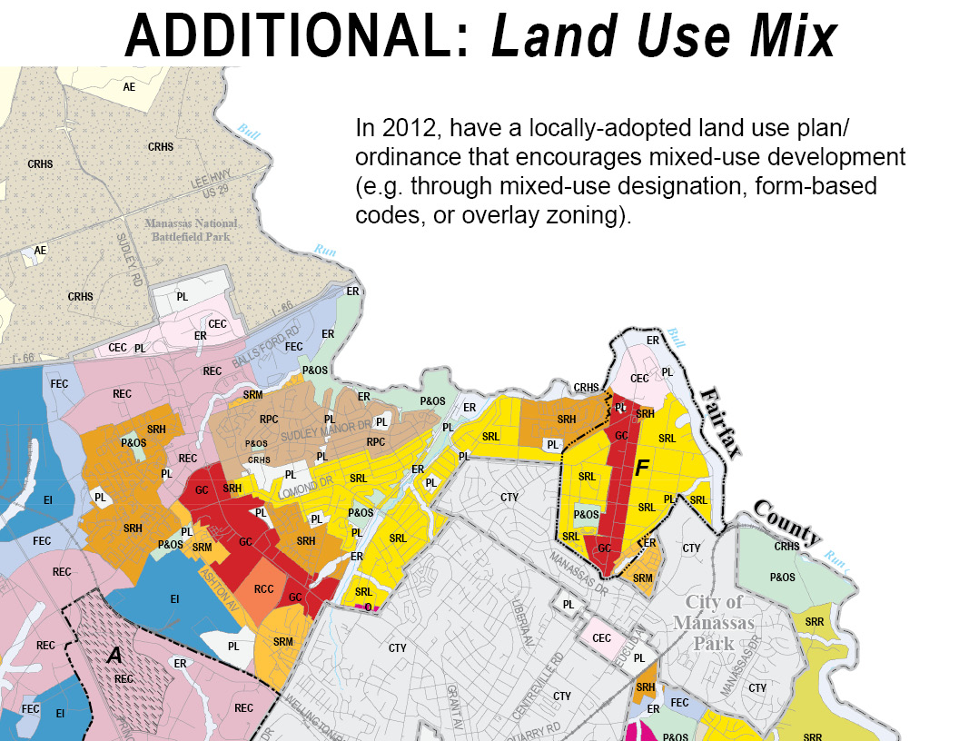
Notes:
In past, AC’s about concentrations of jobs, but activity centers should have a mix of activities – mix of uses so people are coming and going at different times of the day – about placemaking
19

Slide 20
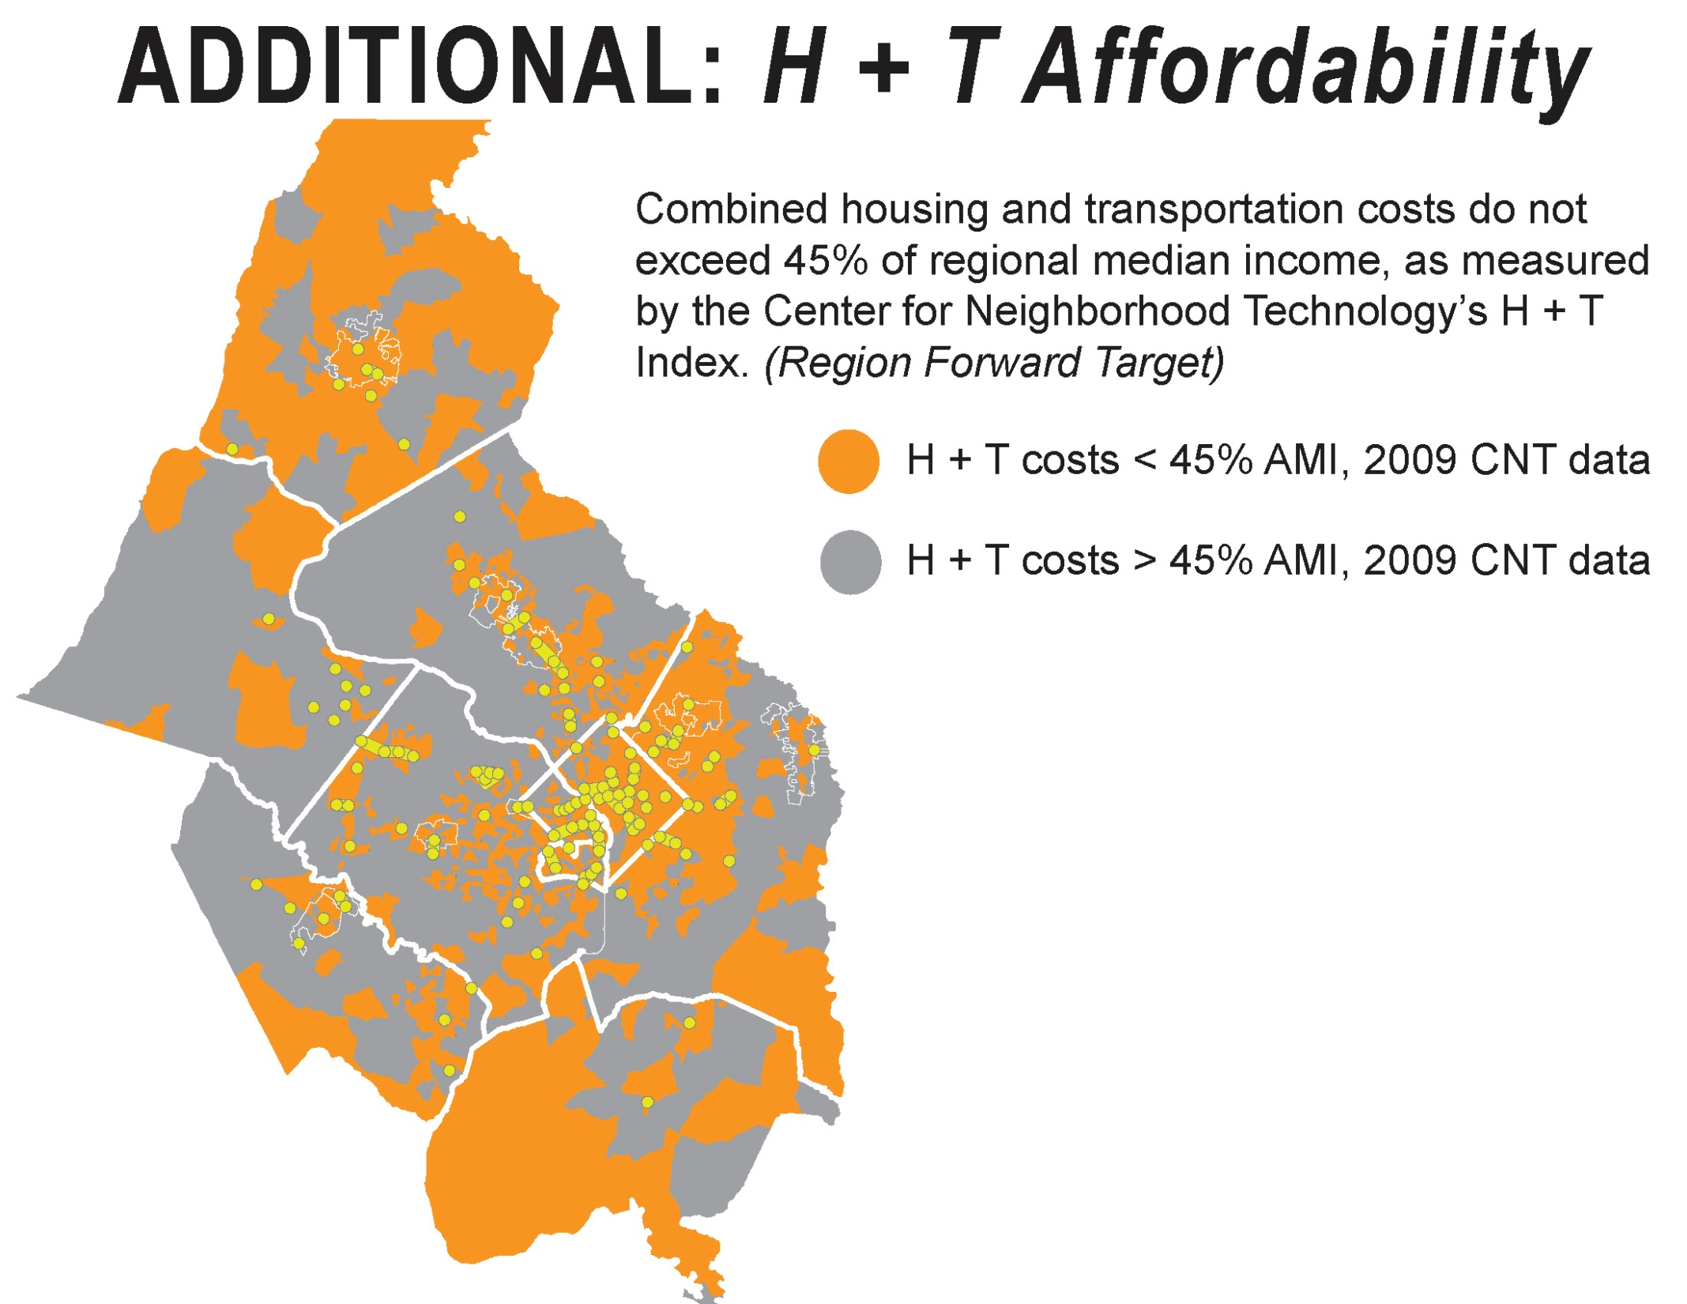
Notes:
20

Slide 21
Notes:
So we started looking first at locally identified centers, then applied the attributes, and this is where we are now

Slide 22
Key Outcomes
Aligned with Region Forward Elements
  Incorporates RF priorities in selection attributes and resulting centers
Aligned with Local Planning
  Picks up places local governments have designated as significant
Notes:
RF aspects of center selection: compact growth, efficient use of infrastructure, transit accessibility, H+T affordability, etc.
22

Slide 23
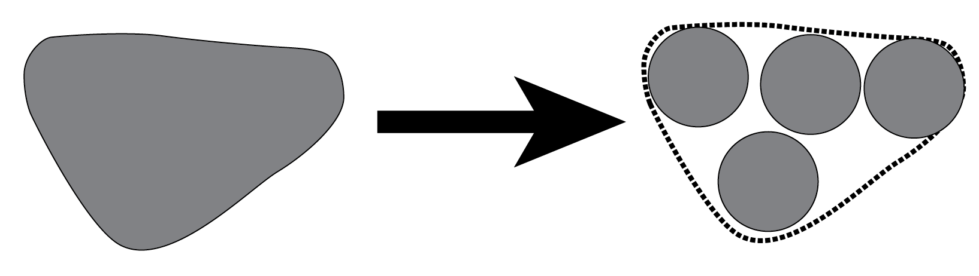
Key Outcomes
More, but Smaller Centers
  Current Centers: 59
  New Centers: 123 – occupy less land area than current centers
  Recognizes potential for wide range of places to contribute to regional goals
  Understand the building blocks of larger regional places
  Better scale for implementing Complete Communities
Notes:
Need to finalize boundaries, but not expanding the footprint of centers in the region – need to make centers concept applicable to the whole region
Smaller places with strong foundations to support future growth
Especially beneficial for implementation - Better scale for placemaking
23

Slide 24

Key Outcomes
Better Leverages Existing and Planned Infrastructure
  Current Centers:
  Many transit stations were not in centers
  40% of centers served by transit by 2040
  New Centers:
  70% of centers served by transit by 2040
Notes:
Many transit stations particularly on eastern side of the region were not located in centers and were underutilized – this brings many more stations into the centers
RF targets: All RACs will have transit accessibility, and transportation investment will link RACs
24

Slide 25
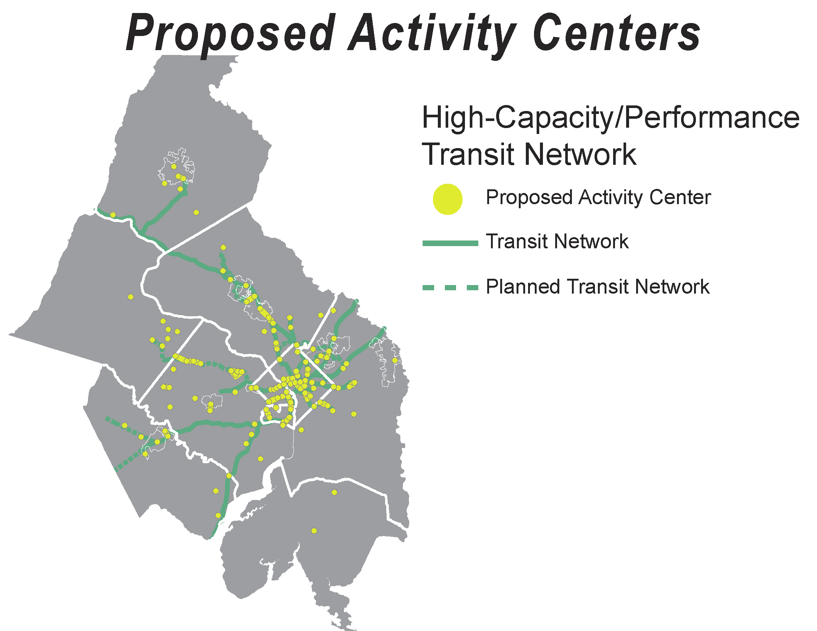

Slide 26
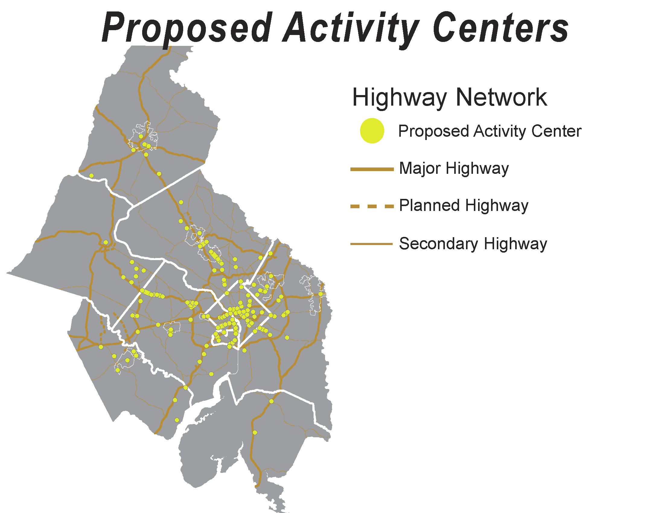
Notes:
Even though this is not one of the attributes, the centers align with existing highway network

Slide 27
Key Activity Center Applications
Now:
Technical: growth forecasts, transportation planning, air quality conformity
Monitoring progress on Region Forward Targets
Notes:
27

Slide 28
Key Activity Center Applications
Future: Enhanced tool for implementing Region Forward
Leverage existing investments & accommodate growth efficiently
Enhance quality of life through small-scale improvements: streetscape, open space, access
Concentrate green infrastructure & green building investment
Coordinate economic development
Prioritize locations for affordable housing production & preservation
Other?
Notes:
Here are the key questions we’re going to discuss at end of the presentation.
Can reference Complete Communities concept – this is about place-making
Examples:
-Making sure that our centers with major job concentrations (e.g. R-B Corridor, NoMA) also provide places for people, including lower-income workers, to live, and the services to support that
-On eastern side of region, many of centers have market affordable housing, but lack the range of services – retail, grocery
-On western side of region, many centers have large job concentrations, but lack adequate workforce and affordable housing
-Centers may be good places to concentrate stormwater mgmt and energy efficiency features – economies of scale
-Making sure that new investment in transit network and station areas doesn’t displace residents and small businesses
-Making sure that transportation network and new investments are fully utilized – concentrating jobs and housing around stations and corridors to increase ridership
28

Slide 29
Key Questions
How can we use the updated Activity Centers in new ways to implement Region Forward targets? What are possible applications for:
  Affordable Housing
  Economic Development
  Transportation
  Public Health
How can you use the updated Activity Centers in your work?
Notes:
Here are the key questions we’re going to discuss at end of the presentation.
Can reference Complete Communities concept – this is about place-making
Examples:
-Making sure that our centers with major job concentrations (e.g. R-B Corridor, NoMA) also provide places for people, including lower-income workers, to live, and the services to support that
-On eastern side of region, many of centers have market affordable housing, but lack the range of services – retail, grocery
-On western side of region, many centers have large job concentrations, but lack adequate workforce and affordable housing
-Centers may be good places to concentrate stormwater mgmt and energy efficiency features – economies of scale
-Making sure that new investment in transit network and station areas doesn’t displace residents and small businesses
-Making sure that transportation network and new investments are fully utilized – concentrating jobs and housing around stations and corridors to increase ridership
29

