Slide 1
Item #5: TPB Complete Streets Policy Guidance and Template
Michael Farrell
Freight Subcommittee
March 8, 2012

Slide 2
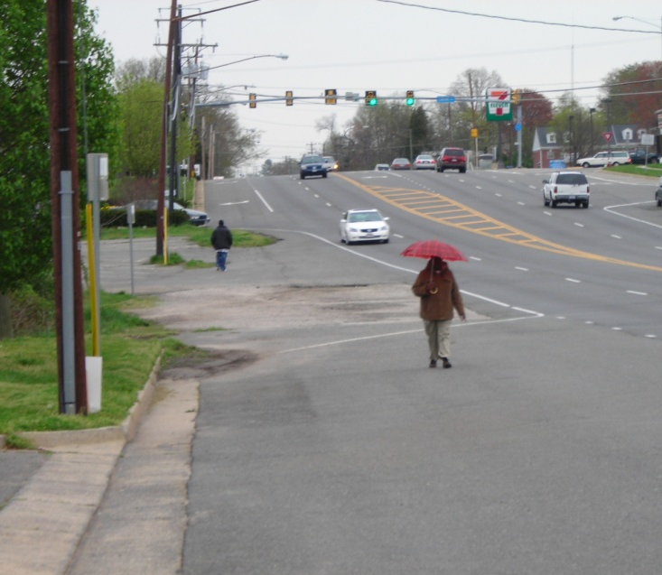
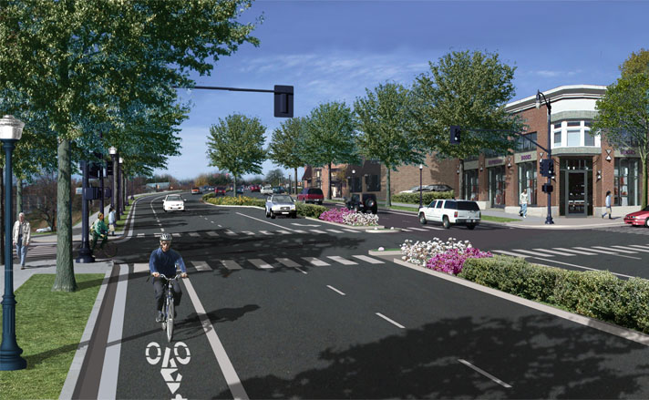
What are Complete Streets?
“Complete Streets are for Everyone”
They are designed, built, and operated to enable safe access for all users, including pedestrians, bicyclists, motorists, and transit riders of diverse ages and abilities.
National Complete Streets Coalition (completestreets.org) has been promoting the Complete Streets concept since 2005.
  Replaced “Routine Accommodation” concept
*Complete Streets – Current Policies, www.completestreets.org
Notes:
Image: A photo-simulation of planned roadway improvements illustrates many Complete Streets features, such as a bike lane, improved sidewalks, medians, landscaping, and adjacent mixed-use development. SOURCE: Thomas Jefferson Planning District Commission, Virginia DOT, City of Charlottesville, Albemarle County, Community Design + Architecture, and Urban Advantage.
Even though a unified description of Complete Streets has not been agreed on, there are themes common in states and communities that embrace Complete Streets:
Sets a vision for the use of public roadway space.
Makes a policy statement that the roadway is intended for all users, regardless of mode.
Requires that all new projects uphold Complete Streets principles.
Identifies a connected, integrated network of streets that allows access to all areas of the city.
Identifies principles that can be incorporated into State and local design guidelines.

Slide 3
Complete Streets Policies
15 states have enacted some form of Complete Streets legislation.
  11 additional states have put statewide Complete Streets policies, design guidelines, or administrative procedures in place.
31 Metropolitan Planning Organizations, 25 Counties, and over 200 cities have also enacted Complete Streets policies.
Example: Wilmapco (which includes MDOT and Cecil County, MD) adopted a Complete Streets Policy as part of their 2030 Regional Transportation Plan (2007)
Notes:
Graphic Source: National Complete Streets Coalition.

Slide 4
Federal Policies
No formal policy called “Complete Streets”, but…
US DOT Policy Statement on Bicycle and Pedestrian Accommodation
March 15, 2011
  Policy Statement: “Every transportation agency, including DOT, has the responsibility to improve conditions and opportunities for walking and bicycling and to integrate walking and bicycling into their transportation systems …. transportation agencies are encouraged to go beyond minimum standards to provide safe and convenient facilities for these modes.”
  Recommended Actions: “The DOT encourages States, local governments, professional associations, community organizations, public transportation agencies, and other government agencies, to adopt similar policy statements on bicycle and pedestrian accommodation as an indication of their commitment to accommodating bicyclists and pedestrians as an integral element of the transportation system.”

Slide 5
State Policies in the Washington Region
  DDOT Complete Streets Policy
    Action Agenda: Create a “walk-centric, bike-centric” city
    Departmental Order No. 06-2010
      “network as a whole shall accommodate the safety and convenience of all users, recognizing that certain individual corridors have modal priorities”
      Exceptions : Safety, Excessive Cost, Absence of Need
  VDOT: “Policy for Bicycle and Pedestrian Accommodation” (2004)
    “VDOT will initiate all highway construction projects with the presumption that the projects shall accommodate bicycling and walking”
      Exceptions: Safety, Excessive Cost, Lack of Demand, Environmental
    Secondary Street Acceptance Requirements 2009
  MDOT: “Strives” to provide facilities “wherever possible”
    Bicycle and Pedestrian Plan (2002)
    Code of Maryland: “Access to and the use of transportation facilities by pedestrians and bicycle riders shall be considered …”
    Access “shall be considered … in all phases” (SHA Memorandum, 2003)
    Exceptions:
      Cost, ROW, Structures, Utilities, Historic, Environmental, Safety, Highway Capacity
    Revised policy currently under development

Slide 6
Local Policies
Alexandria - Council Resolution 2444 (2011)
  “the Department of Transportation and Environmental Services shall make Complete Streets practices a routine part of everyday operations”
Arlington - Master Transportation Plan (2007)
  “Arlington will work to transform its current roadway network into “Complete Streets.”
Fairfax County – Tysons Corner Master Plan (2010)
Loudoun County – Countywide Transportation Plan , Ch. 4 (2010)
Montgomery County – Road Code (Bill 4806), Article II, page 26 (2007)
    “Each County road and street must be designed so that the safety and
    convenience of all users of the roadway system - including pedestrians,
    bicyclists, transit users, automobile drivers, commercial vehicles and freight
    haulers, and emergency service vehicles - is accommodated. Each road and
    street must facilitate multi-modal use and assure that all users can travel
    safely in the public right of way.”
M-NCPPC – Prince George’s County – Countywide Master Plan of Transportation (2009)
  “vision of providing roadways that accommodate all modes of transportation”
  Policy 2: “All road frontage improvements and road capital improvement projects within the Developed and Developing Tiers shall be designed to accommodate all modes of transportation. Continuous sidewalks and on-road bicycle facilities should be included to the extent feasible and practical.”
Rockville – Complete Streets Policy (2009)
  “New construction and re-construction roadway projects in the City shall accommodate users of all ages and abilities including pedestrians, bicyclists, transit users, motorists and adjacent land users.”
Notes:
Most of our jurisdictions and agencies either have adopted, or are considering adopting, some form of Complete Streets policy. Agencies such as Frederick County which have not adopted a “Complete Streets” policy have still moved towards significantly more pedestrian and bicycle friendly policies.

Slide 7
Policy Trends
1950’s – Prohibition on Building Sidewalks with Highway Money
1970’s - Permission
1990’s - Encouragement
  “Shall consider”
2000’s - Mandatory
  “Routine Accommodation”
  “Complete Streets”

Slide 8
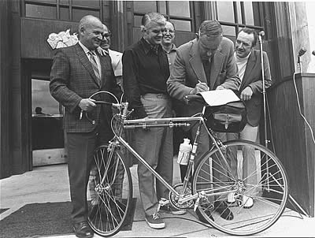
An Early Example: the Oregon Bicycle Bill (1971)
Key Provisions:
  “Routine Accommodation”
    “Footpaths and bicycle trails…shall be provided” as part of every transportation project
  Exceptions
    Public safety (freeways)
    “Cost excessively disproportionate to need or probable use”
    “sparsity of population or other factors indicate the absence of any need”
Oregon Governor Tom McCall signs the Bicycle Bill

Slide 9
Citizens Advisory Committee Recommendation for Complete Streets
June 15th, 2011 - CAC requested that the TPB Develop and Approve a Regional Policy on Complete Streets
  Bicycle and Pedestrian Subcommittee to take the lead
    Also work with the CAC, Access for All, the Bus Subcommittee, and the task force for the TPB’s Priorities Plan
    Use ideal Complete Streets policy from Complete Streets Coalition as a starting point
TPB Chair and Vice-Chair suggested that TPB staff and relevant Subcommittees develop a proposal

Slide 10
Reasons for a Regional Complete Streets Policy
Cost (cheaper than retrofitting)
Supports TPB Vision, Bicycle and Pedestrian Plan, and Region Forward Goals
  Walkable, mixed-use activity centers
  Health and Fitness
  Economic/retail activity & tourism
  Climate/Environmental
  Environmental justice
  Continuous pedestrian and bicycle network
  “If the Region supports Complete Streets, we should say so”
    A regional policy would “act as a catalyst to encourage complete streets across the region”
    Use ideal Complete Streets policy from Complete Streets Coalition as a starting point

Slide 11
Committee Review Process
& Next Steps
TPB Staff worked with the Relevant Subcommittees
  Successive drafts were vetted
  DOT’s and TPB Technical Committee members provided extensive comments
    From “Policy” to “Guidance and Template”
    Less detail on implementation
  January 30th Stakeholder Workshop
  Current draft reviewed by TPB Tech on March 2nd
Information Item for TPB March 21st
  TPB A.M. Work Session on Complete Streets
To be approved at April TPB Meeting

