Slide 1

Item #5
Spring 2011 Campaign Briefing
Michael Farrell
DTP

Slide 3
Spring 2011 Campaign
Concentrated waves of Radio, Transit, Cable, and Internet advertising designed to change driver, pedestrian, and cyclist behavior
Supported by concurrent law enforcement
Funded by Federal Funds with voluntary matching contributions from WMATA, TPB Member Governments, since Fall 2002
Run twice annually since 2007
    Fall and Spring waves
    November 2010 and March-April 2011
    November wave used Spring 2010 materials
FY 2011 budget $597,800
  Spring 2011 $430,000
  DDOT is separately funding a $60,000 observational study
Details at http://BeStreetSmart.net

Slide 4
Spring 2011 Campaign
Campaign Dates:
  March 20 – April 16
  Media Objectives
  Educate the audiences (drivers, pedestrians, bicyclists) on pedestrian and bicycle safety and pedestrian safety around buses.
  Inform the audience about increased law enforcement enforcing pedestrian and bicycle traffic safety laws.

Slide 5
Campaign Development Process
Advisory Group
    Working group of the Bicycle and Pedestrian Subcommittee of the TPB Technical Committee
    Consists of funding agency representatives with safety expertise
    Worked with TPB Staff and consultant to shape campaign strategy, messaging, and materials
  New Campaign Materials
    Existing materials are reaching the end of their ability to grab attention
      Last year’s ads, “shock” ads featuring a woman with a baby in a stroller, have now been in continuous use for over a year
      Advisory Group believed we needed a fresh approach
      New materials increase the ability to achieve “earned” media (e.g. free news coverage) that furthers messaging and outreach
    “Giant Pedestrian Safety Problem”
      Edgy, ironic approach
      Visually striking
      Aimed at grabbing attention from the (young) target audience demographic
        Recent wording changes addressed comments from review committees to clarify the campaign message

Slide 6


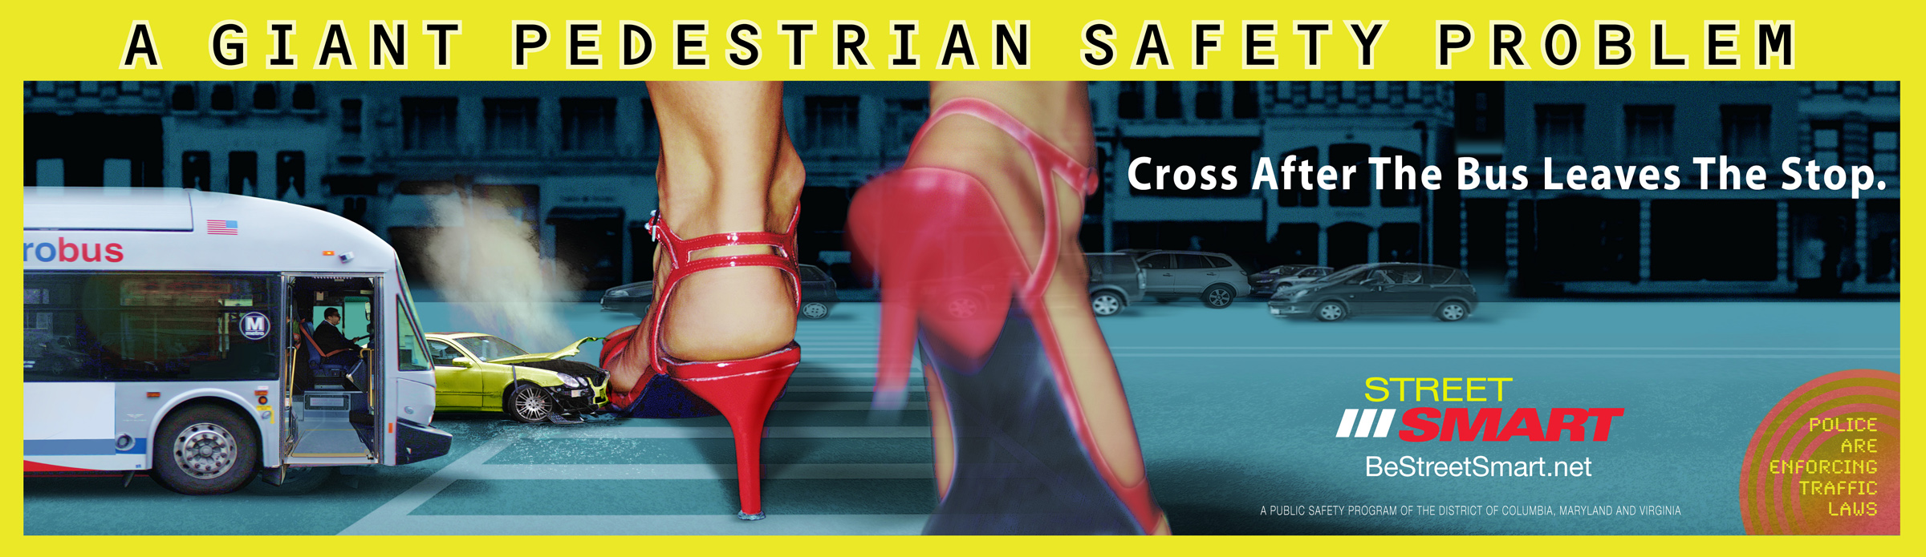
Spring 2011 Campaign

Slide 7
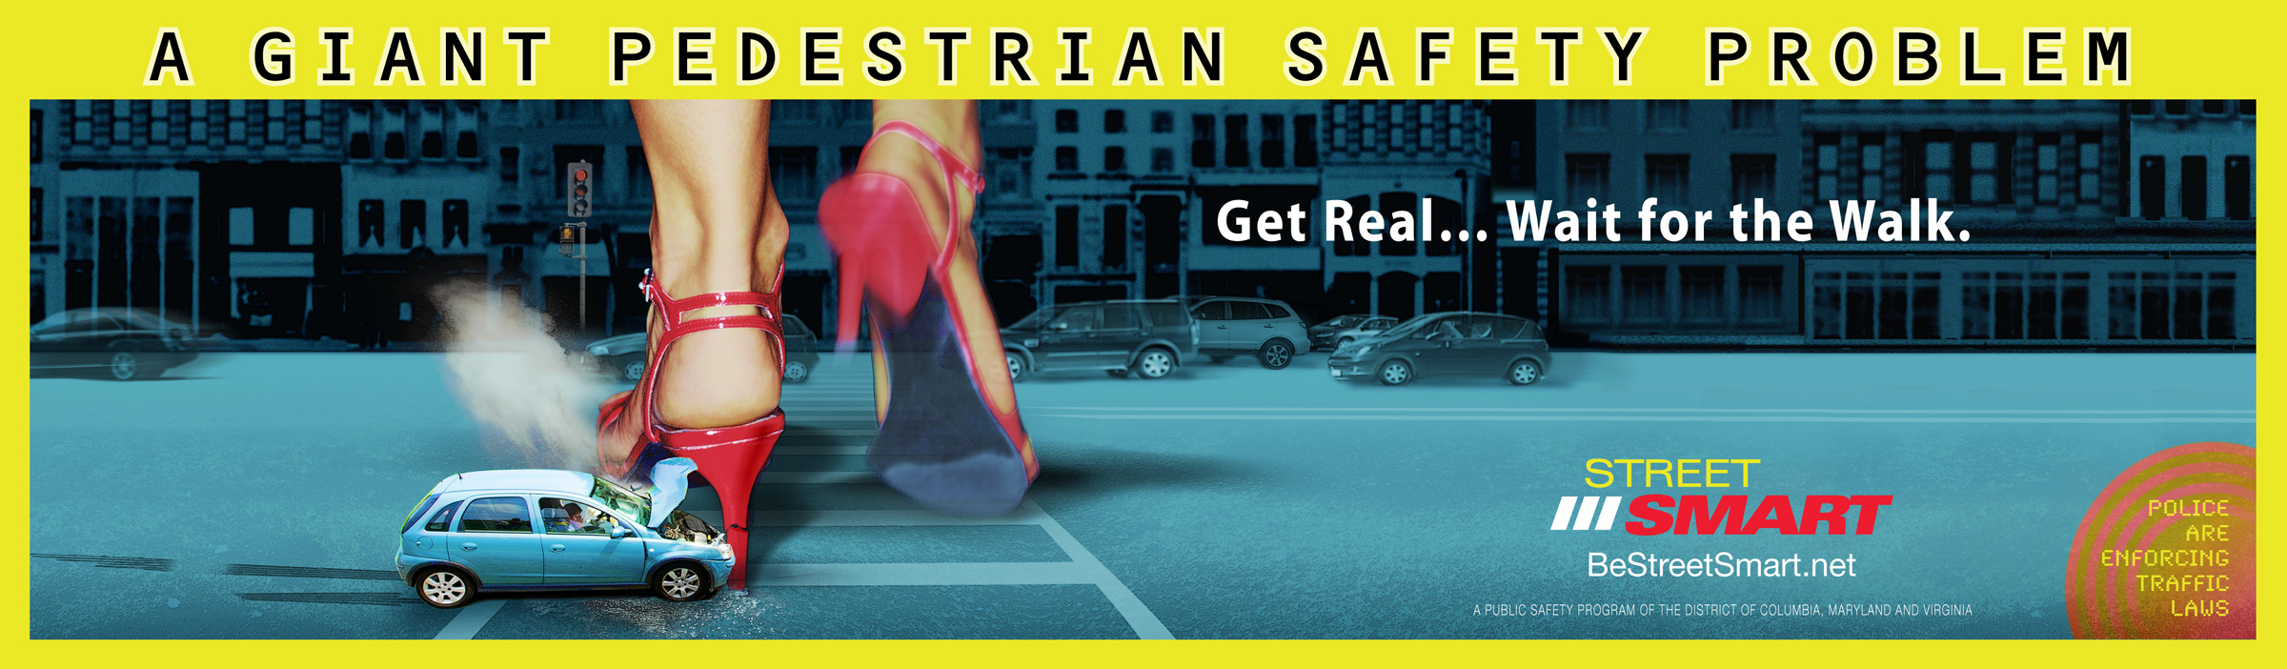

Spring 2011 Campaign

Slide 8
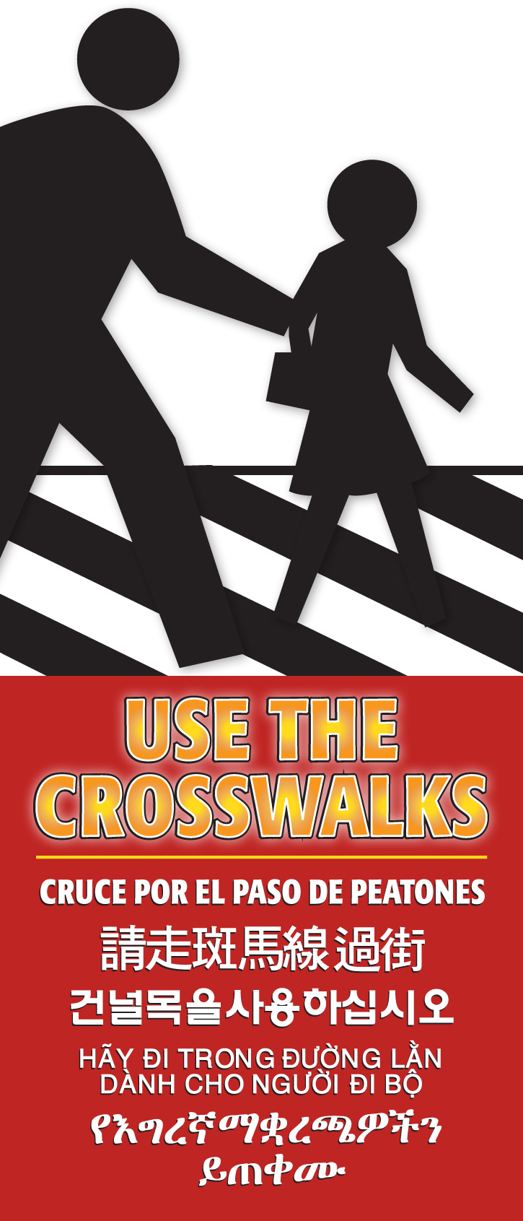
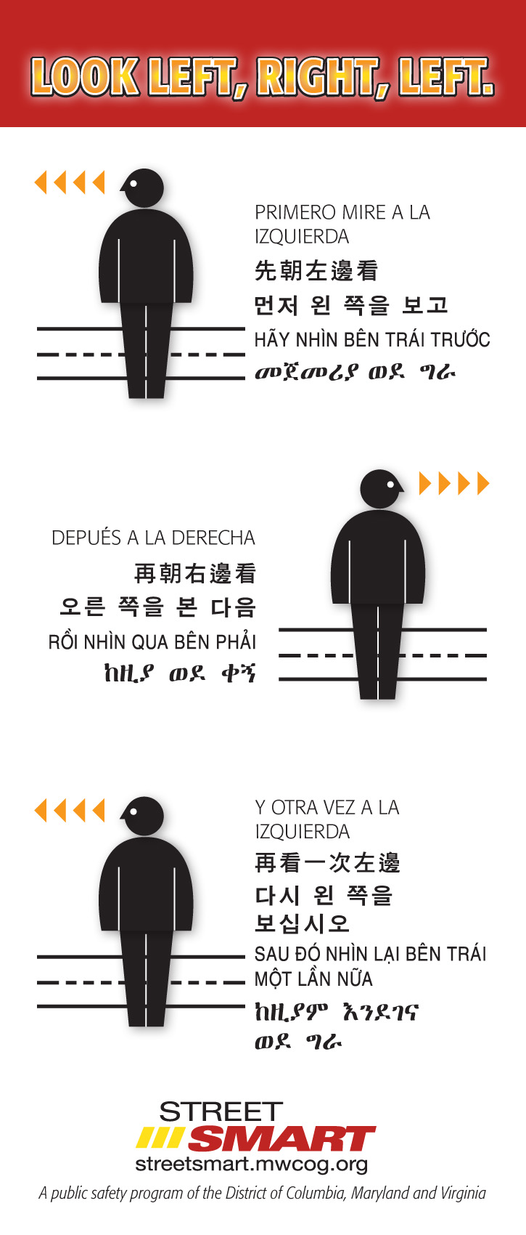
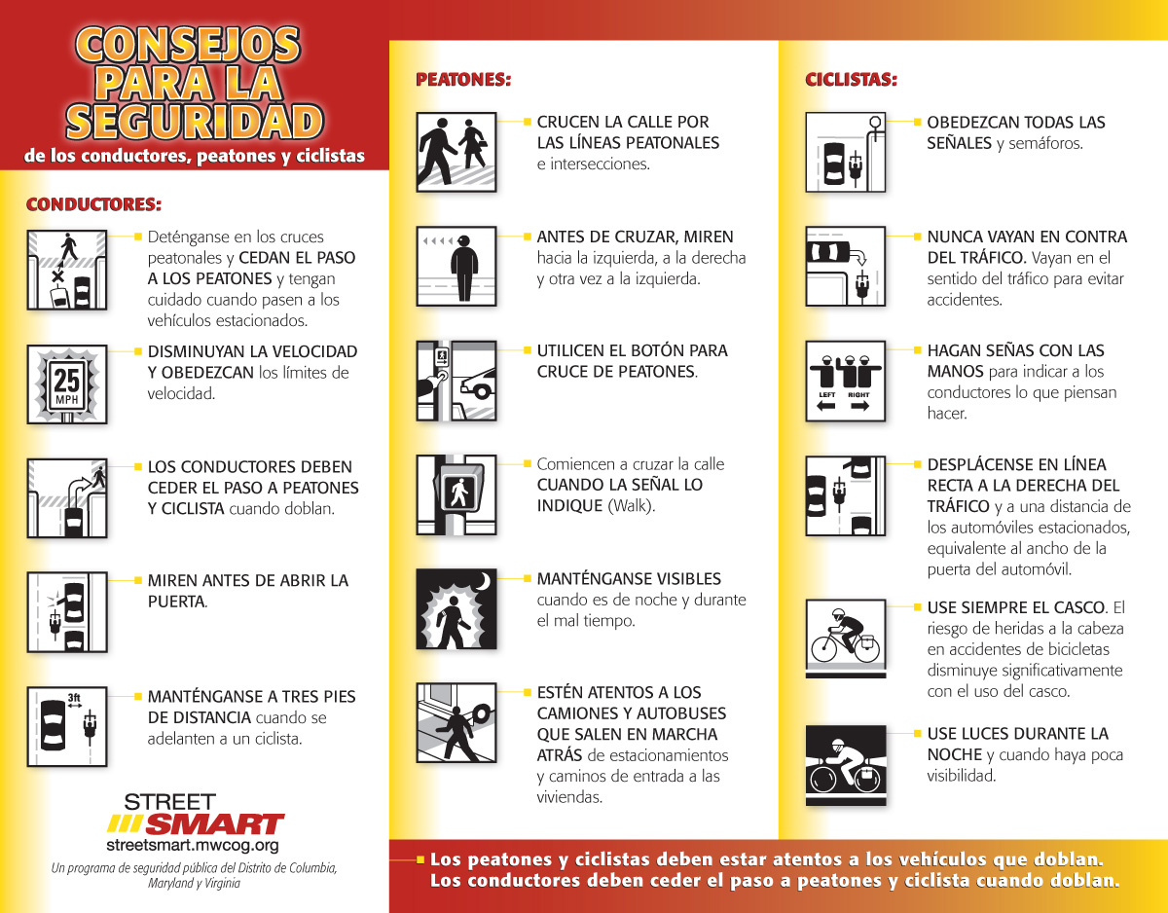
Tips Cards

Slide 9
Spring 2011 Schedule
March
April
Enforcement
Radio
TV
Out of Home
Transit Shelters
Busbacks/Sides
Rail Cards
Interior Cards
Mobile Billboard
Earned Media
(Press Event)
Evaluation

Slide 10
Evaluation
Pre and post-campaign web-based surveys of area motorists
    Shows that people remember the messages, and where they heard them
Before and after observational study
    Selected locations in DC with Traffic Cameras
PR success measured by “earned media”
Law enforcement agencies report citations and warnings issued during the campaign
Annual Report, October 2011

