Slide 1

Climate Action
Survey Results for Progress Report
March 2011

Slide 2
Survey Result Categories
Inventory and Action Plans
Energy Efficiency
Energy Efficiency Outreach Programs
Sustainable Purchasing
Transportation and Land Use
Select Measure Highlights
School Districts
Notes:
16 out of 21 local governments returned the surveys
Surveys not returned include College Park, Greenbelt, City of Frederick, Manassas Park and Takoma Park

Slide 3
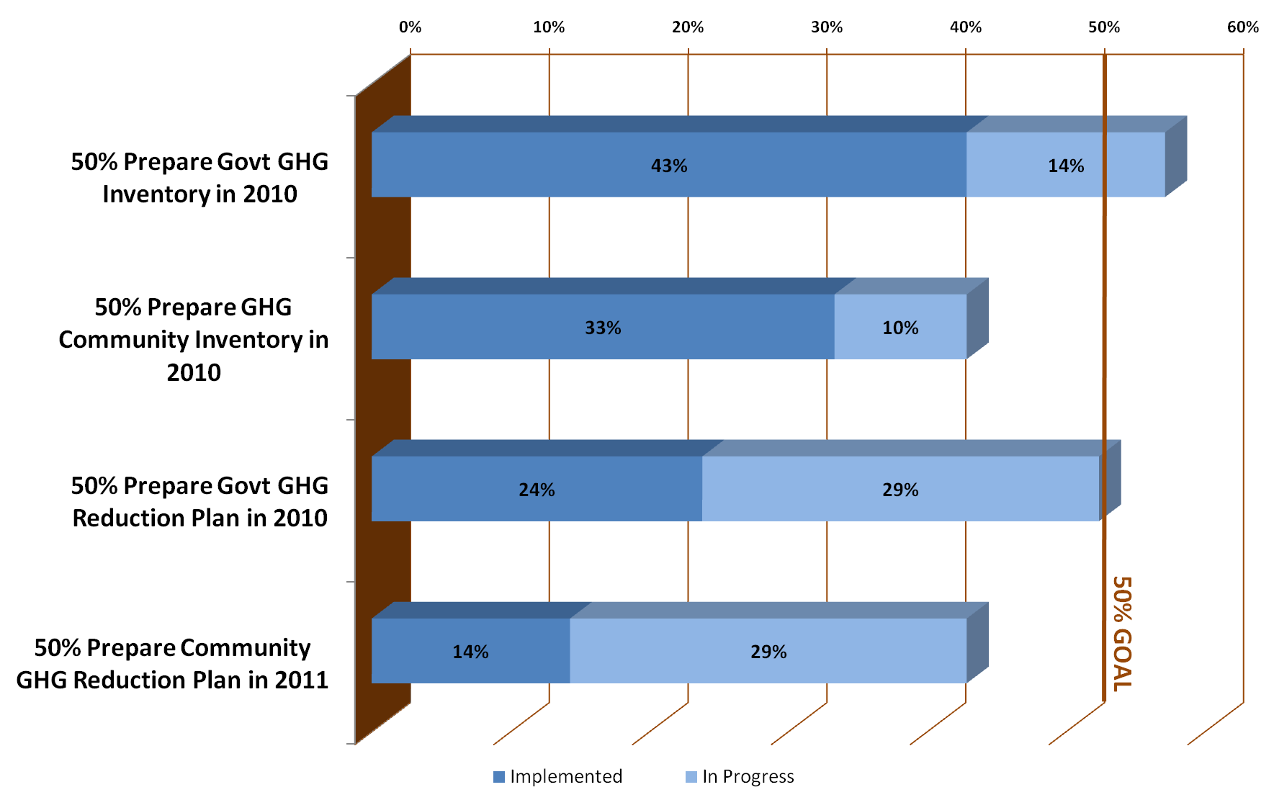
Inventories and Action Plans

Slide 4
Inventory and Action Plan Highlights
Loudoun and Montgomery Counties have implemented all four the following:
  Government GHG Emissions Inventory
  Community-wide GHG Emissions Inventory
  Government Operations Plan to Reduce GHG Emissions
  Community-wide Plan to Reduce GHG Emissions

Slide 5
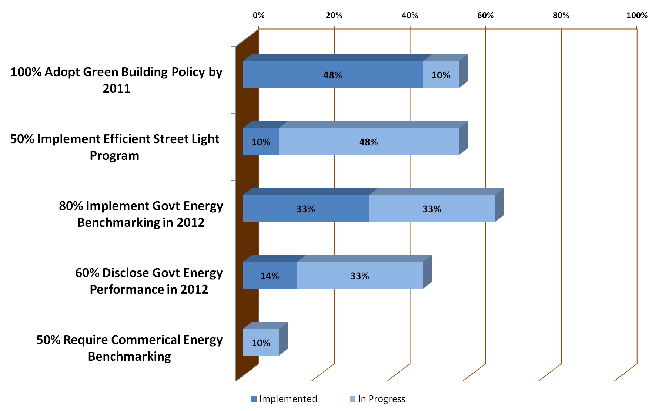
Energy Efficiency

Slide 6
Energy Efficiency Highlights
Green Building:
  District of Columbia has 12 LEED certified DC Govt buildings and 130 non-DC government green certified buildings
  Fairfax County has 7 certified local govt projects, 7 more anticipated to be certified soon and 14 other active development projects are green
Notes:
Do we want to highlight a street light program?
130 non-DC Govt green certified buildings = 126 LEED certified private and nonprofit + 3 LEED certified federal +2 Green Communities projects

Slide 7
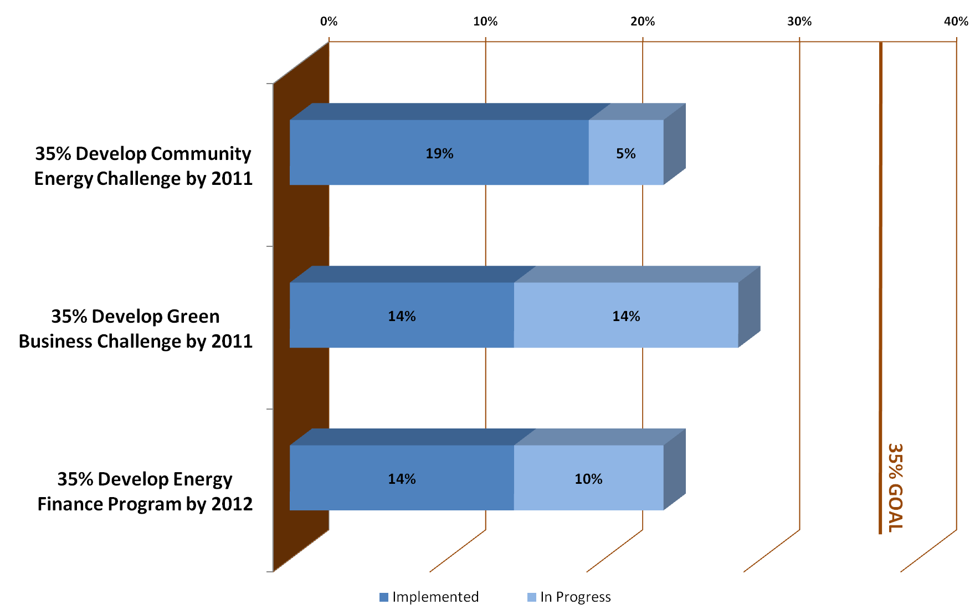
Energy Efficiency Outreach Programs

Slide 8
Energy Efficiency Outreach Program Highlights
Community Energy Challenge/Pledge
  - City of Bowie
  - Fairfax County
  - Loudoun County
Green Business Challenge/Certification
  - Loudoun County
  - Montgomery County

Slide 9
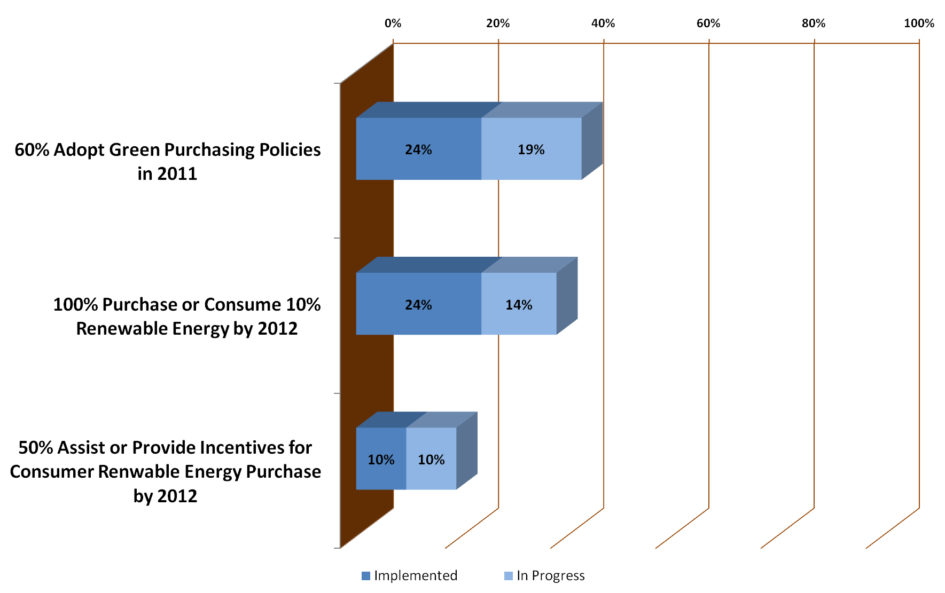
Sustainable Purchasing

Slide 10
Sustainable Purchasing Highlights
Percent of total local government energy use purchased or consumed as renewable energy
  - City of Rockville = 60%
  - District of Columbia = 50%
  - Gaithersburg = 25%
  - Montgomery County = 25%

Slide 11
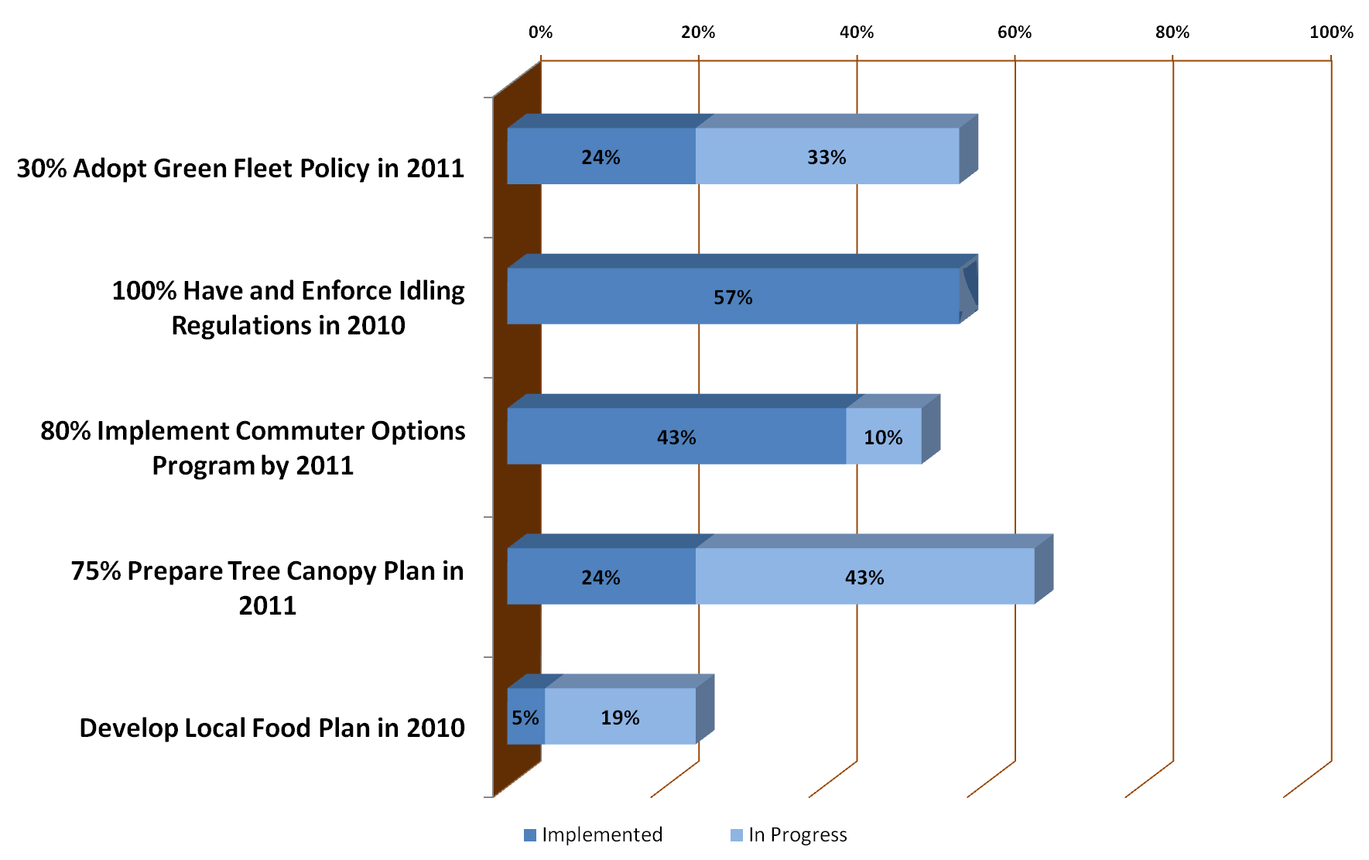
Transportation and Land Use

Slide 12
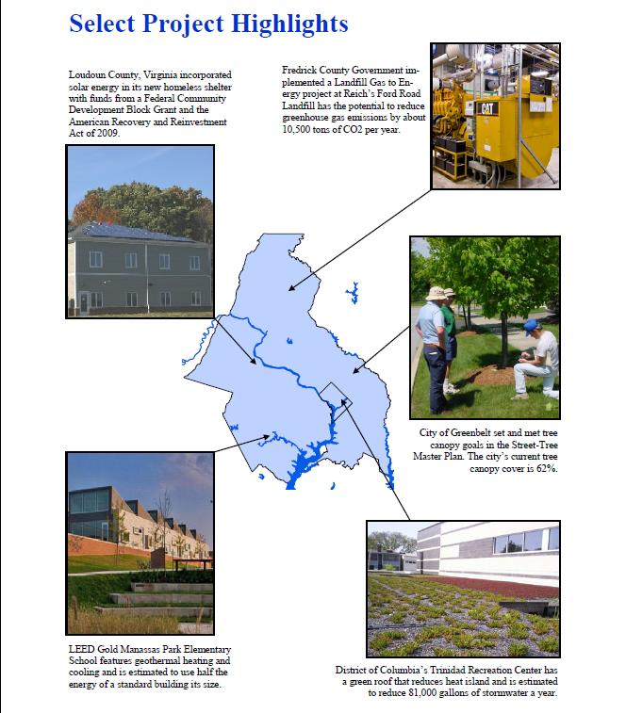
Select Measure Highlights
DRAFT - ILLUSTRATIVE DATA ONLY
Notes:
Could take this out for now.
Small jurisdiction highlights map would go here if can get more small jurisdictions to return survey and/or let us know what they are doing that could be highlighted here.

Slide 13
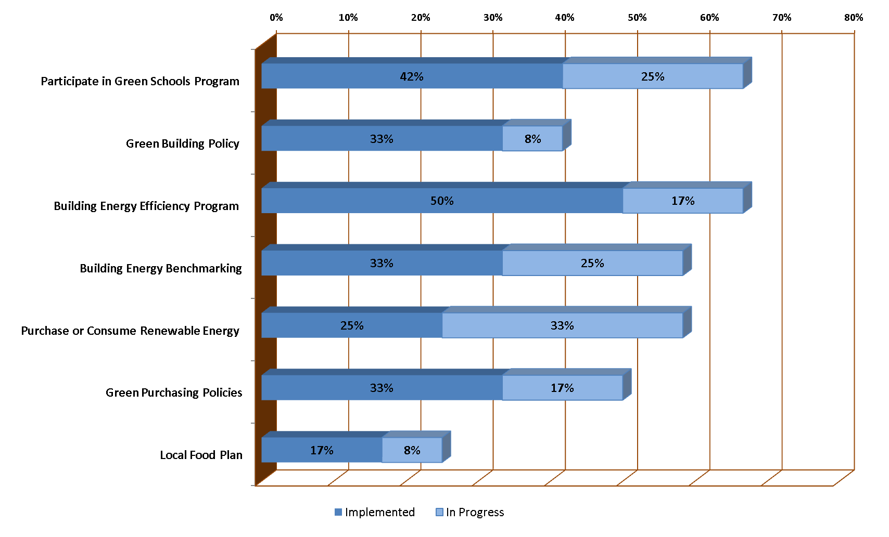
School Districts
Notes:
Percent-wise school districts are further along than local governments in many categories
Results from 8 out of 12 school districts
School surveys not returned include District of Columbia, Arlington County, Frederick County and City of Manassas.

Slide 14
Discussion and
Feedback

